Slide 1



Einstein Telescope
Flame Retardant Insulating Foam
5th August 2024
www.piep.pt | geral@piep.pt

Slide 2







The Project

Slide 3
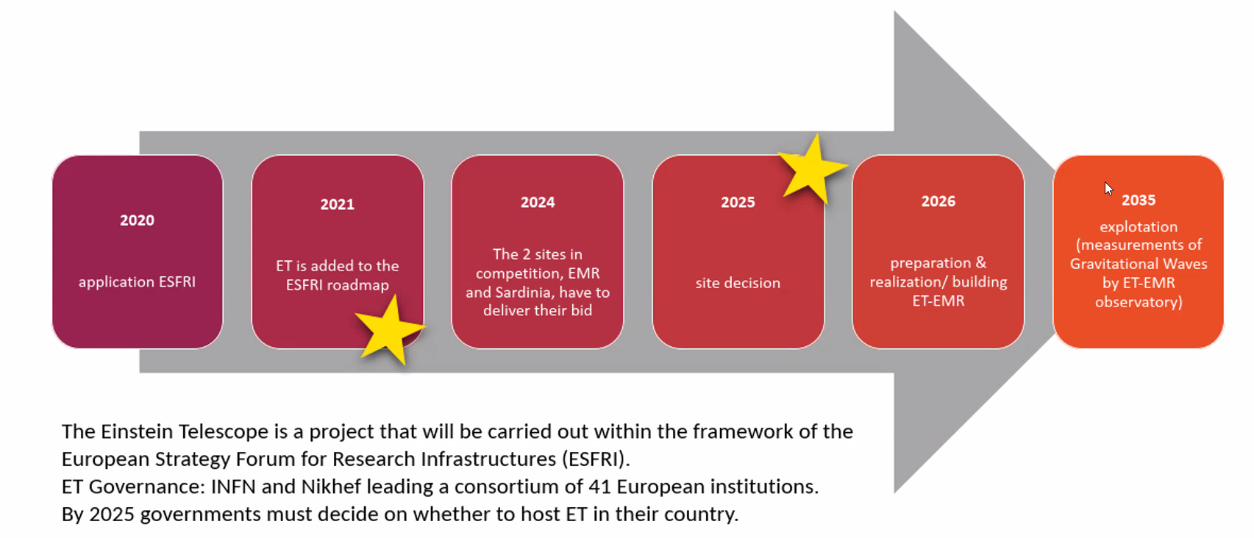
The Project

Slide 4
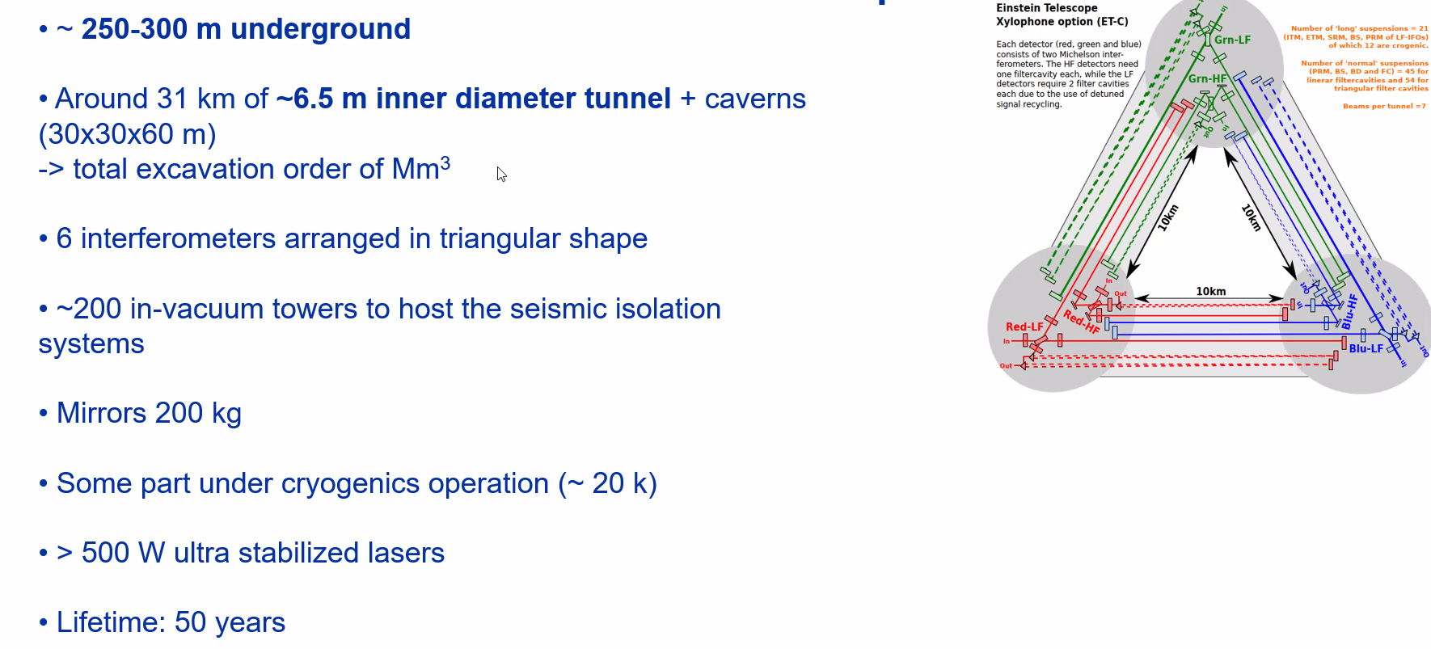
The Project - Flame Retardant Insulating Foam

Slide 5
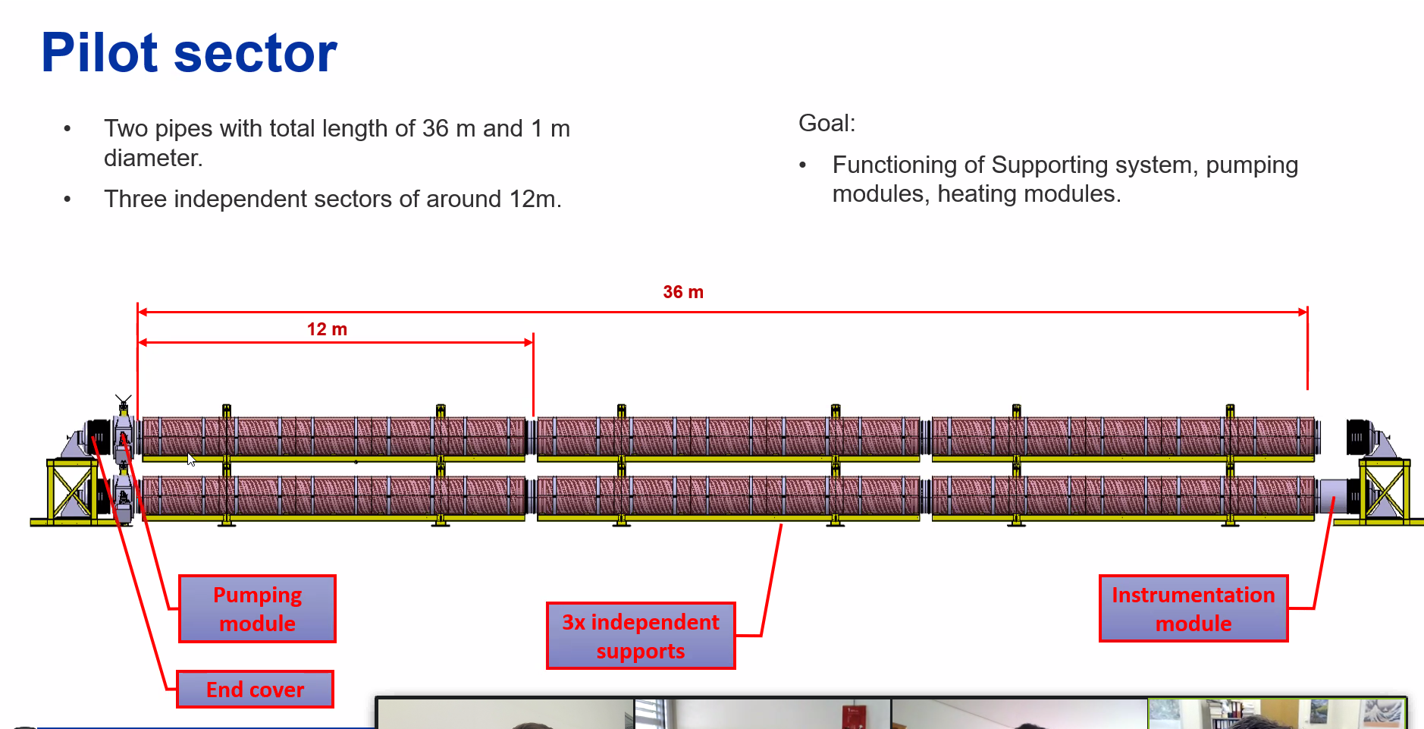
Pilot sector - Flame Retardant Insulating Foam
1.5 m long interior insulation sectors with 5cm thickness
3 m long (or multiples) insulation sectors with 5 mm thickness

Slide 6
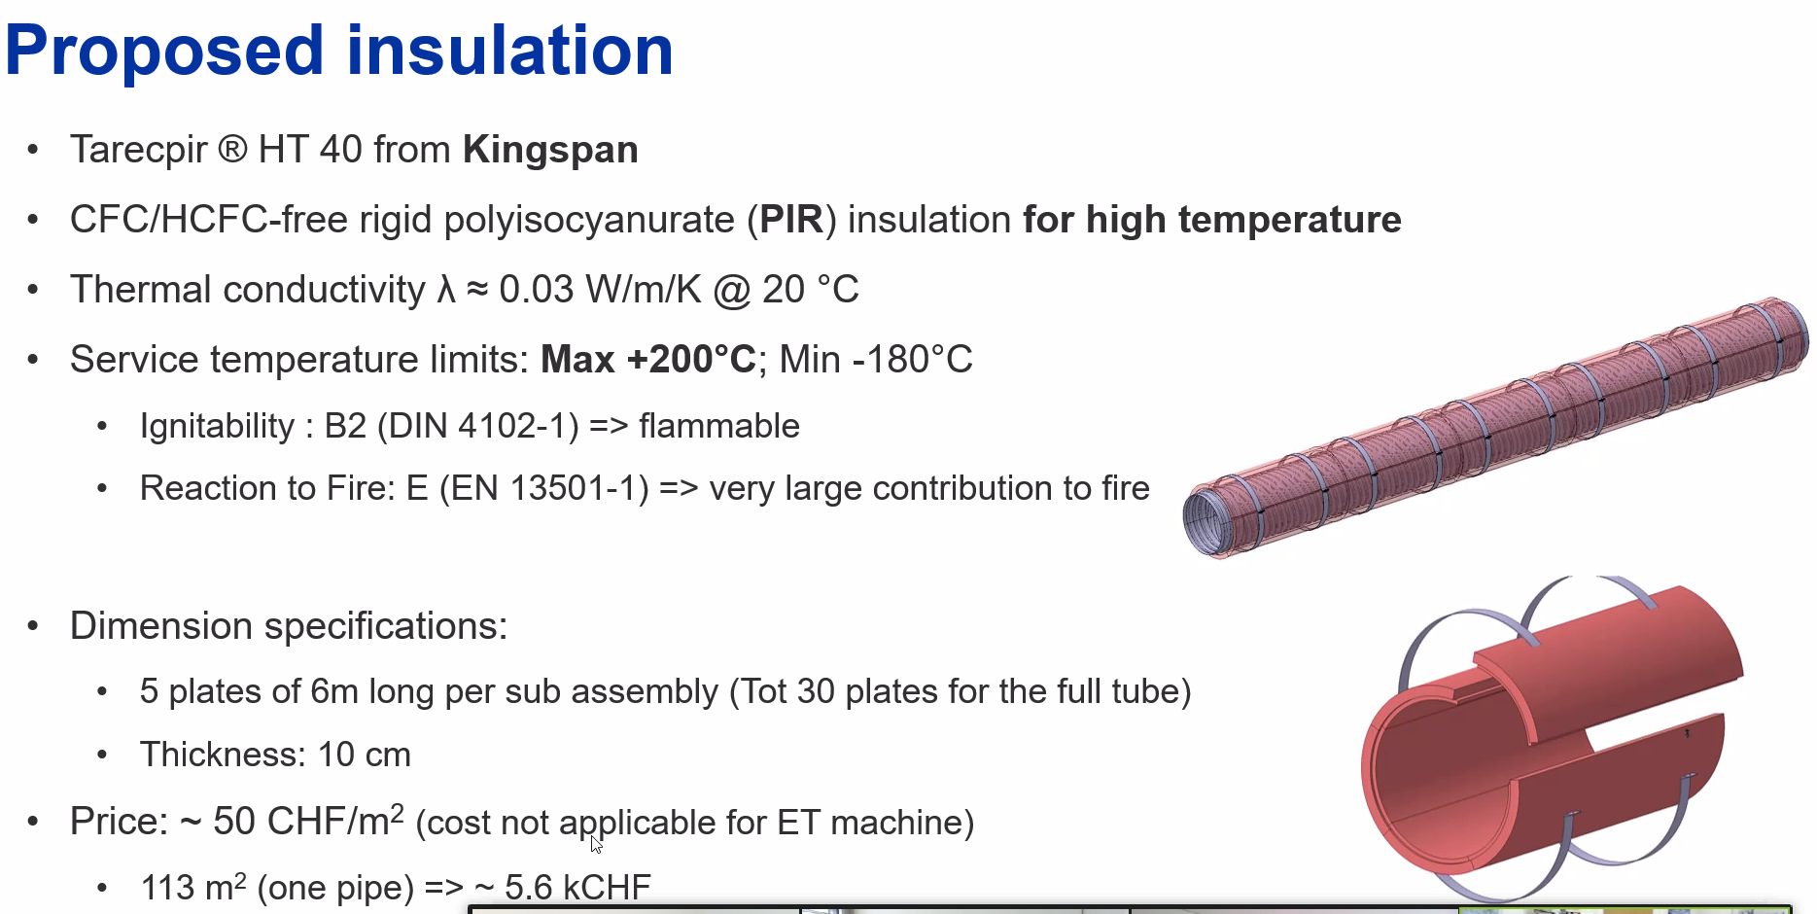
Pilot sector - Flame Retardant Insulating Foam

Slide 7

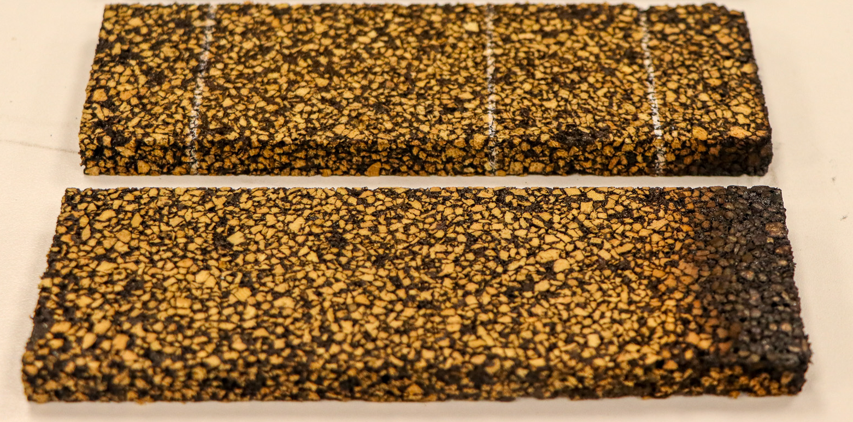
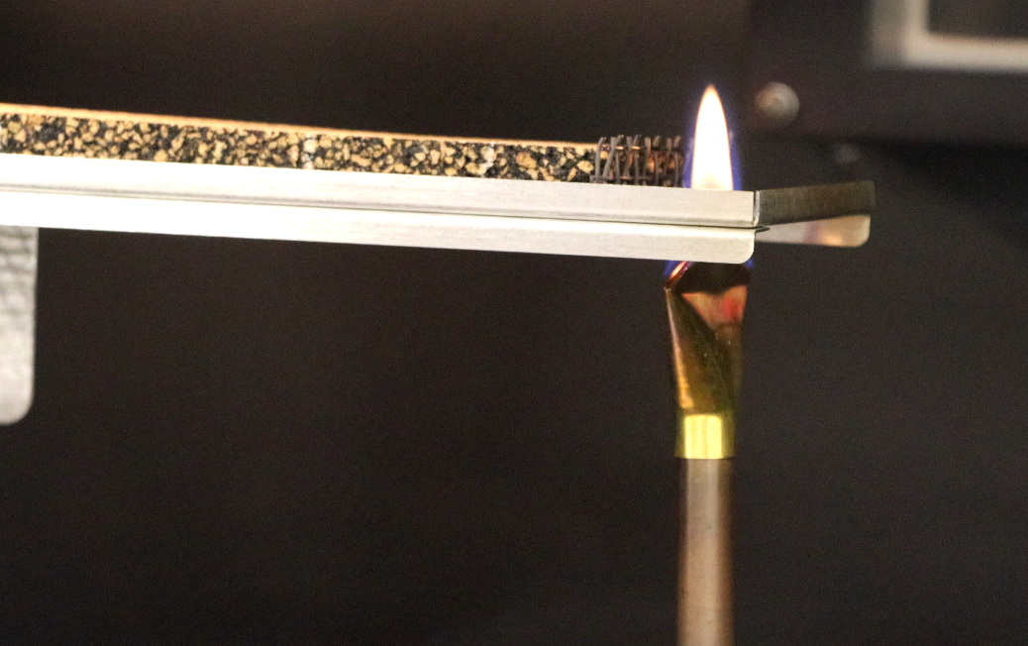
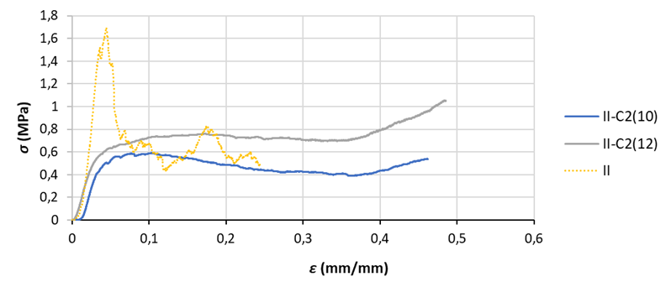
Pilot 1: Furanic-cork biocomposite rigid foam
Introduction
Rigid foam obtained from the chemical expansion of furanic bio-resin, with the incorporation of cork particles;
Material under-development (PIEP and ACC-Amorim Cork Composites) with outstanding fire-resistance and mechanical properties;
Material properties can be tailored considering different concentration of blowing agents, cork weight/granulometry and resin cure conditions.
Estimated Solution cost: ~25 CHF/m^2 (for 10cm thick foam)
(Furanic cork-biocomposite after flammability test- self-extinguishable with HBF, HF-1 classification following standard UL-94)
Uniaxial compression of three different furanic rigid foams. II-C2(10) and II-C2(12) contain cork granules

Slide 8
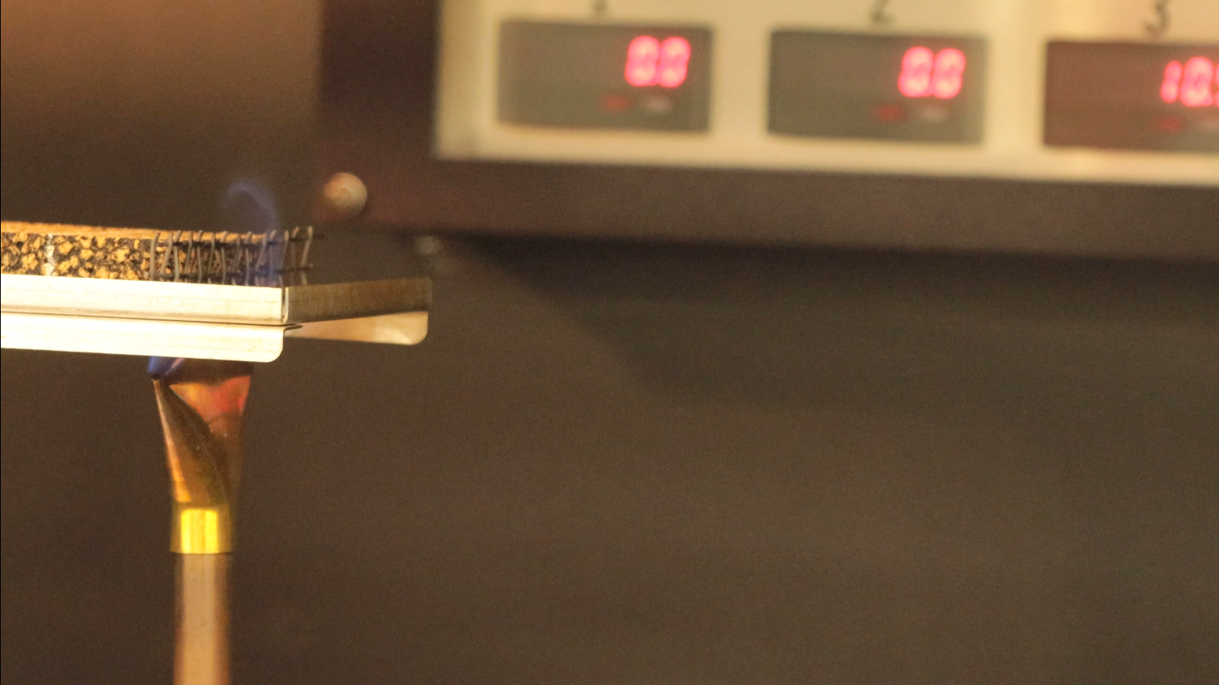
Pilot 1: Furanic-cork biocomposite rigid foam
Introduction
Flammability tests following the standard UL94.
Vídeo of a standard test for a combustible material in: https://fb.watch/rX8rBR7jR_/

Slide 9
Option 1: Furanic-cork biocomposite rigid foam
Steps until material qualification
1) Full thermomechanical characterization for material compliance with specifications
Crushable plasticity-compression (with temperature dependency),
Thermal conductivity (with temperature dependency);
Specific heat;
CTE-Coefficient of thermal expansion (with temperature dependency);
HDT-Heat deflection temperature;
Glass transition temperature (Tg);
Environmental (temperature and moisture)
Fire resistance tests.
2) Material production scale-up;
3) Material constitutive modelling for the uncoupled thermal transient simulations and topological optimization of
the thermal insulation system.

Slide 10
Pilot 1: Furanic-cork biocomposite rigid foam
Development and application roadmap
Real scale prototyping
Assembly and validation of component/material solution
Production of material for prototyping (2 X 36m long)
Prototype assembly in CERN facilities
Qualification and selection of certifiable producers
Estimated Market Costs:
R&D - 50.400,00€ (7 Person-Month)
Characterization*- 7.000,00€
Materials, tools and consumables – 14.000,00€
Total – 71.400,00€
*CTE, UL94, Compression, Density, microscopy, Specific Heat

Slide 11
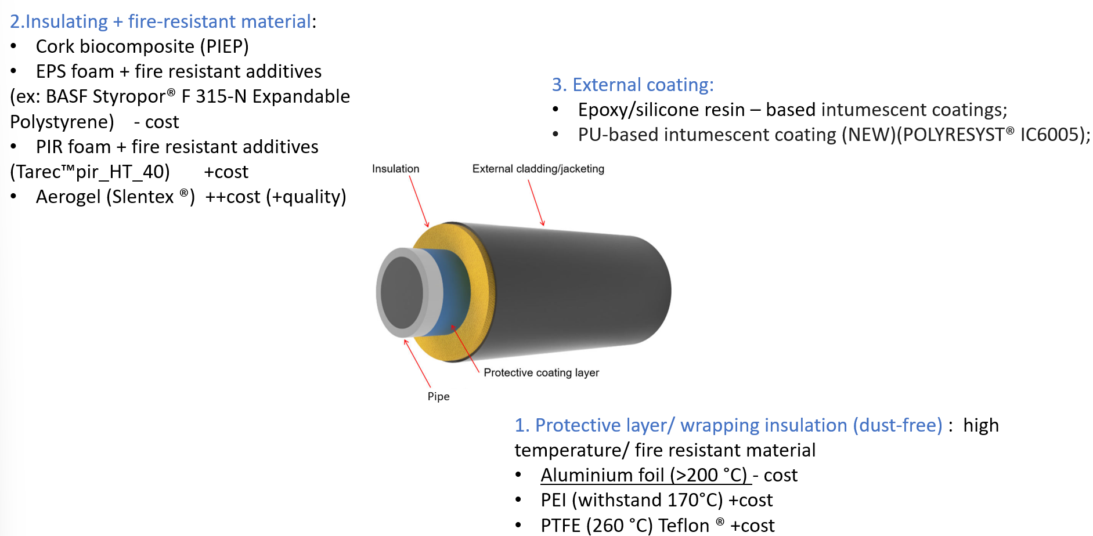
Option 2: Fire Retardant PIR
Introduction
Rigid foam obtained modified PIR to improve fire retardancy properties;
Based on commercially available resins and additives and validation with standard PIR injection equipments;
Material properties can be tailored considering different concentration of blowing agents, additives and resin cure conditions.
Estimated Solution cost: 50-150 CHF/m^2 (for 10cm thick foam)

Slide 12
Pilot 2: Fire Retardant PIR
Development and application roadmap
Selection of most promising PIR´s and additives
Real scale prototyping (20-50 demonstrators for assembly)
Testing real scale prototyping (Flammability + Mechanical)
Assembly and validation of component/material solution
Production of material for prototyping (2X36m)
Qualification and selection of certifiable producers
Estimated Market Costs:
R&D - 70.560,00€ (9,8 Person-Month)
Characterization*- 7.000,00€
Materials, tools and consumables – 14.000,00€
Total – 91.560,00€
*CTE, UL94, Compression, Density, microscopy, Specific Heat

Slide 13
Project Rationale to test both concepts
WP2 - Furanic-cork biocomposite rigid foam
WP3 - Fire Retardant PIR
WP1 - Specifications and materials survey
WP4 - Materials application
WP6 – Prototype Assembly in CERN
WP5 - Technical and project Management
13

Slide 14
Estimated Market Costs:
R&D - 120.960,00€
Characterization* - 14.000,00€
Materials, tools and consumables - 28.000,00€
Total - 162.960,00€
*CTE, UL94, Compression, Density, microscopy, Specific Heat
14

Slide 15
Project Costs:
Estimated Market Costs:
R&D - 120.960,00€
Characterization* - 14.000,00€
Materials, tools and consumables - 28.000,00€
Total - 162.960,00€
*CTE, UL94, Compression, Density, microscopy, Specific Heat
15

