Slide 1
Thermal insulation for the Einstein Telescope (ET) beam pipe vacuum system
Carlo Scarcia on behalf of the ET beampipe vacuum studies group at CERN
CERN-PIEP meeting, 29th August 2025

Slide 2
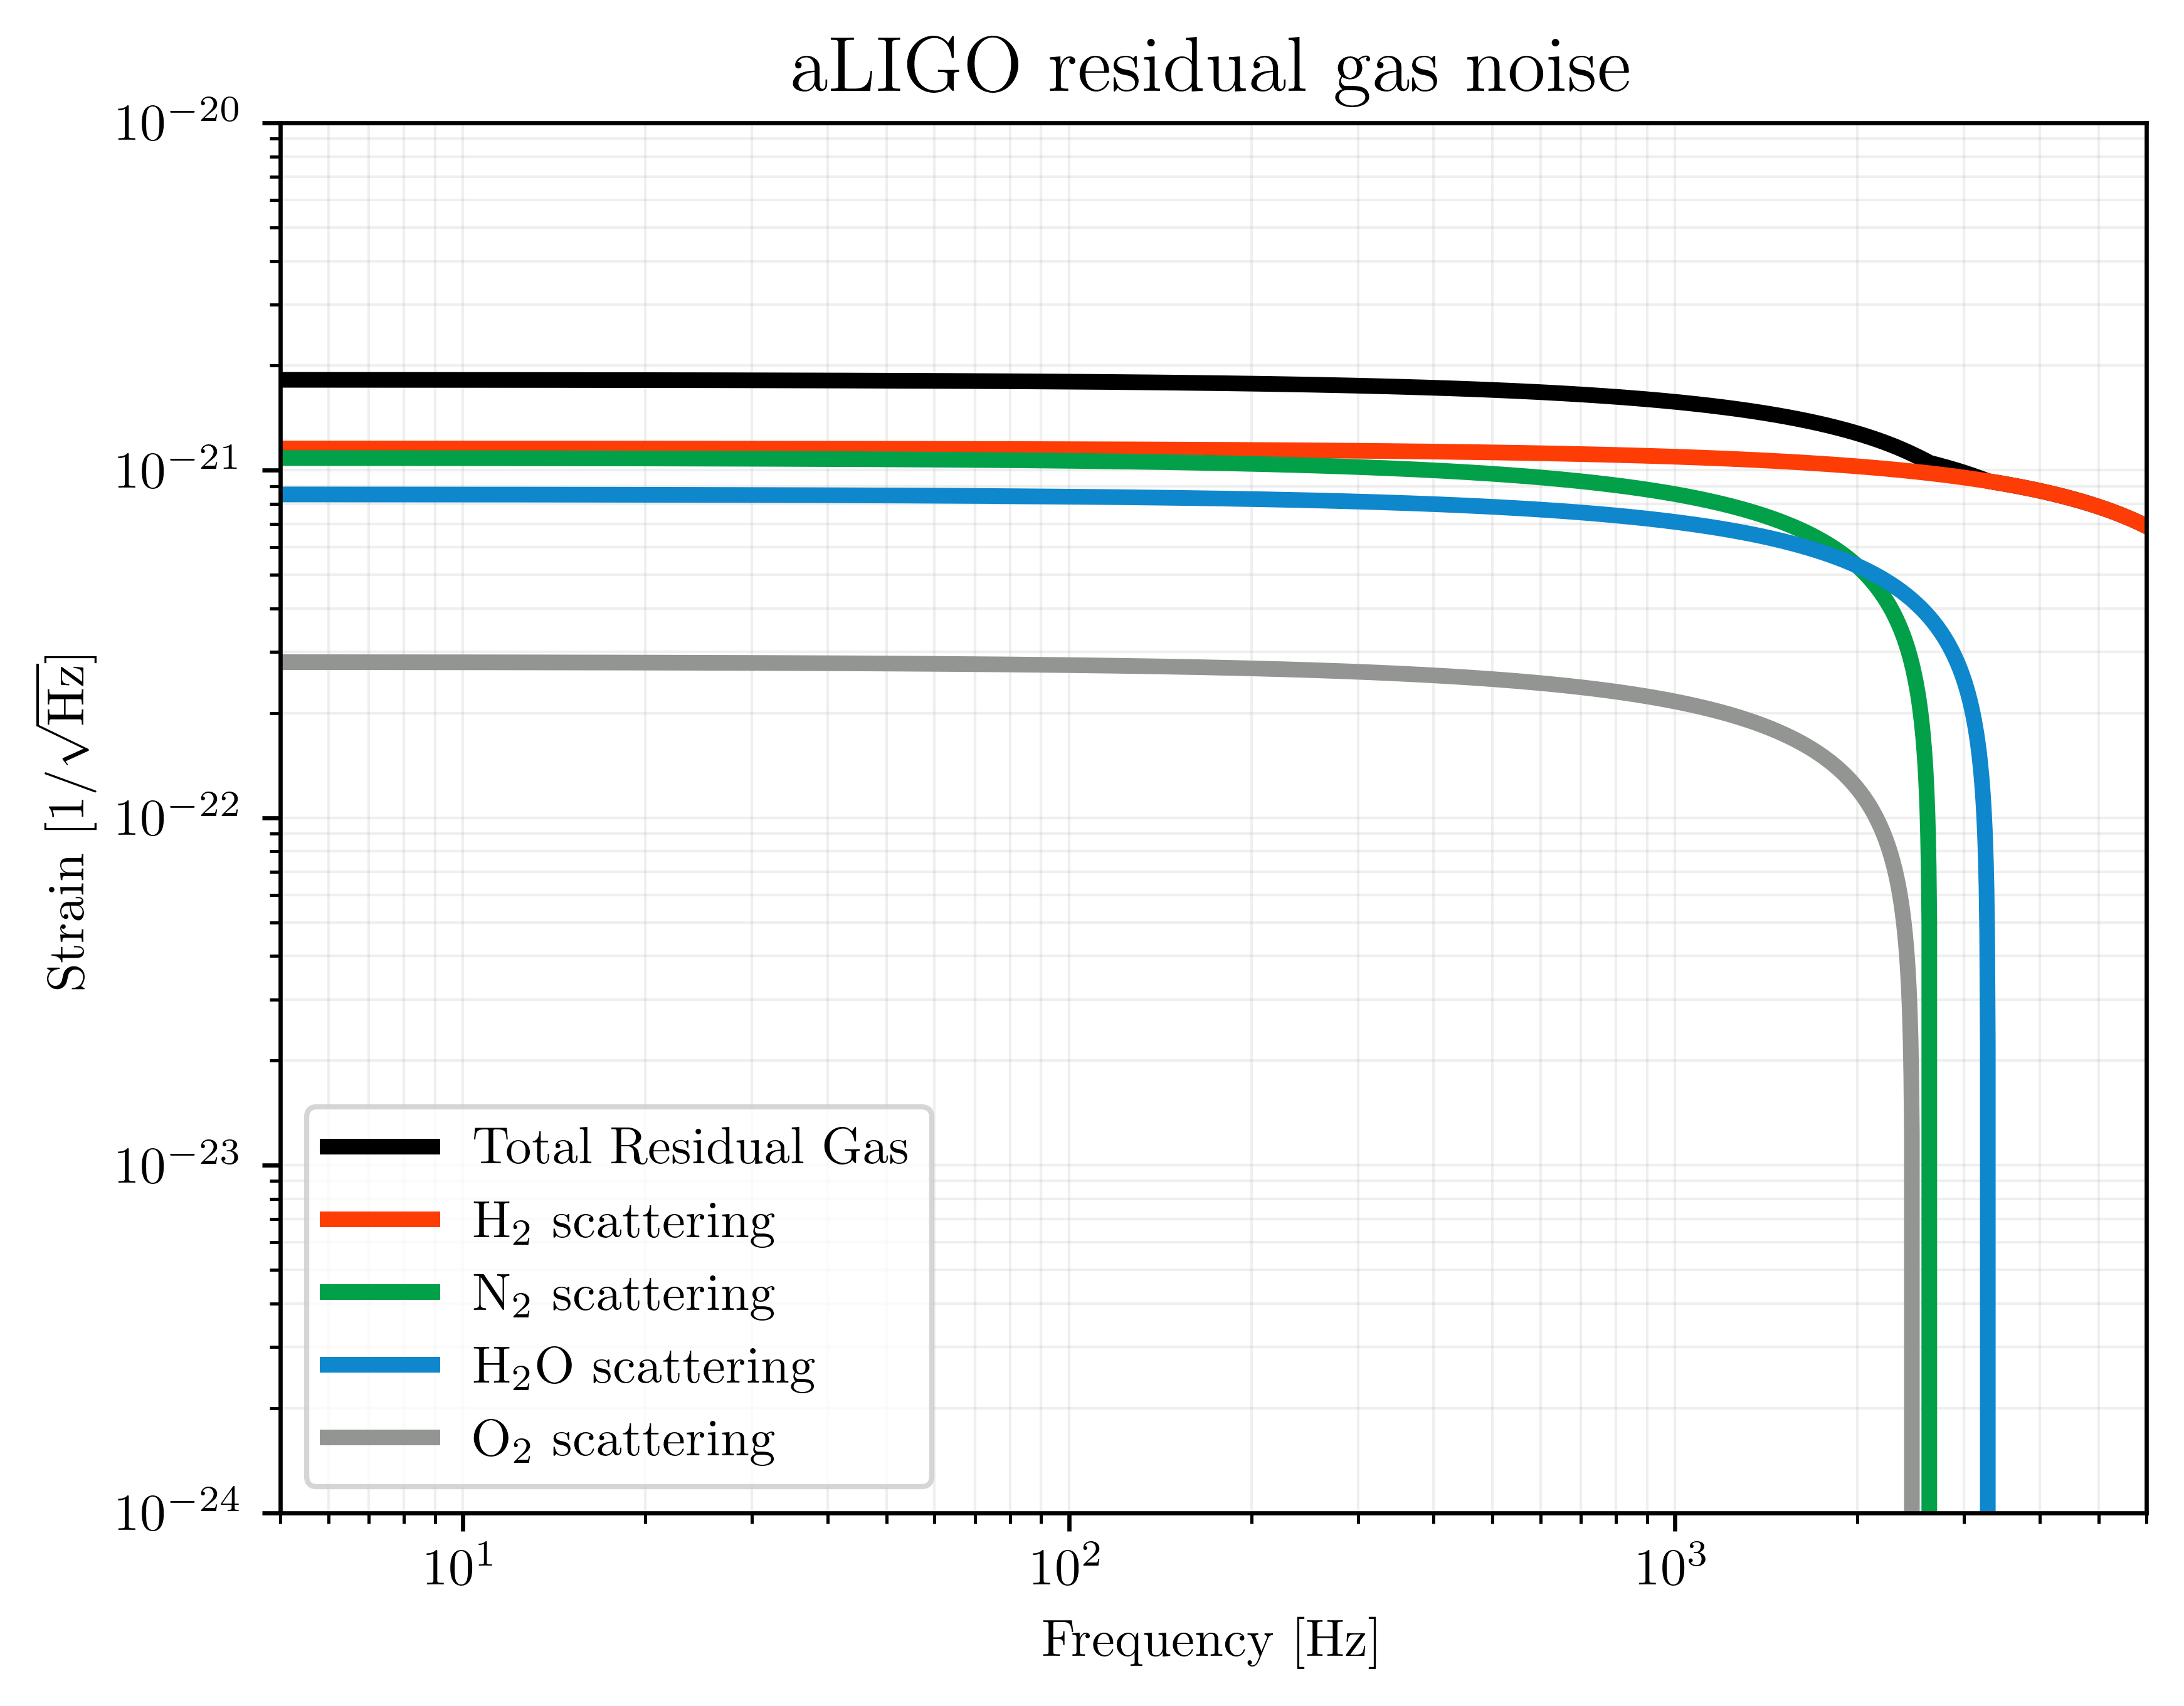

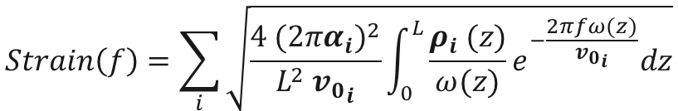






Why ET beampipes ultra high vacuum?
The ET beam pipes require ultra-high vacuum (UHV) to minimise the noise due to gas pressure ﬂuctuations along the laser trajectory (scattering and photon phase shift).
For a gas species, $i$ [3]:
Detectable signal
$$Strain\left(f\right)=\sum_{i}{\sqrt{\frac{4 {(2πα_{i})}^{2}}{L^{2} {v_{0}}_{i}}\int_{0}^{L}{\frac{ρ_{i} (z)}{ω(z)}e^{−\frac{2πfω(z)}{{v_{0}}_{i}}}dz}}}$$
Where:
$ρ(z)$ = gas density ⬄ pressure distribution
$α$ = gas optical polarizability
$$v_{0 }\text{=} \text{most} \text{probable} \text{thermal} \text{speed}$$
$$f \text{=} \text{frequency}$$
$$ω(z) \text{=} \text{laser} \text{beam} \text{gaussian} \text{radius}$$
$L$ = interferometer arm length
[3] M. E. Zucker and S. E. Whitcomb. “Measurement of optical path fluctuations due to residual gas in the LIGO 40-meter interferometer” (1994)

Slide 3
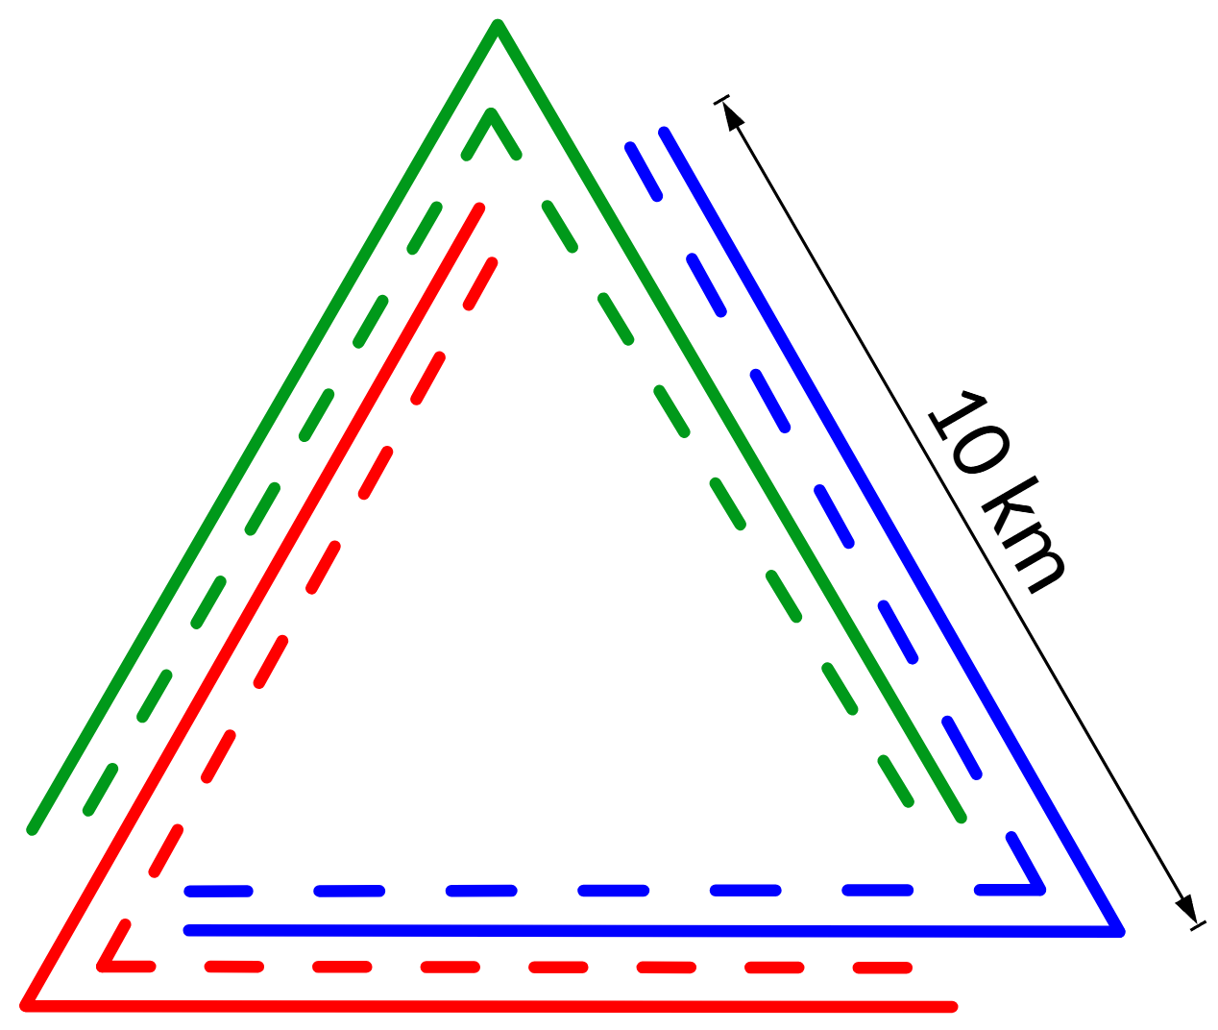
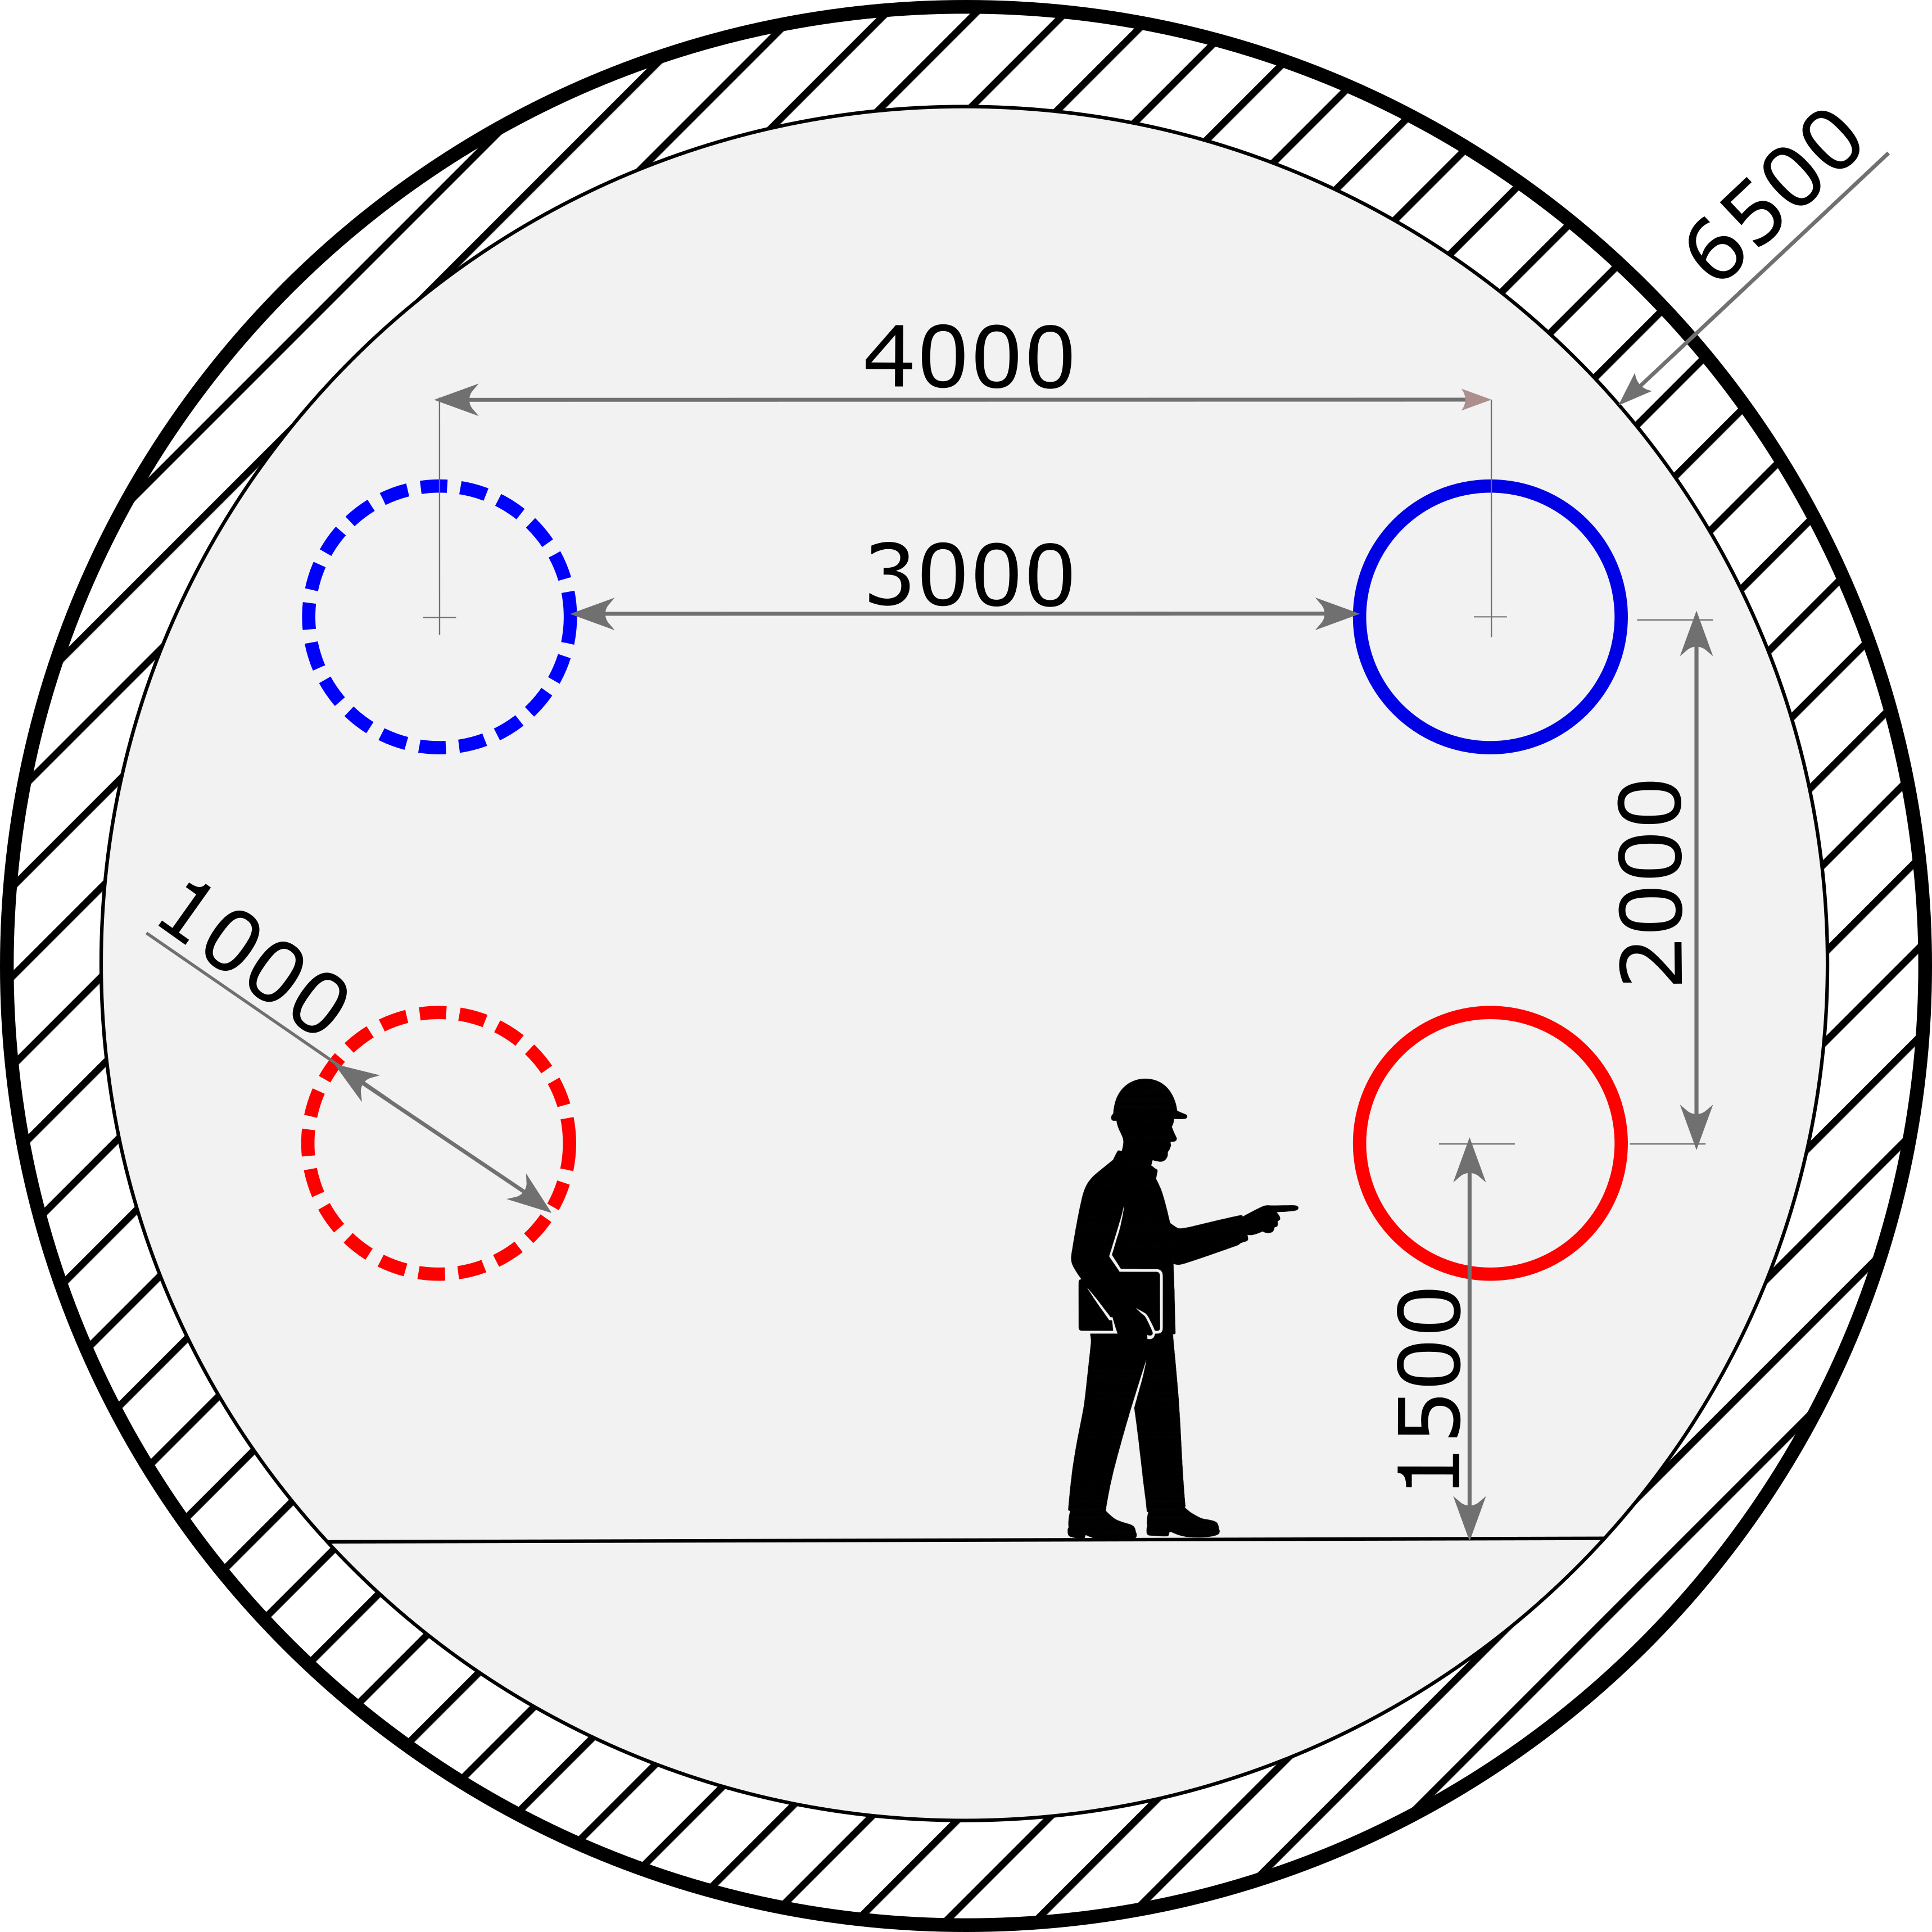
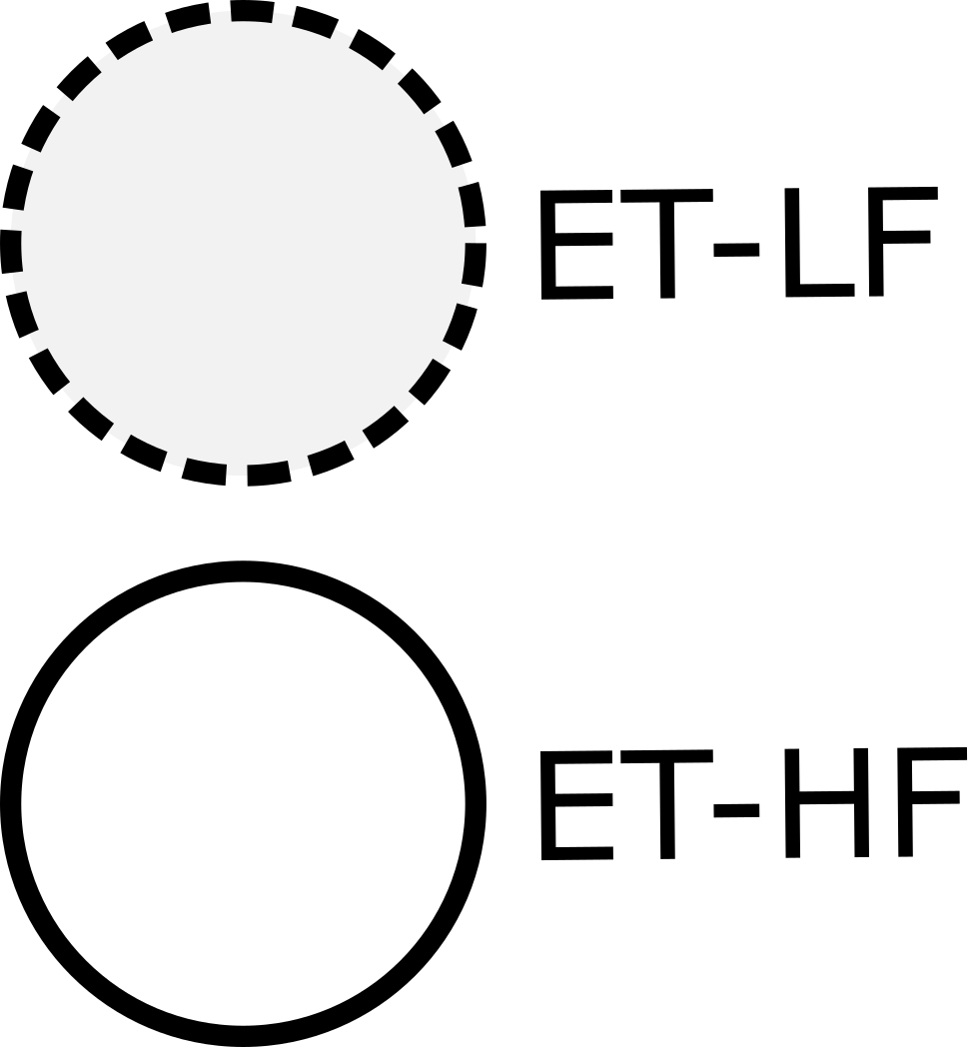
Why ET beampipes ultra high vacuum?
Dimensions
Beampipes internal diameter: 1 m
Total beampipe vacuum system
length: 120 km
Partial pressure requirements
H₂ ≈ 10⁻¹⁰ mbar
H₂O ≈ 10⁻¹¹ mbar
H_{x}C_{y} (> 100 amu) < 10⁻¹⁴ mbar
Sketch inspired from ET design report update 2020 and XIII ET symposium (2023).
Dimensions in mm.

Slide 4
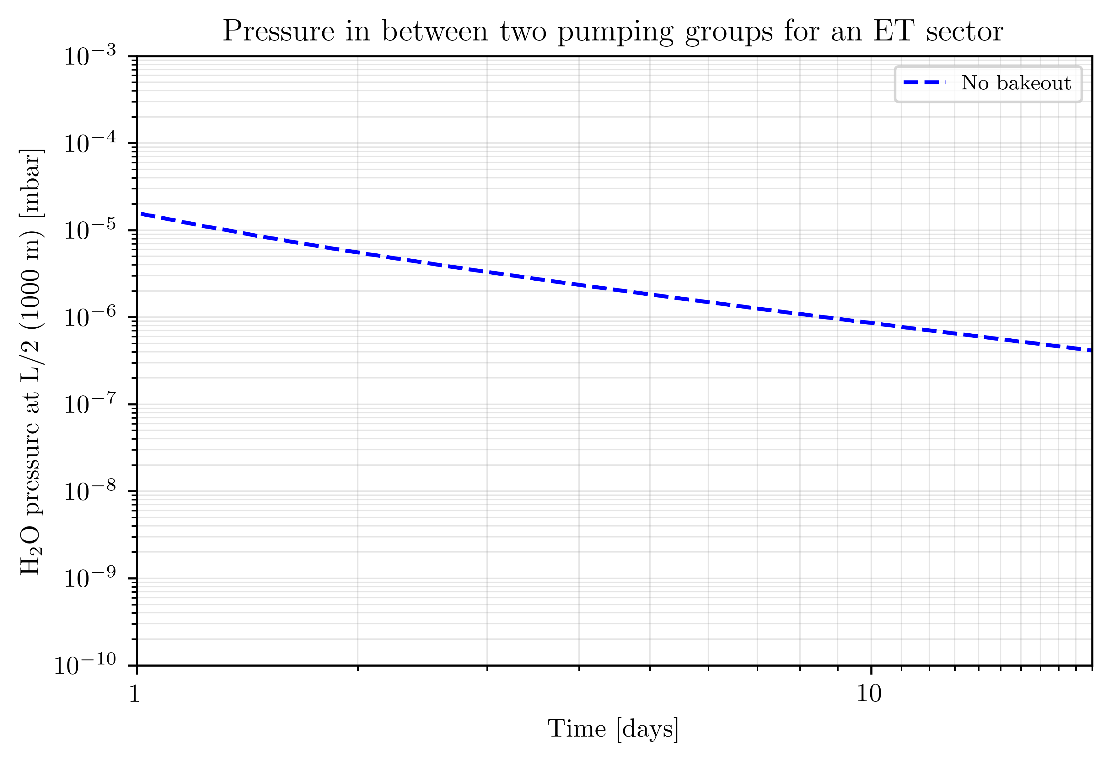
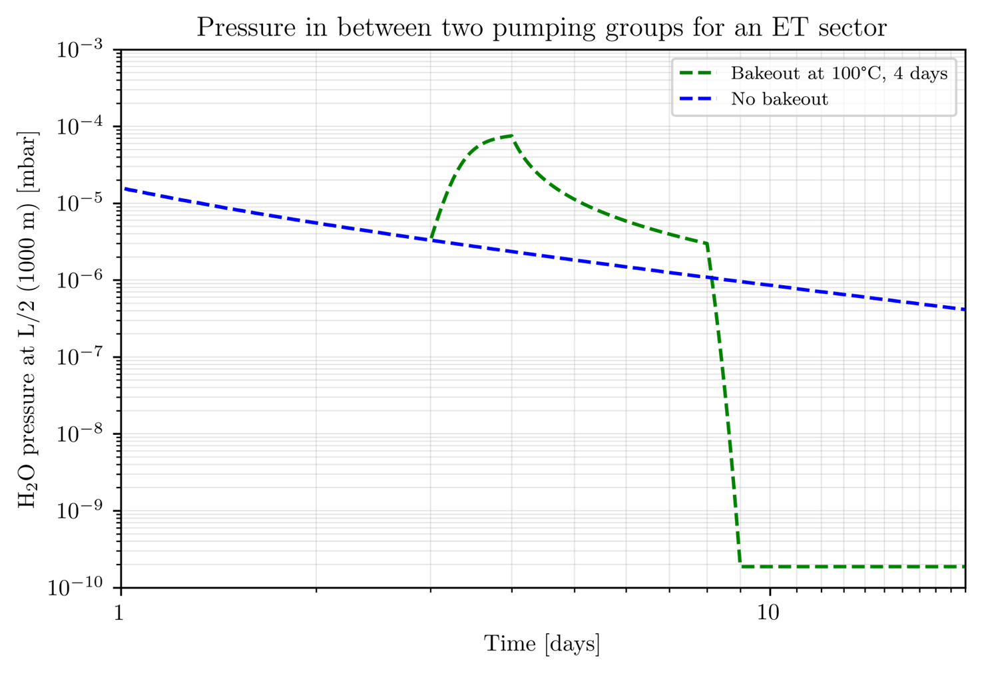
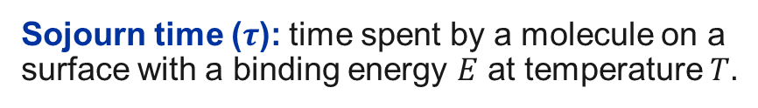
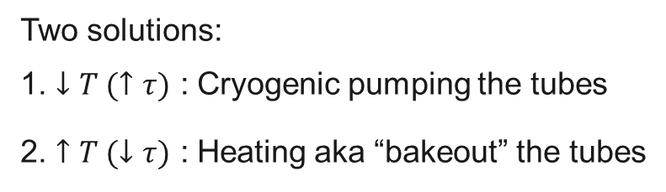
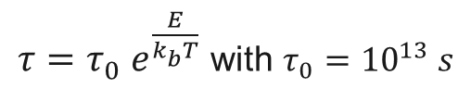
How we can achieve UHV?
After an initial volume evacuation, the pressure decay (pumpdown) is limited by the water vapour molecules adsorbed on the tube surface with an inverse law of the pumping time:
$$P ∝t^{−1}$$
Sojourn time ($τ$): time spent by a molecule on a surface with a binding energy $E$ at temperature $T.$
$τ={τ_{0} e}^{\frac{E}{k_{b}T}}$ with $τ_{0}={10}^{13} s$
Start bakeout
End bakeout
Two solutions:
1. $↓T (↑τ)$ : Cryogenic pumping the tubes
2. $↑T (↓τ)$ : Heating aka “bakeout” the tubes

Slide 5
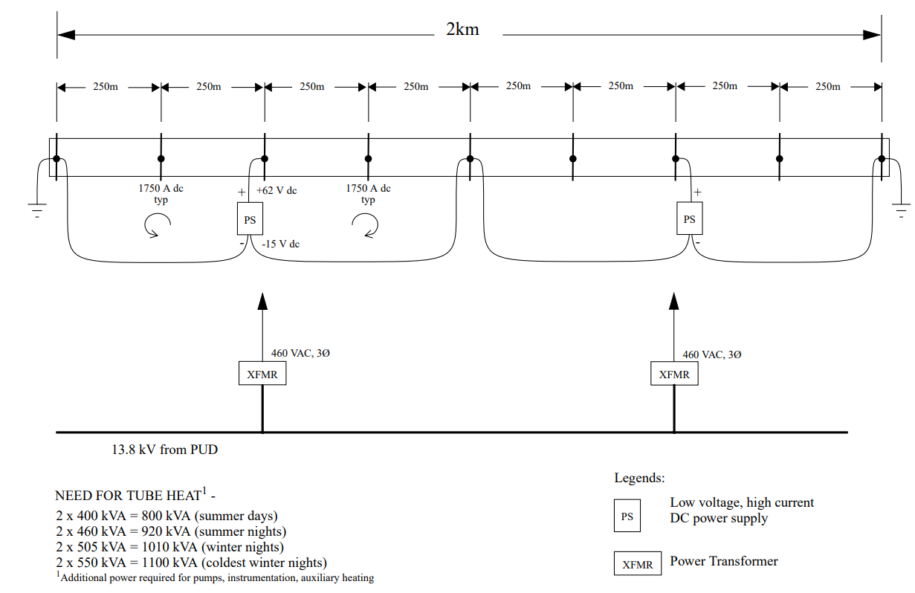
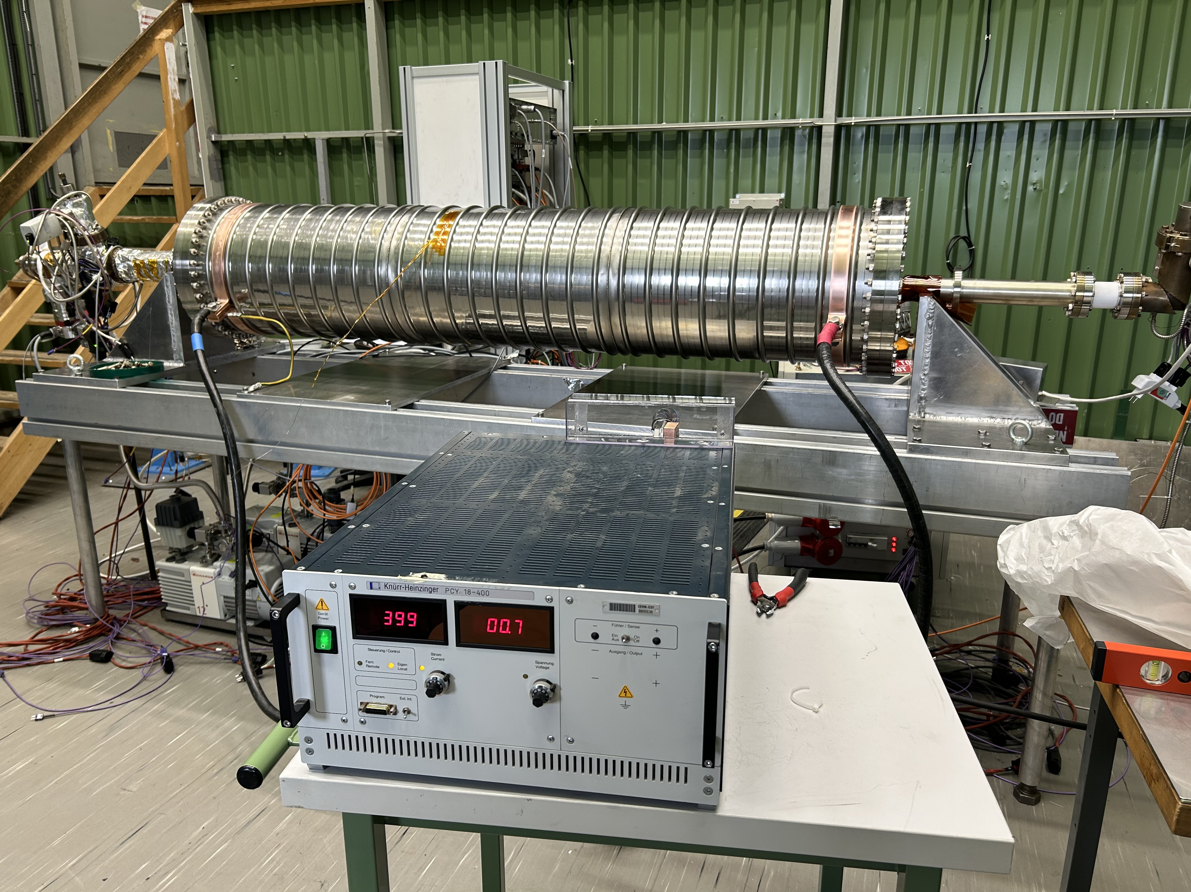
The bakeout of ET beam pipes
To efficiently bakeout the ET beam pipes, we can use direct joule effect (beam pipe = conductor).
LIGO bakeout
electrical heating power
(LIGO-G970071-00-P)
Electrical test of a power supply on an
ET corrugated prototype
(400 A max)

Slide 6
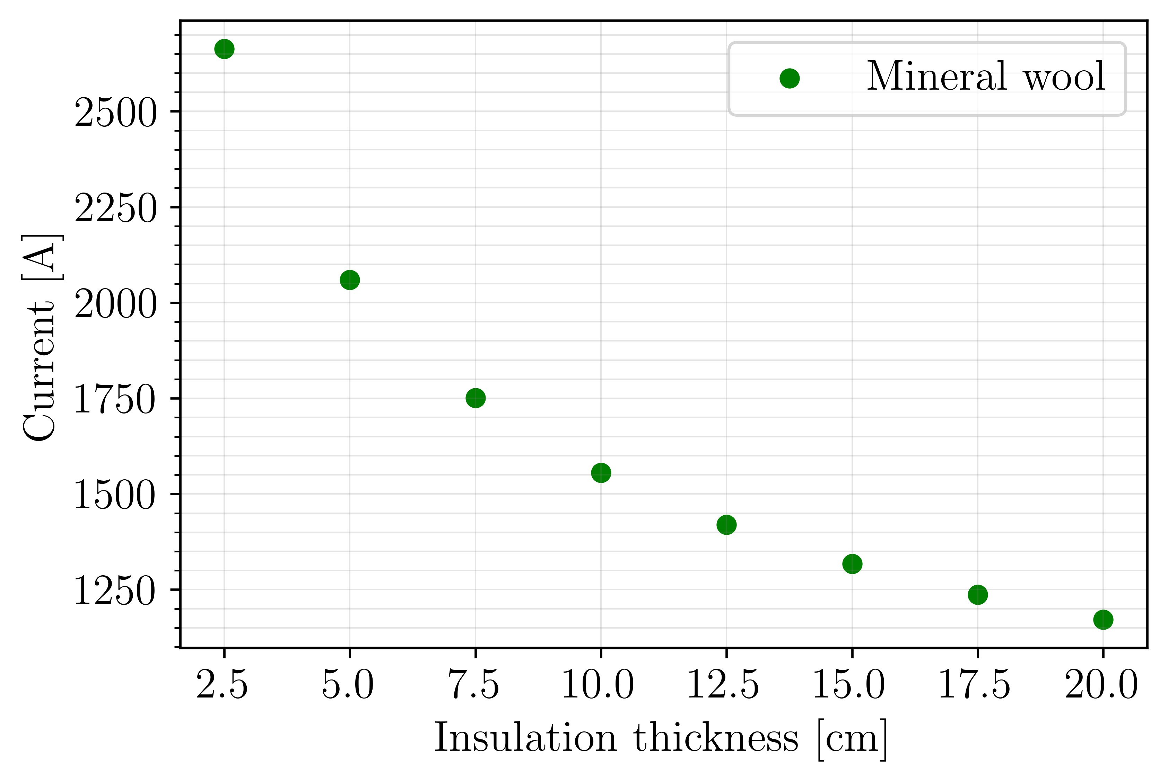
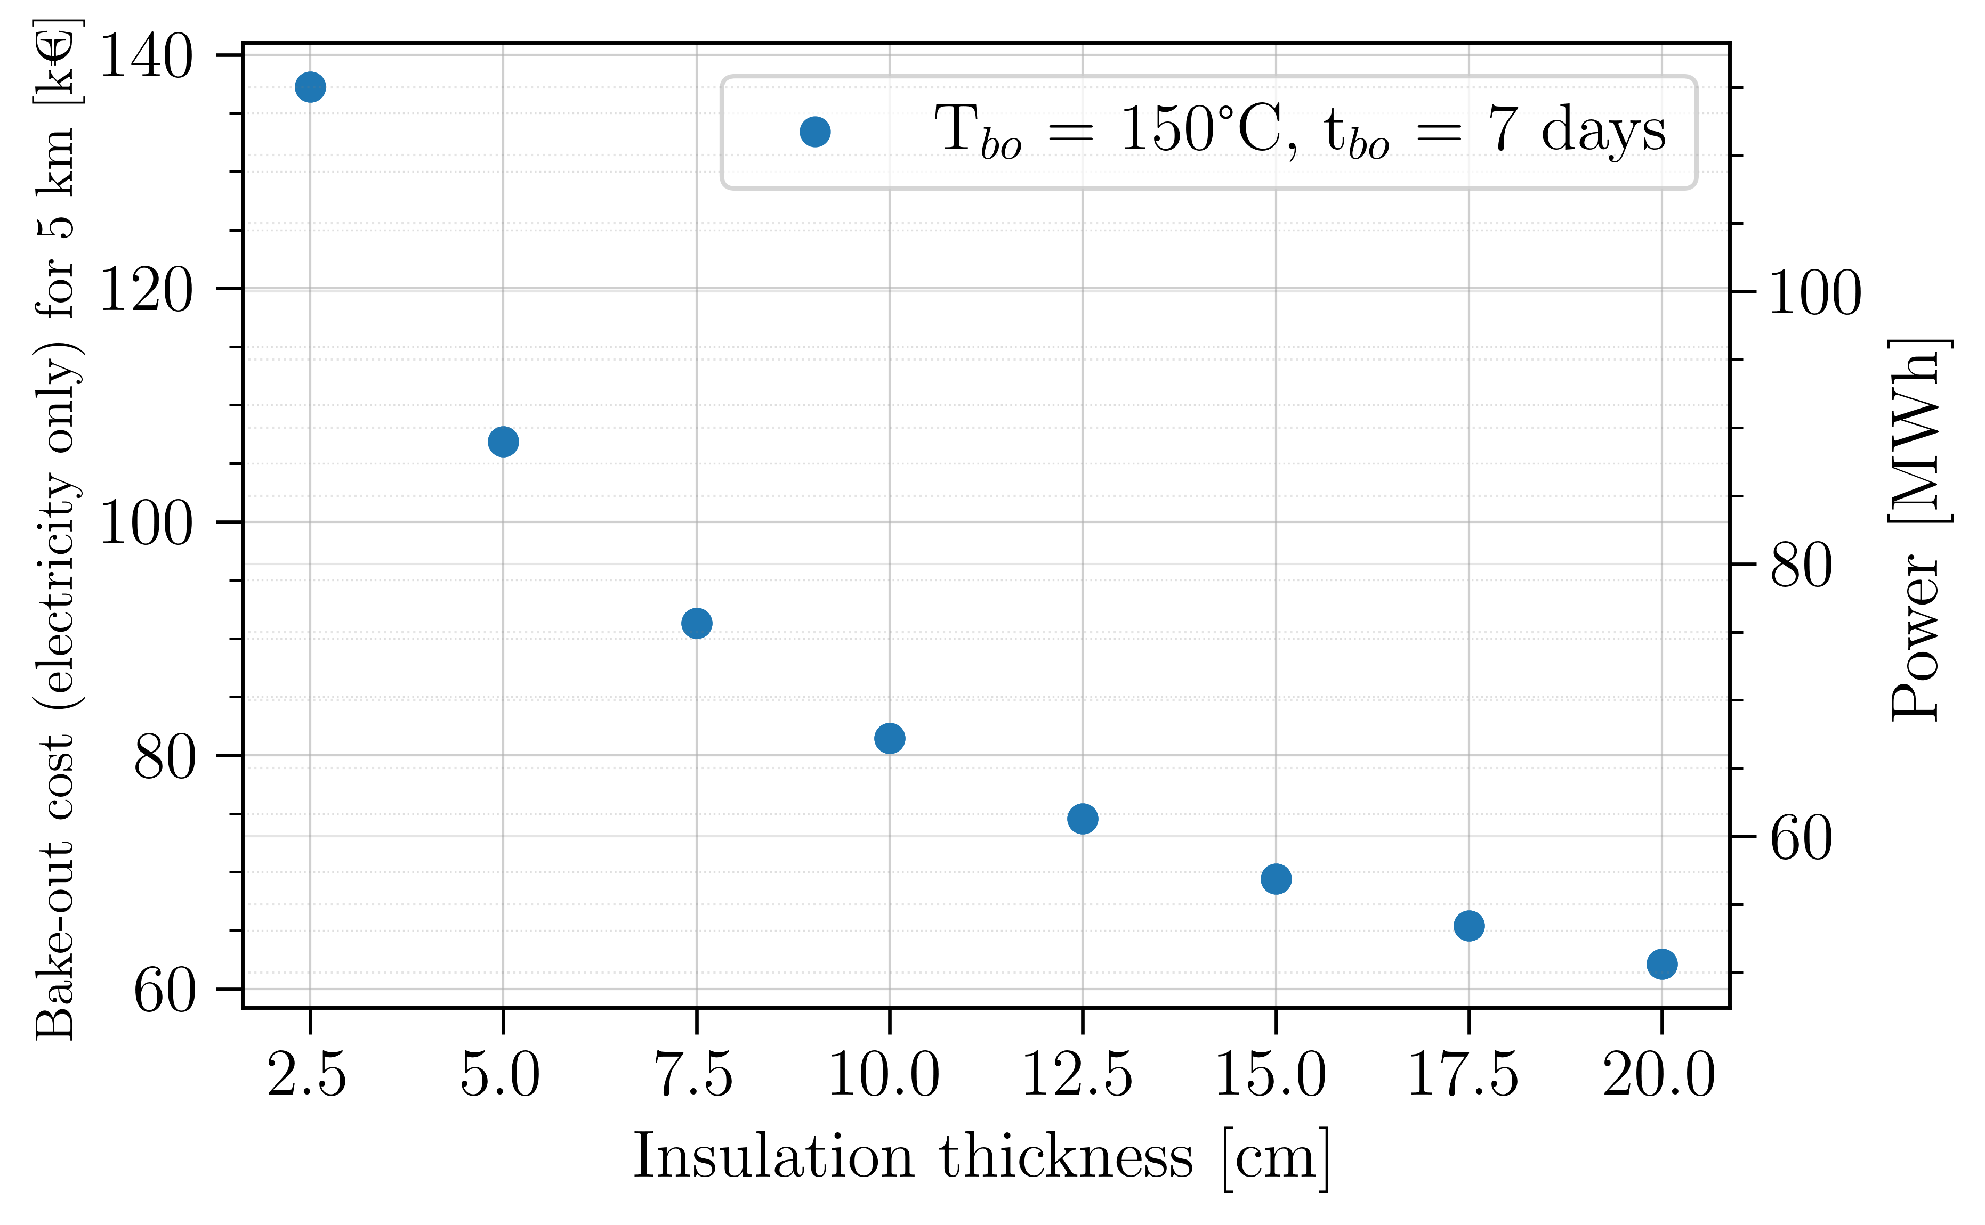
Why do we need insulation?
Limiting heat losses = limiting needed current = lower costs
The system is foreseen to be baked one, maximum two times over 50 years of operation (150°C max).
K_{mineral wool} : 3.65E-7 ΔT²+1.44E-4*ΔT+4.89E-2 W m⁻¹ K⁻¹, ΔT: 130°C (150°C-20°C). Convection coefficient (h): 5 W m⁻² K⁻¹ (calm air, no forced ventilation)

Slide 7
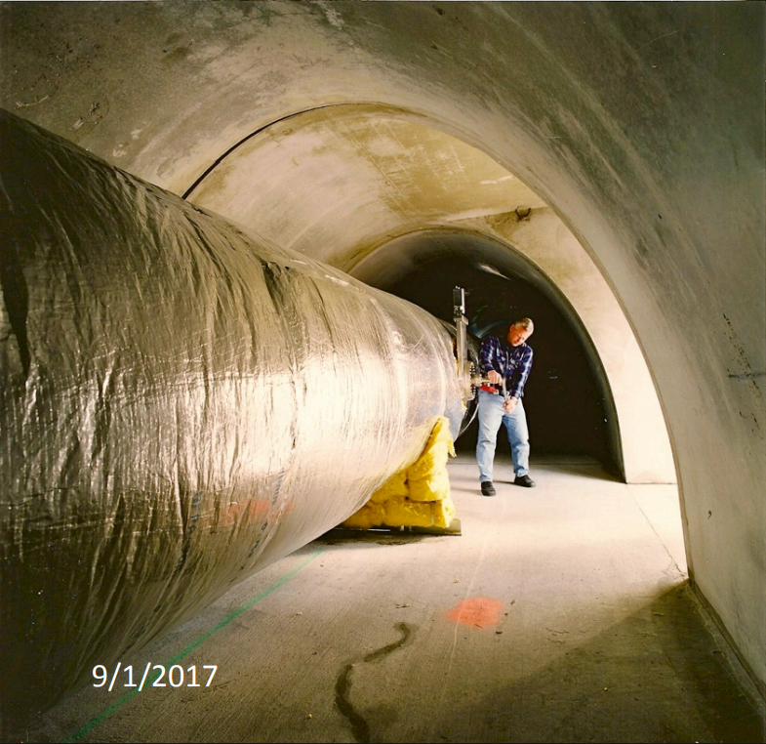
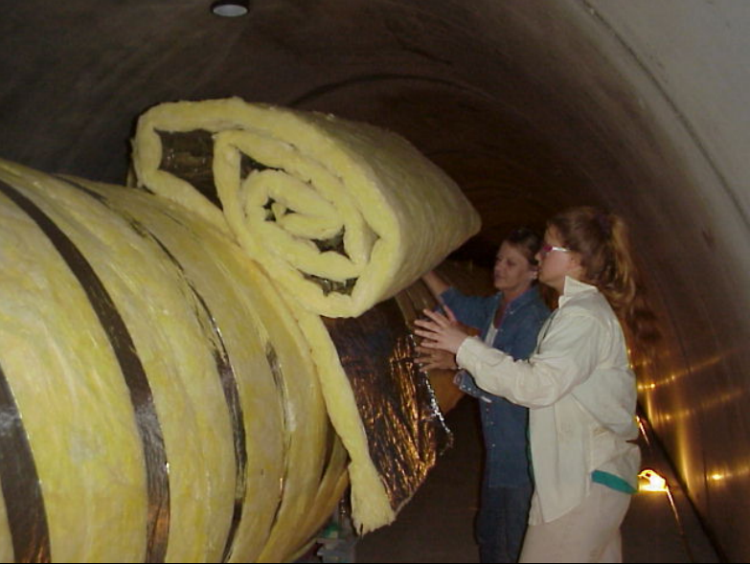
The problem of LIGO and VIRGO approach
Insulation: 15 cm mineral wool (double layer of 7.5 cm) permanently installed.
For ET
Surface to be covered: ~380.000 m² (120 km)
Cost of insulation (mineral wool 10 - 15 cm): ~48 – 60 €/m²
Total insulation cost [€]: ~ 18 - 23 M €
Other concerns:
Depreciation cost if permanently installed?
Storage?
Sustainability?
Cleanliness and dust generation?
Safety (smoke, fire generation, installation, etc.)?
Images courtesy of M. Zucker and R. Weiss

Slide 8
Requirements for the ET insulation
No explicit requirement from the project (ET)
 | Target value | Maximum value
Insulation thickness [cm] | 10
Form | Reusable shells
Maximum operating temperature [°C] | 400 | 300
Thermal conductivity k [W m⁻¹ K⁻¹] (at 20°C) | < 0.04 | < 0.05
Thermal conductivity k [W m⁻¹ K⁻¹] (at 150°C) | < 0.05 | < 0.06
Reaction to fire (EN 13501-1) | Euroclass A1 | Euroclass A2
Smoke production (EN 13501-1) | S1 | S1
Droplets generation (EN 13501-1) | D0 | D0
Water vapour resistance factor | <1 | Not specified
Mechanical properties yet to be determined

Slide 10
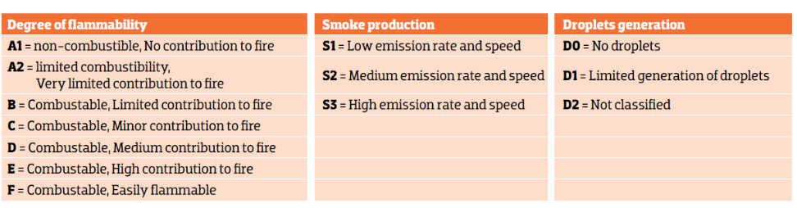
Source: KNAUF insulation

