Slide 1
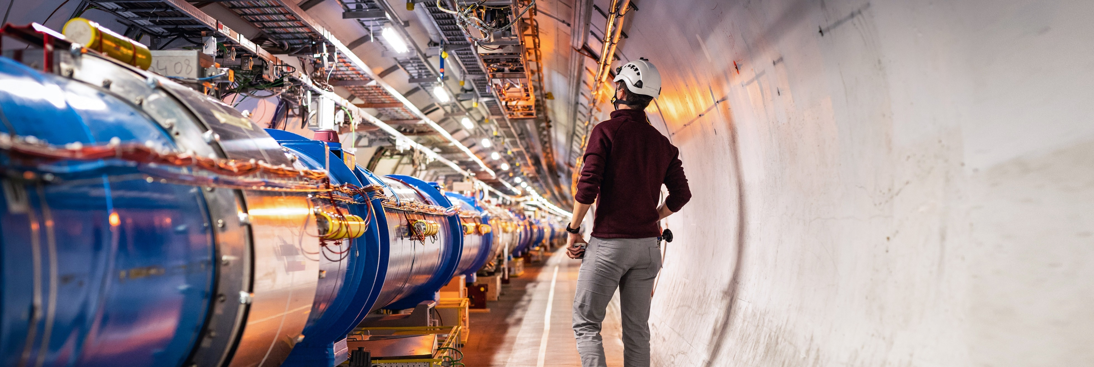
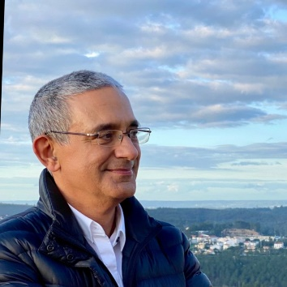
Introdução ao CERN
Paulo.Gomes@cern.ch
TE-VSC Group
CERN Management
Liaison for Portugal
2025
Notes:
THE WELCOME SLIDE
With this slide the speaker:
Introduces him/herself
Describes how this brief presentation aims to give an overview of CERN, as an introduction to the visit that will follow.

Slide 2
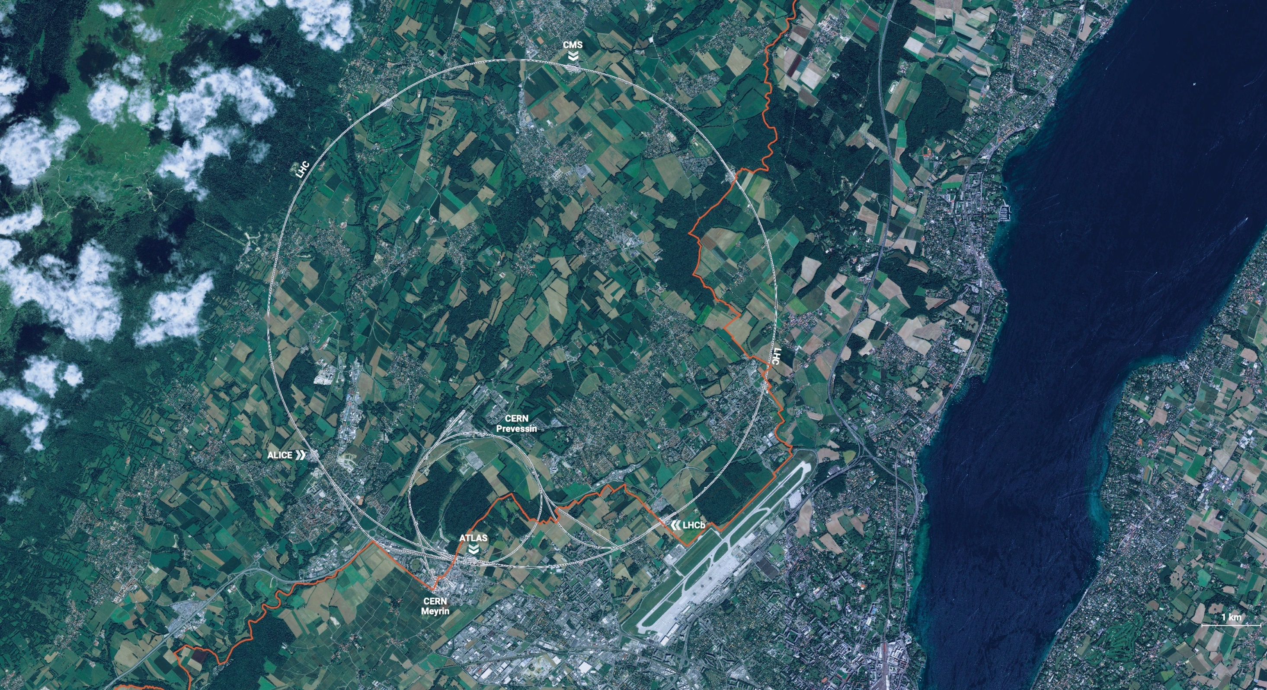
CERN é o maior laboratório no mundo para a física de partículas.
O nosso objetivo é entender as partículas mais fundamentais e as leis do universo.

Slide 3
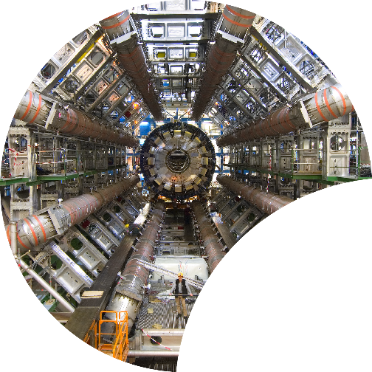
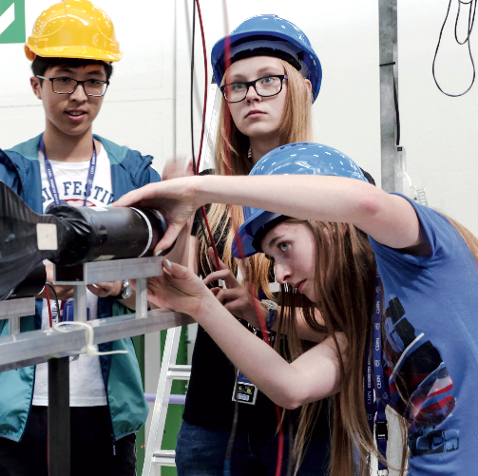
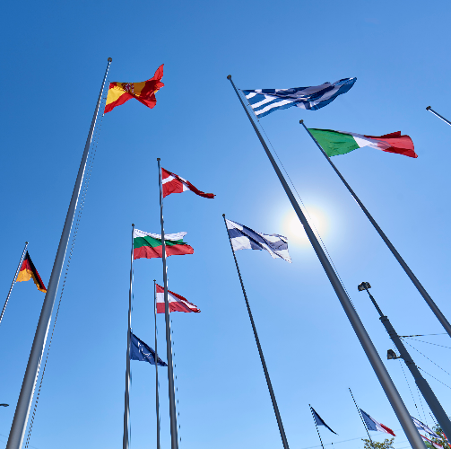
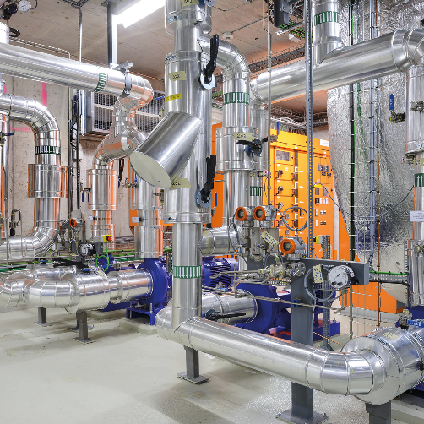

Os quatro pilares da missão do CERN
INVESTIGAÇÃO
EDUCAÇÃO & FORMAÇÃO
COLABORAÇÃO
TECNOLOGIA & INOVAÇÃO
2025
Notes:
This slide introduces the four pillars that underpin CERN’s mission:
Research: To perform world-class research in experimental and theoretical particle physics; and to provide the particle physics community a range of accelerators that enable that research
Collaboration: To unite people from all over the world in the common goal of advancing the frontiers of human knowledge, in a spirit of equal collaboration and openness
Innovation: To push the technology underpinning accelerators, detectors and computing, to drive innovation in order to transfer knowledge to other scientific and technological areas, for the benefit of society
Education and Training: To train future physicists and engineers, to promote careers in science and engineering, and to foster citizens’ engagement in particle physics and in fundamental research.
FROM THIS POINT FORWARD, THE PRESENTATION IS DIVIDED INTO FOUR SECTIONS: ONE SECTION PER PILLAR

Slide 4
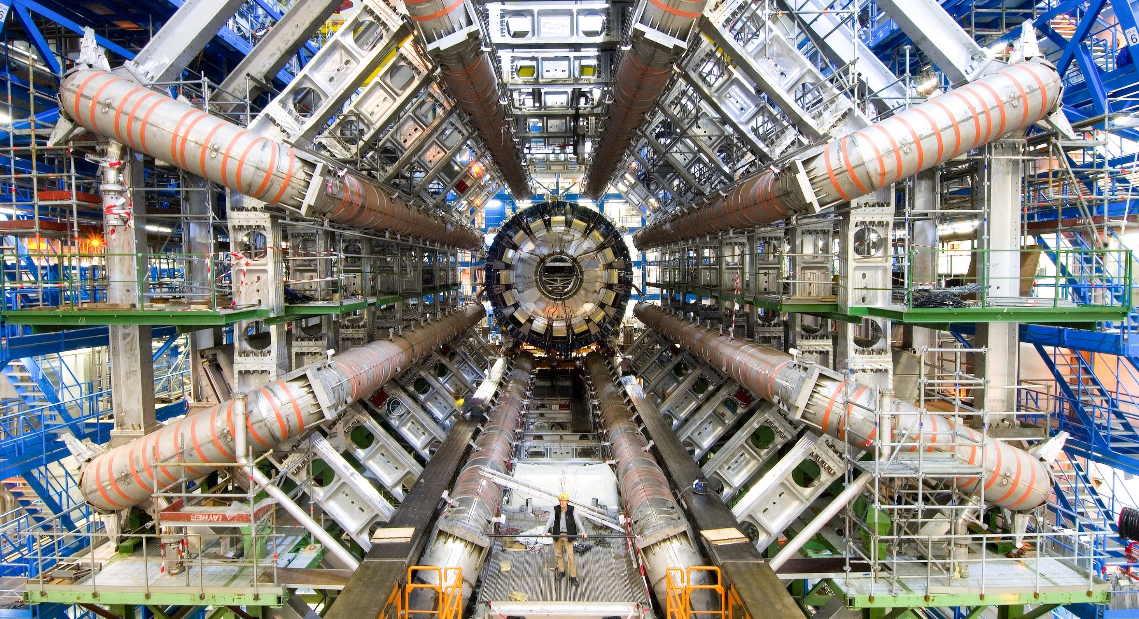
INVESTIGAÇÃO
Notes:
This is the title slide for the section on “Research”.
It can be shown for just enough time for viewers to take in the beauty and impact of the image.
(THIS SECTION HAS 13 SLIDES, INCLUDING ONE OPTIONAL SLIDE)

Slide 5
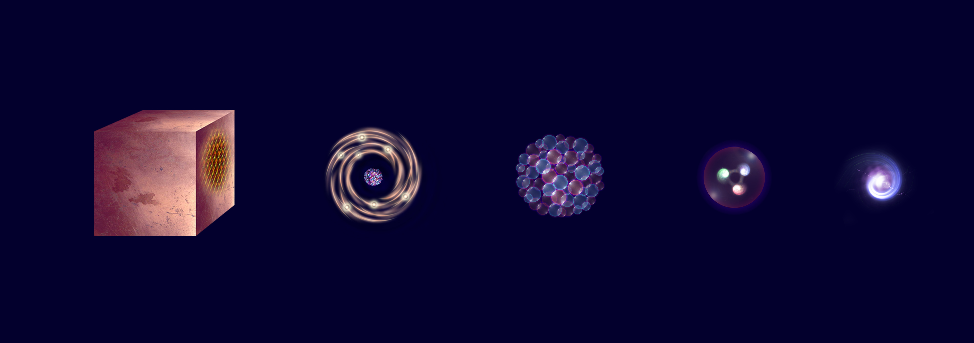
De que é que é feito o Universo?
Estudamos os constituintes elementares da matéria e as interações que determinam os seus comportamentos
Electron
Matter
0,1 m
Atom
~10⁻¹⁰ m
Nucleus
~10⁻¹⁴ m
Proton
~10⁻¹⁵ m
Quark
<10⁻¹⁸ m
Apresentação - Portugal
2025
5
Notes:
This slide and the next address the questions that underpin research in particle physics.
One of the questions is “What are we made of?”
To answer this question, we study the fundamental particles that make up matter.
The speaker takes the visitors on a brief journey from visible matter to the electron and the quark: electrons and quarks are the fundamental particles of matter

Slide 6
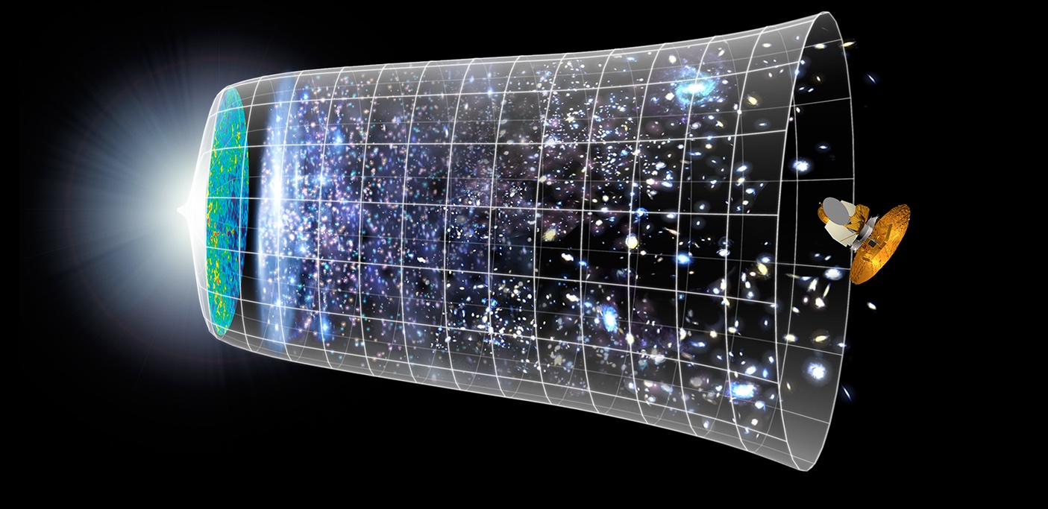

Como é que o Universo começou ?
Big Bang
Reproduzimos as condições* do universo uma fração de segundo após o Big-Bang,
para procurar compreender a sua estrutura e evolução.
Telescópios
Aceleradores
13.8 mil milhões de anos
Hoje
10²⁶ m
*de temperatura, densidade de energia
Notes:
The other question that underpins research in particle physics is “How did the Universe begin?”
We gain insight into the structure and evolution of the Universe, from the first billionth of a second (10⁻¹²s) after the Big Bang.
From the very small (particle physics at modern accelerators allows us to study the fundamental laws of nature on scales down to smaller than 10⁻¹⁸ m)
to the very big (telescope-based astrophysics),
we gain knowledge about the laws and evolution of the universe.

Slide 7
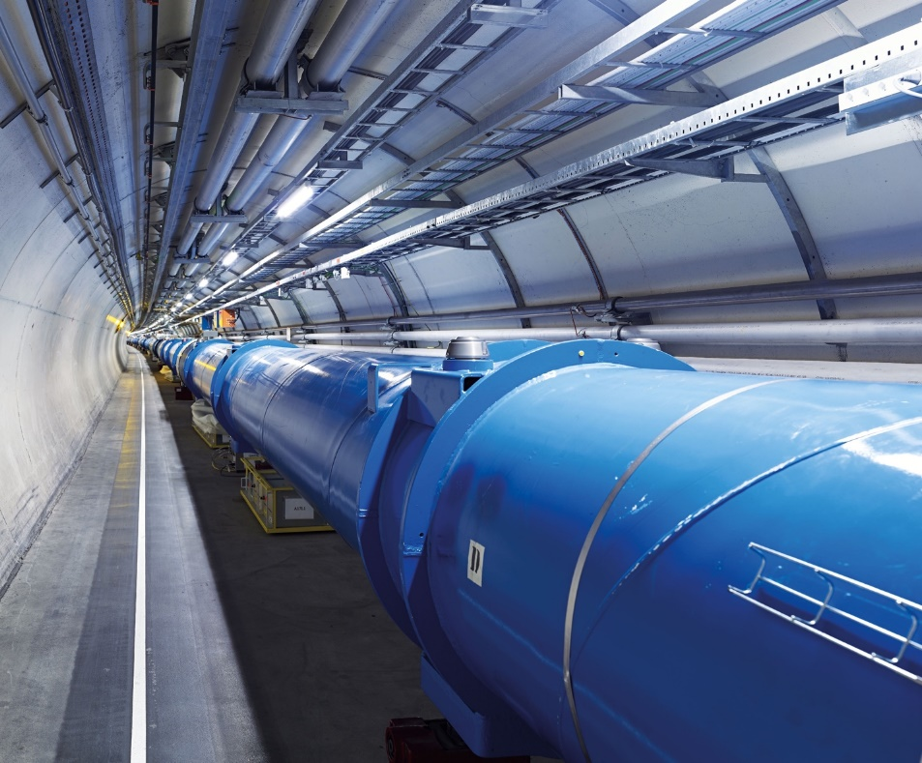
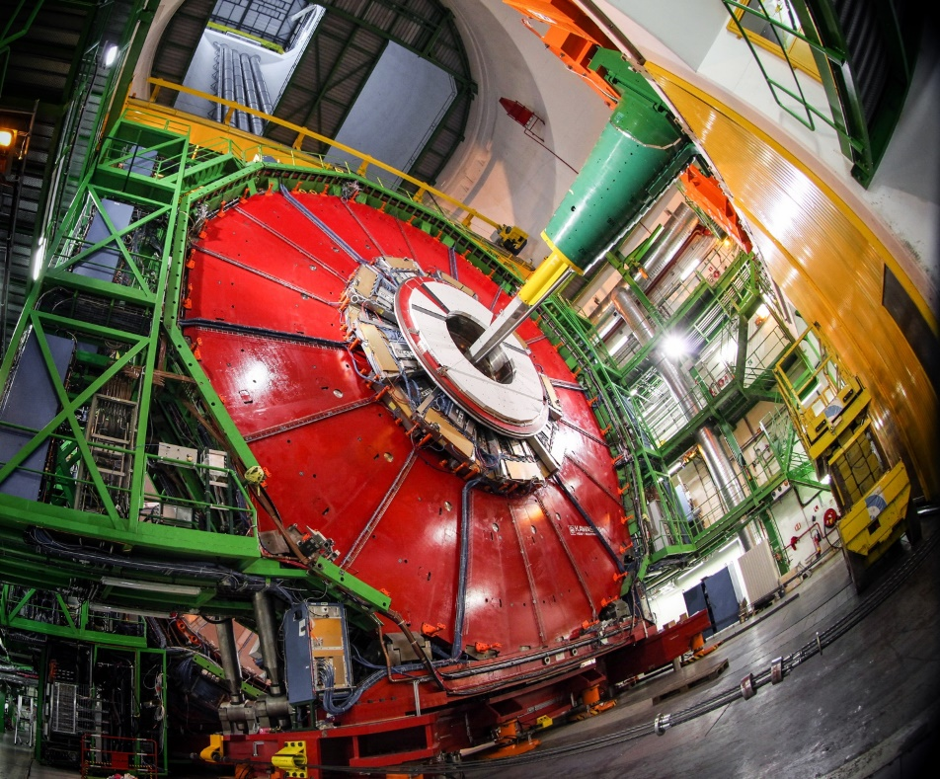
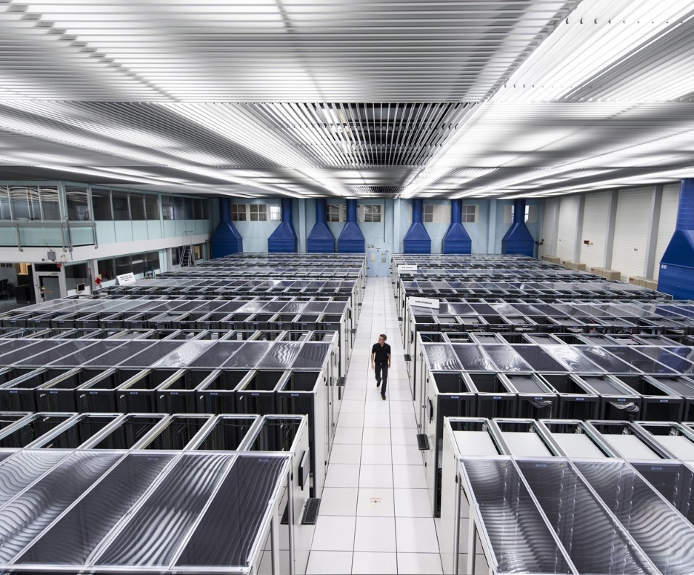
Para responder a estas questões , desenvolvemos tecnologias em 3 áreas
ACELERADORES
DETETORES
COMPUTAÇÃO
Apresentação - Portugal
2025
7
Notes:
This slide presents the three technological fields that allow CERN to answer the questions presented earlier.
The following slides focus on each of these fields, so here the speaker may give a 1-2 sentence description of each.
For example:
Accelerators - We build and maintain a range of particle accelerator facilities, where particles are accelerated to almost the speed of light
Detectors – built by consortia of physicists and engineers from across the globe, this is where collisions occur and where new, hitherto unknown particles may be formed, and new interactions between particles identified.
Computing – experiments at CERN generate enormous amounts of data. This data is collected at CERN and sent around the world to be processed and stored.

Slide 8
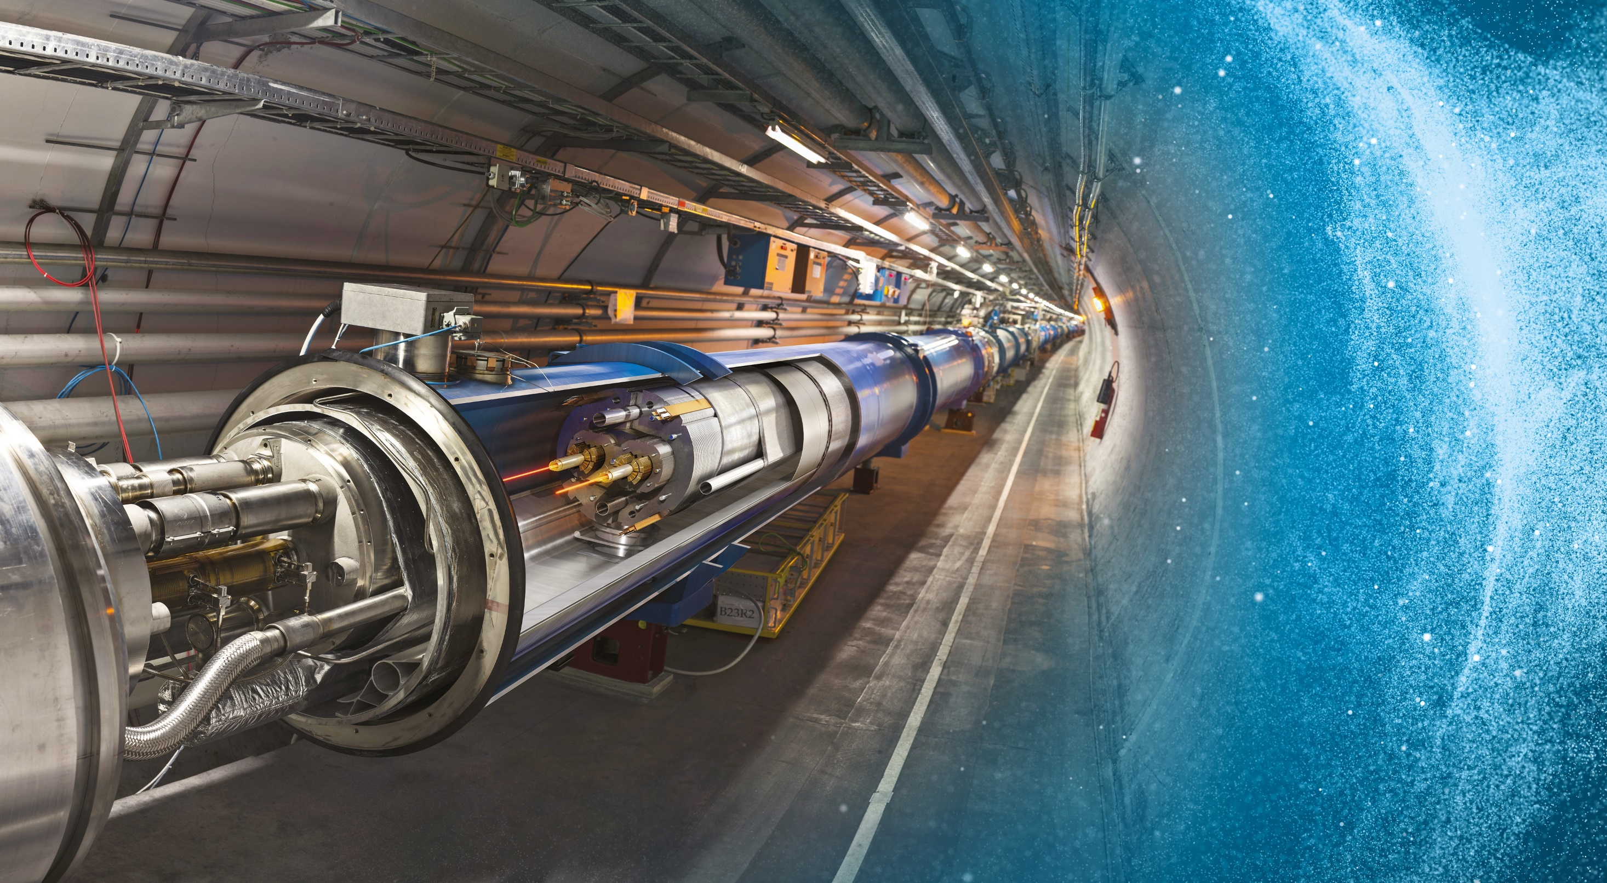
Large Hadron Collider (LHC)
Anel de 27 km de circunferência
A 100 m de profundidade
Partículas são aceleradas até quase à velocidade da luz (no vazio)
Ímanes supercondutores guiam as partículas, que circulam em dois feixes, em sentidos opostos
Notes:
The LHC is CERN’s flagship accelerator.
Possible additional information to complement what is on the slide (TIME PERMITTING):
It is the world’s largest and most powerful particle accelerator
Protons (and lead ions) circulate in two beams, which travel in opposite directions in two separate beam pipes
Protons are accelerated to 99.9999991% the speed of light (11 245 turns/second)
The beam pipes are under ultrahigh vacuum, to avoid collisions between the particles and gas molecules. The vacuum in the beam pipes is 10⁻¹³ atm – similar to the atmosphere on the moon (10⁻¹⁵ atm)
It is one of the coldest places in the Universe (1.9K; -271.3°C)
Superconducting magnets are used to focus the beam (quadrupole magnets) and bend the beam around the circular accelerator (dipole magnets)
The LHC is built in the same tunnel where CERN’s previous flagship accelerator was located – LEP, which accelerated electrons
Collaboration between CERN and European industry

Slide 9
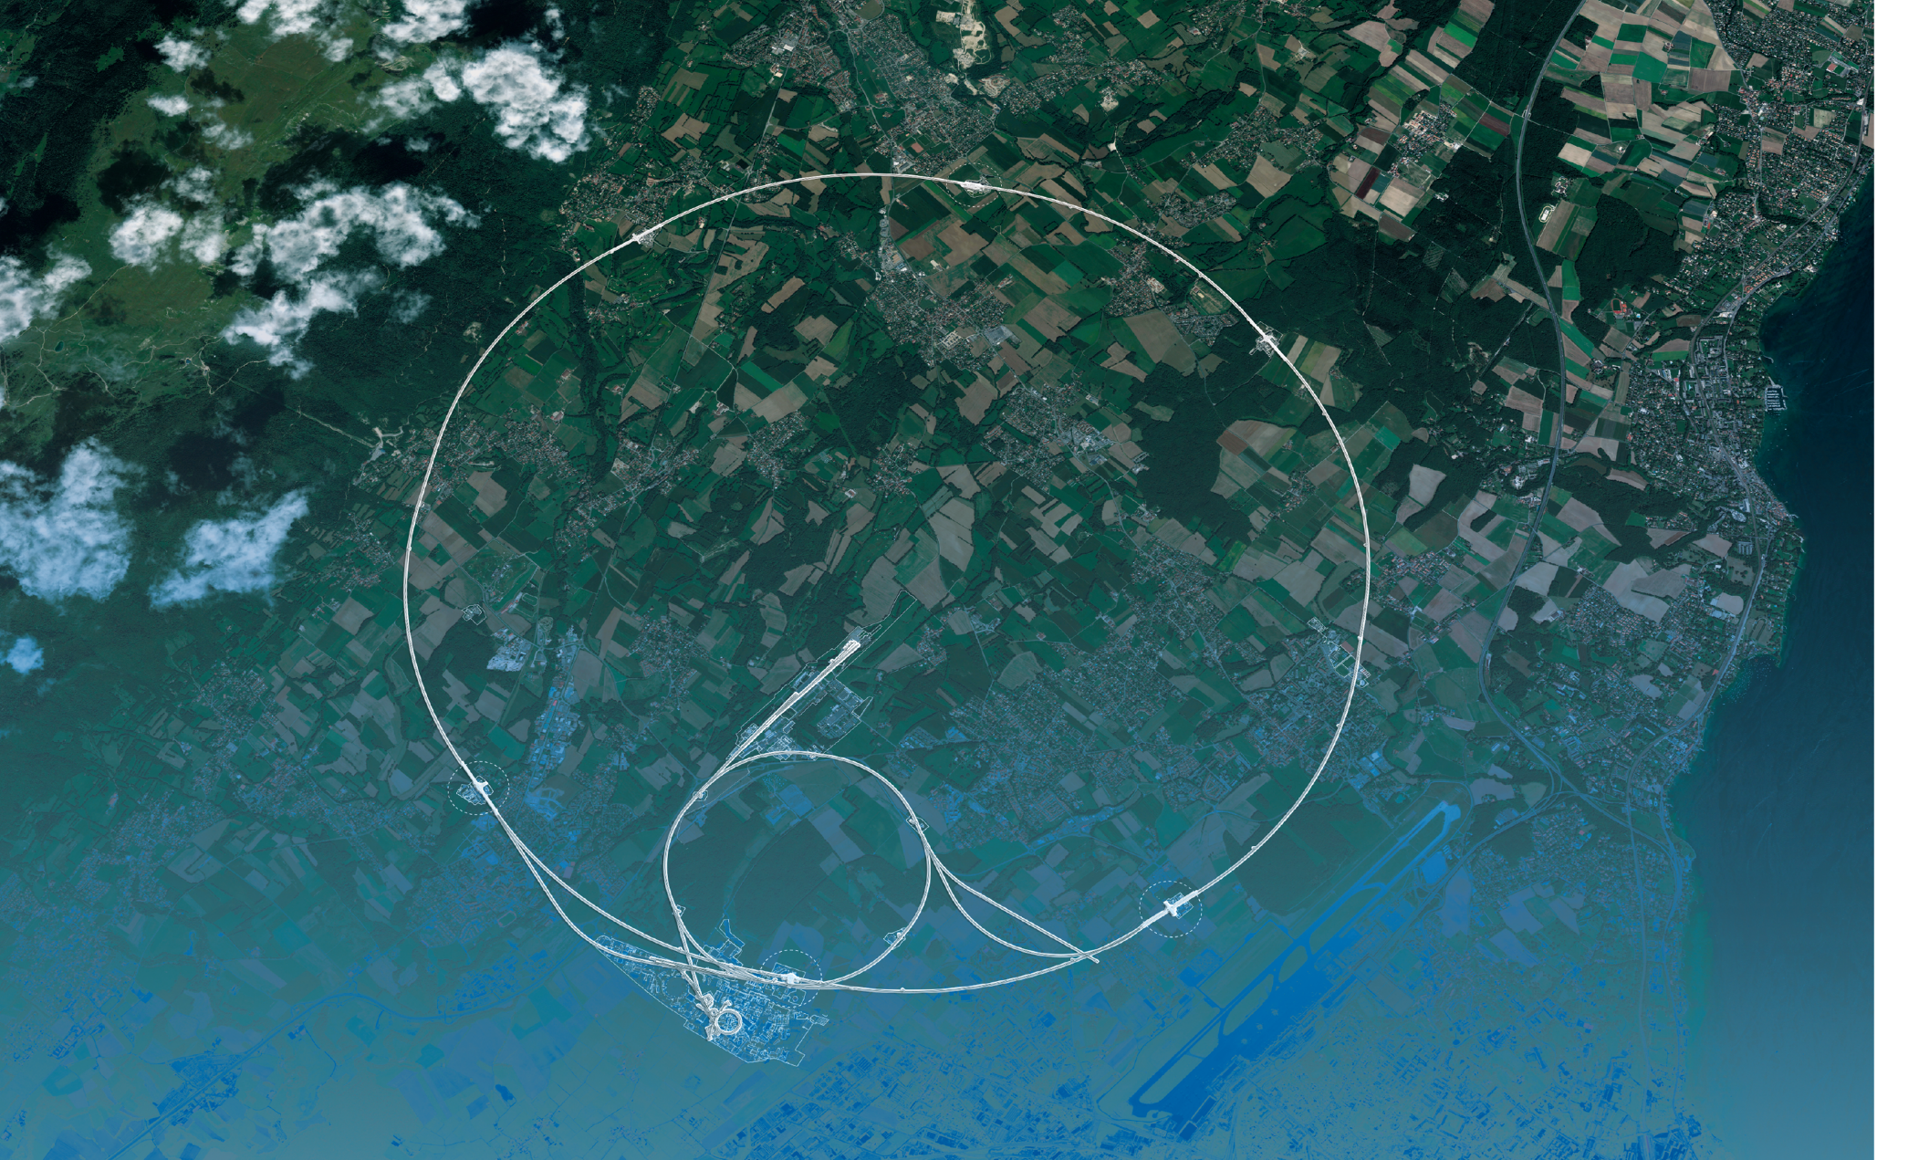
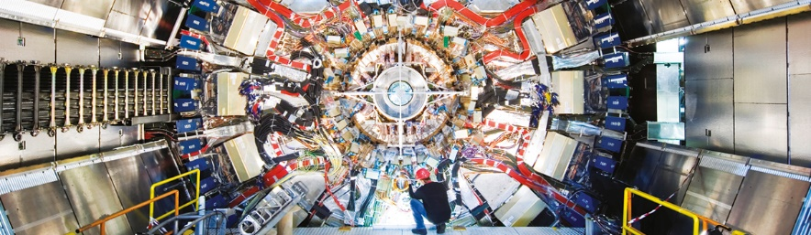
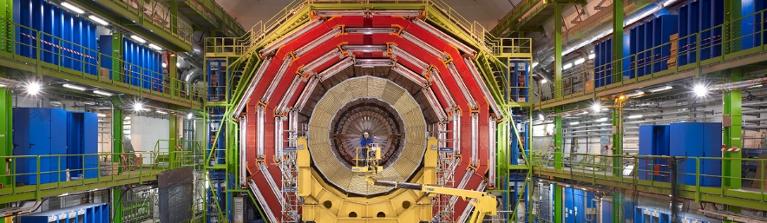
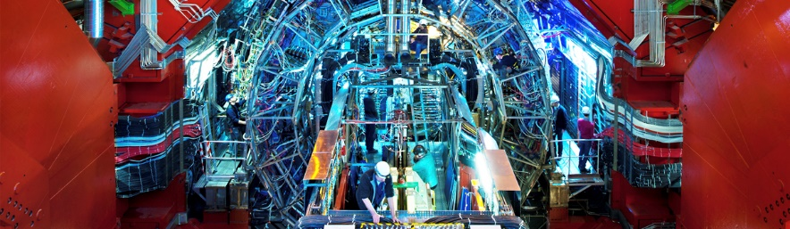
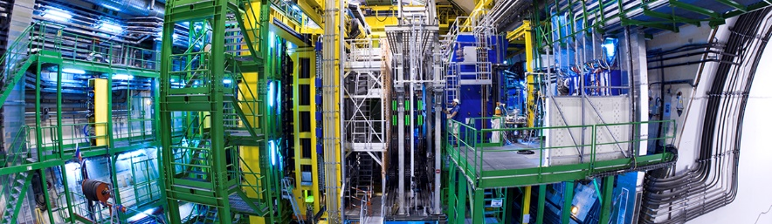
Os dois feixes cruzam-se e colidem em 4 pontos onde detetores gigantes registam os resultados
ATLAS
CMS
CMS
ALICE
ALICE
ATLAS
LHCb
LHCb
Notes:
This slide allows the speaker to describe the accelerator complex and the four main LHC detectors.
About the accelerator complex (OPTIONAL)
The LHC is the last in a chain of particle accelerators, which gradually accelerate particles at increasing energy until they enter the LHC
Particles collide at four points on the LHC, where detectors register the collisions.
(ON CLICK)
About the four detectors, the speaker may give a 1-2 sentence description of the goal of each detector (TIME PERMITTING):
ATLAS – is a general-purpose detector, designed to carry out research ranging from precise measurements of the Higgs boson to searches for new physics beyond the Standard Model, similar to CMS. It is the largest collider-detector ever built (44m in length and 25m in diameter).
CMS - is a general-purpose detector, similar to ATLAS. It is one of the detectors, with ATLAS, where evidence for the Higgs boson was discovered and announced in 2012. It is the heaviest collider-detector (12.5 tonnes).
ALICE – studies the properties of the so-called quark-gluon plasma, a state of matter that probably existed just after the Big Bang, before protons and neutrons were formed.
LHCb – studies the asymmetry between matter and antimatter in interactions of particles containing the so-called b quark. This may help understand why our Universe is made up of only matter.

Slide 10
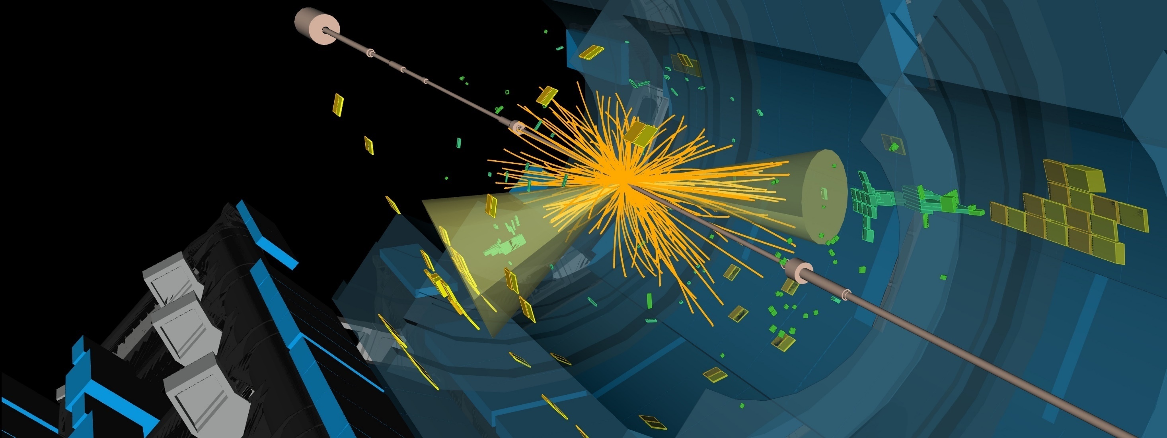
O LHC produz mais de mil milhões de colisões de partículas por segundo
A energia das partículas que colidem
é convertida em novas partículas.
Os detetores medem energia, direção e carga elétrica
das partículas criadas na colisão.
Tiram 40 milhões de “fotografias” 3D por segundo
registando as trajetórias das novas partículas. Apenas 1 000 eventos são guardados por segundo
2025

Slide 11
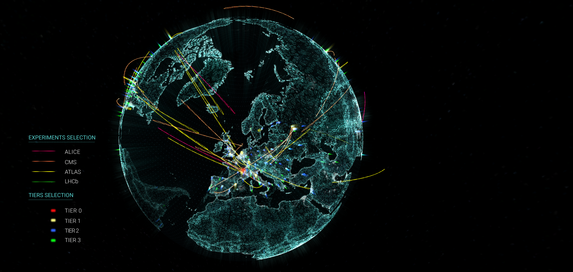

A rede mundial de computação para o LHC
Worldwide LHC Computing Grid (WLCG)
Usada para guardar, distribuir, processar e analisar os dados experimentais do LHC.
1.4 milhão de processadores em 170 centros de dados em mais de 40 países. ( incluindo PT )
1 500 Petabytes de dados do CERN guardados em todo o mundo.
Notes:
** Key facts and analogies:
1500 petabytes of data stored worldwide thanks to WLCG: To put it in perspective, it is equivalent to over 50 000 years of 24/7 HD video recording.
There are duplicates, which explains why we have 1500 PB stored and not about 600 PB (which is what had been produced by the LHC experiments during Run 1 and Run 2 combined).
It should be noted that the LHC experiments plan to collect more data during LHC Run 3 than they did in the first two runs combined.
It means our challenge during LS2 was to get ready to store and analyse more than 600 petabytes of data (600 million gigabytes), which it is equivalent to over 20 000 years of 24/7 HD video recording.
** Narratives and key messages from the CERN IT Comms strategy 2022-2023:
https://cds.cern.ch/record/2836424/files/IT%20Comms%20strategy.pdf
- IT plays an essential part in the particle physics research both directly by serving the scientific programmes of CERN and its user community, and indirectly by powering the daily operations of the laboratory.
It achieves this through reliable services and through technical innovation and research.
- IT is a reliable partner for the experiments: IT evolves services to match ever increasing requirements, and validates preparedness, for example as was done in pre-Run 3 challenges with each experiment. IT tracks or leads technology evolutions and works with domain experts to continuously address future challenges. IT is the main software provider for the distributed computing services of the LHC experiments, which are provided as the Worldwide LHC Computing Grid (WLCG), a global collaboration of more than 170computing centres in more than 42 countries.
- Throughout Run 3 IT will continue to build up storage, compute and network capacity to keep up with the expected growth in data rates. IT will also coordinate the associated build-up of capacity and technology evolution at the tens of loosely coupled facilities worldwide which form the WLCG.
- IT has put mechanisms in place to ensure evolving computing needs continue to be met, realising the full physics potential of the experiments. The building of a new energy-efficient and modular data centre in Prévessin is a key step to meeting these needs.
Appendix in case of questions concerning the analogies’ calculation:
HD video streaming – analogy calculation
One hour of streaming HD video on Netflix takes around 3 GB of data.
That means that one day is 72 GB, and one year is 26298 GB.
For ease, let’s call this 26000 GB per year, or 26 TB per year.
This can also be expressed as 0.026 PB.
We have rounded the numbers so that the analogy is easier to remember.

Slide 12
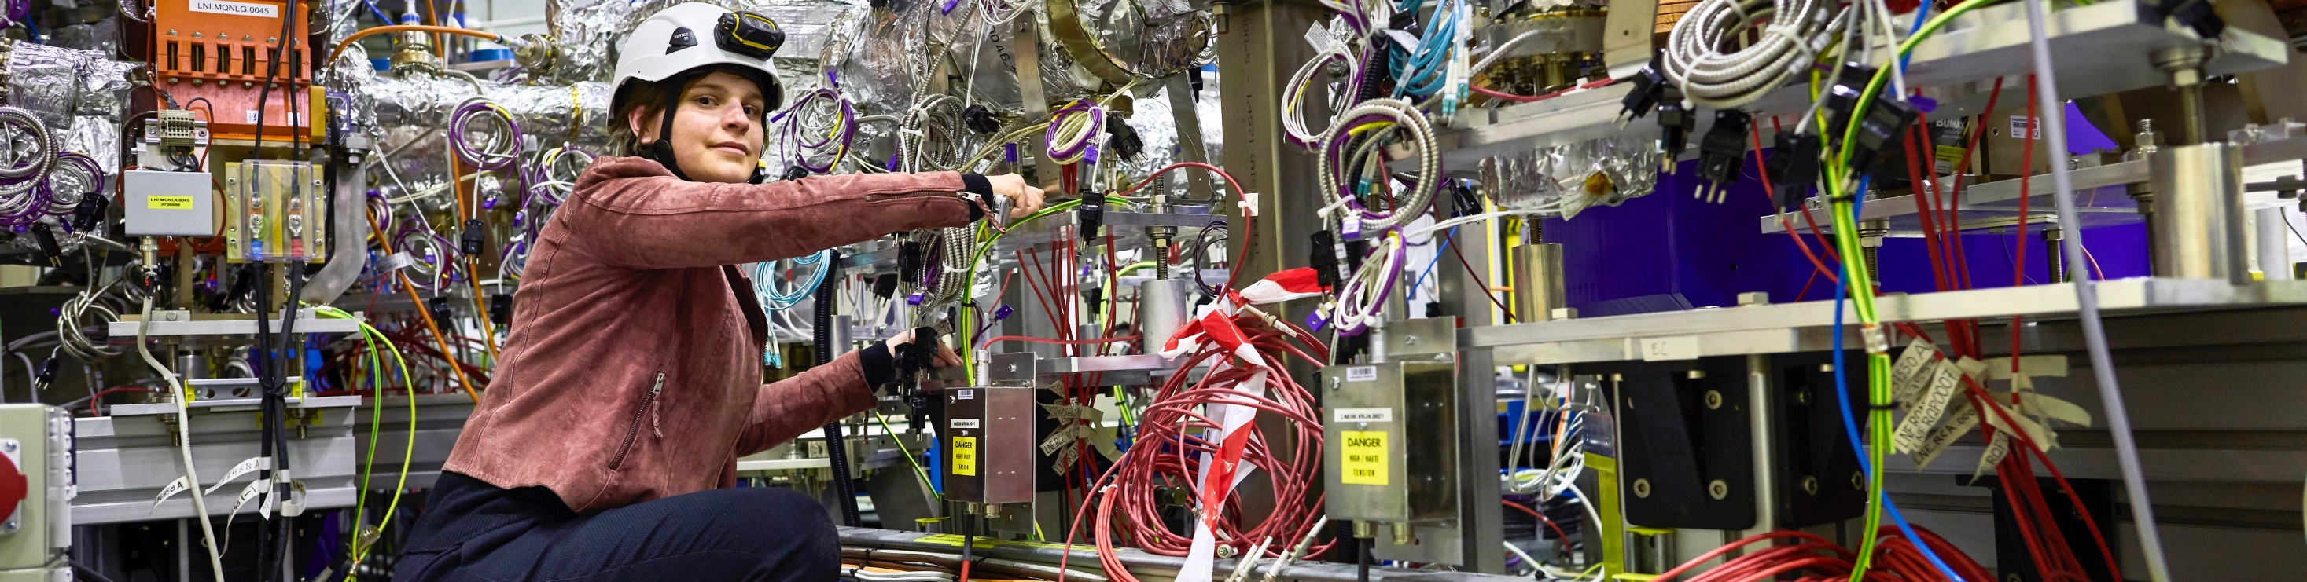
O CERN tem um programa científico diversificado
Física Nuclear ( ISOLDE , n_TOF)
Antimatéria ( AD + ELENA )
Raios Cósmicos e nuvens ( CLOUD )
Fenómenos Raros
( em experiências de alvo fixo )
Colaboração neutrinos USA
( LBNF )
Apresentação - Portugal
2025
12
Notes:
Key messages:
While the Large Hadron Collider (LHC) is the flagship of CERN’s accelerator complex and the results of the LHC experiments are often in the limelight, CERN has a very diverse research programme
This programme covers a wide range of physics topics, from the Standard Model to supersymmetry, from dark matter to cosmic rays.
Experiments at other accelerators and facilities both on-site and off are an equally important part of the Laboratory’s activities.
THE SPEAKER SHOULD AVOID DESCRIBING EACH OF THE EXPERIMENTS SHOWN ON THE SLIDE BUT RATHER FOCUS ON THE MESSAGES ABOVE.

Slide 13
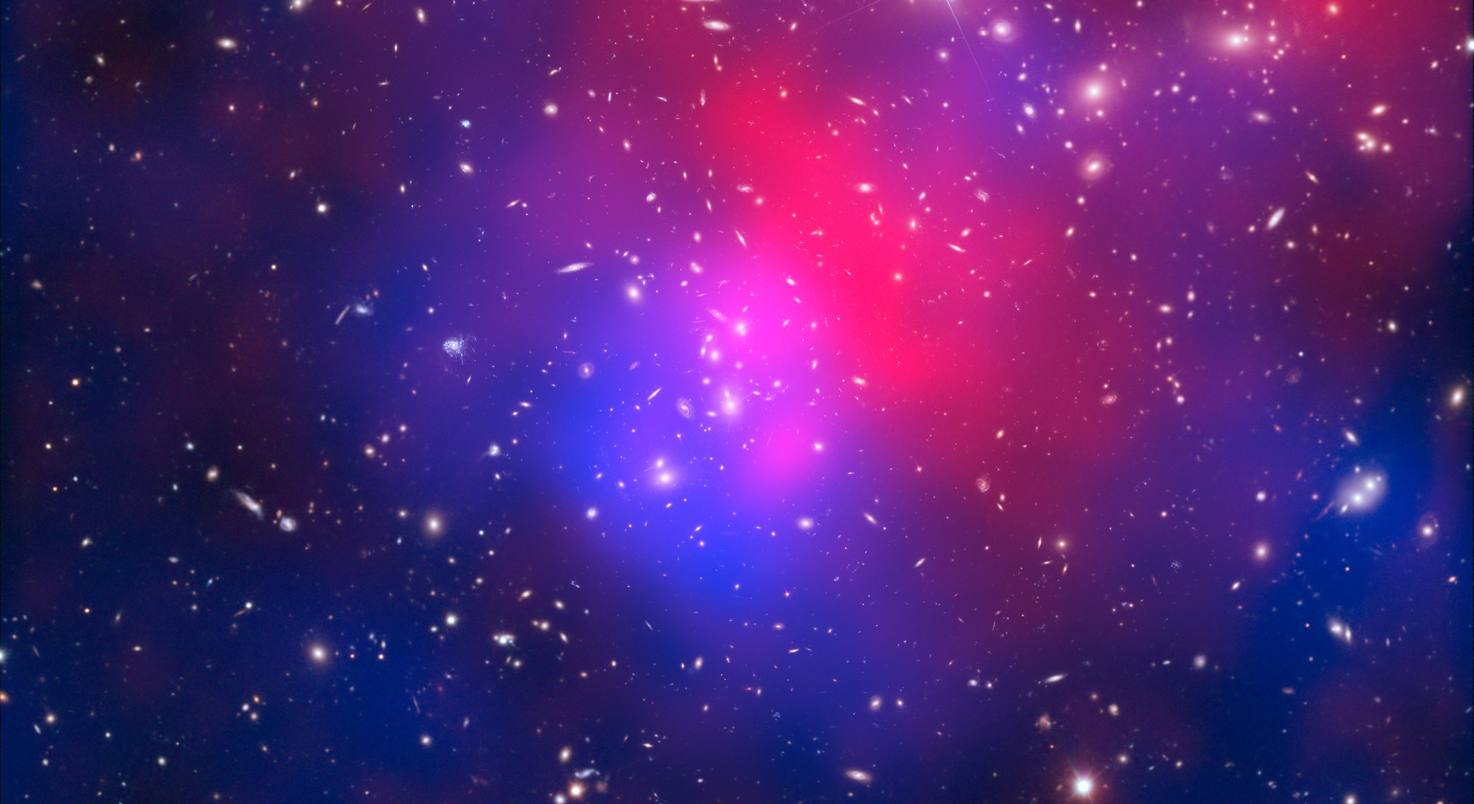
Há muitas questões sem resposta em física fundamental
incluindo
De que é feita 95% da massa e energia do Universo?
Será que o bosão de Higgs interage com a matéria negra?
Porque é que o Universo é feito só de matéria, praticamente sem antimatéria?
Porque é que a gravidade é tão fraca, comparada às outras interações?
Notes:
This slide is a preamble to the following two slides, which focus on CERN’s future projects, aimed at moving closer to answering the questions shown on the slide (and others).

Slide 14
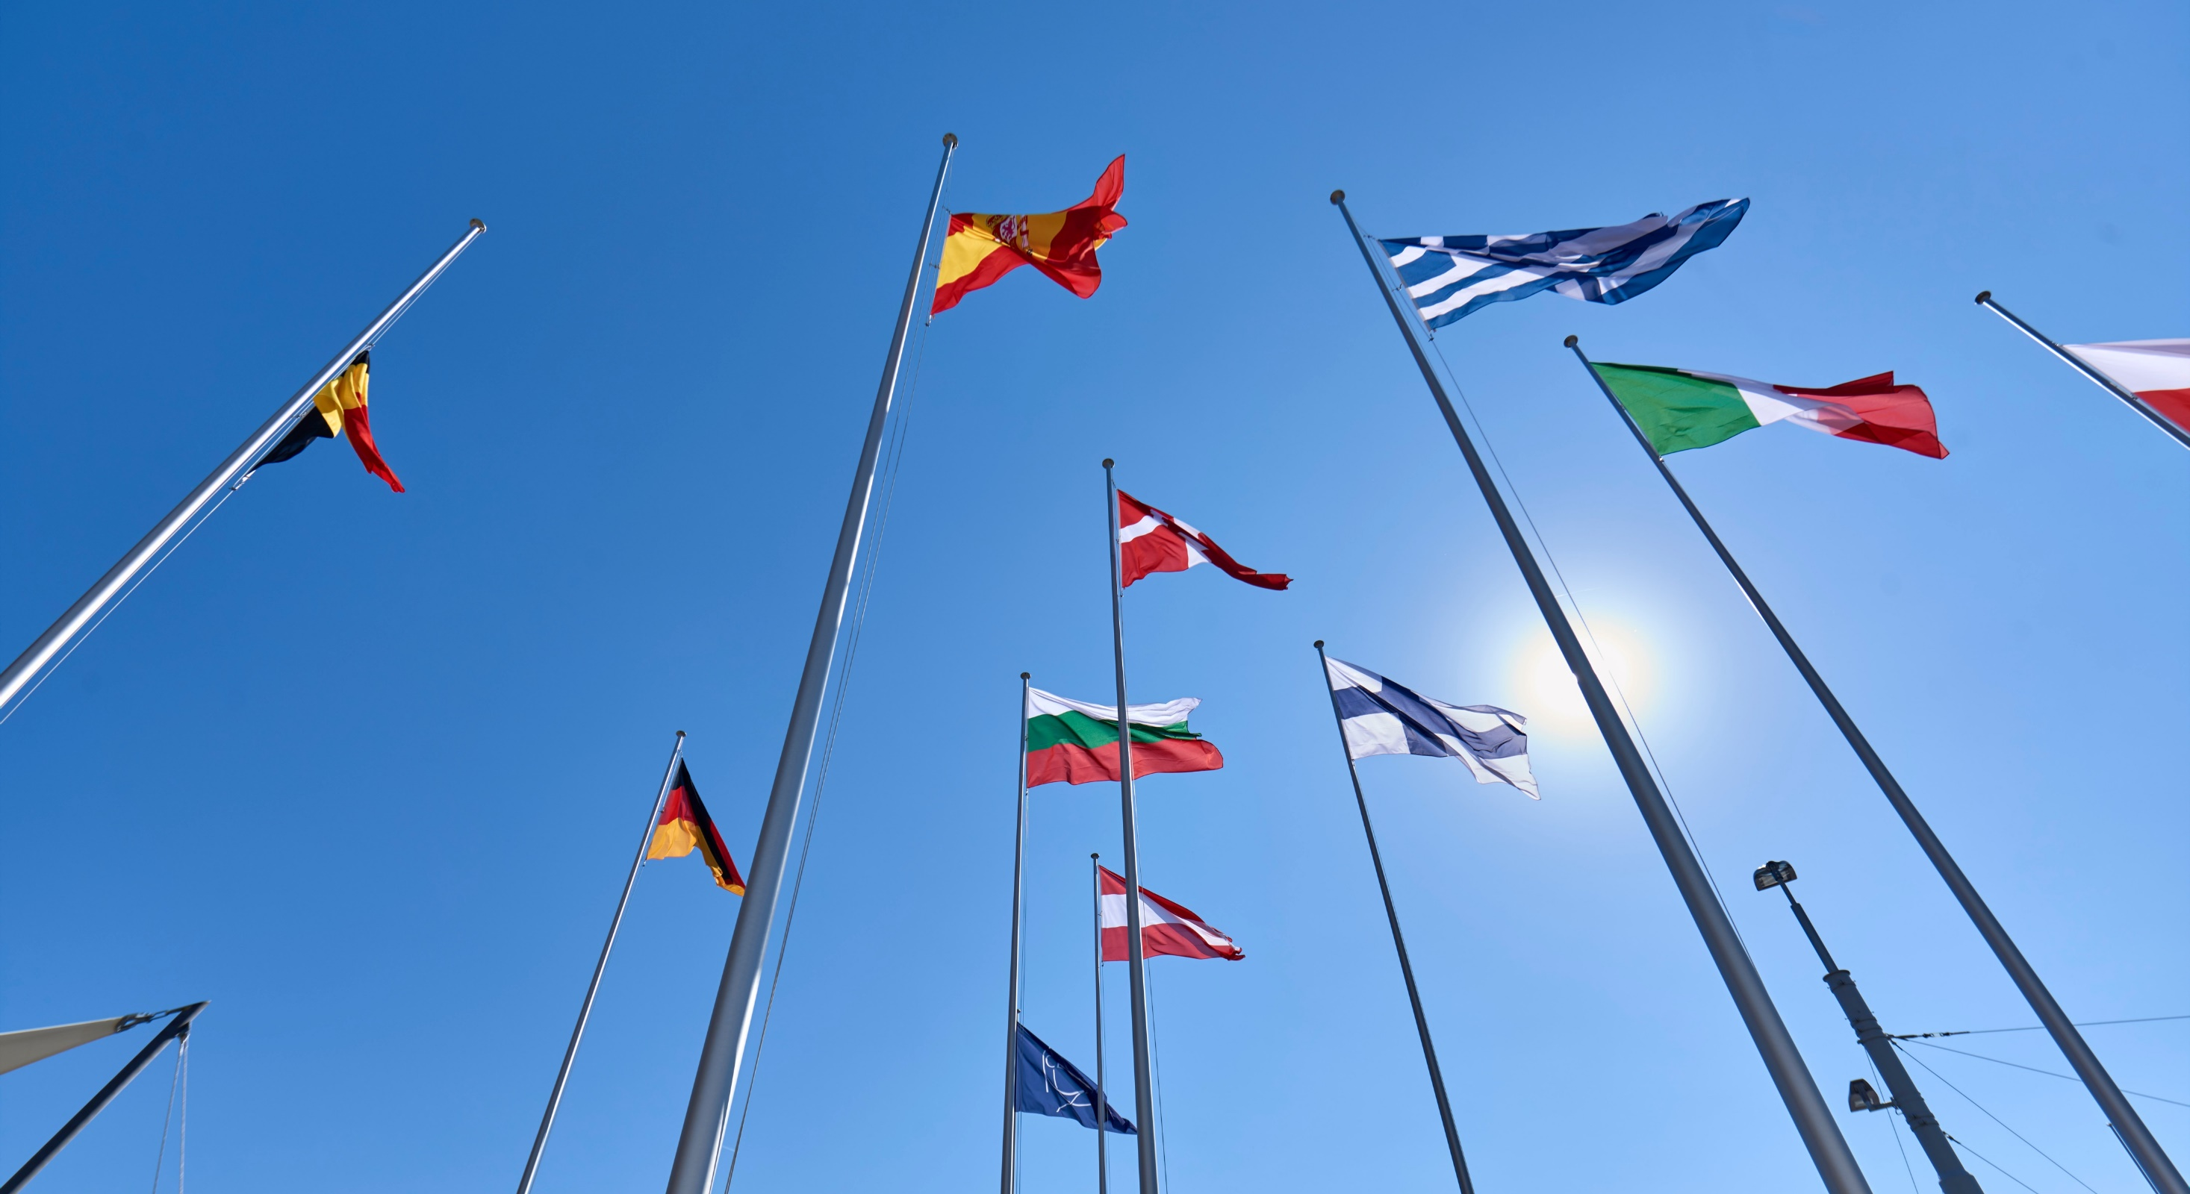
COLABORAÇÃO
Notes:
This is the title slide for the section on “International Collaboration”.
It should be shown for just enough time for the speaker to place it in the context of the four pillars mentioned at the start of the presentation (as a form of ”signposting”)
(THIS SECTION HAS 4 SLIDES)

Slide 15

Ciência para a Paz CERN fundado em 1954 por 12 Estados Membros Europeus
Orçamento anual do CERN é de 1 300 MCHF
( ~1 380 MEUR )
( ~ universidade Europeia de tamanho médio )
Portugal ( aderiu em 1986 )
em 2025 contribui com 13.4 MCHF (1.06%)
( ~14 MEUR )
25 Estados Membros
Austria – Belgium – Bulgaria – Czech Republic Denmark – Estonia – Finland – France – Germany Greece – Hungary – Israel – Italy – Netherlands Norway – Poland – Portugal – Romania – Serbia – Slovakia
Slovenia – Spain – Sweden – Switzerland – United Kingdom
9 Estados Membros Associados
Brazil – Croatia – Cyprus*– India – Latvia – Lithuania – Pakistan – Türkiye – Ukraine
* Associate Member State in the pre-stage to Membership
CERN ( 31 / 12 / 2024 )
2 704 Funcionários
1 181 Graduados
516 Estudantes
885 Associados
12 405 Utilizadores
Diversidade geográfica & cultural :
Utilizadores de 110 nacionalidades
23.7% mulheres entre “MPE”
4 Observadores
Japan – USA – European Union – UNESCO
...e aproximadamente 50 Acordos de Cooperação com Estados e Territórios não-Membros
Portugal ( 31 / 12 / 2024 )
65 Funcionários 2.4%
54 Graduados 4.6%
10 Estudantes 1.9%
16 Associados 1.8%
123 Utilizadores 1.0%
Apresentação - Portugal
2025
15
Notes:
The speaker can highlight CERN’s second mission as stated when it was established: to foster peaceful collaborations between nations that had recently been at war.
Additional information (OPTIONAL)
More than 40% of CERN’s budget is returned to industry through materials, utilities and services

Slide 16
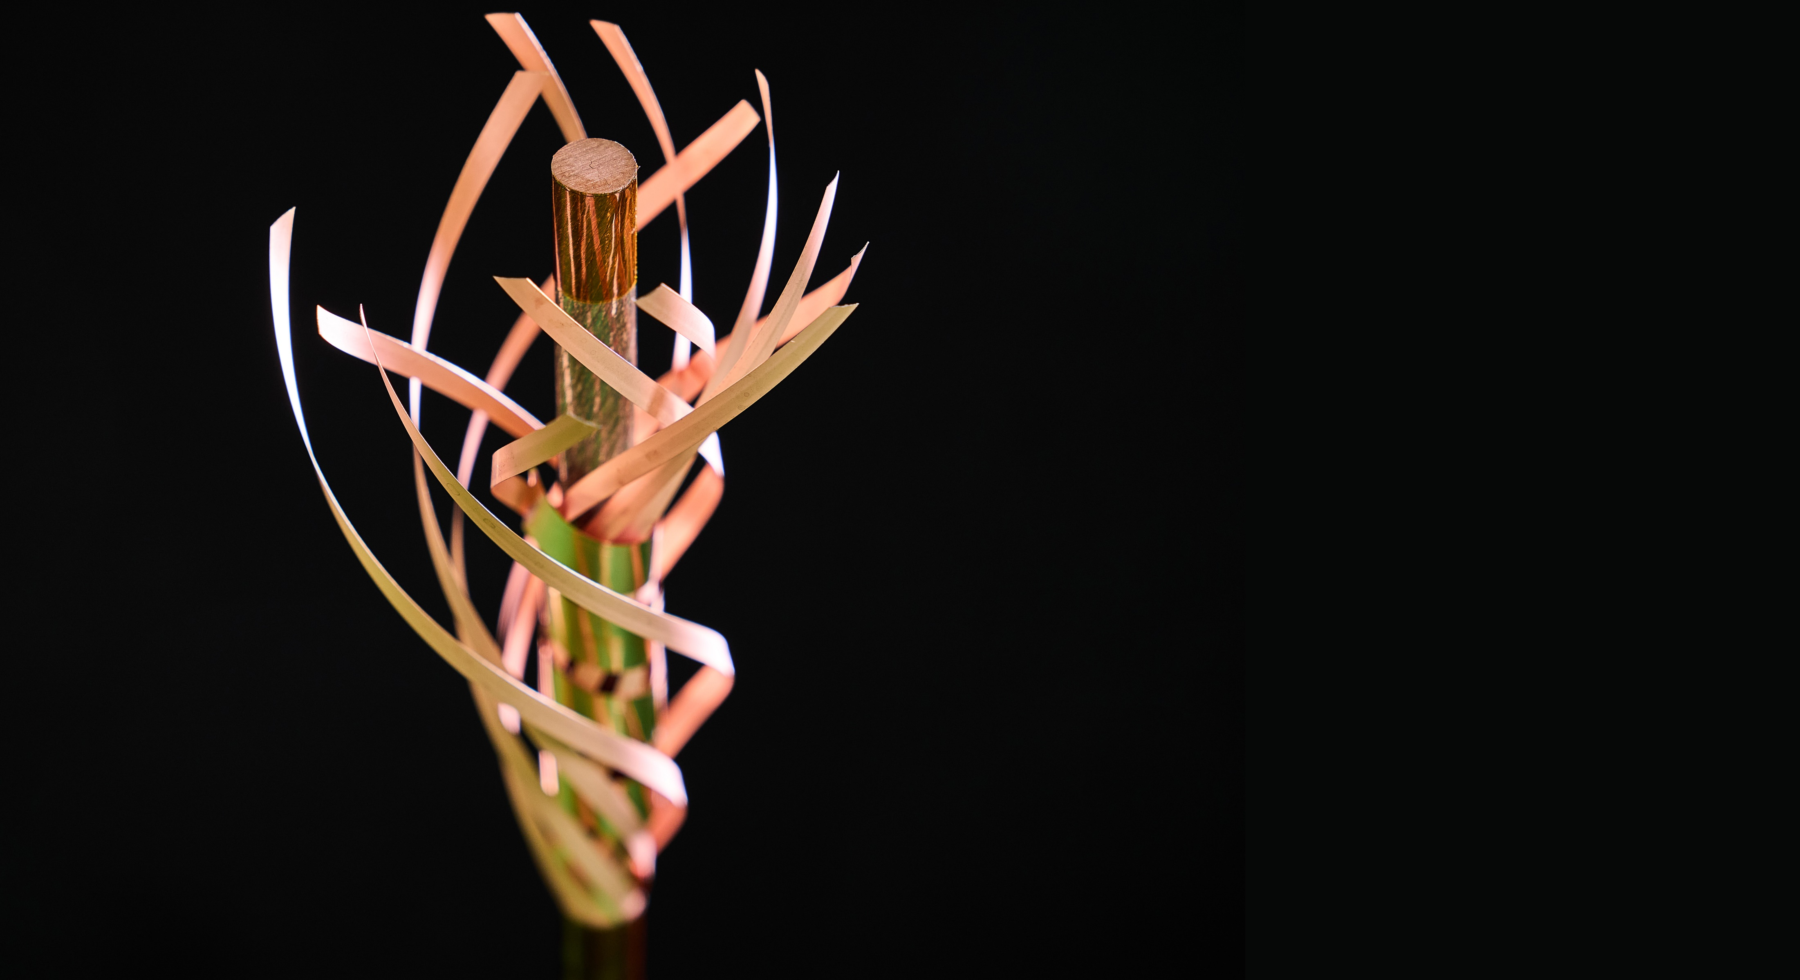
TECNOLOGIAS & INOVAÇÃO
Notes:
This is the title slide for the section on “Innovation” (Knowledge Transfer).
It should be shown for just enough time for the speaker to place it in the context of the four pillars mentioned at the start of the presentation (as a form of ”signposting”)
(THIS SECTION HAS 3 SLIDES)

Slide 17
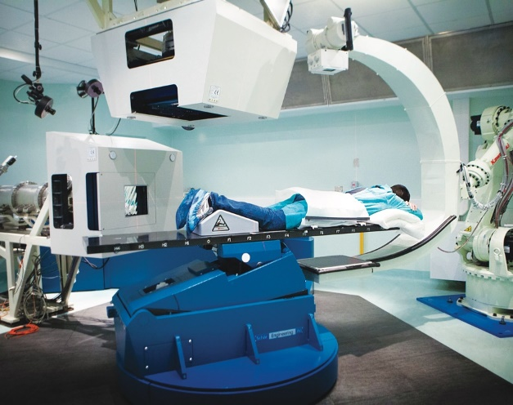
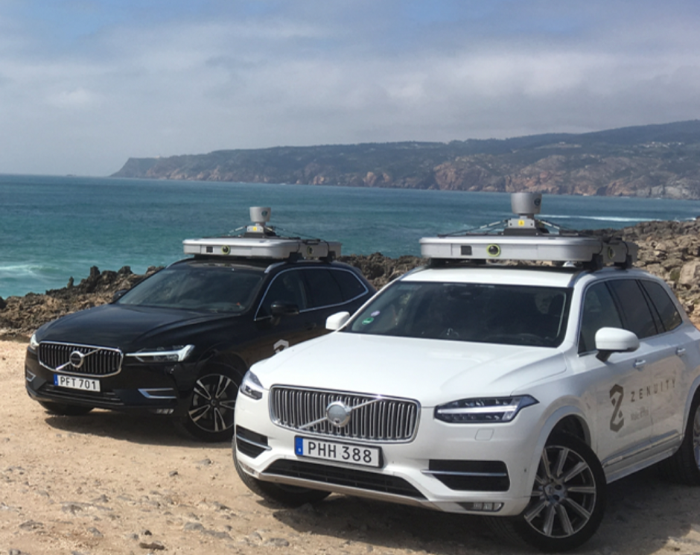
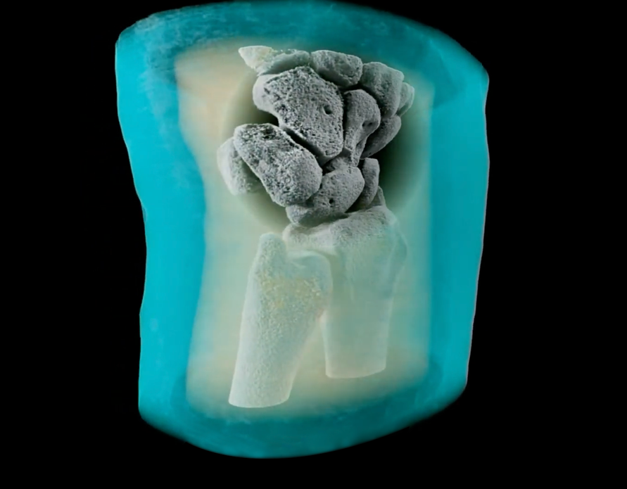
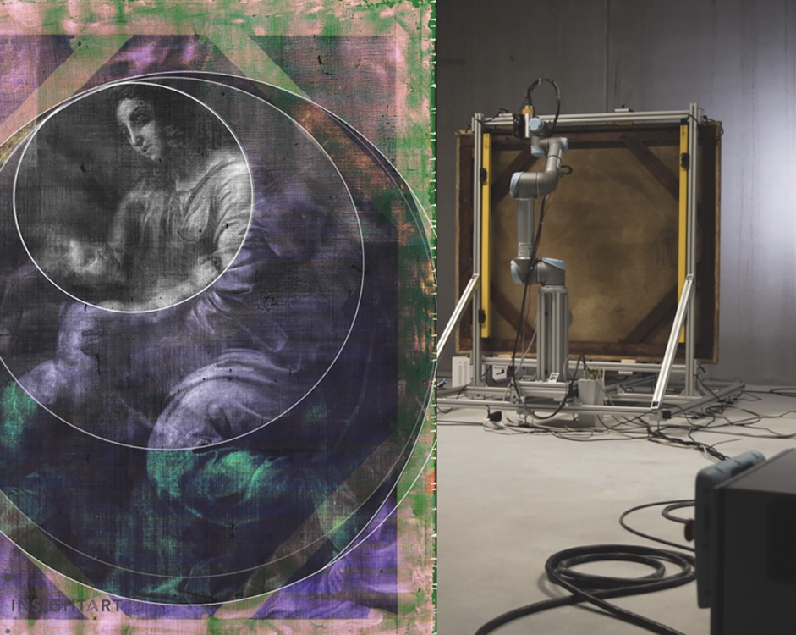
As inovações tecnológicas do CERN têm um impacto importante na sociedade
Tecnologias de detetores de pixel para
imagens de alta resolução com raios X, 3D e a cores.
Tecnologias de
raios X para
restauro de arte e identificar falsificações.
© marsbioimaging
© CNAO
© ENVISION / ENLIGHT
Tecnologias de aceleradores para
radioterapia do cancro com protões, iões e eletrões.
Desenvolvimentos de
IA para
a condução autónoma.
Apresentação - Portugal
2025
17
Notes:
Background information (THE SPEAKER SHOULD NOT GO INTO THE DETAIL BELOW; THE INFORMATION IS PROVIDED AS SUPPORT FOR QUESTIONS AND, IF TIME PERMITS, TO ADD TO THE KEY INFROMATION ON THE SLIDE:
Cancer radiotherapy using protons and other ions instead of photons (used in conventional radiotherapy):
CERN has contributed to the birth of the proton- and carbon-ion treatment centres CNAO, in Italy, and MedAustron, in Austria, and continues to collaborate with them;
CERN also developed an RFQ technology now used by a company in an innovative linac for proton therapy (2021, system under test at STFC Daresbury);
CERN is now involved in the development of cutting-edge technologies for next-generation ion therapy facilities and of a facility for treating tumours with very high-energy electrons at ultra-high dose rates (FLASH therapy, with CHUV Lausanne)
Medical imaging:
CERN contributed to early developments in PET instrumentation (70s-80s);
Since 1995, the Crystal Clear collaboration has been engaged in the development of several organ-specific (breast, pancreas, prostate) and animal-dedicated PET scanner prototypes, and in pushing the limit of coincidence time resolution for time-of-flight (TOF) PET;
overall, the requirements of large-scale physics experiments often drive the mass production for specific equipment (e.g. the BGO crystals for the L3 detector at LEP), and make it possible for other applications to obtain the technology at a reasonable cost for e.g. building PET scanners.
New 3D colour X-rays of human extremities (2018) using CERN-developed Medipix 3 technology, by a start-up in New Zealand.
Volvo is working with CERN to improve safety of autonomous vehicles
InsightART is revolutionising the art world with next-generation x-ray imaging technology.... Our mission is to safeguard the world’s artistic heritage with state-of-the-art tools designed to assist art restoration experts and to unmask forgeries.
THIS IS THE LAST SLIDE IN THE “TECHNOLOGY AND INNOVATION” SECTION

Slide 18
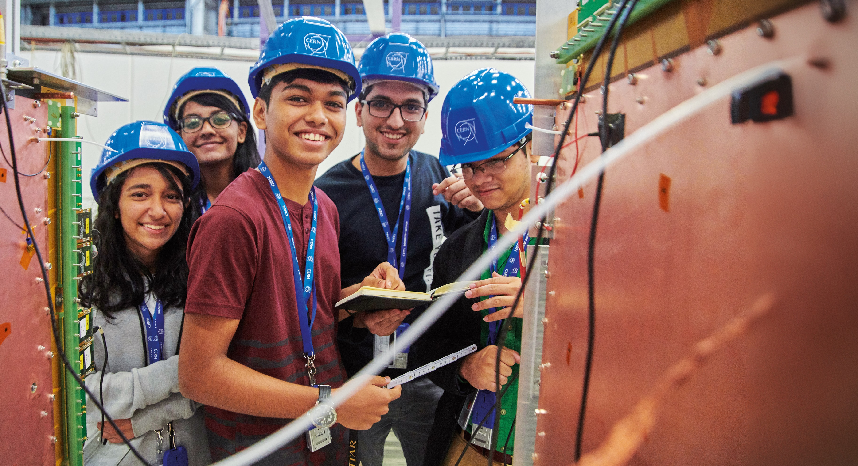
EDUCAÇÃO
& FORMAÇÃO
Notes:
This is the title slide for the section on “Education and Training”
It should be shown for just enough time for the speaker to place it in the context of the four pillars mentioned at the start of the presentation (as a form of ”signposting”)
(THIS SECTION HAS 6 SLIDES)

Slide 19
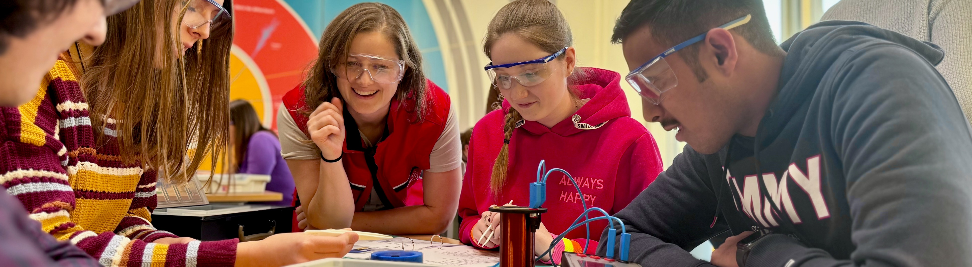
Programas de educação & formação no CERN
1 181 graduados (incl. "Research Fellows")
3 000 estudantes Doutoramento
300 estudantes não graduados programa "Estudantes de Verão”
Portugal
4 estudantes de verão em 2024
537 professores nos Programas para Professores desde 1998
38 equipas na competição BL4S desde 2014
768 estudantes participantes no S’Cool LAB 2015 - 2023
> 15 000 professores, desde 1998
em programas dedicados
2 746 equipas com mais de 20 000 estudantes na competição Beamline for Schools (BL4S), desde 2014
Notes:
THE NUMBERS ON THIS SLIDE NEED REGULAR UPDATING
CERN schools: High Energy Physics; Computing; Accelerator

Slide 20


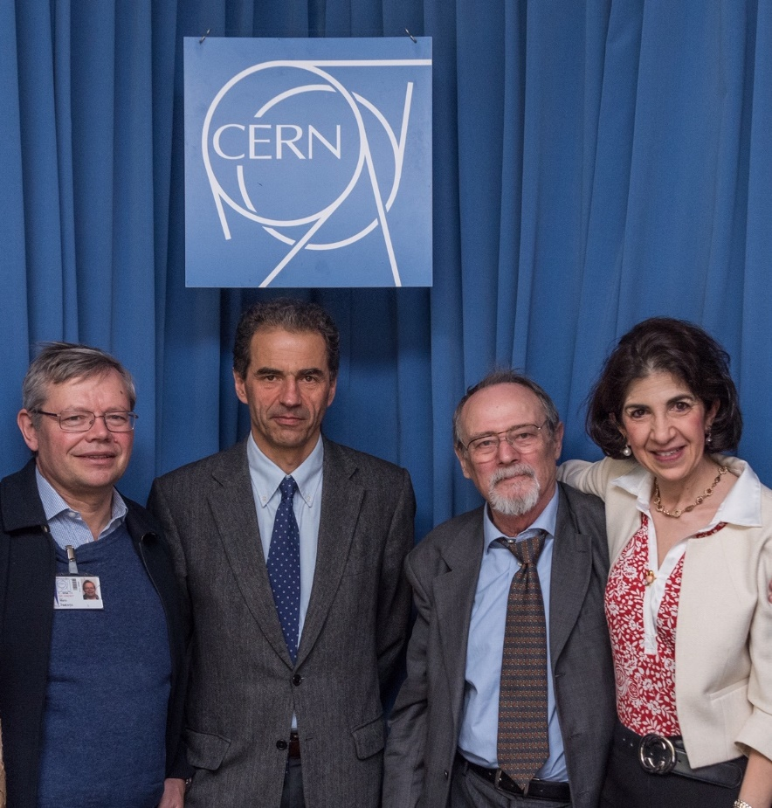
Portugal tem uma posição sólida e multifacetada no CERN
Portugal aderiu ao CERN como Estado Membro em 1986
LIP (Laboratório de Instrumentação e Física Experimental de Partículas) é o parceiro de referência do CERN em Portugal
Participação forte nas experiências do LHC e não-LHC, Programas de I&D (futuros aceleradores, física médica), computação, e teoria
Programas de formação de engenheiros e de professores com enorme sucesso
Bom equilíbrio entre as contribuições no CERN e os investimentos no país; relações com a indústria muito boas
Maio 2016: Visita de Sua Excelência Prof. Manuel Heitor
Ministro da Ciência, Tecnologia e Ensino Superior
Apresentação - Portugal
2025
20

Slide 21
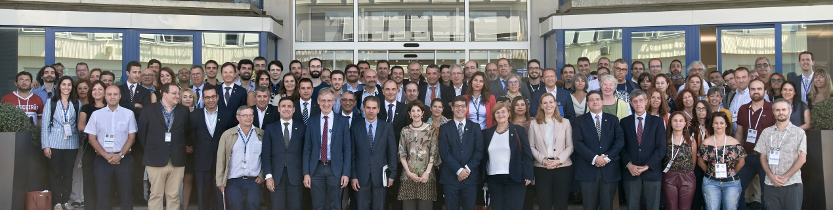
Oportunidades para a indústria, tecnologia e transferência de conhecimento
Set 2019 : visita do Ministro da Ciência, e de outros membros do Governo, da Academia, e da Indústria; juntos com os professores do Programa em Língua Portuguesa, em formação no CERN nesse momento
Mais de 40 empresas tecnológicas Portuguesas colaboram com o CERN
Mais de2.2 M CHF/ano
Forte participação em I&D, para as próximas fases da ESPP,
aceleradores e experiências FCC
Forte participação em I&D para aplicações médicas
Imagiologia, Terapia com partículas
Apresentação - Portugal
2025
21

Slide 22
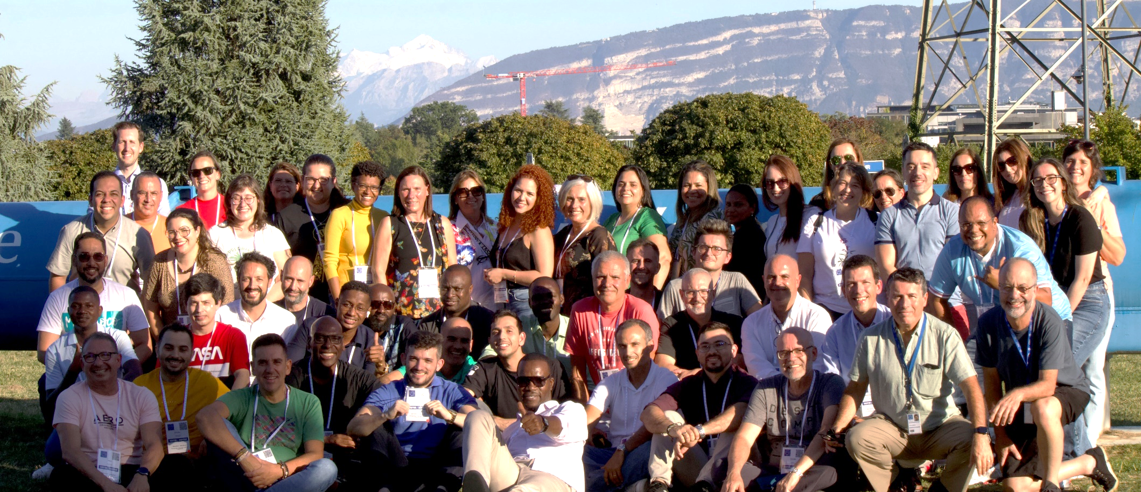

Formação, educação e divulgação
Set 2023 : Escola de
Professores em Língua Portuguesa
Excelente programa FCT de formação de engenheiros > 200 estágios de 2 anos (1996 – 2022)
Contribuição importante de ~ 90 IST Project Associates (2016 – 2022)
Escola anual de Professores em Língua Portuguesa, com enorme sucesso
819 profs. desde 2007, de Portugal, Brasil, PALOP, Timor Leste
Grande participação nas Masterclasses em Física de Partículas (IPPOG) e nas visitas de Escolas ao CERN
Mais de 20 000 estudantes desde 2005
Apresentação - Portugal
1 Sep 2024
22

Slide 23
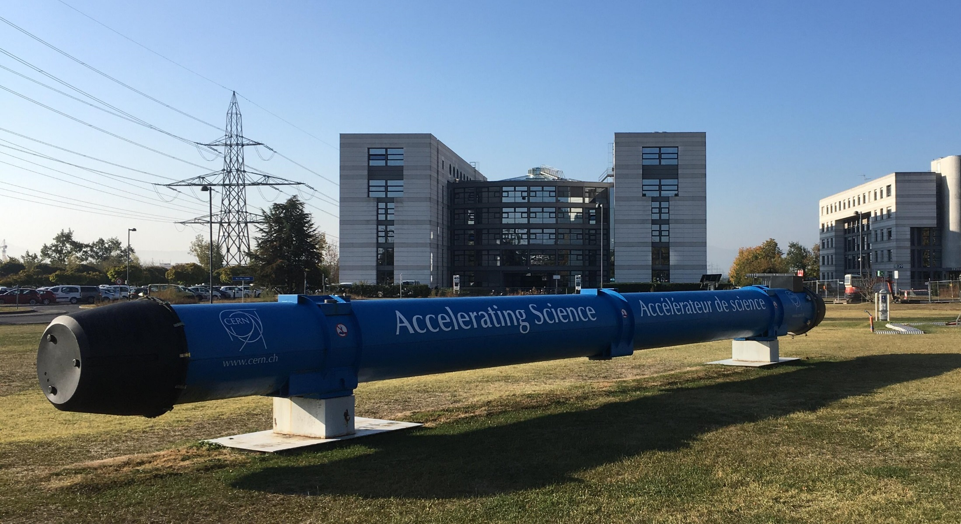


Slide 24

industrial return
Portugal
https://procurement.web.cern.ch/
https://forthcoming-ms.app.cern.ch/#!/
C. Lara/ Doing Business with CERN
2025

Slide 25
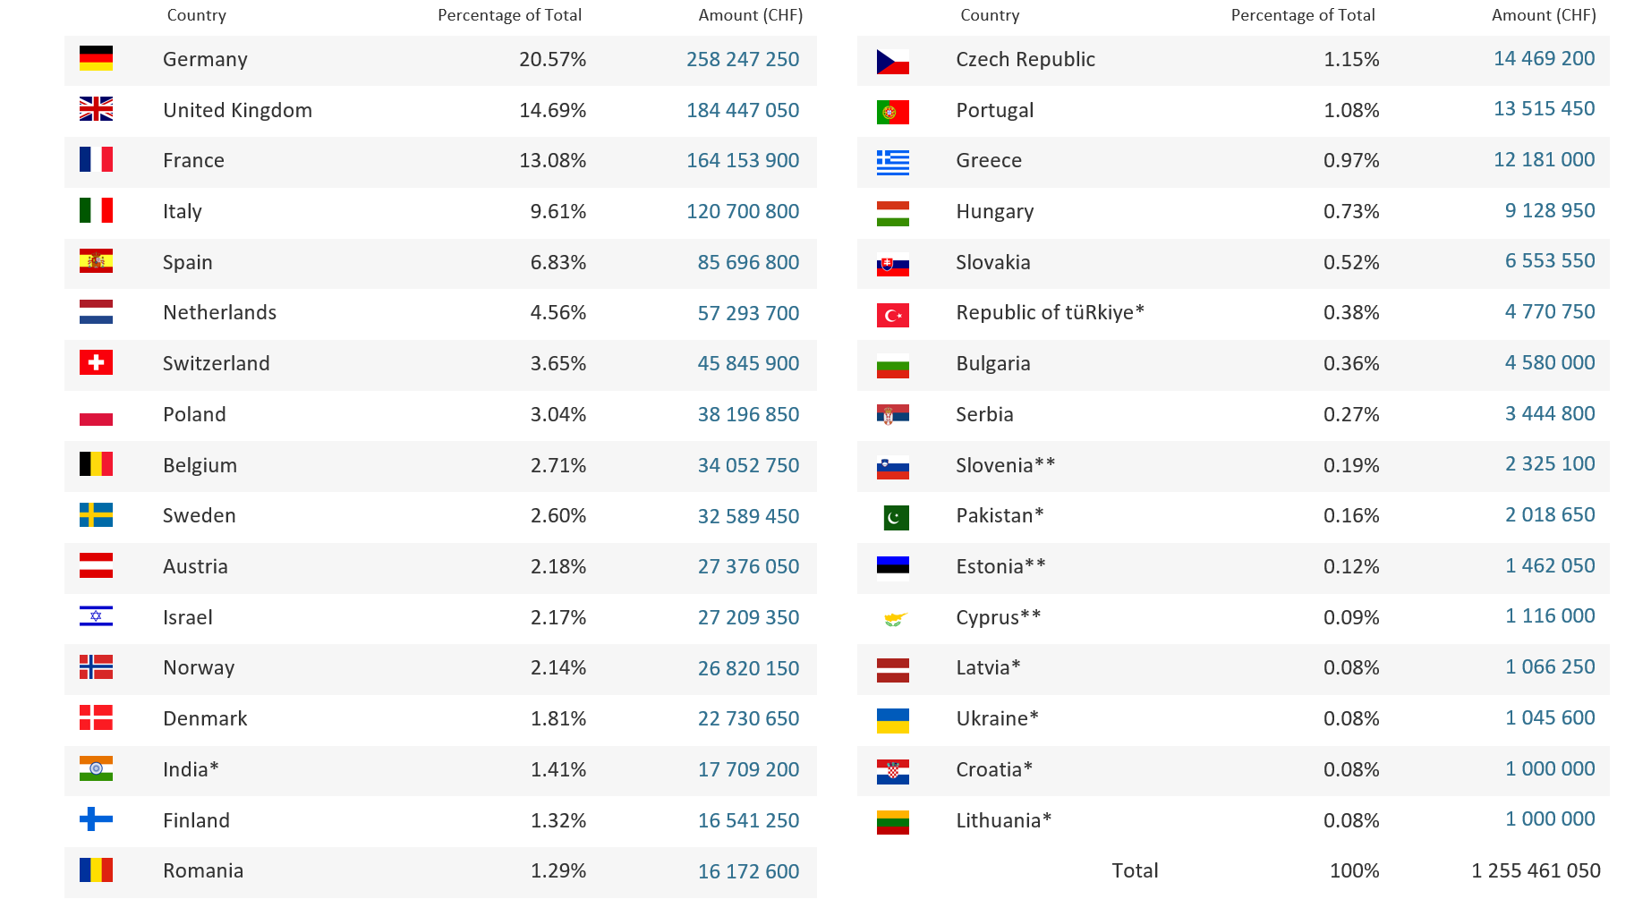
Yearly Budget (contributions 2024)
2025

Slide 26
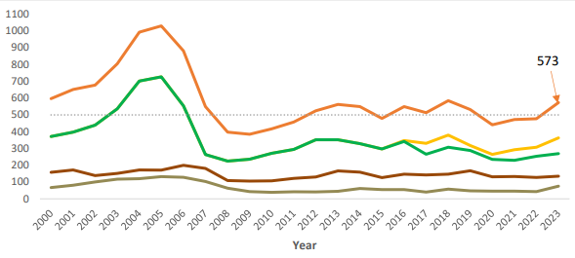
CERN Annual Procurement Expenditure
2025

Slide 27
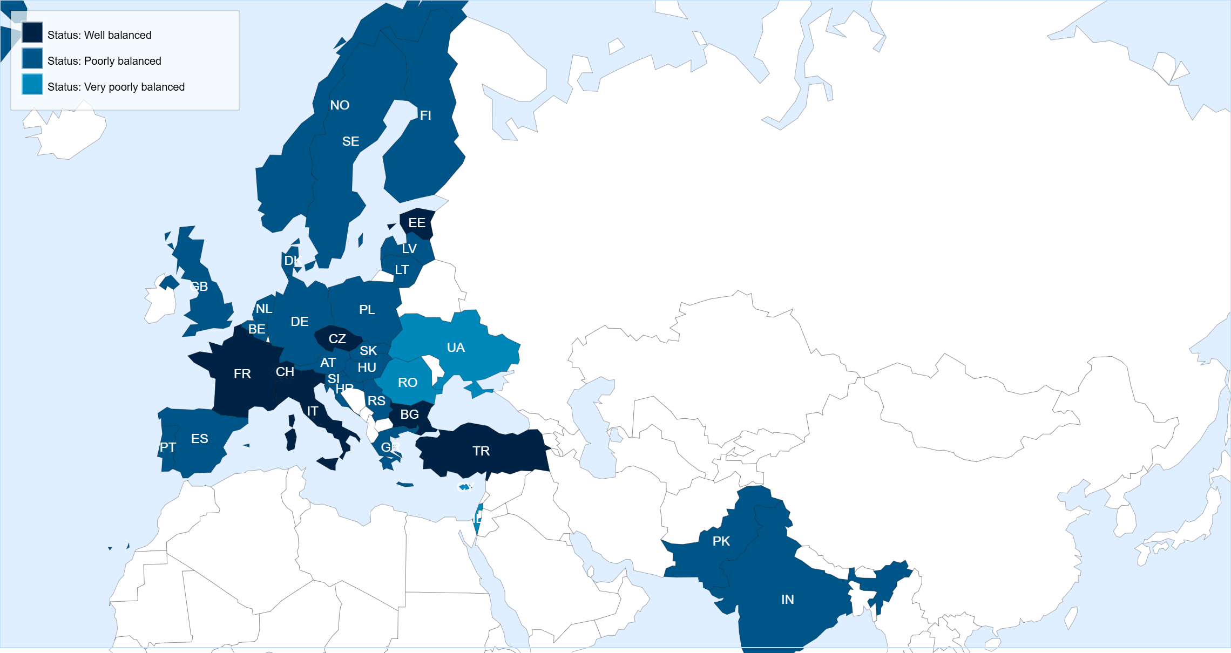
Status of Member States for Supply contracts Mar 2025 – Feb 2026
Key Figures for Portugal (2024)
suppliers registered on eProcurement 237
contracts active 38
new contracts awarded 5
firms contacted for Price Enquiry ( 10 kCHF … 200 kCHF ) 20
firms contacted for Market Survey ( > 200 kCHF ) 40
firms contacted for Invitation to Tender ( after MS ) 8
2025

Slide 28
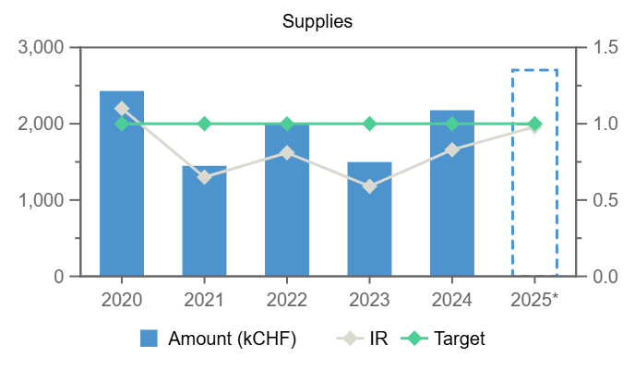
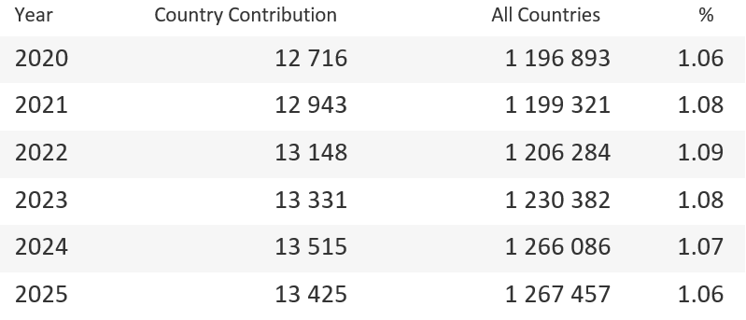
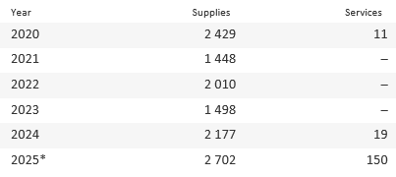
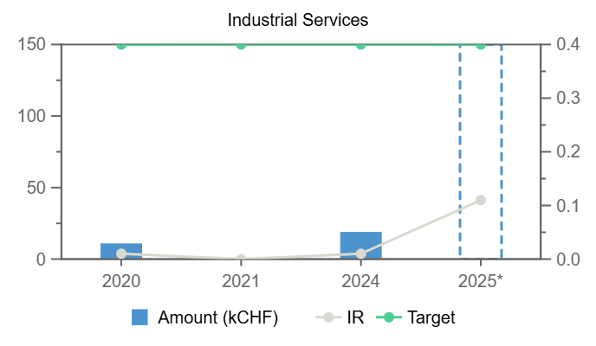
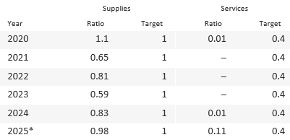
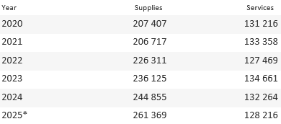
Annual contributions & industrial returns for Portugal (2025)
All Contributions (kCHF)
PT Expenditures (kCHF)
Portugal
Expenditures (all countries totals, kCHF)
PT Industrial Return
*Provisional figure based on commitments
2025

Slide 29
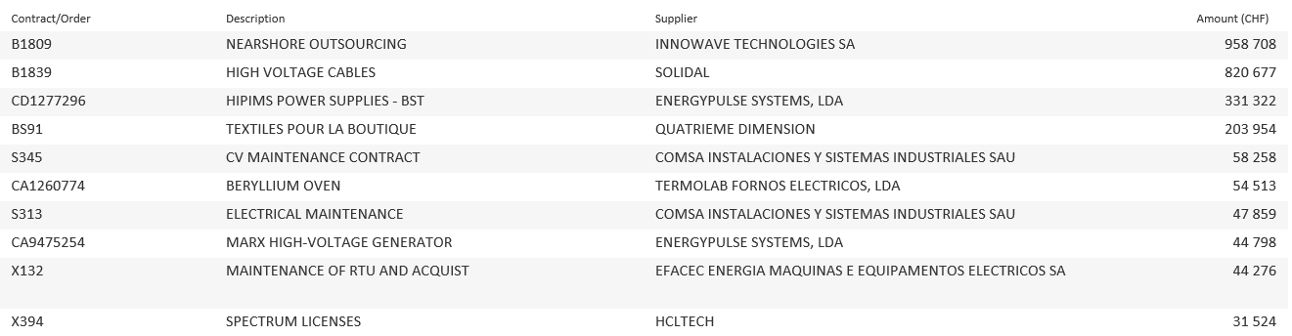
Contract / orders with highest turnover for Portugal (2025)
2025

