Slide 1
EN-EL-CS STATUS CABLING:
AWAKE
Adya ULUWITA
Date: 2nd October 2025
Indico 1581235

Slide 2
Content
  Requirements - DIC
  Cable Trays
  Rack positions

Slide 3
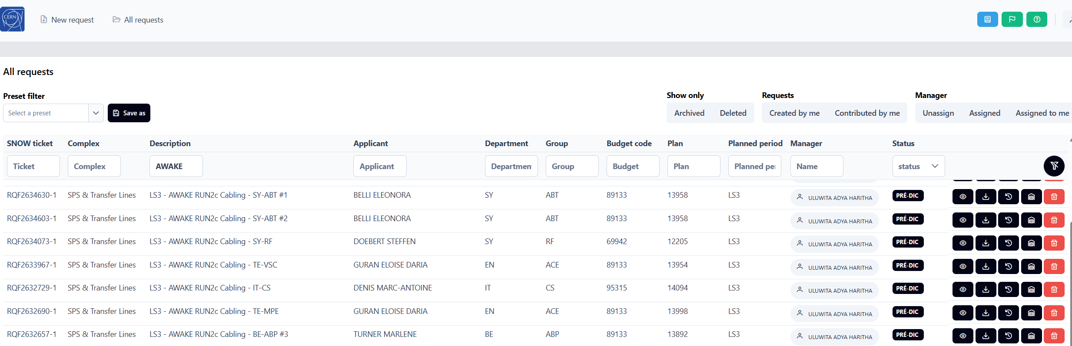
Requirement - DIC
    Requirements missing:
      Cable Types
      Connector types
    Transferred ALL SNOW tickets to DIC Online
    → Comments to be carried out using SNOW
    → But ALL Changes to DICs should be done via https://dic.app.cern.ch/

Slide 4
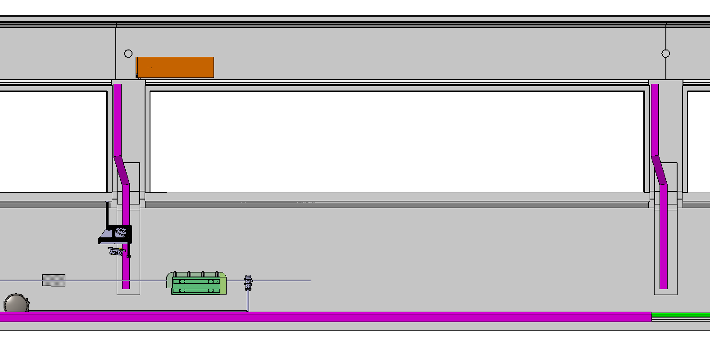
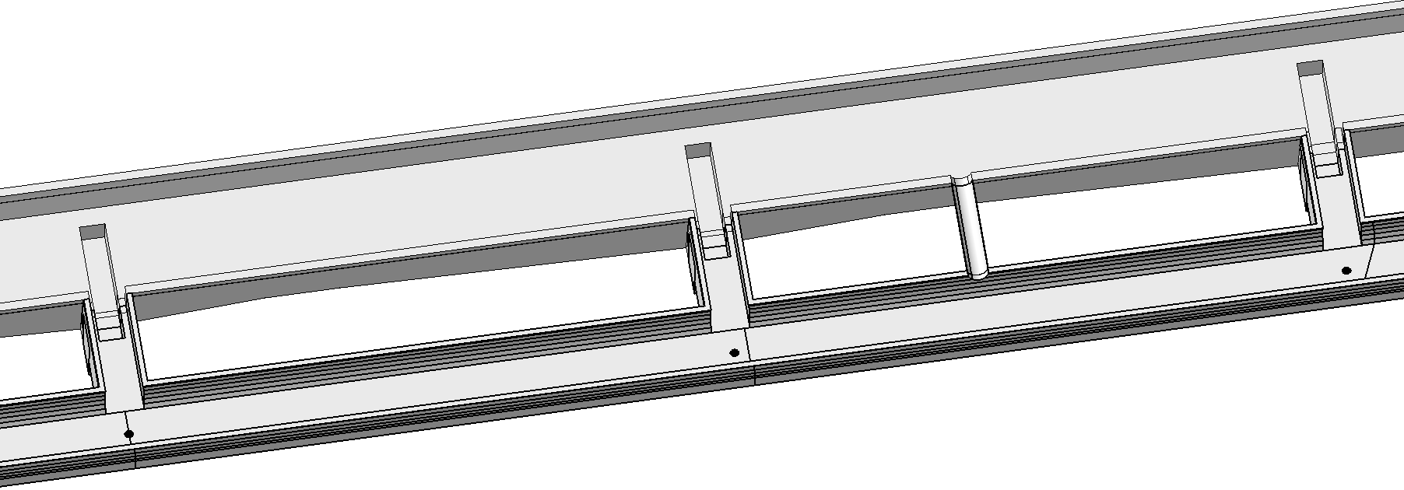
Cable Trays
    3 layers of Cable Tray integration requested in: Integrated already
      TSG44
      TSG45
      TSG46
    Cable tray in TSG42 will need to be used for cables routed from TSG40 and TCV4
    M. Lonjon and EL-CS requested the bunker of TSG42 – TSG46 extended
    Cable Tray from TSG40 – could be implemented?
TSG4
TSG45
TSG46
TCC4

Slide 5
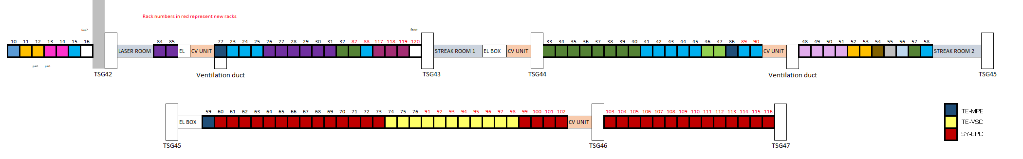
Racks
Final?
    33 Racks?

