Slide 1

Welcome and Introduction to the LIU Project
K. Hanke / CERN

Slide 2
Welcome
CERN is currently designing a new H- charge-exchange injection
system for the PSB, to inject the 160 MeV H- beam from the
new Linac4.
The purpose of this review is to:
Examine the feasibility of the proposed injection system,
Validate the engineering design of the injection equipment,
Eliminate all outstanding questions,
Analyse the commissioning strategy and its timeline.
Review on PSB 160 MeV H- Injection / 9-10 November 2011

Slide 3
Review Board
Mike Plum (Chair), ORNL/SNS
David Johnson, FERMILAB
Ben Pine, STFC/RAL/ISIS
Bryan Jones, STFC/RAL/ISIS
Paul Cruikshank, CERN/TE
Massimo Giovannozzi, CERN/BE
Davide Tommasini, CERN/TE
Review on PSB 160 MeV H- Injection / 9-10 November 2011

Slide 4
LIU Project
The LHC Injectors Upgrade Project (LIU) has been put in place
to propose and implement the means for:
allowing LHC & HL-LHC to reach their maximum potential for physics
ensuring a reliable operation of the LHC for physics until the end of its life (≥ 2030 taking into account possibilities of LHeC & HE-LHC…)
proper use of resources (> 150 MCHF material budget and > 300 man.years) with unavoidable interferences with other priorities of the organization
Review on PSB 160 MeV H- Injection / 9-10 November 2011

Slide 5
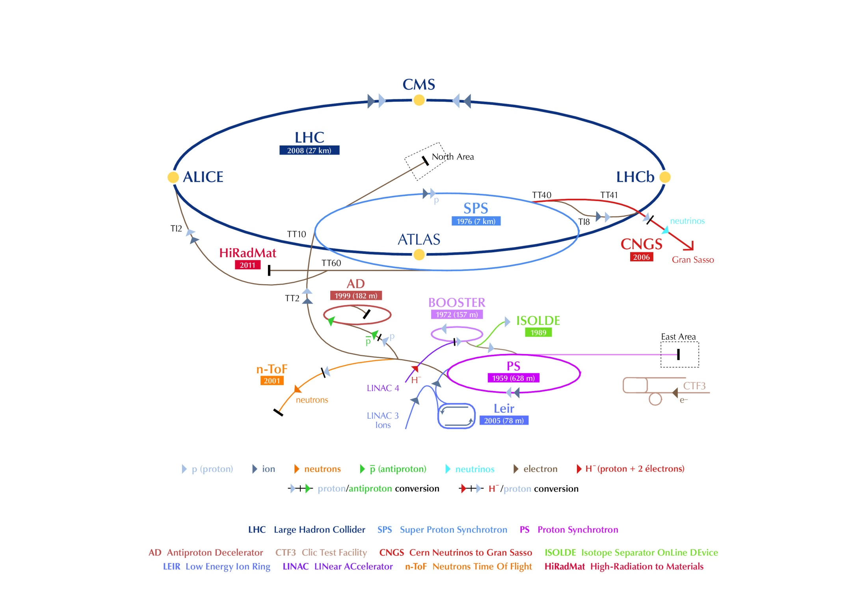
LIU Project
LIU-SPS
LIU-PSB
LIU-L4
LIU-PS
Review on PSB 160 MeV H- Injection / 9-10 November 2011

Slide 6
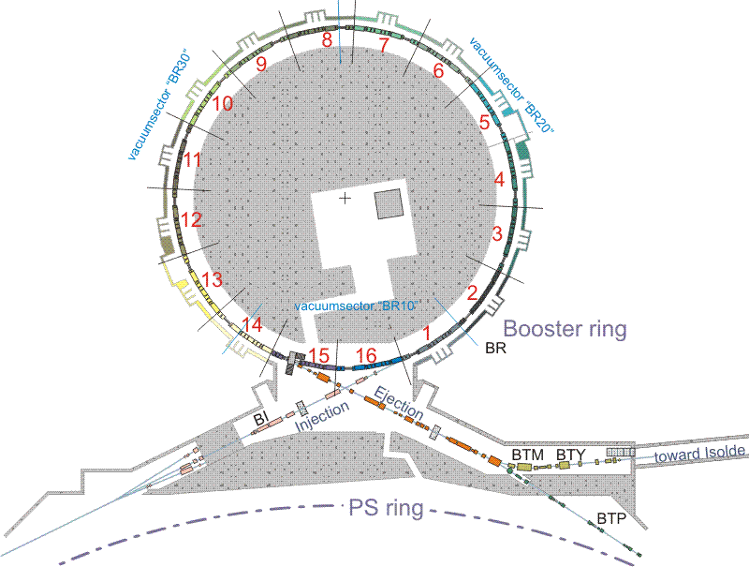
LIU-PSB
Upgrade of Rings and Extraction / Transfer
Upgrade of the Injection
Review on PSB 160 MeV H- Injection / 9-10 November 2011

Slide 7
LIU-PSB
Injection upgrade from 50 MeV protons to 160 MeV H- and increased intensity*
re-build injection line for
160 MeV
replace injection septum by
stripping foil
injection bumps
diagnostics
…
Upgrade of Booster rings, extraction and transfer from
1.4 GeV to 2.0 GeV and increased intensity*
replace main power supply, a
number of smaller power
supplies, magnets, kickers, etc.
→ this review
*although LIU aims at LHC-type beams, all equipment must be compatible with the
highest intensities that can be expected
Review on PSB 160 MeV H- Injection / 9-10 November 2011

Slide 8
Time Lines
2013 |  |  |  |  |  |  |  |  |  |  |  | 2014 |  |  |  |  |  |  |  |  |  |  |  | 2015
1 | 2 | 3 | 4 | 5 | 6 | 7 | 8 | 9 | 10 | 11 | 12 | 1 | 2 | 3 | 4 | 5 | 6 | 7 | 8 | 9 | 10 | 11 | 12 | 1 | 2 | 3 | 4 | 5 | 6 | 7 | 8 | 9 | 10 | 11 | 12
long LHC injectors stop
 |  |  |  | Linac4 commissioning
 |  |  |  |  |  |  |  |  |  |  |  |  |  |  |  | Linac4 reliability run
 |  |  |  |  |  |  |  |  |  |  |  |  |  |  |  |  |  |  |  |  |  |  |  |  |  |  |  |  |  |  |  |  | potential
2016 |  |  |  |  |  |  |  |  |  |  |  | 2017 |  |  |  |  |  |  |  |  |  |  |  | 2018
1 | 2 | 3 | 4 | 5 | 6 | 7 | 8 | 9 | 10 | 11 | 12 | 1 | 2 | 3 | 4 | 5 | 6 | 7 | 8 | 9 | 10 | 11 | 12 | 1 | 2 | 3 | 4 | 5 | 6 | 7 | 8 | 9 | 10 | 11 | 12
 |  |  |  |  |  |  |  |  |  |  |  |  |  |  |  |  |  |  |  |  |  |  |  | long LHC injectors stop
slot |  |  |  |  |  |  |  |  | potential slot |  |  |  |  |  |  |  |  |  |  |  |  |  |  | present official slot for connection
Connect to the PSB during an intermediate length shut-down (2015/16 or 2016/17) *
Connect to the PSB during LS2 (assumed 2018)
Depending on the physics results, there is still a (minor) possibility that LS1 could move; in this case, one could connect e.g. in 2015.
*4-5 month shutdown for upgrading the pixel detector required by CMS for 15/16 or 16/17; we need 7 months for the connection, and if we start during the end-of-year ion run the time would be sufficient.
Review on PSB 160 MeV H- Injection / 9-10 November 2011

