Slide 1

Beam Intrumentation in the PS BOOSTER injection region
J. Tan
On behalf of BE-BI group
With the contributions of BI, ABP, OP and TE/ABT groups
Review on PSB 160 MeV H⁻ Injection
CERN 09 November 2011

Slide 2
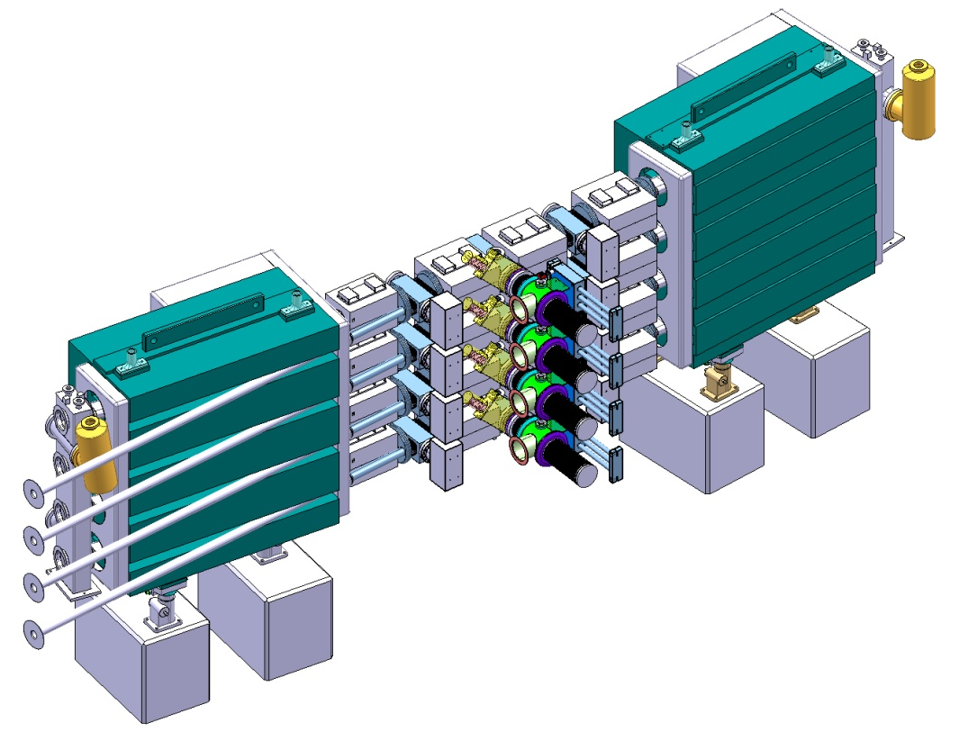
Outline
  Introduction
  Intrumentations at stripping foil :
    Beam profile
    Visual inspection
  Instrumentation in front of the injection dump :
    H0/H- population measurement
    Beam Loss Monitors
    Injected beam matching and emittance monitor
      Turn by turn transverse profiles measurements
      Beam trajectories
  Spare Policy
  Summary

Slide 3
Introduction
New H⁻ charge-exchange injection through a thin foil requires a complete design of injection scheme with new magnets
Beam instrumentation is essential for
  a reliable machine protection system : beam permit, foil & dump
  the commissioning phase : steering, injection matching
  Routine operation : regular checks, machine start-up
Specifications are challenging
  integration
  reliability

Slide 4
Stripping foil : Beam profile monitor & Visual Inspection
From recommendations found in specification papers:
- measure injected beam position and size to steer the beam onto the foil
- accuracy : 0.2mm
- visualize stripping foil
- allow the measurement of the beam position after one turn
→ BTV system
Mechanics
- luminescent screen (Al₂O₃) insertion device
- lights for calibration and online visualization
- optical density filter wheel
- all support
Electronics/detector
- radiation-hard camera
- Drivers for screen, filter wheel and lights
- frame grabber
- interlock system connected to the stripping
foil mechanism : under investigation

Slide 5
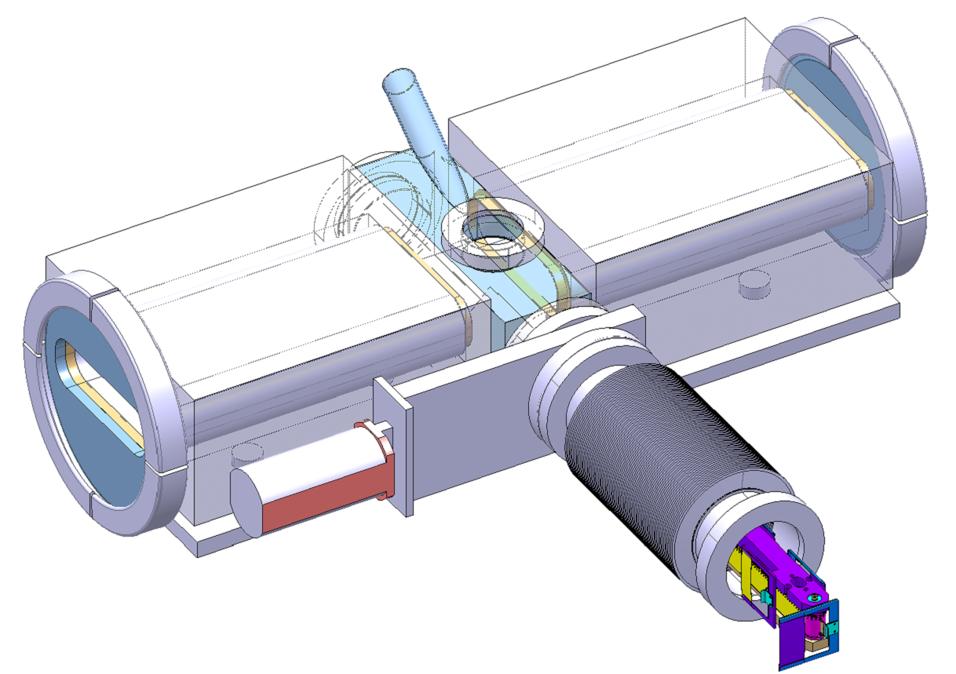
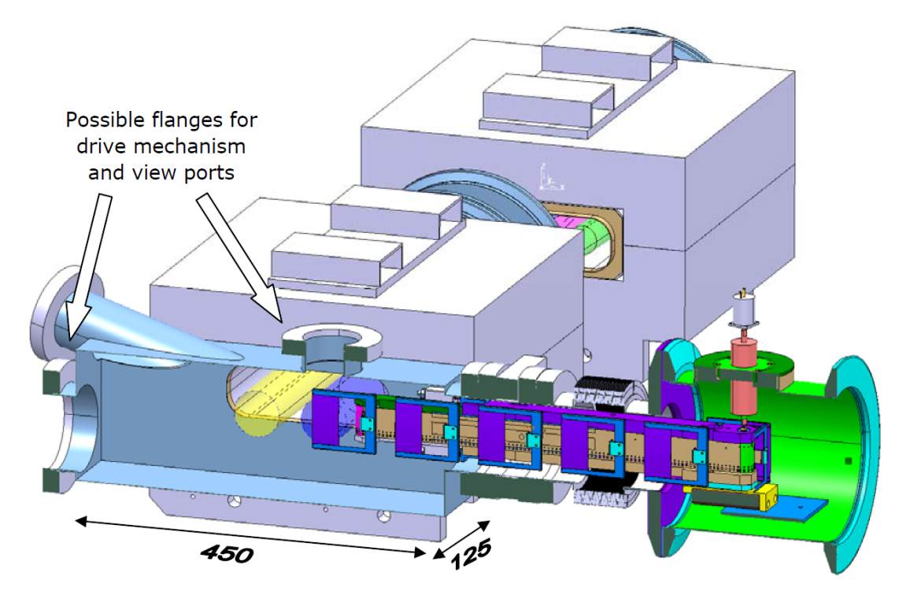
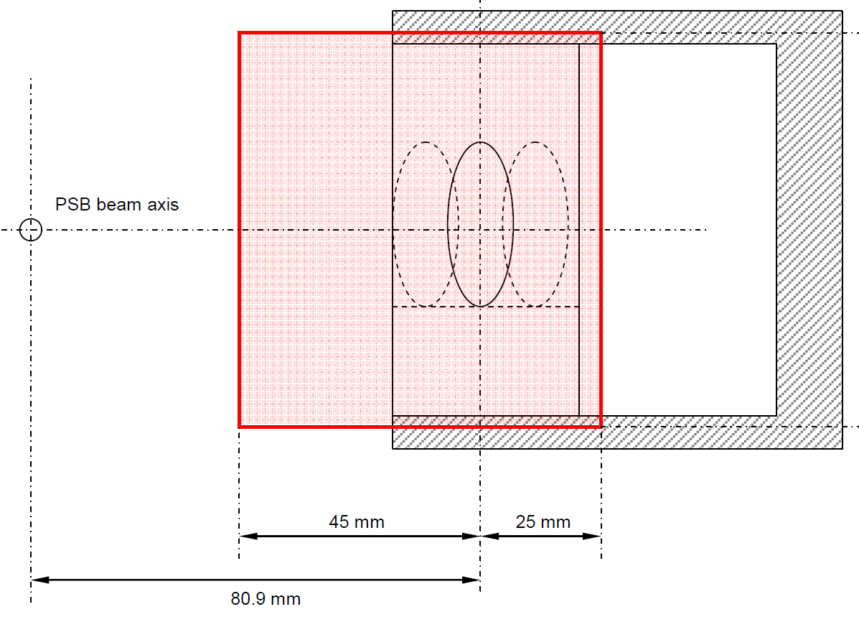
Space constraints
Screen size and position
Simulation of the emittance blow up as
a function of screen thickness
60mm
Thickness [mm] | ε_{norm} [μm] (Inj.) | ε_{norm} [μm] (1st turn) | ε_{norm} ratio | Size ratio
0.5 | 0.30 | 2.60 | 8.68 | 2.95
1 | 0.30 | 3.63 | 12.11 | 3.48
2 | 0.30 | 20.43 | 68.17 | 8.26
70mm
Not much use in measuring the beam size after one turn

Slide 6

Screen mechanism idea
Injected beam
Circulating beam
H⁻ beam observed
Image of front of screen and front of foil
Fixed mirror inside the chamber -> single movement (screen)
Tricky design of supports (tilted)

Slide 7
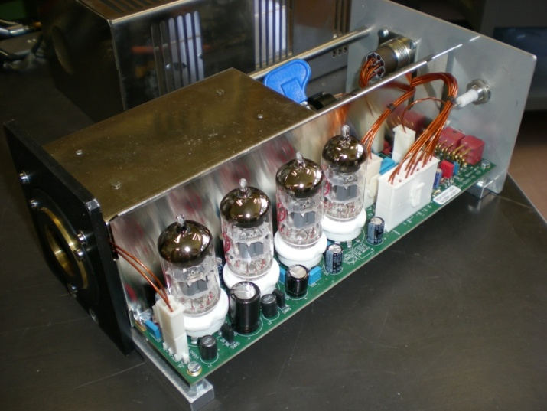
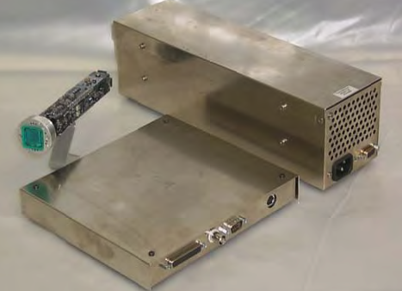
BTV acquisition
Cameras
We will need 4 or 8 cameras depending if one camera can visualize both the screen and the stripping foil or not
Electronics
Present BTV card can be used
Driver for VIDICON camera
Drivers for screen / filter wheel / lights
Frame grabber @ 1.11Hz
VIDICON tube-based radiation-hard camera
CERN’s standard installation
CIDTEC CID Radiation-Hard camera
Pros : More sensitive and better linearity,
Cons : less resistant to radiation : ~5 MRad for ϒ

Slide 8
Outline
  Introduction
  Intrumentations at stripping foil :
    Beam profile
    Visual inspection
  Instrumentation in front of the injection dump :
    H0/H- population measurement
    Beam Loss Monitors
    Injected beam matching and emittance monitor
      Turn by turn transverse profiles measurements
      Beam trajectories
  Spare Policy
  Summary

Slide 9
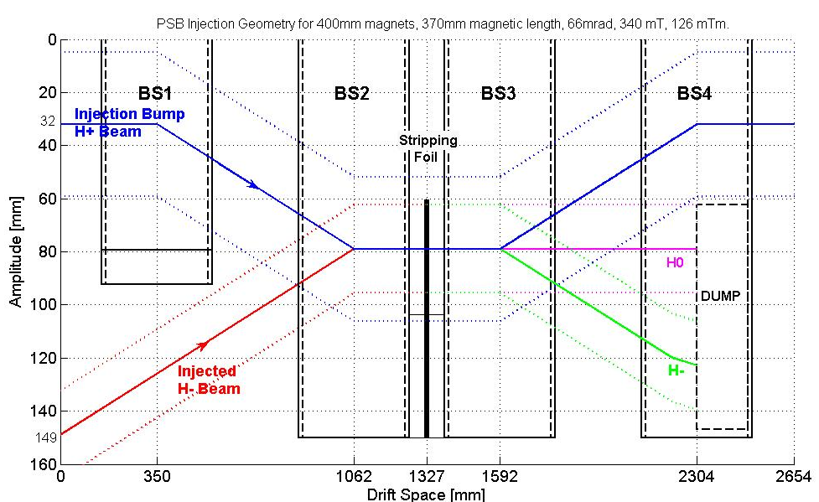
H0/H⁻ population measurement after the stripping foil
From recommendations found in specification papers: measure the H⁰ and H⁻ beam current
  to allow efficient set-up of the injection
  to monitor the stripping efficiency
  to be able to detect any foil degradation or failure

Slide 10
Challenging specifications
Monitor
Linear response
Dynamic range : 5.10⁷ – 5.10¹²
Very high reliability due to activated zone
Mechanics
Integration monitor attached to the dump, or rear vacuum flange
Integration of electrical feedthroughs
Withstand bakeout cycles : 200°C for 24h
Withstand pulsed magnetic field of 0.34T
Vacuum : dynamic pressure 10⁻⁸mbar with beam

Slide 11
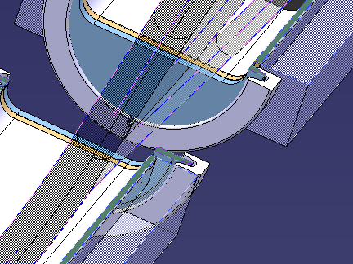
Measurement principle
BSW4
Dump
H⁰/H⁻
H+
Circulating beam
Stripping efficiency : 99%
e⁻
2e⁻
A
Ratio H⁰/H⁻ = 10⁴
2 acquisition channels needed ?
H0:1%
A
H-
BSW3
Cross section of the H0/H- dump:
Foil size and position
BSW2

Slide 12
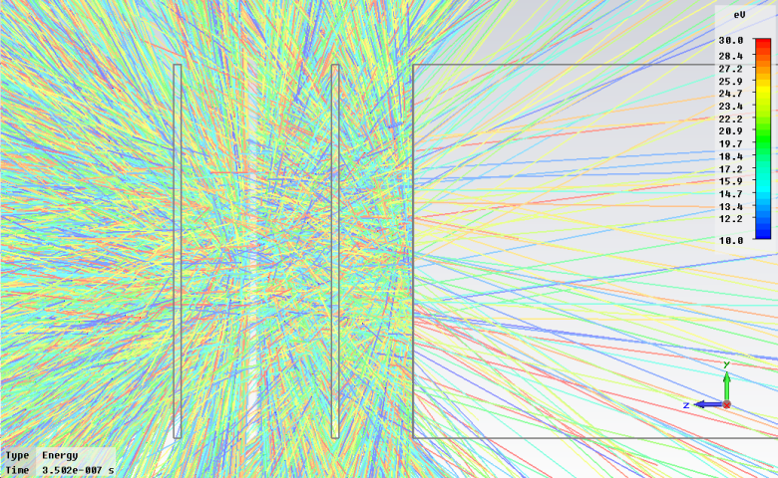
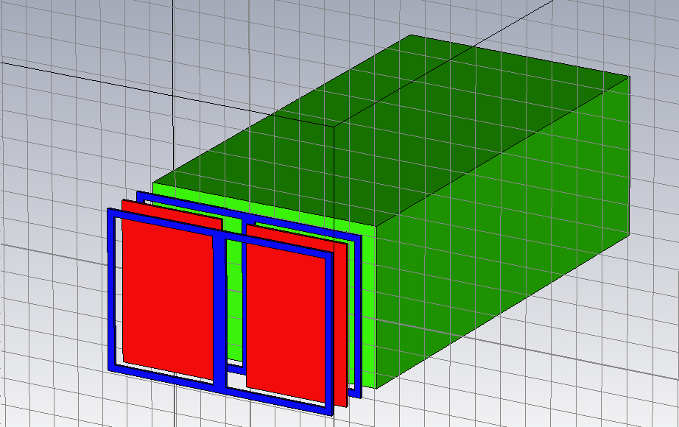
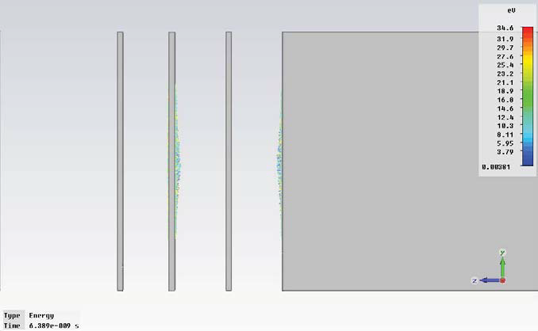
Faraday Cup for H0/H- meas.
Foil material: Aluminum and Titanium are good candidates:
*Negligible thermal load : full pulse of 40mA, 100μs ΔT = 50K for Al,
ΔT = 80K for Ti
*Favor low Z material ⇒ lower yield of neutrons + γ (FLUKA simulations)
For mechanical reasons, a 0.5 to 1mm-thin Aluminum foil is a good compromise
Secondary electrons exiting the foil and/or the dump
Secondary electrons trajectories with V_{bias}= 0V
Secondary electrons trajectories with V_{bias}= -1kV
Suppression of the secondary e- with 2 polarization rings
electrons [keV-1MeV] are neglected : ~1%
Compact design: 30 mm from the first ring to the dump
30mm

Slide 13
Outline
  Introduction
  Intrumentations at stripping foil :
    Beam profile
    Visual inspection
  Instrumentation in front of the injection dump :
    H0/H- population measurement
    Beam Loss Monitors
    Injected beam matching and emittance monitor
      Turn by turn transverse profiles measurements
      Beam trajectories
  Spare Policy
  Summary

Slide 14
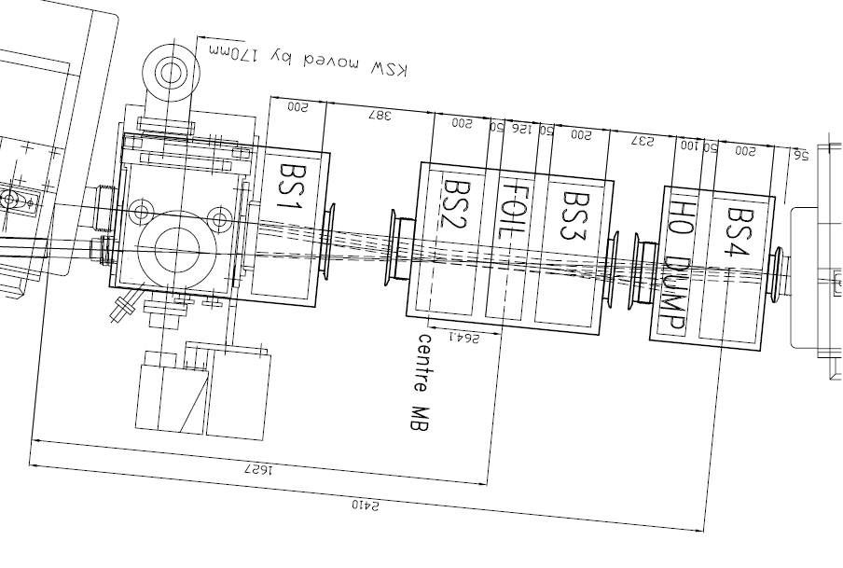
Machine protection concerns
From recommendations found in specification papers:
  Region of injection bump : CRITICAL
  Machine protection : foil and H0/H- dumps dump designed for 1bad pulse only : 2.5x10¹³ , 500 J
  Monitor foil degradation
  High reliability : integration in the FAST reaction system for material protection (BIS)
Basic parameters
Max loss 2.5x10¹³ protons per ring
Min 10⁸ protons per ring
Slow time resolution 1 ms during the acceleration cycle (530 ms)
User- specific BLMs : enable/ disable thresholds
detect a flux change on the percent level
Fast time resolution 2 μs , 500 samples
fast trigger beam stop for losses > threshold




Slide 15
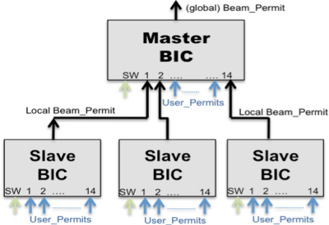
BLM types
BLM’s jargon | FAST | INTERMEDIATE | SLOW
Time resolution | 100 ns | 500 ns | 2 μs
Type | Diamond ACEM | Cherenkov monitors (PEP II) | Ionization chambers
Comments | ACEM : $1500/piece Readout OASIS | Under test at CERN | Large # spares : for free Very reliable (25 years in SPS)
ionization chamber
signal
Beam stop trigger
Activate
Linac4 pre-chopper
or chopper
Beam loss
event
BLM processing
2 μs
Beam Interlock System
5 μs
15 - 20 μs
50% of the loss are integrated in 300ns
The rest in 300 μs
time
300 μs

Slide 16
System features
Generic system for the injectors
  Highly configurable and high performing system
  Acquisition part compatible with most monitor type (IC, LIC, SEM)
  Use reprogrammable parts to target all injectors’ requirements
Acquisitions synchronized with the start of the cycle :
  calculation of integration periods and comparisons with threshold.
  The threshold values will need to be unique per channel
Up to 4 integration periods
  2 μs, 400 μs, 1 ms and 1.2 s (full cycle for ambient radiation meas.)
System has to block injections
  “remove Beam permit” if losses exceed threshold
System has to remember if the user is allowed to have beam
  i.e. “give permit” if previous cycle for the user was ok (or errors cleared)
The Beam Interlock Controller will be configured in the “Non-latch” mode.
  the BLM system will need to follow timing and notify in advance.
Only data from the current cycle need to be considered.
  Timing in the electronics essential (i.e. possible failure mode)
Need FLUKA simulations to relate BLM thresholds with beam losses + measurements

Slide 17
Outline
  Introduction
  Intrumentations at stripping foil :
    Beam profile
    Visual inspection
  Instrumentation in front of the injection dump :
    H0/H- population measurement
    Beam Loss Monitors
    Injected beam matching and emittance monitor
      Turn by turn transverse profiles measurements
      Beam trajectories
  Spare Policy
  Summary

Slide 18
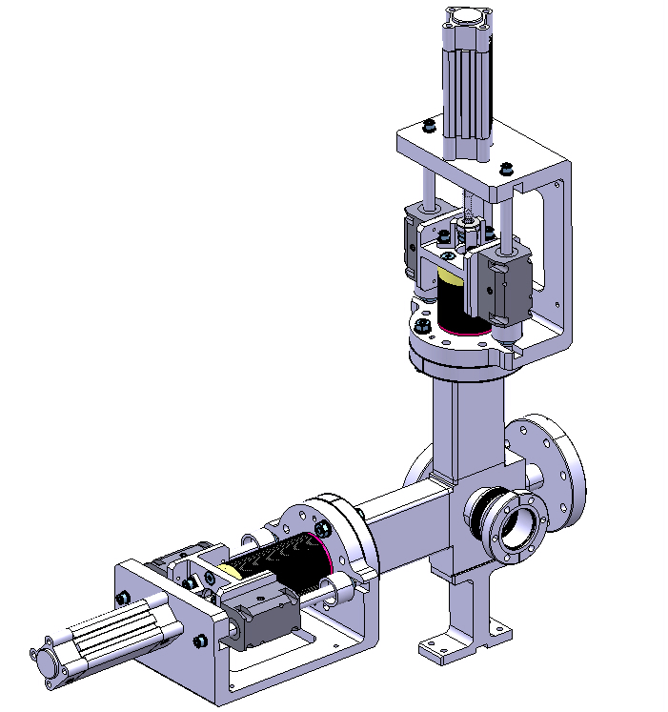
Injection matching and Emittance measurement
From recommendations found in specification papers:
  to allow matching and emittance measurement of the Linac4 arriving at the PSB
  a pair of monitors (H+V) in one ring is sufficient
  injection of half a PSB turn (i.e. 0.5 μs) to well separate turn-by-turn profiles
  acquisition of – say up to 20 – consecutive profiles
Basic parameters
Beam energy 160MeV
Relativistic factors γ_{rel} = 1.171 β_{rel} = 0.52
Circulating particles 2x10¹¹ protons
Average intensity 32 mA
Physical RMS ε_{rms} of incoming beam 0.5 μm
RMS beam size with betatron mismatch x2 1.1 - 2.2 mm
Betatron function of the PSB in straight sections β_{T} = 5 m
Actuator V
Actuator H
Tank
Beam
Example : Intertank SEM grid of Linac4

Slide 19
Scattering angles and energy loss with graphite
Compact monitor
Grid size : 20mm
48 graphite wires
Density ρ | radiation length X₀ | wire spacing w | wire radius r
2.265 g/cm² | 18.8 cm | 0.4 mm | 17 μm
  Average values for average (effective) thickness d = r² π/w = 2.1 μm
  Rms scattering angle
  With logarithmic correction : ϑ = 0.09 mrad
  Energy loss corresponding to
  Blow-up (phys. rms emittance) due to interaction with monitor: 0.06 μm/turn
    ⇒ Blow-up per turn due to monitor almost one order of magnitude lower than the expected emittance of 0.5 μm (rms)
    ⇒ Measurement can be envisaged
    Expect significant tails, which may lead difficulties with profiles widths estimates (systematic errors)
w
wire spacing 0.4 mm
Diametre ∅= 33 μm

Slide 20
Other considerations (1)
Electronics
Beam interaction : ~ 10 μA max in the graphite wire
Amplifier Type Integrator
Input impedance 50 Ω
Bandwidth 5MHz
Equivalent input noise 0.1 μA
Sampling rate 10MHz
Cable length the shorter the better (max ~8m tbc)
Material
Tungsten would yield ~3x larger signal but proton scattering is also larger
Can on rely on blow-up due to wires to remove protons ?
Concerns on radiation ageing
Is sensibility of central wires seeing more beam reduced w.r.t. outer wires ?
Amplifiers : should we keep them permanently in the machine or just for commissioning & start-up time ?
10 μA max

Slide 21
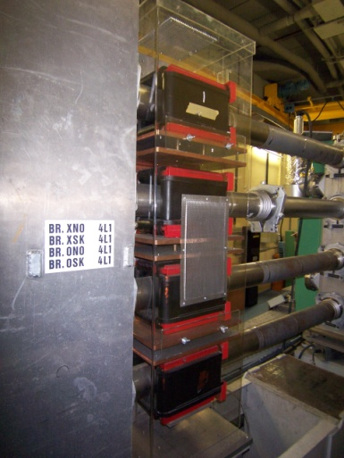
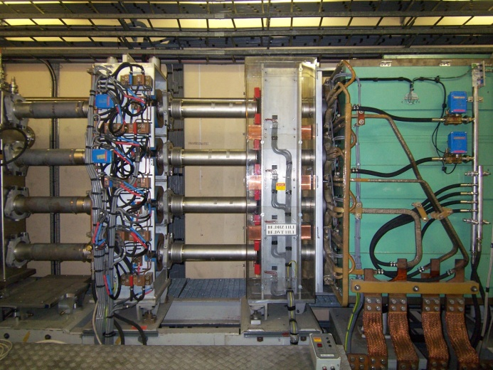
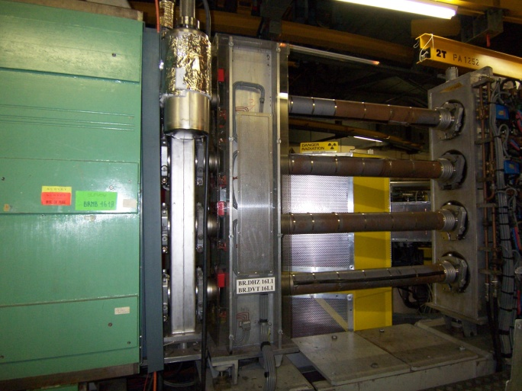
Other considerations (2)
Space charge
Direct space charge tune shift -0.13 with bunching factor 0.5
Damping of turn-by-turn beam size ?
Mitigate space charge by reducing beam current for measurement ?
Beam dump
Pulse injection kicker to remove beam after 20 turns to prevent wire damage ?
Vacuum intervention requests
Proper vacuum sectorization
Installation far from sensitive equipments (e.g. septa, RF cavities…)
Available straight sections for the monitor in the PSB ring
4L1 11L1 16L1

Slide 22
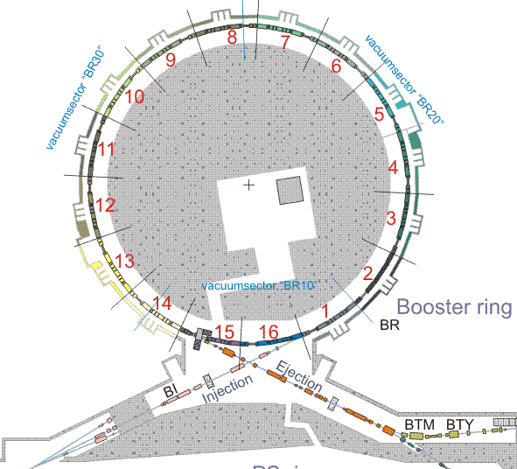
Beam trajectories at injection
From recommendations found in specification papers:
  Bump closure measurement
  Injection steering
  Injection trajectories turn-by-turn over the first ~100 turns
  Resolution / absolute precision : 0.2 mm / 0.3 mm
Basic parameters
Injection energy 160MeV
Filling half a PSB ring 500ns Linac4 bunch length
Circulating particles up to 2x10¹¹ protons
Revolution frequency 0.99 MHz
16 dual-plane PUs per ring
Total : 64 PUs
STATUS : The present ORBIT measurement is obsolete
BI group proposal :
Keep the monitors
New Front-end electronics (amplifiers, ADCs..)
New Cables
Data processing : complete trajectories, orbit
Every ring will get its own acquisition (no multiplexing)

Slide 23
Outline
  Introduction
  Intrumentations at stripping foil :
    Beam profile
    Visual inspection
  Instrumentation in front of the injection dump :
    H0/H- population measurement
    Beam Loss Monitors
    Injected beam matching and emittance monitor
      Turn by turn transverse profiles measurements
      Beam trajectories
  Spare Policy
  Summary

Slide 24
Spare policy
TV Screens at stripping foil :
  Mechanics : two spares
  Vidicon-tube-based cameras : enough spares
H0/H- current monitor attached to the dump, and integrated in BSW4 : align spare policy of the monitor to the spares policy of the BS magnets
Ionization chambers : enough spares
SEM grids :
  Mechanics : one spare
  Amplifiers : 10-20 spares
Pick-ups :
  a stack of four monitors available
  Amplifiers : 10 spares

Slide 25
Summary
A set of beam instruments proposed, based on specifications for
  machine protection system
  commissioning
  routine operation
Spare should be fine
Concerns
  Zone characterized by little space available : Instrument integration is done in close collaboration with all equipment specialists
  Reliability due to heavy activation
  Are the proposed instruments sufficient ?

