Slide 1

Injection foils and handling system
Review on PSB 160 MeV H⁻ Injection
9-10 November 2011
W. Weterings
C. Boucly, M. Hourican, R. Noulibos, Y. Sillanoli

Slide 2
Abstract
The linac4 beam will be injected horizontally into the PSB by means of an H⁻ charge-exchange injection system using a graphite stripping foil to paint the beam into the required emittance.
This presentation will describe the hardware requirements and constraints, the performance specifications of the stripping foil and the conceptual design of the foil exchange unit and motorisation.

Slide 3
Outline
Introduction
Requirements
Constraints
Stripping foil specifications
  Stripping efficiency
  Beam losses
  Emittance growth
Conceptual design
Motorisation
Outstanding issues

Slide 4

Requirements
Number of foils
  The foil lifetime is expected to be dominated by mechanical effects or by accidents.
  A minimum of 4 foils per ring, and per type, should be available in the exchange unit.
Positioning and adjustment
  Horizontal movement of ±8 mm will be needed for injection adjustment.
  No vertical adjustment necessary, the foil should cover the total vertical acceptance of the PSB.
  The foil position known and adjustable at the level of ±0.1 mm.
Alignment
  Mechanism aligned with ±0.5mm precision, including manufacture and assembly tolerances .
Vacuum isolation
  Possibility to isolate foils from PSB vacuum to avoid foil damage due to differential pressure.
  Interlock to avoid venting of the PSB vacuum system before isolation of foil exchange unit.
Radiation considerations
  Reduced radiation exposure of personnel during replacement, repair or maintenance (ALARA).
  Remove complete systems without dismantling and replaced by spare assembly.
Foil recuperation
  Foil dust-debris recuperation system for activated foils that break or disintegrate during operation or maintenance (inhalation or pollution inside vacuum).

Slide 5
Constraints
148mm

Slide 6
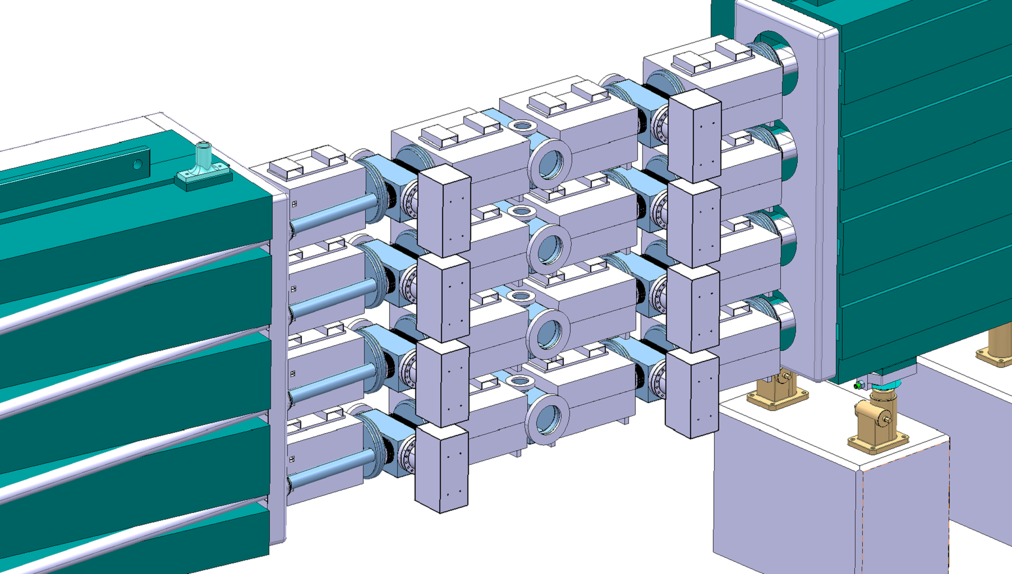
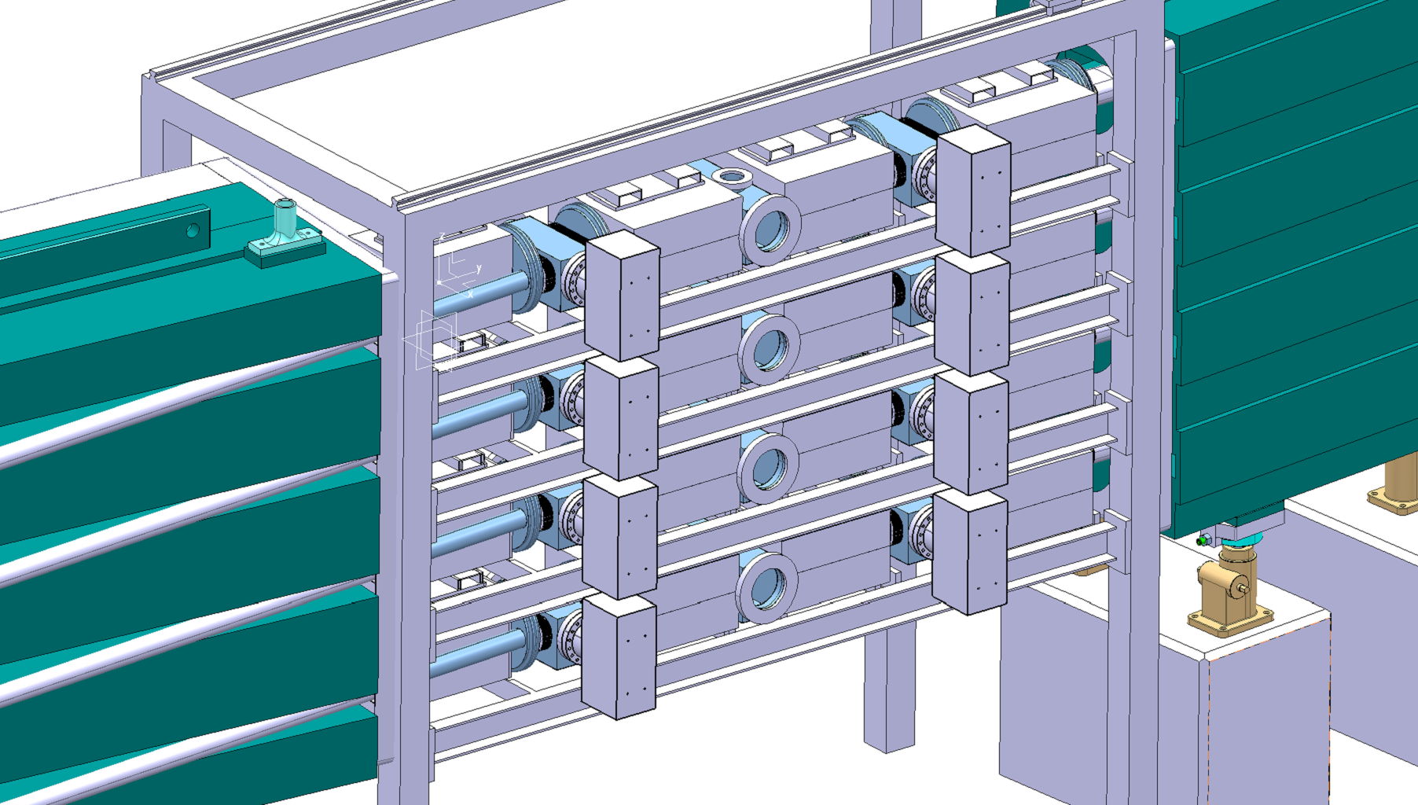
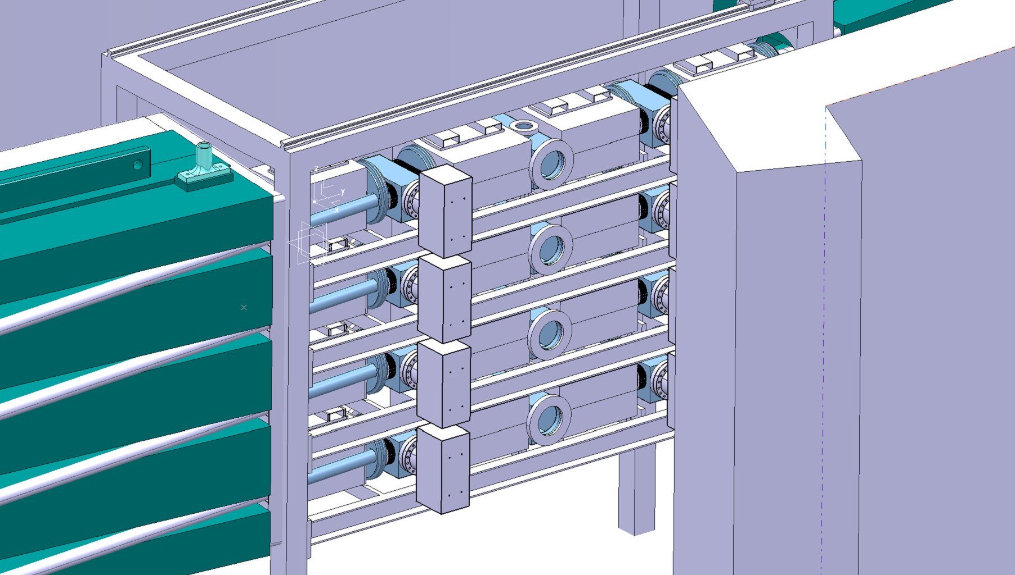
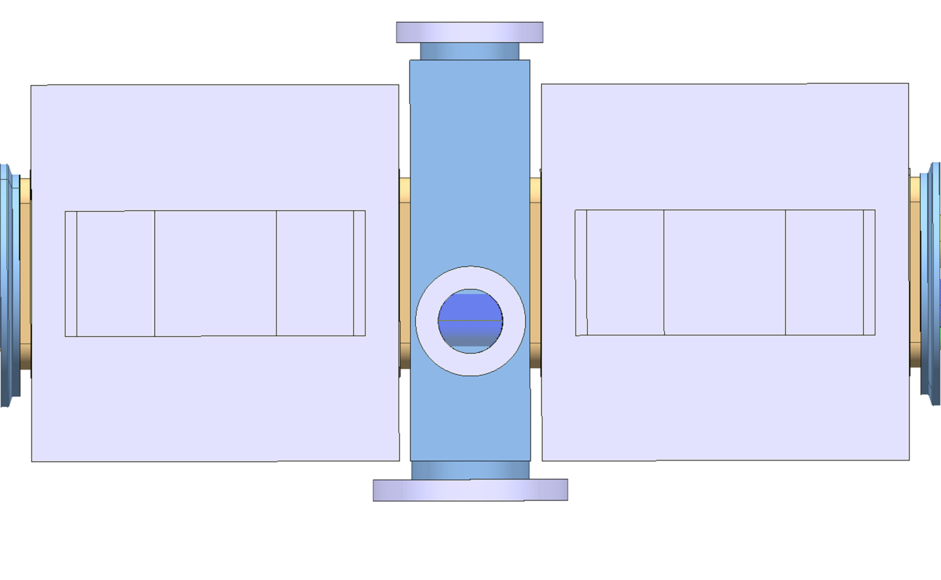
Constraints
  Small vacuum tank shared with BI (Camera and BTV)
  Limited space between BSW magnets, Vacuum equipment and support structure
  Entrance area with concrete wall and outside passage PSB
148mm
~120mm
Top-View

Slide 7
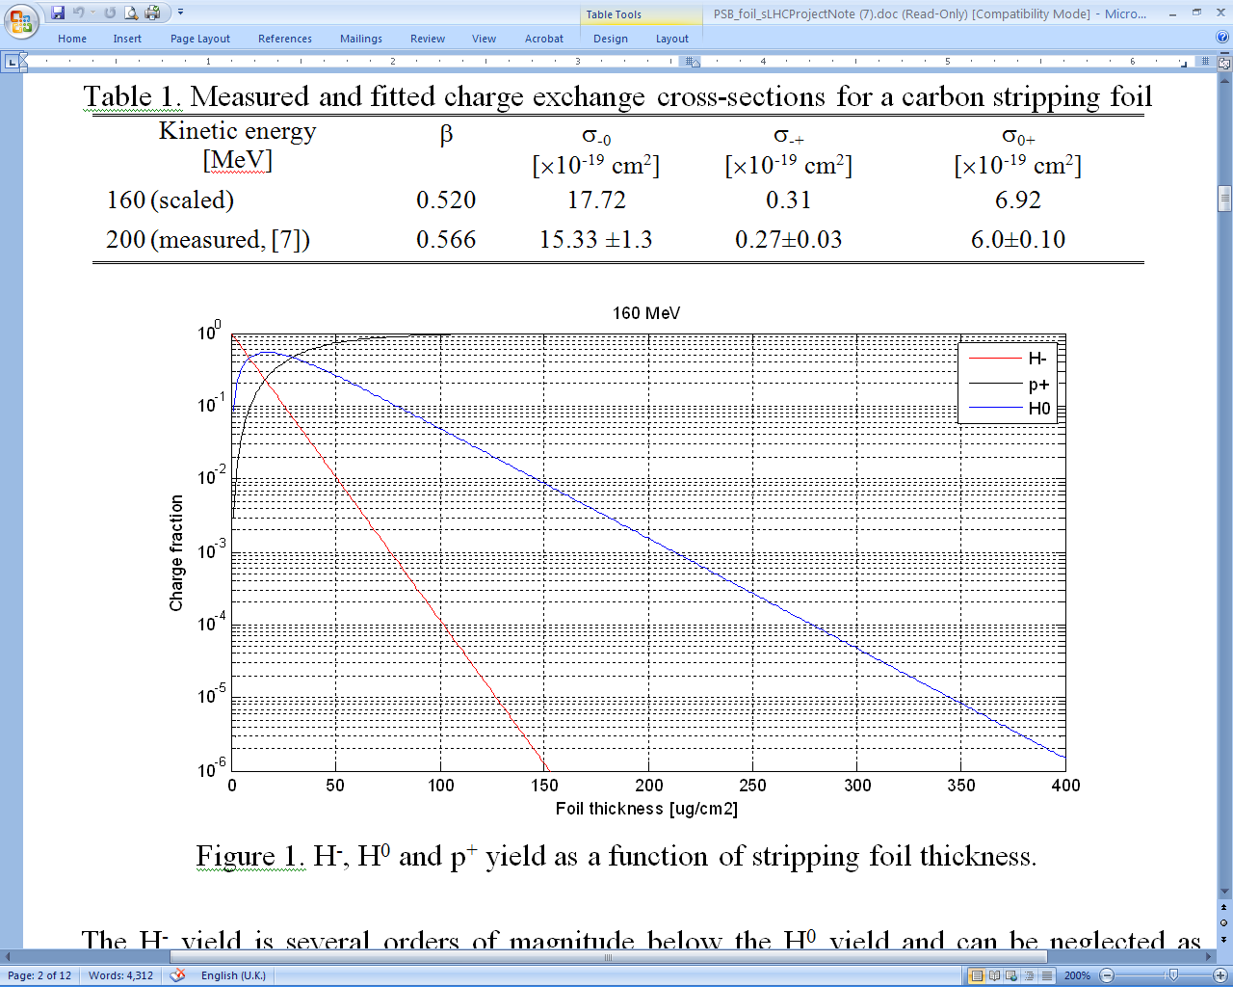
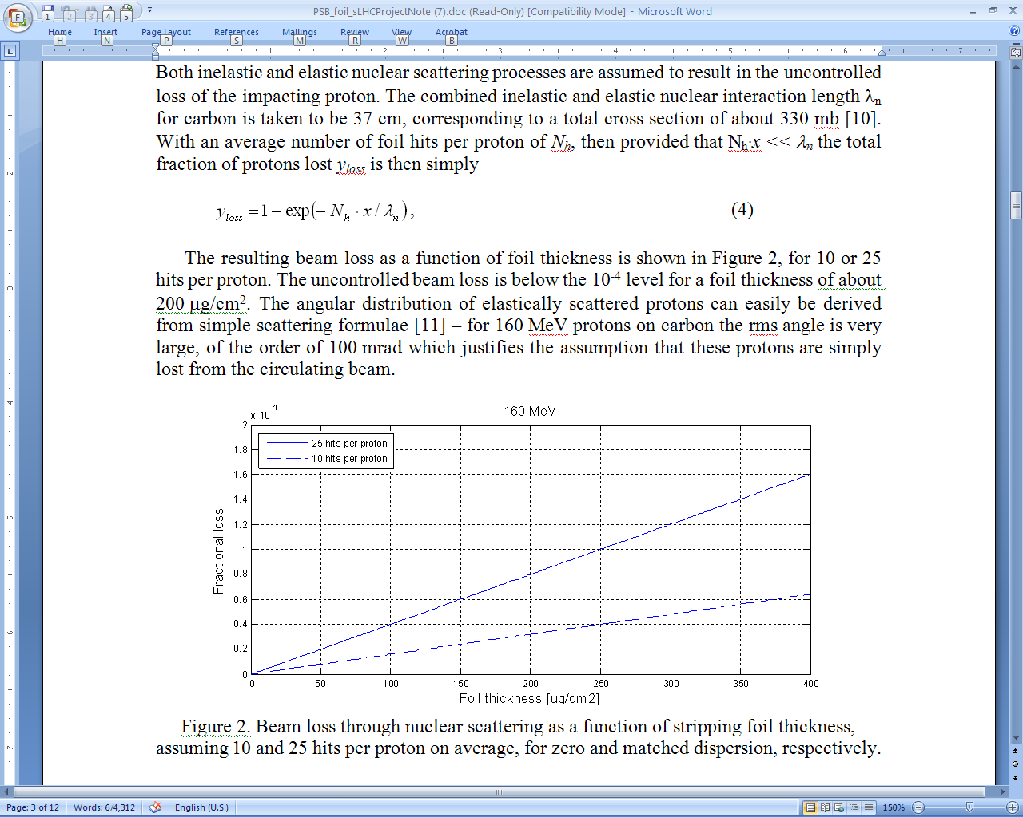
Foil specification - 1
Stripping Efficiency
  H⁻, H⁰ and p⁺ yield as a function of stripping foil thickness.
  Stripping efficiency of > 99%
  Foil thickness < 150 µg/cm²
Beam loss by nuclear scattering
  Beam loss through nuclear scattering as a function of stripping foil thickness, assuming 10 and 25 hits per proton on average, for zero and matched dispersion, respectively.
  Uncontrolled beam loss < 10⁻⁴ level
  Foil thickness < 250 µg/cm²

Slide 8
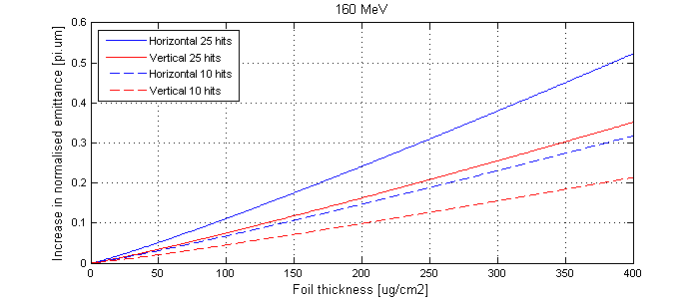
Foil specification - 2
160MeV
Emittance growth by Coulomb scattering
Emittance growth by multiple coulomb scattering as a function of foil thickness, assuming 10 and 25 hits per proton on average. The required LHC beam emittance was ≈ 2 π ·µrad (now “as small as possible”).
  Emittance growth < 0.15-0.25 π·µrad
  Foil thickness < 200 µg/cm2
Thickness
  Foil thickness of 200 μg/cm² (~1 μm) has been chosen.
The benefits of a thicker foil outweighs the disadvantages of extra foil heating, beam losses and emittance blow-up.
  Composition
    Carbon Stripping foil material (Amorphous carbon or diamond form)
    Thermal stability
    High sublimation temperature
    Radiation resistance
    sufficient strength
    low Z (atomic number Z=6)
Self-supported carbon foils having natural isotopic composition are made by evaporation from a vacuum arc onto glass microscope slides or substrates. Evaporated carbon foil bulk density is 1.7-2.0 g/cm³.

Slide 9
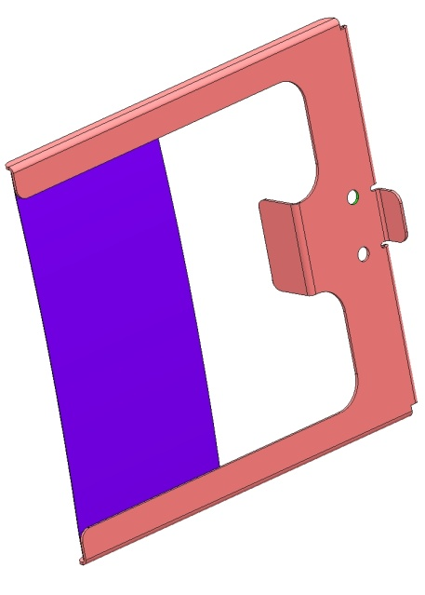
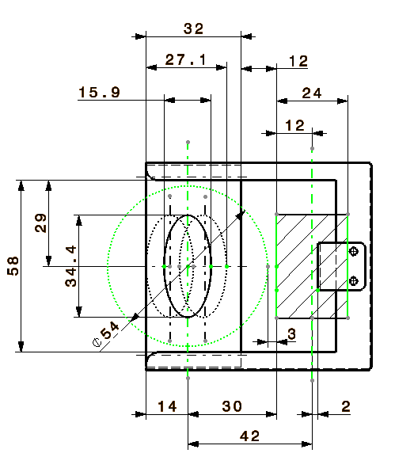
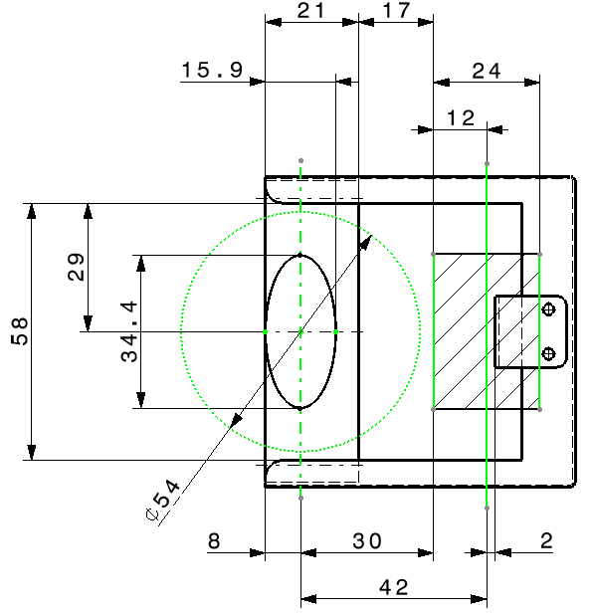
Foil specification - 2
Foil Dimensions
  Sufficiently large to cover the incoming H⁻ beam fully.
  Small enough to avoid larger numbers of foil hits per proton during injection.
  Foil holder outside the acceptance of the PSB.
  Foil and support size and clearances required for zero dispersion (left) and matched (-1.4 m) dispersion (right) at injection point.
Beam envelope (Ø54mm)
Foil changer system pulley (Ø24mm)

Slide 10
Foil heat generation
Temperature rise in carbon foil for CNGS beam. The peak is about 280 K.
Thermal dynamic stresses currently studied by technical student
Evolution of maximum temperature in carbon foil for 1.3 × 10¹³ p+ CNGS beam injected at 1.2 s intervals. The equilibrium peak temperature is about 650 K.

Slide 11
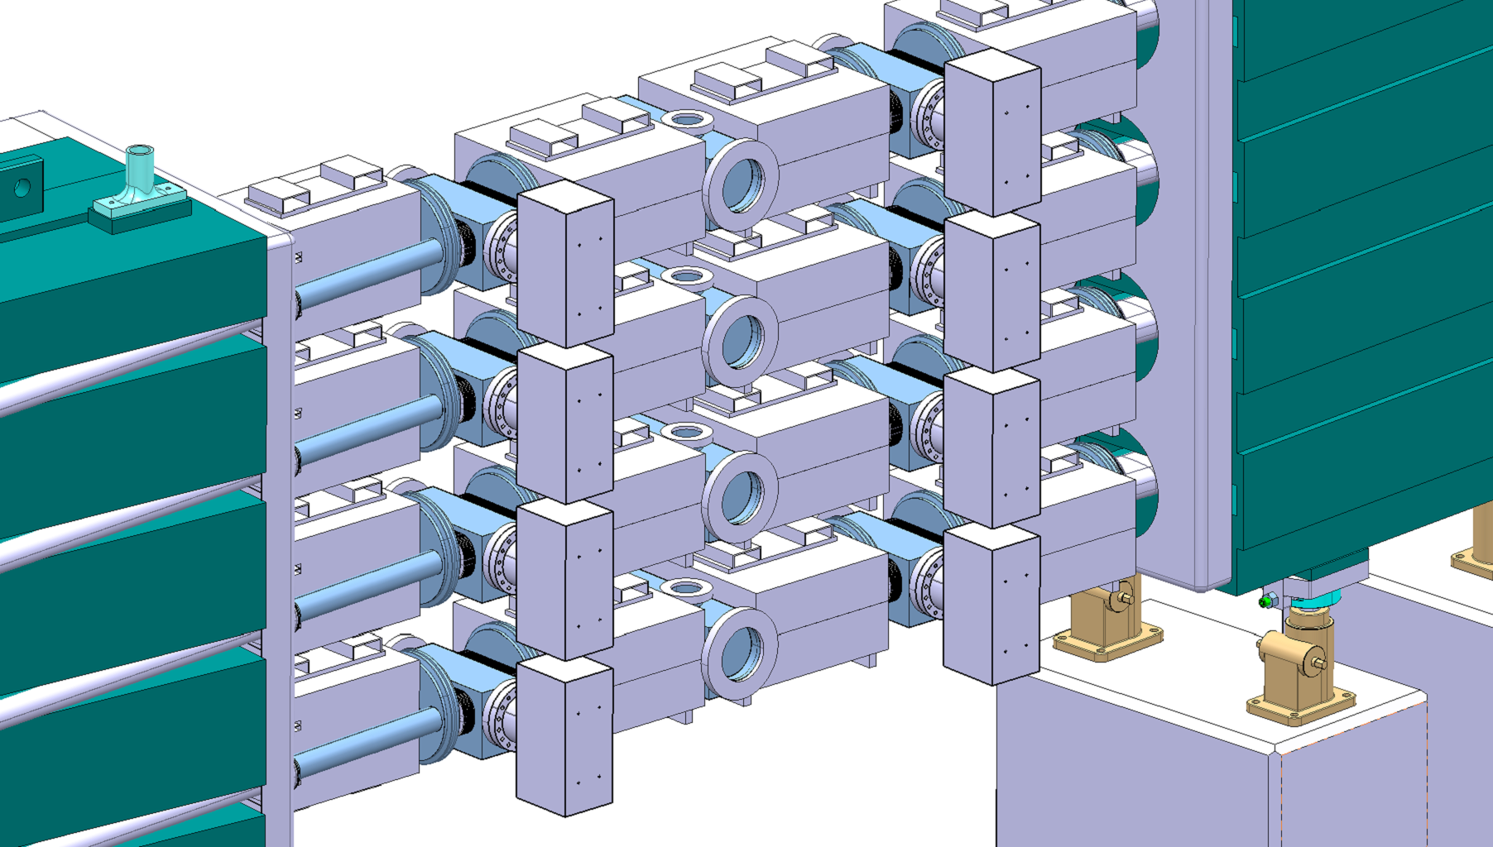
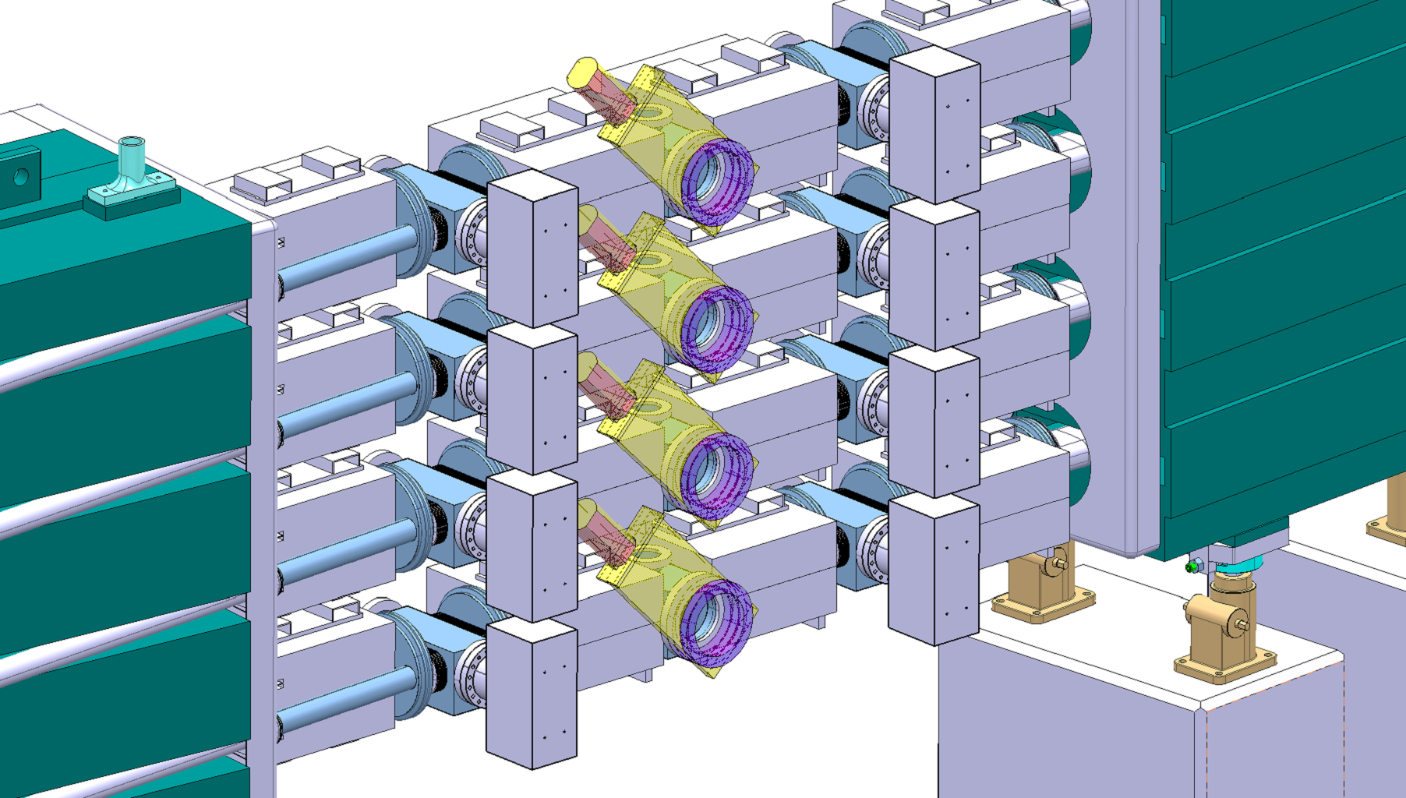
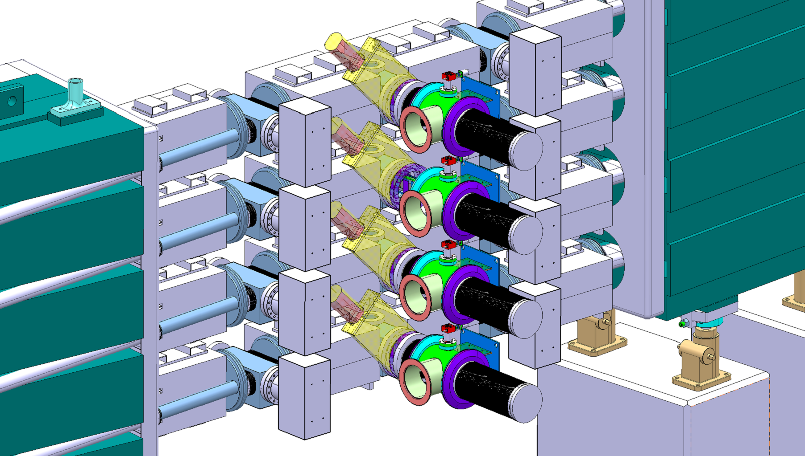
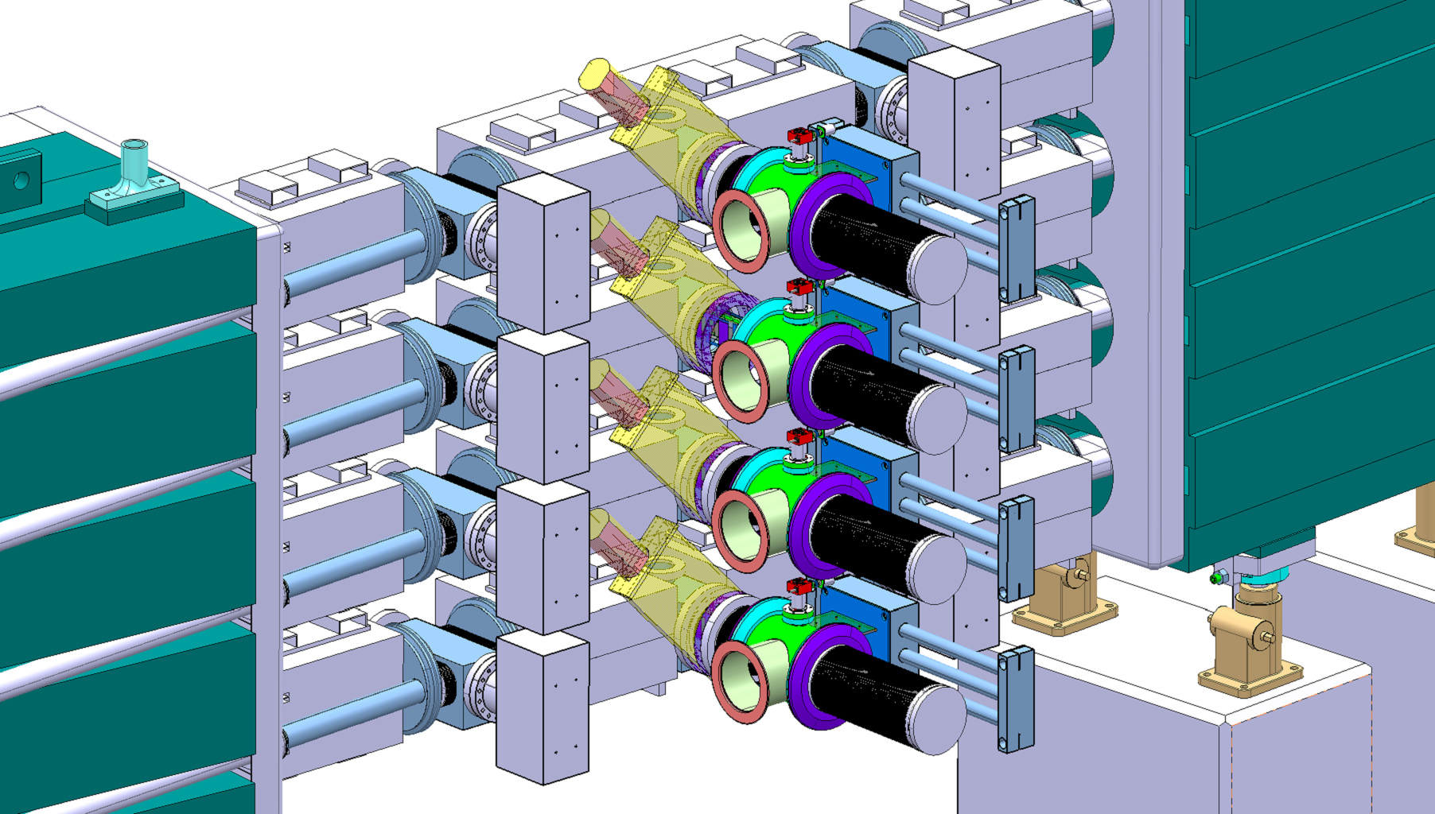
Foil exchange unit - 1
Vacuum Valve
Bellow
Motorisation
Retraction system
Foil Mechanism
Compensation Bellow
Injection zone

Slide 12
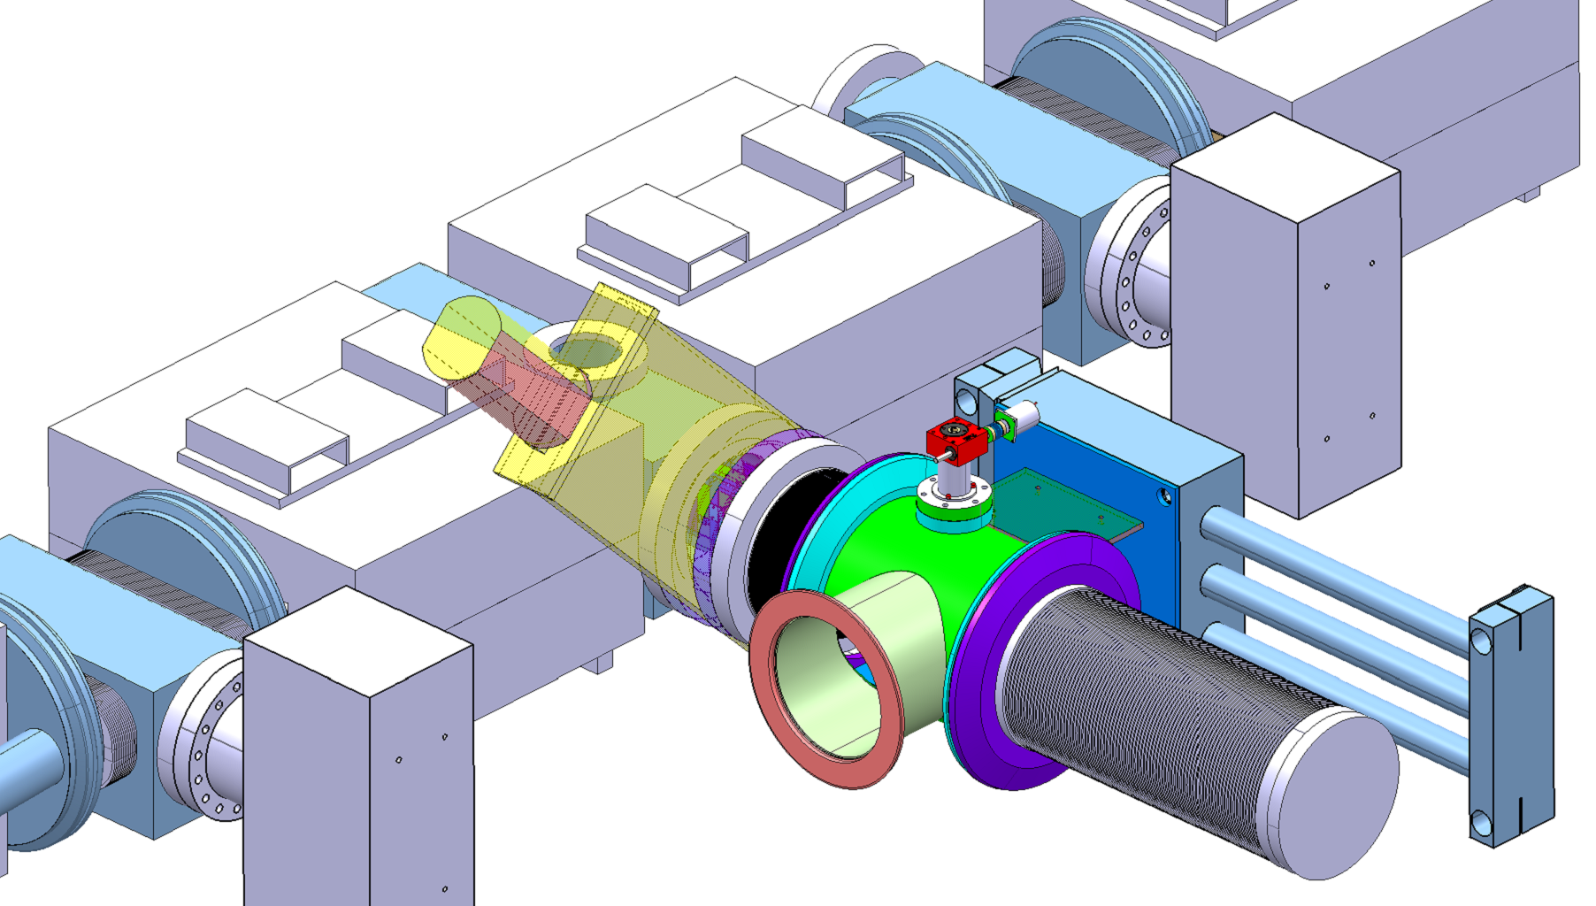
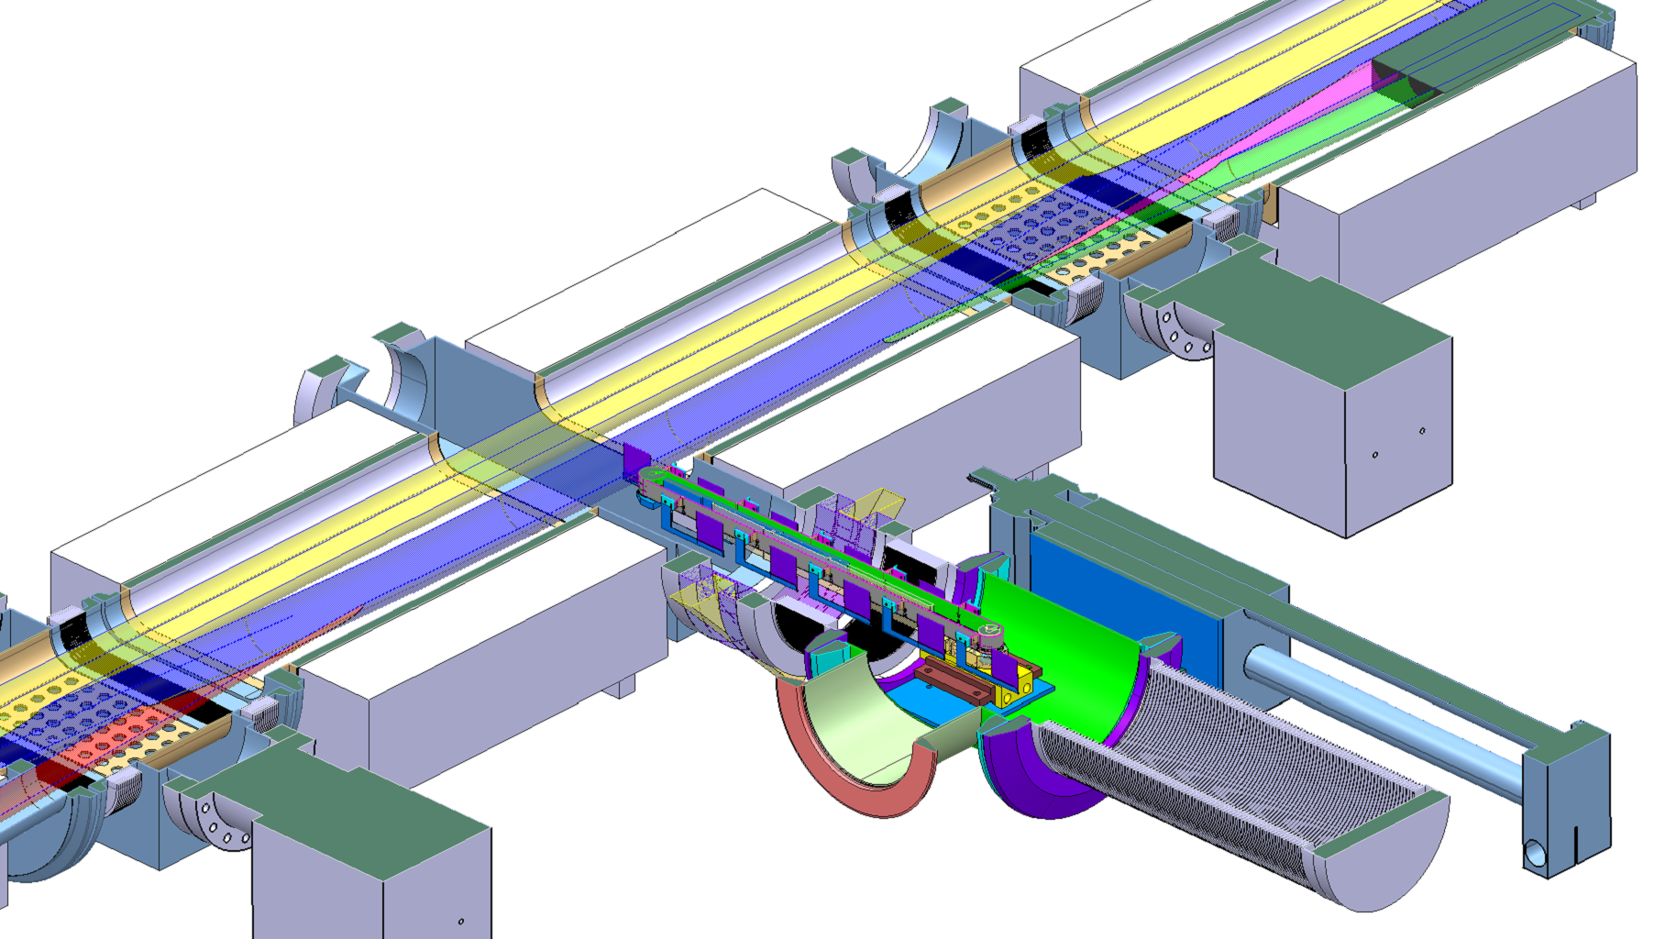
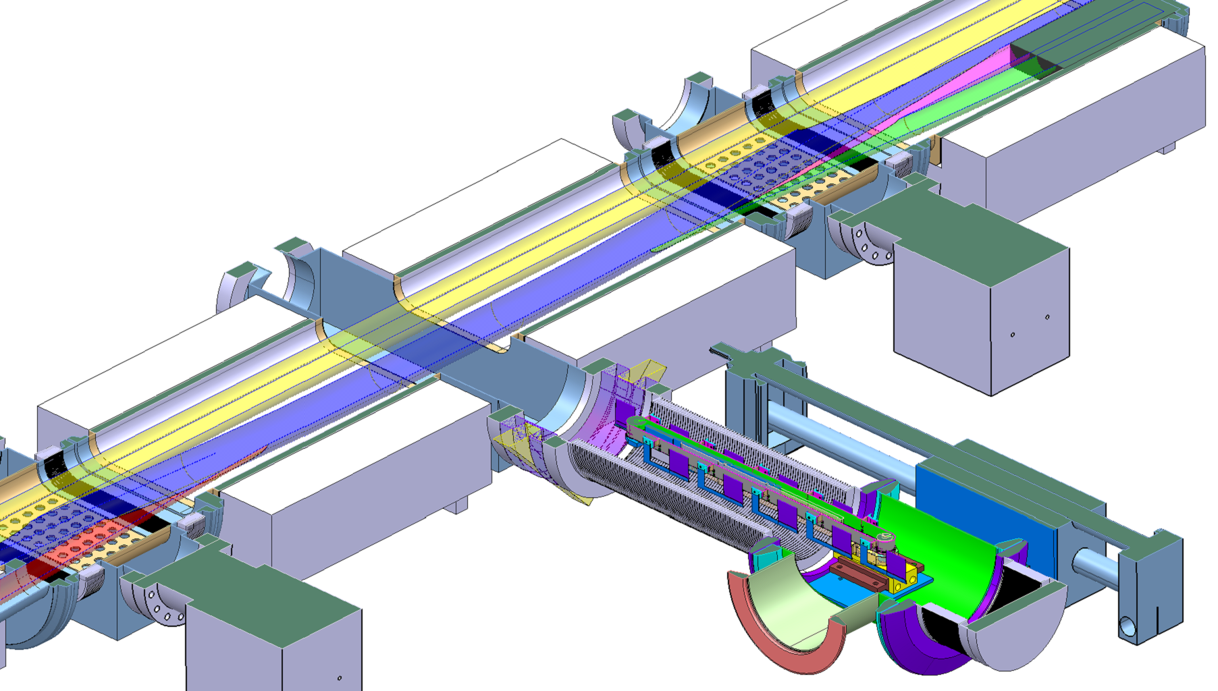
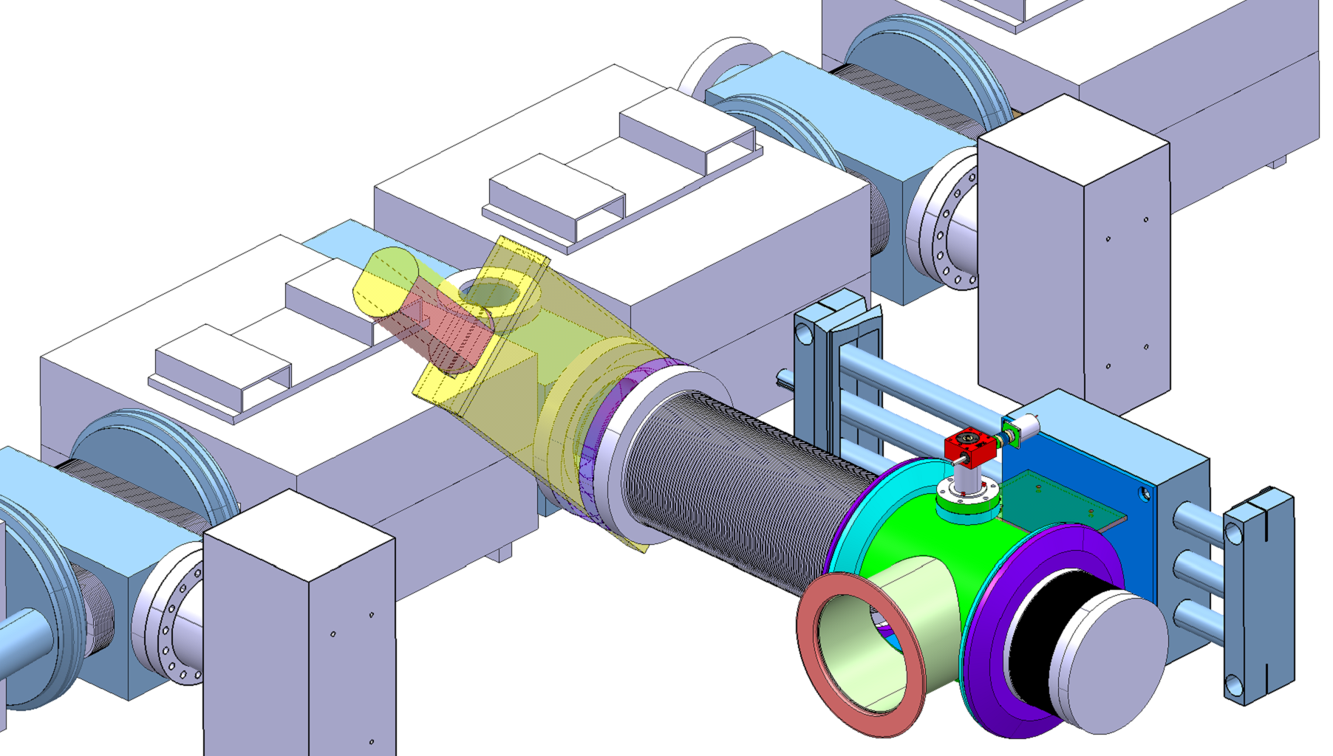
Foil exchange unit - 2
Foil “in beam” position
Foil “retracted” position
Valve can now close to isolate system
Minimum required length for retraction

Slide 13
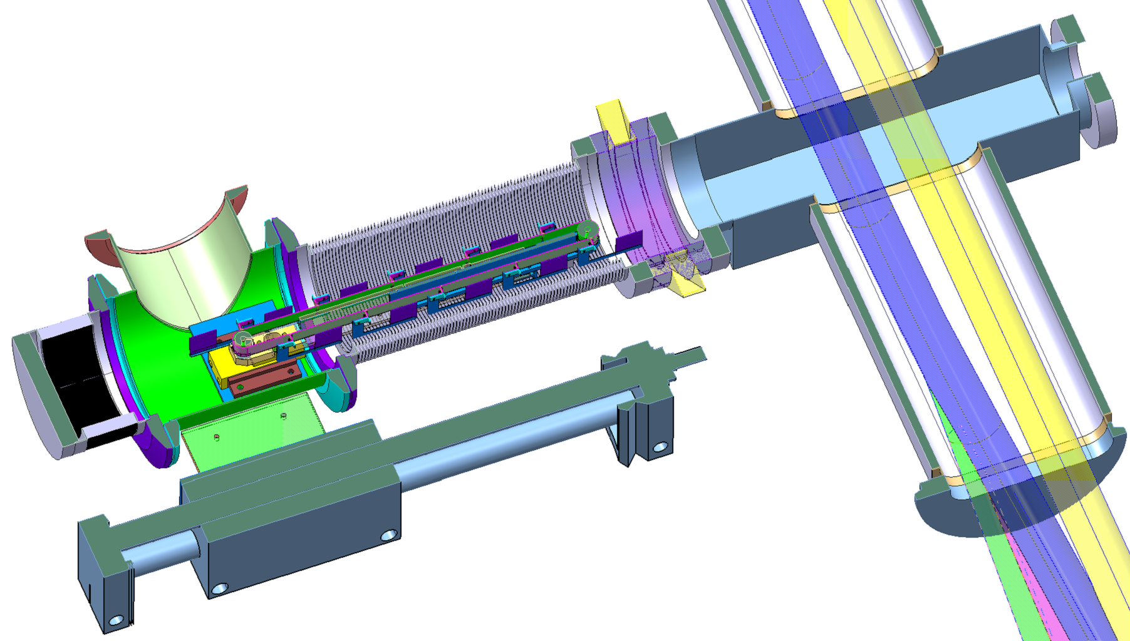

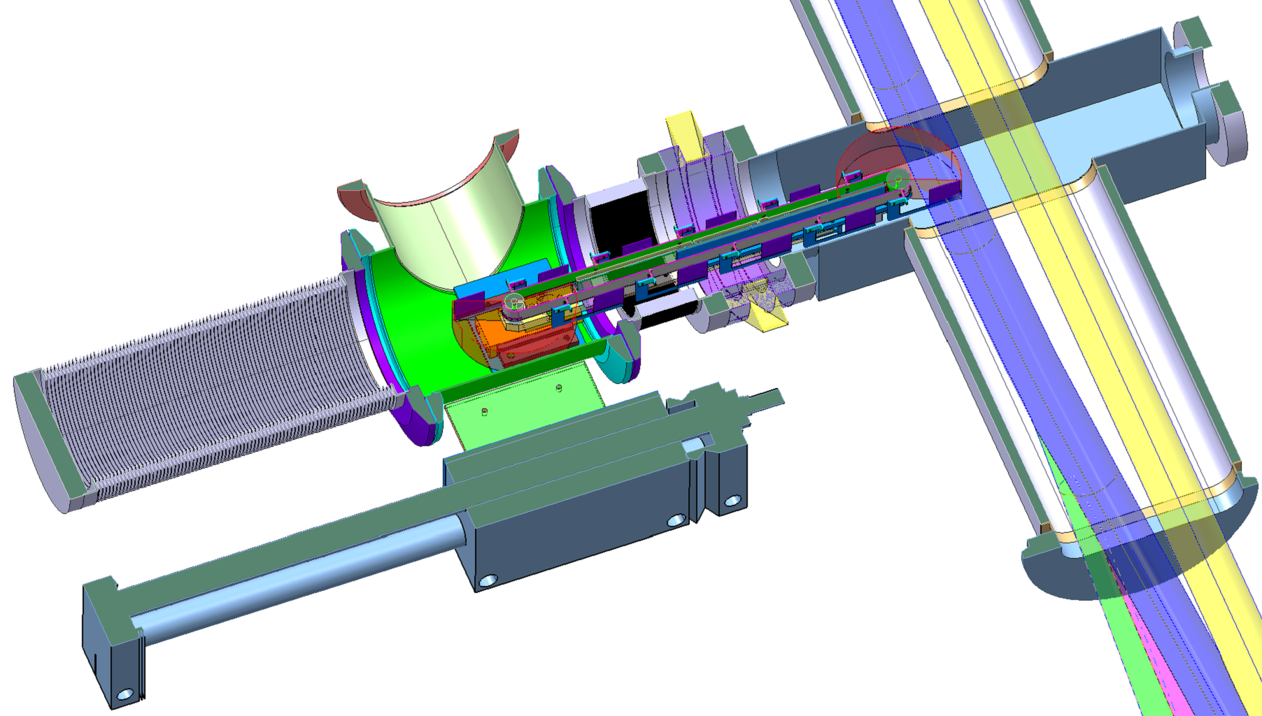
Foil mechanism
Limited space for foil rotation
Possibility for
‘in situ’
foil changing
Avoid interference with BTV screens.
Valve Closed
Valve open

Slide 14
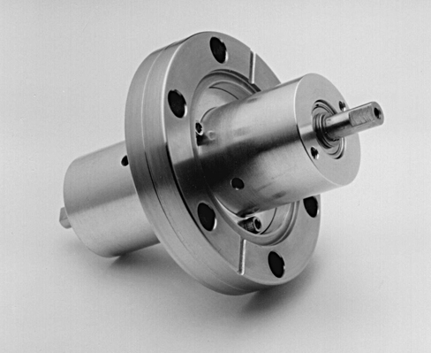
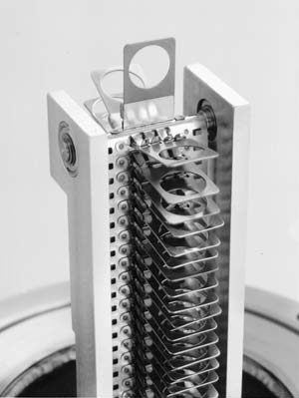
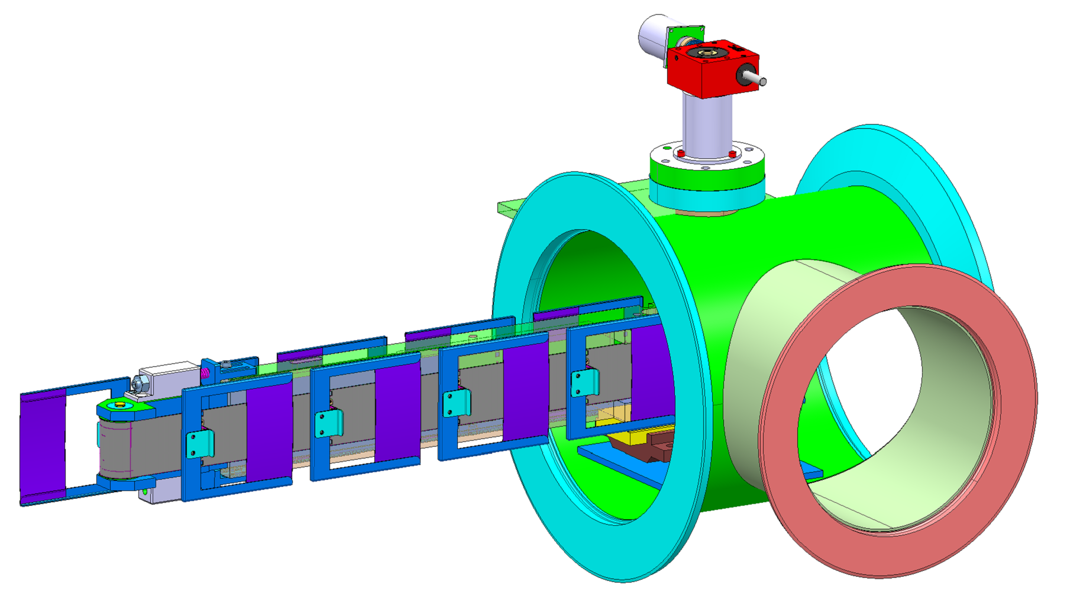
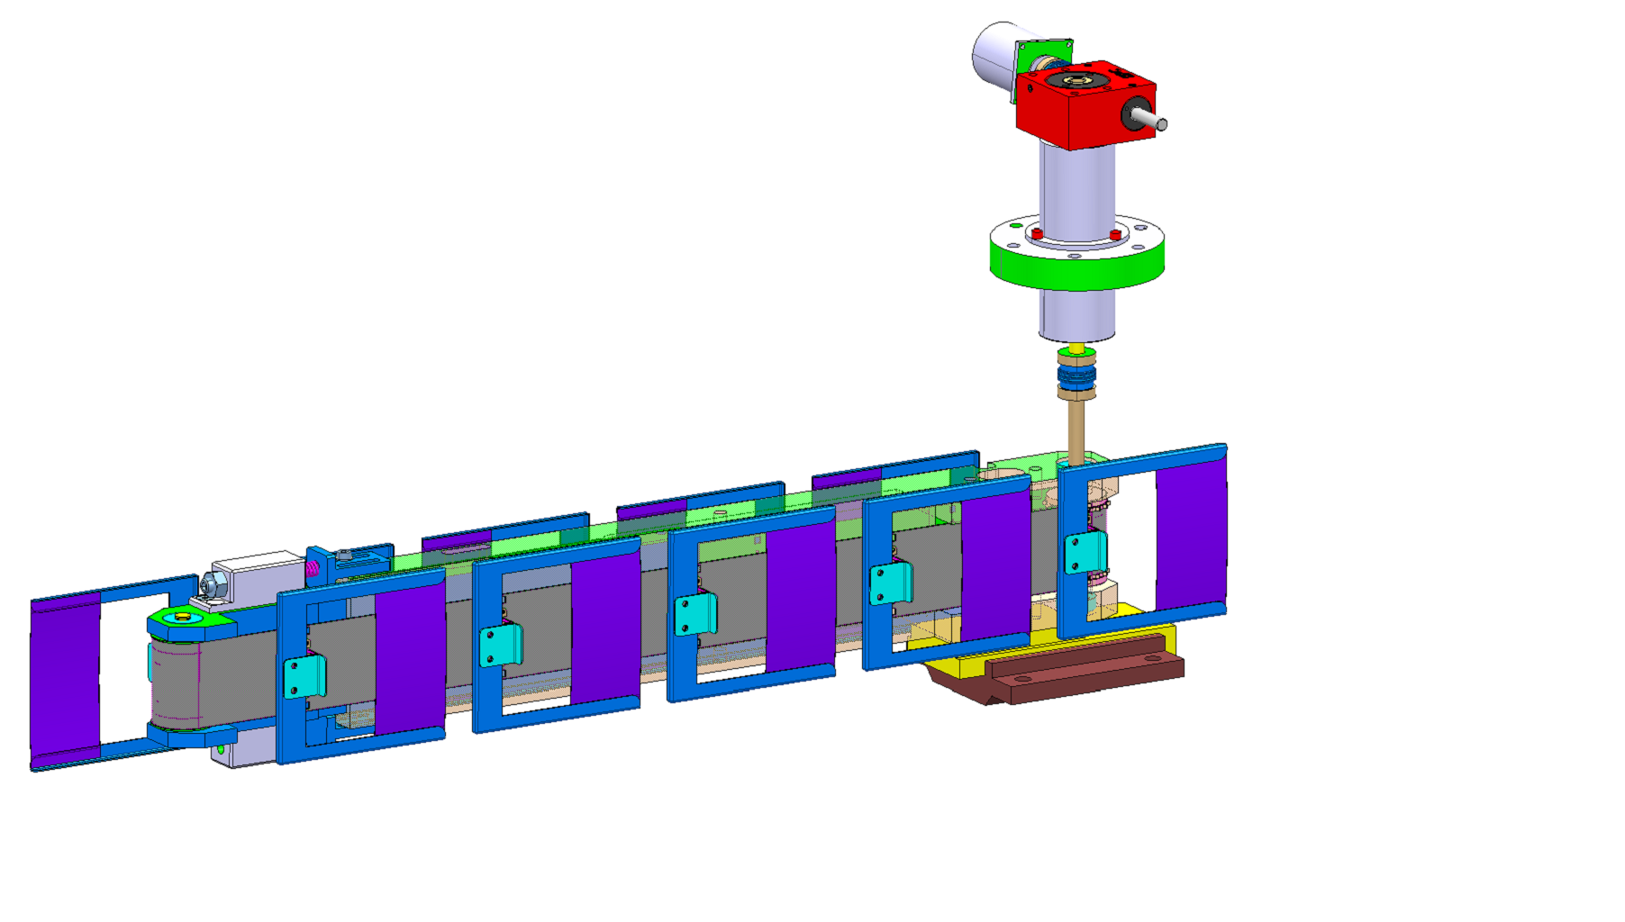
Foil carrier
VSS25 Phytron
stepping motor
90° angle worm gearbox
Magnetic rotary vacuum feedthrough*
Foil support band from NEC* Foil/Target Changer Model
Types of foils:
- ACF-200 Carbon
- MicroMatter DLC
- ?
Foil frame with bracket for
micro-switch foil position indexation
Foil fitting on frame
(manipulation, gluing, storage, transport )
* National Electrostatics Corp.
7540 Graber Rd., P.O. Box 620310, Middleton, WI 53562-0310 USA

Slide 15
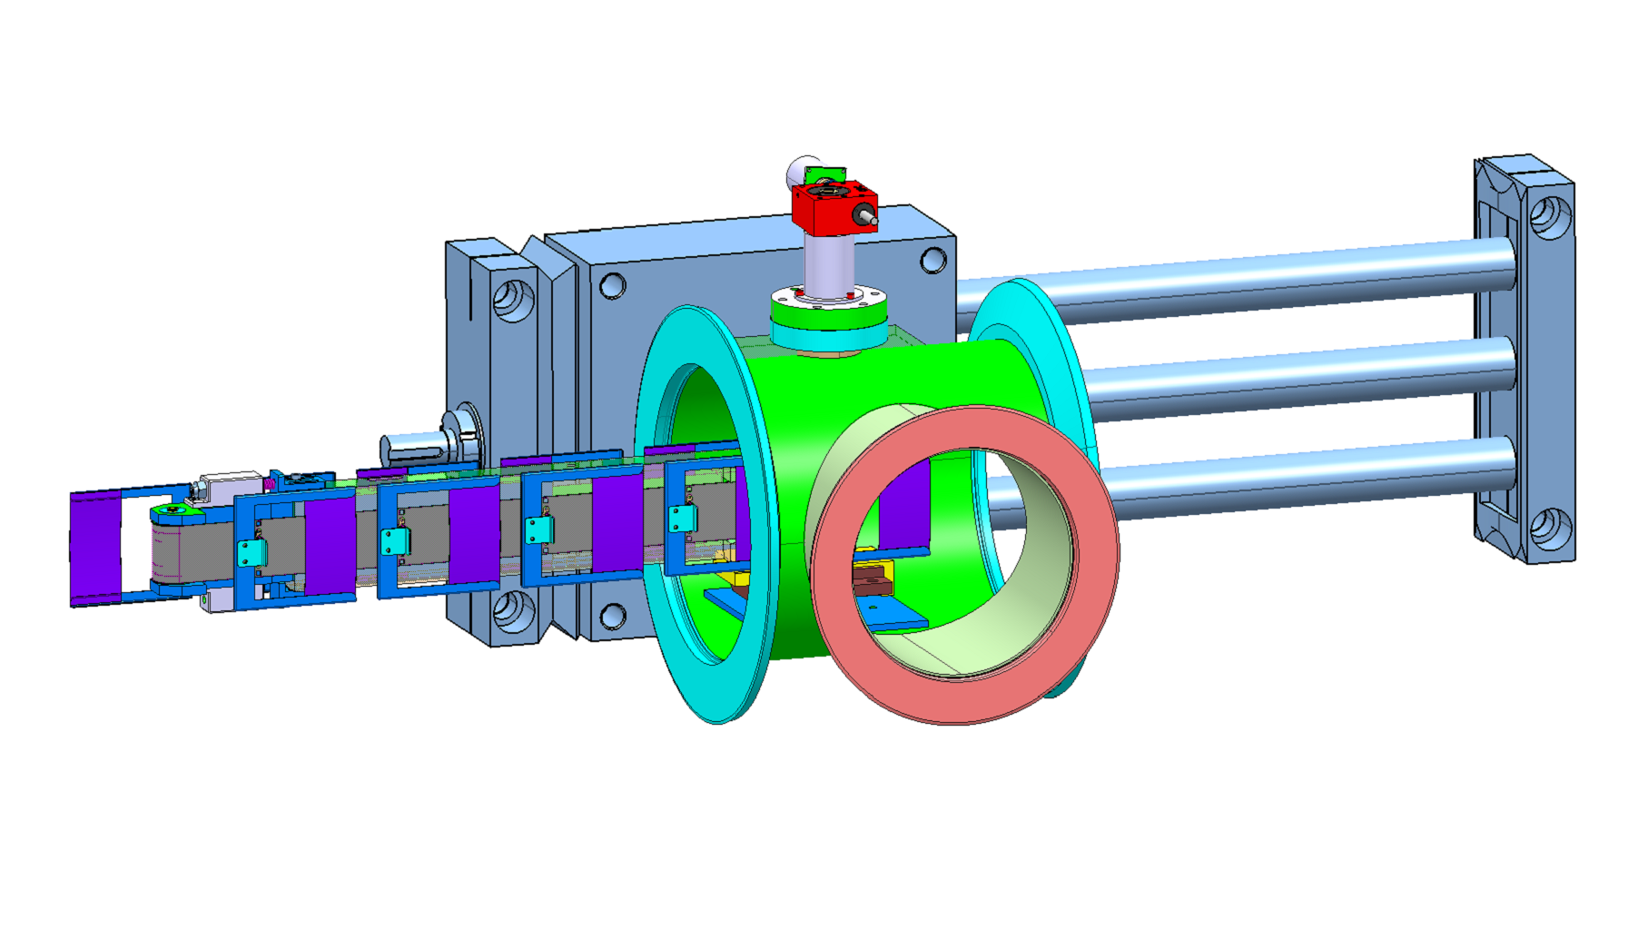
Foil positioning control
Radiation hard VSS25 Phytron stepping motor
0.45° step size, ~1160 steps/foil change
Horizontal movement:
260mm stroke, ±8mm rough injection adjustment
Radiation hard Yaskawa JKPM-9ZFG DC servo motor with reduction gear
Horizontal movement: 90mm stroke, ±2 mm fine adjustment, speed ~1mm/sec
4-10 foils / carrier

Slide 16
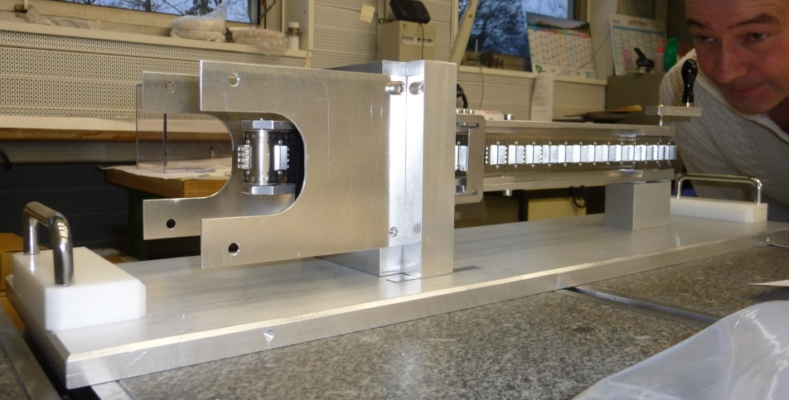
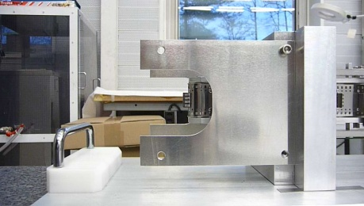
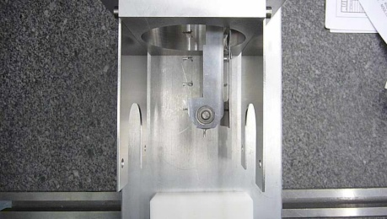
Prototype
NEC FS6 foil changer used in Pelletron® Systems
Simulating vacuum chamber walls and DN100 flanges
316 SST belt with riveted foil holder attachments

Slide 17
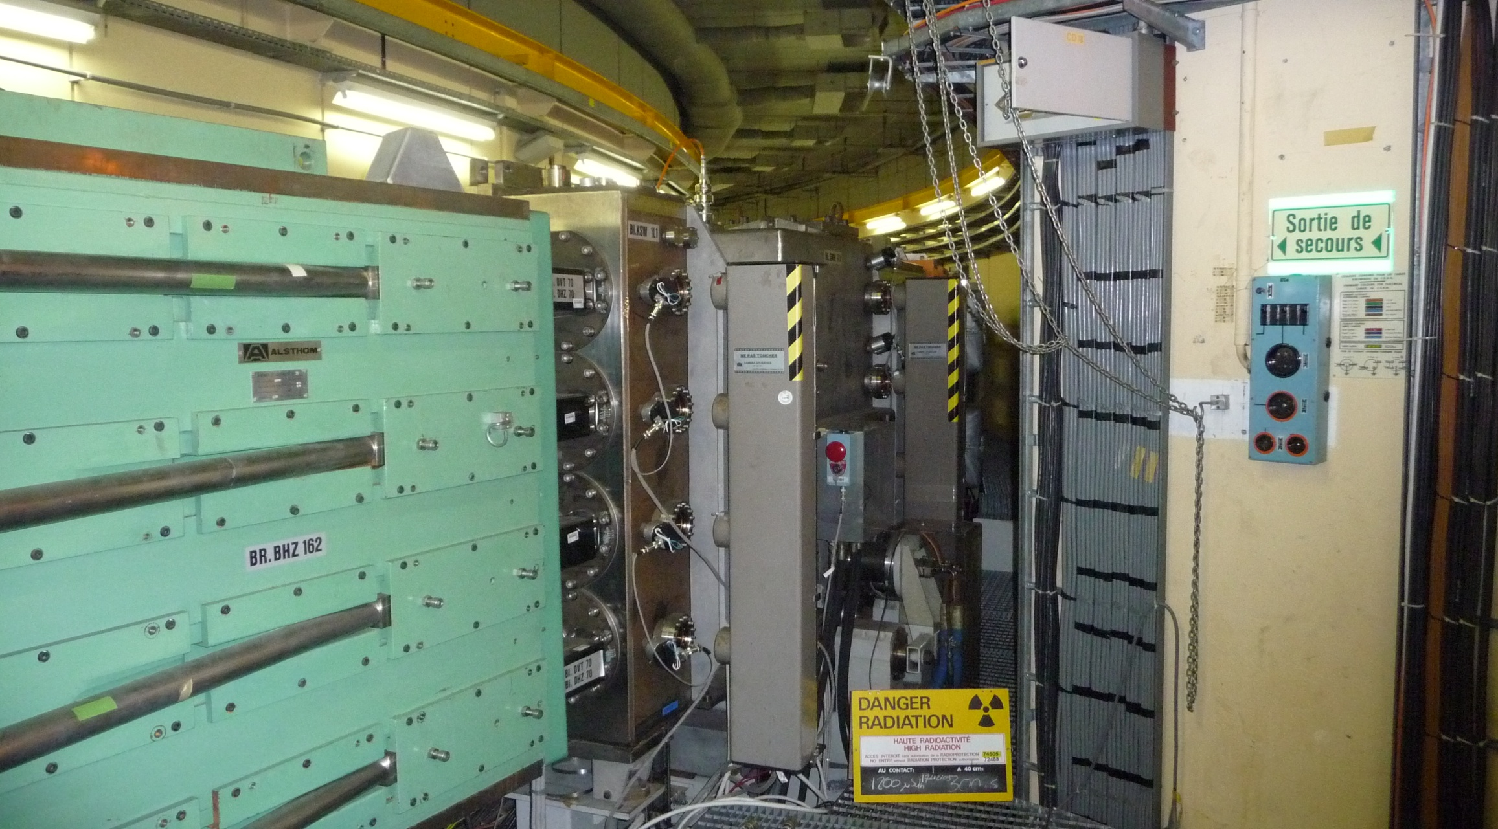
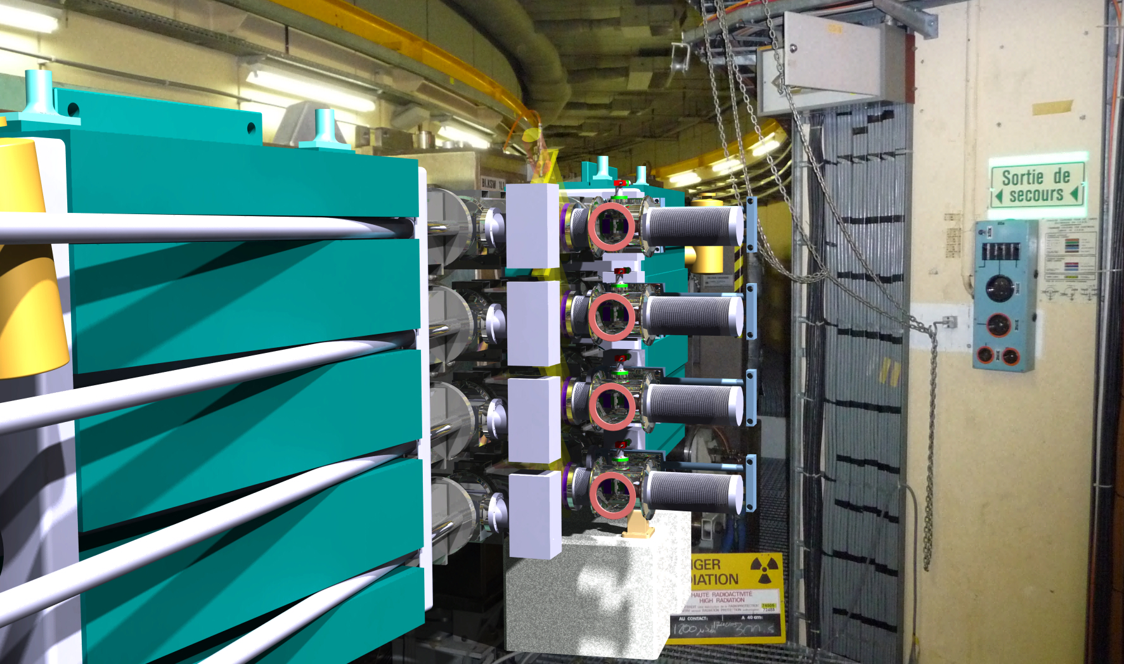
Space limitation - 1
Present Situation
Future Situation
Blocking of the passage acceptable ?
~20 cm

Slide 18
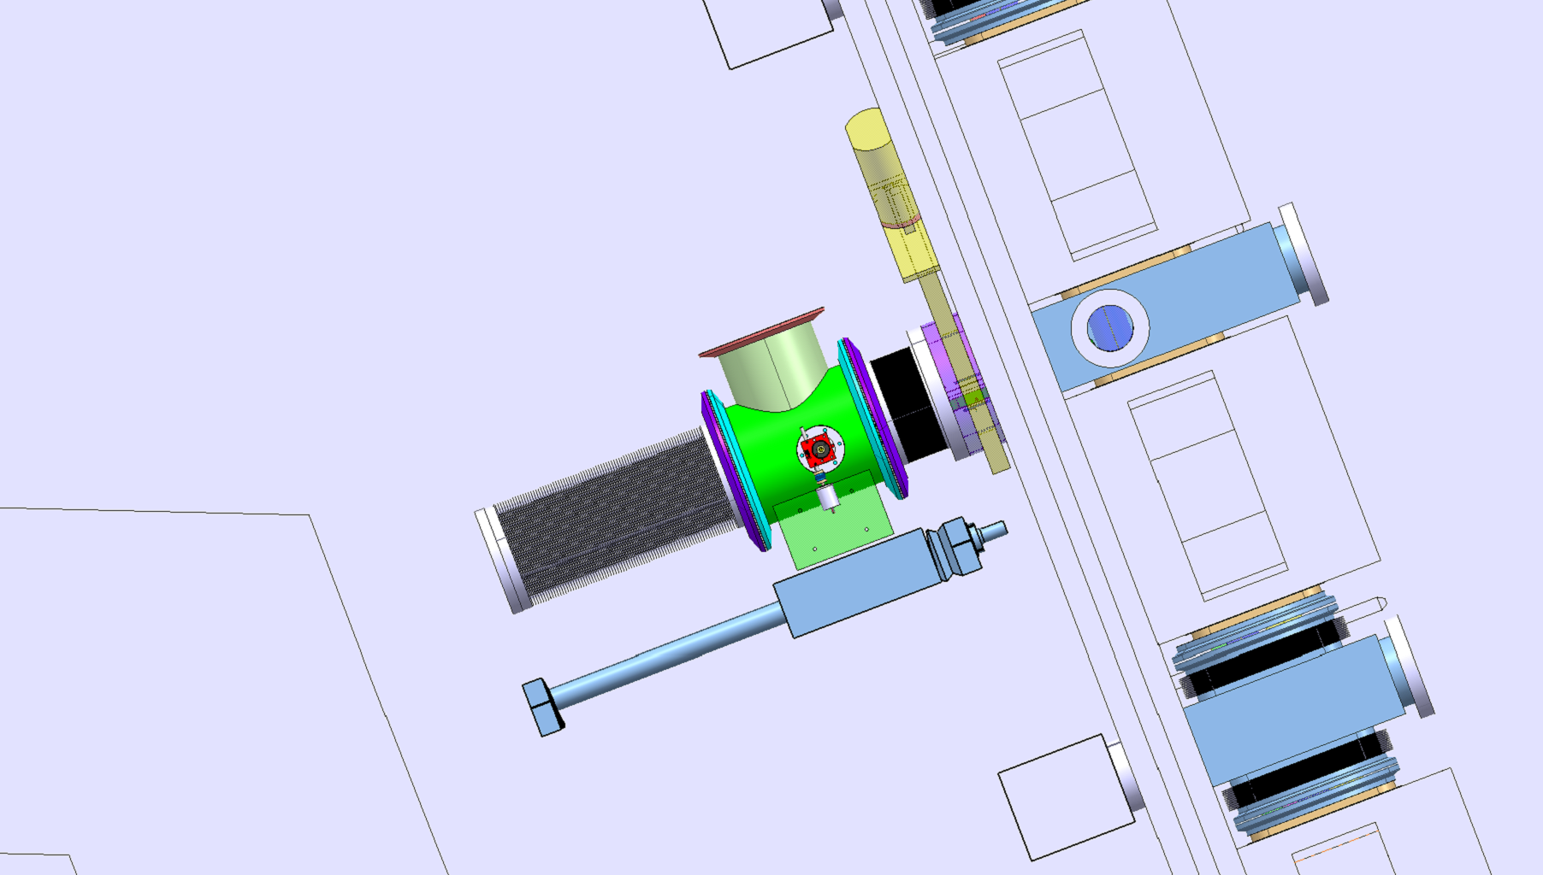
Space limitation - 2
Obstruction of the outside PSB passage.
Limited space for removal of complete foil mechanism.
Possibility to remove part of the wall to be discussed.
~20 cm

Slide 19
Summary & Outstanding issues
Stripping foil mechanism with 4-10 foils, replacement of single foils or complete system to be studied (ALARA).
How to recuperate damaged foils and debris inside the vacuum system.
Vacuum isolation system foreseen, but will valve shock damage foils? (manual or automatic valve)
Foil thickness < 200 µg/cm2, handling and foil fitting issues to be studied.
Prototype with ACF© and MicroMatter© DLC foils, other suggestions?
Guidance system to prevent bellows sagging to be studied.
Space between equipment and concrete wall tight.
Limited space for support structure (integration still to be studied).
Influence BSW2-3 leak field on foil performance (see talk J. Borburgh).

Slide 20
Thank you for your attention

