Slide 1
“Beam Losses”
Christian Carli PSB H⁻ Injection Review, 9th November 2011
Several topics more or less related to beam losses, a study still somewhat at the starting phase (resources)
Outline:
Beam Losses and Activation to be expected
  Losses to be expected (vague estimates)
  Activation at present and in future
PSB Acceptance and Apertures
  Smaller “BeamScope” Window
  Apertures and acceptance
Very preliminary study on Collimation
Injection steering
Summary and questions

Slide 2
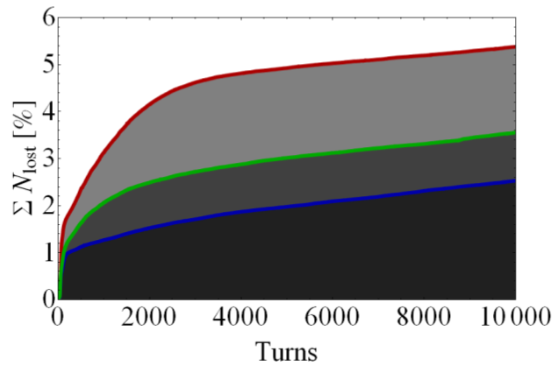
Losses to be expected – first 5 ms
Partially stripped and unstripped H⁰ and H⁻: 1% to 2 % (see previous presentations)
During injection and chicane fall: ~5% (from Diploma thesis of
M. Scholz)
  Perturbations of lattice
  due to new injection
  Compensation with additional
  quadrupolar components (trims
  on lattice quadrupoles)
    Blue: perfect compensation
    Green and red: too high
    (+10%) and too low (-10%)
    compensation settings
Accumulated versus number of times
(“slow” chicane with active compensation)

Slide 3
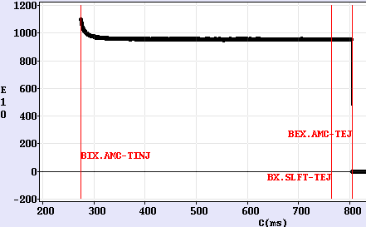
Losses to expected - extrapolations from present
Intensity
> 0.9 10¹³ protons
ejected
Circulating beam intensity as function of time for User NTOF (one high intensity bunch for the PS)
  About 15 % or 1.5 10¹² protons lost

Slide 4
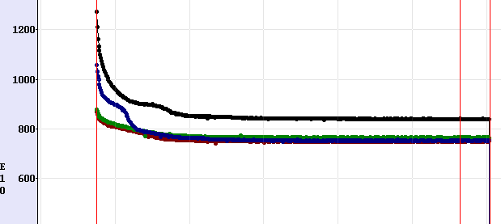
Losses to expected - extrapolations from present
Intensity
Intensity versus time for a high intensity cycle for ISOLDE
  Normal loss for the two rings with highest initial intensities?
  Say about 15 % of protons lost at low energy

Slide 5
Losses to expected - comparison with present
“Low energy” losses
  Losses at present with Linac2:
    For high intensity beams, about 55% of the protons from Linac2 are lost (most at injection at 50 MeV)
    Losses to generate one high intensity bunch with 10¹³ protons: 1.2 10¹³ protons
  Losses to be expected with Linac4 (from simple extrapolations)
    About 20 % (5 to 10% during injection and chicane fall plus 10 to 15% during low energy part)
    (disregarding effect of higher injection energy on
    Losses to generate one high intensity bunch with 1.6 10¹³ protons: 0.4 10¹³ protons
  Effect on activation assuming 10 times higher activation per lost proton at 160 MeV
    About a factor three more activation
“High energy” losses
  Linac4 aims at increasing the intensity by a bit less than a factor 2
  Larger energies with upgrade (2.0 GeV instead of 1.4 GeV)
  Expect a factor two more activation and integrated dose per year to equipment
Expect an increase of PSB activation and annual dose with Linac4

Slide 6
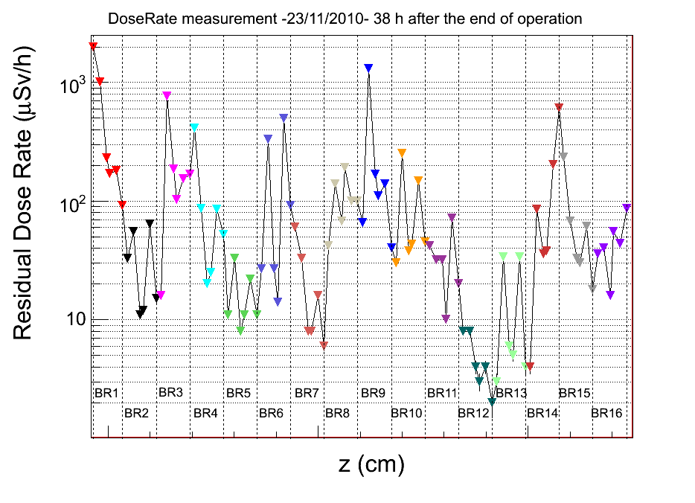
Beam Losses to be expected
SB Radiation Survey
on 23/11/2010 and
38 hours after the end
of operation
(M. Widorski)
Impact of Linac4 (apart
possible average increase)
  Reduction of the spike
  in section 1 (from conv.
  multiturn injection)
  Increase downstream
  from BeamScope window
  (possible shifted into
  section?)
“BeamScope” window
(determines PSB
aceptance)
Spike related
to “BeamScope”
BR.BHZ51
BR.QDE5
BR.BHZ52

Slide 7
  PSB Acceptance and Apertures -
  Smaller “BeamScope” Window
With 160 MeV injection energy, maximum normalized emittance possible at injection increased by almost a factor two
Aim with Linac4: similar normalized emittances available at ejection
  Is this still valid with a 2 GeV upgrade?
  (slight) decrease of physical emittance with higher energy
Decrease of the machine acceptance possible
  Installation of a window similar to “BeamScope” window
  Loss of large amplitude protons at low energy (less radiation and activation) and not after acceleration in the ejection channel
  Profit from larger acceptance in rest of the ring for a (rough) collimation system
  Injection foil less in machine acceptance after fall of injection painting bump (only chicane fall moves foil definitely out of acceptance)

Slide 8
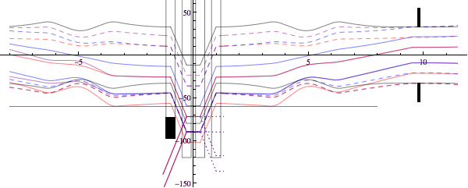
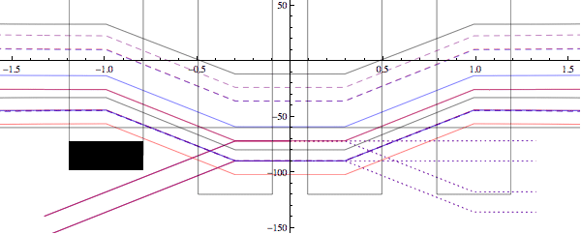
  PSB Acceptance and Apertures –
  Apertures and acceptance
D_{inj} = 0 m,
35 mm painting bump
Colors:
  Blue: Δp/p = -4.4 10⁻³
  violet: Δp/p = 0.0 10⁻³
  Red: Δp/p = 4.4 10⁻³
Solid lines: start of injection
Dashed: largest emittances for
given momentum offset
Black: maximum beam position
after painting bump fall

Slide 9
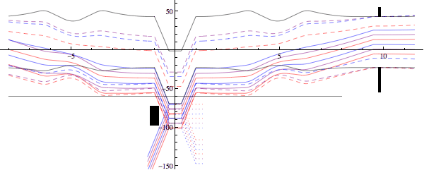
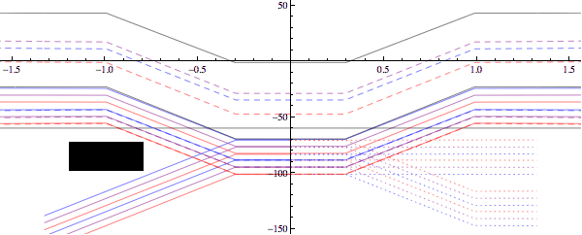
  PSB Acceptance and Apertures –
  Apertures and acceptance
D_{inj} = -1.4 m (matched),
50 mm painting bump,
window shifted by 10 mm
Colors:
  Blue: Δp/p = -4.4 10⁻³
  violet: Δp/p = 0.0 10⁻³
  Red: Δp/p = 4.4 10⁻³
Solid lines: start of injection
Dashed: largest emittances for
given momentum offset
Black: maximum beam position
after painting bump fall

Slide 10
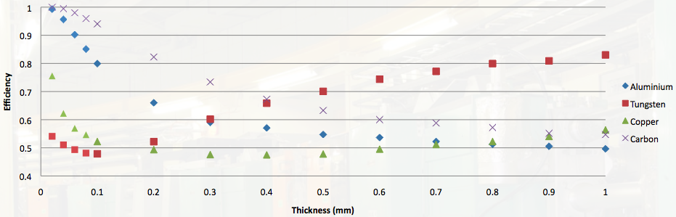
Very preliminary study on collimation
First investigations on collimation assuming (LHC like) multiturn approach (by doctoral student P. Jackson)
  Profit from acceptance margin; collimation may reduce PSB acceptance by almost a factor two
  Proton interacting with collimator still makes many turns and several interactions with collimation
  Efficiency (simplified model) for vertical loss at 160 MeV (from a presentation by P. Jackson)
  Very thin primary collimators (otherwise no multiturn behaviour), heating an issue
Around 1995, first study by T.Trenkler and H.Schonauer on single turn system
Study should start with better understanding of present situation
NO RESOURCES AVAILABLE SO FAR TO STUDY COLLIMATION IN PSB LINE AND RING
Absorption mainly after first
interaction (model realistic?) for high Z primary

Slide 11
PSB Injection Steering
Update of the study from 2008 taking voluntary offsets introduced since then into account
Principle
  Two steerers/plane and ring in last part of the line to adjust position and angle at the injection septum (individual for all four rings)
Shifting second dipole upstream increases deflections needed
Injection
(reference)
DHZ/DVT50
DHZ/DVT70
l₂
l₁

Slide 12
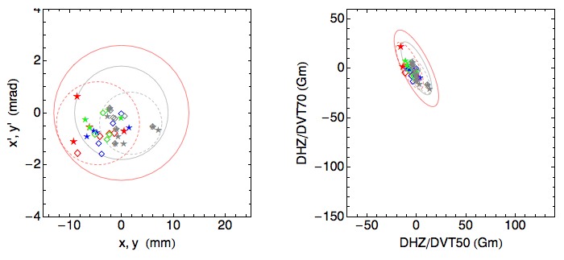
PSB Injection Steering:
Analysis of present situation
Currents programmed for DHZ/DVT 50 and 70 (for both planes, all four rings, different USERs, in 2008 and 2011) converted into position and angle
Scatter plots of position and angle (left) and integrated strengths (right)
  Data from 2008: different colour for USERs LHC25A , NORMGPS and LHCINDIV
  Data from 2011:
  Two USERS, all
  plotted in gray
  Stars and diamonds
  for horizontal and
  vertical plane
  (similar picture in
  both planes)
  Contours describe estimated tuning range required
    Up to ±12 mm and ±2.4 mrad (ratio is ~5m, i.e. the betatron function) around origin …
    Smaller contour (not used further) … if mean correction can be done upstream
  Required strength well below maximum possible strengths

Slide 13
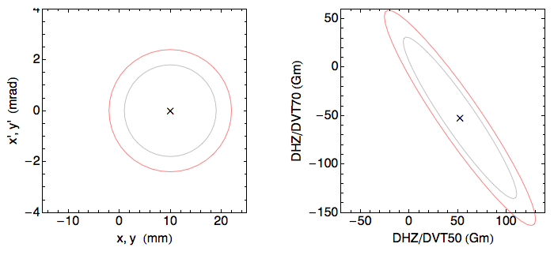
PSB Injection Steering:
Analysis Extrapolation to Linac4
Beam rigidity increased by a factor ~1.9
DHZ/DVT70 moved upstream by ~2 m (precise position to be determined)
  Assumption l_{D50} = 7.27 m and l_{D70} = 3.14 m
Offset of ~10 mm at the injection point required
  10 mm in horizontal with reference position of incoming beam moved towards PSB center
  Up to 10 mm in vertical to generate required emittance (no active painting)
Maximum strength of 130 Gm and 160 Gm to have some safety margin
  DHZ/DVT50 position further upstream increases required strengths

Slide 14
Summary and Questions
Many of the topics presented at a very preliminary stage (resources)
Preliminary estimates on machine activation and annual dose to be expected
  Increase (not dramatic) to be expected without mitigation measure
  Can losses be an issue for equipments (accumulated doses ..) and people (activation)?
PSB acceptance and apertures
  Machine acceptance reduction only a proposal
  Should we implement it?
  … would require a serious study and design (too late anyhow?)
Collimation
  Conclusion of very preliminary study: multiturn approach looks not feasible
  Priority/time-scale to study another scheme?
  ….. first understand present beam losses, then try to design a collimation system
  Study of collimation in the injection line?
  ….. discussed, but never studied, to protect sensible devices like
Injection steering
  New steerers to be constructed and installed
  Approach and requested strength appropriate?

