Slide 1
Davide Casarotto
28/08/2025

Slide 2
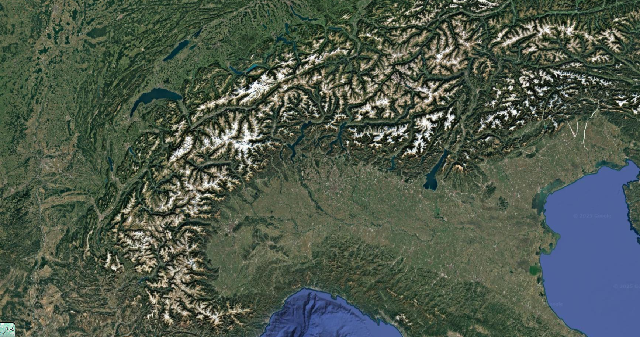
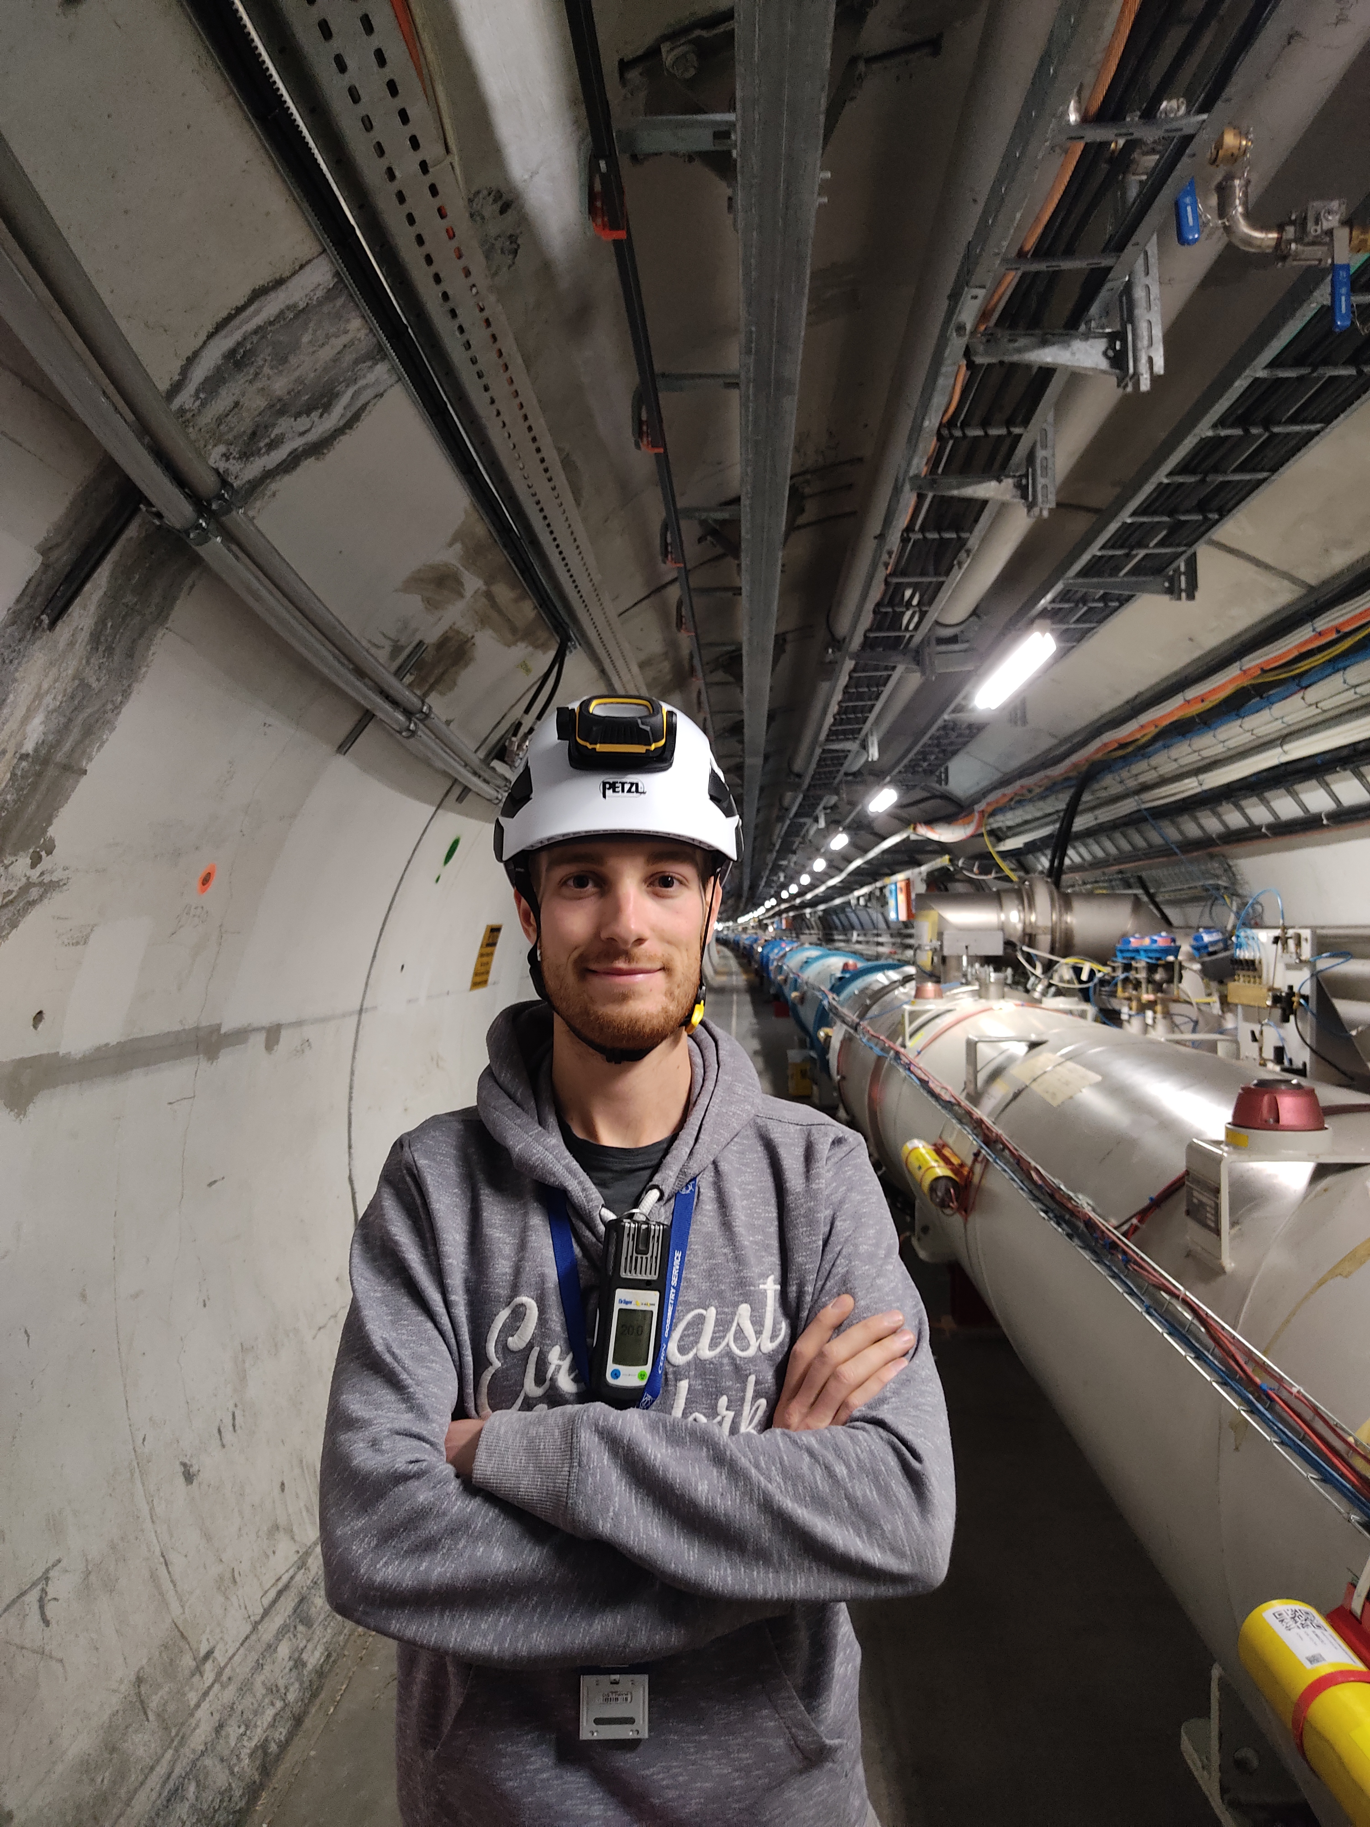
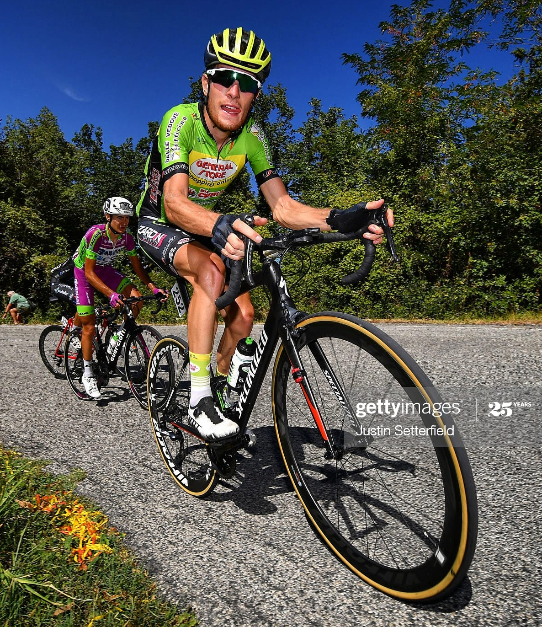
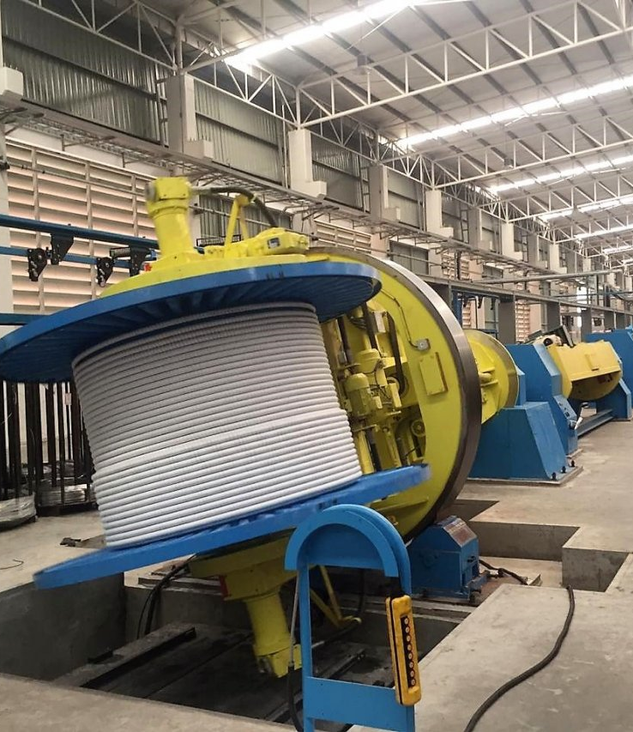
About me
CERN
(09/2022 - ongoing)
Geneva
Electrical Technical Diploma (09/2010 - 07/2016)
Verona
Vicenza
Professional cyclist
(2016 - 2020)
SPElettronica
(03/2021 - 08/2022)
Notes:
Vicenza small city where I had my technical studies

Slide 3
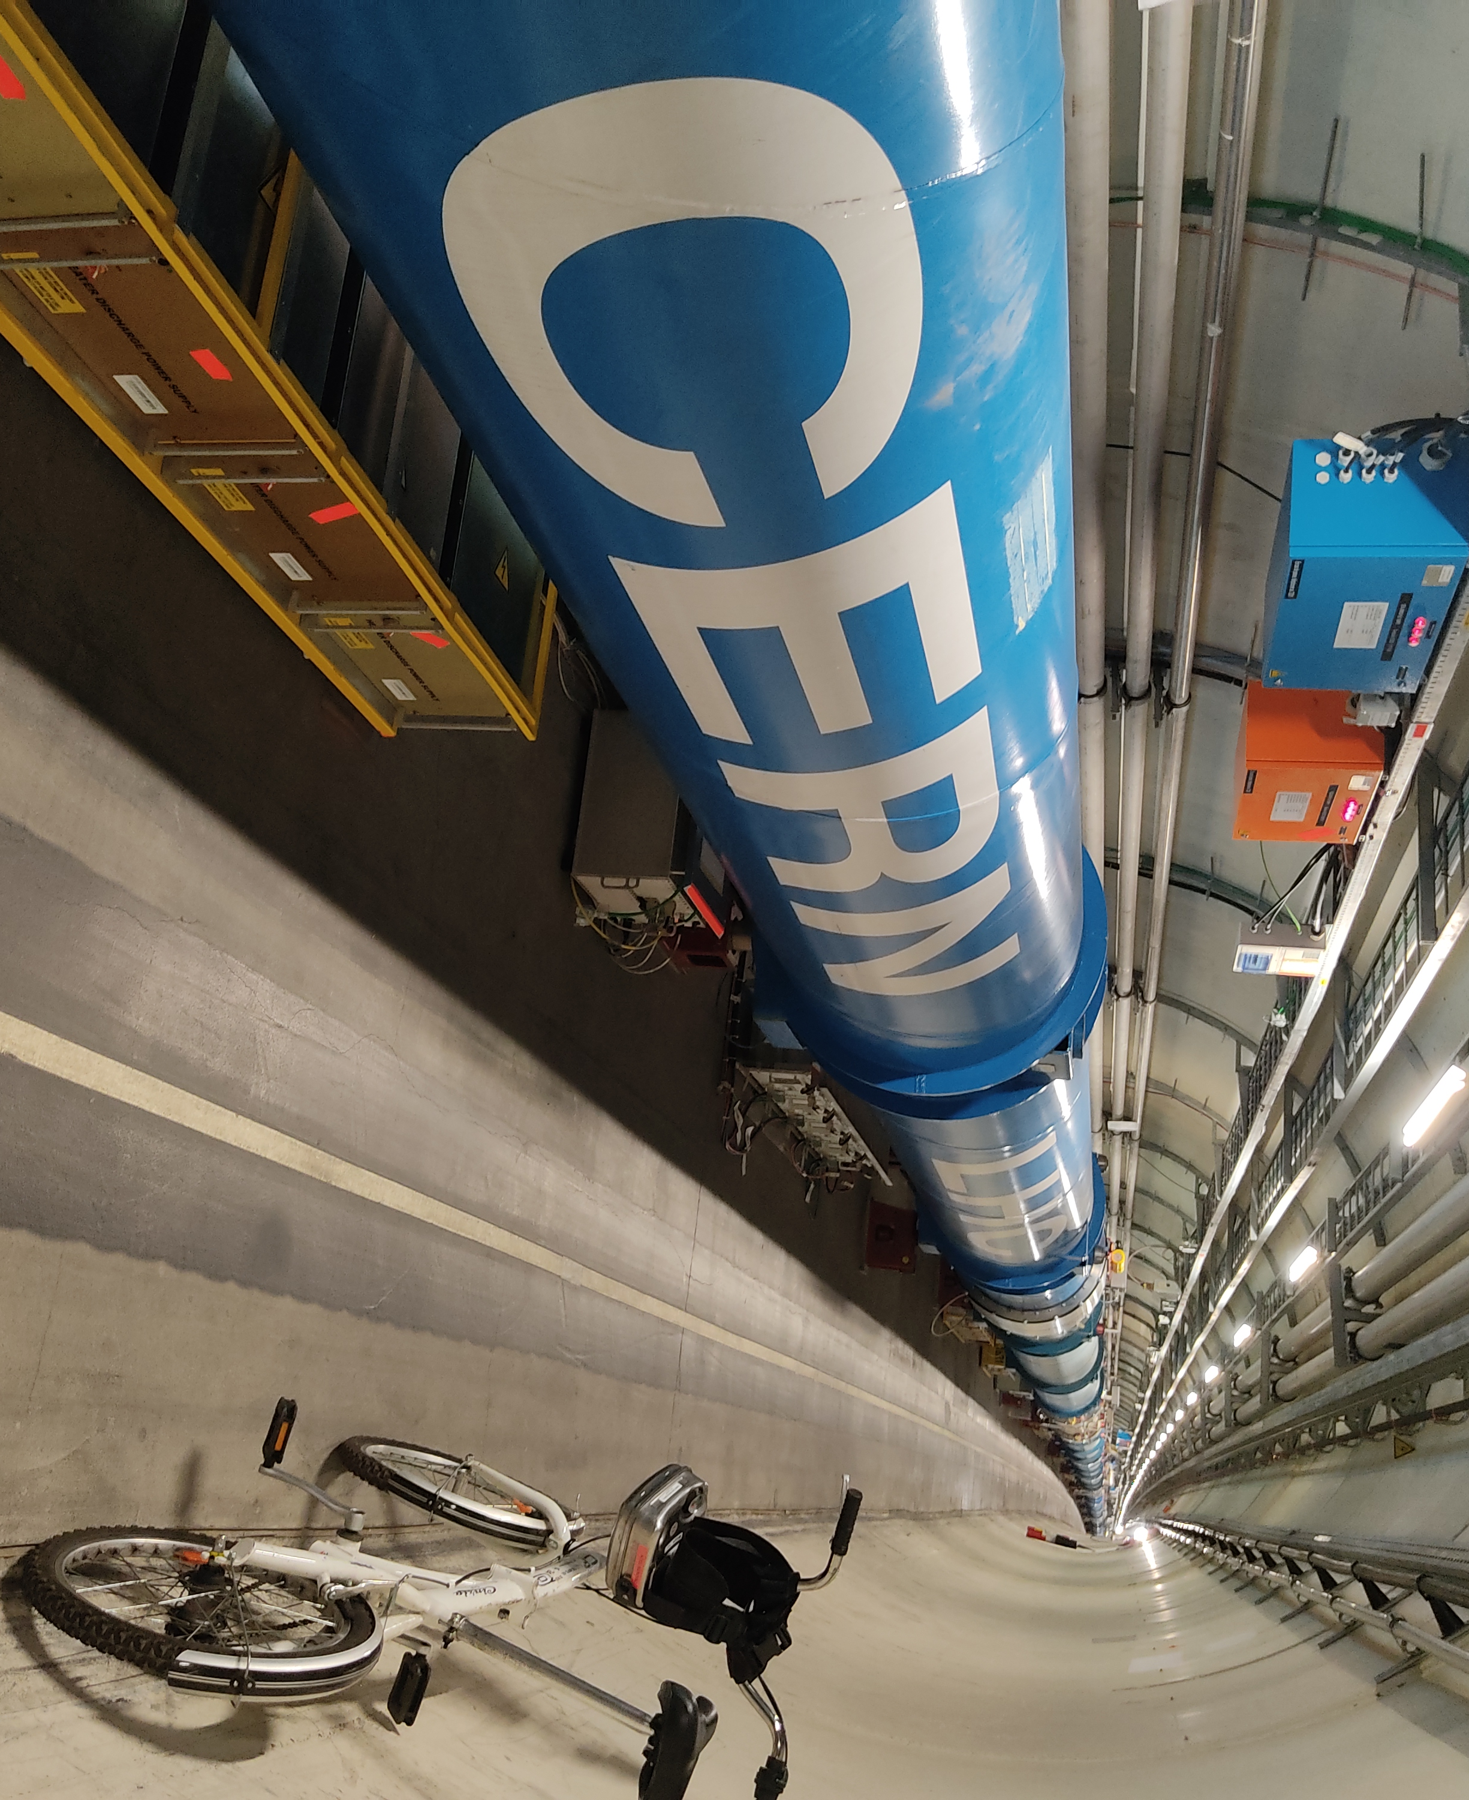
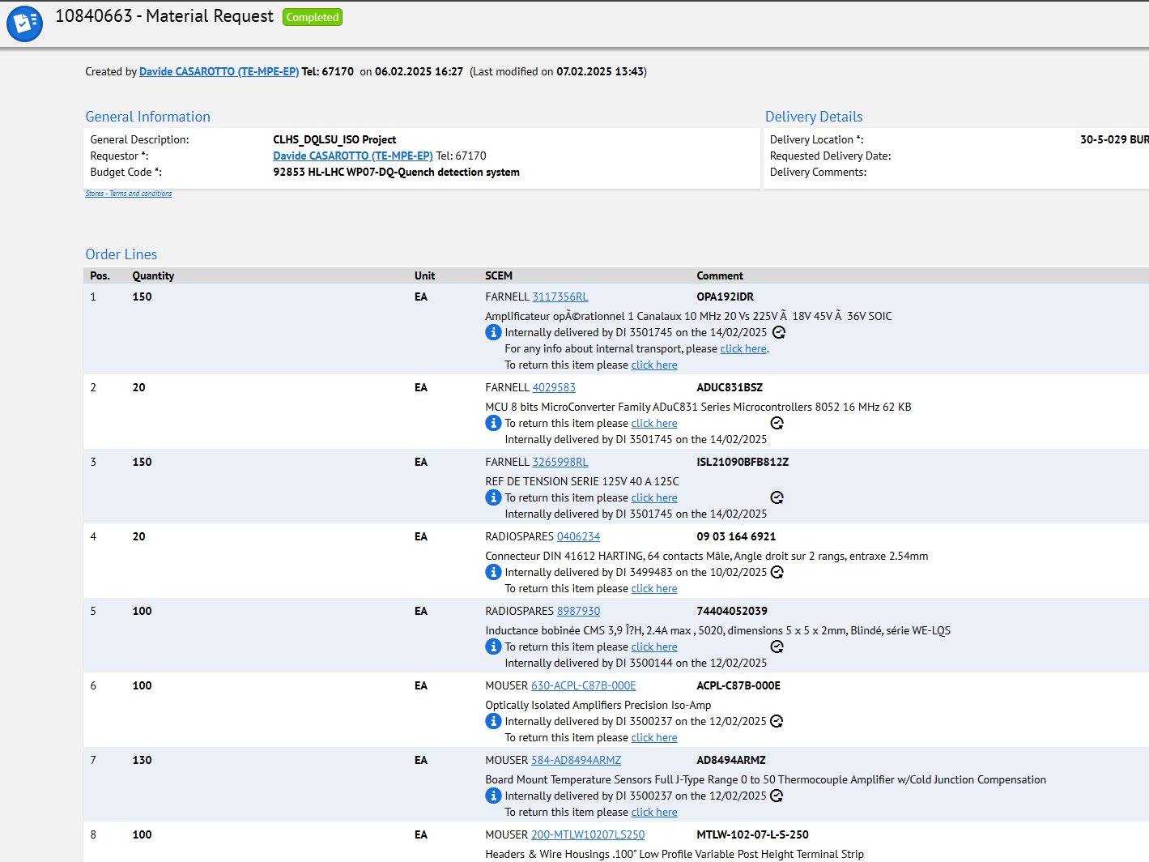
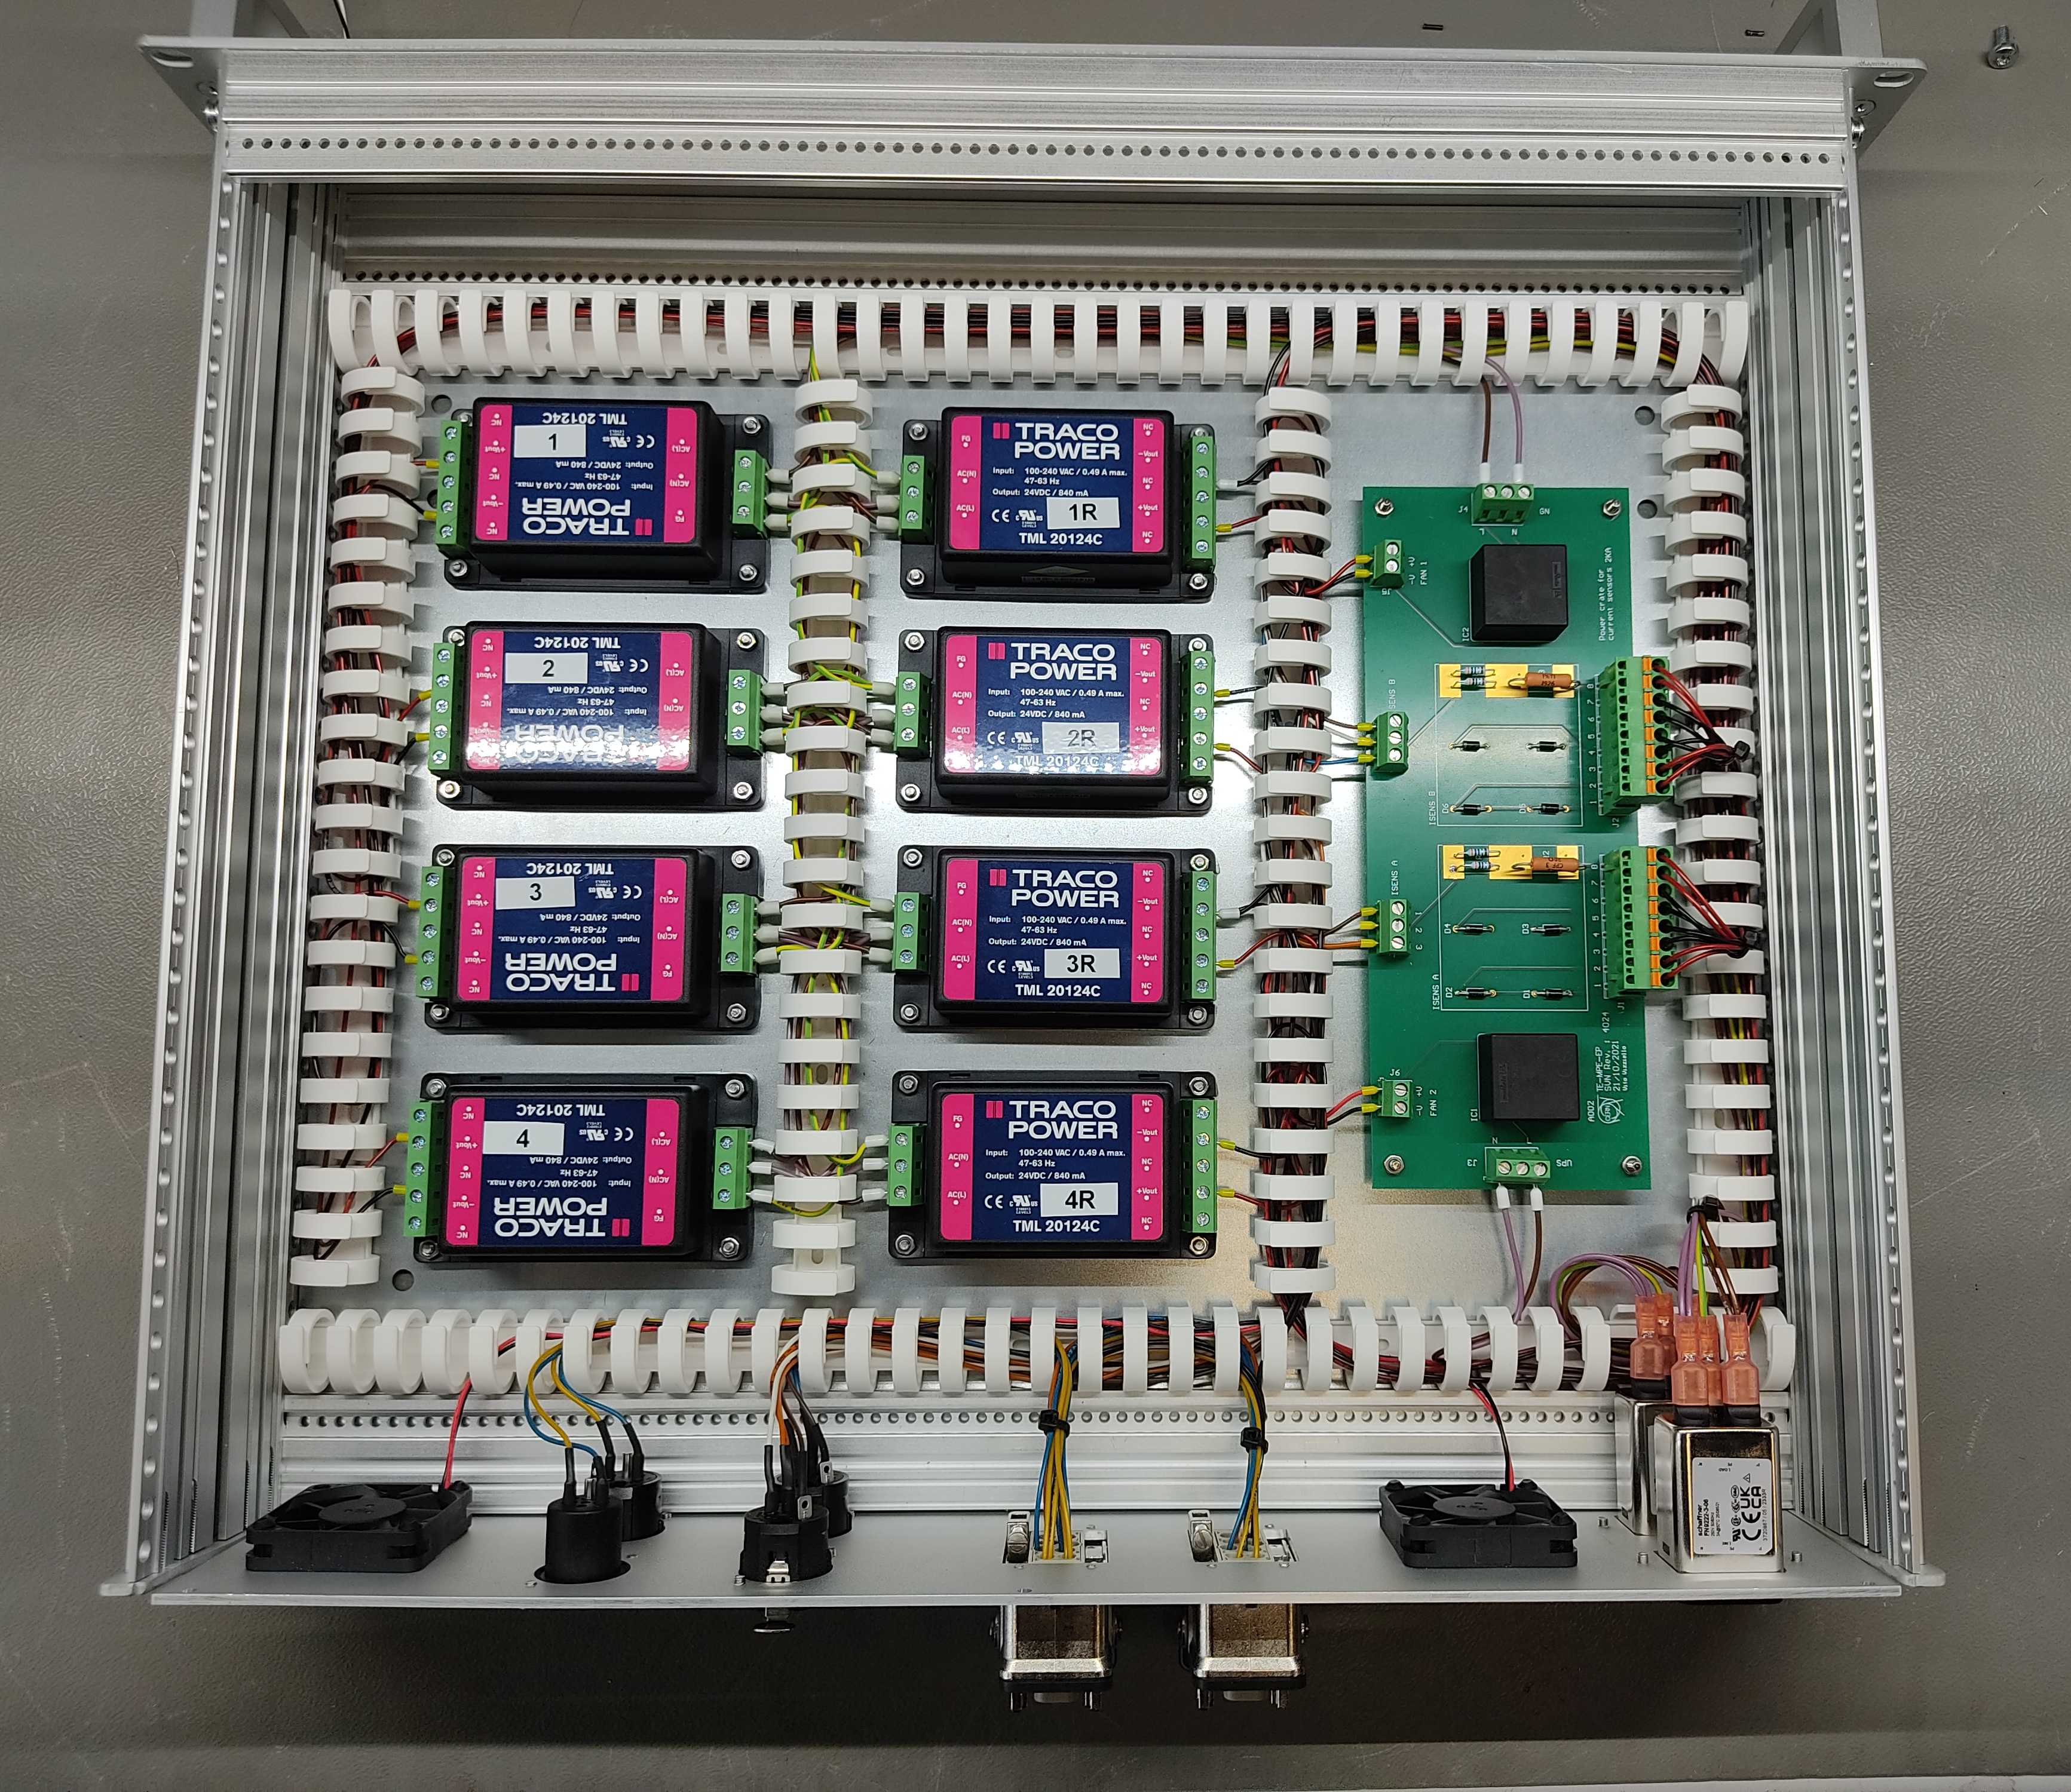
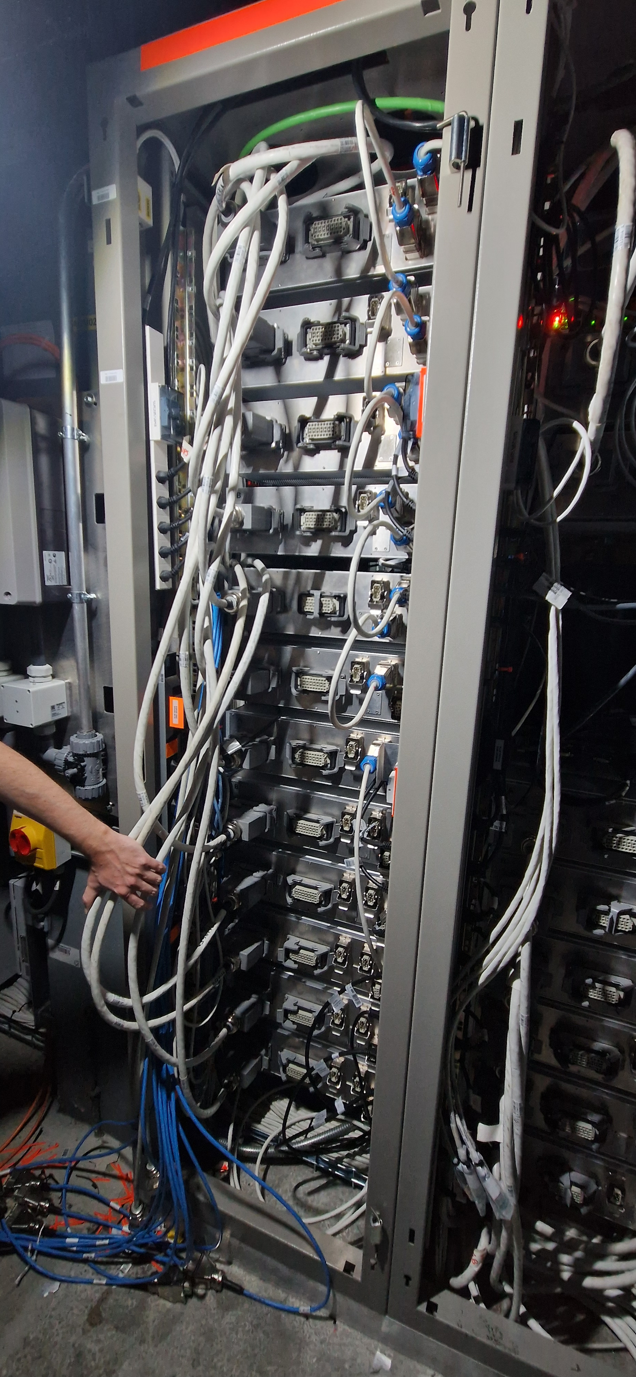
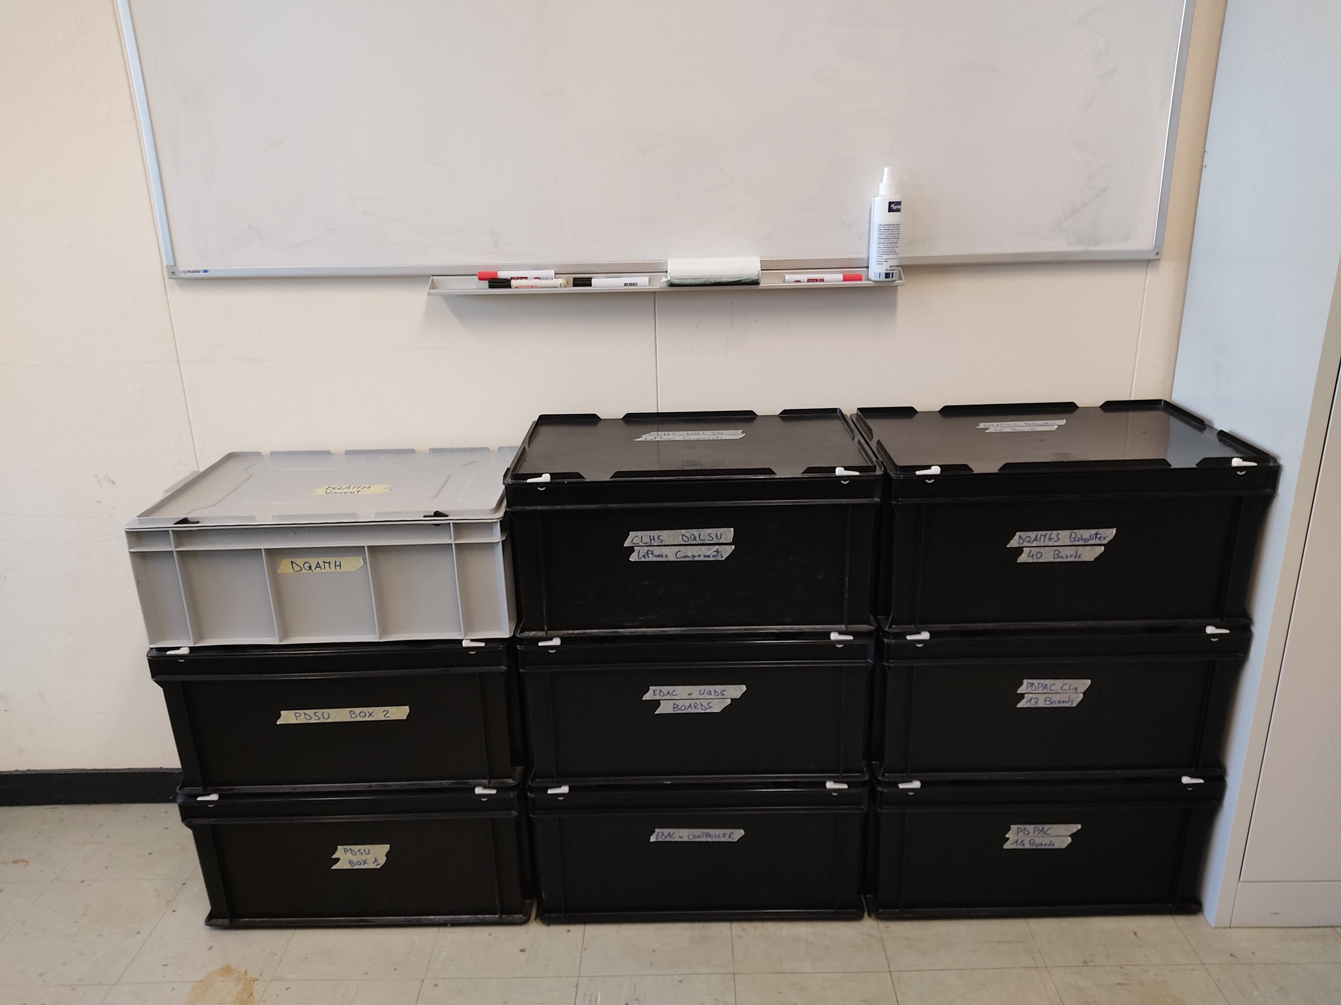
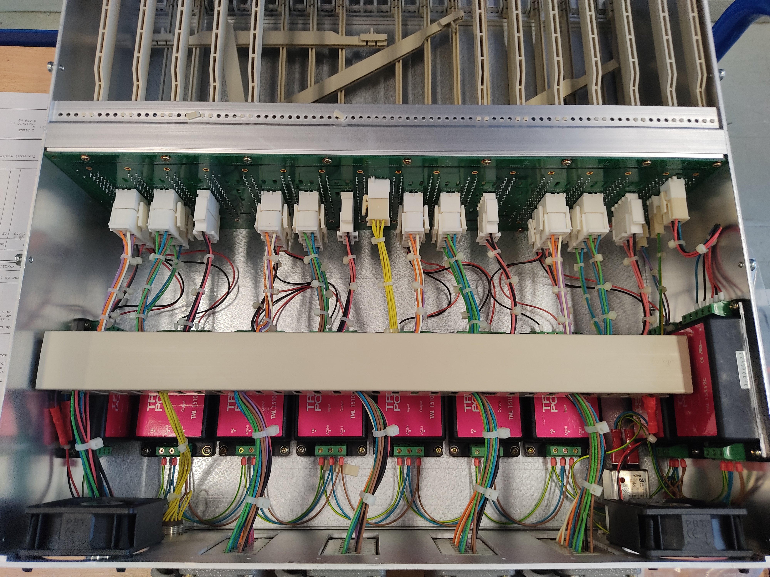
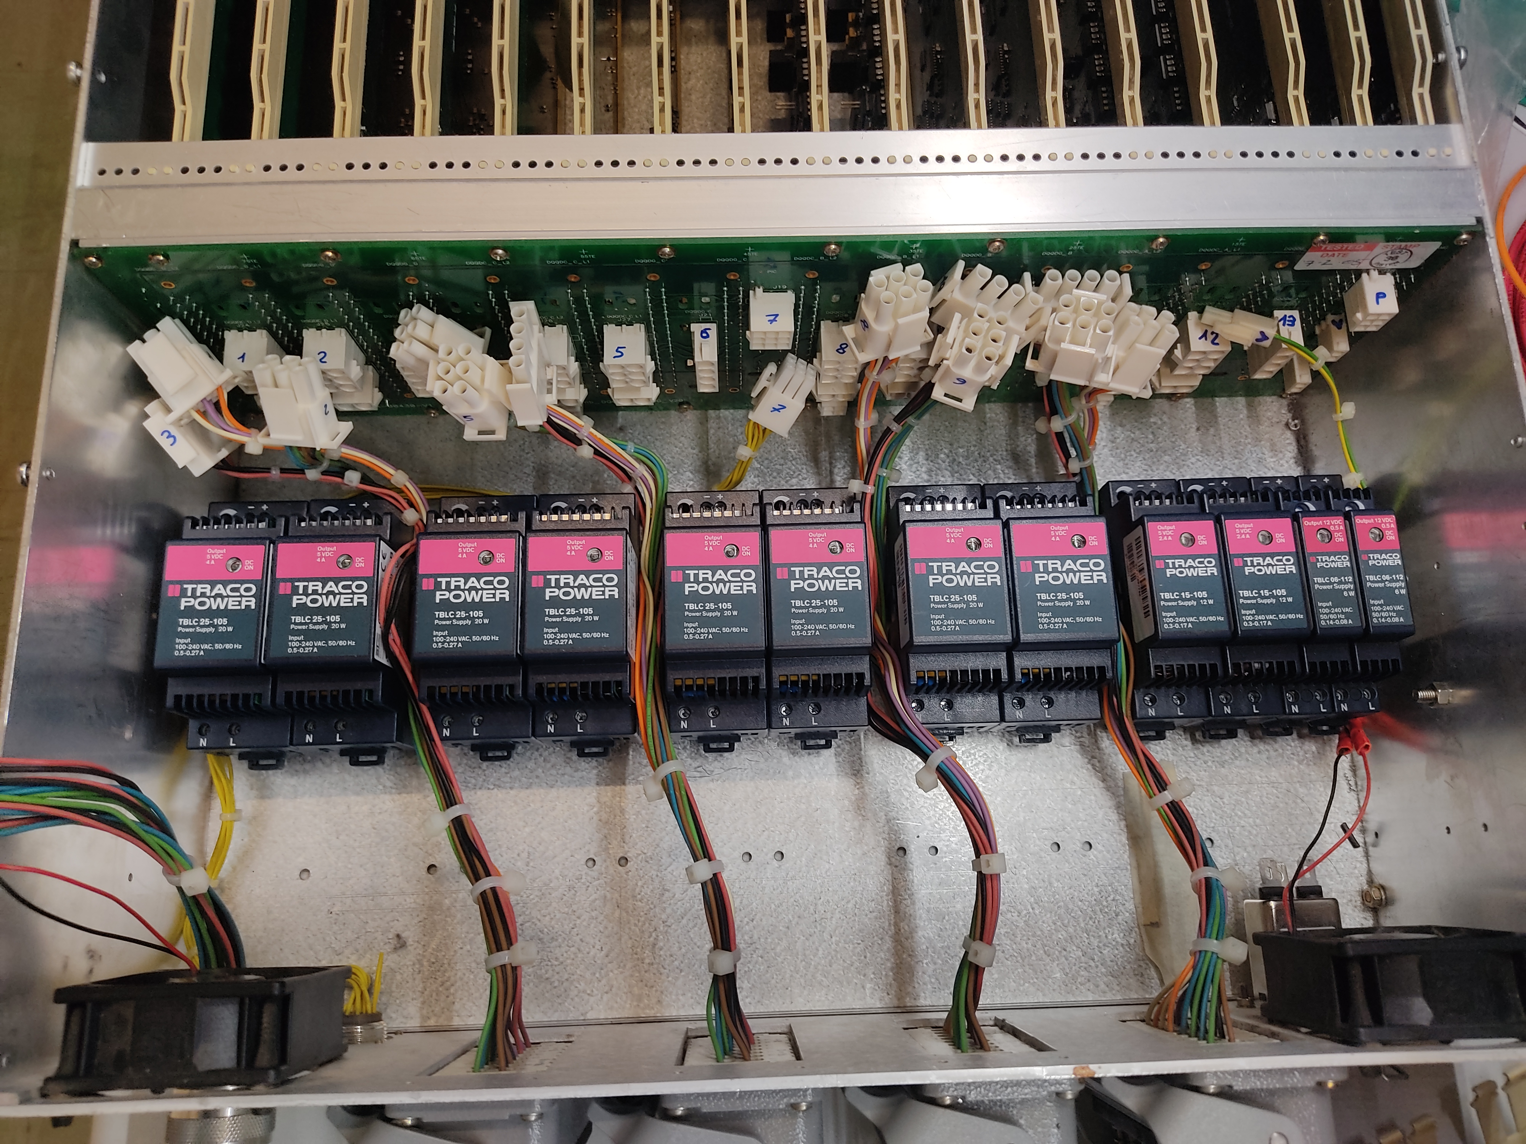
My fellowship at CERN
TTE Program in TE-MPE-EP from September 2022
Material purchasing and inventory management
Assembly and wiring of subrack crates
Assembly of SM18 test benches
Maintenance of electrical equipment installed in the LHC tunnel
Notes:
Other tasks I’m in charge of are:
Assembly and wiring of subrack crates
Preparation of cables and connectors
To finally assemble test benches
This specifically is the installations of ....
Aside, the team is taking care of the maintenance of electrical equipement
In this project specifically I had to

Slide 4
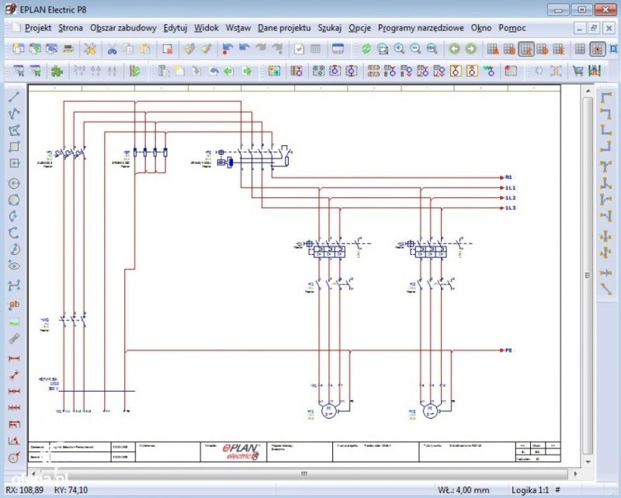
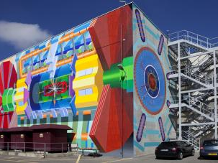
CERN: Gas Team
Starting from September 1st I will join the Gas Team in EP-DT-FS
Main roles:
Taking care of the electrical development of the Gas Systems, both LHC and not
Operation and maintenance of ATLAS Gas System
Notes:
Other additional skills I have acquired during my time at cern are:
Soldering of PCBs at the microscope
Mechanical processing of prototypes pieces in the workshop
The design of back panels based on electrical drawings
Intervention in the tunnels

Slide 5
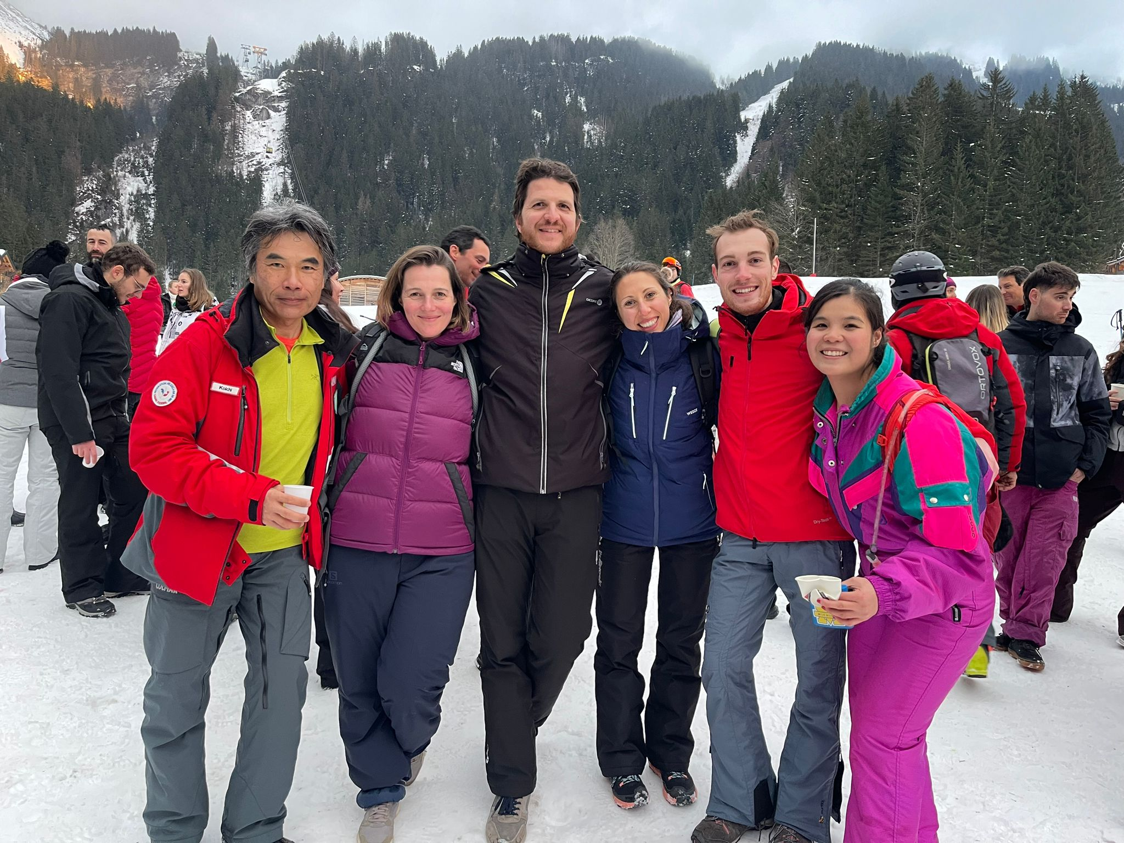
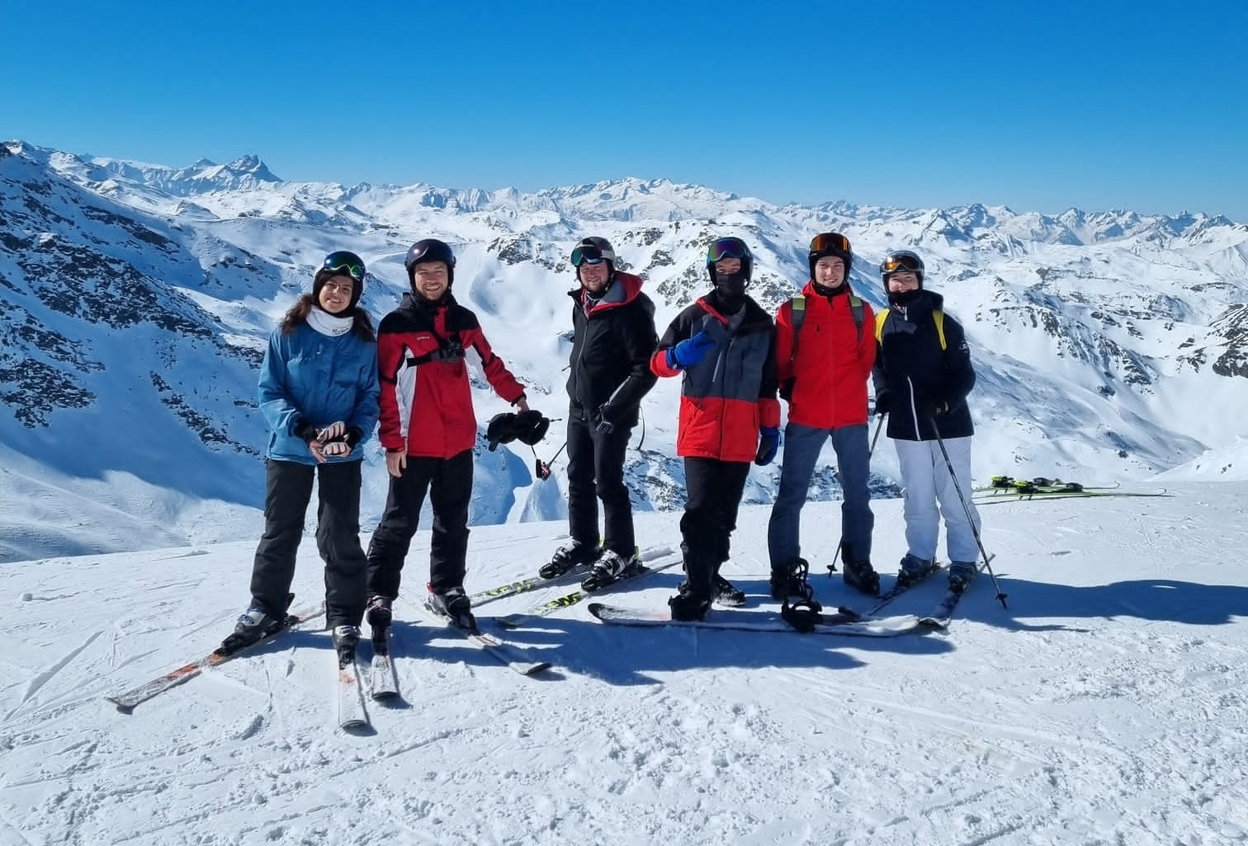
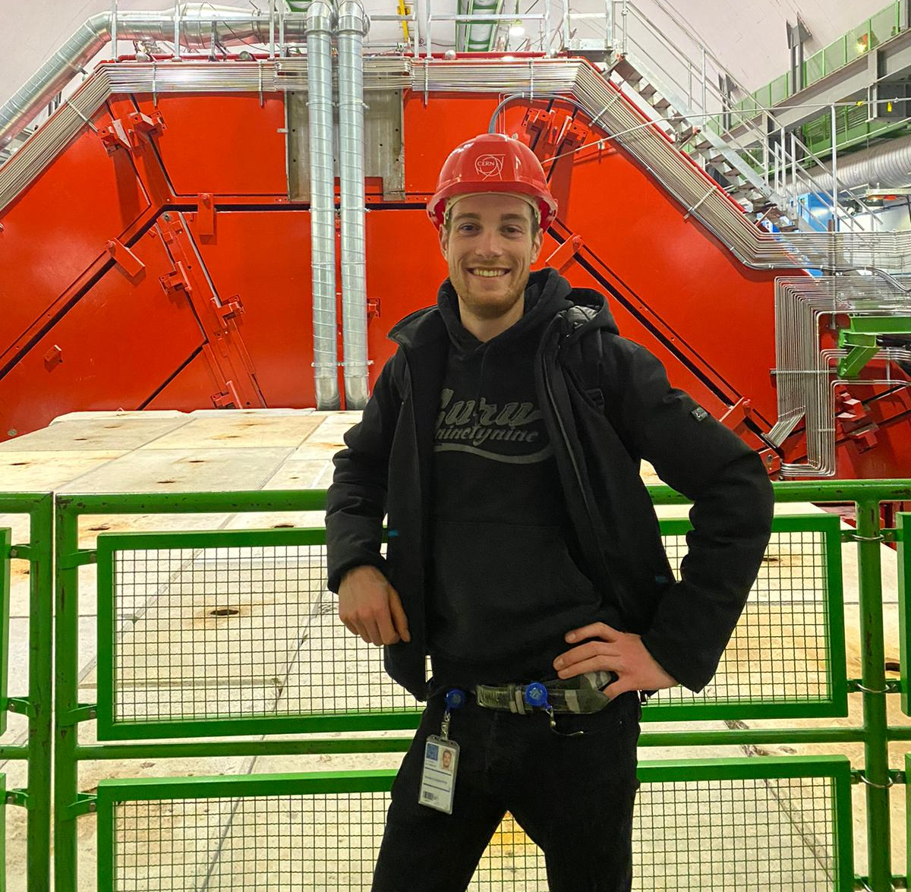
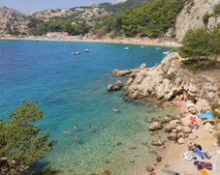
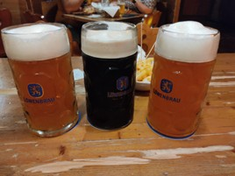
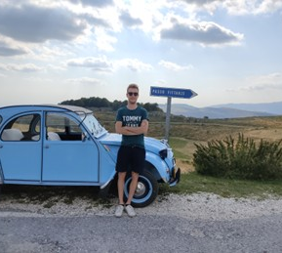
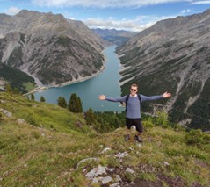
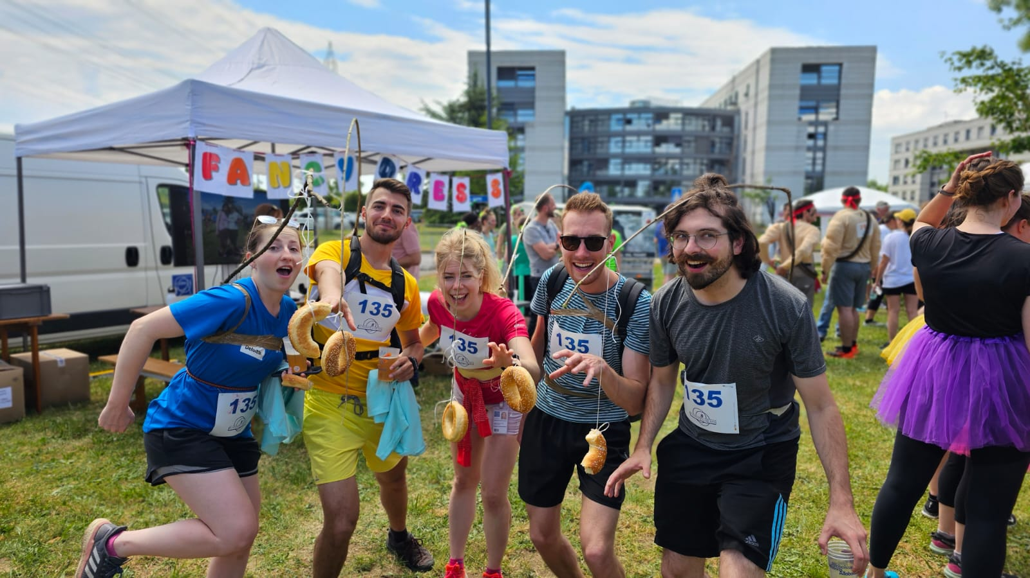
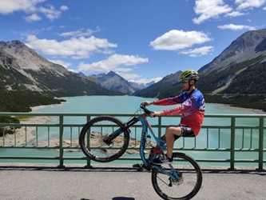
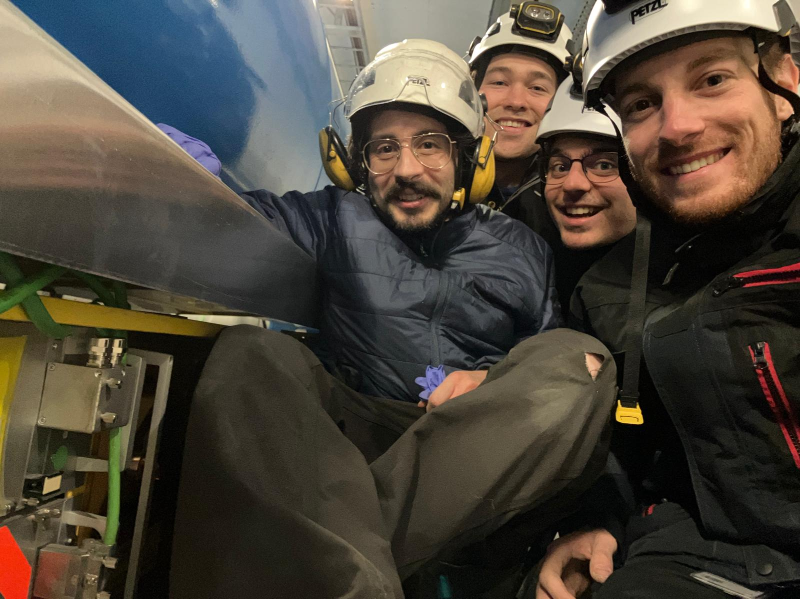
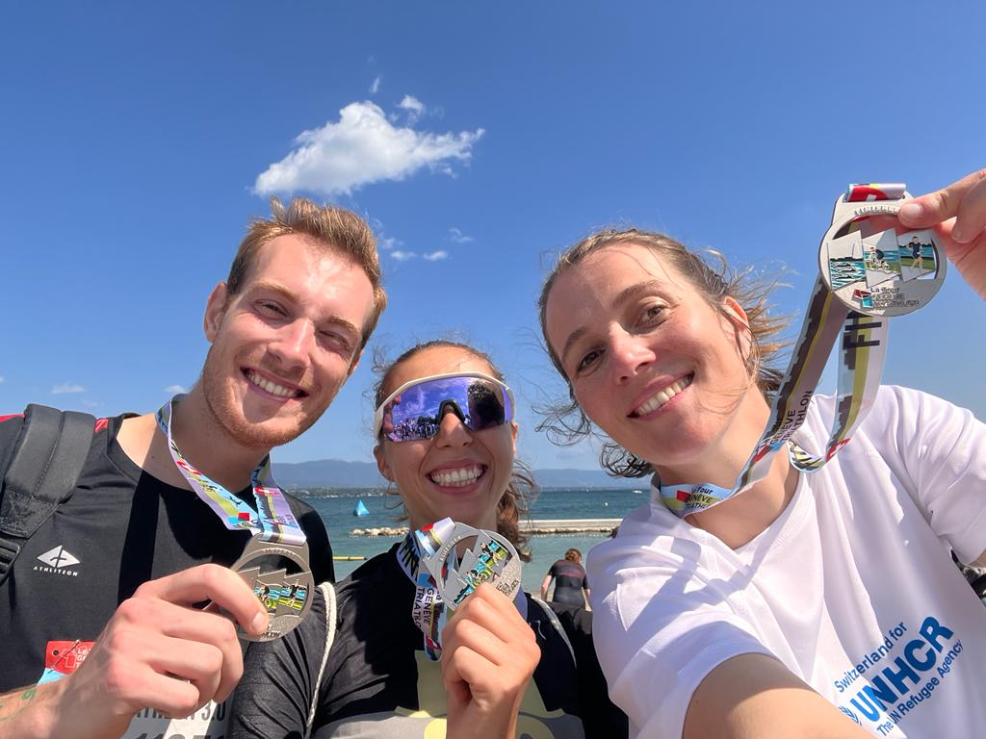
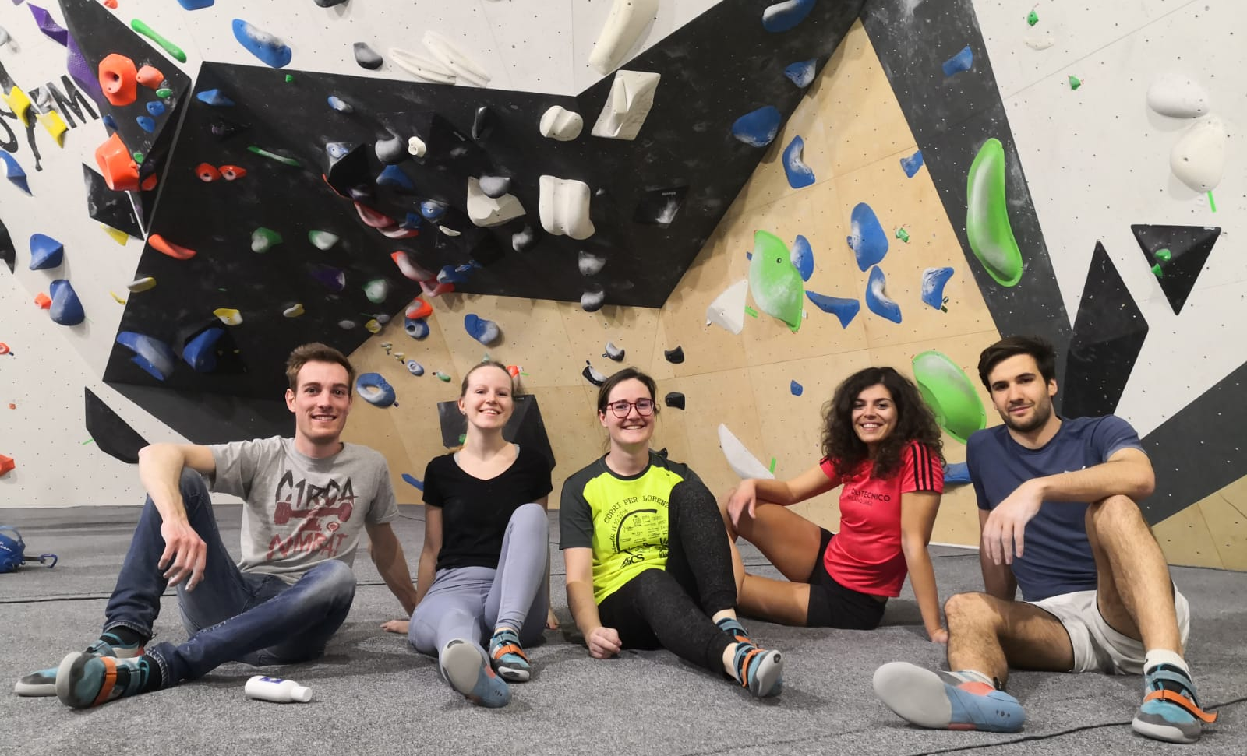
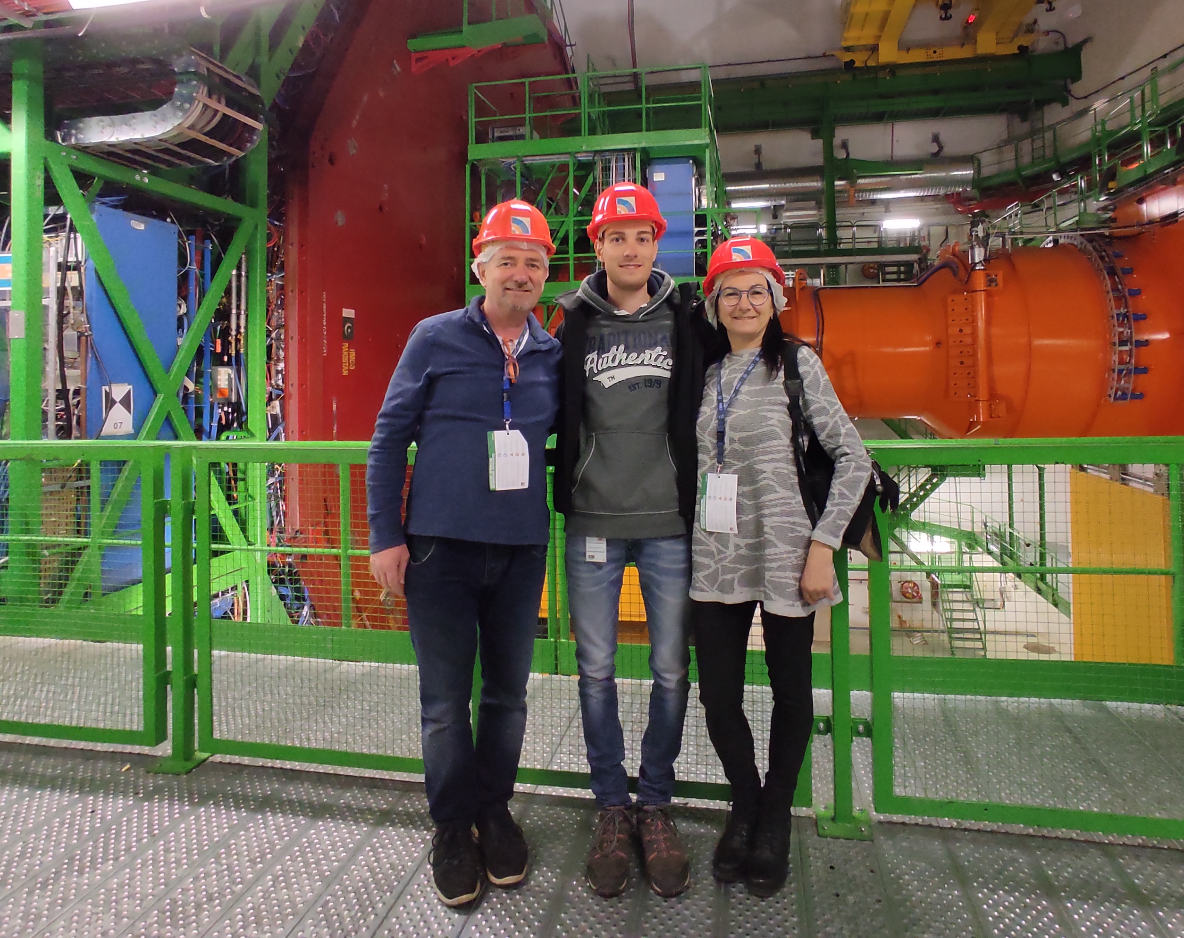
Outside CERN
Notes:
I really liked my experience at CERN so far , the last 3 years have been amazing
I really love be part CERN comunity and to
As you can see I’m active part of numerous clubs and I love to partecipate to the activities the CERN propose!

Slide 6
Thank you for your attention!

