Slide 1


UK Work on the Supplier Database
Hugh Alabaster
Notes:
The abstract pattern can be removed or repositioned if required. Be careful to ‘Send to Back’ so that it does not obscure any important information.

Slide 2

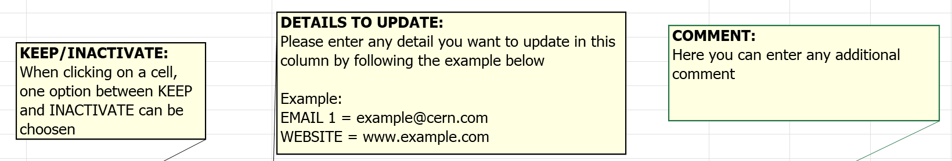
Overview
CERN requested an update of the database, moving firms into a ‘Keep’ or ‘Inactivate’ column and updating contact details.
~ 3,500 UK firms on CERN’s database. Initial project concerned ~900 firms.
This plan is carried out on CERN’s behalf. Ultimately, it is CERN’s project.
UK ILO team agreed to ask firms to update their own records and to pass final recommendations to CERN to act on.

Slide 3
Basic Plan
CERN database cross-referenced with internal UK database
Firms divided and allocated in blocks within the ILO Team.
ILO team contact weekly quota of firms using template email.
Firms responding positively automatically put in the “keep” column. Any relevant details updated on the internal spreadsheet.
Non-responsive firms contacted over the phone where possible.
Review on completion in team meeting.
Relay responses and discuss with CERN.

Slide 4
Work Allocation
Proposed allocation and target for initial contact:
  HA – 40%, 40 per week / 160 per month
  JP – 20%, 20 per week / 80 per month
  SF – 20%, 20 per week / 80 per month
  RF – 10%, 10 per week / 40 per month
  AS – 10%, 10 per week / 40 per month

Slide 5
Project Timeline
Project Start
Follow-up contact complete
Final team review
Initial contact complete
Project close
May 2025
July 2025
August 2025
August 2025
September 2025

Slide 6
Results – Response rates
Total firms contacted: 877
Bounce-backs: 37 (4.2%)
Requested to be removed: 6 (0.7%)
Company not applicable (not-UK, no longer exists, etc.): 25 (2.9%)
Confirmed updated details: 311 (35.5%)
No response: 498 (56.8%)
CERN confirmed ~260 updated details in Q2/Q3 2025

Slide 7
Analysis / Reflection
Overall, the initial project was a resounding success.
Response rates were higher than expected (threshold of 20%)
Effort in sending/receiving emails was manageable, but individual follow-ups and enquiries was more effort-intensive.
Productive for both the UK and CERN.

Slide 8
Next Steps
Circulate final list to team for comment and approval (including recommendations/suggested actions.)
Send list with recommendations to CERN.
Host meeting with CERN to verify all are happy.
Consider work on full database (~3500 UK firms) starting with kick-off meeting.

