Slide 1
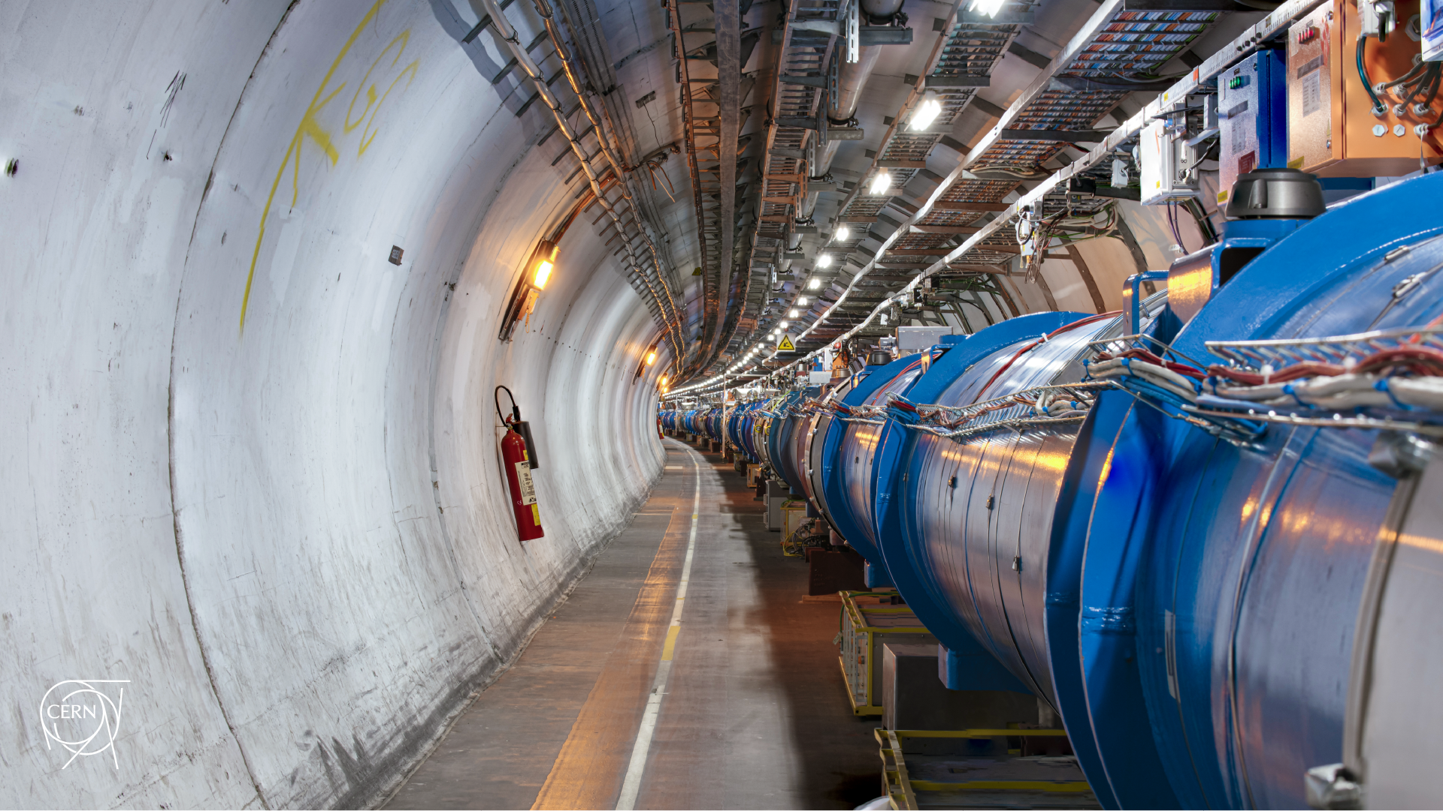
Updated procedure for MD15209: IR3 operational losses limit
D. Mirarchi, A. Butterworth, R. Bruce, P. Hermes, B. Karlsen, A. Lechner, S. Morales, S. Redaelli, B. Salvachua, M. Solfaroli, K. Taylor, H. Timko, J. Wenninger

Slide 2
Introduction
Two main updates w.r.t. what presented before MD1:
Only partial scraping will be performed to avoid triggering BPM interlock on bunch intensity
Main implication: more bunches than the initially planned need to be injected
Initial estimation: full scraping of 20 bunches of 1.6e11 p sufficient to get 200 kW power loss
Updated estimation:
Scraping down to 1 σ of 54 bunches of 1.6e11 p, or with 28 bunches if scraping down to 0.5 σ, to ultimate target of 200 kW power loss
Scraping down to 1 σ of 136 bunches of 1.6e11 p, or with 70 bunches if scraping down to 0.5 σ, to ultimate target of 500 kW power loss
Injection of trains needed to have an efficient filling
Main change w.r.t. initial request: possibility to inject Nx36b trains (no specific filling scheme needed)

Slide 3
Preparation (no changes w.r.t. MD1)
IR6 BPM interlock:
A momentum cut of ~3.5e-3 dp/p is performed by TCP.3: full scraping achieved with a max RF trim of ~480 Hz
An interlock window of 3.5 mm around local orbit at BPM.6 is present
A max D_{x} of about -70 cm is present at BPMSI.B4R6.B1: max orbit drift of ~2.5 mm is expected with 500 Hz
No changes on BPM.6 interlock window is necessary
Max RF offset interlock:
Interlock on max RF offset are normally to ±100Hz and must be increased as indicated below:
Device | Nominal | MD
ALLVTUFCCGB1/RFMeasurementMode#rfmmLowBoundOffs | 20 | 420
ALLVTUFCCGB1/RFMeasurementMode#rfmmUpBoundOffs | 180 | 580
ALLVTUFCCGB2/RFMeasurementMode#rfmmLowBoundOffs | 20 | 420
ALLVTUFCCGB2/RFMeasurementMode#rfmmUpBoundOffs | 180 | 580
BLMs:
Dedicated threshold will be deployed just before the MD
Updated BLM decomposition matrix for 2025 run to be loaded in LSA
BIS:
Mask of “All loss maps”
No other changes are planned and machine must be as nominal as possible

Slide 4
Updated procedure
The final aim of the MD is to demonstrate that up to 500 kW in IR3 can be reached without limitations.
The increase of phase knob after TS1 to mitigate hierarchy breakage at start of ramp caused asymmetric losses in the two beams, with main off-momentum losses caught in IR7 for B1. Therefore, main focus will be on B2.
A gradual approach will be used:
Inject 1 INDIV of 1e11
Retract Inj. Prot. collimators
Perform wire scanner
Perform an RF shift of +400 Hz
Check that obtained loss rate and BLM/threshold response is in agreement with expectations
Check that no BIS interlock were triggered
Inject 4 INDIVs of 1e11
Repeat 2 to 6
Inject 1x12 INDIVs of 1.6e11
Repeat 2 to 6
Inject the required combination on Nx12 or Nx36 INDIVs of 1.6e11 to achieve target power loss
Repeat 2 to 6
Step 11 will be repeated with difference speed of RF frequency trim, in order to adjust loss rate and eventually probe sustained losses over multiple seconds.

Slide 5
Recovery
To be reverted:
BLM threshold, play sanity check
BIS interlock of RF frequency offset to nominal value, see table in slide 3
Unmask BIS
Restore nominal RF FGC settings (i.e. acceleration of 80 Hz/s² and linear rate of 40 Hz/s if modified), play RF preparation sequence

