Slide 1
FRAS – Protection Layers: Relay implementation
R. Fernandez Bautista
2025.08.28

Slide 2
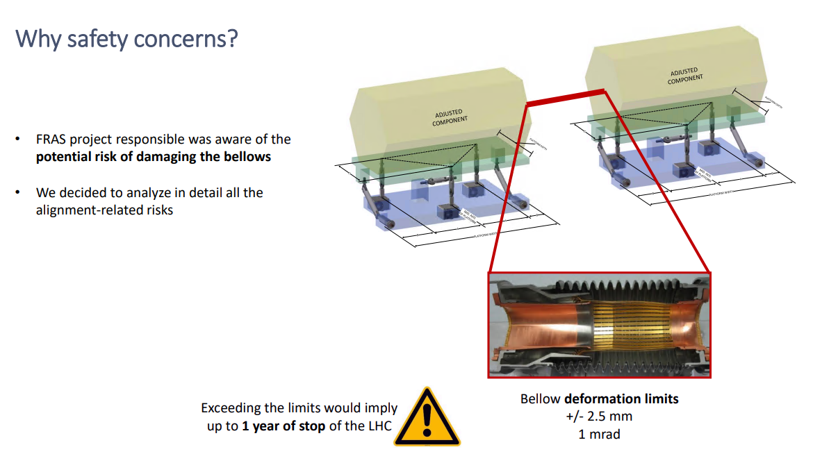
FRAS Safety Layers - Motivation
Reference:
HL-LHC FRAS interfaces meeting, Thursday 9 Nov 2023,
https://indico.cern.ch/event/1310984/ - Safety Strategy, slide 3

Slide 3
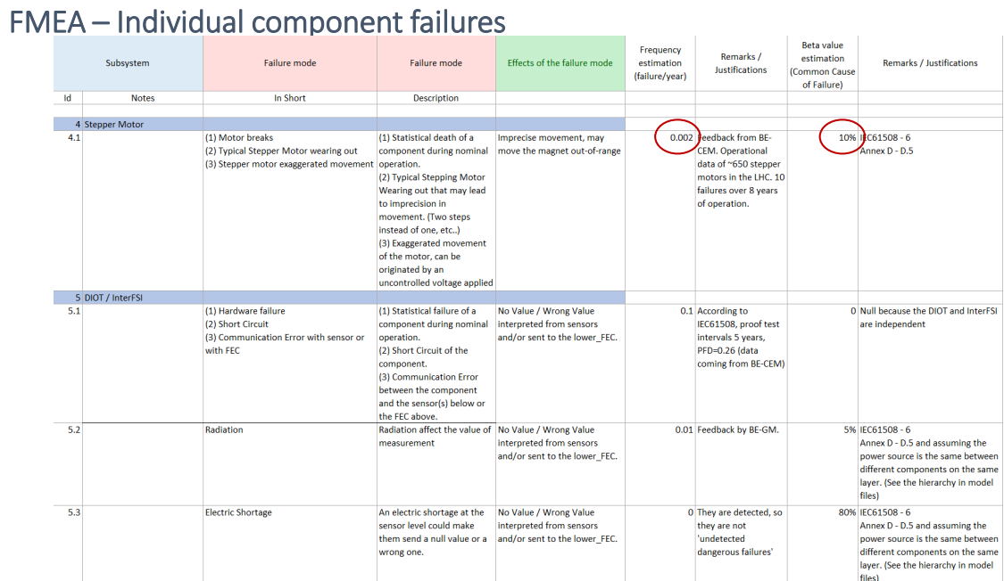
FRAS Safety Layers - Motivation
Failure Modes and Effects Analysis (FMEA)
Reference:
HL-LHC FRAS interfaces meeting, Thursday 9 Nov 2023,
https://indico.cern.ch/event/1310984/ - Safety Strategy, slide 12

Slide 4
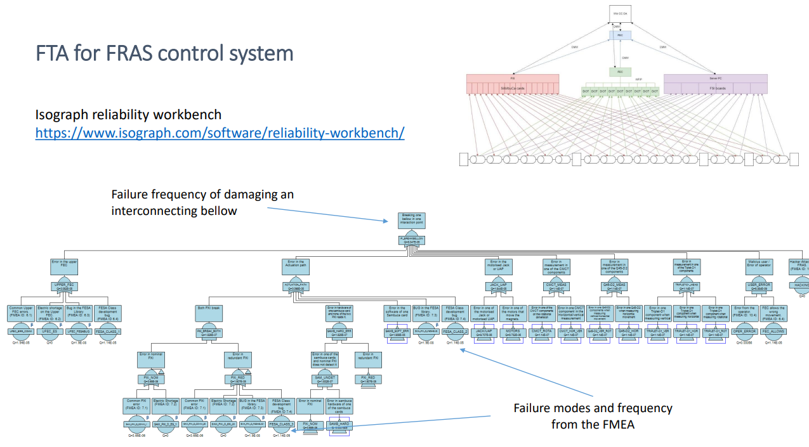
FRAS Safety Layers - Motivation
Fault Tree Analysis (FTA)
Reference:
HL-LHC FRAS interfaces meeting, Thursday 9 Nov 2023,
https://indico.cern.ch/event/1310984/ - Safety Strategy, slide 14

Slide 5
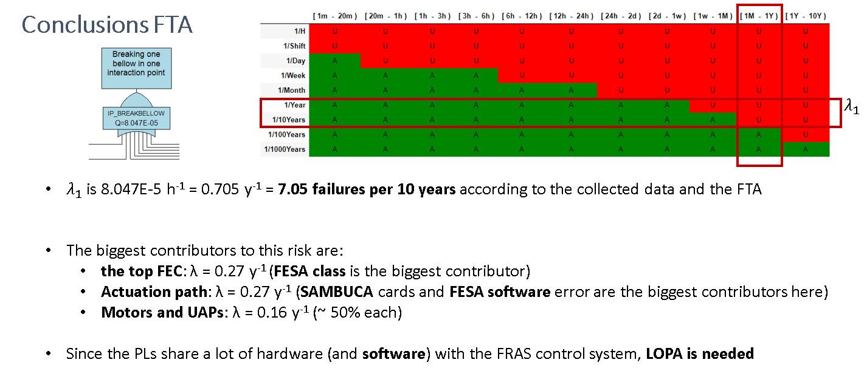
FRAS Safety Layers - Motivation
Machine protection:
Based on experience of the MPE group at CERN – risk matrices for the LHC (EDMS2647876)
Considering the initial freq. ($λ_{1}$) between 1/Year and 1/10Year and an expected LHC delay between 1 month and 1 year,
then the necessary Risk Reduction Factor (RRF) is 100
Reference:
HL-LHC FRAS interfaces meeting, Thursday 9 Nov 2023,
https://indico.cern.ch/event/1310984/ - Safety Strategy, slides 14 + 18

Slide 6
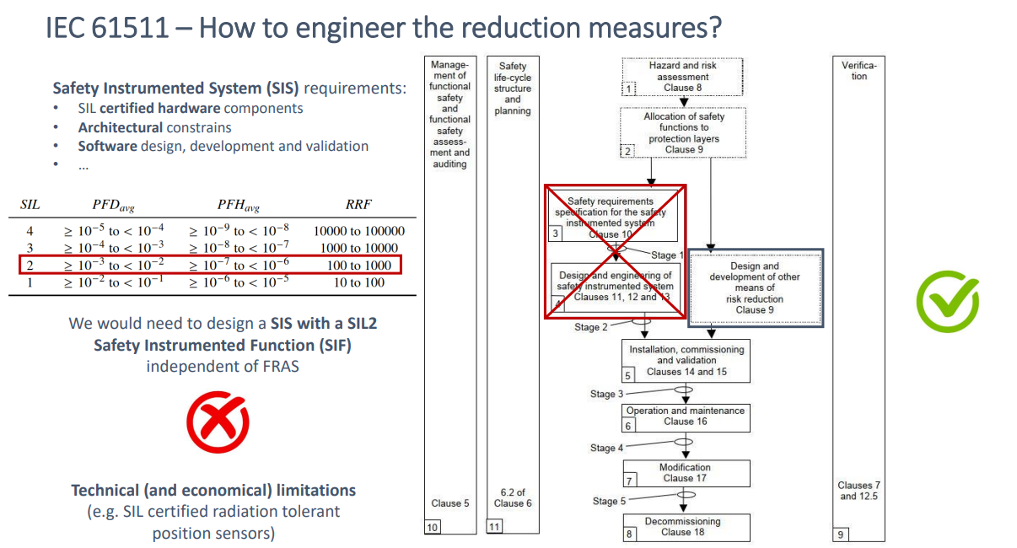
FRAS Safety Layers - Motivation
Reference:
HL-LHC FRAS interfaces meeting, Thursday 9 Nov 2023,
https://indico.cern.ch/event/1310984/ - Safety Strategy, slides 20

Slide 7
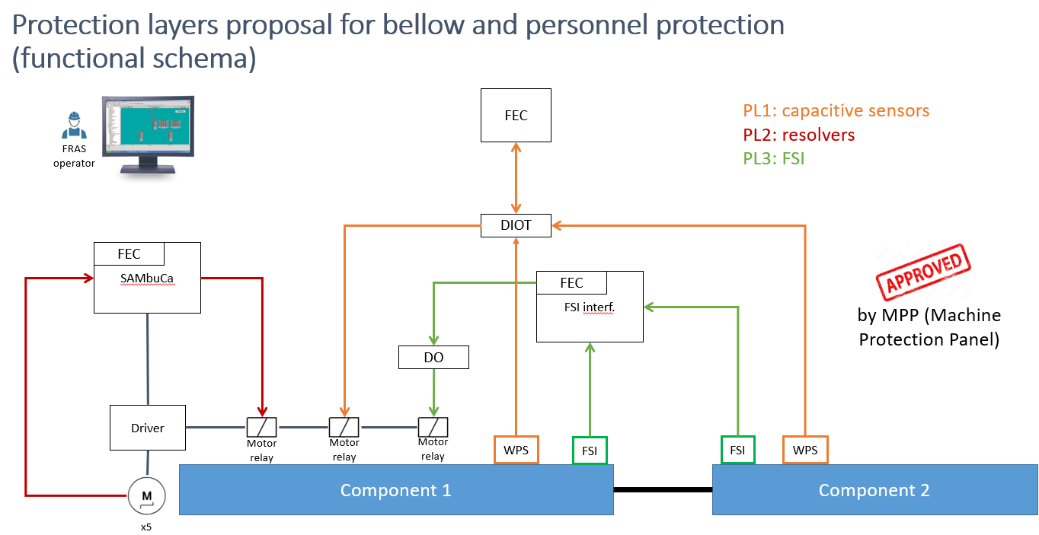
FRAS Safety Layers - Motivation
Guarantee to turn off motors (failure <1/100 years)
Reference:
HL-LHC FRAS interfaces meeting, Thursday 9 Nov 2023,
https://indico.cern.ch/event/1310984/ - Safety Strategy, slide 24

Slide 8
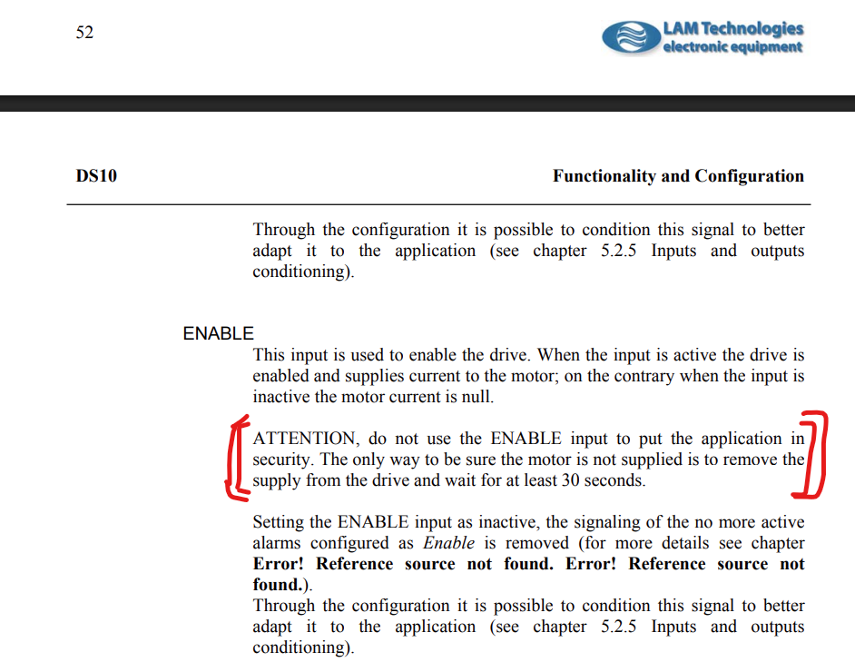
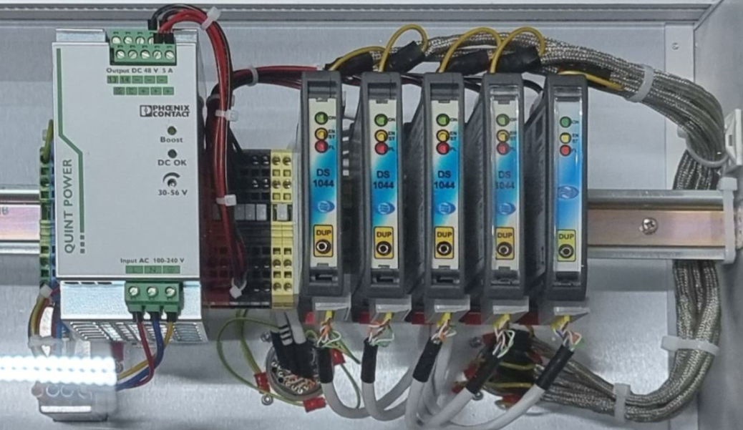
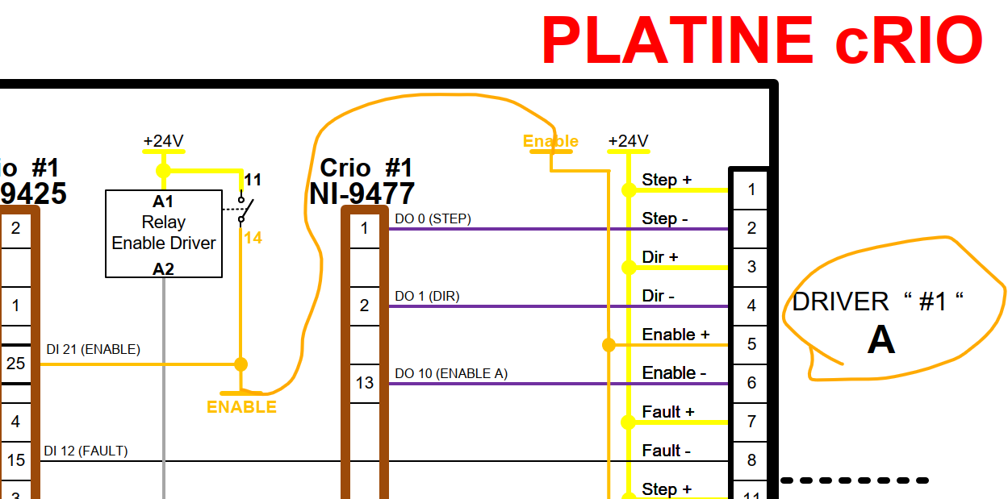
Implementation status and analysis
Motor driver: LAM Technologies DS1044

Slide 9
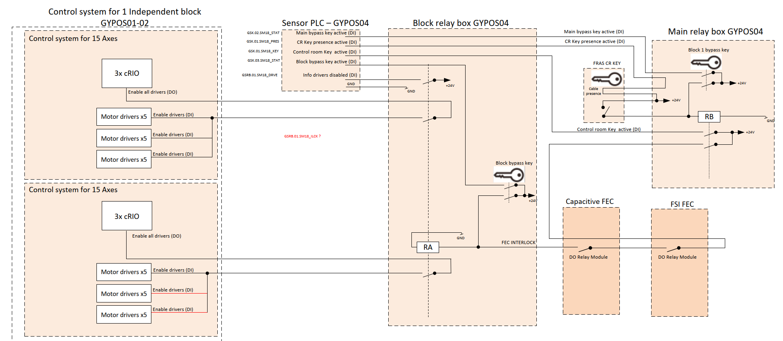
Implementation status and analysis

Slide 10
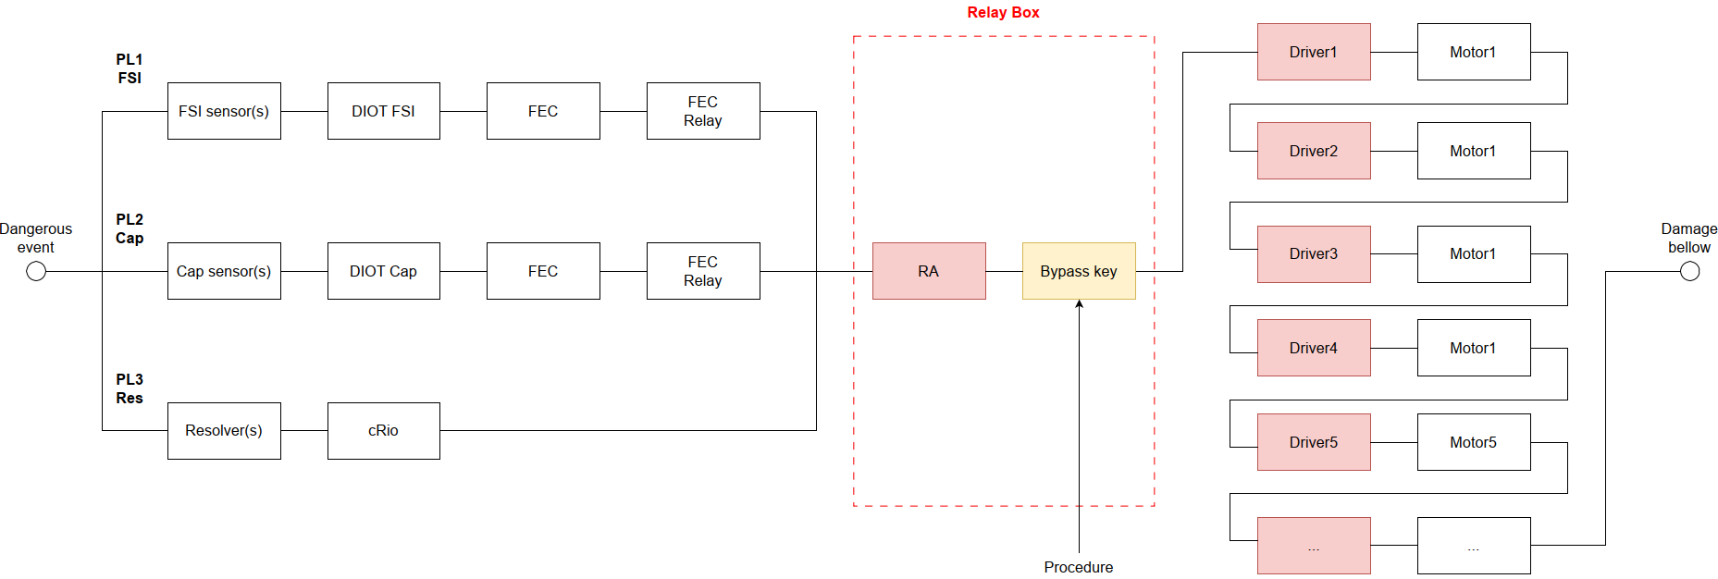
Implementation status and analysis
Relay = Single point of failure
Driver= single point of failure (10x per bellow)

Slide 11
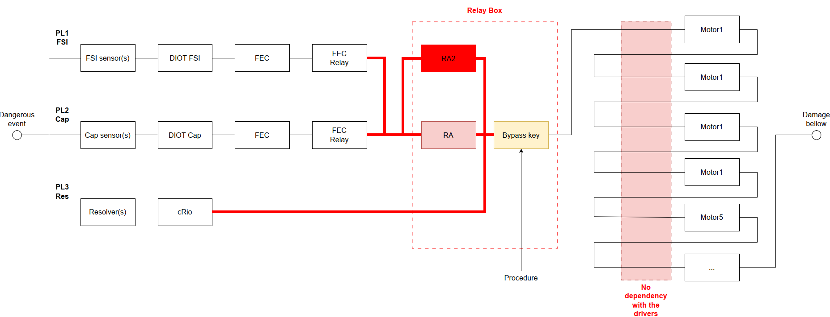
Implementation status and analysis
Change to safety relay
(SIL 2 or better)
Remove dependency on driver
(cut motor power with SIL 2 or better)

Slide 12
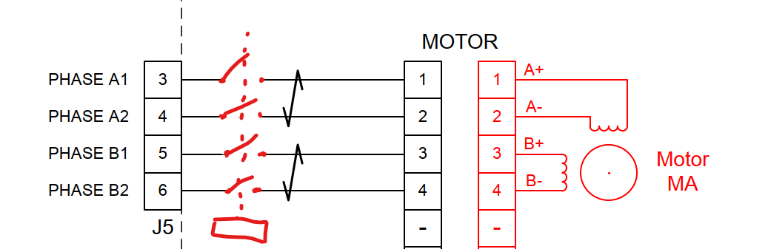

Motor power cut off possibilities
Opt. 1: Cut lines between motor and driver (preferred)
Opt. 2: Cut power to driver (quicker solution for IT String)
Residual energy in driver capacitors may still allow motor rotation a short amount after power off, but expected to be less than 1 second to fully discharge (movement of 20um)
In either case, safety relay rated SIL 2 rating or greater should be used

Slide 13
Changes summary
RB = Safety relay
SIL2 or better
Cut power to motors /drivers
(SIL2 or better)
RA = Safety relay
SIL2 or better

Slide 14
Other topics (Motors + Resolvers)
Resolve the stability issue with resolver readings.
Update the FESA motor classes to reflect the new wiring conventions.
Make the motor test bench compatible with the update to the new wiring conventions.

Slide 15
Thank you!

