Slide 1
Overview of INFN activity within DRD1
3 Sept 2025

Slide 2
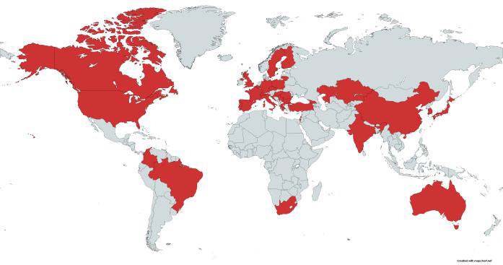
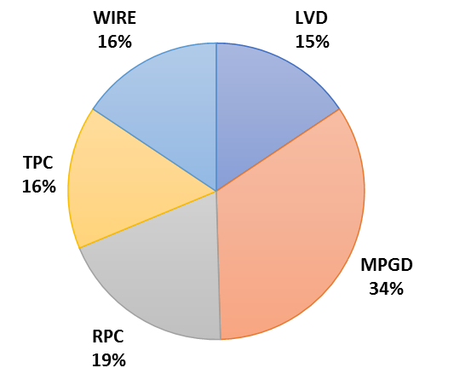
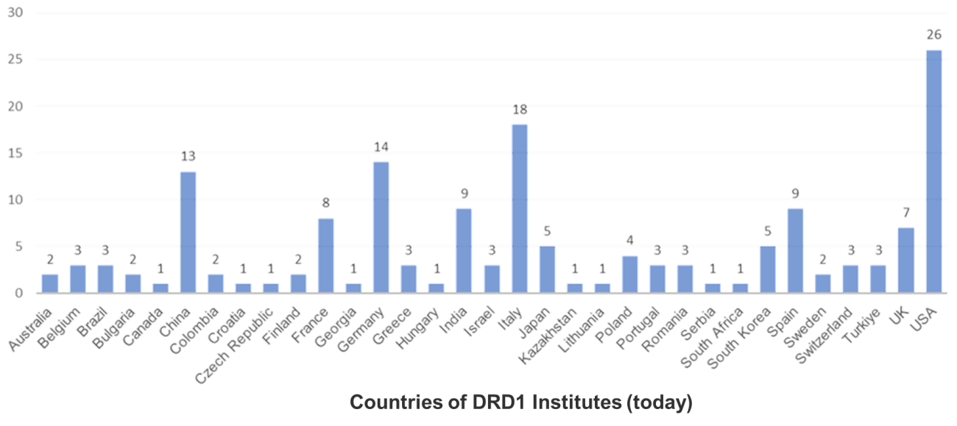
DRD1: A very large and diversified set of technologies and community
More than 160 Institutes: 18 INFN
More than 30 Countries
More than 700 members
5 Industrial, Semi-Industrial and Research Foundations

Slide 3
DRD1 MoU & Annexes
DRD1 MoU Annexes submitted to CERN Management on Nov. 8, 2024 (151 page)
63 institutes received the MoU for signature and 27 already signed
Annex 1 Collaborating Institutions and their Contact Persons
Annex 2 Funding Agencies and their Representatives
Annex 3 Equipment Structure and Technical Participation of the Collaborating Institutions
Annex 4 The Organizational Structure of the Collaboration
Annex 5 Overview of the Financial Participation of the Funding Agencies (Common Funds)
Annex 6: Specific Obligations and Responsibilities of CERN as the Host Laboratory of the DRDnCollaboration
Annex 7: Work Packages
Annex 8: Working Groups
Annex 9: Other work Entities (Common Project, Common Investment)
Annex 10 Included Background IP
Annex 11: Conflict of Interest Disclosure Form
Annex 12 CERN General Conditions Applicable to Experiments

Slide 4
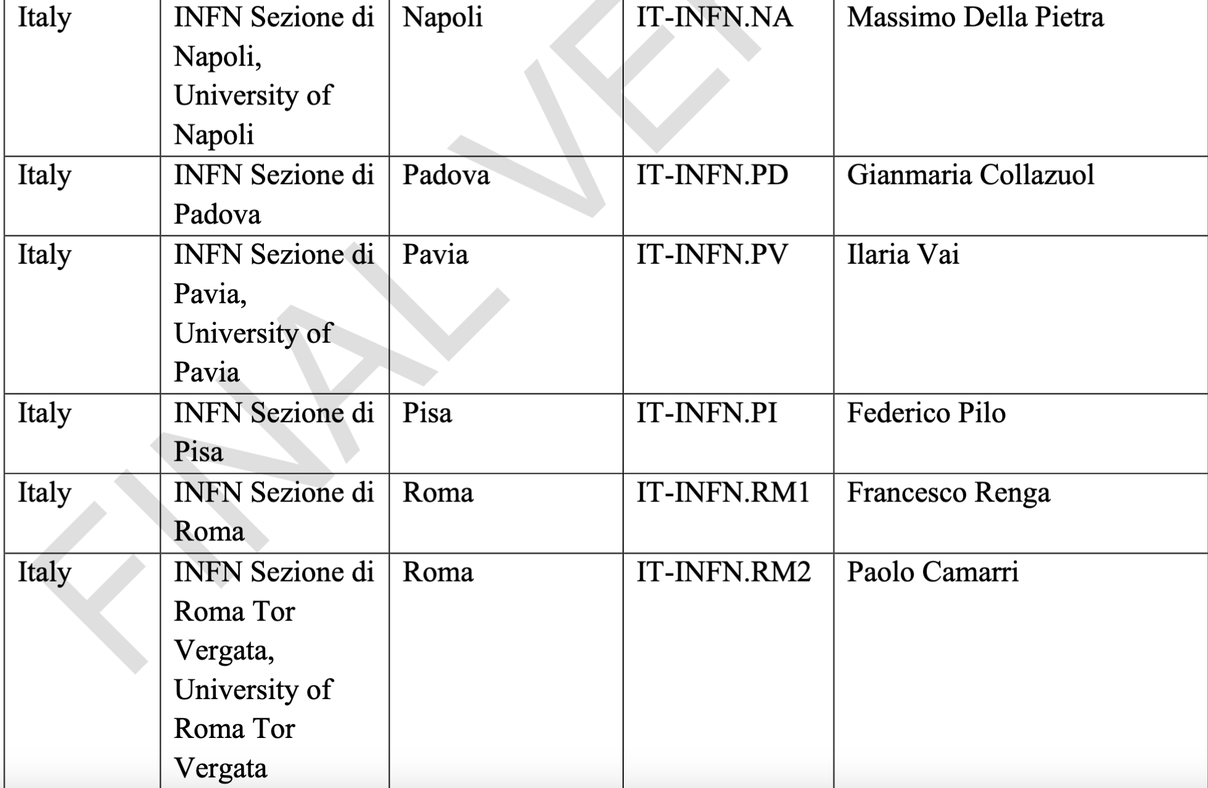
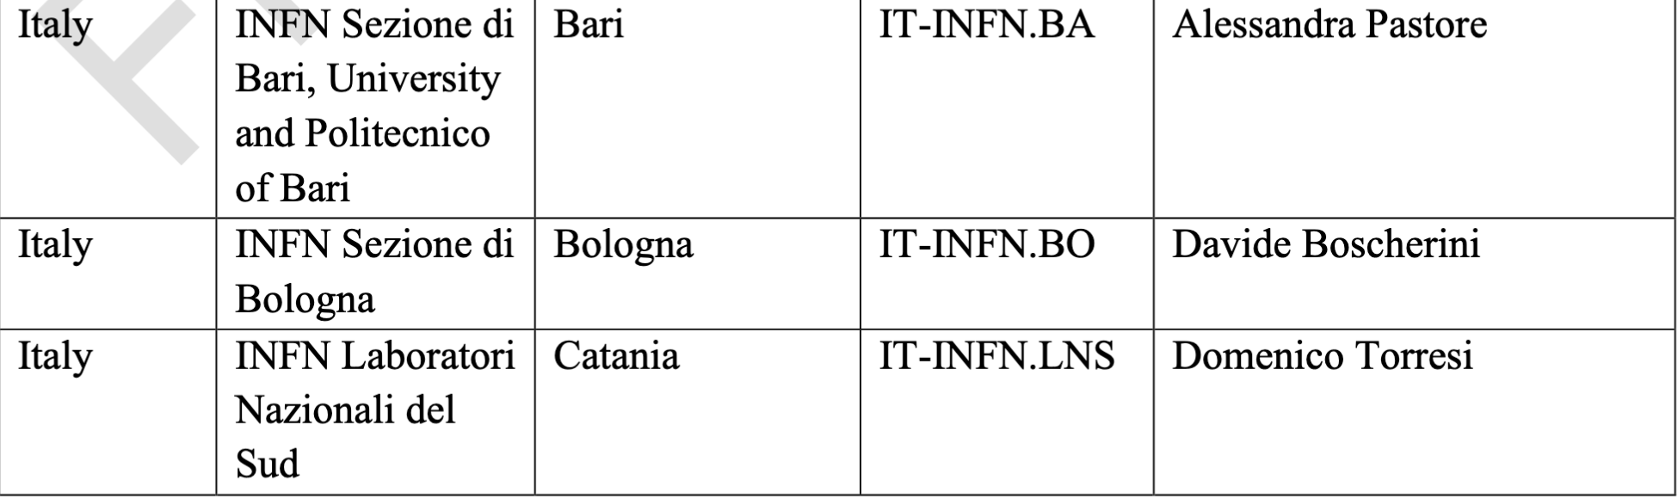
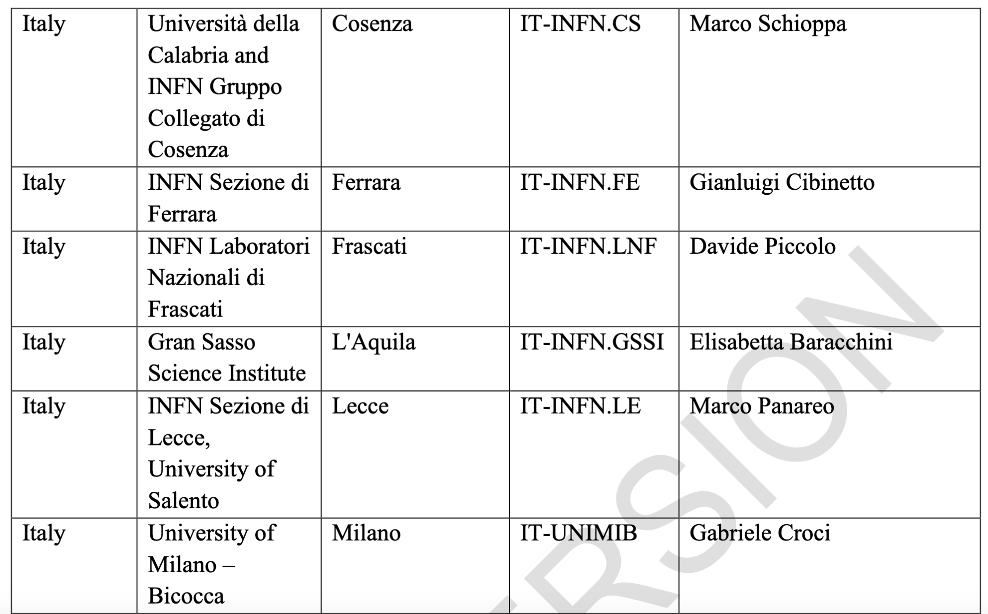
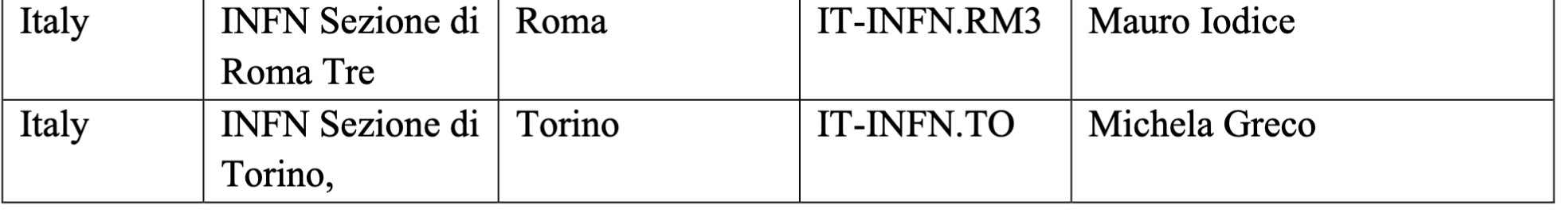
MOU - Annex 1: Collaborating Institutions and Contact persons
18 INFN institutions and Contact persons

Slide 5
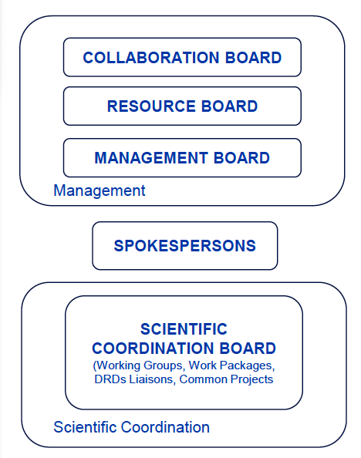
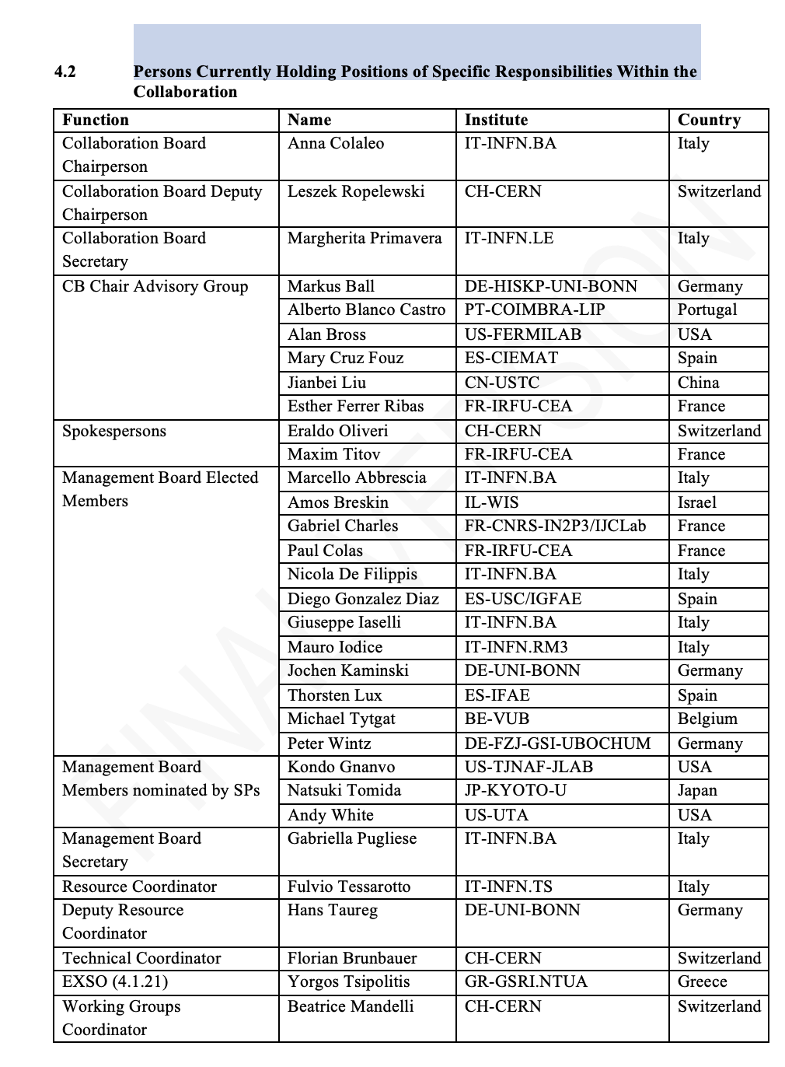
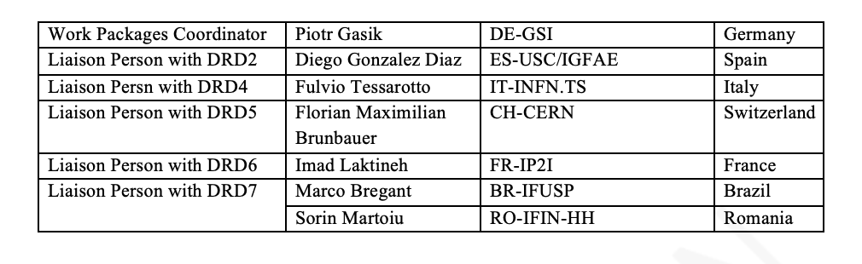
DRD1 - Annex 4 The Organizational Structure
The INFN community holds leading roles within the DRD1 Management positions: this ensures high international visibility for INFN and strengthens its strategic role in detector R&D.

Slide 6
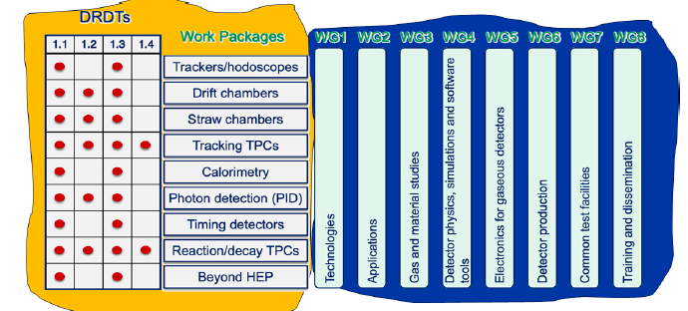
DRD1 Organization (1)
Organized in:
-Working Groups:
Serve as the backbone of R&D: provides a platform for sharing knowledge, expertise & efforts by supporting strategic detector R&D directions, facilitating the establishment of joint projects between institutes
-Work Packages: reflect the ECFA DRDTs: long-term projects addressing strategic R&D goals, outlined in the ECFA Detector R&D roadmap with dedicated funding lines
-Common Projects: enhance synergies in “blue sky” and generic R&D between institutes: short-term blue-sky R&D or common tool development with limited time and resources, supported by the Collaboration
ref. Eraldo Oliveri, EP-DT, GDD, CERN
RPC2024, Santiago De Compostela

Slide 7
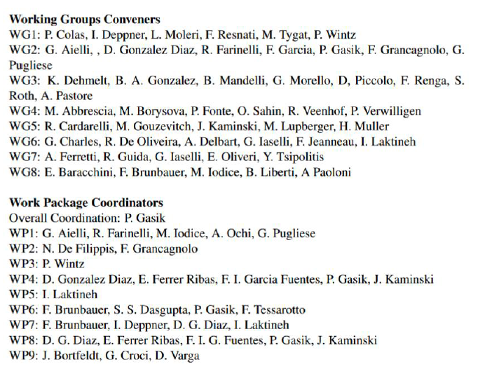
DRD1 organization (2)
INFN people holds leading roles as both WG conveners and WP coordinators

Slide 8
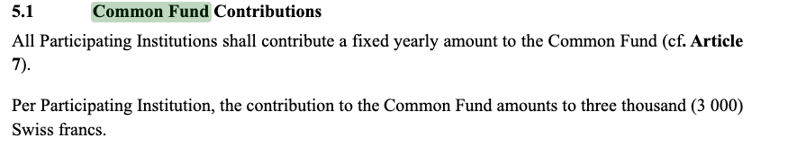
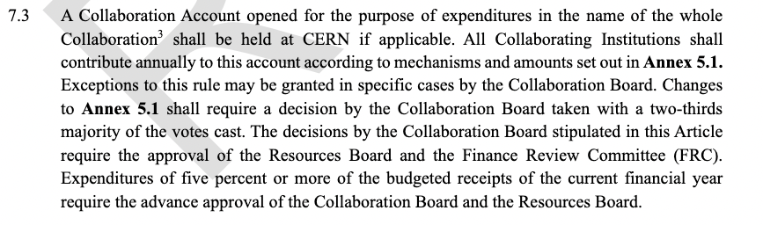
Annex 5 - Contribution to Common Fund
A fraction of this contribution can be in-kind
The amount of three thousand can change in future

Slide 9
Use of the Common Funds
The common funds are essential to support the following activities:
Test beam
DRD1 offers a structured organization that provides: dedicated test beam weeks; guaranteed access to the test area with pre-assigned spaces; ready-to-use trigger setup, gas system, and DAQ; availability of the necessary electronics for the tests.
This results in significant savings in terms of technical missions and costs related to the purchase or rental of instrumentation.
Support in electronics development DRD1 collaboration (like RD51) includes groups with advanced expertise in front-end electronics and DAQ systems development. Having access to a community that designs, builds, and provides ready-to-use electronics for tests is a huge advantage, especially for groups without dedicated local resources. This allows research groups to focus on detector development, reducing both time and costs associated with designing electronics from scratch.
Common Projects They have been a success story within the RD51 collaboration: we directly benefited from these projects, particularly for the development of an R&D line on calorimeters, which is now recognized and adopted by several experiments (Mucol and possibly Allegro). The Picosec project (proposed for MUcol and other initiatives) also originated as a common project. They are distinct from the Strategic R&D of the Work Packages, which are more focused on specific experimental applications.

Slide 10
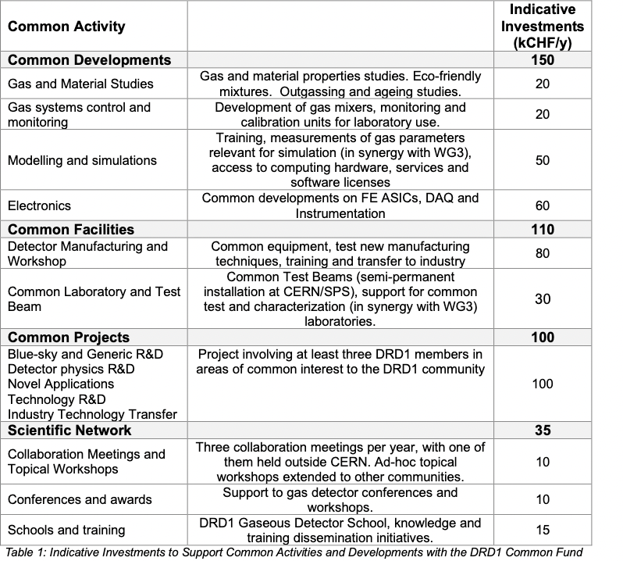
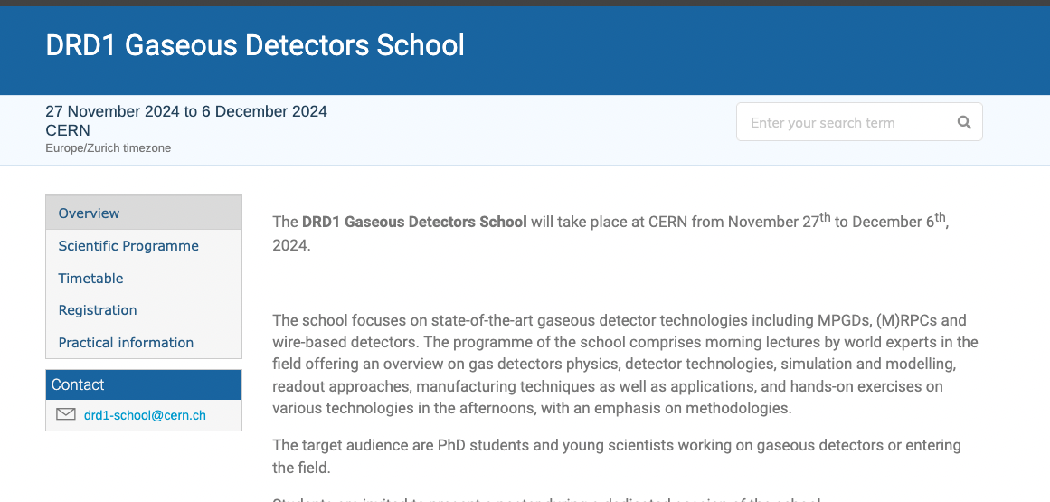
Use of the Common Funds (as defined in the Membership document)
The first DRD1 Common Project call:
Bari, Napoli e Roma3 submitted a proposal (Industrialisation of Resistive Bulk Micromegas)
First DRD1 School – 2024
7 young INFN members (out of 82) attended the lectures and hands-on labs in person.
30 participants (out of 247) registered and followed the online lectures free of charge.
Thanks to the leftover funds from RD51 and the contribution of some FAs that decided to pay the 2025 Common Fund in advance (in 2024), some activities have already started.

Slide 11
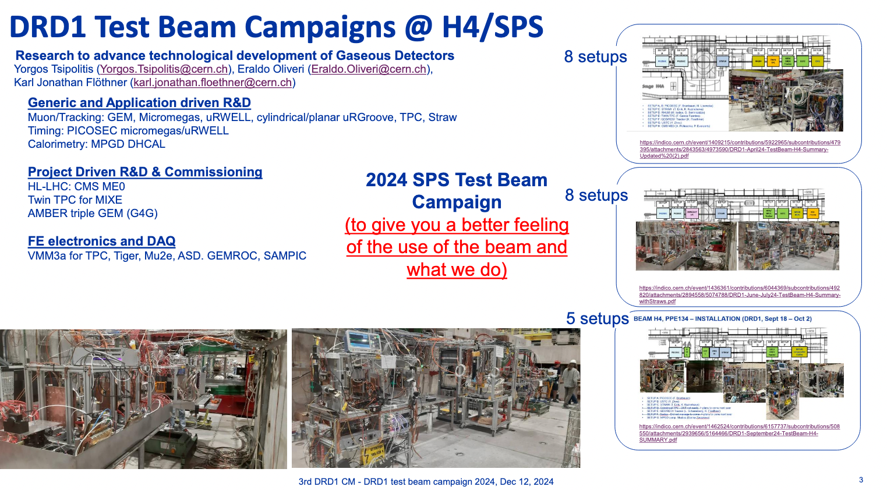
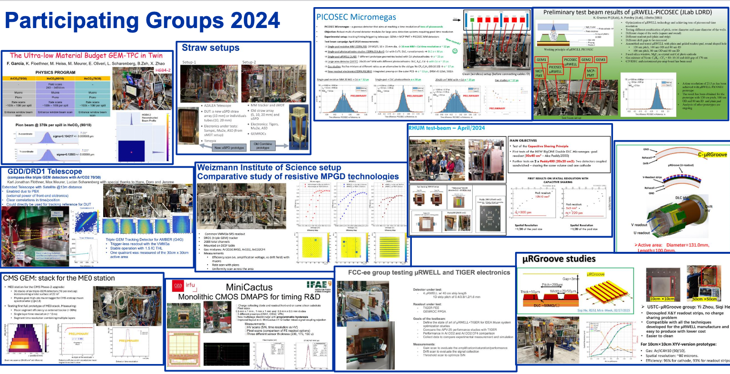
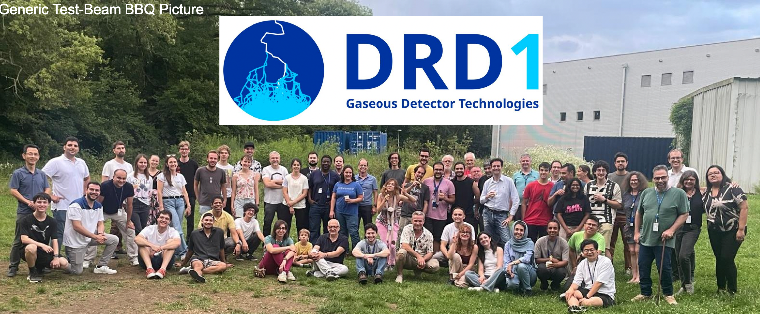
Common laboratories and TB
MPGD: Bari, Naples, Roma3, Ferrara and Pavia people participated in 2024 and iin 2025 TBs
RPC: Bari people participates in 2025.
WIRE: Bologna, Pisa participates in 2025.

Slide 12
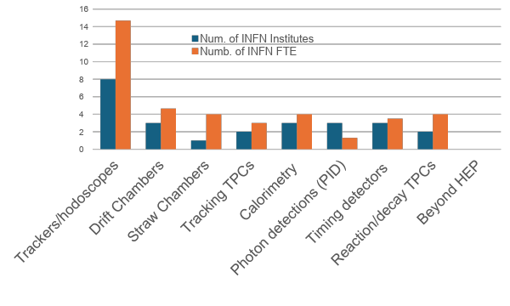
Annex 7: Work Packages
Out of the 18 INFN institutes, 13 have expressed interested in one of the DRD1 WPs, declaring activity with a significant number of FTEs
In most cases, each institute is involved in two WPs.
5 institutes participate in the WGs only

Slide 13
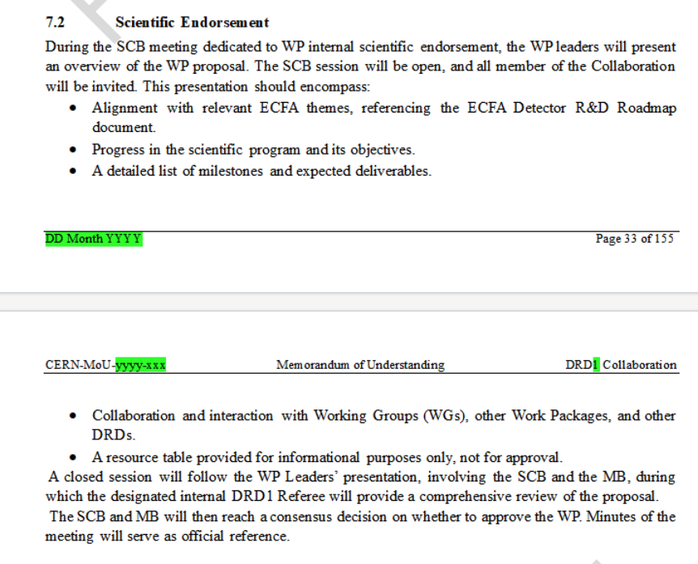
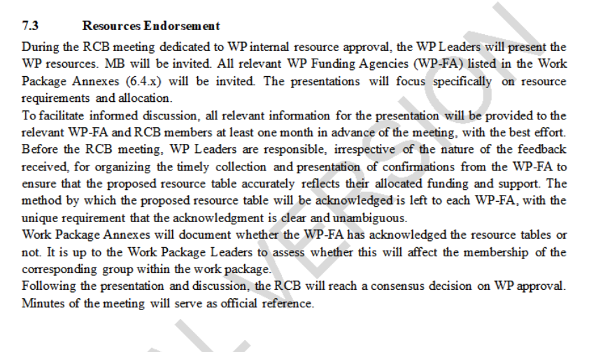
WP Scientific and Resources Endorsement

Slide 14
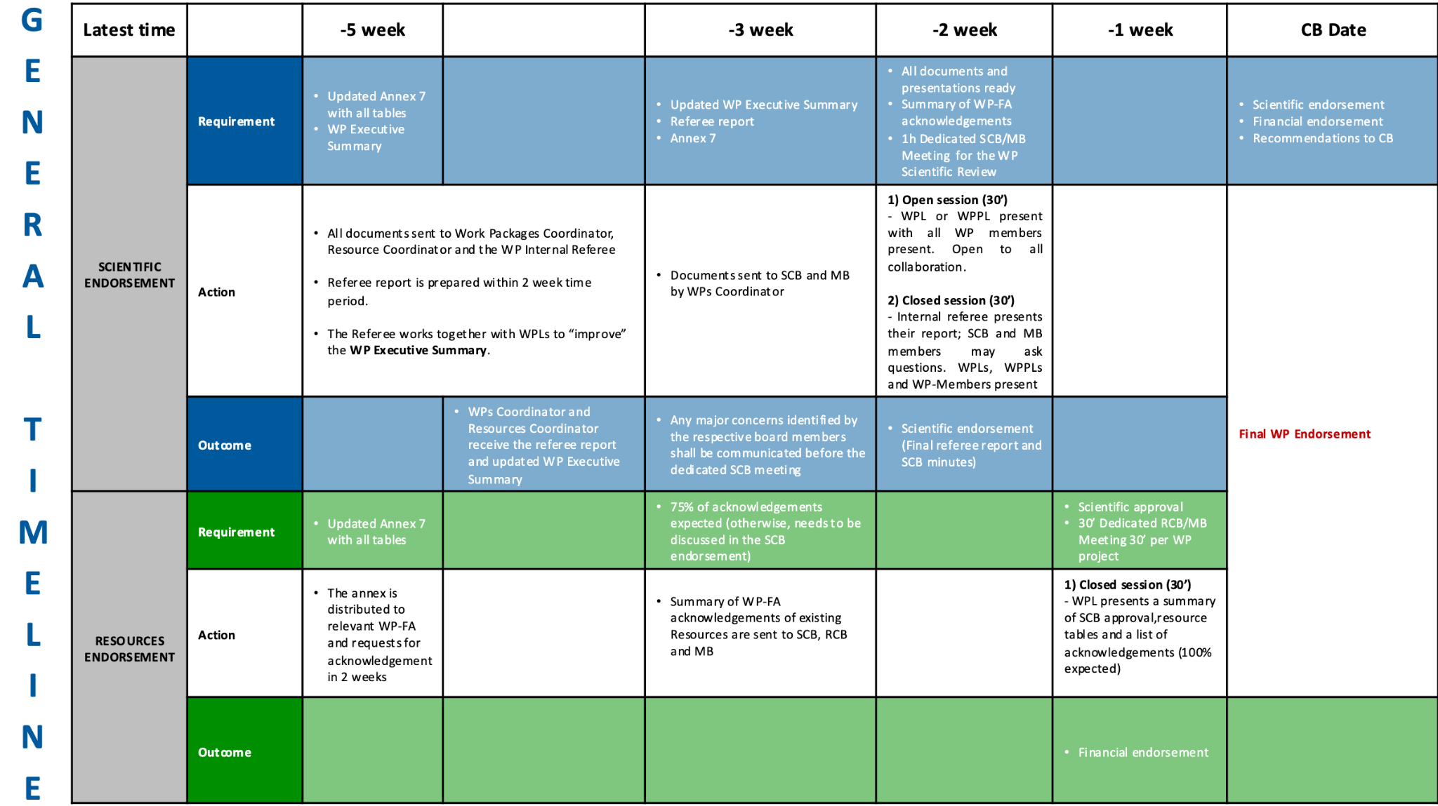

Slide 15
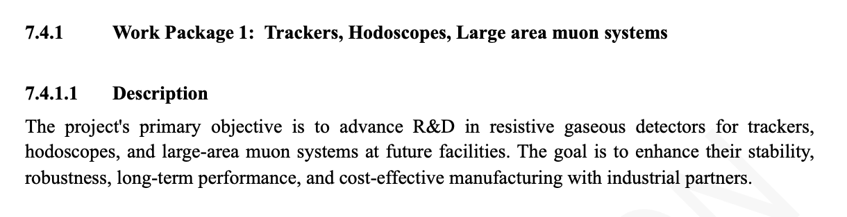
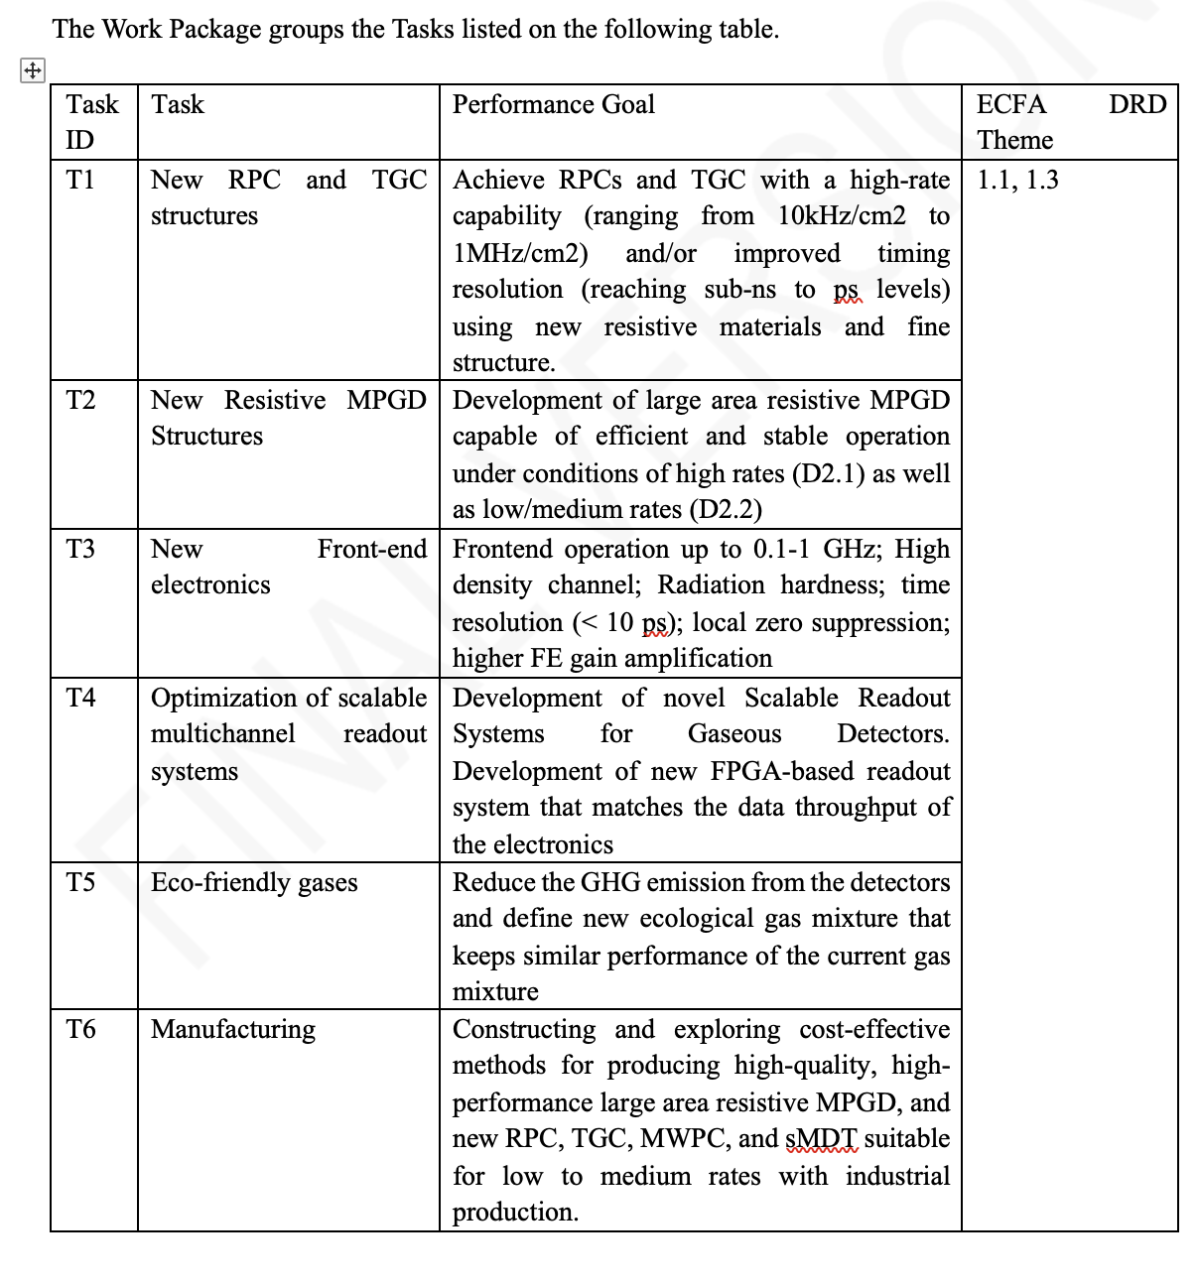
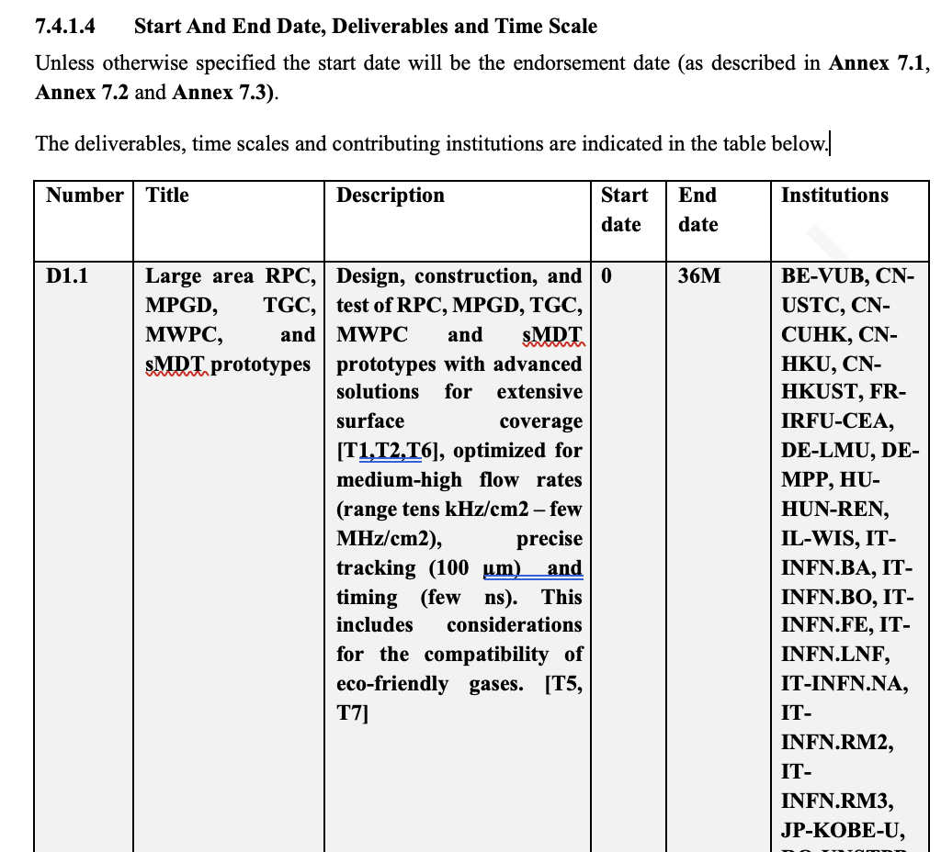
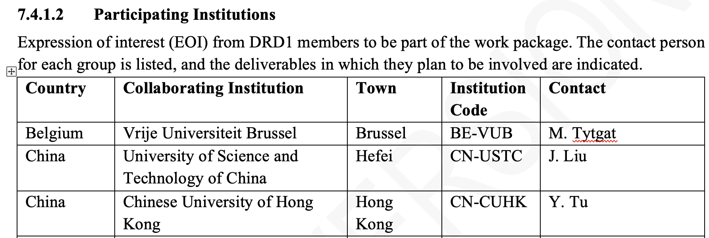
WP1 example
List of the Tasks
Participating Institutions
Funding Agencies
Deliverables and Time Scale

Slide 16
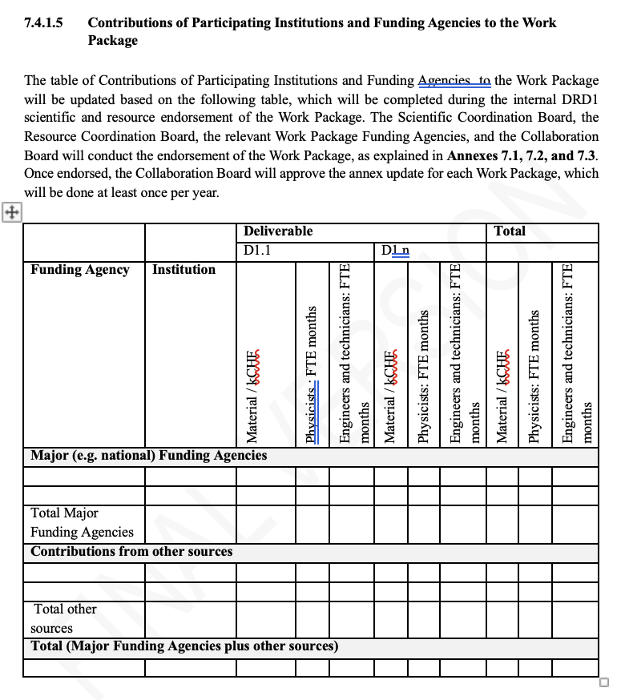
WP1 example

Slide 17
SPARES

Slide 18
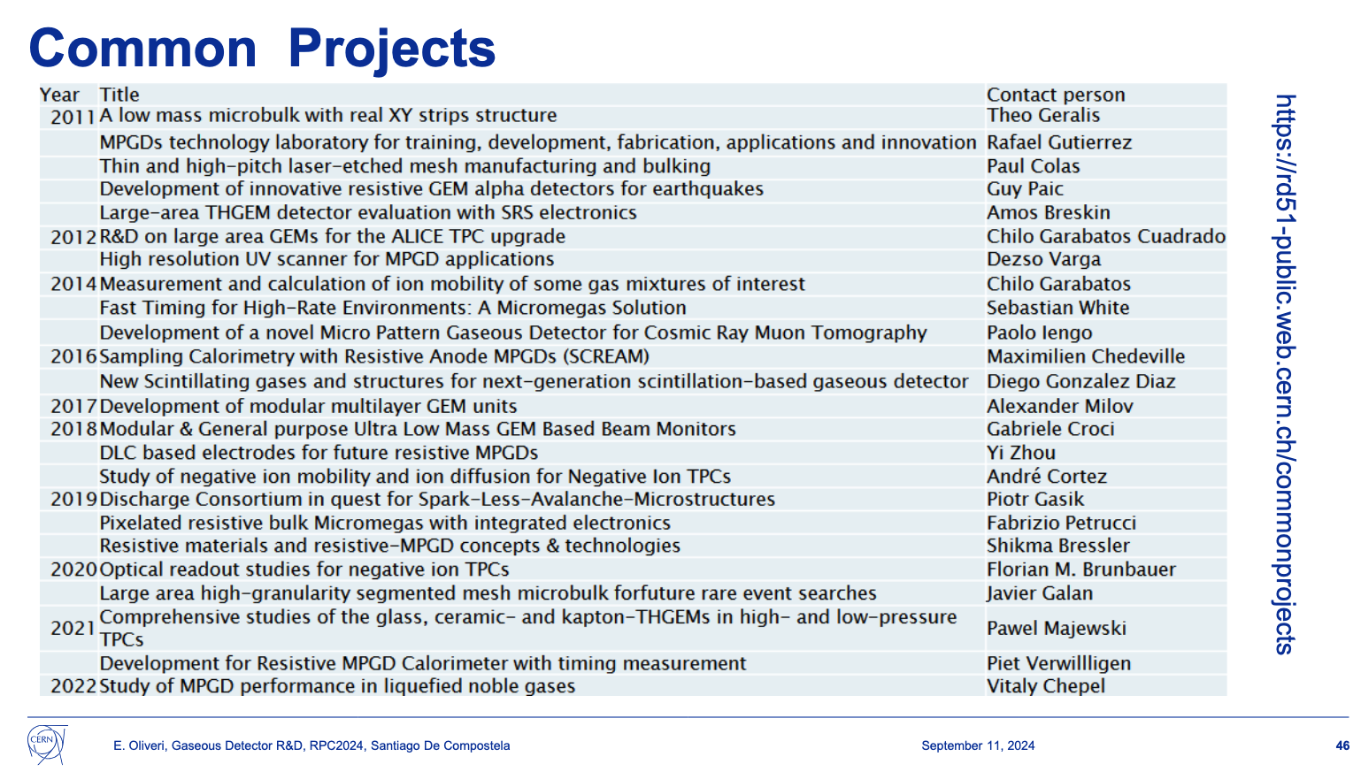
RD51 CPs

