Slide 1





Muon Collider MDI & IR – key topics
Funded by the European Union (EU). Views and opinions expressed are however those of the author only and do not necessarily reflect those of the EU or European Research Executive Agency (REA). Neither the EU nor the REA can be held responsible for them.

Slide 2
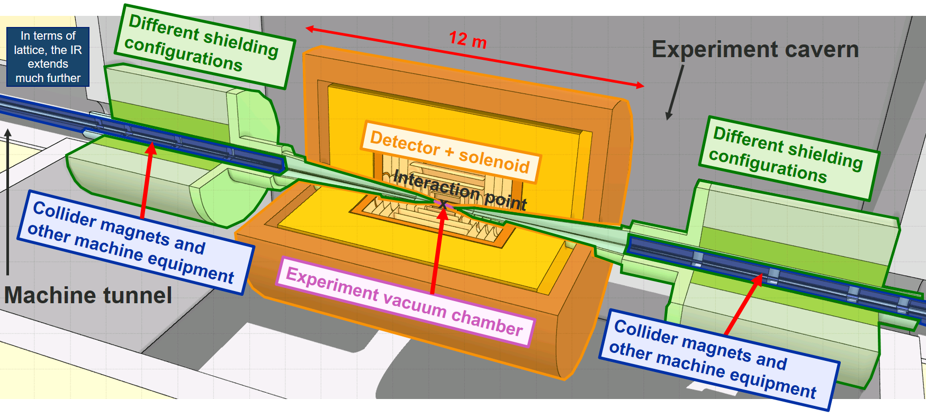
MDI and IR design for 10 TeV Muon Collider
The present MDI design is still very conceptual (based on MAP design)
Need to work towards a more realistic (technical) design and integration

Slide 3
MDI and IR design (10 TeV) – key topics (1/2)
  Interaction region lattice design under consideration of various constraints (beam-induced background, heat load, technical limits for magnets, interconnect lengths)
    Several iterations in the past years, significant challenges due to small β*, for example β functions of O(1000 km) in FF
    Key aspects require further discussions (L*, required drift lengths, radial build of IR magnets)
  Beam-induced background simulation, conceptual shielding design (incl. nozzle) and other background mitigation measures
    Started from shielding concepts & nozzle developed by US-MAP (only small modifications, potential for further optimization limited)
    Performed detailed studies of decay-induced background for present MDI&IR layout
    Obtained first estimates of incoherent pair background (need to revisit event generator?),
    Halo background remains to be studied (important open questions remain: halo formation? Is a 5σ IR aperture acceptable? Halo removal system far from the IP?)
Important to continue background studies as the MDI&IR design evolves → feeds into detector design

Slide 4
MDI and IR design (10 TeV) – key topics (2/2)
  Luminosity monitoring, forward detectors
    First ideas and preliminary studies, but no concrete proposals yet
    Important to understand if any forward monitor/detector is needed within L* (very difficult integration)
  Beam instrumentation in MDI region, vacuum system in the MDI region
    Work did not start
  Technical design of key MDI components (nozzle, central vacuum chamber etc.)
    Work did not start, different aspects to be addressed (mechanical design, cooling concepts, impedance, supports, etc.),
  Integration of accelerator, shielding, detector, including support structures, infrastructure
    About to start first (2D) integration studies, need input from different experts (magnets, cryo, vacuum, detector, instrumentation, civil engineering) → Javier takes the leak on this activity
    Expect that the MDI design will evolve once the integration model becomes more mature

Slide 5
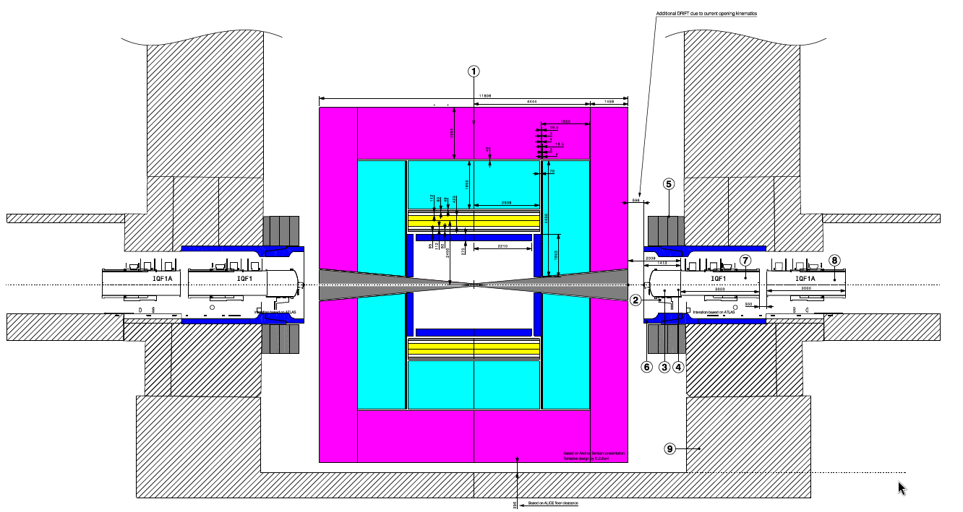
Towards a MDI integration model
Work about to start
  Define first longitudinal and lateral space requirements for all key elements (detector, shielding, machine equipment) and identify/resolve possible integration conflicts
  Define the required support structures
  Establish strategies for access/maintenance (how to move detector and shielding, and associated space requirements)
  Provide input for CE (detector cavern and junction to machine tunnel)
See presentation of Javier
Evidently, this will be an iterative process

Slide 6
MDI&IR layout: next steps
  Need to iterate on the following topics in order to converge on the IR layout
  Space requirements between nozzle and first FF quadrupole (Q1)
  Requirements and technical constraints for drift spaces between different FF quadrupoles
  Radial build (apertures) of different FF magnets (acceptable heat deposition → shielding thickness → aperture vs achievable field strength)

Slide 7
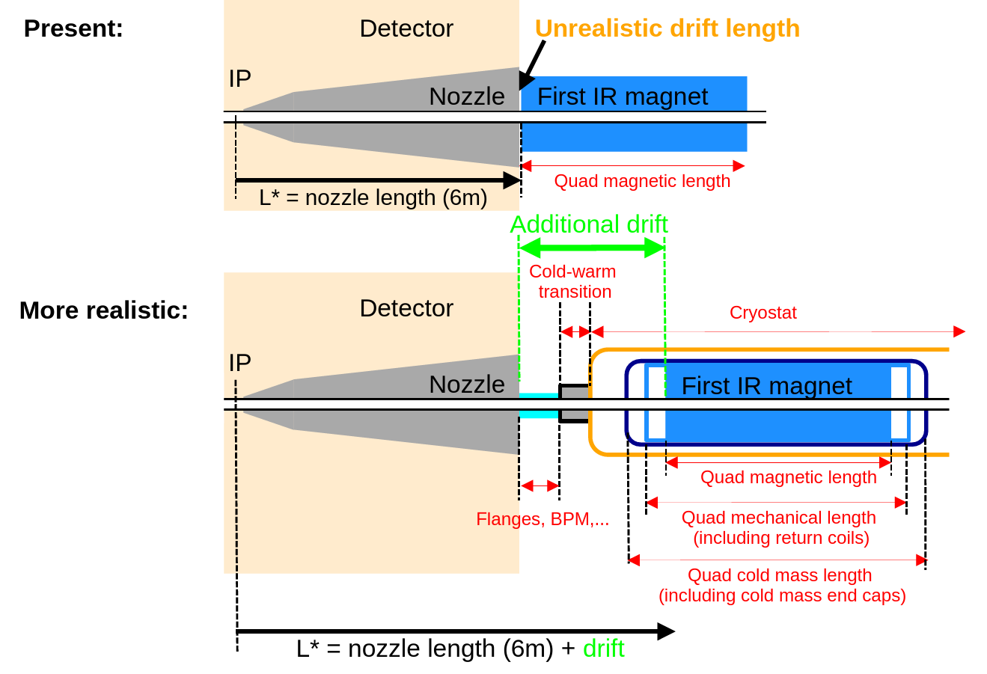
MDI&IR layout: connection to Q1
  For the moment, there is no space between nozzle and first magnet, i.e., the nozzle length = L* = 6m
  This is unrealistic since we have to account for the cold mass length, cryostat, cold-warm transition, and other equipment (flanges, BPMs, vacuum pumps etc.)
  This might require an increase of L*
  Important to quantify how much space is realistically needed

Slide 8
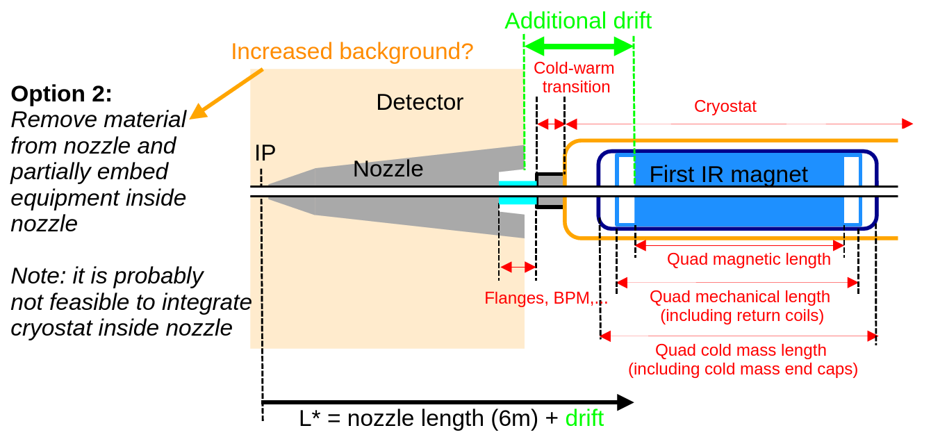
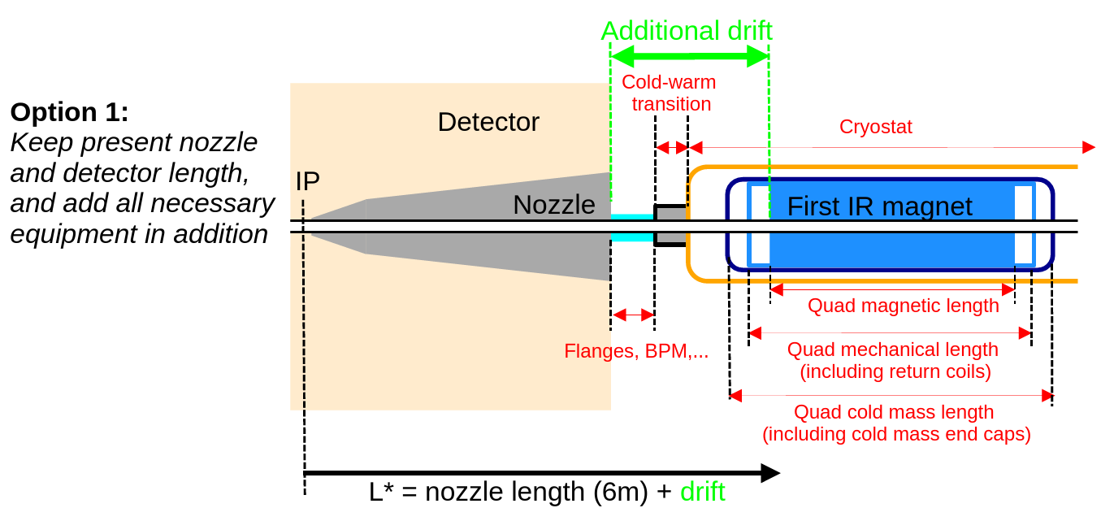
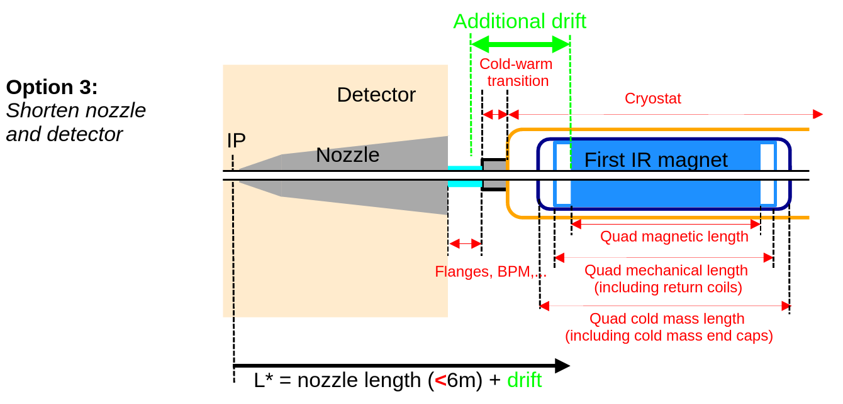
MDI&IR layout: connection to Q1
  To minimize the increase of L* (challenging for lattice design), other options to be discussed
  Embed beam line equipment partially inside nozzle?
  Shorten nozzle and detector?

Slide 9
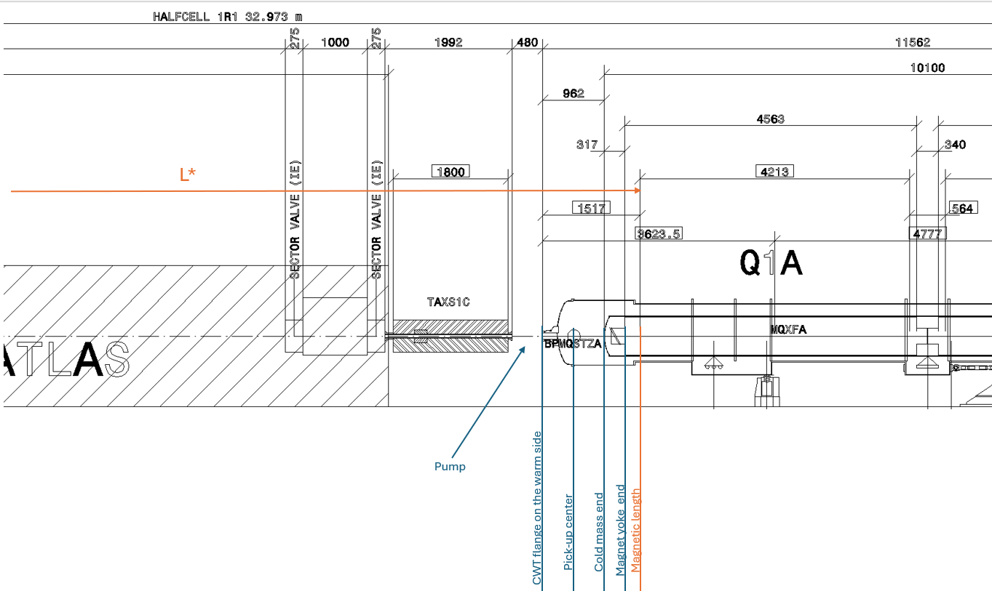
MDI&IR layout: connection to Q1
Examples from other machines: HL-LHC
  HL-LHC is a real-life example with a detailed engineering design and integration study
  Common feature with Muon Collider: SC final focus magnets outside of detector (significant magnet aperture)
  Distance between TAXS (forward shielding) and start of Q1 field is about 2 meters
  Evidently, need to squeeze this for the Muon Collider, but the HL-LHC example shows that space requirements are not negligible
~2m
Should also look at other machines (e.g. SuperKEKB, ILC) but situation not always comparable

