Slide 1




Parametric IR optics studies for key parameters
Marion Vanwelde
19th September

Slide 2
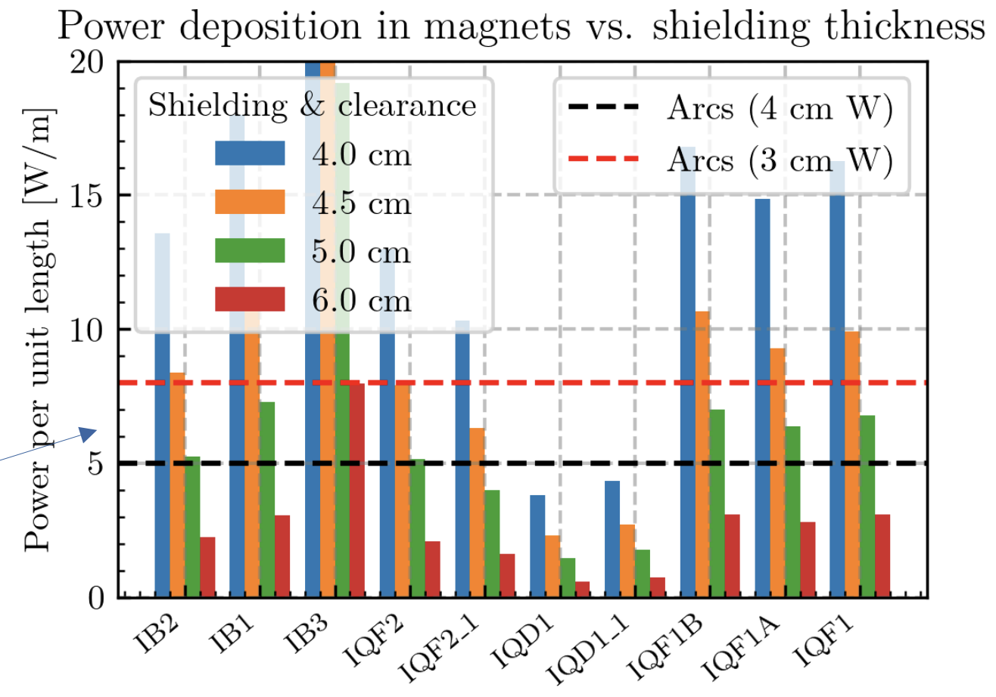
IR design – Radial build
1
Study the impact of increased W shielding thickness on the optics and collider performance
Tungsten shielding thickness:
Aperture= $5σ+$W shielding$+1.51$cm
Still need to determine which power load is acceptable from the cryo perspective
Tungsten shielding of 2.53cm probably not sufficient
Cryogenics issues
Local heat extraction issues must be addressed, considering a representative coil section and the cooling channels design.
@D. Calzolari
Discussion at annual meeting & https://indico.cern.ch/event/1573241/

Slide 3
IR design – Interconnects length & L*
2
Study the impact of an increased L* on optics and collider performance
L*+ nozzle-quadrupole interconnect
  Need to account for the interconnect length between the nozzle and the first triplet quadrupole (currently not included in design: L* = 6m).
  Either increase L* (modify IR layout) or reduce detector length.
Interconnect length >1m
  Current assumption: 30cm → Increase by more than a factor of 3!
  Longer interconnects→ Increased IR length and modified optics.
3
Include interconnects of 1m in the IR design and evaluate their impact on collider performance.
Sensitivity analysis of the 3 parameters to assess their individual impact

Slide 4
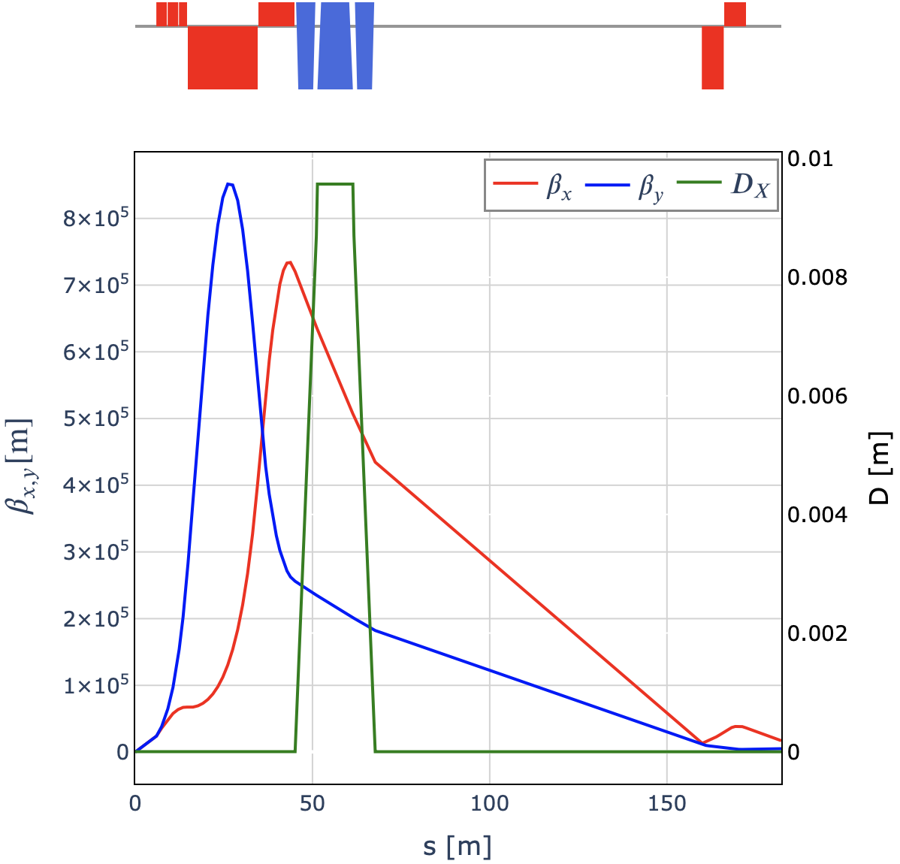

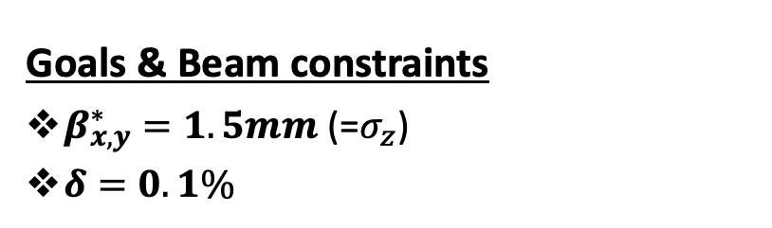
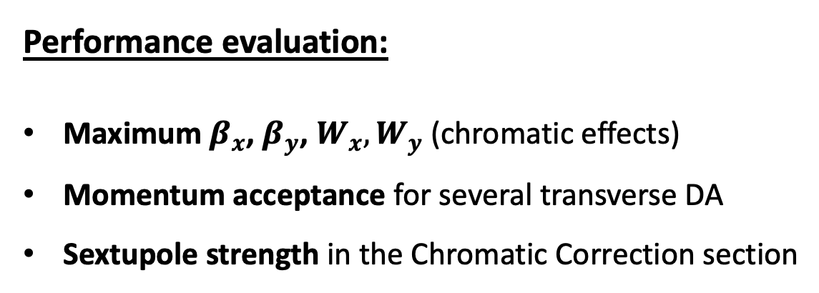
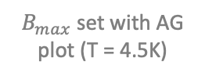
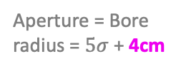
IR design – collider performance
Sensitivity studies carried out independently for the 3 parameters to assess their individual impact on collider performance
Goals & Beam constraints
$β_{x,y}^{∗}=1.5mm$ (=$σ_{z}$)
$δ=0.1\%$
Required performance:
Transverse DA: $∼$3-4$σ$
Momentum acceptance: $∼$2-3 $σ$
Baseline lattice:
No combined-function
L* = 6m
Chicane
Long Straight 110m
~20m
Short drift = 30cm
Performance evaluation:
Maximum $β_{x}$, $β_{y}$, $W_{x}, W_{y}$ (chromatic effects)
Momentum acceptance for several transverse DA
Sextupole strength in the Chromatic Correction section
Aperture = Bore radius = $5σ$ + 4cm
(Total clearance)
$B_{max}$ set with AG plot (T = 4.5K)

Slide 5
Sensitivity study on total clearance
1
Study the impact of increased W shielding thickness on the optics and collider performance

Slide 6
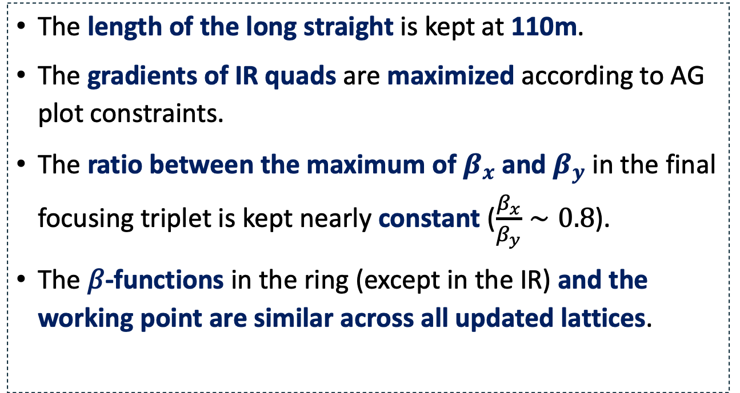
Sensitivity study on total clearance
The IR lattice has been adapted for each value of W shielding thickness (total clearance: 3.5 to 5.5cm) using similar matching and optimization procedures.
The length of the long straight is kept at 110m.
The gradients of IR quads are maximized according to AG plot constraints.
The ratio between the maximum of $β_{x}$ and $β_{y}$ in the final focusing triplet is kept nearly constant ($\frac{β_{x}}{β_{y}}∼0.8$).
The 𝛽-functions in the ring (except in the IR) and the working point are similar across all updated lattices.
Long Straight 110m

Slide 7
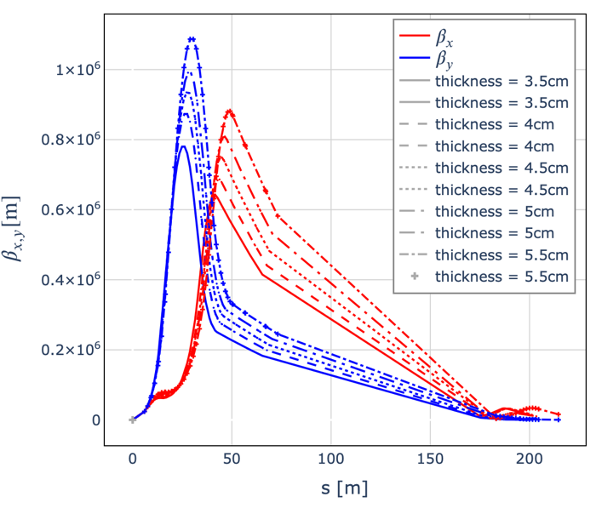
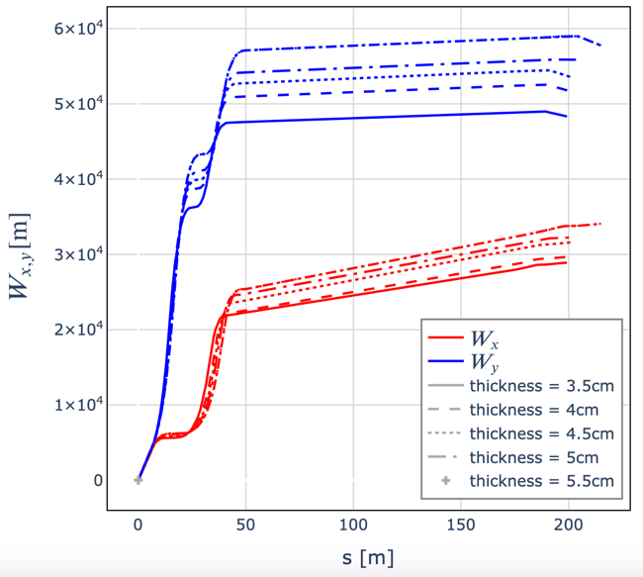
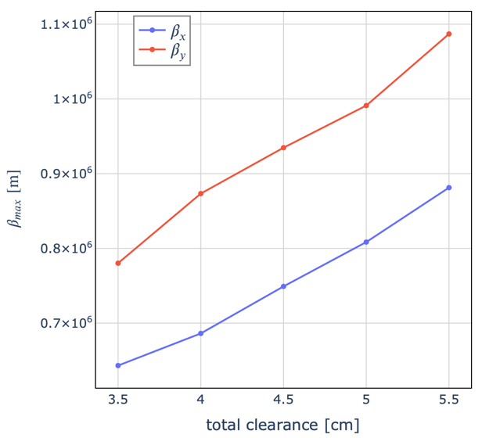
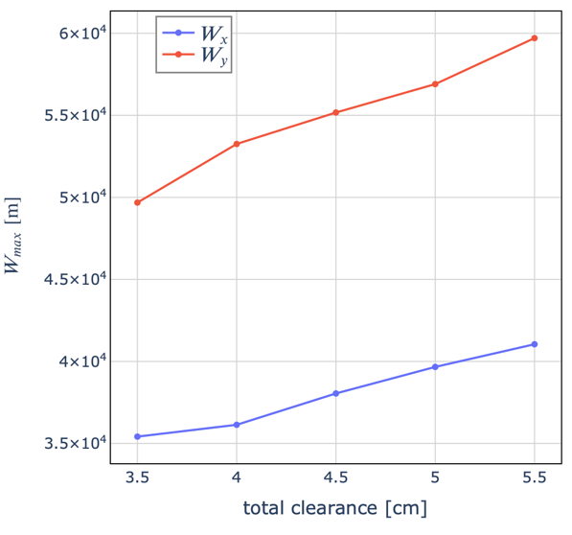


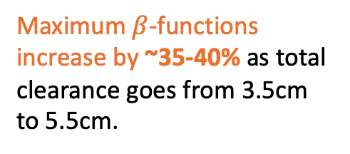
Results - $β$ and W functions
Larger W shielding thickness → higher maximum $β$ and aperture, and lower gradients in the IR quadrupoles. The maxima of W increase accordingly
Maximum$β$-functions increase by ~35-40% as total clearance goes from 3.5cm to 5.5cm.

Slide 8
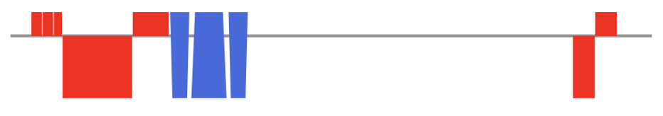
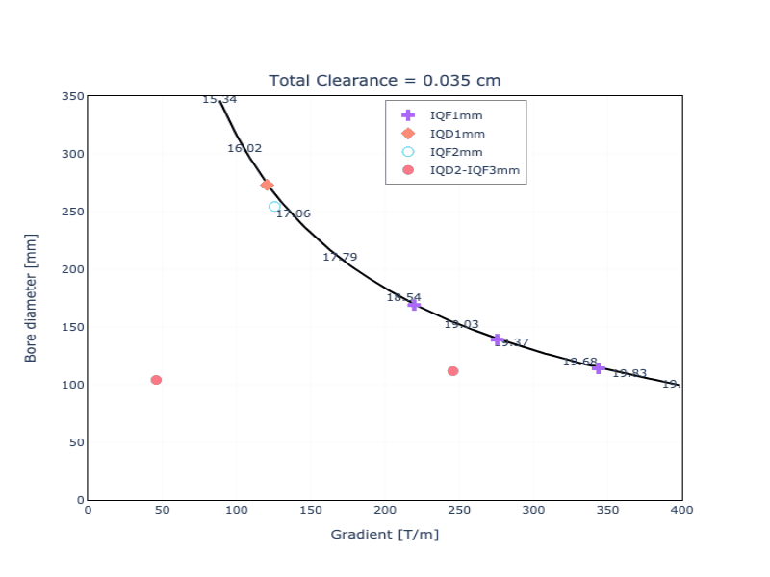
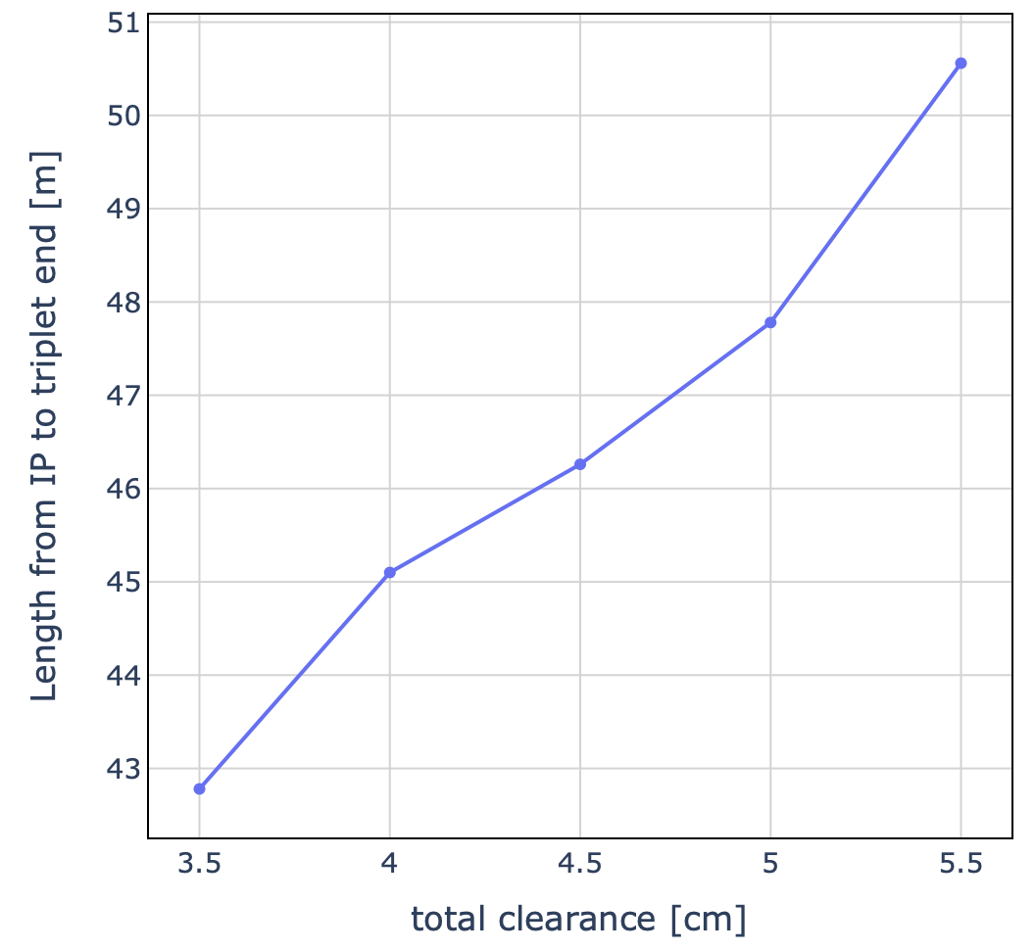
Length of the Final focusing triplet
An increased W shielding thickness leads to larger magnet apertures → smaller gradients, longer magnets.
Doublet quads lengths also adapted to match the CC
W thickness increases
W thickness increases

Slide 9
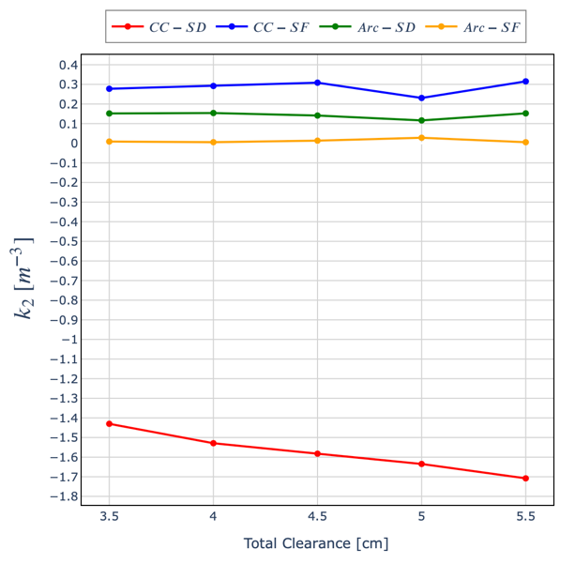
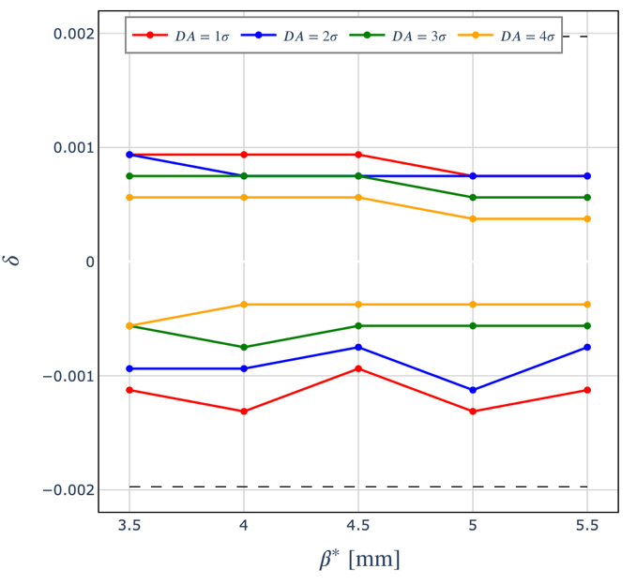

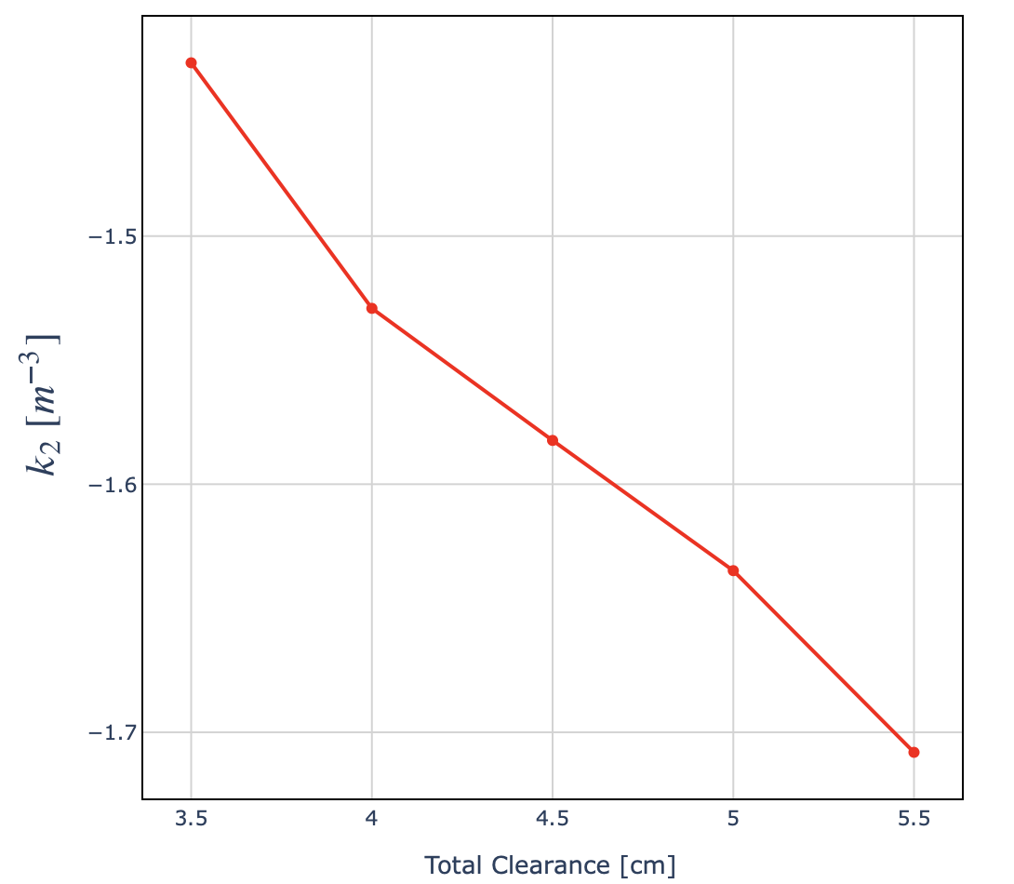

Performance and sextupole strenght
No significant degradation of momentum acceptance by increasing the total clearance, BUT large increase of sextupole strengths in the CC (chromatic effects increase):
  Larger magnetic field in sextupole magnets, larger feed-down for given offsets;
  Lattice more sensitive to errors.
Change in 𝑘2→ ~15 T change in sextupole
DA on 100 turns

Slide 10
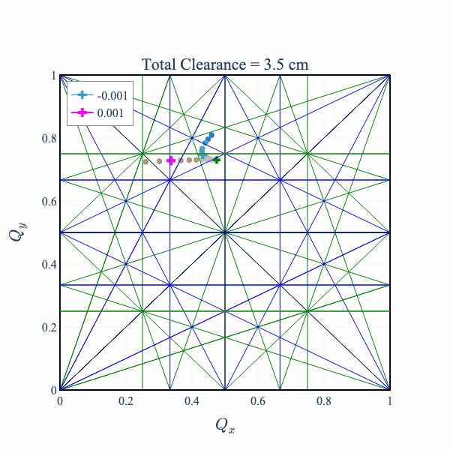
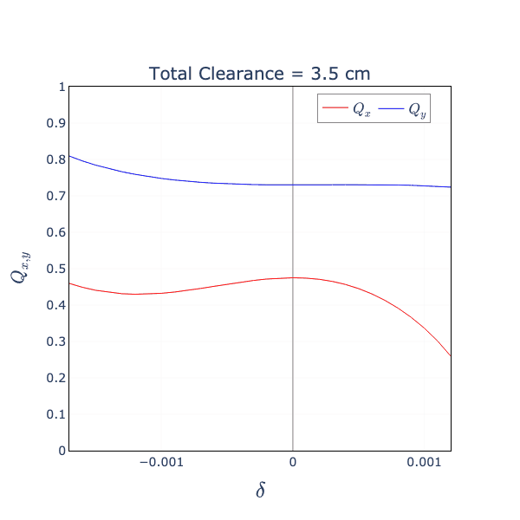
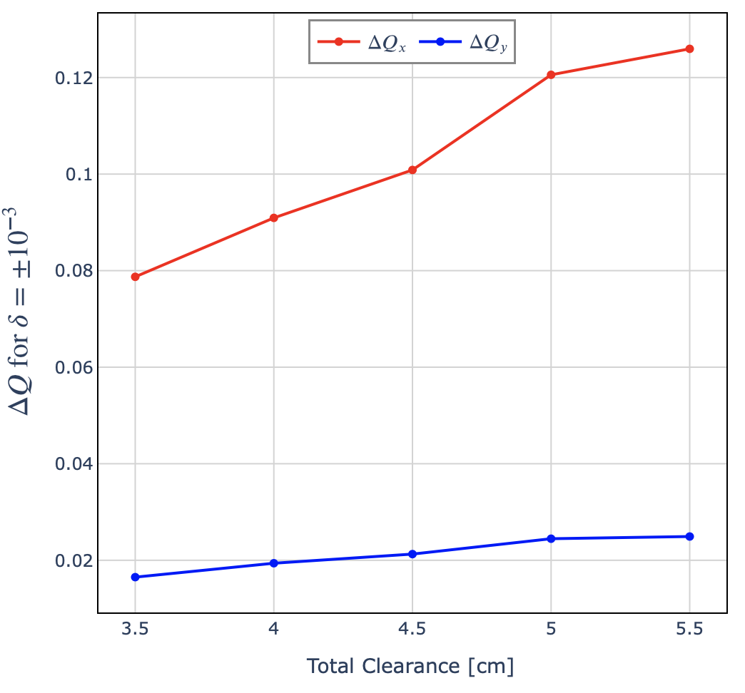
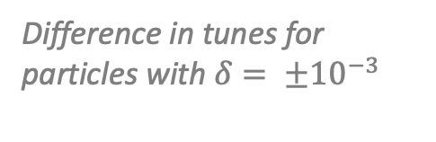
Total clearance – Tune spread
Large differences in tunes for off-momentum particles, but similar energy dependence across all updated lattices.
Difference in tunes for particles with $δ= ±{10}^{−3}$

Slide 11
Sensitivity study on L*
2
Study the impact of an increased L* on optics and collider performance

Slide 12
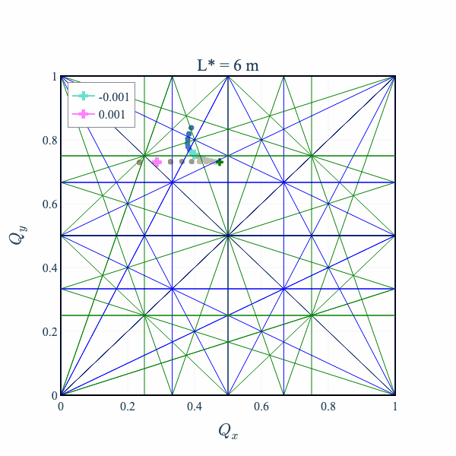
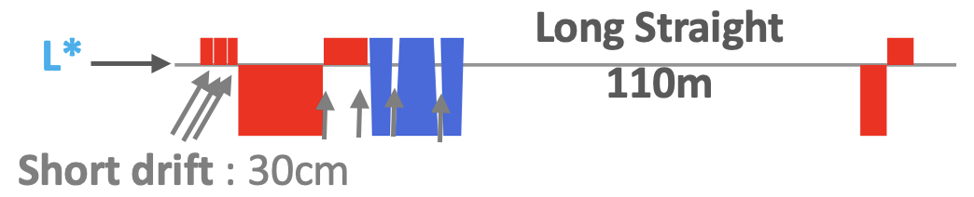
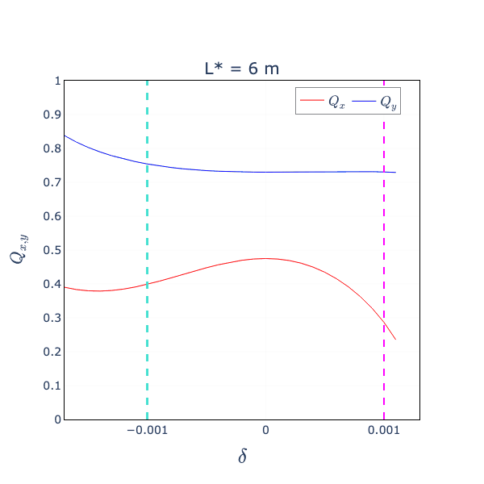
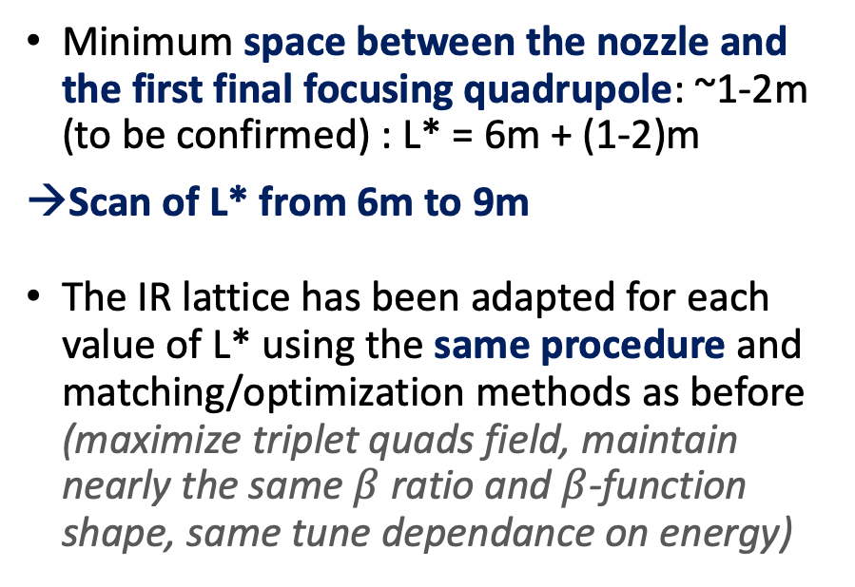
Sensitivity study – L*
Minimum space between the nozzle and the first final focusing quadrupole: ~1-2m (to be confirmed) : L* = 6m + (1-2)m
Scan of L* from 6m to 9m
The IR lattice has been adapted for each value of L* using the same procedure and matching/optimization methods as before (maximize triplet quads field, maintain nearly the same $β$ratio and $β$-function shape, same tune dependance on energy)

Slide 13
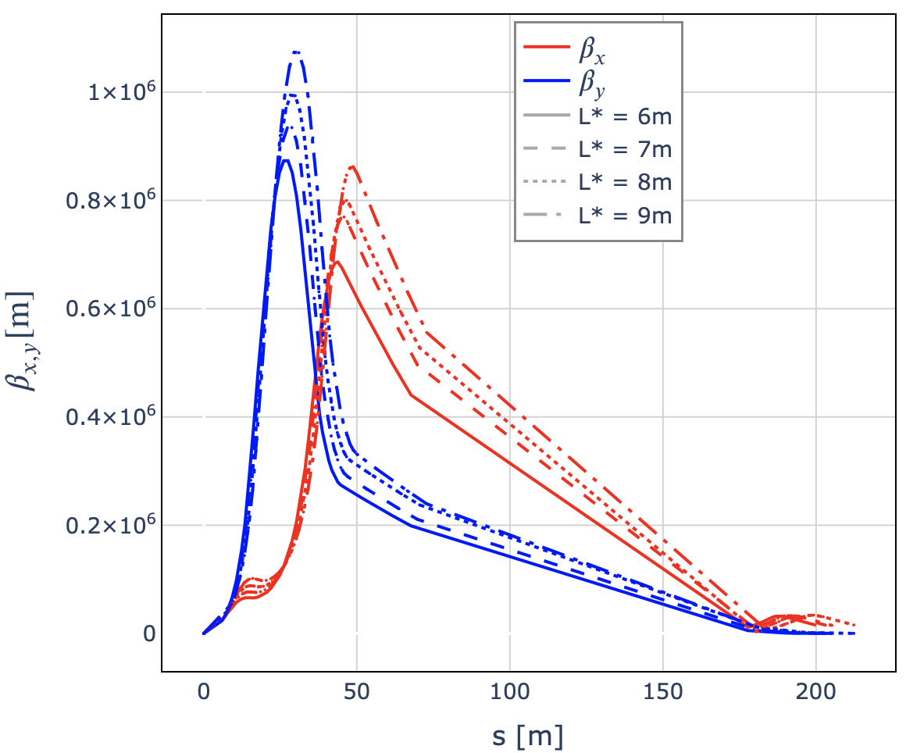
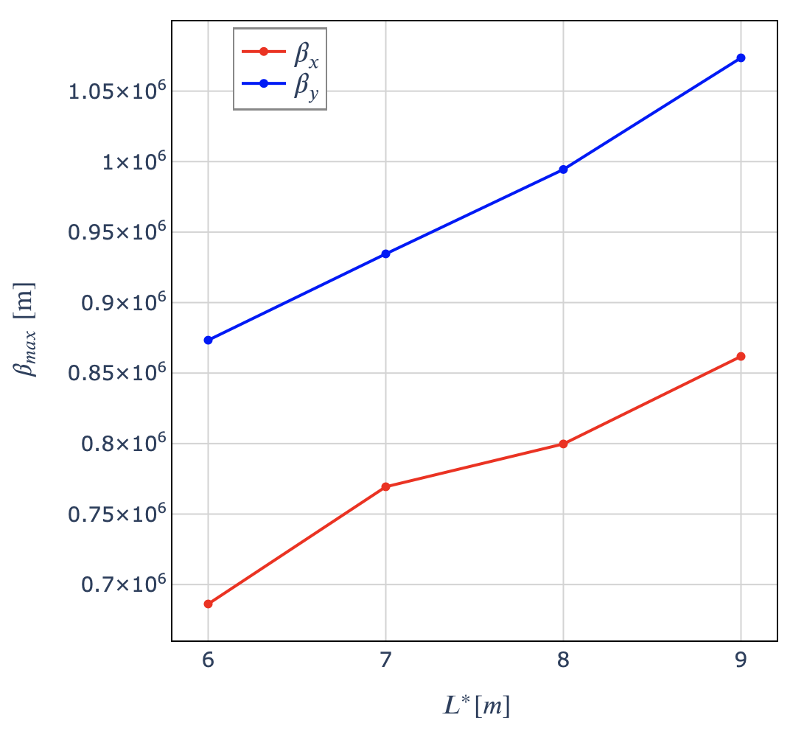
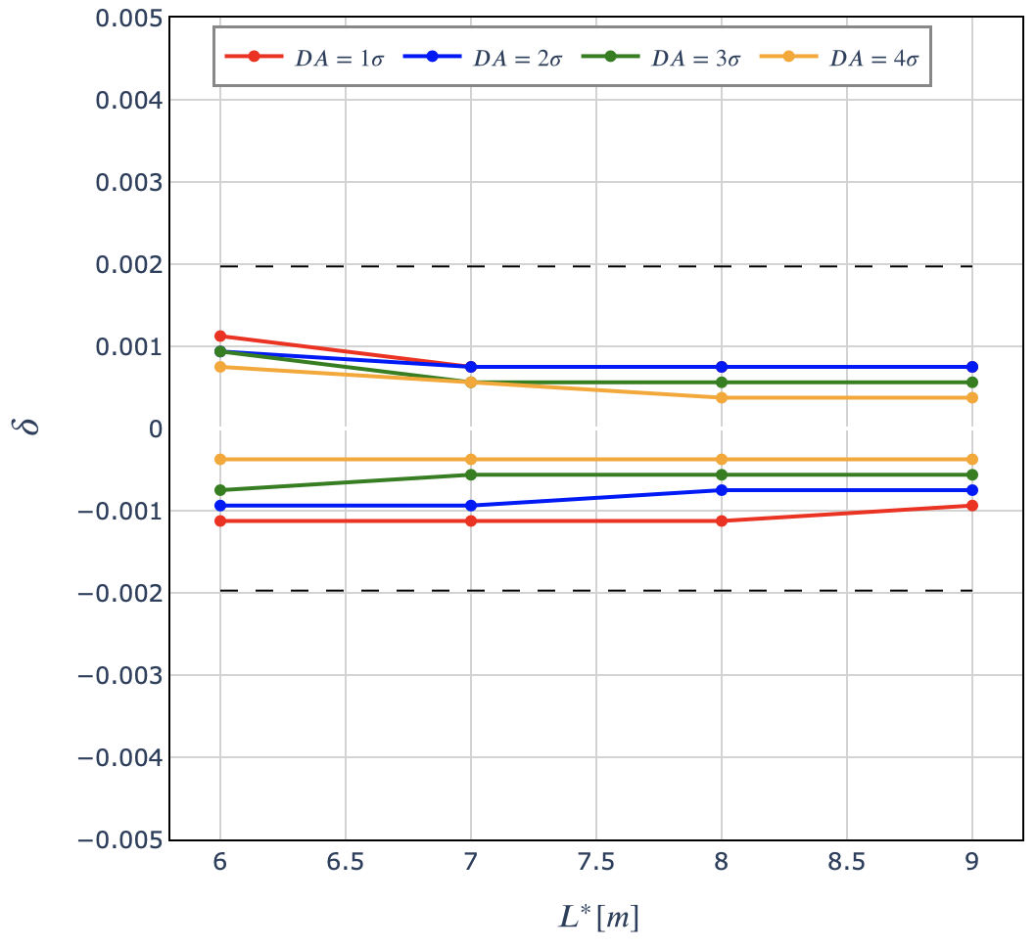
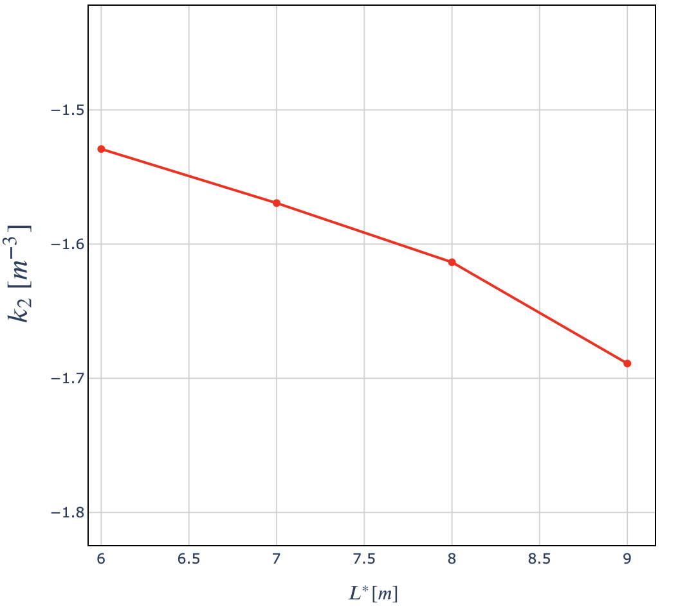
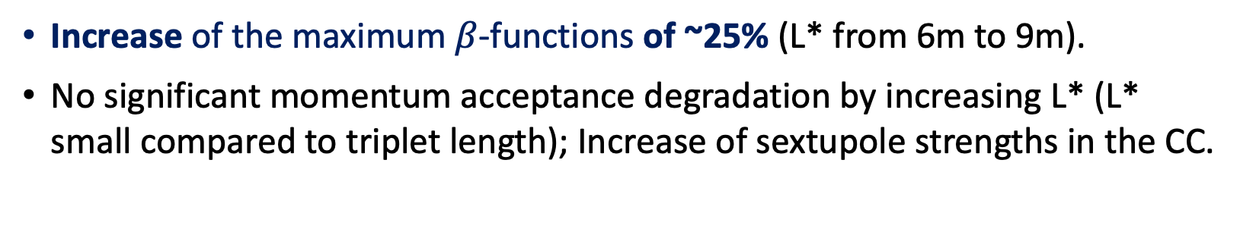
Sensitivity study on L* - Results
Increase of the maximum $β$-functions of ~25% (L* from 6m to 9m).
No significant momentum acceptance degradation by increasing L* (L* small compared to triplet length); Increase of sextupole strengths in the CC.
𝑘2 for sextupoles in CCY

Slide 14
Sensitivity study on interconnects length
3
Include interconnects of 1m in the IR design and evaluate their impact on collider performance.

Slide 15
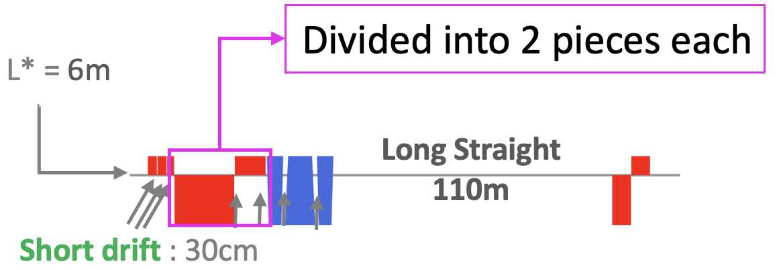
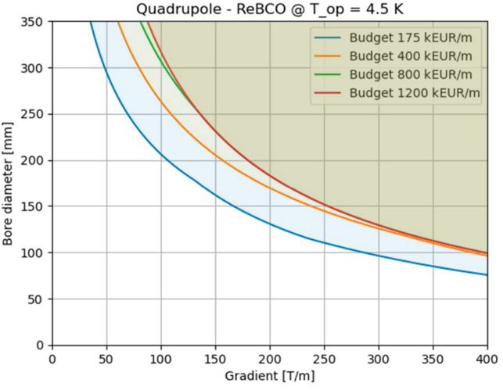
Baseline preliminary changes
Maximum magnetic field based on AG plots for 800k€/m (vs. 1200k€/m)
  Only minor differences between the two curves
~20m
Adapt the IR lattice to keep the magnet lengths reasonable (~10m, to be confirmed):
  The triplet defocusing quadrupole (IQD1) and last focusing quadrupole (IQF2) are split into 2 pieces each.
  Impact 30cm interconnects is small compared to 1m.
D. Novelli, https://indico.cern.ch/event/1410212/

Slide 16
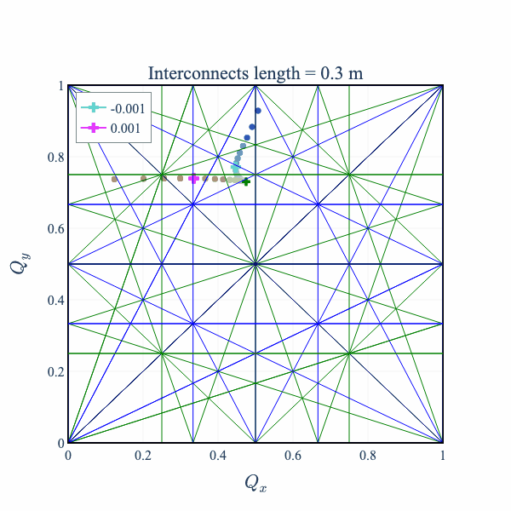
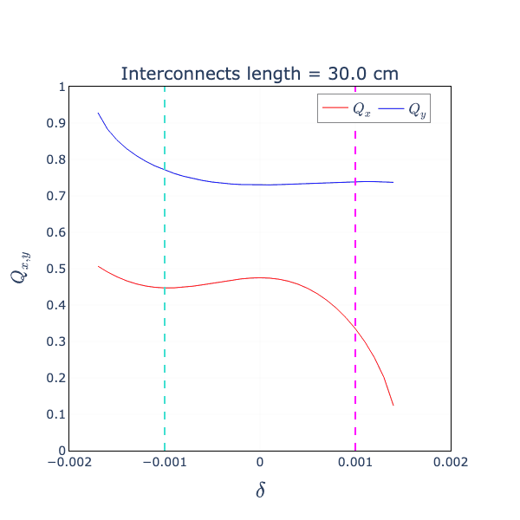
Sensitivity study- interconnects
The IR lattice has been adapted for each value of interconnect length (30cm, 60cm, 100cm), using the same procedure as before.
The quadrupole fields have been maximized for each piece, assuming IR quads can be custom-made.
The interconnects length are changed only in the IR, not (yet) in other parts of the collider.
Similar 𝛽-functions, working point and tune dependence on energy across all updated lattices

Slide 17
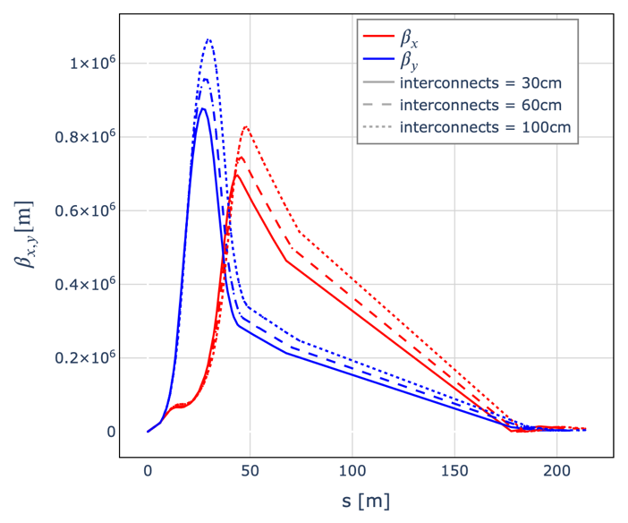
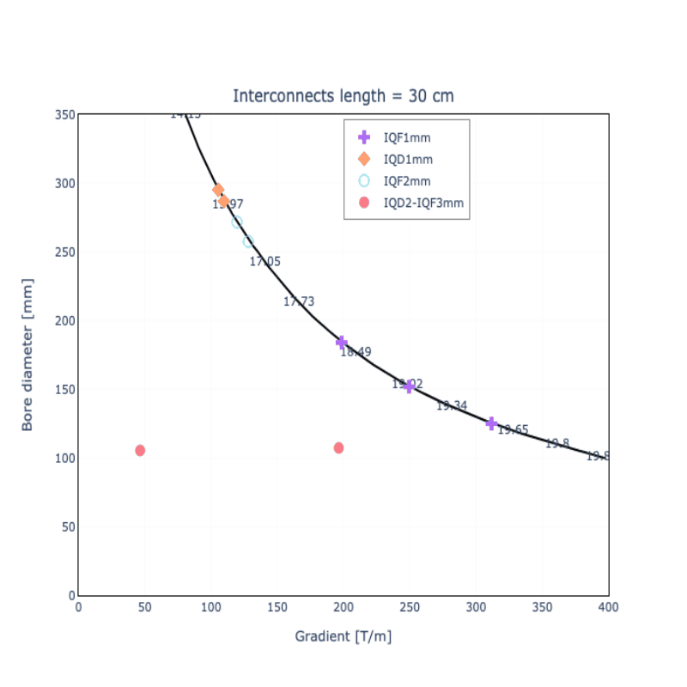
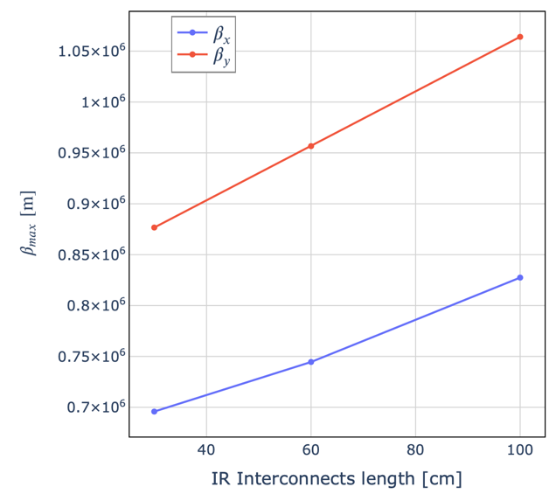
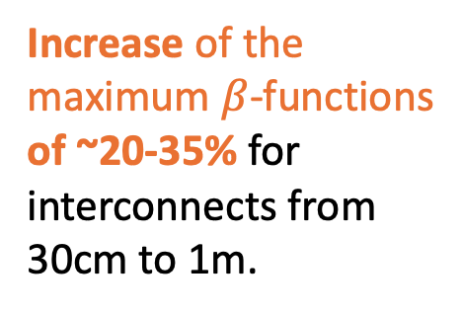
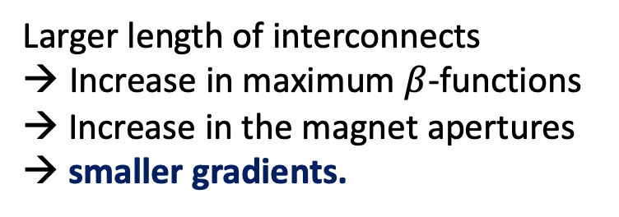
Interconnects - Results
Increase of the maximum $β$-functions of ~20-35% for interconnects from 30cm to 1m.
Larger length of interconnects
Increase in maximum $β$-functions
→ Increase in the magnet apertures → smaller gradients.

Slide 18
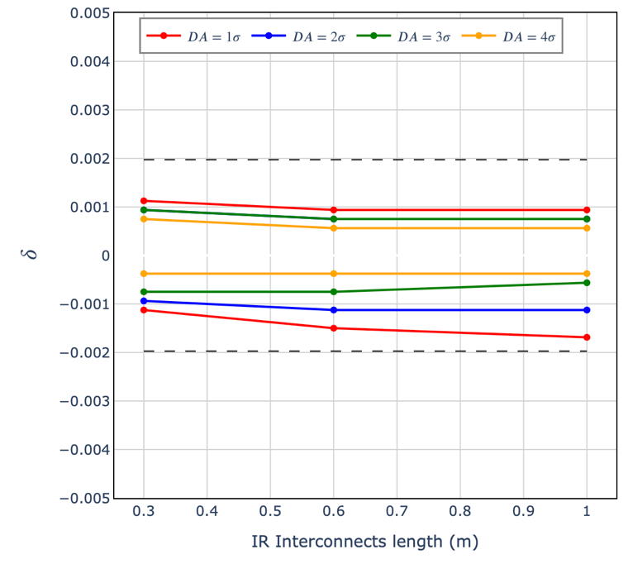
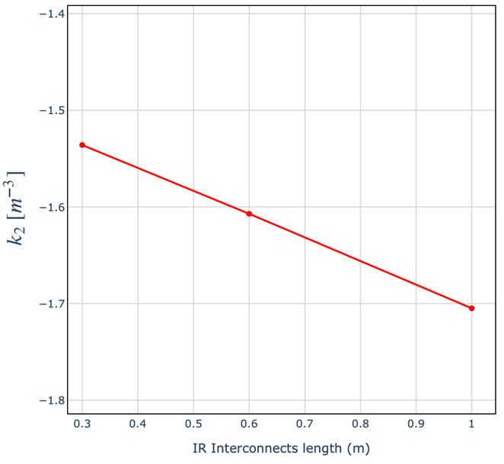

Interconnects - Results
Similar conclusion as for the the W shielding thickness sensitivity study: no significant changes in momentum acceptance for DA ~ 2-3$σ$, but a significant increase in sextupole strength in the CC
𝑘2 for sextupoles in CCY

Slide 19
Conclusion and Next steps

Slide 20
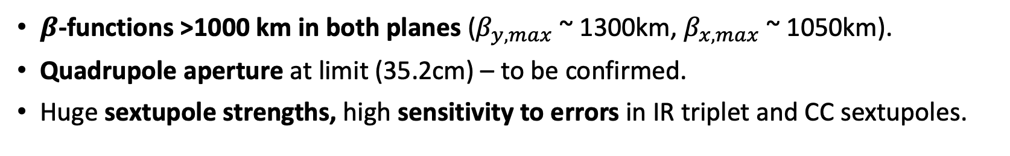

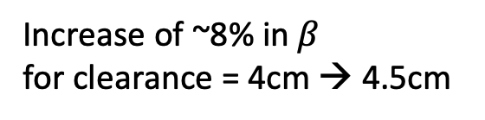



Rough estimate of $β_{max}$ combining effects
Sensitivity studies carried out independently for the 3 parameters to assess their individual impact on collider performance
First rough estimate of maximum $β$ if we combine the effects:
Assume interconnects length of 1m, L*=8m, and total clearance of 4.5cm
${ β}_{y, max}$ ~ 1064 $km$
$$β_{x, max}\text{ \sim }\text{827} km$$
Increase of ~15% in $β$
for L* = 6m → 8m
Increase of ~8% in $β$
for clearance = 4cm → 4.5cm
$β$-functions >1000 km in both planes ($β_{y, max}$ ~ 1300km, $β_{x, max}$ ~ 1050km).
Quadrupole aperture at limit (35.2cm) – to be confirmed.
Huge sextupole strengths, high sensitivity to errors in IR triplet and CC sextupoles.
More precise results → complete lattice design

Slide 21
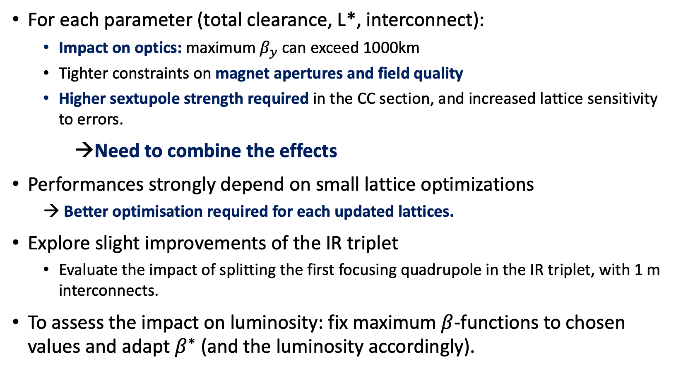
Conclusions and next steps
For each parameter (total clearance, L*, interconnect):
  Impact on optics: maximum $β_{y}$can exceed 1000km
  Tighter constraints on magnet apertures and field quality
  Higher sextupole strength required in the CC section, and increased lattice sensitivity to errors.
→Need to combine the effects
Performances strongly depend on small lattice optimizations
  → Better optimisation required for each updated lattices.
Explore slight improvements of the IR triplet
  Evaluate the impact of splitting the first focusing quadrupole in the IR triplet, with 1 m interconnects.
To assess the impact on luminosity: fix maximum $β$-functions to chosen values and adapt $β^{∗}$ (and the luminosity accordingly).

Slide 22
Thank you for your attention
The lattice presented is still a work in progress and subject to change in the future

Slide 23
Back-up slides

Slide 24


Impact of interconnects for IQD1/IQF2
For the same line, splitting IQD1 et IQF2 into two pieces has a small impact for interconnects of 30cm, but a significant impact for interconnects of 1m.
Interconnect length of 1m
Interconnect length of 30cm

Slide 25



Interconnects - $β$ and W functions

Slide 26


L* - $β$ and W functions

Slide 27




Muon Collider: Interaction region
Montague chromatic functions:
W describe variations of Twiss 𝛼 and 𝛽 for (small) momentum offsets.
The very small $β^{∗}$at the IP induce very large $β$-function in the strong focusing FF quadrupoles, resulting in significant chromatic effects.
→ Very large W functions at the end of the IR.
→ Need for a local Chromatic Correction section.

