Slide 1




Requirements for field-free drift regions in the Muon Collider IR region
B. Caiffi¹, S. Mariotto^{2,3}, L. Bottura³, H. Prin³,
¹INFN – Genoa, ¹University of Milan, ³INFN – Milan, ³CERN
Funded by the European Union (EU). Views and opinions expressed are however those of the author only and do not necessarily reflect those of the EU or European Research Executive Agency (REA). Neither the EU nor the REA can be held responsible for them.

Slide 2
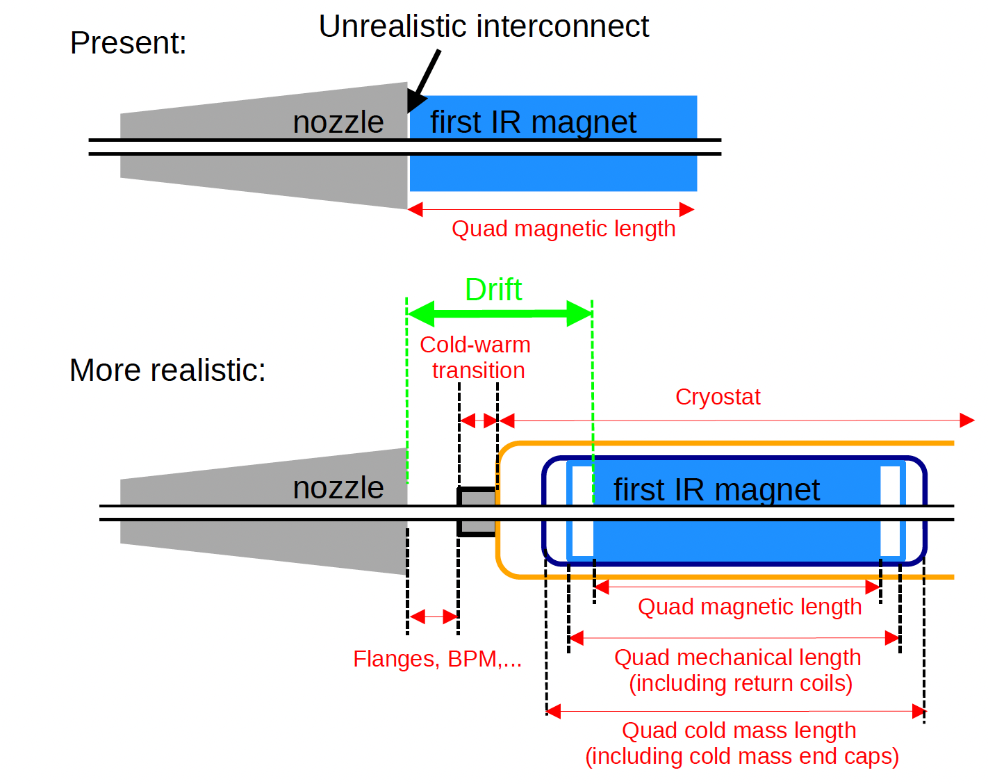
Field-free Region
mechanic quadrupole length
cold mass length
cryostat length
cold-warm transition outside of cryostat
other equipment outside of cryostat (flanges, BPM, vacuum pumps, bellows).
Courtesy of A. Lachner

Slide 3
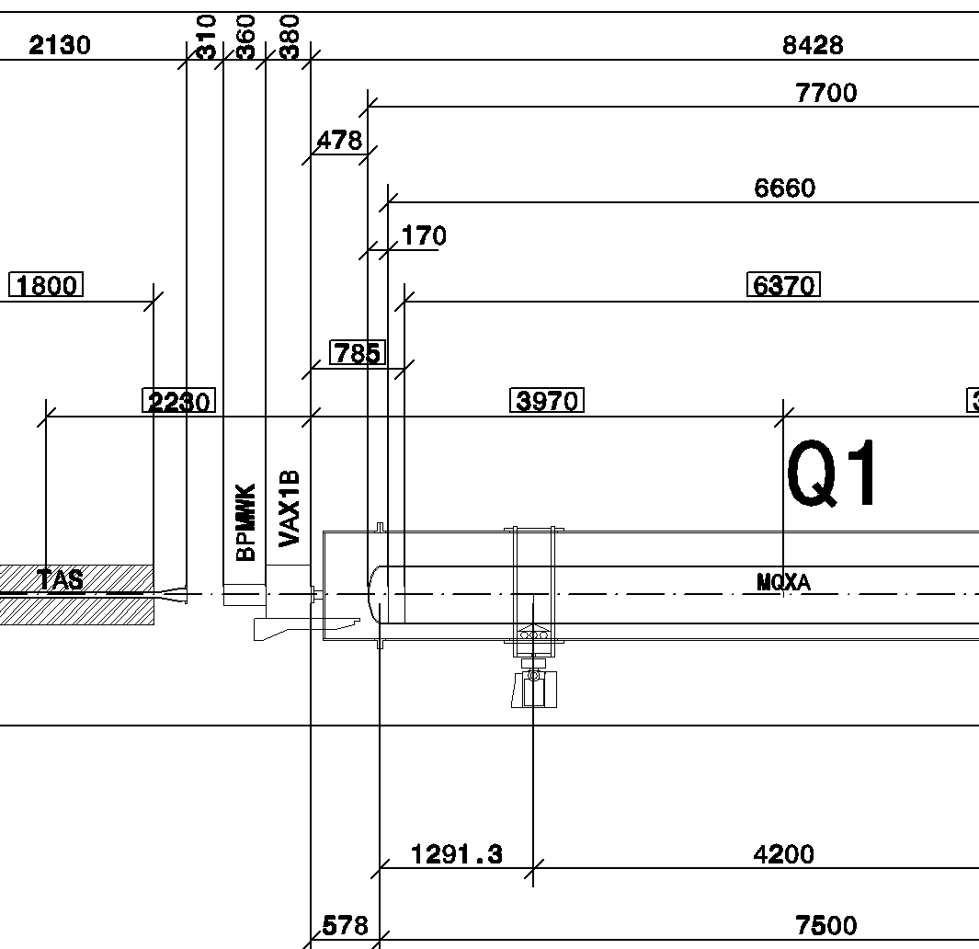
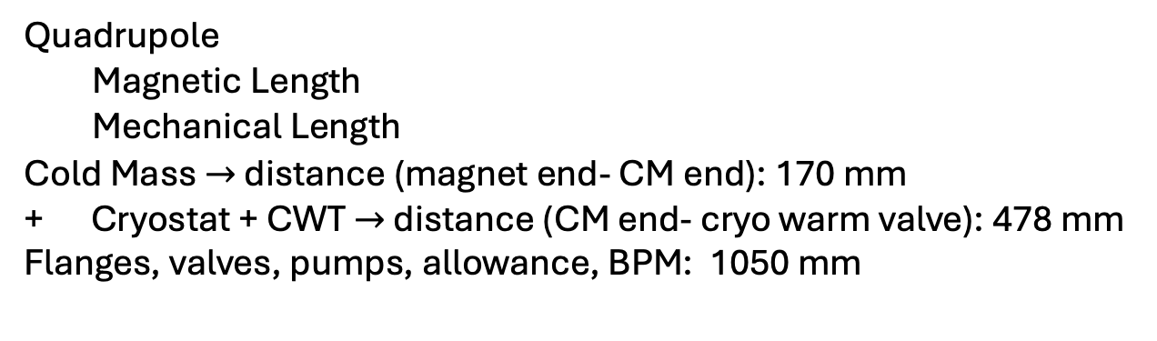
LHC Drift FFR
First IR magnet
Quadrupole
Magnetic Length
Mechanical Length
Cold Mass $→$ distance (magnet end- CM end): 170 mm
+ Cryostat + CWT$→$ distance (CM end- cryo warm valve): 478 mm
Flanges, valves, pumps, allowance, BPM: 1050 mm
L_{end}=137 mm
Total: 1835 mm
Courtesy of H. Prin

Slide 4
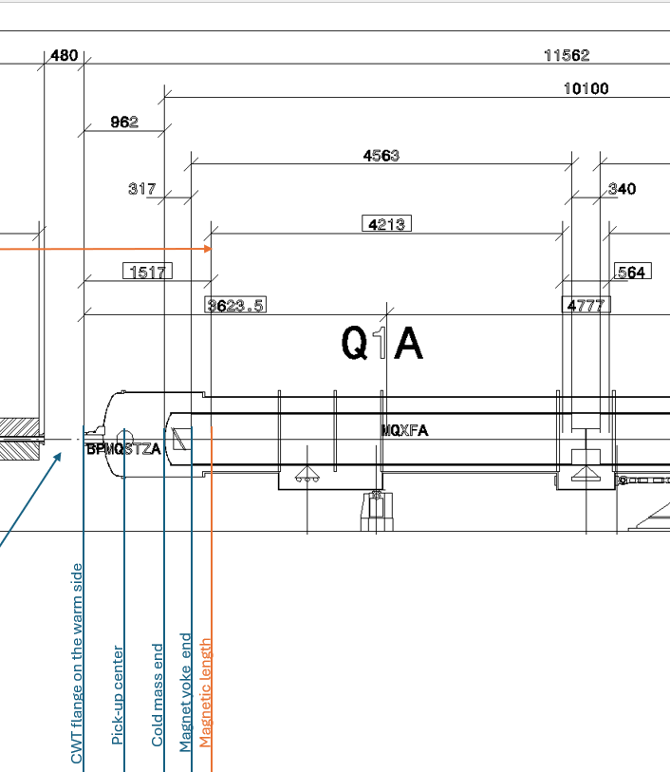
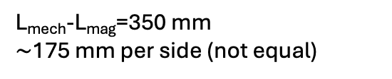
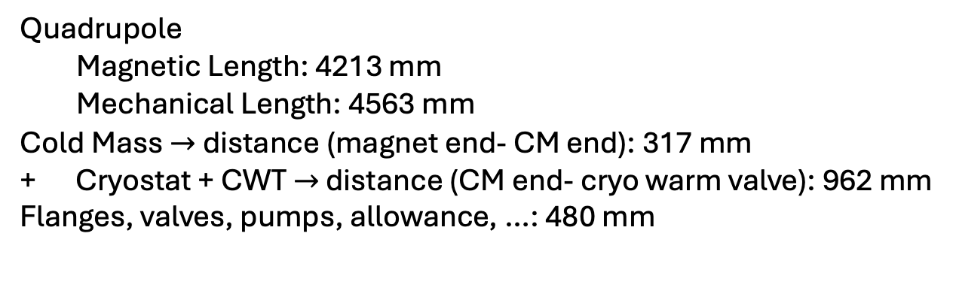
Hi-Lumi LHC Drift FFR
First IR magnet
Quadrupole
Magnetic Length: 4213 mm
Mechanical Length: 4563 mm
Cold Mass $→$ distance (magnet end- CM end): 317 mm
+ Cryostat + CWT $→$ distance (CM end- cryo warm valve): 962 mm
Flanges, valves, pumps, allowance, …: 480 mm
L_{mech}-L_{mag}=350 mm
$\sim$175 mm per side (not equal)
Courtesy of H. Prin
Total: ~1934 mm

Slide 5
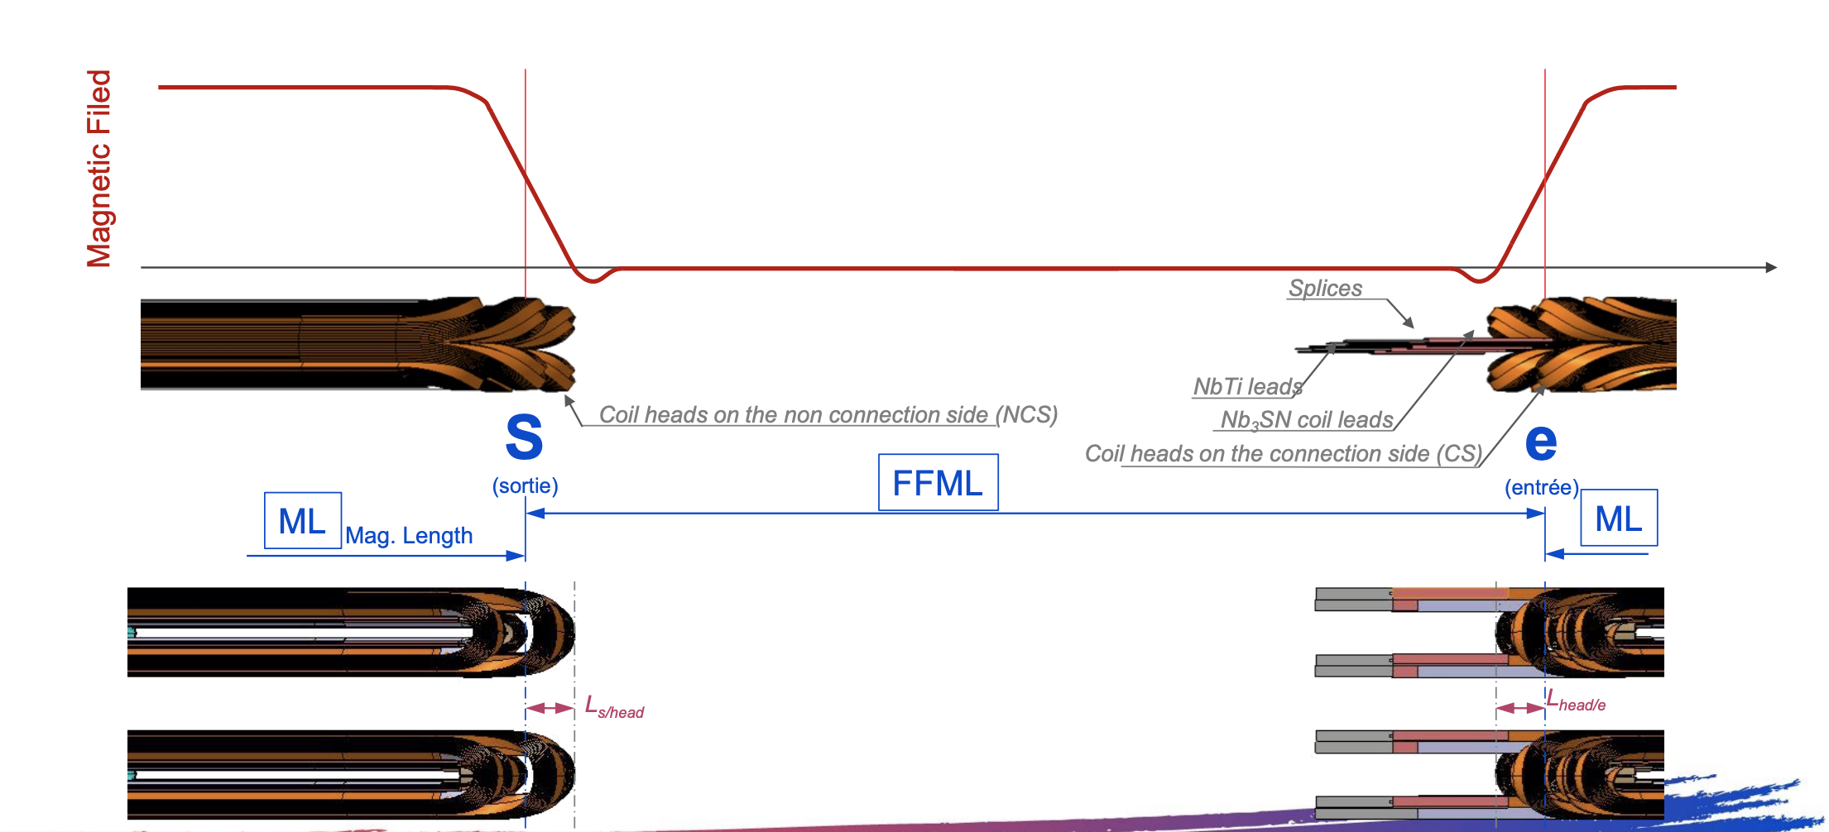
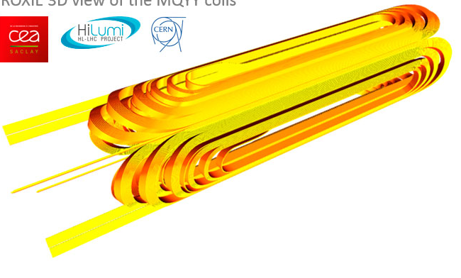

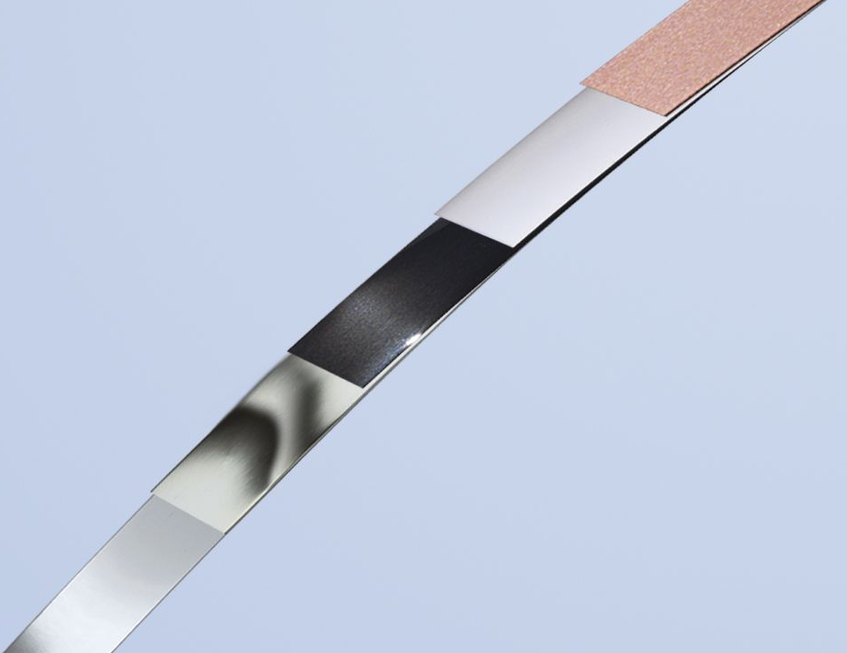
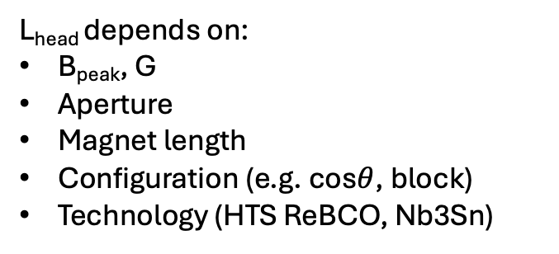
Coil Ends
L_{head} depends on:
B_{peak}, G
Aperture
Magnet length
Configuration (e.g. cos$θ$, block)
Technology (HTS ReBCO, Nb3Sn)
L_{head} = 175 mm (from Hi-Lumi LHC)
LTS Nb₃Sn
HTS ReBCO
H. Prin presentation @ mmWG 13th June 2024
175 mm is already quite challenging, we cannot gain more space in this part.
NB: preliminary evaluations: for Nb3Sn technology the value 175 mm is a lower bound (higher length may be need with higher fields and different apertures). For HTS technology longer lengths have to be considered Missing inputs: aperture, G, magnet length.

Slide 6
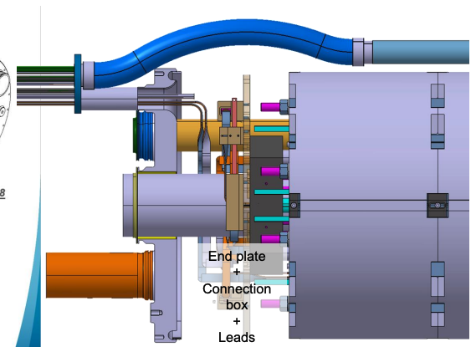
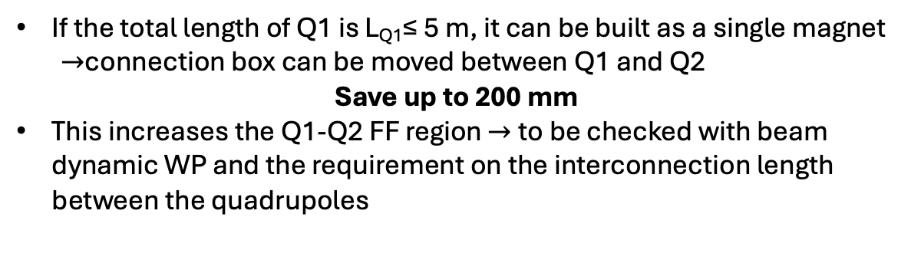
Coil Ends – Cold Mass
120
End plates
Connection box
Leads
H. Prin presentation @ mmWG 13th June 2024
Courtesy of H. Prin
If the total length of Q1 is L_{Q1}≤ 5 m, it can be built as a single magnet
$→$connection box can be moved between Q1 and Q2
Save up to 200 mm
This increases the Q1-Q2 FF region $→$to be checked with beam dynamic WP and the requirement on the interconnection length between the quadrupoles

Slide 7
Cold Mass -Cryostat
500
If operating at T_{op} ≥ 4.5 K, there is no need for a phase separator (no liquid helium), which saves a further ~500 mm.
No further gain for highet T
pick-up coil inside the cryostat
BPM: 250 mm in the CWT inside the cryosyat
Courtesy of H. Prin
Courtesy of H. Prin
Courtesy of H. Prin

Slide 8
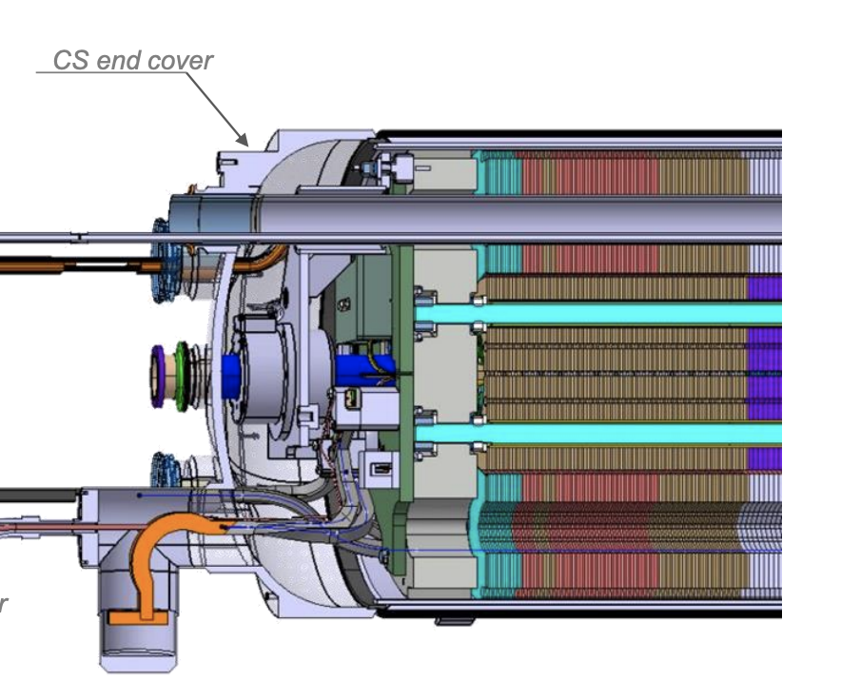
Cold Mass End Covers – Cryogenic Vessel Closures
End covers are closing the volume of the cold masses in the extremities.
End covers volume houses the busses expansion loops and the spool pieces correctors.
Dished end covers can be used, flat ones also exist (SSS on the CS, HL-LHC cold masses). In this last case, material thickness must be adapted to sustain the pressure. It is not guaranteed that longitudinal space can be saved.
To be discussed with Cryogenics WP
In any case, no big gain in this section
H. Prin presentation @ mmWG 13th June 2024

Slide 9
Warm Equipments
?
Depending on the required vacuum level, an alternative scheme to the usual valve–pump–valve layout can be considered, with only one valve on the IP side.
nozzle
pump
Cryo
nozzle
pump
Cryo
CWT
CWT
valve
valve
valve
This should be evaluated together with the Vacuum and Cryogenics WPs.
In any case, no significant space gain is achievable in this region, since allowance and clearance must always be ensured.
Courtesy of H. Prin

Slide 10
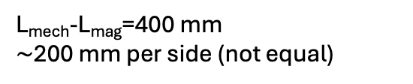
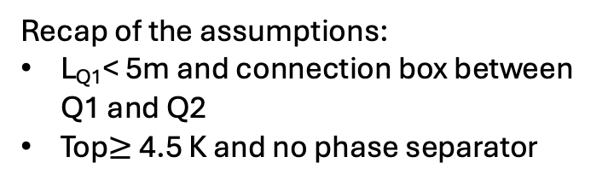
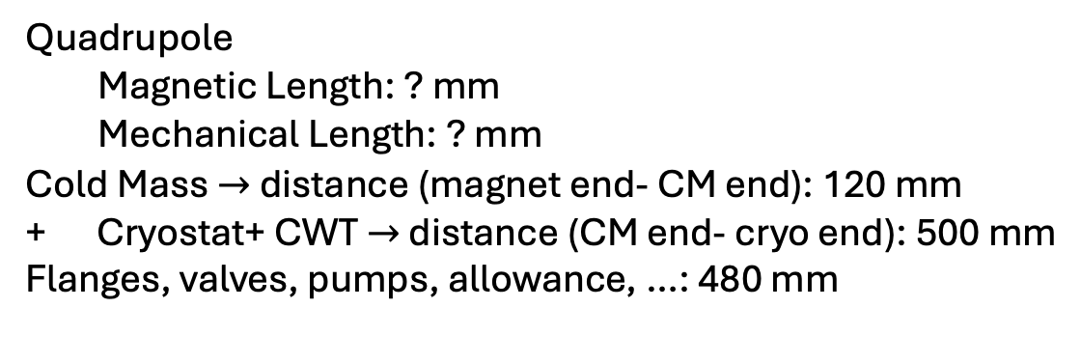
MuCol Drift FF Region
Recap of the assumptions:
L_{Q1}< 5m and connection box between Q1 and Q2
Top$≥$ 4.5 K and no phase separator
First IR magnet
Disclaimer:
These estimates are very approximate and rely on several assumptions and hypotheses made to compensate for the lack of important information.
B, G, apertures and magnet length should be finalized as soon as possible.
Are there any other parameters or estimates you are missing from our side that are preventing progress in the design?
Quadrupole
Magnetic Length: ? mm
Mechanical Length: ? mm
Cold Mass $→$ distance (magnet end- CM end): 120 mm
+ Cryostat+ CWT $→$ distance (CM end- cryo end): 500 mm
Flanges, valves, pumps, allowance, …: 480 mm
L_{mech}-L_{mag}=400 mm
$\sim$200 mm per side (not equal)
Total: ~1835 mm for LHC
Total: ~1934 mm for HL-LHC
Total: 1500 mm for MuCol
(1300 mm + 200 mm as a safety margin)
integration in this area has always been a challenge, in LHC, HL-LHC...
we didn't take any margin anywhere,
we don't know what will be the distance between the magnetic length and the end of the magnet until the design has been completed,
the position of the pick-up might be at a parasitic crossing position

Slide 11
Thanks for the Attention

