Slide 1
Detector Integration Progress Integration study of FCC-ee detectors
EP-FCC
08.09.2025
Gianluca Gilmore Kerr

Slide 2
EP-FCC
In a nutshell
Preliminary CAD model developed of a detector in the large experimental caverns – Ready for further population
Initial location plan of main structures and working platforms surrounding the detectors
Feasible method of cable chain management for services during opening scenario – Verified by a manufacturer
Initial agreement with CE for modification of connection tunnels to Experimental caverns
Case put forward to CE for modification of smaller caverns

Slide 3
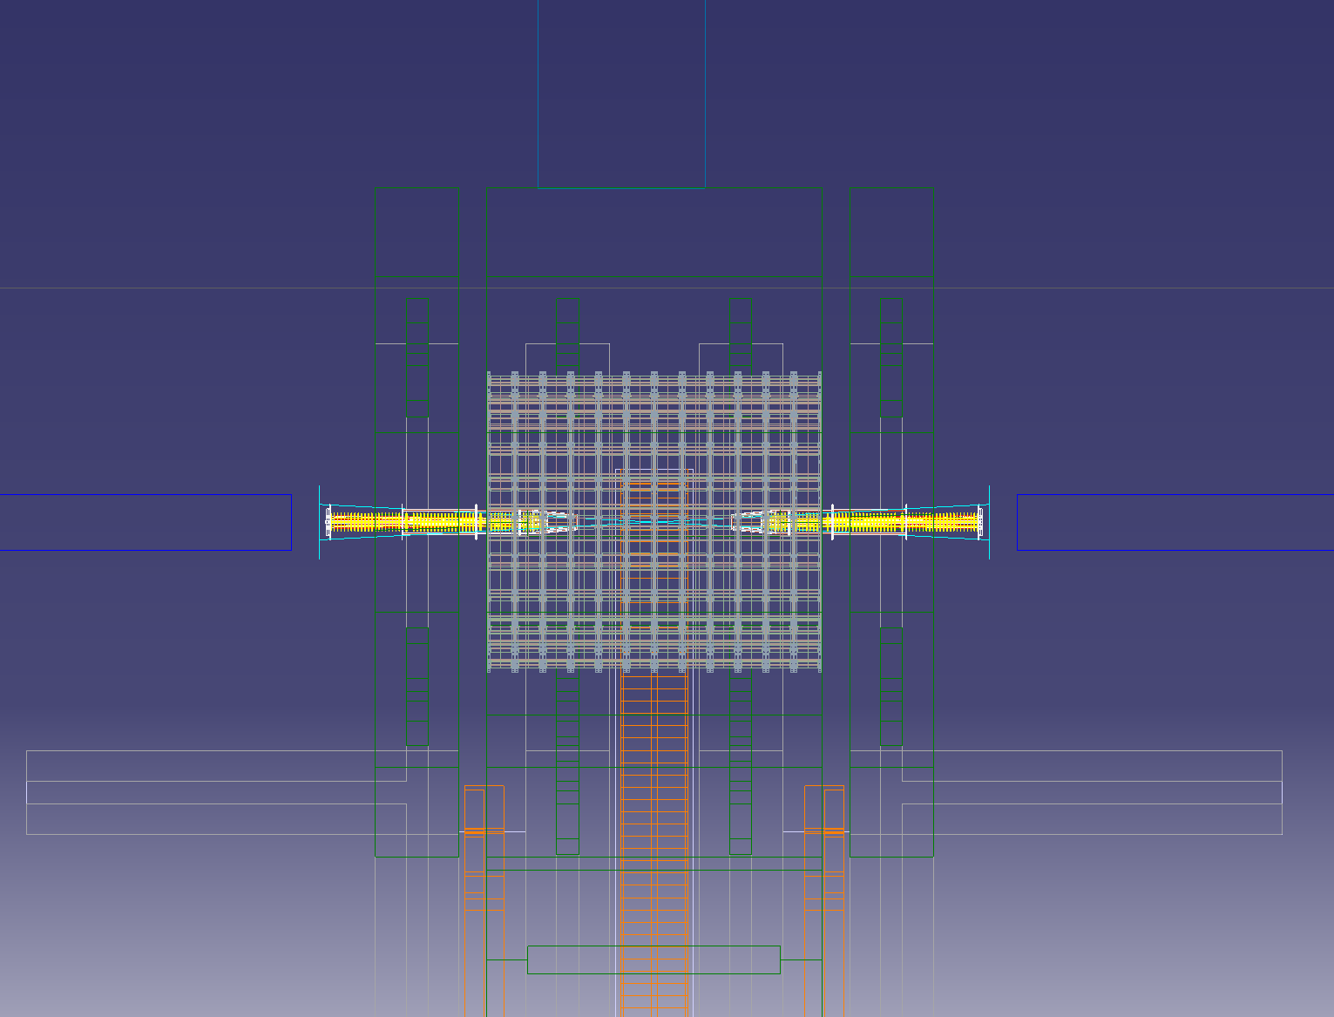
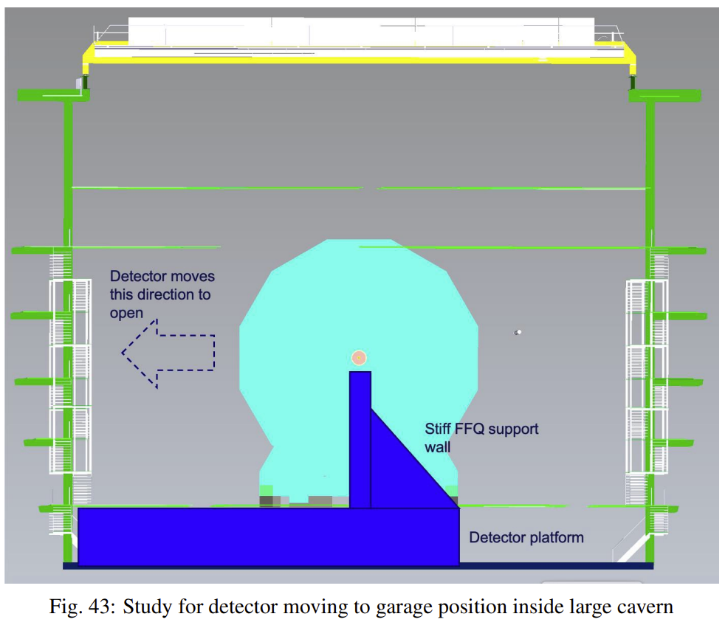
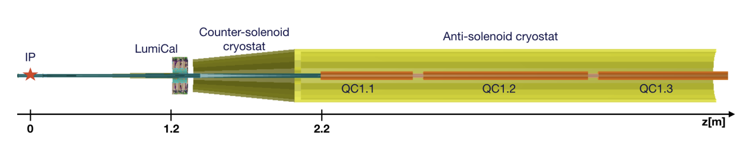
EP-FCC
Machine Detector Interface for FCC-ee
Plan view:
Final Focusing Quadrupole placed at 2.2m from IP
Machine elements are deep inside the detector
Alignment and stability of these components are pivotal
Supports for these components are therefore immovable
Ends of detector
Stiff FFQ support wall
FFQs

Slide 4
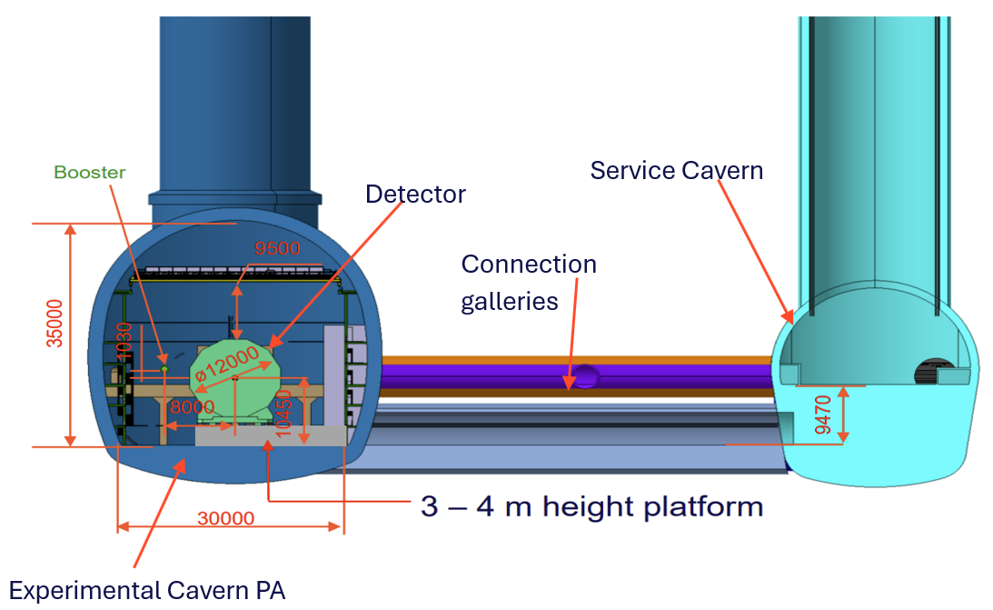
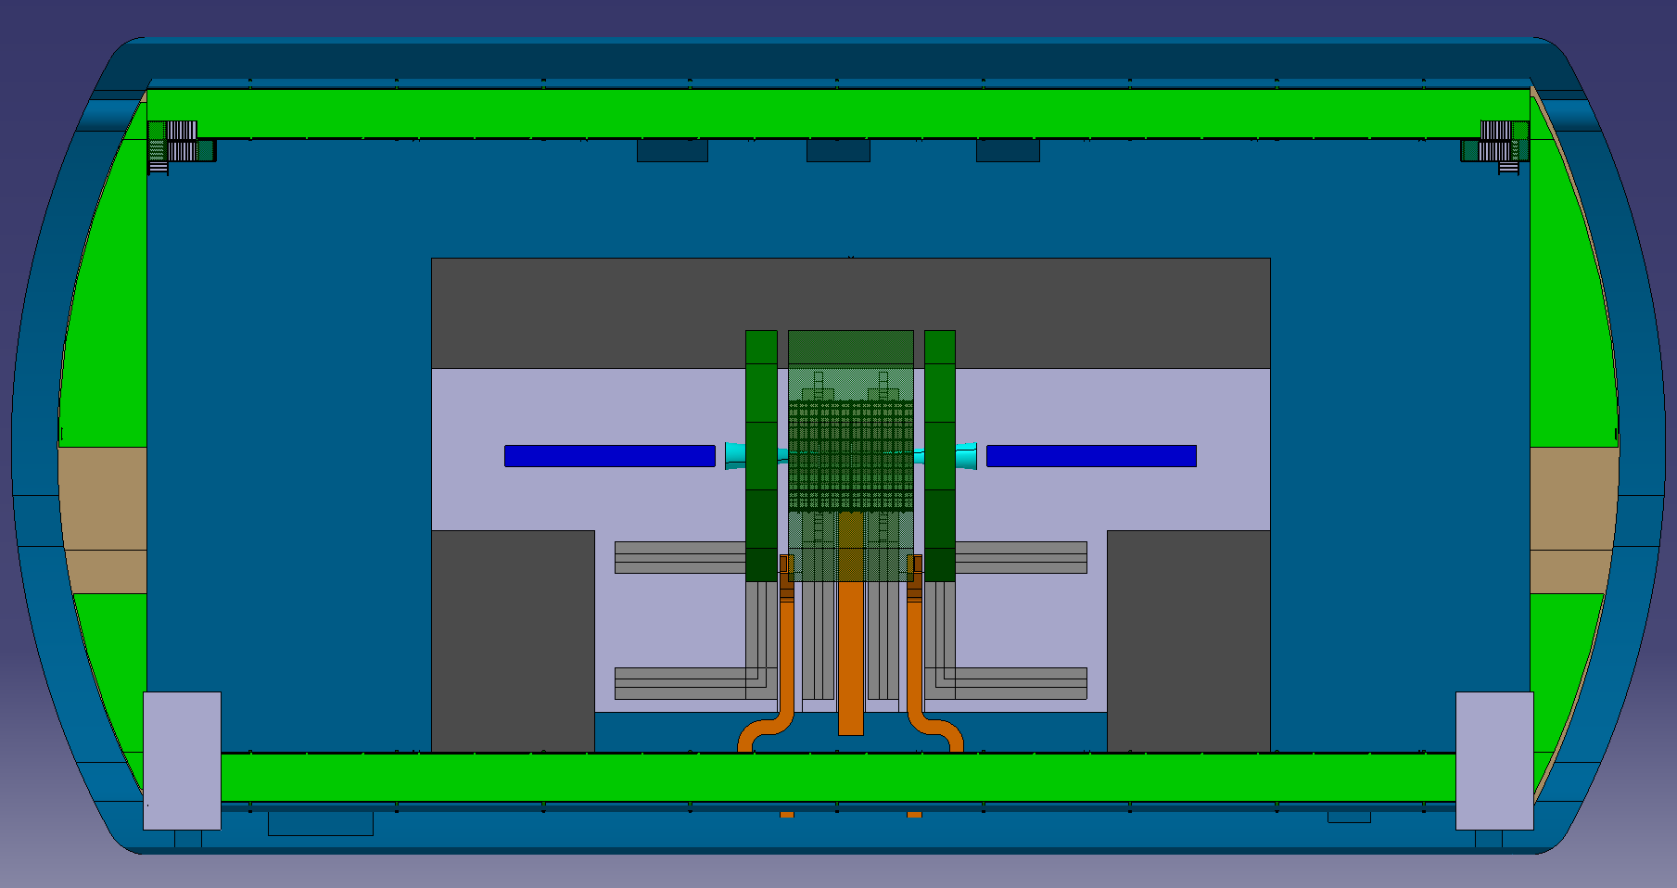
EP-FCC
Plan for PA and PG
Plan view
KEY:
Concrete platform & trenches – Light grey
Detector (barrel and endcaps) – Dark green
Steel platforms/enclosures – Dark grey
Detector tracks/guides – Grey
Machine elements (fixed and immovable) – Dark blue
MDI Envelope – Light Blue
Cable chains – Orange
Transversal cross – section
ST2427449_01 AA.04 FCCee CAD XPA Integration pre-TDR

Slide 5
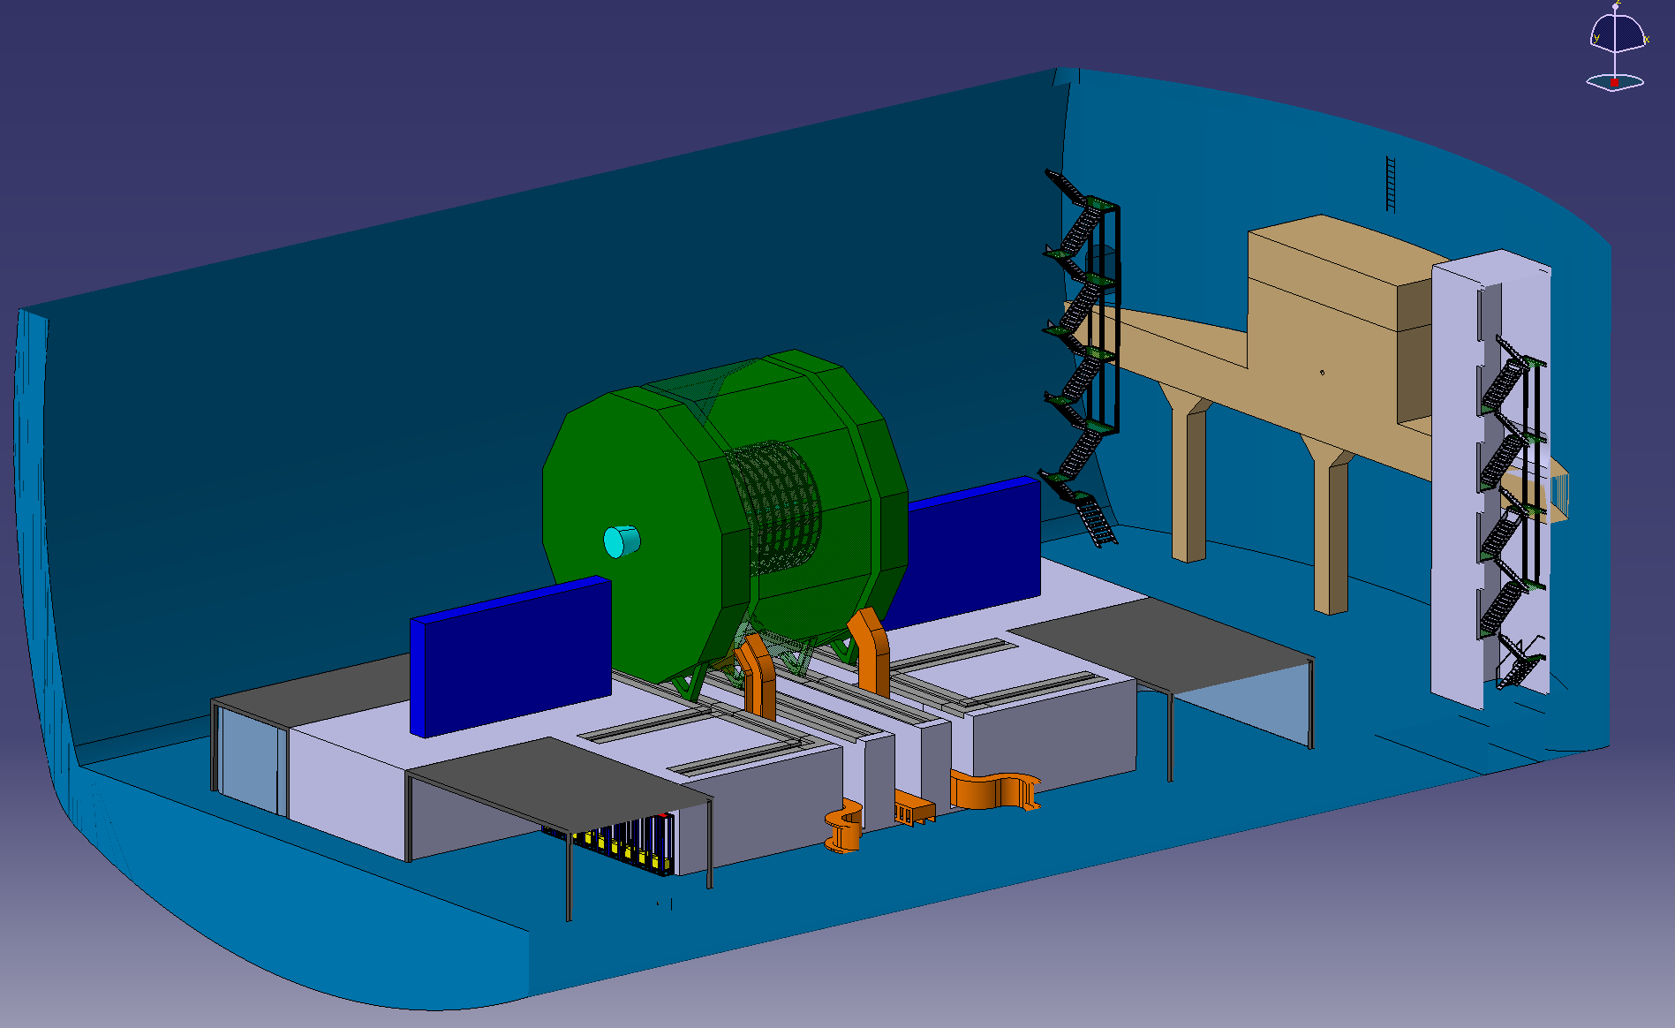
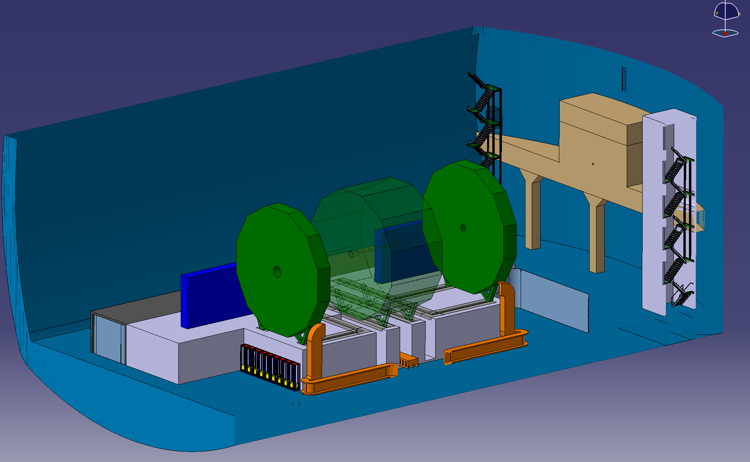
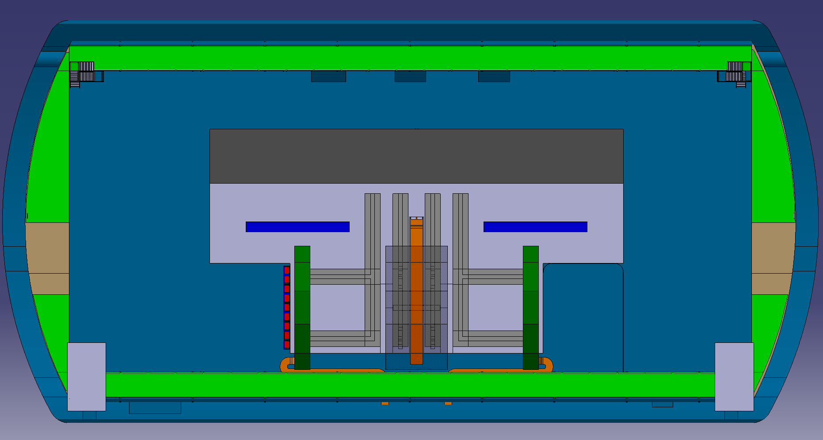
EP-FCC
Current plan at PA and PG
Closed scenario:
Open scenario:
Machine fixed support structure for final machine elements.
Detector must be moved transversally to clear the supporting structure before the endcaps are opened
Only few cm of clearance between cavern structures and detector
ST2427449_01 AA.04 FCCee CAD XPA Integration pre-TDR

Slide 6
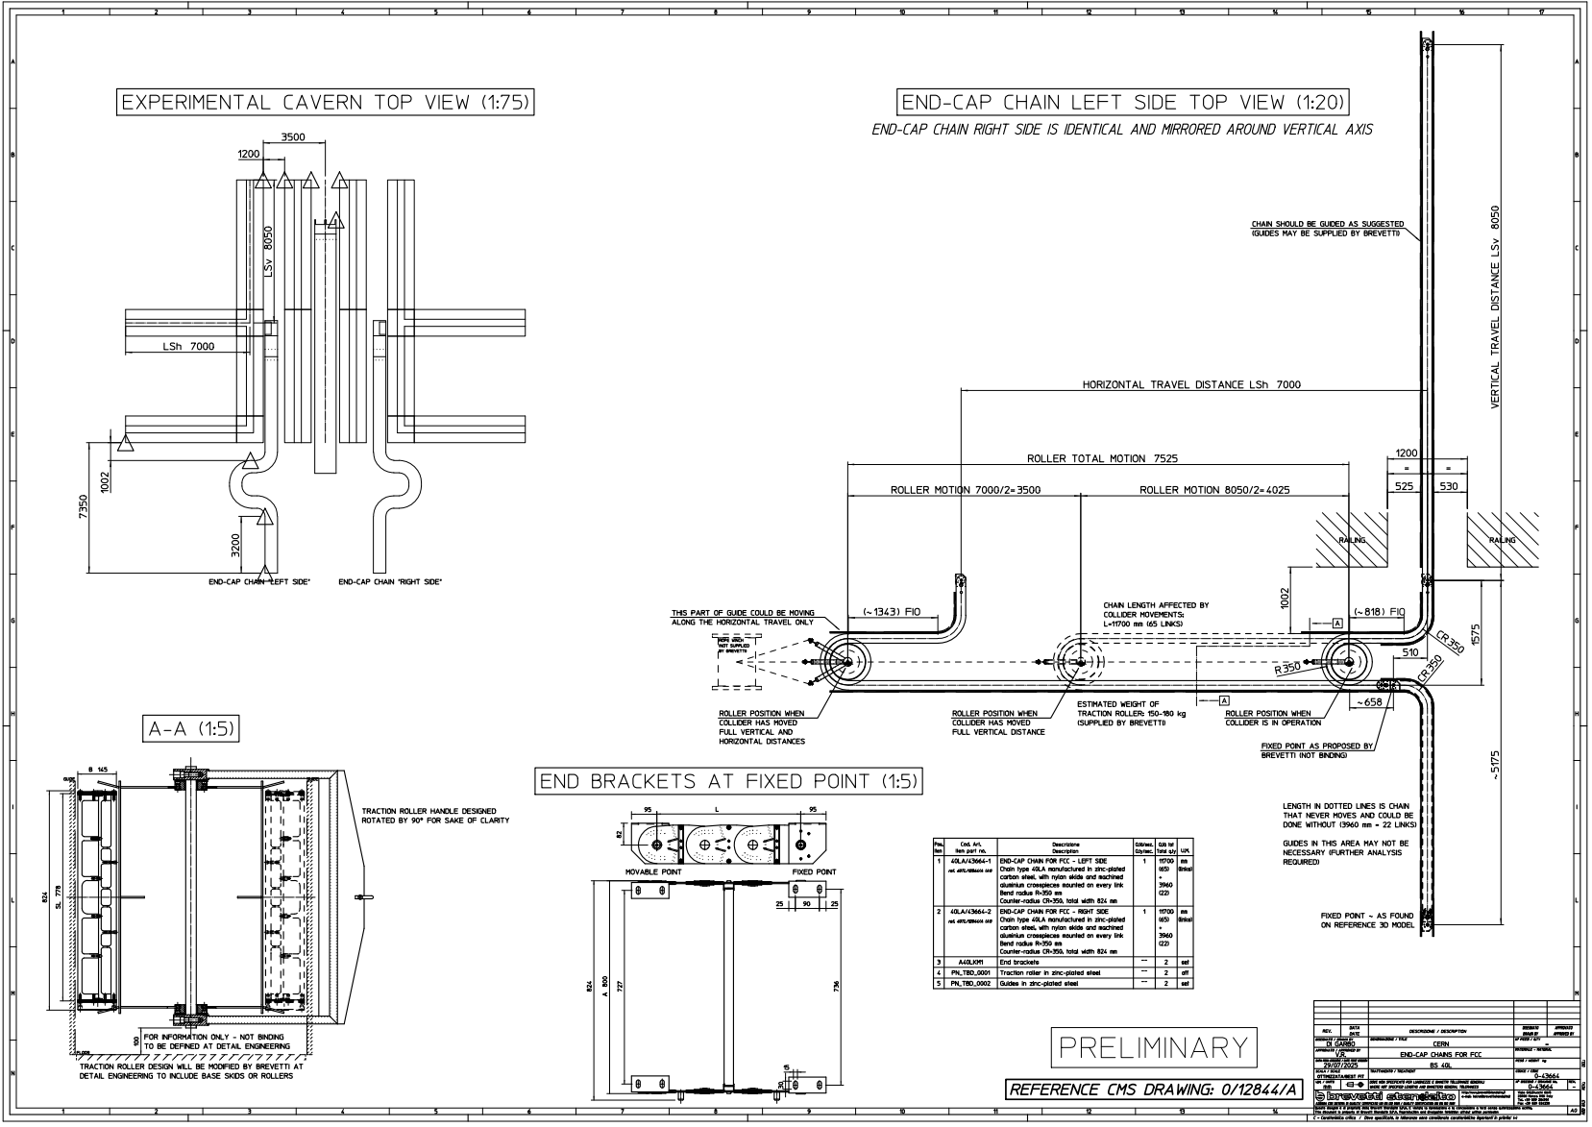
EP-FCC
Current plan at PA and PG
“For sure there is no problem in putting our chains to work in the FCC specific conditions. Our experience with CMS is precious and helpful to fine-tune its successful working philosophy and manufacturing principles to FCC’s specific needs” – Brevetti, CMS cable chain supplier

Slide 7
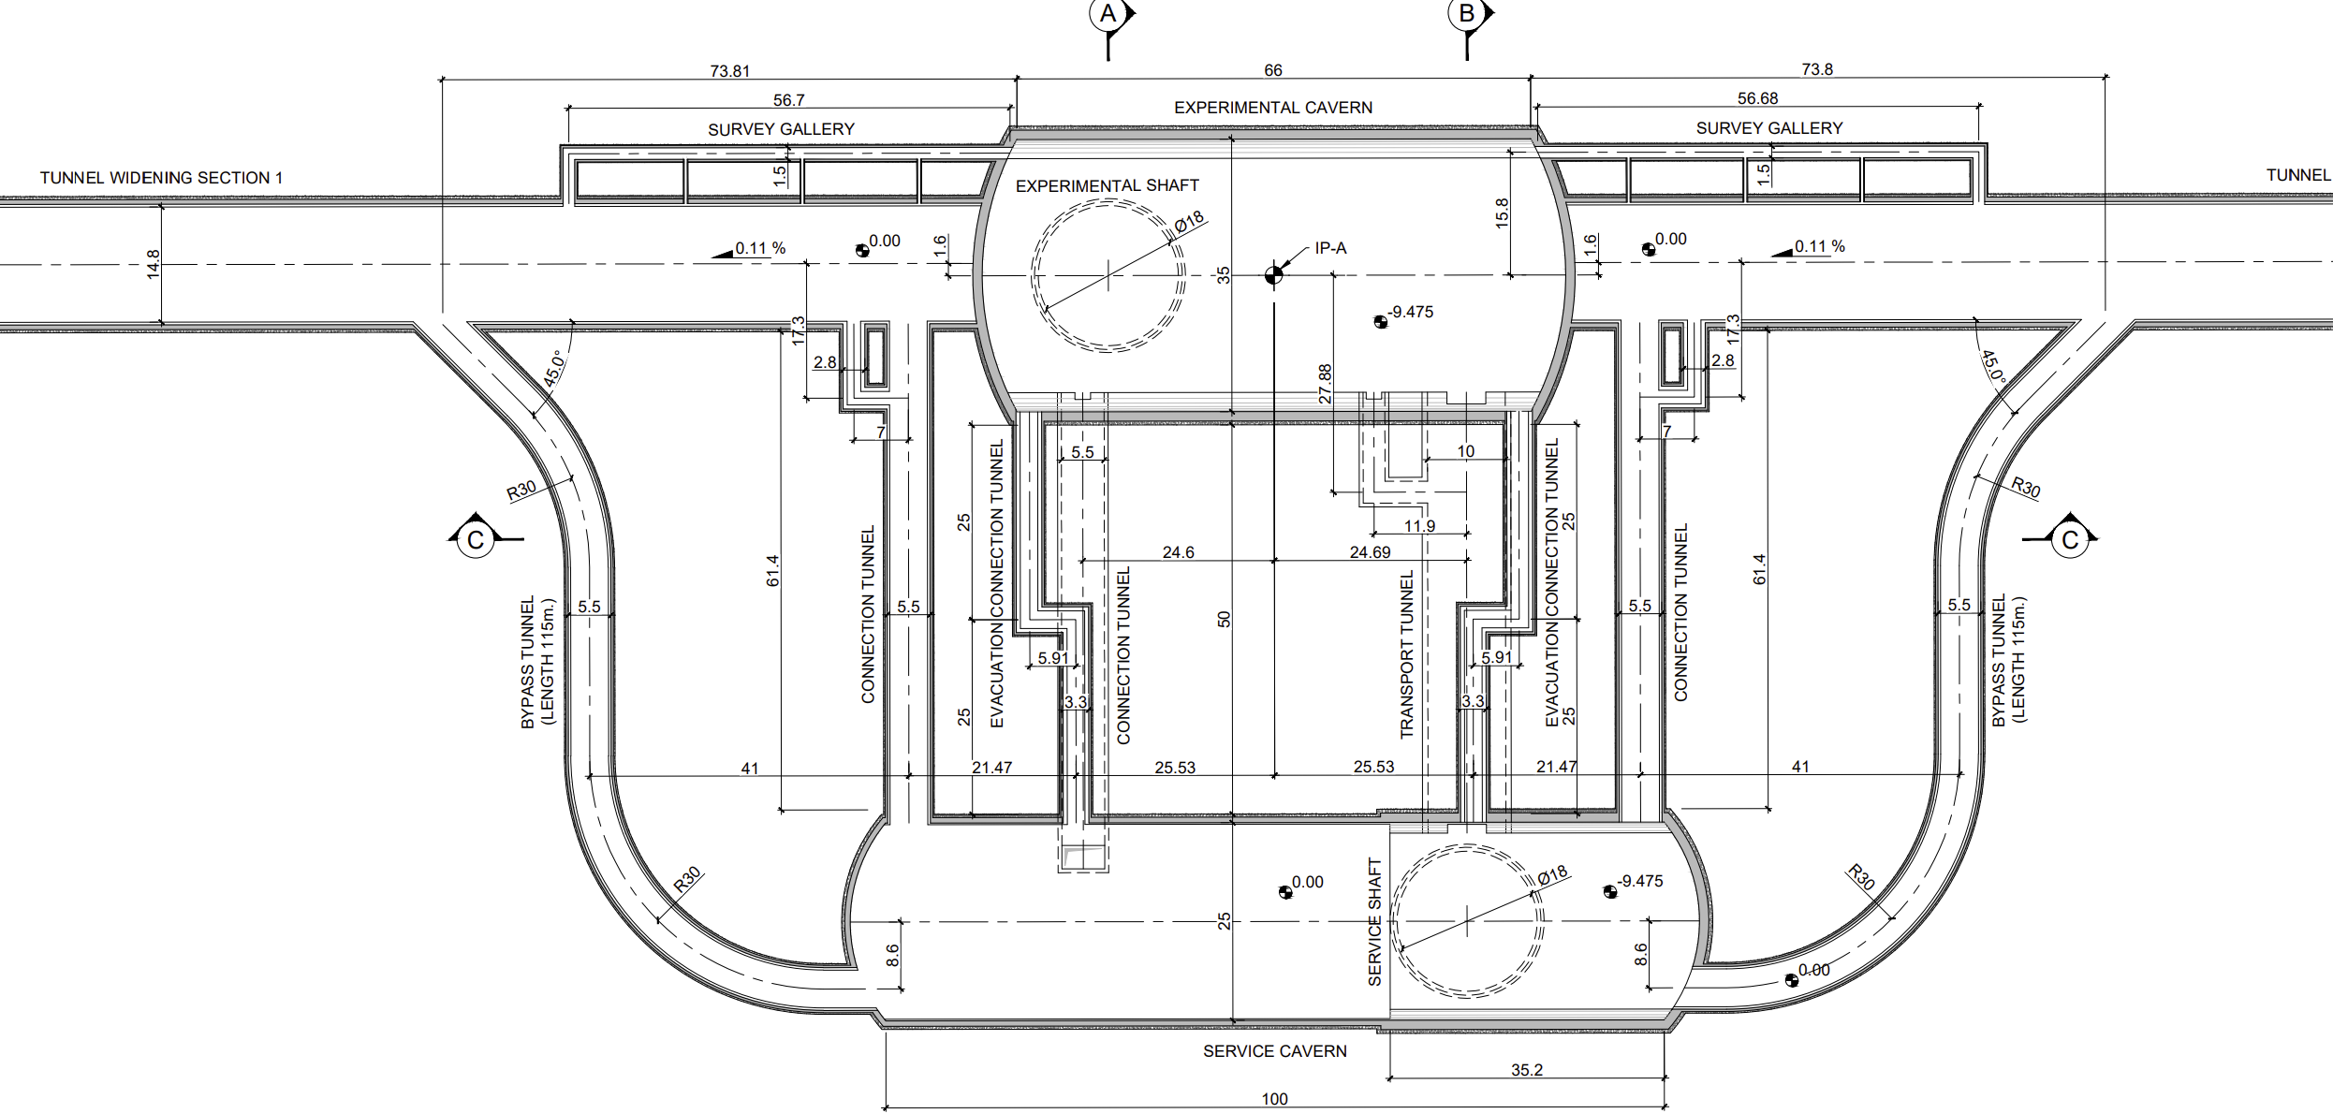
EP-FCC
Services supply - Civil Engineering Tunnel Modification
Current design
Proposed new design
*Pending verification of compatibility with FCC-hh integration*

Slide 8
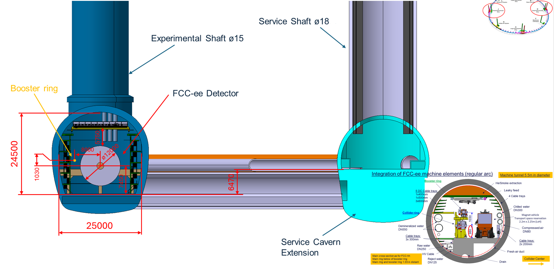
EP-FCC
FCC-ee Underground Structure at PD and PJ

Slide 9
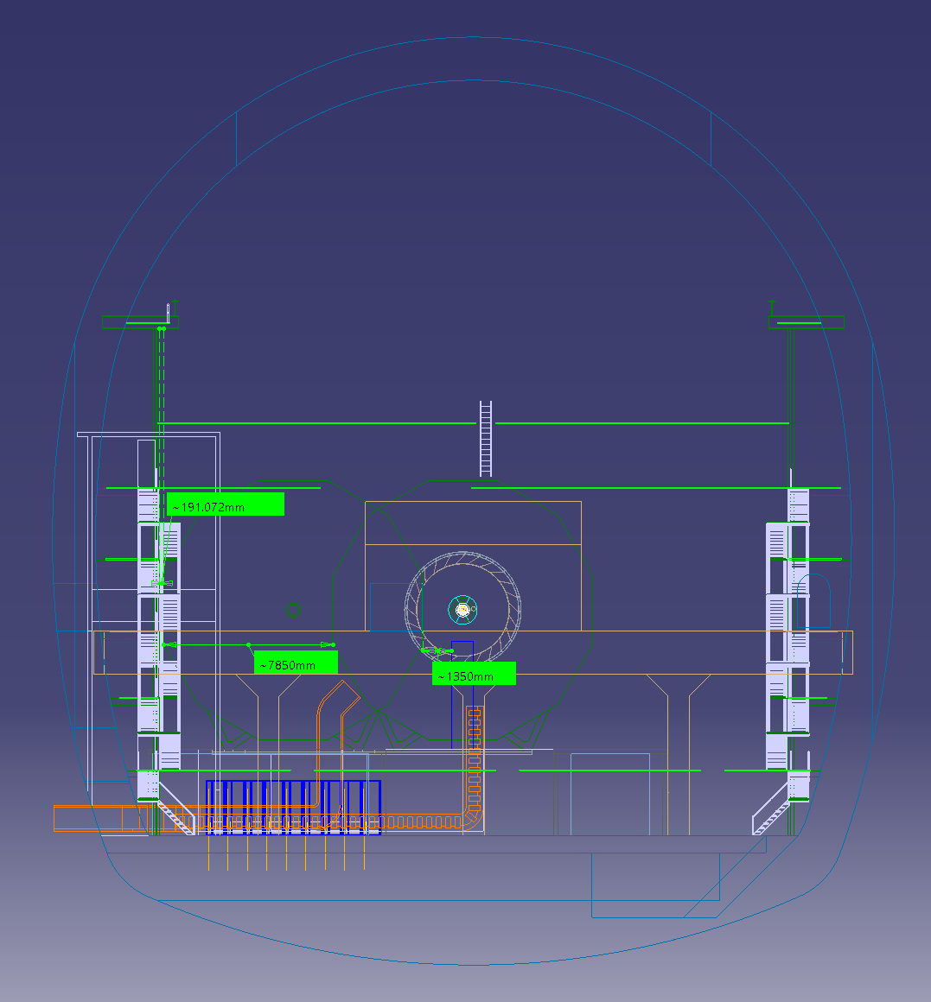
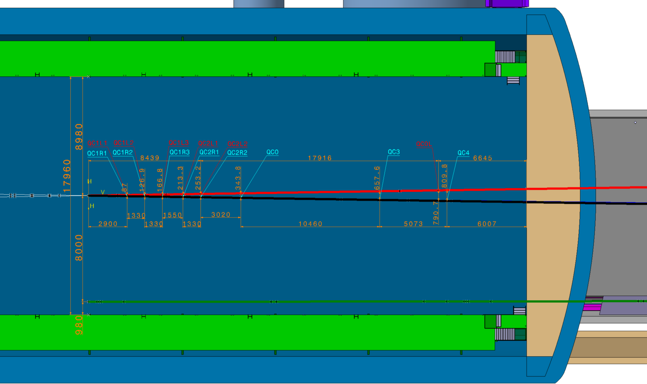
EP-FCC
PA/G vs PD/J in terms of transverse space
PA/G:
PD/J:
7850 + 6000 = 13850mm from transverse space required from IP, with minimal clearance left

Slide 10
EP-FCC
Showstoppers in PD&J cavern design and possible solutions
Problems:
FFQs inside the detector – Detector must be moved away from the beamline
Very high hermeticity required by FCC-ee detectors – Split endcaps become challenging (Physicists strongly against split endcaps)
Detector must be move transversally to clear the FFQ support wall to open
Not enough transverse space in small caverns to accommodate (even if the beamline is moved off-centre)
Possible solutions:
Create an additional alcove (25x8 m – LxW) for the detector to move into during maintenance (*)
or
Widen the entire cavern at PD and PJ, as well as shorten its length (roughly similar overall excavation volume to keep excavation cost flat) plus optionally move the beamline off-centre (t.b.d. with FCC-hh detector representatives)
(*) as requested by M. Boscolo & F. Palla (MDI study group conveners) in a mail dated Jan 9th, 2025

Slide 11
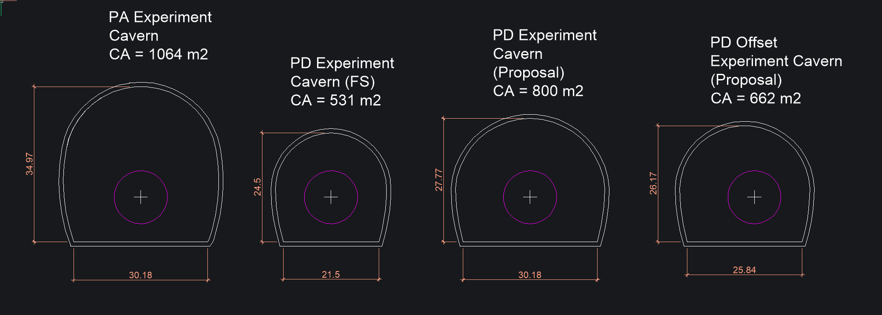
EP-FCC
Small cavern modifications – Preliminary sketches

Slide 12
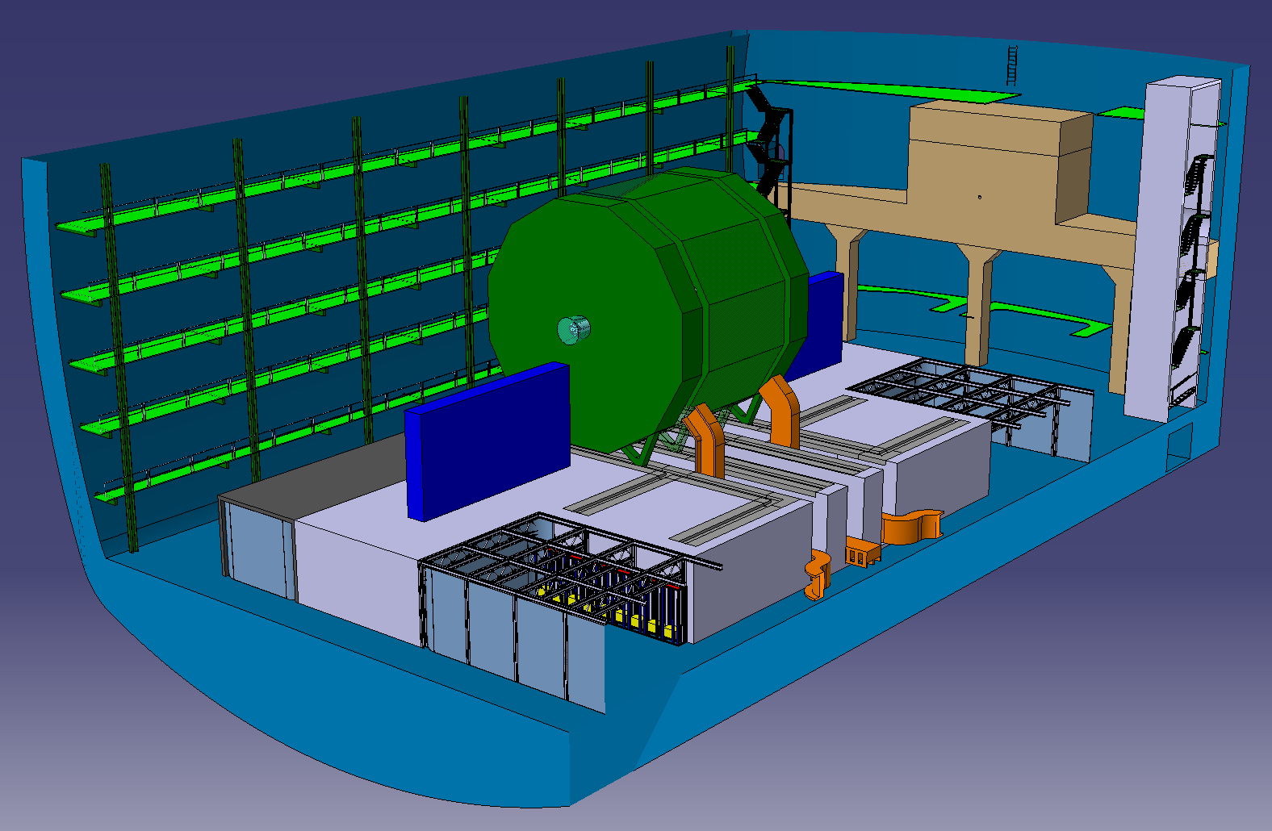
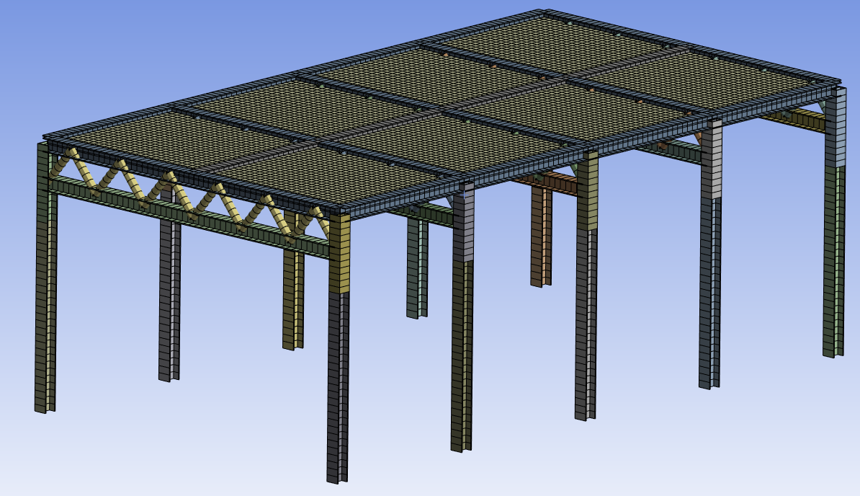
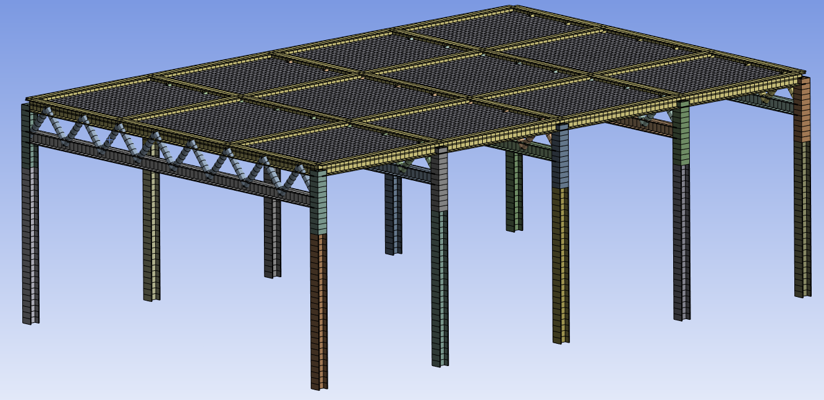
EP-FCC
Working area platforms
Initial CAD design of both platforms
FEA completed to a load of 4tonnes/m² across structural steel surfaces
Deflection, buckling factors and fasteners compliant with Eurocode 3
Generates very valuable shielded space very close to the detector
Service distribution, Racks, etc.
10m
5.5m
11m
7.75m
2.5m
2.75m
4m
4m
Long platform module
Corner platform

Slide 13
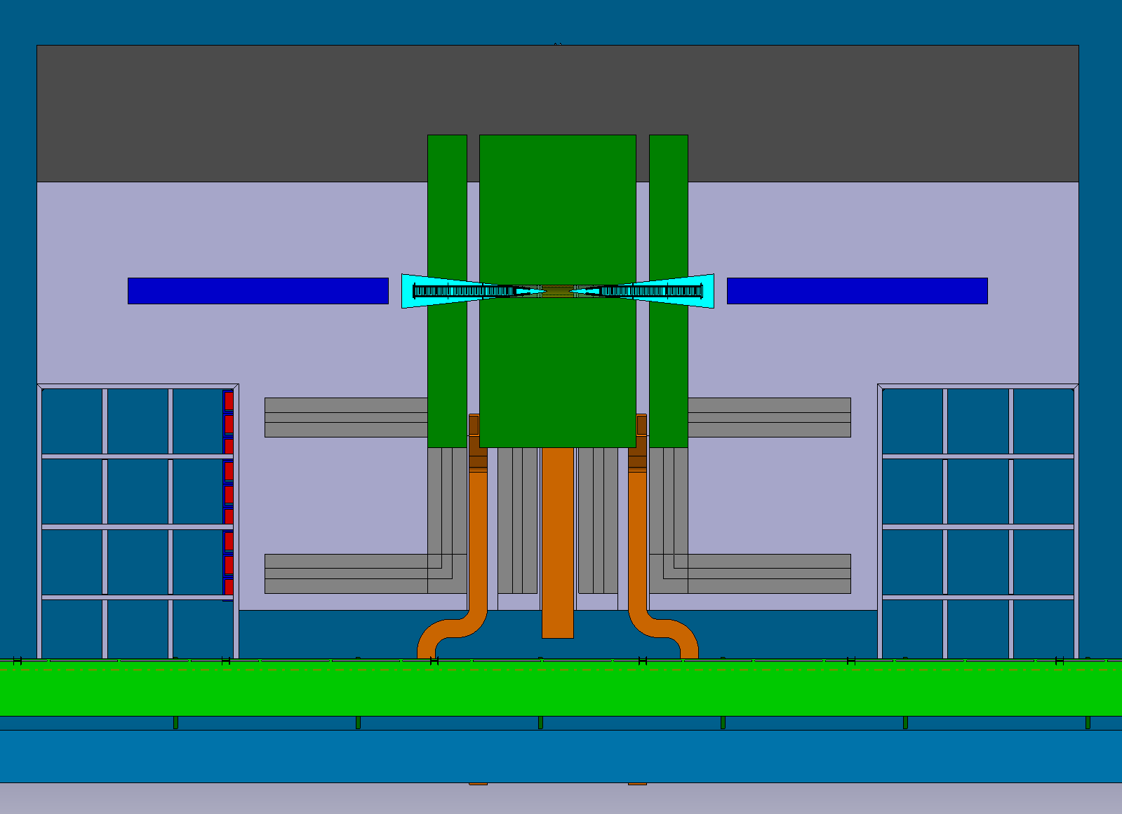
EP-FCC
Next steps
Validate XPA and XPD caverns layout with FCC civil engineering.
Integrate FFQs and their services, including alignment.
Study FFQs removal/installation scenario during detector maintenance.
Model 3D realistic detector proposals and integrate them in the experimental sites → Physics groups
MDI group

Slide 14
Thank you for your attention.
EP-FCC
Gianluca Gilmore Kerr
14

