Slide 1
Interest to submit in common TPSCo 65nm ISC runs
Short project description
Particam aims to create a pixel sensor with sub-micron resolution (pitch ≤ 5μm). We already have a proof-of-principle
sensor in another technology but would like to port it to a process which allows for some depletion to improve charge
collection and thus efficiency. The first step would be to design a smaller port and move to larger demonstrators
later.
Special requirements/comments
• Device is a pixel sensor
o No special layers required
o Might be reverse biased
o High resistivity substrate/epi desired
• Would prefer the option of 3.3V devices for IO but not strictly necessary
• No stitching
• Status: port from other technology
Submission plans
Currently we don’t have access to the PDK so the earliest submission date for us would be at least 3-4 months
after access to the PDK is granted. The development will likely require multiple runs where smaller chiplets are
preferred. We don’t have a specification for a large area chip but would like to do one once the design has matured
sufficiently.

Slide 2
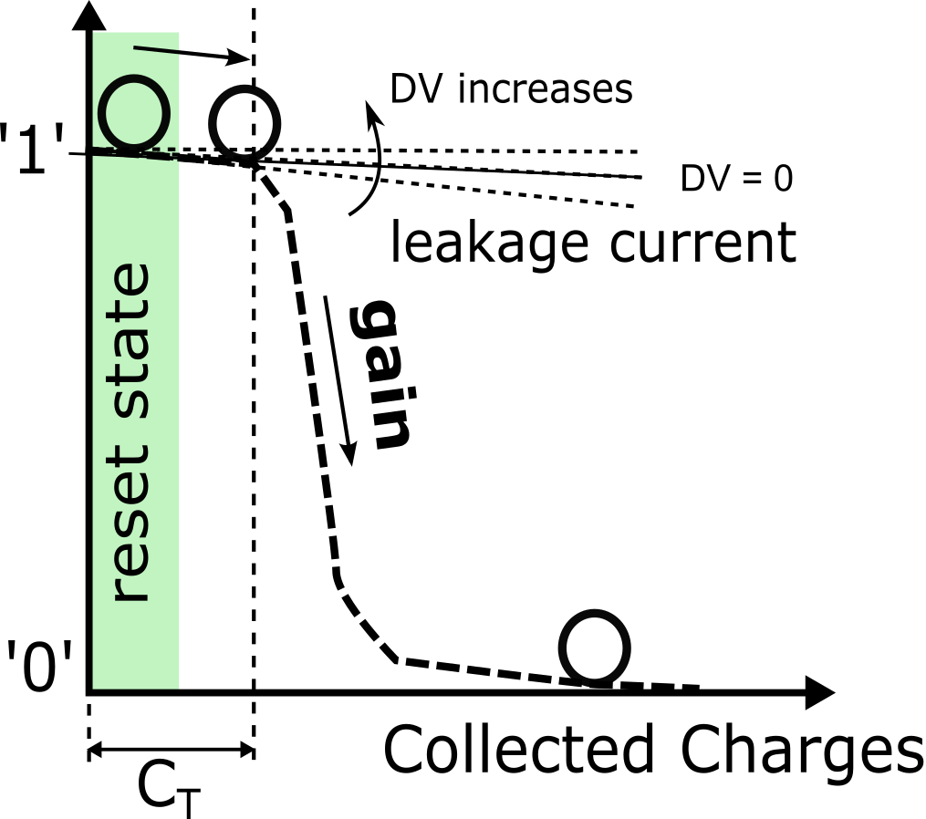
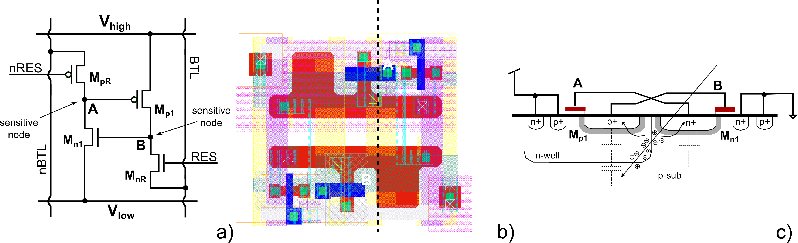
Concept
Pixel is implemented as mono-stable flip-flop
Reset state is unstable
Collected charge or leakage flip the bit
Core circuit only requires 4 transistors

Slide 3
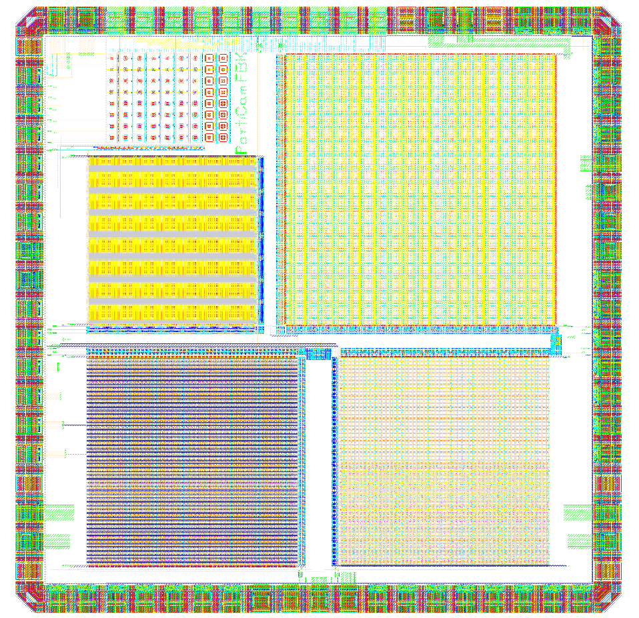
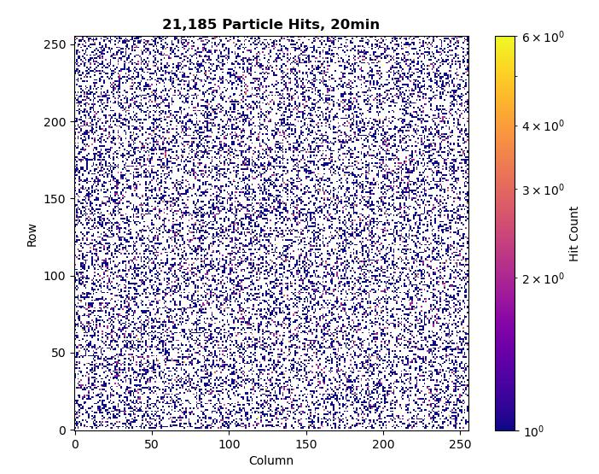
Particam1
Proof-of-Principle demonstrator in UMC 65nm
Multiple different pixel flavours and sizes implemented
Primitive address decoder based readout
To minimize the pixel size only shallow junctions have been used
Charge collection/efficiency is rather poor due to identified/ expected reasons
Need deeper junction for better charge collection
SPAD test
structures
Test pixels
128x128
Exploratory
Array
6.5μm × 6.5μm
256x256
Aggressive
Array
2μm × 2μm
256x256
Custom
Array
2.5μm × 2.5μm
256x256
Standard
Array
2.5μm × 2.5μm
2.1mm

Slide 4
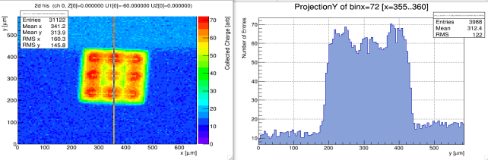
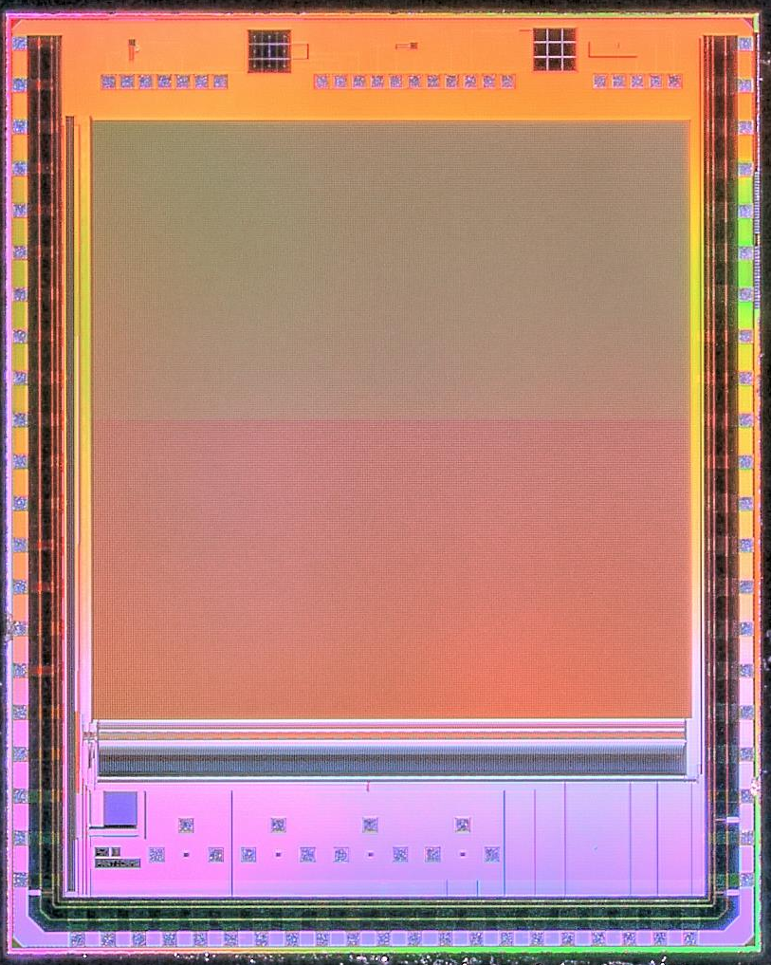
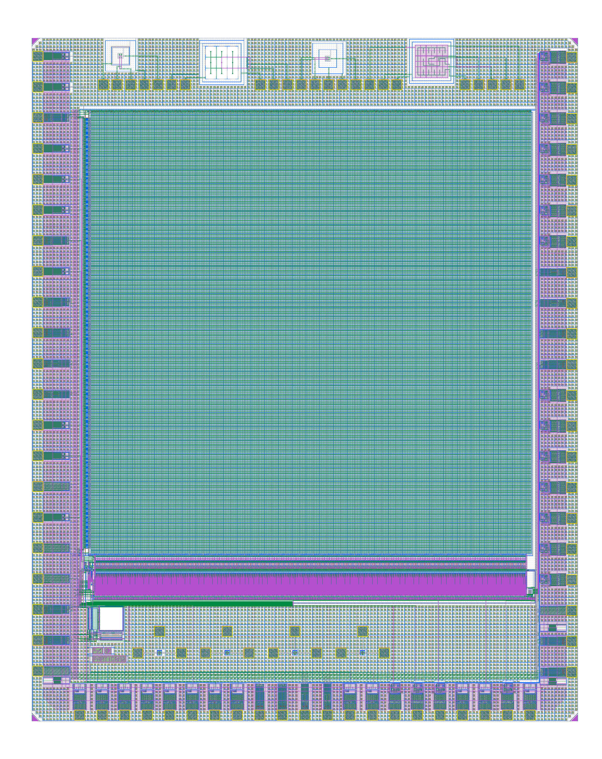
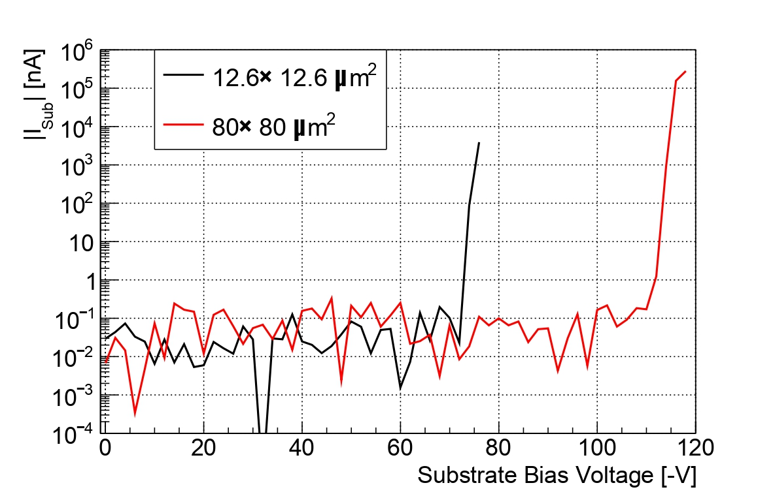
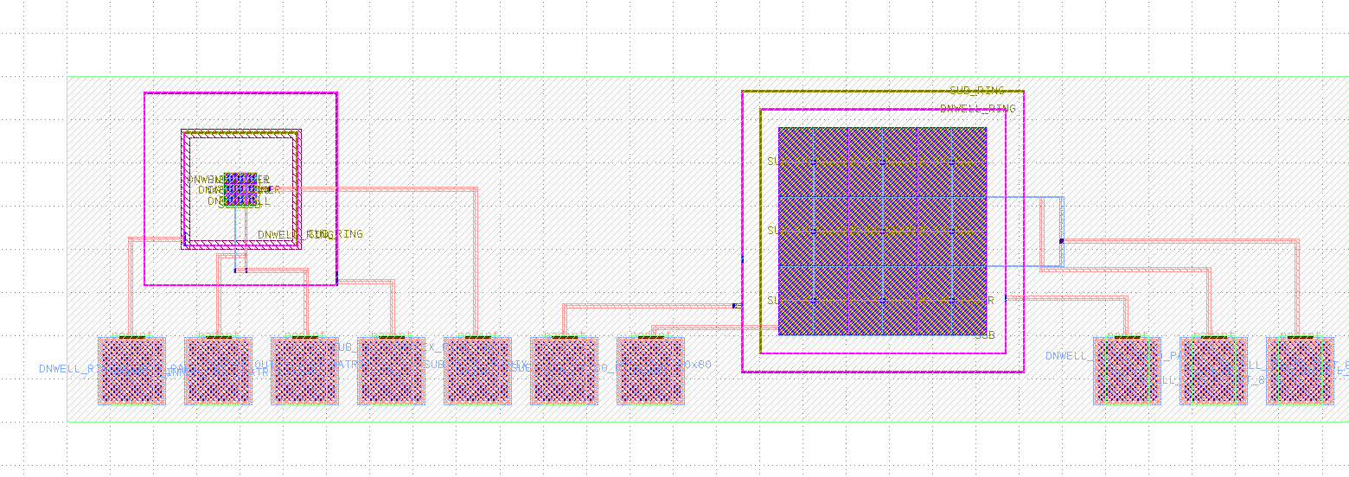
Particam2

Slide 5
Design Status + Submission Plans
Still no access to the PDK
Have ideas for improved pixel circuits but need simulations and test layouts
Readout of Particam1 port should be straightforward
Pixel layout will need some work
Small pixels will be at the edge of the design rules
Need to know which can be broken and which cannot/fundamental limitations of the process
Most likely will have to do lots of test structures to test charge collection and breakdown of small pixels
If offered, we would be interested in thinned and/or backside processed samples

