Slide 1
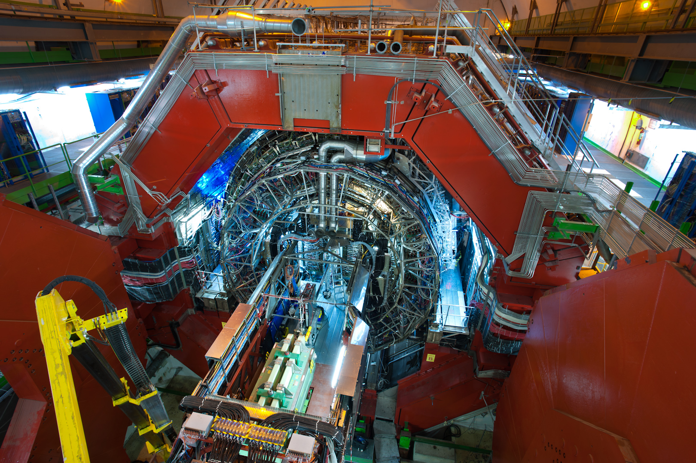
ALICE : A Large Ion Collider Experiment

Slide 2
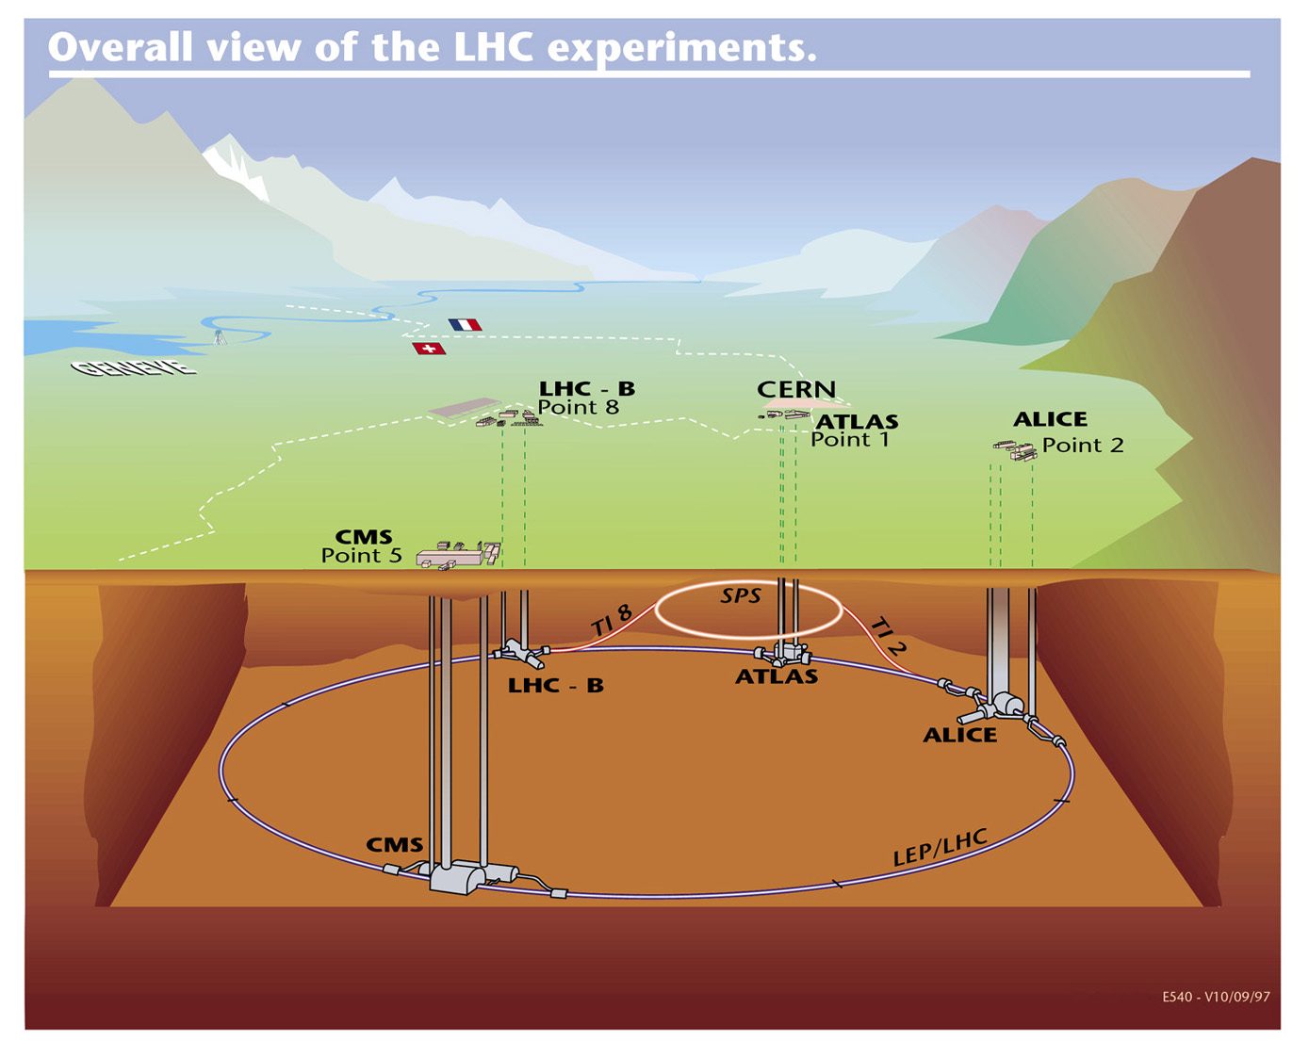

Slide 3
Heavy ions at LHC
In addition to protons, LHC accelerates and collides lead ions isotope Pb ²⁰⁸ with 82 protons and 126 neutrons in the nucleus
Pb atom -> Pb²⁹⁺ -> Pb^{54+ ->} Pb⁸²⁺ (bare lead nucleus)
Run 1 : Εnergy 3.5 ΤeV x 82 = 287 TeV (574 TeV at collision point)
Run 2 : Εnergy 6.5 ΤeV x 82 = 533 TeV (1066 TeV at collision point)
Run 3 : Εnergy 6.8 ΤeV x 82 = 557.6 TeV (1115 TeV at collision point)
Why are lead ion collisions at high energies of particular interest?

Slide 4
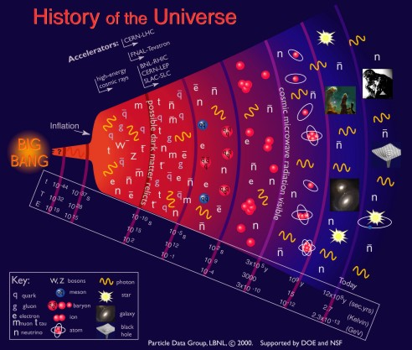
Millionths of a second after the big bang, all matter is made of free quarks and gluons,
THE QUARK GLUON PLASMA
As the universe cools and expands, the quarks and gluons are “imprisoned” for ever inside hadrons: from these, only protons and neutrons remain today
13.7 billion years ago the universe was born from a Big Bang

Slide 5
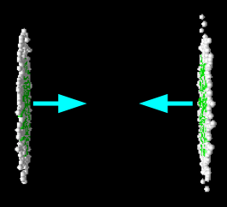
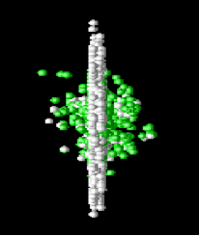
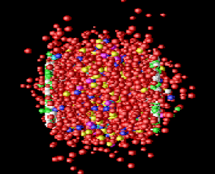

Little Bang
By colliding lead nuclei at very high energies we recreate the conditions of density and temperature which existed fractions of a second after the Big Bang
The protons and neutrons which constitute the lead nuclei melt liberating the quarks and gluons which are bound inside them
A new state of matter is created : the QUARK GLUON PLASMA
By studying its properties
We will understand better the processes which took place during the first fractions of a second in the life of the universe
We will understand better the strong interaction and how the protons and neutrons acquire their mass

Slide 6
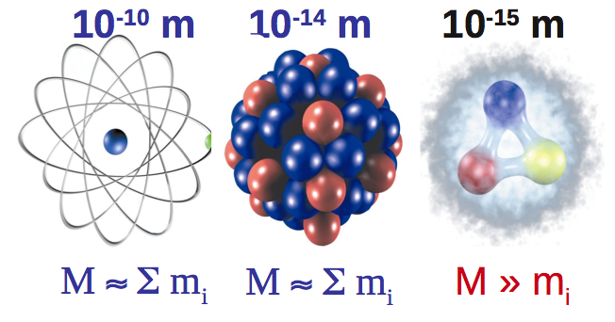
atom nucleus nucleon
In nucleons (protons and neutrons) the mass is not defined by the sum of masses of their constituents but mainly from the energy due to the movement of quarks and the energy of the gluons
Example
the proton (uud) mass : 938 MeV/c²
up quark mass : 1.7 – 3.3 Mev/c²
down quark mass : 4.1 – 5.8 MeV/c²
Sum : 7.5 -12.4 MeV/c²

Slide 7

ALICE studies strong interactions..
  Why are quarks permanently confined inside hadrons?
F=kr₁
F=kR₂
F=kR₁
F=kr₂
q
q
q
q
q
q
q
q
Notes:
Στα αδρονια τα κουαρκ συνδεονται με την ισχυρη δυναμη, που η ισχυσ της μεγαλωνει με την αποσταση και που εχει να κανει με το φορτιο του χρωματος Αν προσπαθησουμε να διαχωρισουμε τα δυο κουαρκ, δινοντας ενεργεια στο συστημα, οταν η ενεργεια κανει δυνατη τη δημιουργια ενος ζευγαριου κουαρκ-αντικουαρκ, σπαζει ο δεσμος και καταληγουμε με δυο αδρονια (αντι του αρχικου ενος)

Slide 8
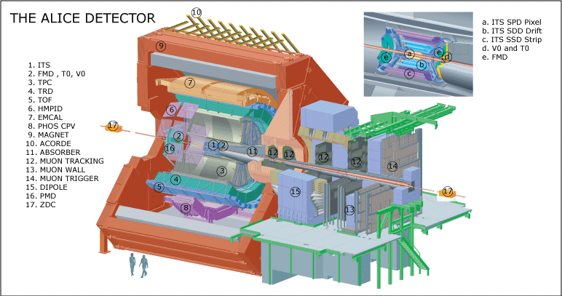
ALICE : A Large Ion Collider Experiment
16 m x 16 m x 26 m 10 0000 tons installed at point 2 of LHC, 56 m underground

Slide 9

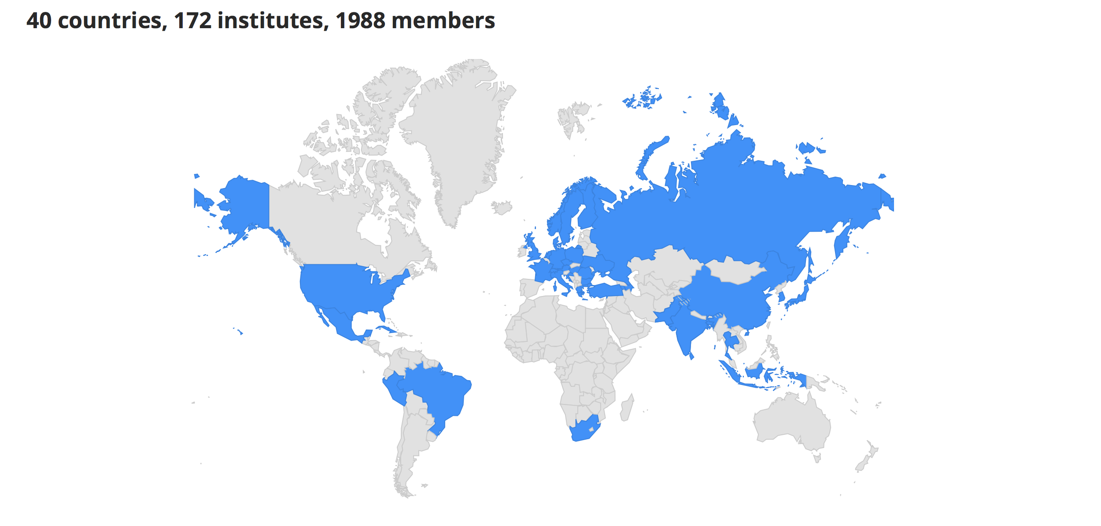
The Collaboration

Slide 10
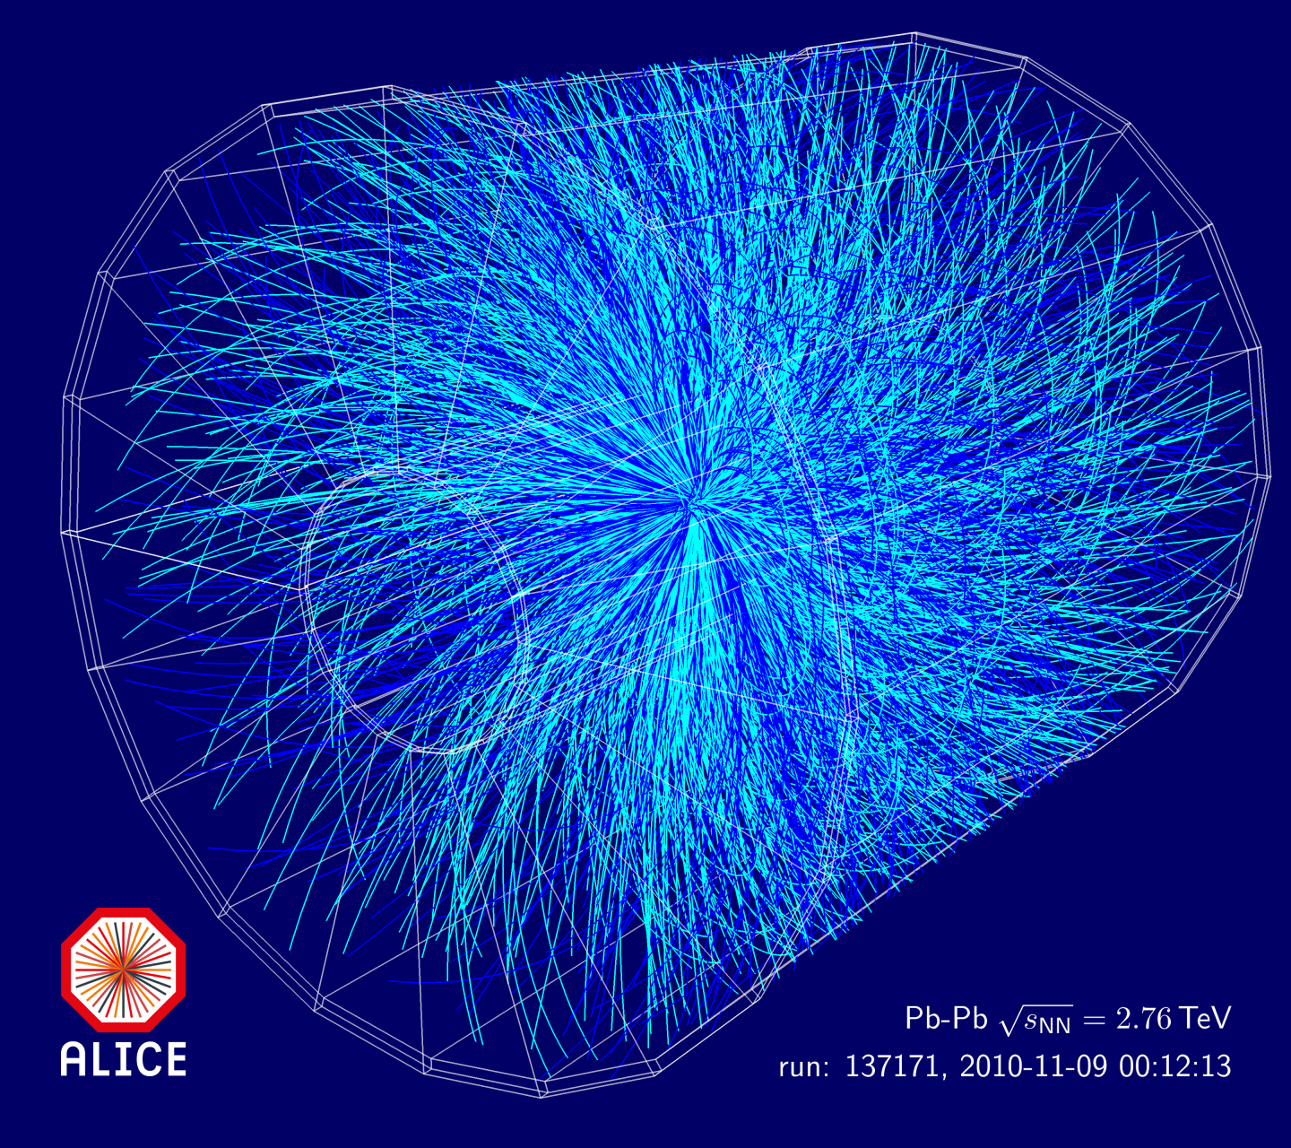

Slide 11
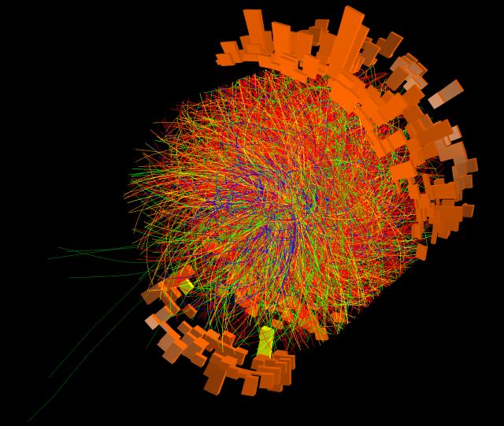

Slide 12
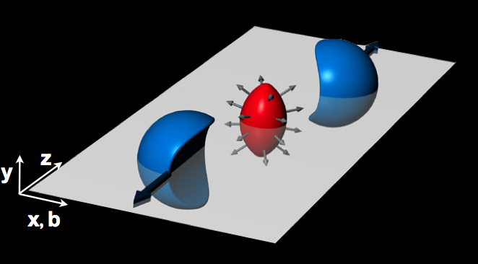
A perfect liquid at LHC
The primordial matter recreated by high energy lead ion collisons at the LHC was initially expected to behave like a gaseous plasma; instead, it appears to behave like a perfect liquid, with coordinated collective motion (“flow”) among the constituent particles.
This had already been announced by experiments at RHIC
The dense matter created by lead collisions flows almost with no friction (like water, which has low viscosity) and not like honey (which has high viscosity)
Almond shape
More hadrons are observed parallel to the interaction plane than in the plane perpendicular to it
One of the most spectacular results of heavy-ion experiments

Slide 13
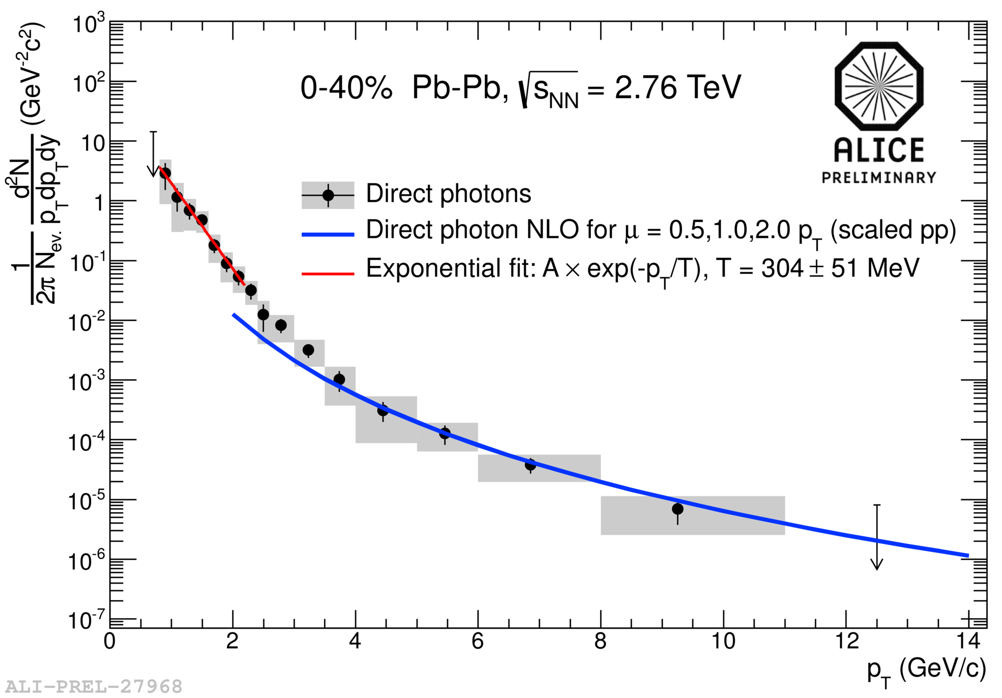

Highest man-made temperature
Thermal photons, radiated by the quark gluon plasma (“direct” photons, not coming from decays of hadrons) reflect the temperature of the system.
The inverse slope of the distribution of these photons suggests that the initial temperature of the system created by lead collisions is some trillion of degrees Kelvin.
This temperature is 250 000 times higher than the temperature in the core of the sun
The hottest piece of matter ever formed
Before heavy ion collisions at LHC

Slide 14
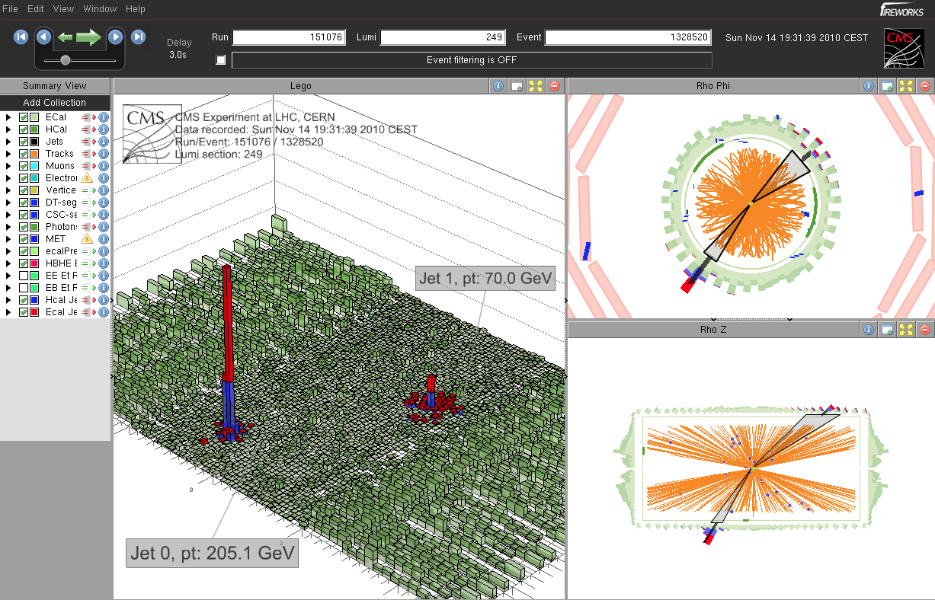
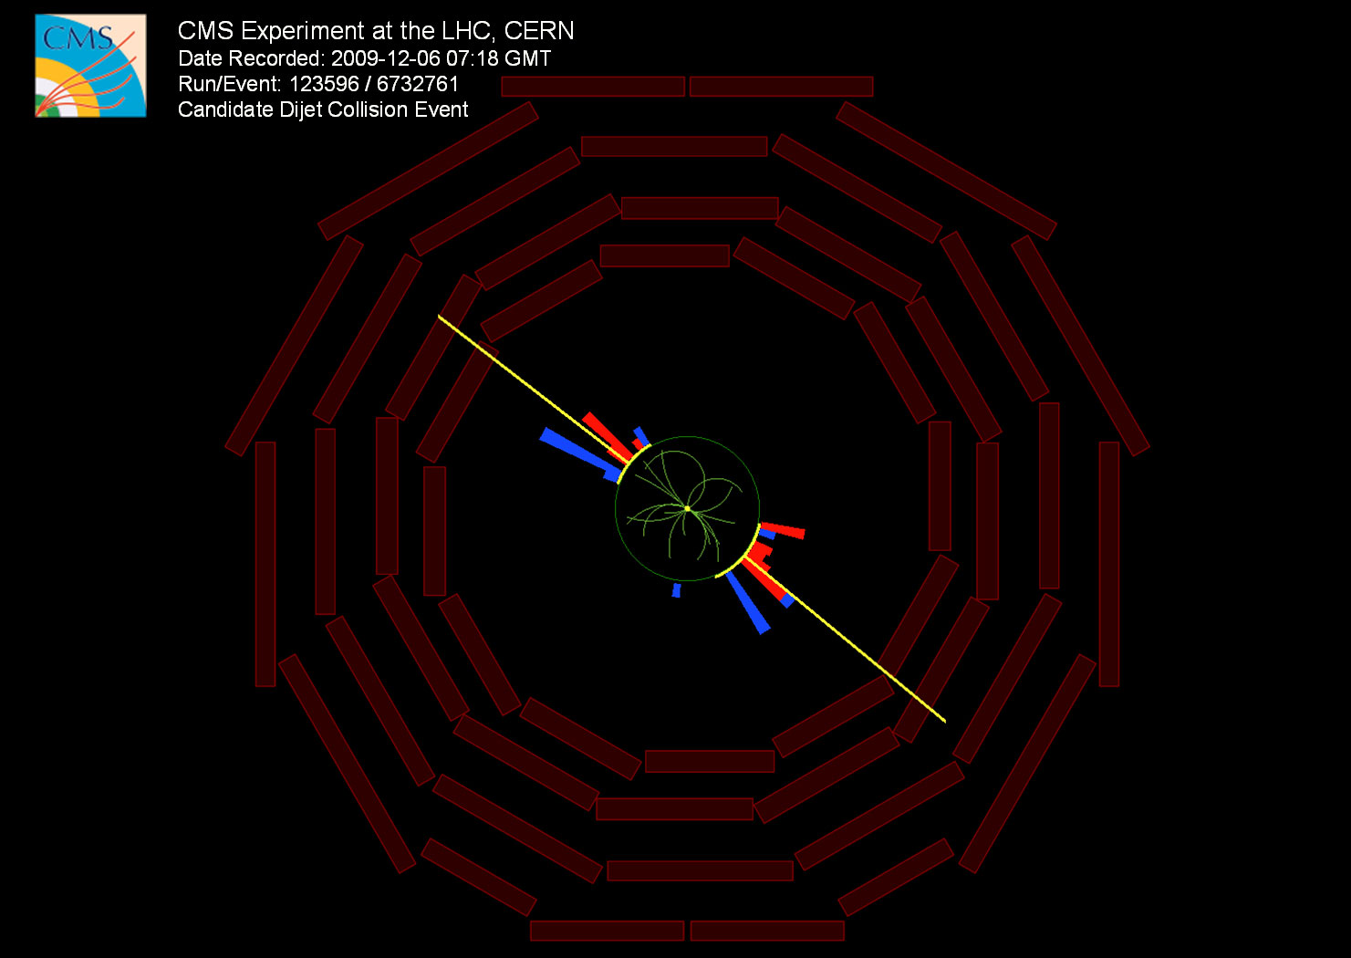
Energy loss
One of the first announcements from the first lead ion run at LHC, December 2010)
Jets going in opposite directions
have ~ equal energies
Lead ion collision event
One jet has much less energy than the other.
The jet produced near the QGP surface has high energy whereas the one that traverses the QGP is absorbed and scattered by the dense medium losing big part of its energy
Proton collision event – two jets with energy of ~20 GeV

Slide 15
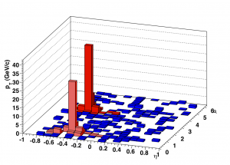
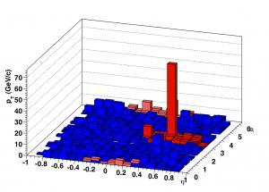
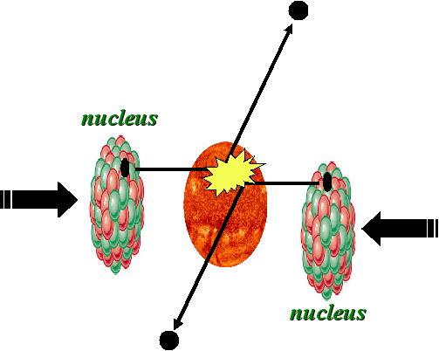
Jet Quenching
ALICE – peripheral lead ion collisions- two jets
ALICE – central lead ion collisions
1 jet is visible, the other has been absorbed while travelling through the QGP and does not come out

Slide 16
The J/Ψ mystery
J/Ψ Discovered in 1974, almost simultaneously, at Brookhaven (proton-nuclei collisions) and at SLAC (collisions e⁺e⁻)
Bound state of a c quark and a c anti-quark (mass 3 GeV)
The two “object” that make the J/Ψ are bound due to strong interaction
Inside the quark gluon plasma, due to the high number of free colour charges, the binding between c-quark and c-antiquark becomes weaker, the pair disintegrates and the J/Ψ disappears
Suppression of the observed J/Ψ signal
(J/Ψ -> μμ and J/Ψ -> e⁺e⁻)
Suppression depends on QGP temperature

Slide 17
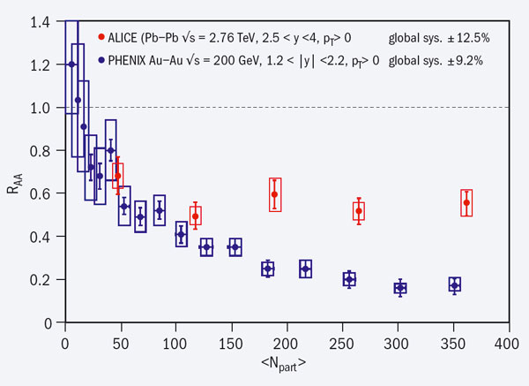
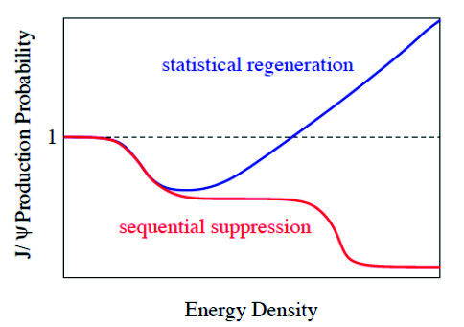
The J/Ψ mystery
Regeneration of J/Ψ at very central collisions
Two competing phenomena
Suppression of J/Ψ due to interaction with the quark gluon plasma
Creation of many J/Ψ due to the high number of c – anti-c pairs created from the huge collision energy
Nuclear modification factor R_{AA}
number of J/Ψ observed in lead ion collisions
_____________________________________________________________
number of J/Ψ observed in proton collisions

