Slide 1

Perfect vortex and 4 wave mixing to create photon pairs
Chemistry-Physics inter-departmental day
Paul Séguigne
Encadrants: Laurence Pruvost
Laboratoire : LCPMR-Laboratoire de Chimie Physique - Matière et Rayonnement

Slide 2
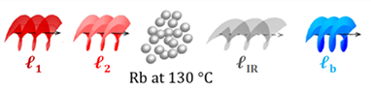
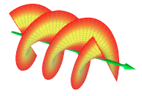
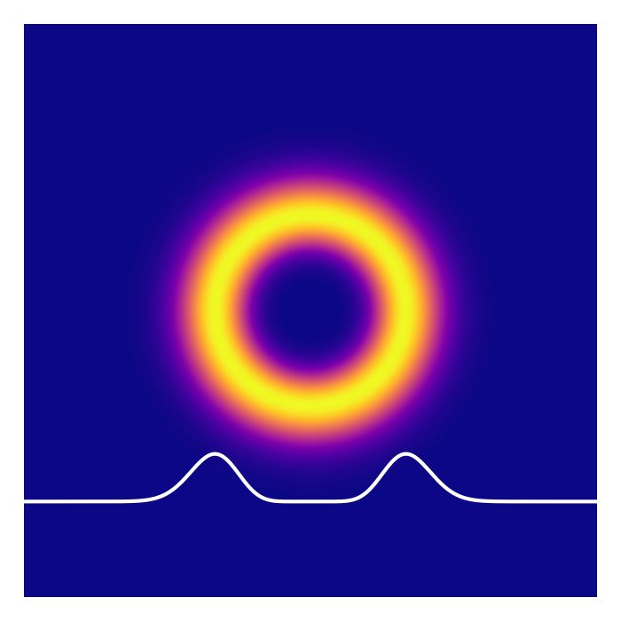


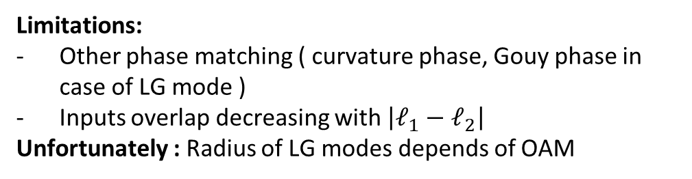





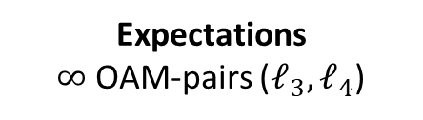
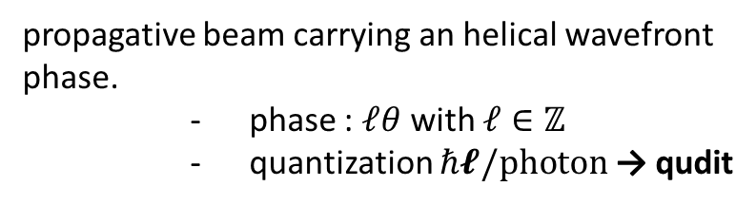

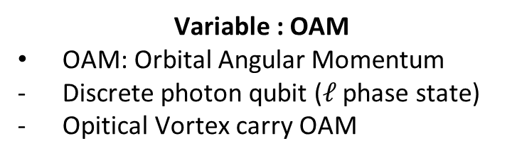


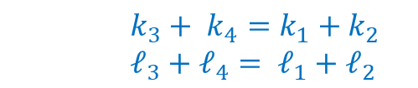
OAM-pairs generation as Quantum Source
QTech needs entanglement states that can be easy controll/encoding information→ New QSource
Variable : OAM
OAM: Orbital Angular Momentum
Discrete photon qubit ($ℓ$ phase state)
Opitical Vortex carry OAM
Medium: Hot Rb vapor Spontaneaous Four Wave Mixing
5230nm
$${5D}_{5/2}$$
$${6P}_{3/2}$$
776nm
$$ℓ_{1}$$
$$ℓ_{2}$$
$$ℓ_{3}$$
$$ℓ_{4}$$
420nm
$${5P}_{3/2}$$
780nm
$${LG}^{ℓ}$$
$${5S}_{1/2}$$
Condition:
Energy conservation
→ Many phase matching
Expectations
$∞$ OAM-pairs ($ℓ_{3},ℓ_{4}$)
$$k_{3}+ k_{4}=k_{1}+k_{2}$$
$${ℓ_{3}+ℓ_{4}= ℓ}_{1}+ℓ_{2}$$
$𝓁=2$
Limitations:
Other phase matching ( curvature phase, Gouy phase in case of LG mode )
Inputs overlap decreasing with $\left|ℓ_{1}−ℓ_{2}\right|$
Unfortunately : Radius of LG modes depends of OAM
propagative beam carrying an helical wavefront phase.
phase : $𝓁θ$ with $𝓁∈ℤ$
quantization $ℏ𝓵/photon$ → qudit
Perfect vortex and 4 wave mixing to create photon pairs
Paul Seguigne
2/ 5

Slide 3
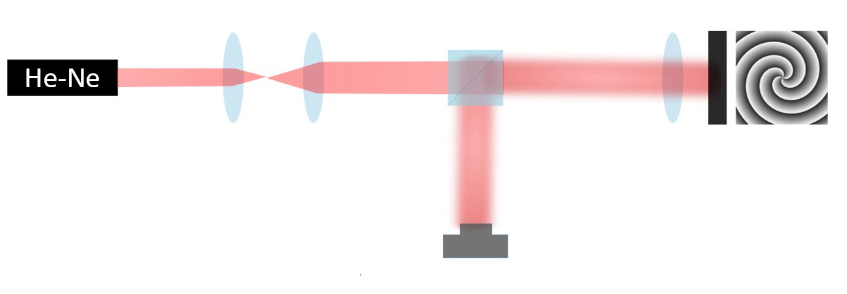
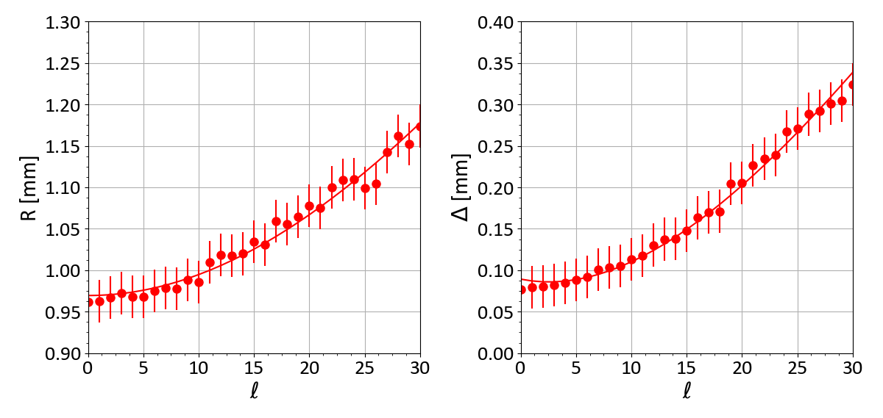
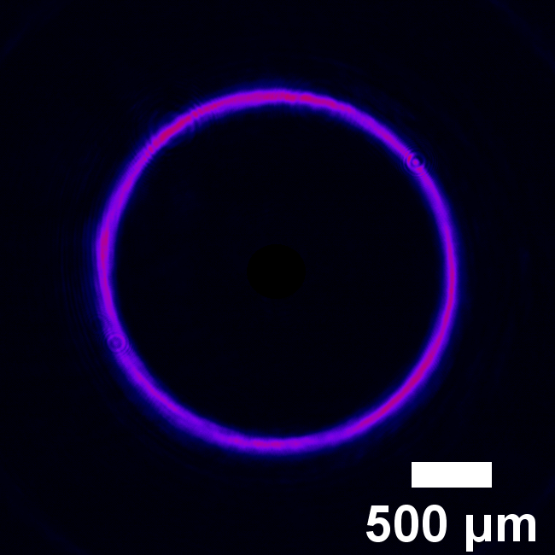
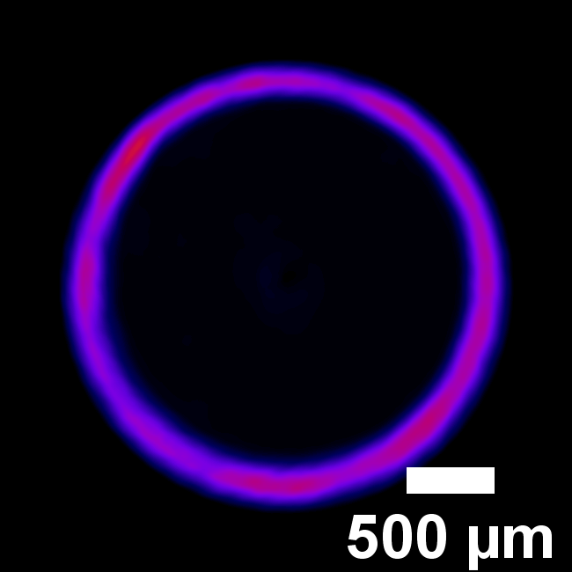
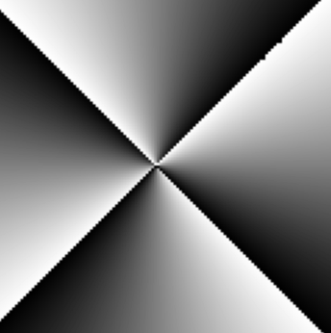
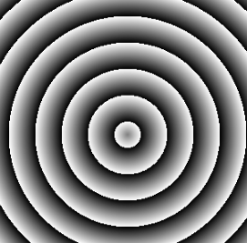
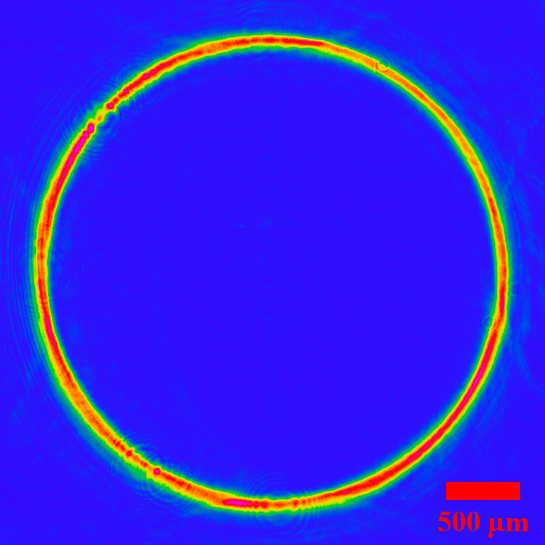








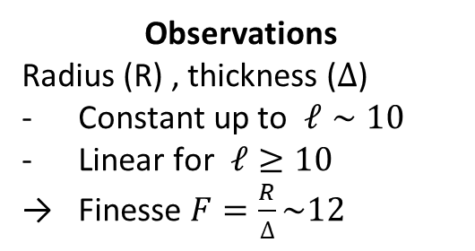



Perfect Vortex beam as new vortex class
$${{PV}^{𝓁}=e^{ikz}e}^{i𝓁θ}δ\left(r−R\right)$$
PV : An ideal PV has ring radius and thickness independent of the OAM
Set-up: Fabrication of PV
Independent of the OAM ?
BS
?
$$ℓ=4$$
$$ℓ=24$$
$$f_{1}$$
$$f_{2}$$
$$w_{in}$$
SLM
Beam expander
CCD
$$ℓ=4$$
$$φ=ℓχ [2π]$$
$$φ=k_{a}ρ$$
$$f_{e}$$
$${PV}^{ℓ}$$
Observations
Radius (R) , thickness ($∆$)
Constant up to $ℓ∼10$
Linear for $ℓ≥10$
Finesse $F=\frac{R}{∆}\sim 12$
Perfect vortex and 4 wave mixing to create photon pairs
Paul Seguigne
3/ 5

Slide 4
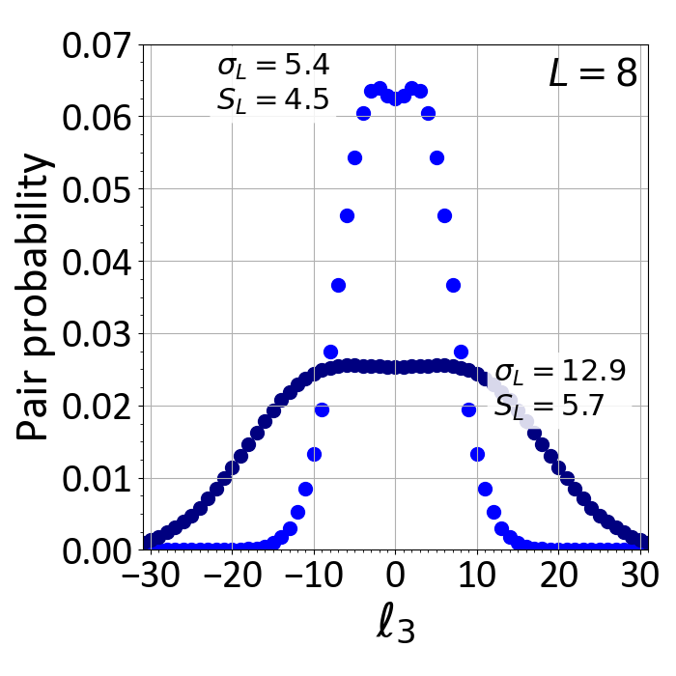
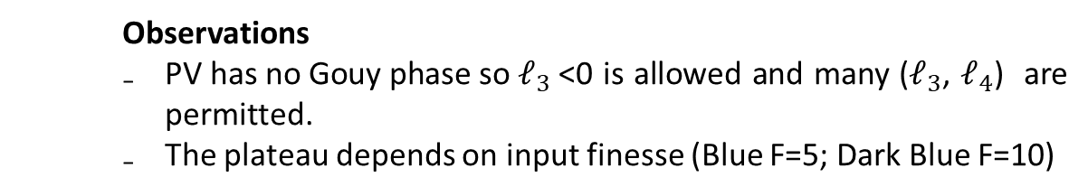
Prediction : OAM-pairs and probability with PV
$$P_{1234}=\iint{A_{1}A_{2}A_{3}A_{4}2πrdr dz}≃L_{cell}\int{A_{1}A_{2}A_{3}A_{4}2πrdr}$$
Assumptions : (i) the input is optimized ($ℓ_{1}=ℓ_{2}$); (ii) the vortex beams have the same Rayleigh range (Boyd’s criterion); (iii) SFWM generates PV; (iv) the output light exists at the ring of the inputs.
Observations
${\text{PV} \text{has} \text{no} \text{Gouy} \text{phase} \text{so} ℓ}_{3}$<0 is allowed and many ($ℓ_{3}$, $ℓ_{4}$) are permitted.
The plateau depends on input finesse (Blue F=5; Dark Blue F=10)
Results
PV provide many OAM-pairs with the same probability: High entanglment
The number depends only on the finesse of the input PVBs
PV would provide an large output space for OAM-entanglement
Perfect vortex and 4 wave mixing to create photon pairs
Paul Seguigne
4/ 5

Slide 5




Thank you for your attention
Team: L.Pruvost (DR of CNRS)

