Slide 1
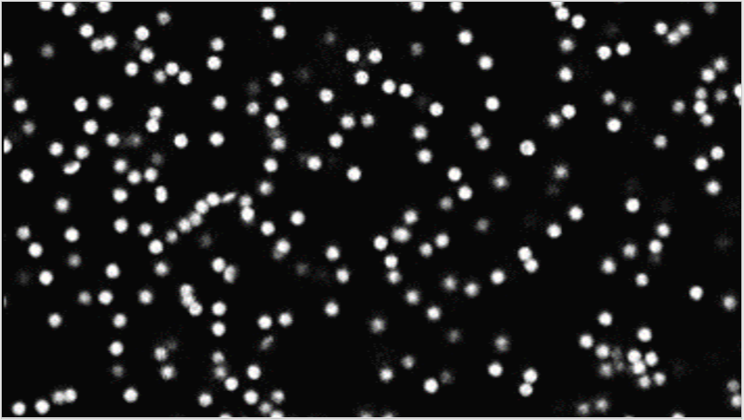
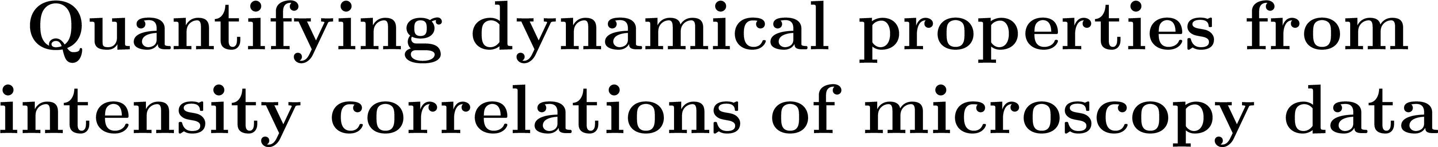




Slide 2


Slide 3
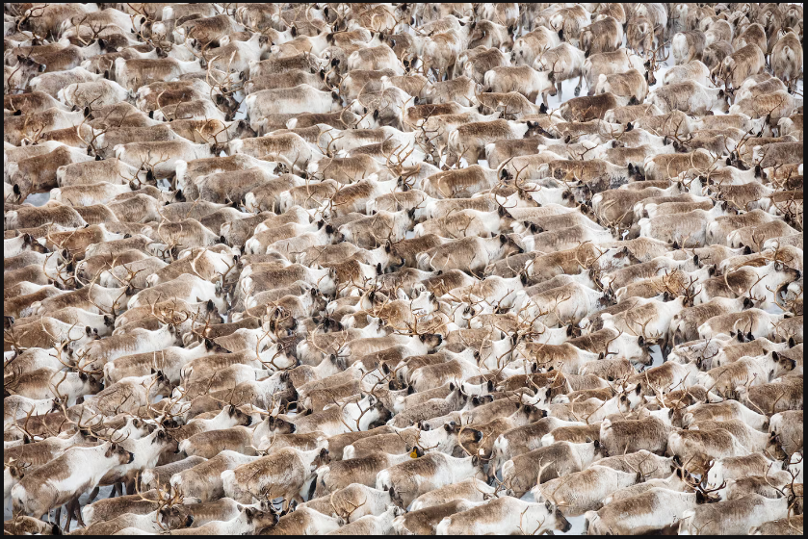

Slide 4


Slide 5
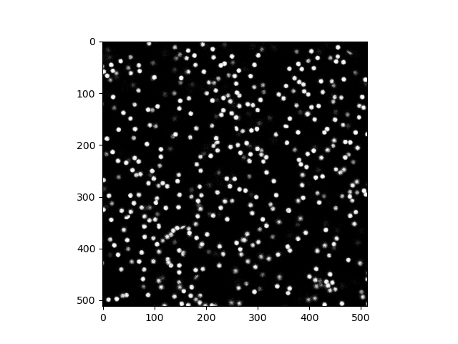



Slide 6


Slide 7
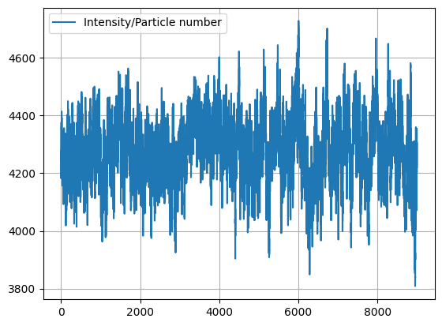
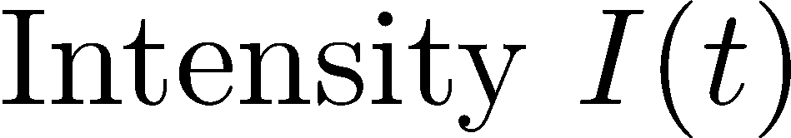


Slide 8


Slide 10
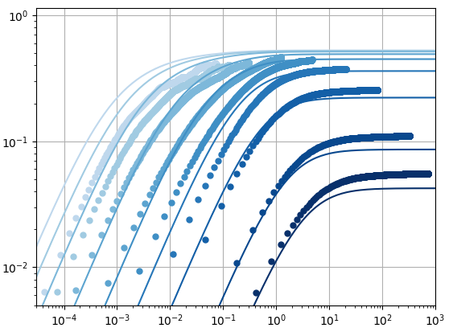
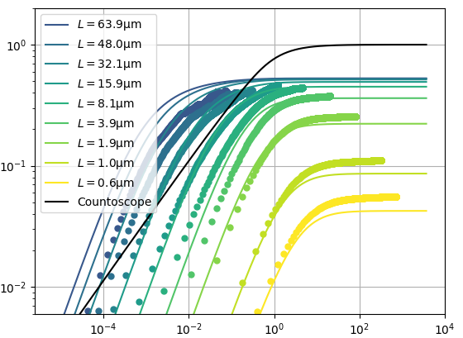
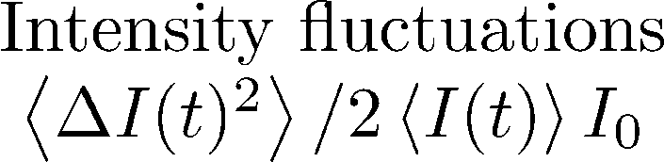





Notes:
Theory: From before,
Shpe: Gaussian, Box: Square in 2D, but Gaussian in 3D
Learn D; Genereall – also applied to Brightfield, Radiometry,…

Slide 11
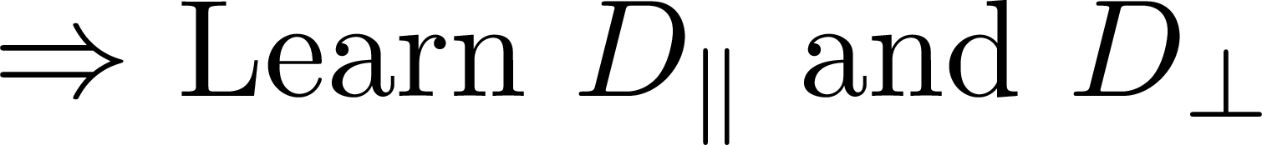
Notes:
And if you’re interested, how results look for bad image qualitiy, come to my poster

Slide 12
