Slide 1
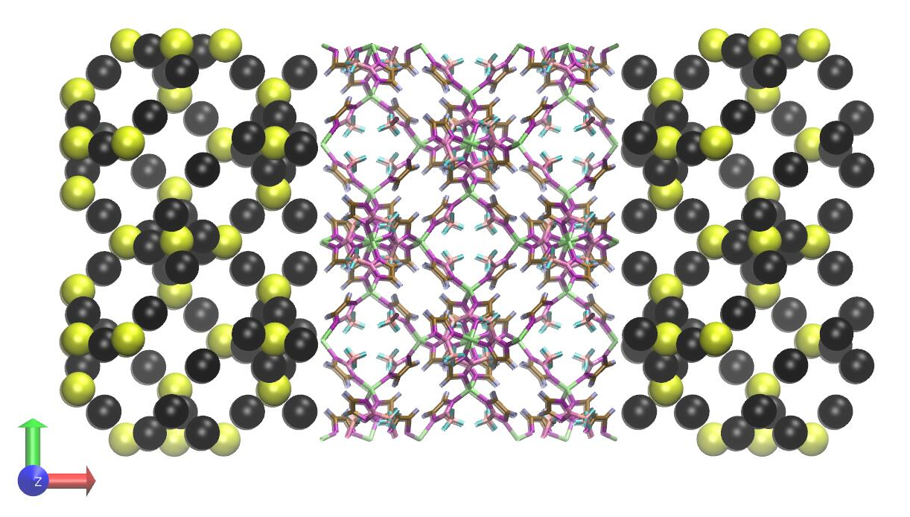



Development and implementation of hybrid atomistic/coarse grained modeling applied to complex interfaces
Hari Haran Sudhakar, Alessandra Serva, Rocio Semino
Physico-chimie des Electrolytes et Nanosystemes Interfaciaux
Sorbonne Université, CNRS, Paris, France

Slide 2
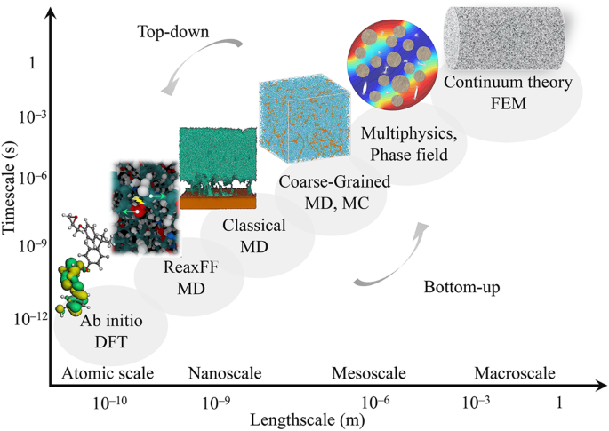
Lin, K., Wang, Z. Commun Mater 4, 66 (2023).

Slide 3
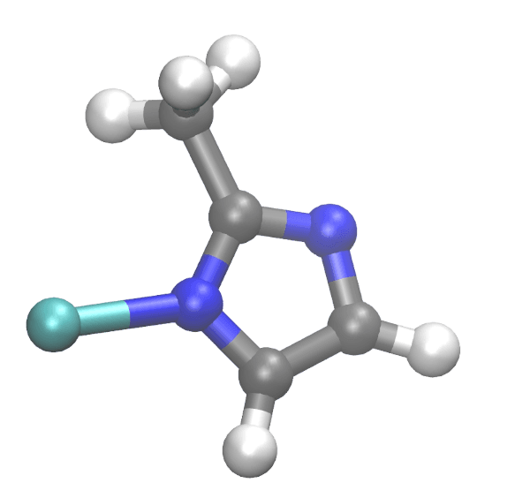
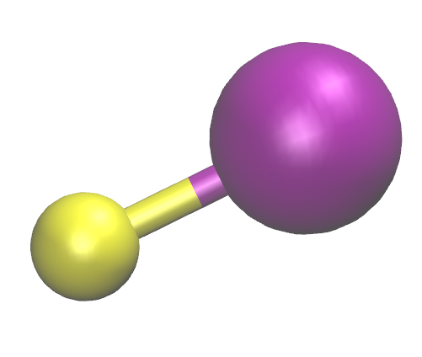
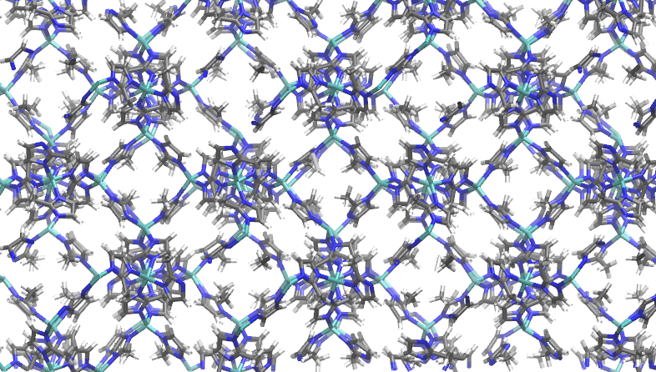
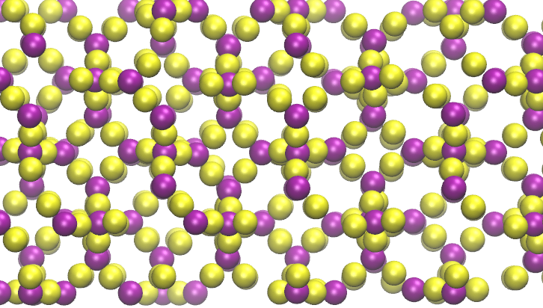
All atom scheme
Coarse grained scheme
Metal-organic framework: ZIF-8
Zn ²⁺ + 2(2-methyl imidazolate⁻)
Zn(2-methyl imidazolate)₂

Slide 4
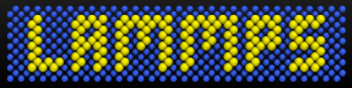
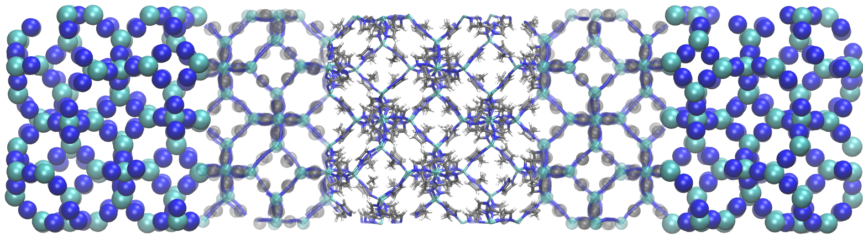
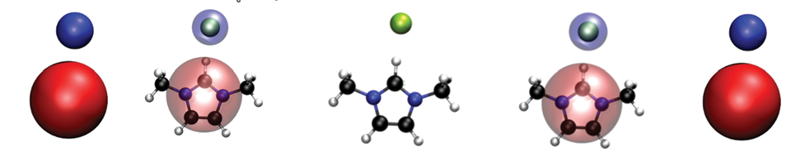
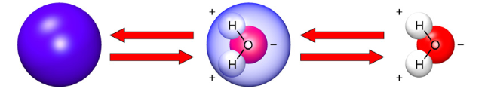
Solution ?

Slide 5
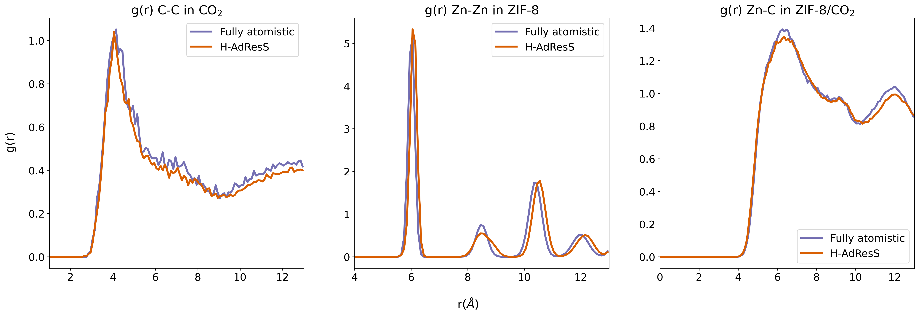
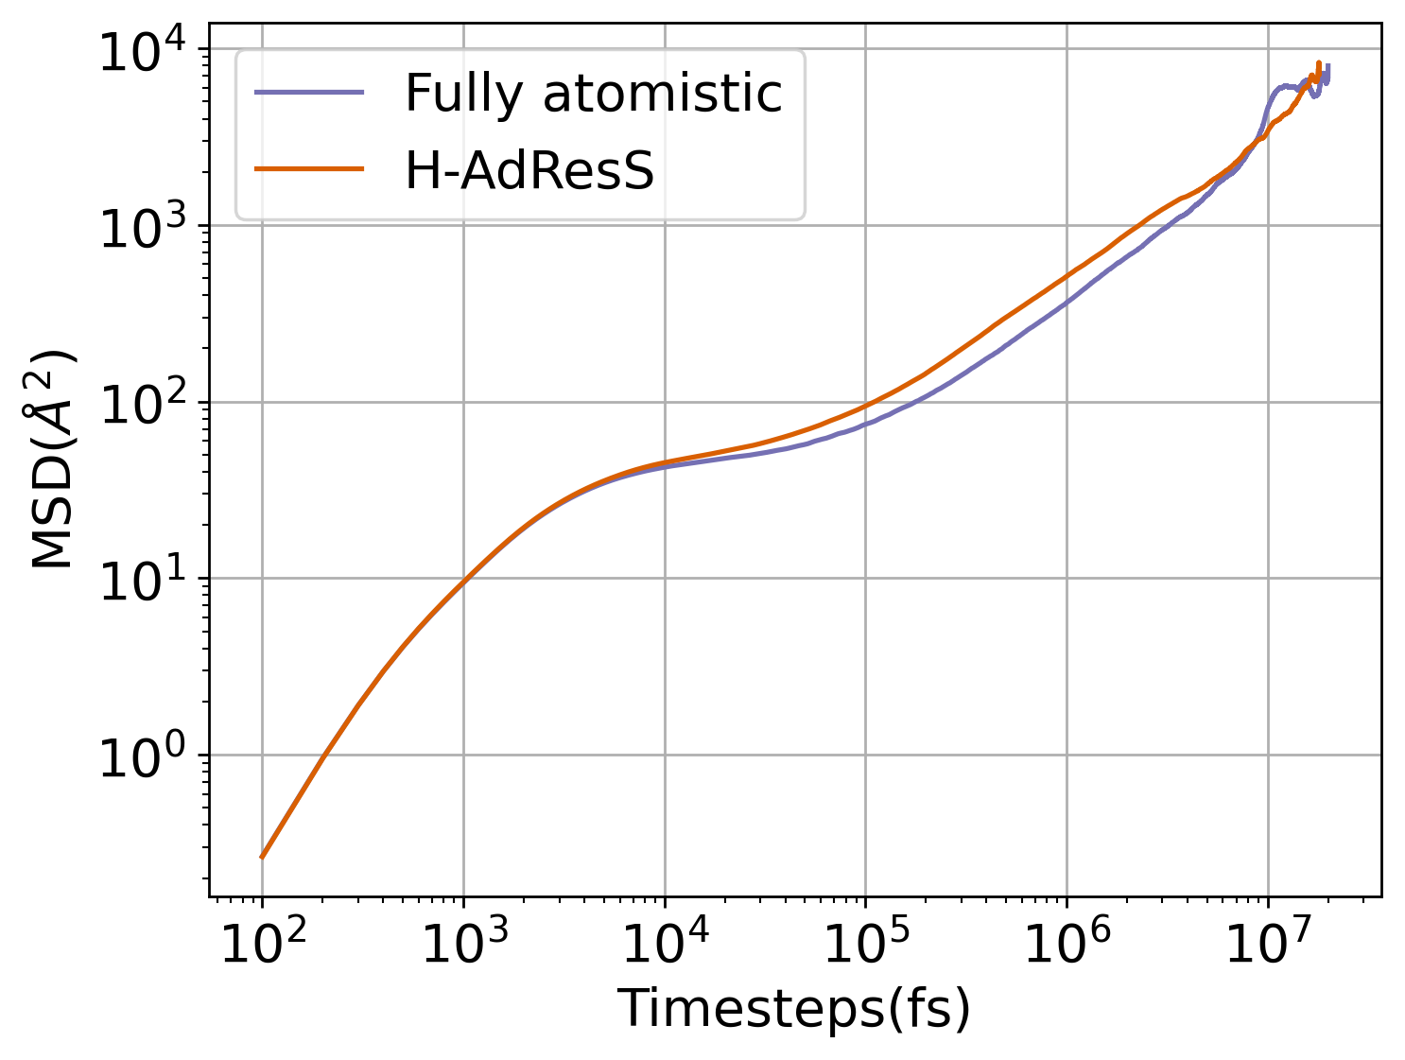
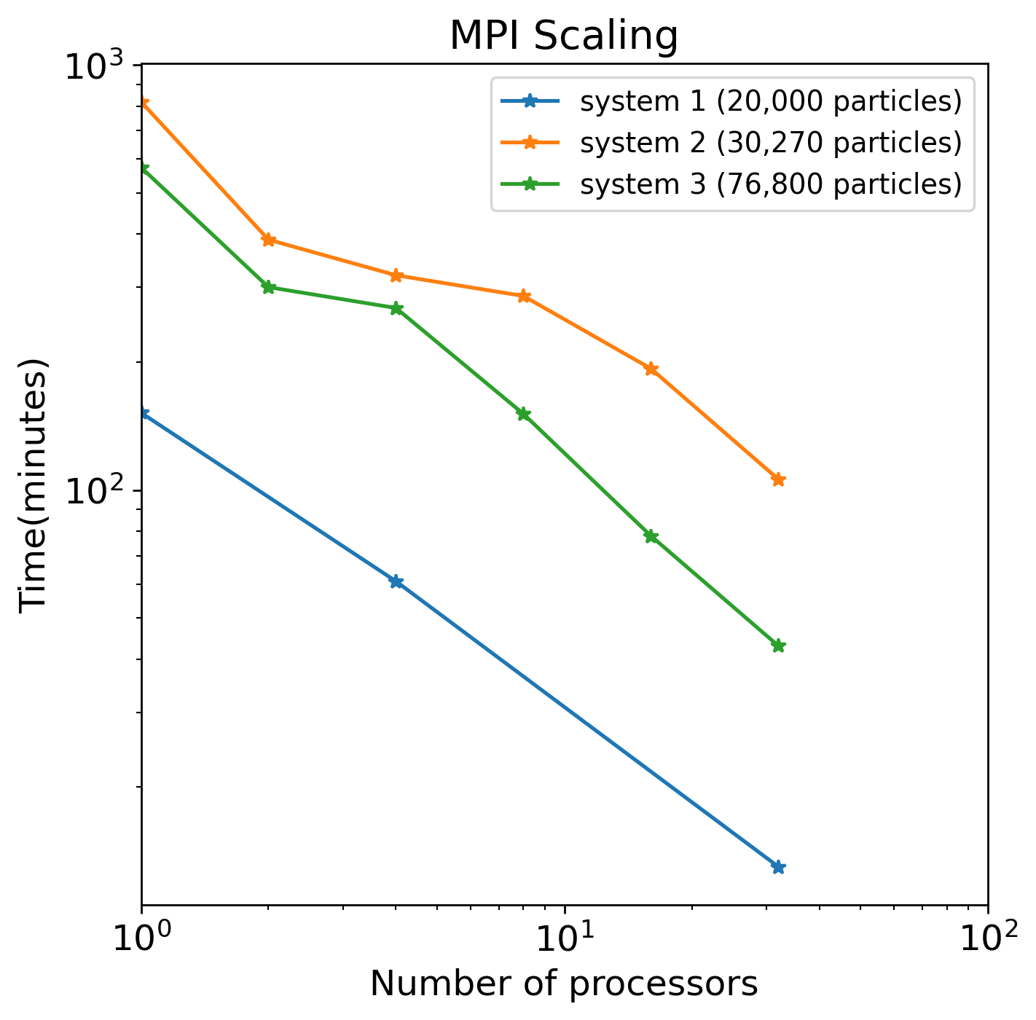

Slide 6
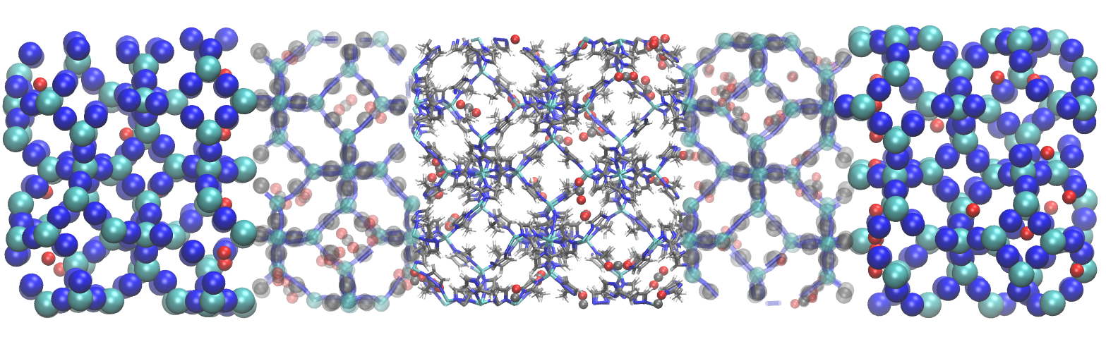

Please do visit my poster!
CONTACT
hari-haran.sudhakar@sorbonne-universite.fr

