Slide 1
TPC DAQ developments
Gilles De Lentdecker, Yifan Yang, Erik Verhagen,
IIHE-ULB (Brussels)

Slide 2
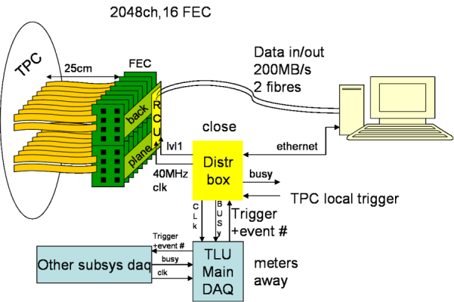
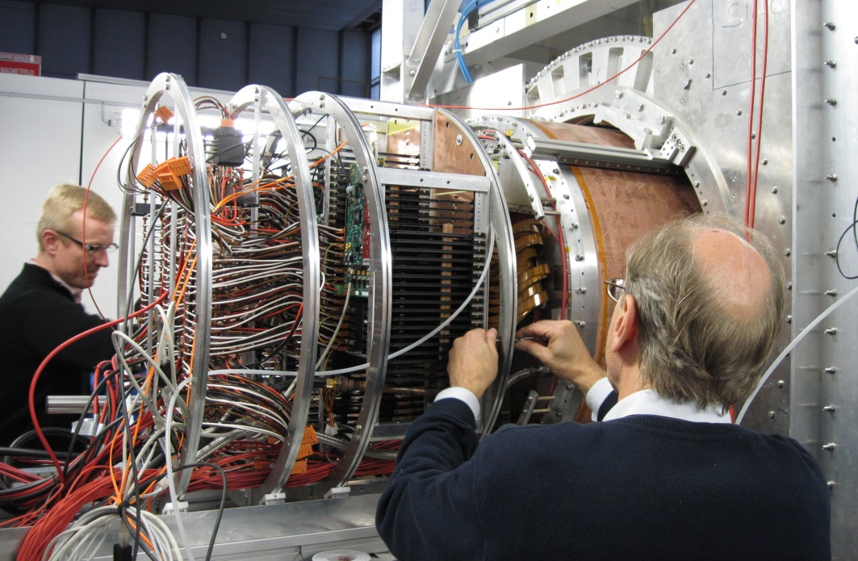
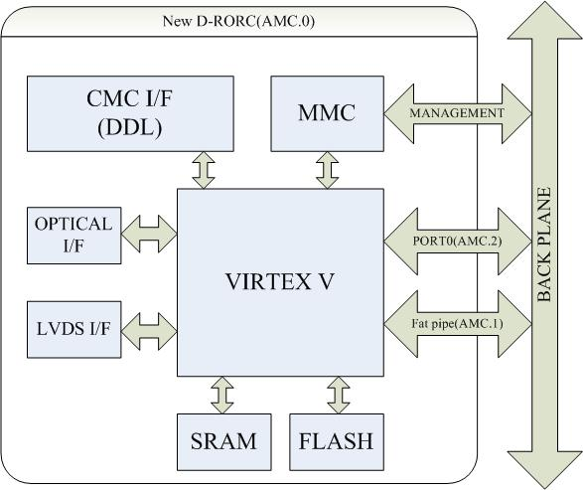
ILC TPC: New D-RORC design
Based on ALICE Hardware: FEC, RCU, DDL, DRORC (PCI)
DDL DRORC
From PC to µTCA
SFP
PCIe
Collaboration with DESY, Lund
HDMI
Notes:
D-RORC(read out receiver card) DDL(detector data link)

Slide 3
Specifications
From detector:
DDL : 200MBps
GBT : 400MBps
To DAQ:
PCI (64bit@100MHz) :800MBps
PCIe (serial link) : 250 or 500 MBps/lane (up to 8 lanes)
Plateform :
PC
MicroTCA (Micro Telecommunication Computing Architecture)

Slide 4
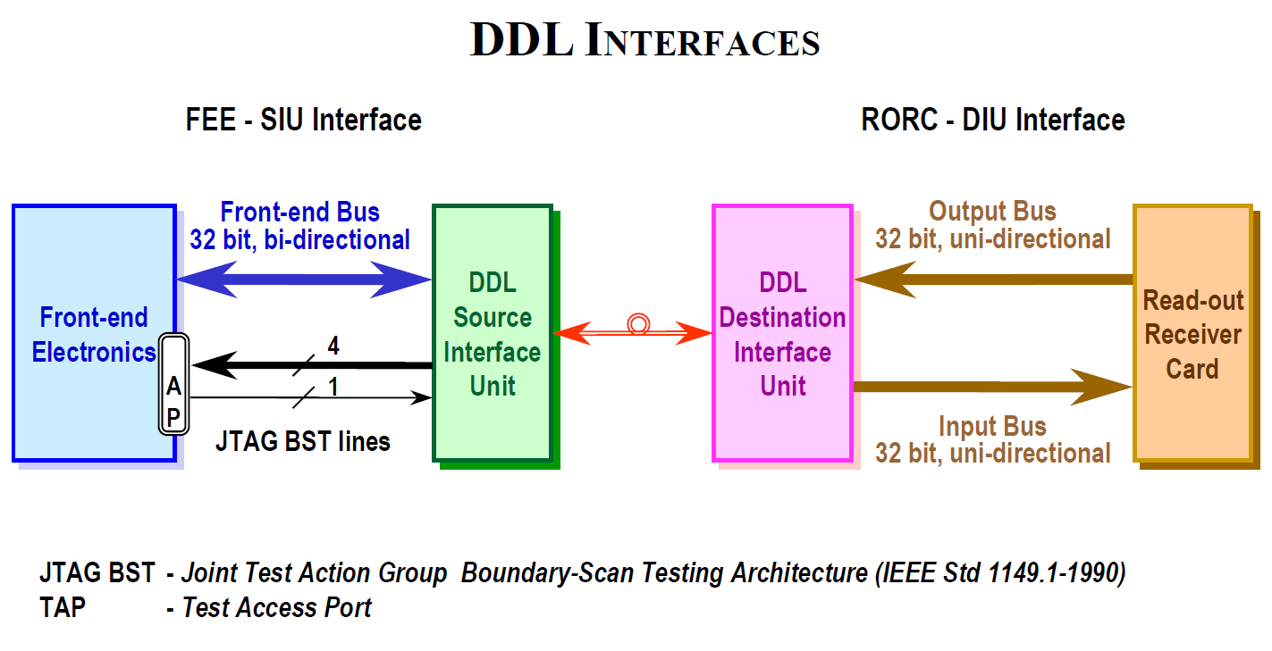
Interface
Separated board with GBIC

Slide 5
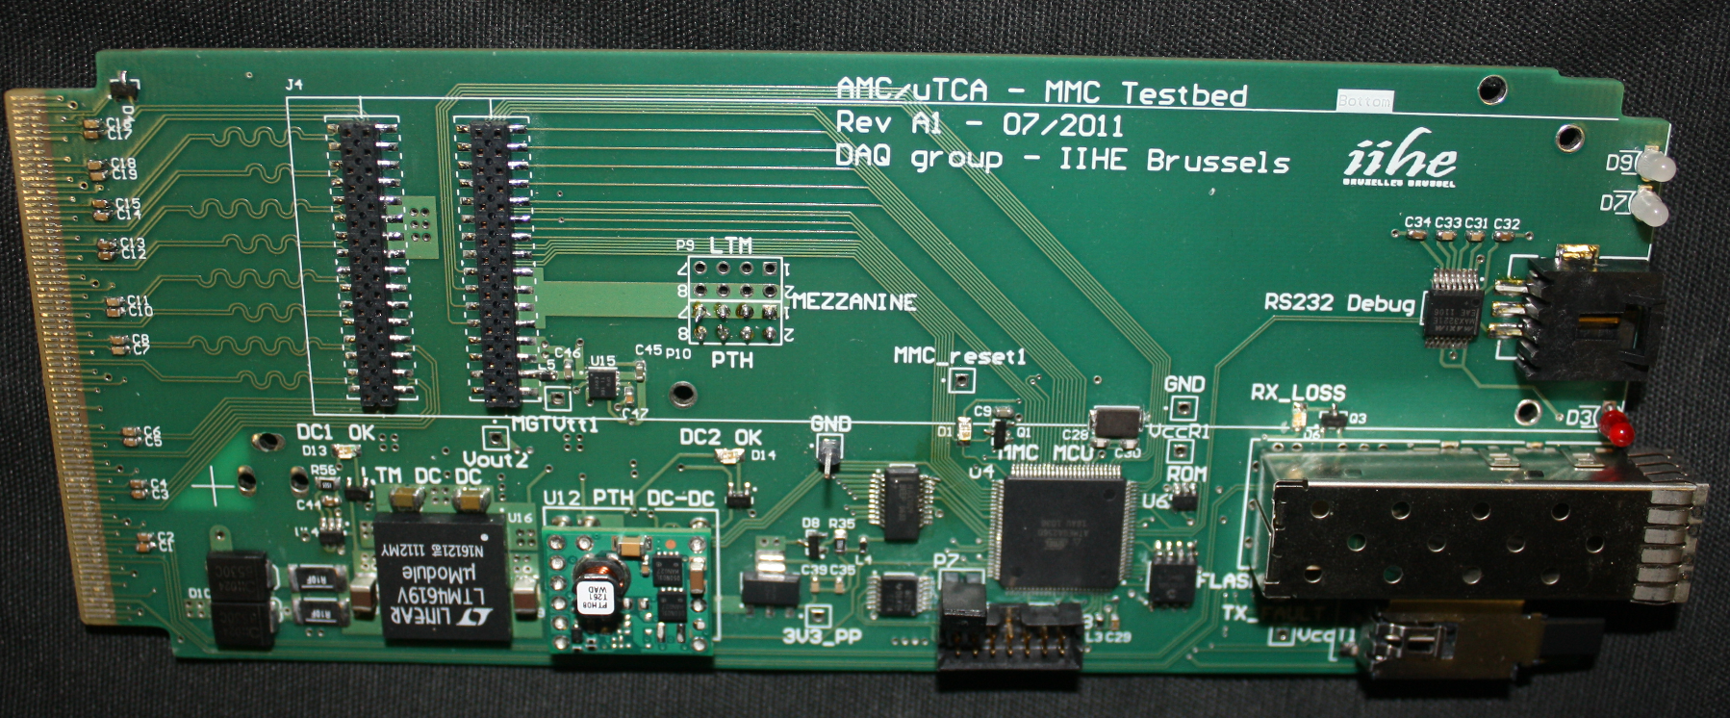
MMC study
AMC connector CMC connector
Power module MCU Sensor SFP module

Slide 6
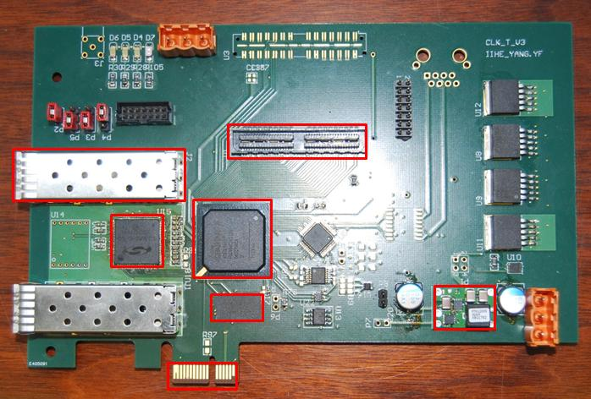
PCIe study
QSE connector
Optical module
Jitter cleaner
DDR2 memory
PCIe×1 connector
FPGA Power module

Slide 7
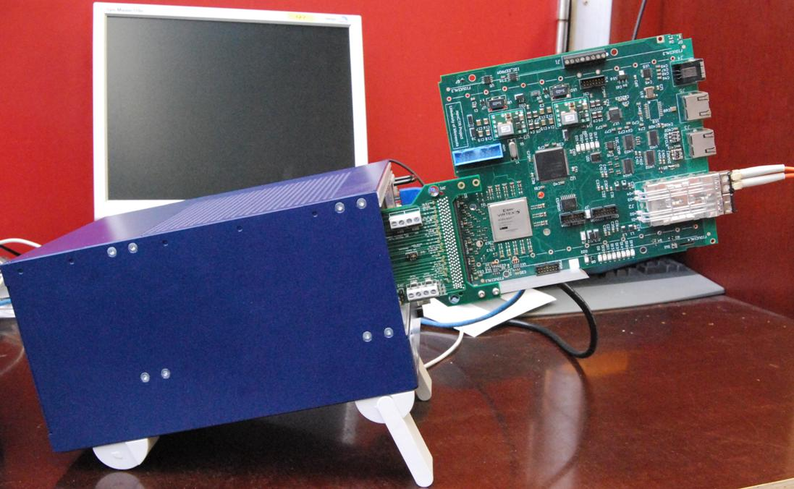
Future plan
A large
interconnection
network with
high bandwidth
(10G ethernet ,
PCIe, etc)
Large processing
power with
some flexibility
µTCA crate
SFP
POWER MODULE
FLASH MEMORY
MCU
FPGA
BACKPLANE

Slide 8
Thank You!

