Slide 1
AIDA Annual Meeting: WP3
Objectives of WP3
Definition of the program
Agenda of first annual meeting
  Status of milestones and deliverables
  Progress report by established sub-projects
  Discussion: projects not yet established and
Groups not yet associated to a project
Conclusions

Slide 2
WP3 Objectives
Task 3.1: Coordination and communication
  • To coordinate and schedule the execution of the WP tasks
  • To monitor the work progress and inform the project management and the participants within the WP
  • To follow-up the WP resource utilization
  • To prepare the internal and Deliverable Reports
Task 3.2: 3D Interconnection
  • Creation and coordination of a framework to make 3D interconnection technology available for HEP detectors
  • Organisation of a network of contacts with industry to enable fabrication of sensors and electronics optimized for 3D interconnection
  • Assess 3D vertical integration techniques enabling the HEP community to advance the state of the art of particle detectors
Task 3.3. Shareable IP Blocks for HEP
  • Creation and coordination of a framework for the design of low and medium complexity microelectronics libraries and blocks in advanced submicron technologies to be made available to the community of users in HEP
  • Organization of the design and qualification of a set of blocks using selected and qualified technologies
  • Distribution and documentation of the library of functional blocks
  • Organisation of regular Microelectronics Users Group meetings to exchange information, plan and coordinate actions related to the creation of a shared library of macro blocks.
Participants: CERN, CEA, CNRS, MPG-MPP, UBONN, INFN, AGH-UST, CISC, UB, UU, STFC
Associates: IPASCR, NTUA, UNIGLA, UNILIV, FOM
2

Slide 3
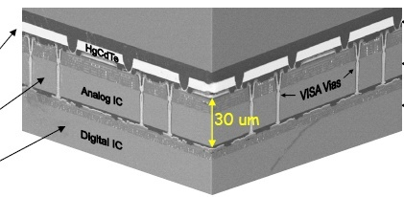
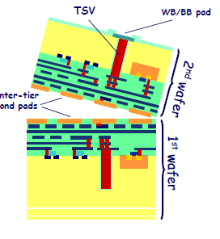
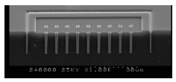
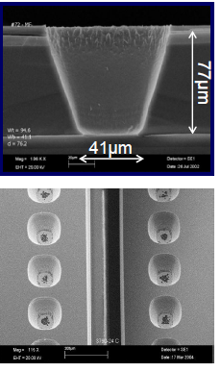
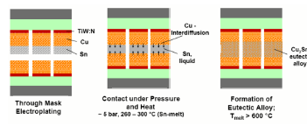
3D Interconnection
How to integrate good sensors and good electronic circuits?
3D Interconnection:
Two or more layers (=“tiers”) of thinned semiconductor devices interconnected to form a “monolithic” circuit.
Many ways to do it
Si pixel sensor
AIDA meeting
30.3.2012
DESY, Hamburg
BiCMOS analogue
CMOS digital

Slide 4
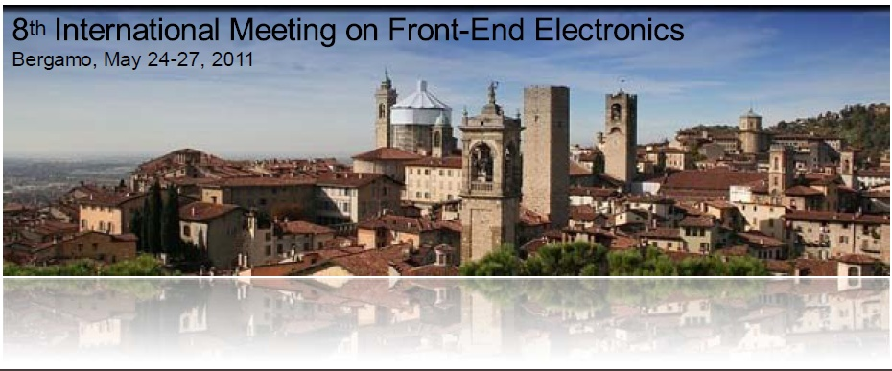
Workshop with Industry
Workshop with industry held in Bergamo, May 23.
CEA-Leti (Mark Scannell)
CMP (Kholdoun Torki)
Fraunhofer EMFT (Armin Klumpp)
Fraunhofer IZM (Thomas Fritsch)
IMEC (Piet De Moor)
T-Micro (Makoto Motoyoshi)
VTT (Sami Vaehaenen)
In general technologies rated as ‘mature’ (by the company!) offer rather large TSV (small aspect ratio) and TSV/interconnection pitch (>50 µm). Few companies/institutes offer more advanced technologies with allowing smaller pitch, but they are still more on an R&D level.
4

Slide 5
WP3 strategy
We agreed upon a “via last ” approach to 3D integration to build a 2-layer device
in heterogeneous technologies, where the two layers are fabricated independently, and TSVs and interconnections are made as the last steps of the process. The “via last” approach could be applied to different device structures
A more conservative approach can be based on “mature” technologies, with ~50 µm pitch for bonding and (peripheral) TSVs. This seems to be already commercially available, as confirmed by several R&D activities in our community
A more aggressive approach could go for real fine pitch and small TSV. This will target very future sensors (ILC, CLIC) and interconnections of individual pixels (like in 3D CMOS or SOI sensors). This has certainly higher profile and potential, higher costs and need of special ASICs.
We may agree to follow both approaches, closely monitoring the evolution and the availability of 3D technology in industry. Of course, this cannot be done with AIDA resources only; WP3 could support other R&D projects and contribute to the dissemination of results and know-how
We asked the participating institutes to propose projects
In a series of meetings we discussed and evaluated the proposals (including their funding)
One aspect was to merge similar proposals or ask participants to partner, in order to focus the resources
5

Slide 6
Approved Sub-Projects: WP3.2
1) Bonn/CPPM:
Interconnection of the ATLAS FEI4 chips to sensors using bump bonding and TSVs from IZM (large diameter TSV, large interconnection pitch).
2) CERN:
  Interconnection of MEDIPIX3 chips using the CEA-LETI process
3) INFN/IPHC-IRFU:
Interconnection of chips from Tezzaron/Chartered to edgeless sensors and/or CMOS sensors using an advanced interconnection process (T-MICRO or others)
4) LAL/LAPP/LPNHE/MPP:
Readout ASICs in 65nm technology interconnected using the CEA-LETI or EMFT process.
5) MPP/GLA/LAL/LIV/LPNHE:
  Interconnection of ATLAS FEI4 chips to sensors using SLID interconnection and ICV (high density TSVs) from EMFT.
6) Barcelona
use a 2-tier approach to increase the fill factor of APD-sensors (based on Tezzaron/Chartered)

Slide 7
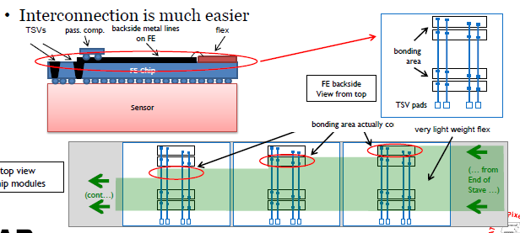
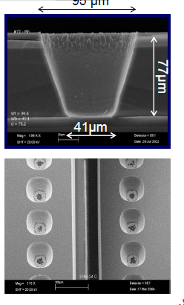
Bonn/CPPM
TSVs in ATLAS FEI4 chips and bump bonding to sensor
Large tapered vias by IZM. Successfully tested with FEI3
‘mature’ technology
FEI4 ASICs exists on wafers (3 reserved for project)
Run with IZM will start soon => results end of 2012
Run with LETI is planned
=> on schedule

Slide 8
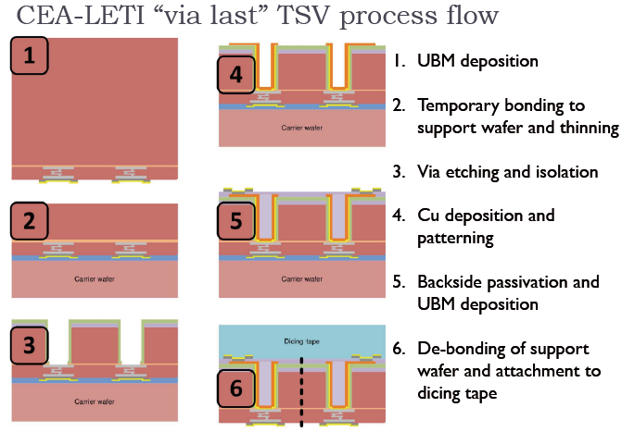
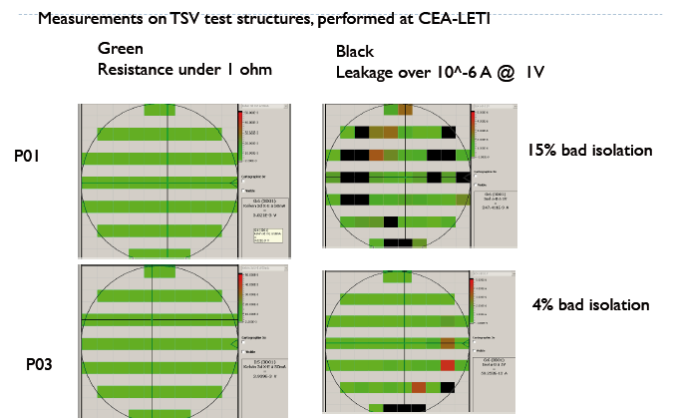
CERN
TSVs by LETI in Medipix3 ASIC
Phase I: TSV processing on Medipix3
Phase II; Hybridisation
Phase III: Demonstrator Module
Rather large vias of 60µm diameter
1:2 aspect ratio
=> ‘mature technology
Phase I done, good yield after some initial problems
Phase II started: bonding at VTT
(need for sensor wafers)

Slide 9
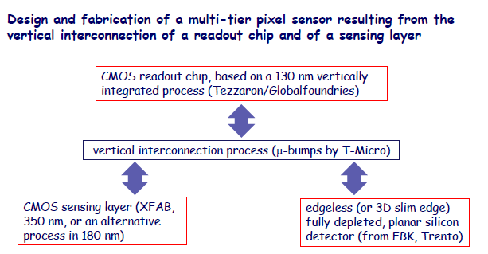
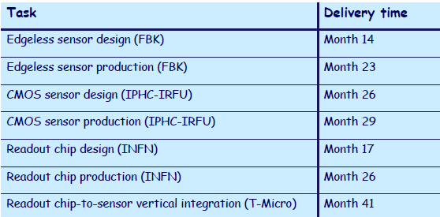
INFN/IPHC-IRFU
Challenging project, ‘aggressive’ technology
Sensor order soon
On schedule

Slide 10
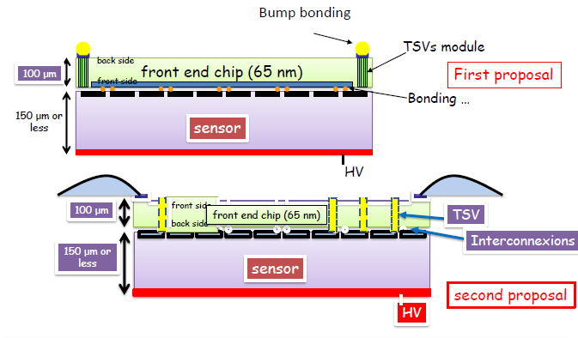
LAL/LAPP/LPNHE/MPP
OMAEGAPIX2 pixel chip & sensor (35x200µm² pixels)
130nm Tezzaron version submitted in 2012
65nm planned (perhaps via AIDA WP3.3
A-operation: is to get slim edge Pixel sensors (IZM) with Omegapix2 chip- 05/2012
B-operation is to get edgeless pixel sensors (VTT) with Omegapix2 chip- 05/ 2012
Third step is to have an Omegapix ASIC readout 130nm (end 2013)and later-on 65nm
Deliver a 4 side abuttable monolithic edgeless device where I/O signals are routed vertically through the readout chip (~2015)

Slide 11
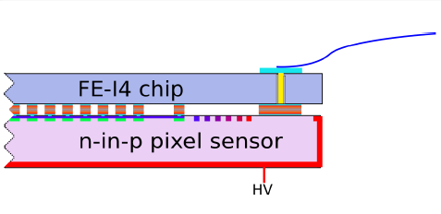
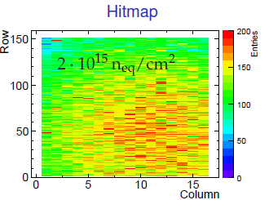
MPP/GLA/LAL/LIV/LPNHE
Demonstrator module for SLID and TSV technologies based on ATLAS FE-I4
chip and n-in-p pixel sensors with a thickness of (150-200) mm:
SLID as possible alternative to bump-bonding.
TSV with Via Last approach below the wire bonding pads for backside readout
Similar to Bonn project, but more ‘aggressive technology
SLID ok for smaller pitch
3µm 1:10 vias
3 FEI4 wafer already available
Sensors in production (VTT, Micron)
Successful test of SLID with FEI3:
100% connected pixels, radiation tested
Challenge: adapt TSV technology to FEI4
(etching from backside instead of frontside)

Slide 12
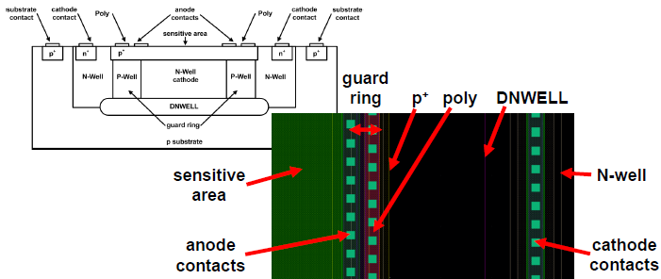
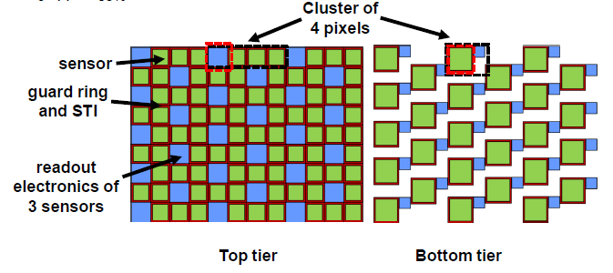
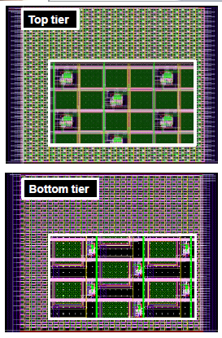
Barcelona
Basic idea: tracking sensor based on Geiger APD realized in CMOS (incl. readout)
Use 2 tier 3D to increase fill factor
Option 1: Tezzaron/Chartered MPW in Sept. 2012
alternatively (e.g. design rule mismatch)
Option 2: AMS 0.35µm HV + AIDA interconnection
Because of late schedule not yet in D3.1 => addendum

Slide 13
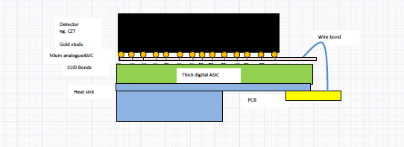
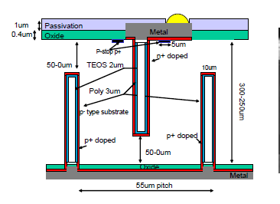
Other projects
RAL:
2 tier readout chip for GZT X-ray detector using EMFT SLID interconnection & TSVs
ASICs exist & tested
Not yet approved by AIDA since not fully funded
Uppsala will join
Could get ‘critical mass’
Decision April/May
CNM:
Offer sensors (slim edge, 3D)
Masks available for Medipix, & FEI4
Interest by CERN and LAPP

Slide 14
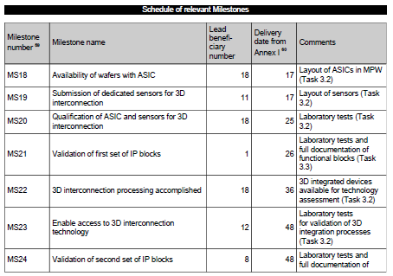
Milestones

Slide 15
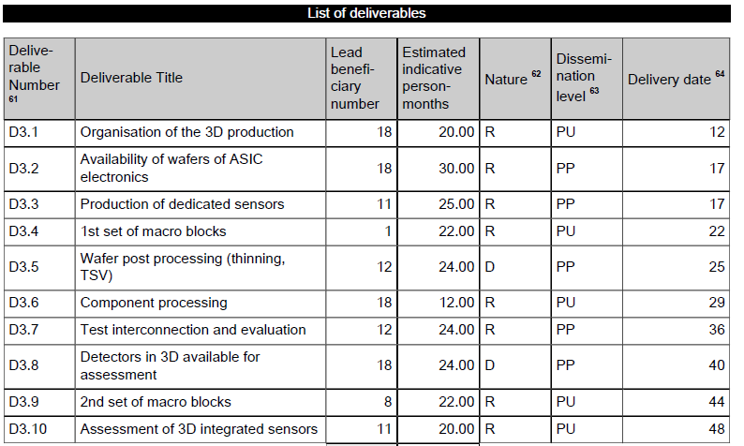
Deliverables

Slide 16
Milestones and Deliverables in 2012
Milestones:
1) MS18 Availability of ASIC wafers, M17 (July 2012)
already met (FEI4, Medipix)
2) MS19 Submission of dedicated sensors, M17 (July 2012)
INFN: production of edgeless sensors (April 2012)
MPP: sensor procurement (CSEM/VTT) (July 2012)
Deliverables:
D3.1 Organisation of the 3D production M12 (Feb 2012) - done
2) D3.2 Availability of ASIC wafers M17 (July 2012)
already delivered (FEI4, Medipix)
3) D3.3 Production of dedicated sensors M17 (July 2012)
INFN: production of edgeless sensors (April 2012)
MPP: sensor procurement (CSEM/VTT) (July 2012)

Slide 17
IP Blocks: WP 3.3
Provide sharable IP blocks for HEP
Lead institutions: CERN & LAL
large interest: Bonn, INFN, CNRS (LAL; LAPP; LPNHE, CPPM), AG
First set of blocks for 65nm CMOS
depends on CERN (frame contract expected end 2012)
Deliverable date D3.4 (M22, Dec, 2012) might be a problem
Second set of blocks for SiGe
First: technology choice: 350nm (AMS) or 130nm (IBM, ST, IHP)
depends on the cost
(130nm is rather expensive and needs a additional contribution)
decide within one year
Deliverable date D3.9 (M44 should be ok.

Slide 18
Conclusions
WP3.2 (3D integration) fragmented into many sub-projects (6 + 1)
Thanks to the institutes willingness to contribute own resources and to the availability of ASICs (FEI4, Timepix) we can afford this large program
This allows exploring different technologies (of different maturity, potential, and risk) and different sensor readout ASIC concepts (Planar/3D/CMOS-sensors) and 1 or 2 tier ASICs in different technologies (130nm, 65nm)
Depending on the technological challenges the projects have different schedule. However, the ones using ‘mature’ will certainly meet the AIDA milestones and delivery dates.
WP3.3 has also defined its program, providing IP blocks for 65nm CMOS and SiGe.
65 nm CMOS depends on CERN to provide a frame contract with a manufacturer. The target date may force us to delay D3.4
SiGe is on a longer timescale. Next step is to choose the best (or affordable) technology.

