Slide 1


R&D towards a 3D - Via last interconnect Technologies for Pixel detectors
Atlas IN2P3 project
Abdenour Lounis, Gisèle Martin-Chassart, Damien Thienpont, Jeanne Tongbong, Benoit Lachacinski
Laboratoire de l’accélérateur Linéaire
Université Paris XI, Orsay,
Giovanni Calderini, Jean François Genat, Olivier Ledortz
Laboratoire de Physique des Hautes Energies, Paris VI
Teddy Todorov, Renault Gaglione, , Julie Prast, Fatima Lachani
Laboratoire Annecy –le-Vieux de Physique des Particules

Slide 2
Why do we go for 3D technologies, for HL-LHC. Criteria to be fulfilled :
Better granularity & 4 size abuttable devices (Shrink pixel dimensions to decrease the form factor of the final device)
Low material budget (Submicron technologies + thin sensors using innovative interconnect techniques: slid, microbumps…)
Radiation hard Si detectors (Oxygenated silicon) and electronics (CMOS 130 nm and 45 nm)
Low power dissipation systems (low noise electronics and use of TSV technology in place of wire bonds, bumps…)

Slide 3
Prospects
In parrallel : To exploit and combine two major technology advances and evaluate potential beneficts
Use 130 nm CMOS and potential availability of 65 nm in Research laboratories in close cooperation and coordination with CERN-Mic
( process of building a 65 nm « club » or task force)
Take advantage of « open » TSV providers in Europe to demonstrate the feasability of TSVs on functional detector chips.

Slide 4
OMEGAPIX2 project : CHIP for pixel readout
(IBM 130 nm) chartered-Tezzaron
Targets :
Low threshold (1000 e)
Low noise ~300 fF
Cope with high leakage current (up to 100 nA per channel)
8 bits local threshold adjustment
Time-Over-Threshold measurement
  3 bits
  Clock multiplier (40Mhz to 160 Mhz) possible
  Optimized readout for maximum charge measurement accuracy and event pile-up
On pixel memory of up to 3 event between each Lv1 clear
Ambitious goal is to couple this chip to a sensor and bring it in test-beam for performance study, radiation damage studies
Entangled with Slim Edge sensor R&D to produce 4 side buttable device
3 bits
Range = ~ 10,000 e-
Step = ~ 1250 e-
Submitted end 2011

Slide 5
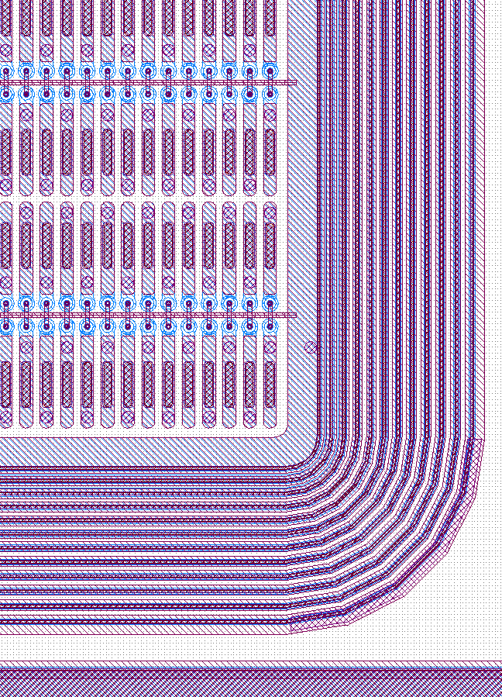
OMEGAPIX2 sensor For ATLAS HL-LHC
Reduction of Phi resolution has been shown to be more beneficial to ATLAS tracking performance than Z resolution -> Pixel of 35x200 um
OMEGAPIX2 will provide a complete read-out chain usable in testbeam and other complete standalone system test
The chip could provide spectroscopic measurements at low luminosity (ie details charge measurement) and fast operation at higher luminosity
Active
inactive
Planar Pixel Sensor

Slide 6
Sensor developpement: Guard Ring Sensor
0. 4mm
0. 4mm
6 mm
0. 36mm
Chip
Z
Active area
Phi
Guard rings
GR over chip
4.5 mm
In X : 24 pixel of 200 microns
In Y : 96 * 35 microns
0. 5mm
Active zone : 4.8mm x 3,36
The GR are overlapping the chip by
100 um on the Z edges and by
140 um on the top Phi edge
1 mm
Omegapix2 chip
Foundry Cis

Slide 7
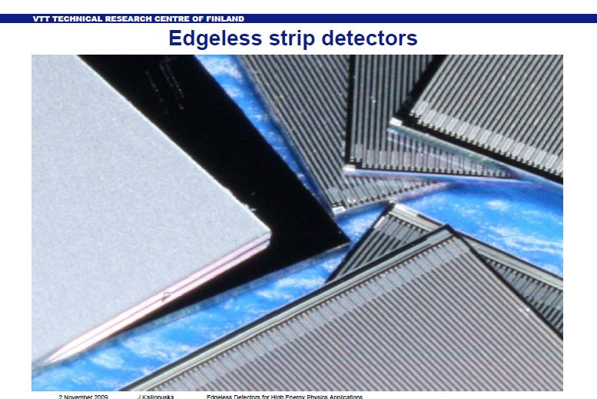
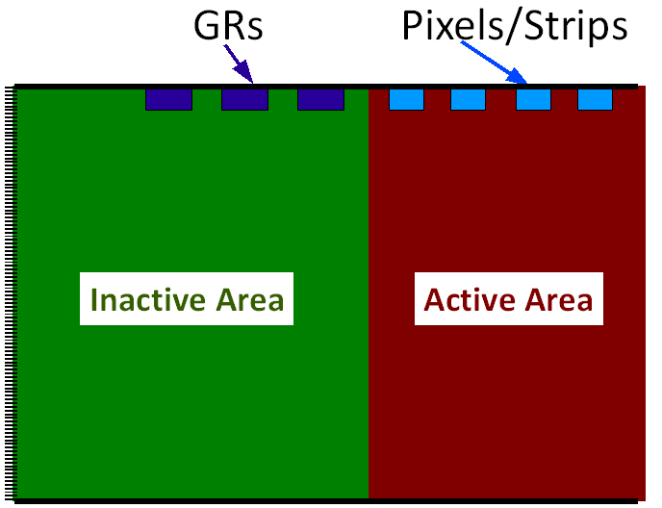
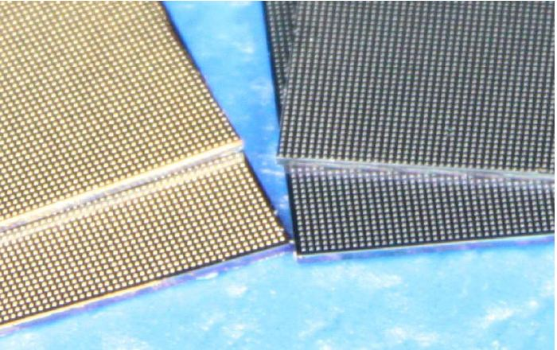
Towards Edgless sensor technology

Slide 8
Sensor developpement: Active Edge Sensor
0. 1mm
0. 1mm
5 mm
Chip
Z
Active area
Phi
Guard rings
3.46 mm
Long pixels
In X : 24 pixel of 200 microns
In Y : 96 * 35 microns
Chip 5x5mm
100 um edges in z side
50 um edge in phi side
1.59 mm
Omegapix2 chip
Foundry VTT

Slide 9

VTT Edgless pixel matrix under production

Slide 10
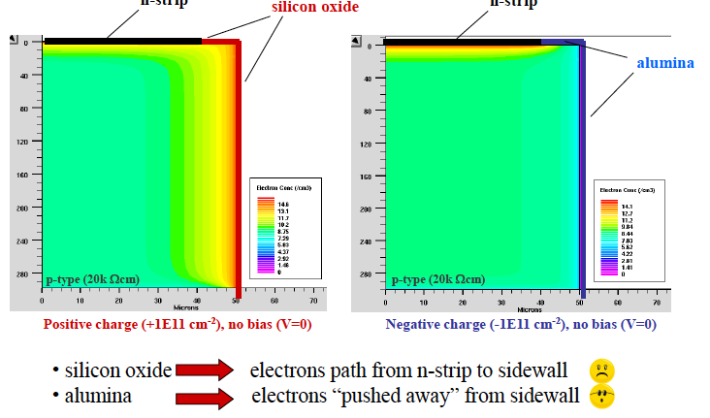
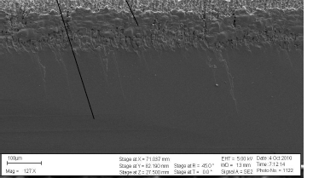
Promising approach :RD 50 Slim Edges
Slim edge is achieved through post-processing by creating a clean cut at the edge of the sensor:
Laser scribing
Cleaving
Passivation of the edge using Alumina Atomic Layer Deposition can be used with new material to control oxide charge and control potential drop in the sensor.
Santa Cruz

Slide 11
Via Last AIDA project: LAL + LPNHE+ LAPP
Bump bonding
TSVs module
back side
front side
front end chip (65 nm)
100 μm
First proposal
Bonding …
150 μm or less
sensor
HV
100 μm
front side
back side
front end chip (65 nm)
TSV
Interconnexions
150 μm or less
sensor
second proposal
HV

Slide 12
First proposal
Classical bump bonding
TSVs module
back side
front side
front end chip (65 nm)
100 μm
Bonding …
150 μm or less
sensor
HV
Process steps
Front end chip fabrication in 65 nm techno (IBM) with analog and digital signal processing and sensor fab
  no pads, only available area for futures TSVs
via-last post-processing
  I/O access by the chip’s back side
  Several TSVs for one pad => better yield
thinning up to reach TSVs, back metallization (100 μm final thick)
bonding sensor: ~ 35 μm pitch
Matrix organization
Pixel bonding will be placed in alternance to get minimal pixel width
35 μm

Slide 13
Second proposal
Much more ambitious!!
100 μm
front side
back side
front end chip (65 nm)
TSV
Bonding …
150 μm or less
sensor
HV
Process steps
Front end chip fabrication in 65 nm techno (IBM) with analog and digital signal processing and sensor fab
via-last post-processing
  one TSV by pixel
thinning up to reach TSVs, back metallization (100 μm final thick)
bonding sensor: ~ 35 μm pitch
Matrix organization
Pixel bonding will be placed in alternance to get minimal pixel width
35 μm

Slide 14
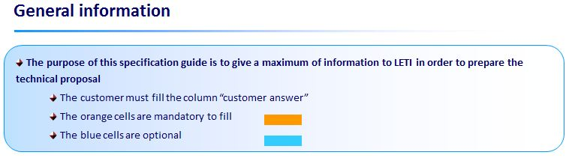
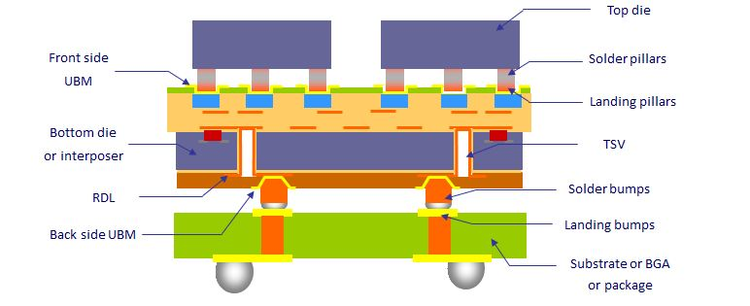
Exploit industrial know how
Open 3D™ Initiative (LETI-GRENOBLE)
Meeting scheduled April 20th,2012 at Grenoble

Slide 15
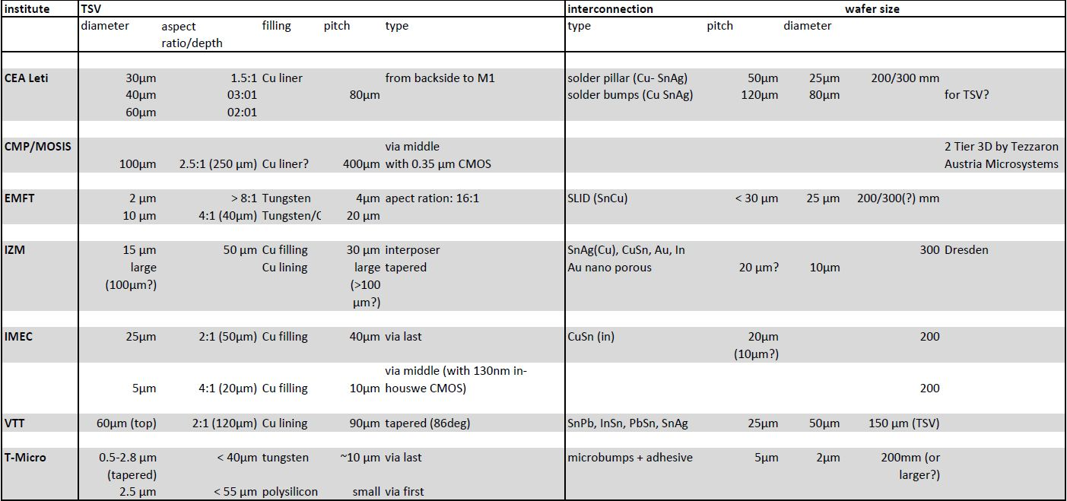
Industry offers

Slide 16
Project forecast & Time scale
A-operation: is to get slim edge Pixel sensors (IZM) with Omegapix2 chip- 05/2012
B-operation is to get edgless pixel sensors (VTT) with Omegapix2 chip- 05/ 2012
Third step is to have an Omegapix ASIC readout 130nm (end 2013)and later-on 65nm
Deliver a 4 side abuttable monolithic edgless device where I/O signals are routed vertically through the readout chip (~2015)
Thank you

Slide 17
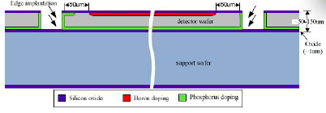
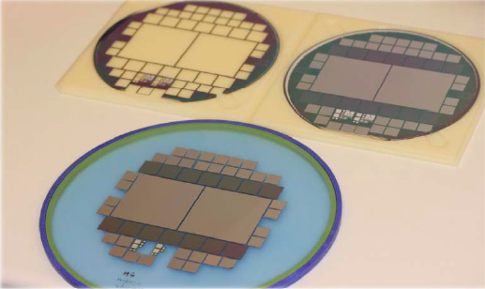
VTT slim edges sensors
Slim edge is achieved through:
Extreme quality of the sensor surface
Implantation of the edges after etching
Important requirements:
Implementation of p-spray and moderated p-spray implantation in VTT process
Radiation hardness

