Slide 1

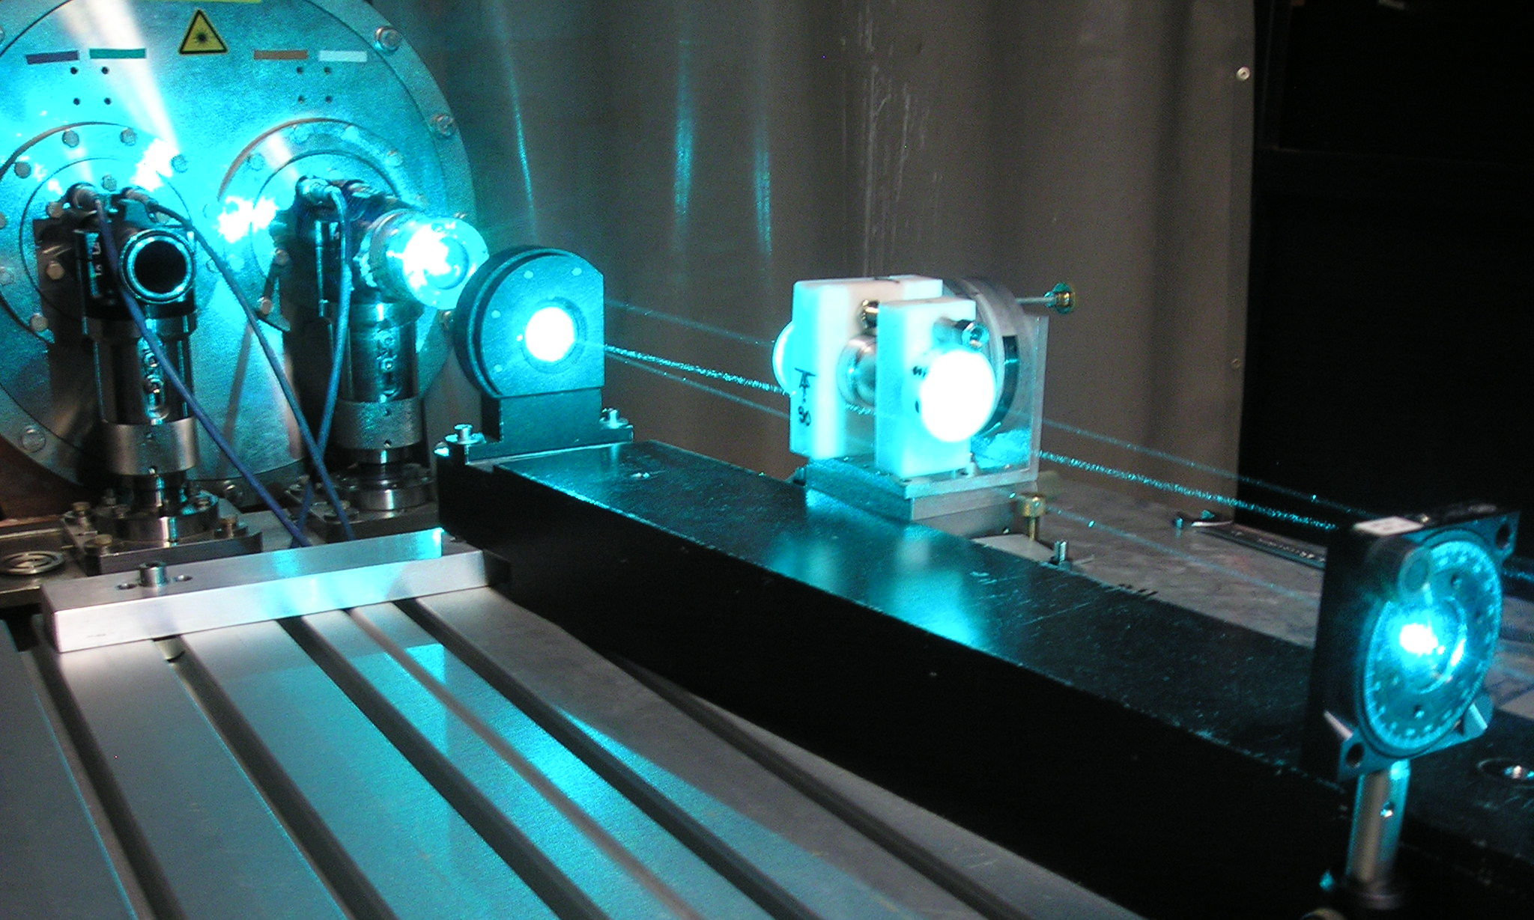
Optical Search for QED vacuum magnetic birefringence,
Axion & photon Regeneration
Laser-based Particle/Astroparticle Physics Experiments at CERN
To test QED & probe the Low Energy Frontier…
2011 Photon Regeneration Run
with 3 W of Optical Power
2011 Status Report , from P. Pugnat on the behalf of the OSQAR Collaboration
103rd Meeting of the SPSC (CERN), 25 October 2011

Slide 2















► 26 Members from 11 Institutes (CERN, Cz, Fr & Po)
CERN, Geneva, Switzerland
G. Deferne, P. Pugnat (now at LNCMI-CNRS), M. Schott, A. Siemko
Charles University, Faculty of Mathematics & Physics, Prague, Czech Republic M. Finger Jr., M. Finger, M. Slunecka
Czech Technical University, Faculty of Mechanical Engineering, Prague, Czech Republic J. Hošek, M. Kràl, K. Macuchova, M. Virius, J. Zicha
ISI, ASCR, Brno, Czech Republic
A. Srnka
IMEP/LAHC - INPG, 38016 Grenoble, France L. Duvillaret, G. Vitrant, J.M. Duchamp
IN, CNRS – UJF & INPG, BP 166, 38042 Grenoble, France
B. Barbara, R. Ballou
LASIM , UCB Lyon1 & CNRS, 69622 Villeurbanne, France
M. Durand (now at NIST, Gaithersburg), J. Morville
LSP, UJF & CNRS, 38402 Saint-Martin d'Hères, France R. Jost, S. Kassi, D. Romanini
TUL, Czech Republic
M. Šulc
Warsaw University, Physics Department, Poland
A. Hryczuk, K. A. Meissner

Slide 3
Outline
Introduction
Significance of the OSQAR Experiments
  VMB & Photon Regeneration (PR)
  Short & Long Term Perspectives
Some Highlights from Collaborating Institutes
Preparatory Phase for the VMB measurement
  PR Experiment at CERN - Ongoing Progress
Summary, Perspectives & Requirements for 2012

Slide 4

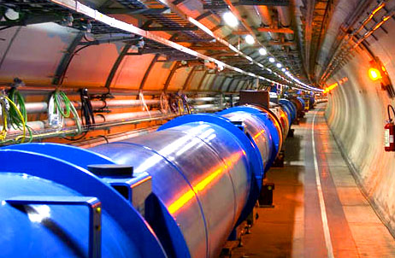
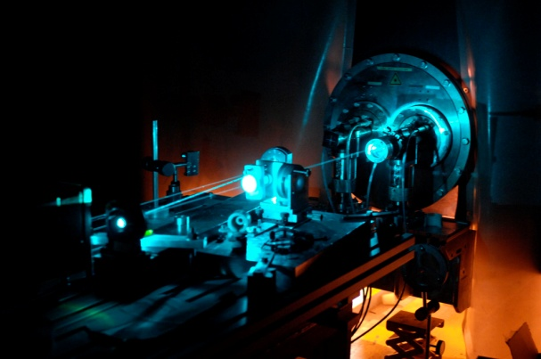
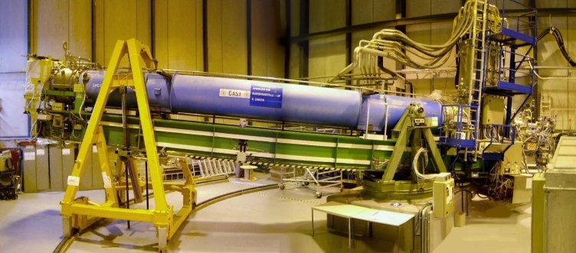
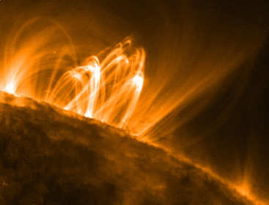
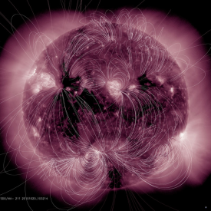
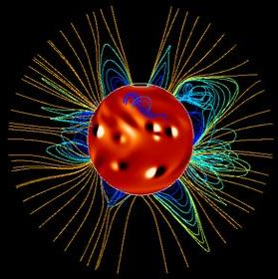
Scientific Motivations
► Complementary to LHC & CAST
Physics at the TeV scale to search WIMPs (Weakly Interacting Massive Particles)
Physics at the Sub-eV scale to search WISPs (Weakly Interacting Sub-eV Particles)
Many extensions of the Standard Model, like those based on supergravity or superstrings, predict not only WIMPS but also WISPs…
OSQAR being more model independent is complementary to CAST. To compare only the sensitivity of both experiments can be misleading as solar models have difficulties to take into account the solar magnetic field… see for example K. Zioutas et al. in J. of Phys. Conference Series 39 (2006) 103-106

Slide 5

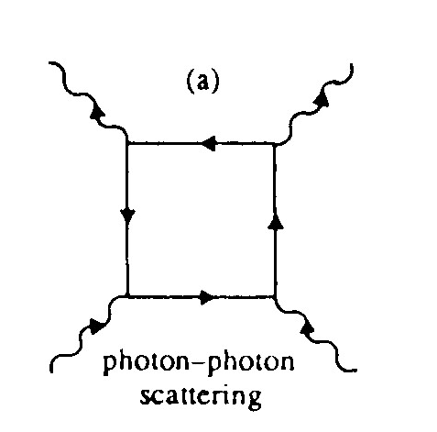
Scientific Motivations in a Nutshell
To measure for the 1st time the QED Vacuum
Magnetic Birefringence (Heisenberg & Euler,
Weisskopf, 1936) i.e. the vacuum magnetic
“anomaly” of the refraction index
“ n-1” ~ 10⁻²² in 9.5 T
To explore the Physics at the Low Energy Frontier (sub-eV)
  Axion & Axion Like Particles i.e. solution to the strong CP problem (Weinberg, Wilczek, 1978) & Non-SUSY Dark Matter candidates (Abbott & Sikivie; Preskill, Wise & Wilczek, 1983)
  Paraphotons (Georgi, Glashow & Ginsparg, 1983), Milli-charged Fermions
  Chameleons (Khoury & Weltman, 2003)
  The Unknown … “Exploring a new territory with a precision instrument is the key to discovery”, Prof. S.C.C. Ting
A New Way of doing Particle Physics based on Laser beam(s)
Spin-offs in the domain of the metrology of electric & magnetic fields
x
x
Delbrück scattering

Slide 6

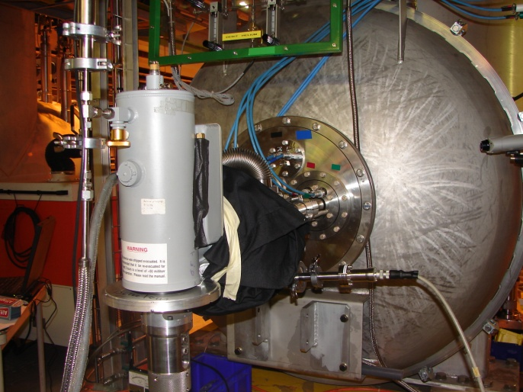
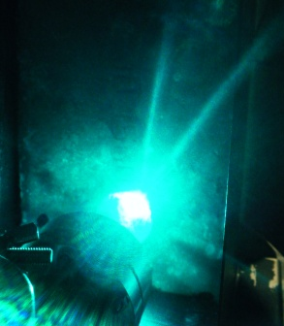
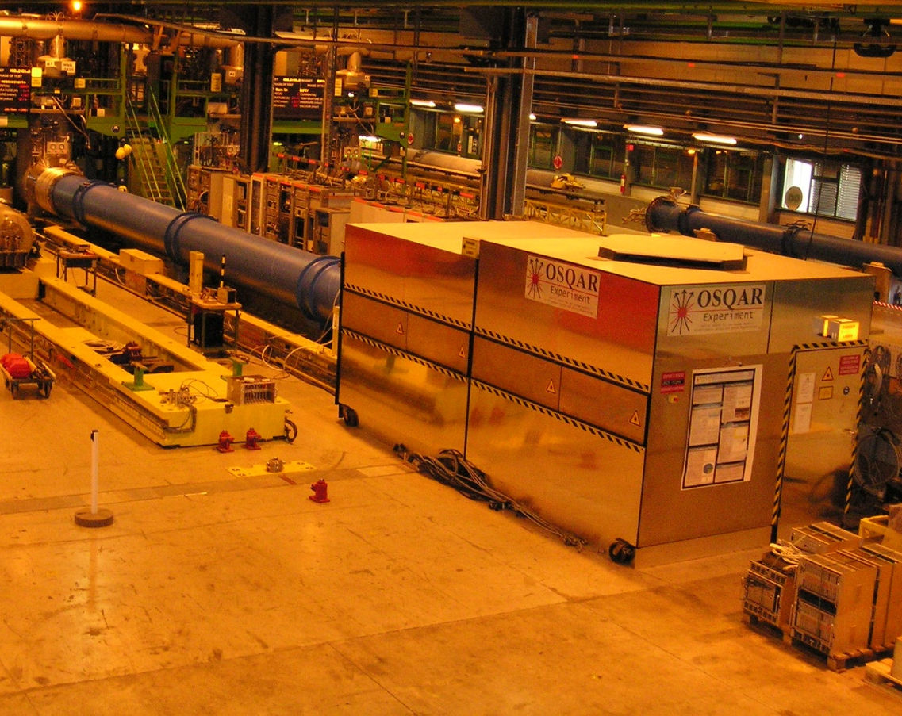

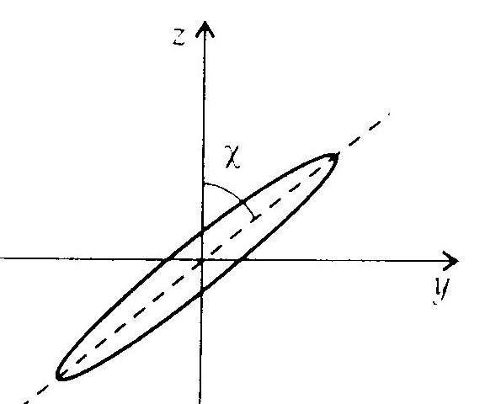
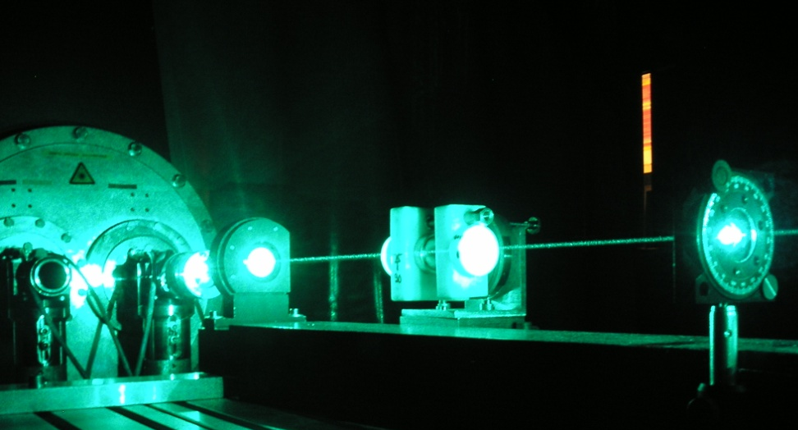

Principles of the Experiments
LN₂ cooled CCD
Use of 2 LHC cryo-dipoles (double apertures, 9 T over 2 x 14.3 m)
► In one aperture of dipole-1, measurement of the Vacuum Magnetic Birefringence & Dichroïsm
► In the 2nd aperture of dipole-1 & one aperture of dipole-2, Photon Regeneration Experiment
a
γ
γ
9.5 T
x
x
~ 53 m

Slide 7

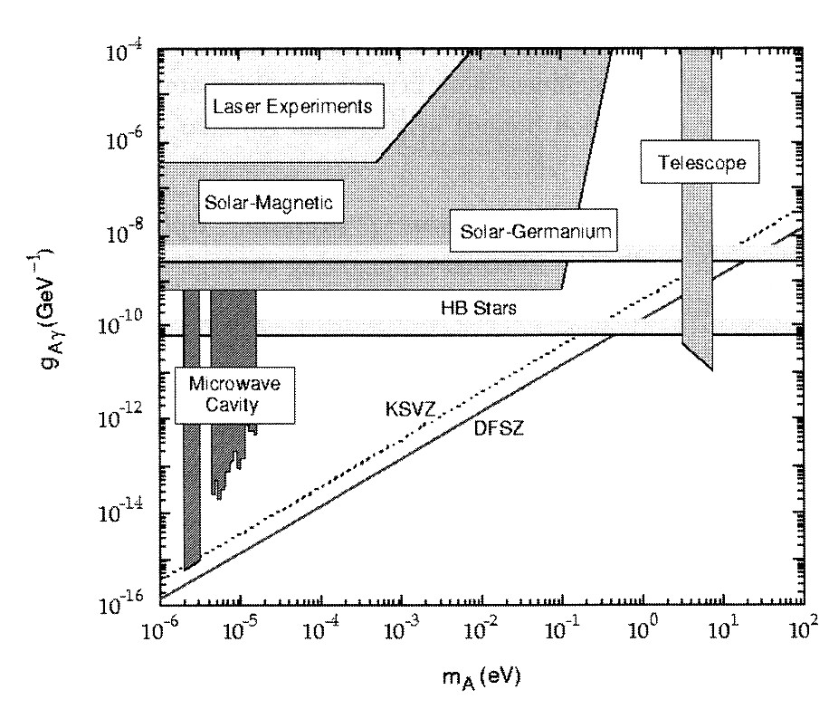
Experiments
- Expected results - Short & “Long” Term Perspectives
Axion Search
From C. Hagmann, K. van Bibber, L.J. Rosenberg, Physics Lett. B, vol.592, 2004
Photon regeneration Experiment
  Preliminary Phase to test PVLAS results; 1 dipole with/without gas (done) * *
  Phase-1 : 2 dipoles, CW laser beam, extra & intra cavity to improve BFRT/GammeV results (2009-2010) and ALPs (2011-2012)
  Phase-2 : 2 dipoles, CW laser beam & High Finesse FP cavity (2013-2014)
  Phase-3 : more than 2 dipoles to be competitive with CAST (long term)
“n-1 Experiment” i.e. VMB & Linear Dichroism
  - Phase-1&2 : Measurements of QED prediction in O(α²) & O(α³) respectively within 1 dipole (started, long term…)
PVLAS, PRL 96 (2006)
CAST-2003, PRL 94
(2005)
ALPs 2010
Expectation for 2011/12 OSQAR-PR
*P. Pugnat, et al. Czech Journal of Physics, Vol.55 (2005), A389;
Czech Journal of Physics, Vol.56 (2006), C193;
* * P. Pugnat, et al. Phys. Rev. D 78, 092003 (2008)

Slide 8


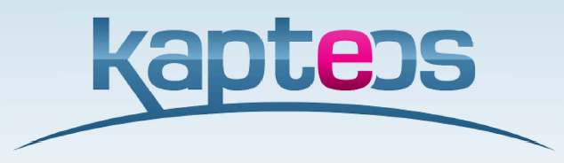
Highligths

Slide 9
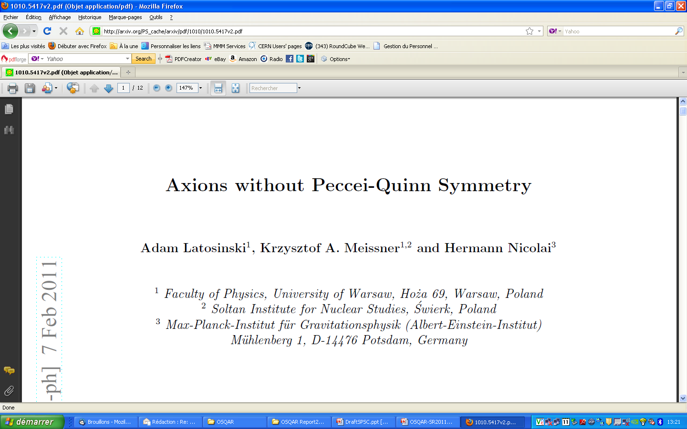

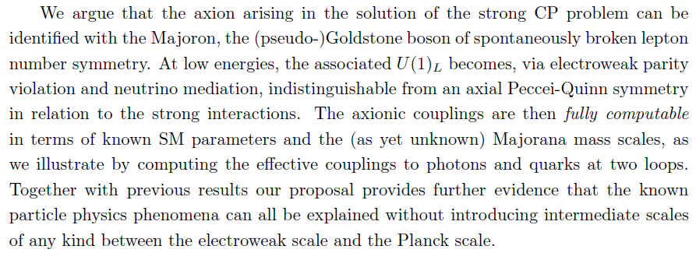
New theoretical development

Slide 10
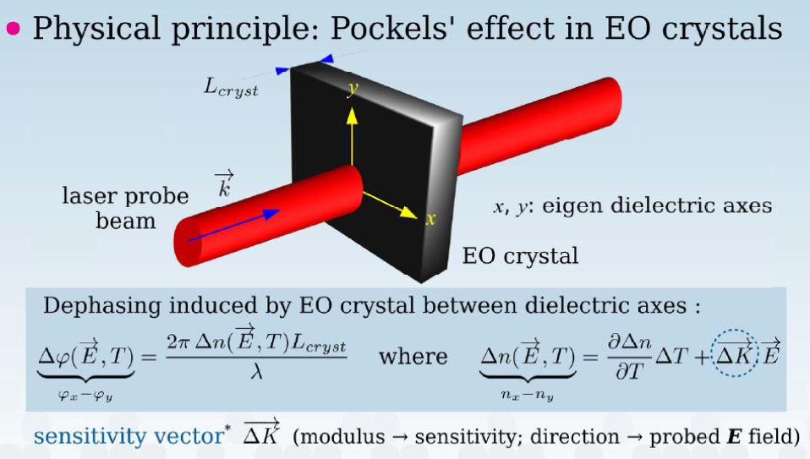





Spin-off : a New Start-up has been created by Prof. L. Duvillaret
(Addressed in CERN-SPSC-2006-035)
www.kapteos.com
Partners
Awards
10 staffs at present
► Strong motivations to apply the know-how for precise magneto-optic measurements
Dynamic range 70 dB
Bandwidth 18 GHz
2008
2009
2010
2011
* L. Duvillaret et al., J. Opt. Soc. Am. B 19, p 2704-2715 (2002)

Slide 11

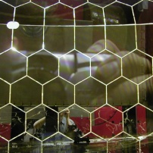
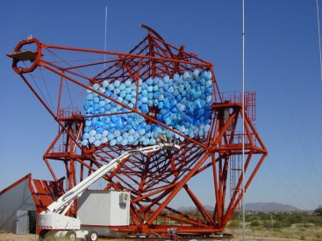
Highlights from the Czech Team
Funding awarded for Axion Detection by Laser-based Experiments from Czech Science Foundation (March 2011 – December 2013)
Participants and main responsibilities
  Technical University of Liberec, Department of Physics, Qualification of optical elements of FP cavities for VMB measurement
  Czech Technical University in Prague, Department of Precision Mechanics and Optics, production and measurement of high finesse FP cavity
  Charles University in Prague, Faculty of Mathematics and Physics , Department of Low Temperature Physics, provides a new CCD for the Photon Regeneration Experiment
  + R&D for new detectors
Examples of contributions
  Ring Imaging Cherenkov Detector
  HESS Mirror Telescopes (High Energy Stereoscopic
  System for the
  investigation of
  cosmic γ rays
  in the 100 GeV range)

Slide 12
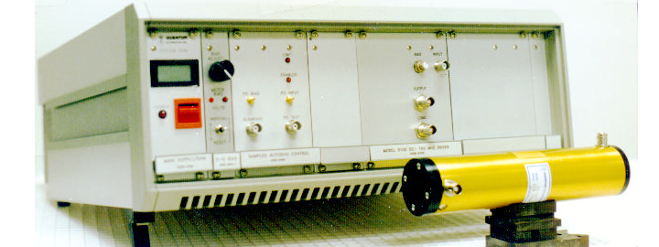
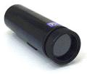
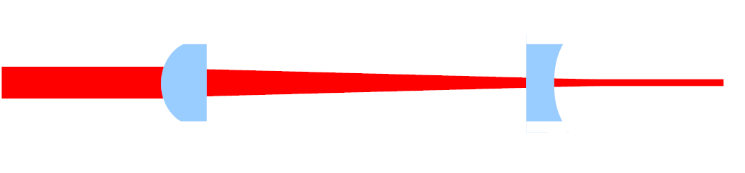
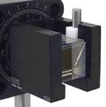
Preparatory Phase for the VMB Measurements in Czech Universities
The rotating half-wave plate of the initial optical set-up will be replaced by an electro-optical modulator to increase the modulation frequency from 100 Hz up to ∼ 50 MHz ⇒ signal to noise ratio will be x1000
Two Melles Griot Beam Expander 09LBM015 for small beam divergence in LHC magnet pipes
Two Glan-Taylor prisms PTYL-10.0-425-675 with extinction
ratio 5·10⁻⁵ for more precise setting of light polarization
EOM Quantum Technology, Inc, USA,
Model 3050
Standard Aperture 2.5 mm
Extinction Ratio 500:1 (633 nm)

Slide 13
VMB & Linear Dichroism measurements to test QED & Search Axion/ALP: Principle & Proposed Optical Scheme
Axions ⇒ Change of the linear polarisation of a laser beam after propagation in the vacuum with B transverse :
  Elliptical
  “Pseudo”-rotation
Background for the ellipticity coming from the QED VMB
⇒ Physics is guaranteed
Very small effects
~10⁻¹⁴ rad / T² km³
⇒ optical cavity to increase the path in B
P. Pugnat, L. Duvillaret, M. Finger, M. Kral , A. Siemko, J. Zicha
Czechoslovak Journal of Physics, Vol.55 (2005), A389;
Optical scheme with inputs from D. Romanini.
CERN-SPSC-2006-035
Phase 1
VMB ~10⁻¹⁴ rad / T² km
Field Modulation at 1-10 mHz
& dedicated filtering techniques
L. Maiani, R. Petronzio, and E. Zavattini, Phys. Lett. 175B (1986) 359

Slide 14
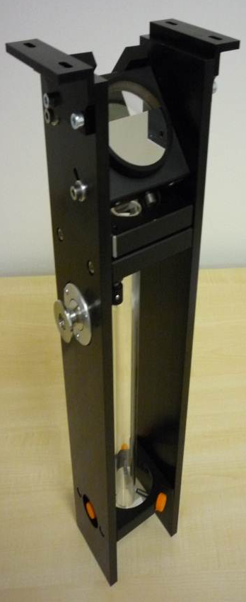
Preparatory Phase for the VMB Measurements in
Czech Universities
Prototyping of resonant high finesse cavities have just started
Conception & design
The light will be locked inside the cavity by using the Pound-Drever-Hall lock-in technique
The cavity mirror holder have to provide 5° of freedom, very high precision of adjustments & long-term stability
Elastic joint with integrated piezo-ceramics driver
CTU Prague will build a 1 m long cavity for 632.8 nm He-Ne laser
TU Liberec will build a 30 cm long vacuum cavity

Slide 15
VMB measurement – The key problem to solve : How to get rid of the birefringence & dichroism of the optical cavity ?
In the OSQAR proposal (CERN-SPSC-2006-035 , SPSC-P-331)
In 2009, complementary approach proposed by OSQAR LASIM (SPSC-SR-053-2009)
Active compensation method based on MOKE + field modulation (10 mHz)
Use residual mirrors birefringence as
optical bias for homodyne detection
From SPSC-SR-053 | Expected sensitivity
10 hours of time integration | 10⁻¹³ rad
Cavity in transmission instead of reflection | 2∙10⁻¹⁴ rad
Optimized mirrors in the long cavity | 2∙10⁻¹⁵ rad
Optimized electronics | 10⁻¹⁵ rad
θ_{out}
y
B
x
θ_{in}
φ_{out}
φ_{in}
VMB ~10⁻¹⁴ rad
Key issue: Maintain the high finesse of the cavity during the synchronous rotation of the mirrors around their optical axis

Slide 16
VMB Measurements : Unique opportunity with LHC dipole(s)
Experiment | BFRT | PVLAS | BMV | OSQAR
Status | Terminated | Achieved | Achieved/ Phase-1/Phase-2 | Phase-1/Phase-2
λ (nm) | 514.5 | 1064 | 1064 | 1550
Finesse of the FP cavity | N ~250 | 10⁵ | 5.10⁴/6.10⁵/10⁶ | 10⁴/10⁵
Sensitivity (rad/Hz^{1/2}) | 4.10⁻¹⁰ | 10⁻¹¹ | 10⁻⁹/10⁻¹⁰ | 10⁻¹³/10⁻¹⁵
B (T) | 4 | 6 | 14.3 (during 0.1 s) | 9.5
B² l (T² m) for QED Test | 140 | 36 | 28 | 1 290
B² l² (T² m²) for ALPs Search | 1 240 | 36 | 4 | 18 460
B² l³ (T² m³) for ALPs Search | 10 900 | 36 | 0.5 | 263 910
Magnetic duty cycle (R)* | ~1 | ~1 | 10⁻⁴ | ~1
Also Q&A collaboration has reported in 2007 a sensitivity of 4∙10⁻¹¹ rad/√Hz with a cavity of finesse equal to 30 000 and a modulation frequency of 10 Hz

Slide 17

Photon Regeneration Runs
K. van Bibber et al. PRL 59 (1987) 759
P. Sikivie, PRL 51 (1983) 11415
Exclusion limit for | g_{Aγγ}
B (T) | B⁻¹
Magnetic Length (m) | L⁻¹
Optical power (W) | P^{-1/4}
Detection threshold (γ/s) | dN_{γ} /dt ^{1/4}
Time integration | Δt^{-1/8}

Slide 18

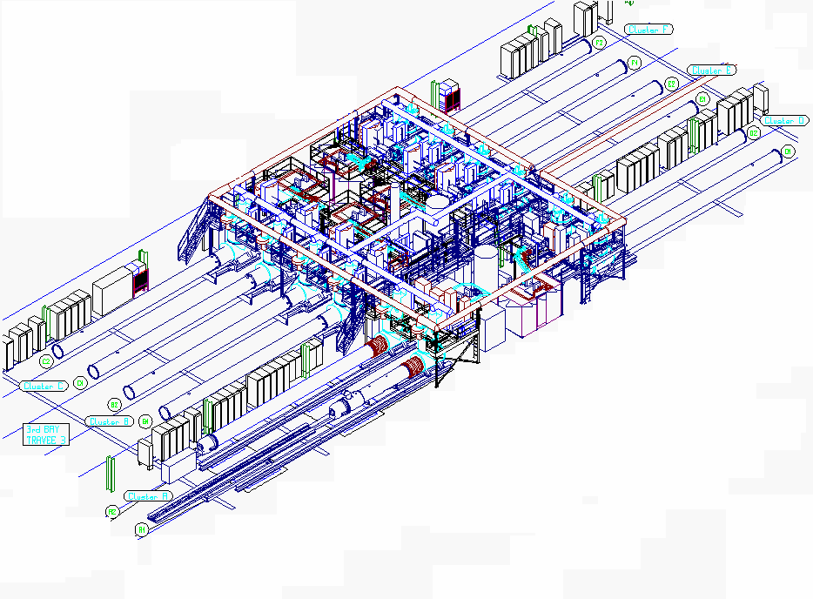
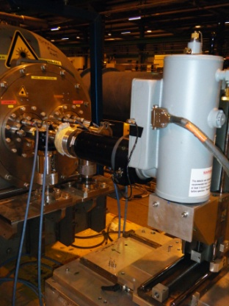
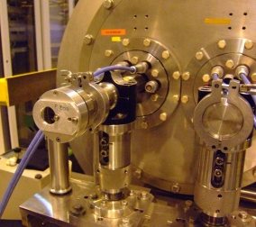
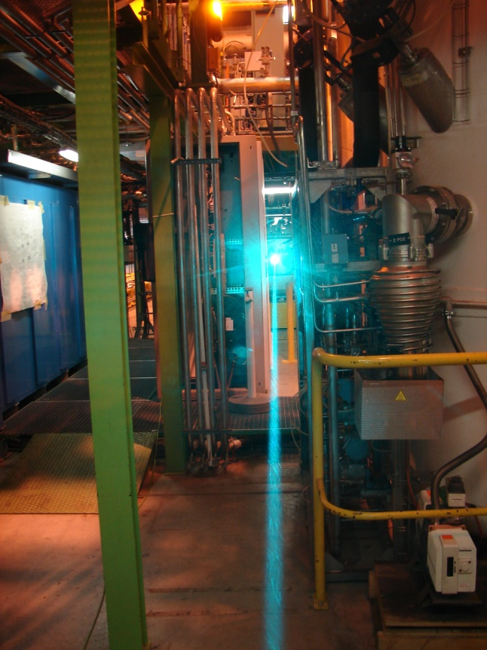
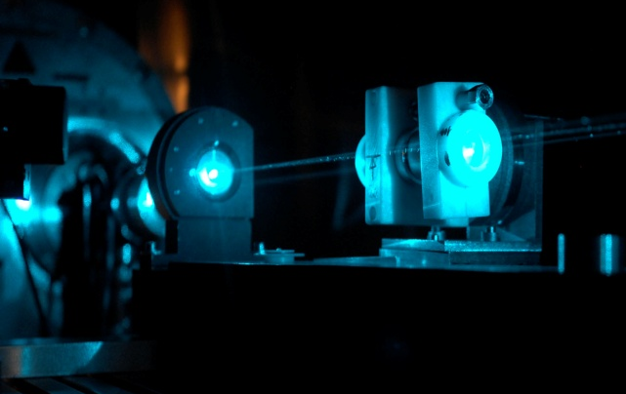
Photon Regeneration
► 1st operation in 2010 with 2 aligned LHC dipoles
“An invisible light shining through a wall”
K. van Bibber et al.
PRL 59 (1987) 759
F
F
E
E
53 m
D
E1
D
B1
C
C
B
B
A
A

Slide 19
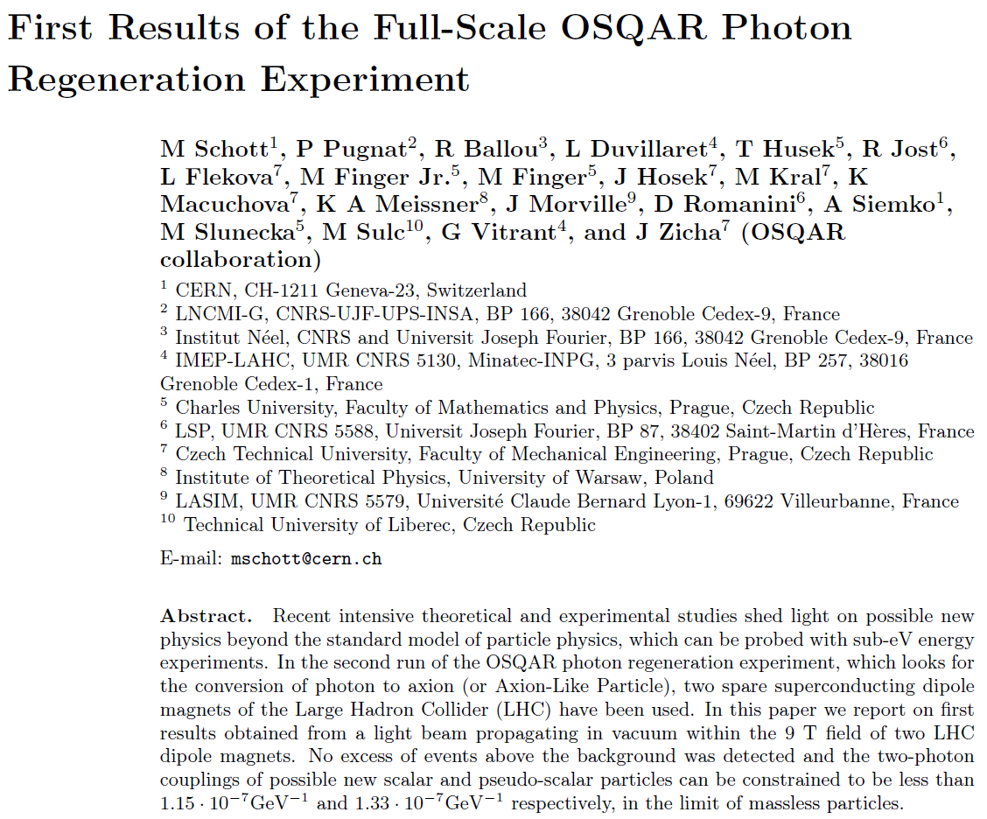
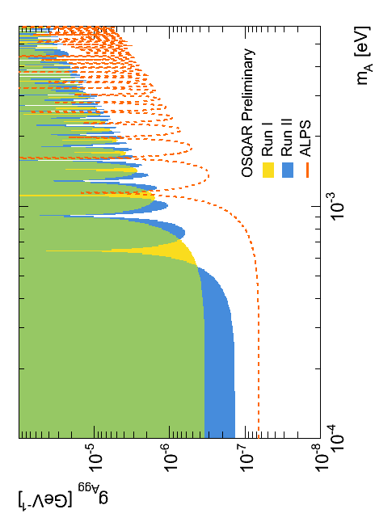
2010 results submitted for publication
arXiv:1110.0774v3
► The targeted sensitivity of 2009 (SPSC-M-770) has been reached

Slide 20

Overview of the experimental runs in 2011
Period | OSQAR configuration | Data acquisition runs
20 June – 1 July | Photon Regeneration ► 2 LHC dipoles temporary used at 9T ► Ar+ laser with linear polarization // and ⊥ B | No validated data because of the improper functioning of the CCD Study of the stability of the laser beam alignment
6 July- 12 September | Shutdown of the cryogenics at SM18
19 - 23 September | Photon Regeneration ► 2 LHC dipoles at 9 T ► New CCD ► Ar+ laser with linear polarization // and ⊥ B, maximum power of 3 W only… | Cumulative time integration of validated data ► 28.5 h for pseudo-scalar search ► 24 h for scalar search ► 10 h for background
14 - 20 November (planned) | Photon Regeneration ► 2 LHC dipoles at 9 T ► New CCD ► Ar+ laser with linear polarization // and ⊥ B

Slide 21

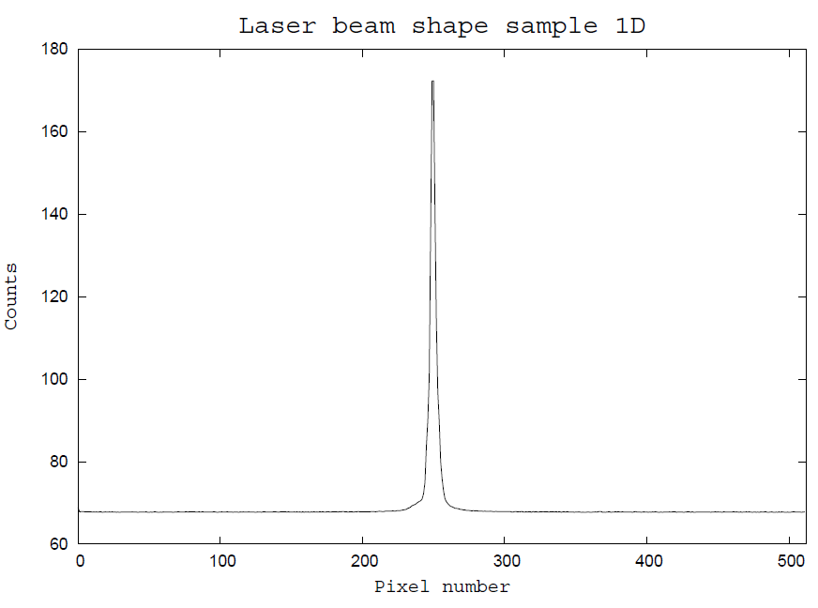
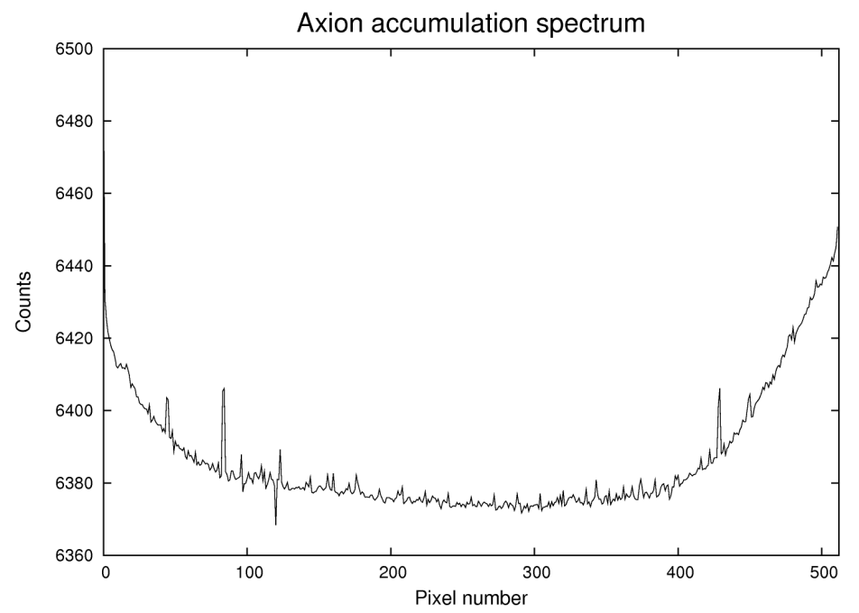

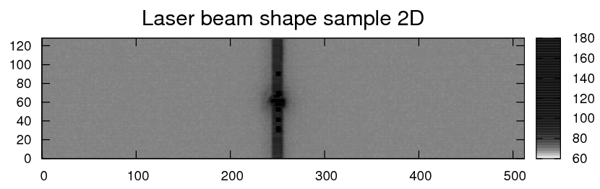
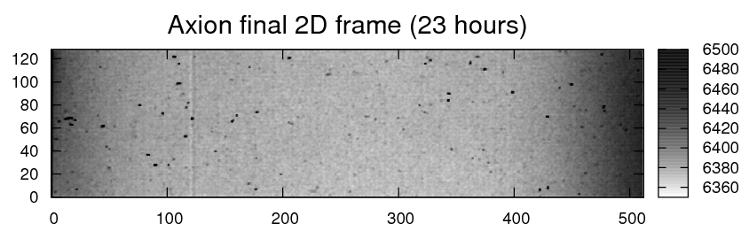
Exemple of data from the New CCD
LN/CCD-
1024E/1
- Lowest read noise in the industry
Lowest dark current using cryogenic cooling
QE ~ 30 % at 488-514 nm
Spurious signals coming from cosmic rays
⇒ Optimisation of the CCD use 1D vs. 2D
CCD chip, EEV 1024 × 256 square
pixels of 26 μm, 26.6 x 6.7 mm

Slide 22
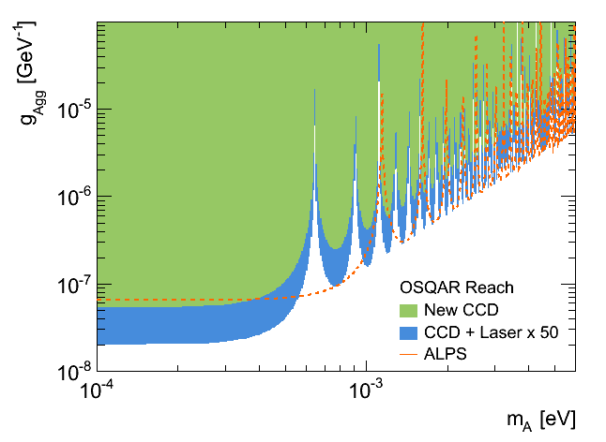
Expected Exclusion Limits for 2011/12
The targeted sensitivity (SPSC 2010)
► To improve ALPs limit by x5
Assumptions
- 24 h of time integration
- Larger Optical power
- New CCD with background reduction of 50
Expectation
► On the way, despite of the fact the laser starts to show some weaknesses (P ≈ 3 W instead of 6 W in 2010)…

Slide 23
How to further improve the sensitivity ?
R&D program at the Charles University in Prague (Faculty of Mathematics and Physics) to develop single-photon counting systems with
  extremely low background
  high energy resolution
Transition Edge Sensors (TES) are promising; TES basically consists of a thin superconducting film deposited on an absorber. The film is held at the transition edge between normal and superconducting phase, preferably in the milli-K temperature range with a dilution ³He-⁴He refrigerator. An excess of energy deposited in the absorber by the incident particle causes the film to steeply increase its resistance generating a signal that can be detected by low noise SQUID readouts.

Slide 24
Summary, Perspectives & Requirements for 2012
The potential discovery of the OSQAR-PR was significantly improved since 2010 with the simultaneous use of 2 LHC dipoles
providing 9 T field over 2 x 14.3 m
The new CCD will allow to further improve the sensitivity for pseudoscalar & scalar search in 2011 & 2012
The sensitivity is on the way to reach the foreseen target presented to the SPSC in 2010
OSQAR-PR limitations due at present to the :
- Reduced optical power of the laser, which starts to show some weaknesses…
Perspectives for 2012 & 2013
- To break the OSQAR-PR limitations
► Increase the time integration
► Extend the laser cavity up to 20 m
- This, to improve the exclusion limits for pseudoscalar & scalar search by about one order of magnitude
- To develop a first prototype of a rotating Fabry-Perot cavity for the VMB measurement
Requests for 2012
- 2 LHC dipoles at 1.9 K for 6 weeks in total (1 period of 2 weeks & 4 periods of 1 week each)

Slide 25
Acknowledgements
The OSQAR collaboration would like to thank
The management of CERN-TE department for continuous support
The CERN teams of the SM18-test hall (MSC-TF, CRG-OD, RF-KS) for their valuable technical contributions and inputs
The CERN safety unit (HSE) for advices.

