Slide 1



Academia meets industry
The LHCb Experiment and the LHCb Upgrade
Paula Collins
CERN

Slide 2
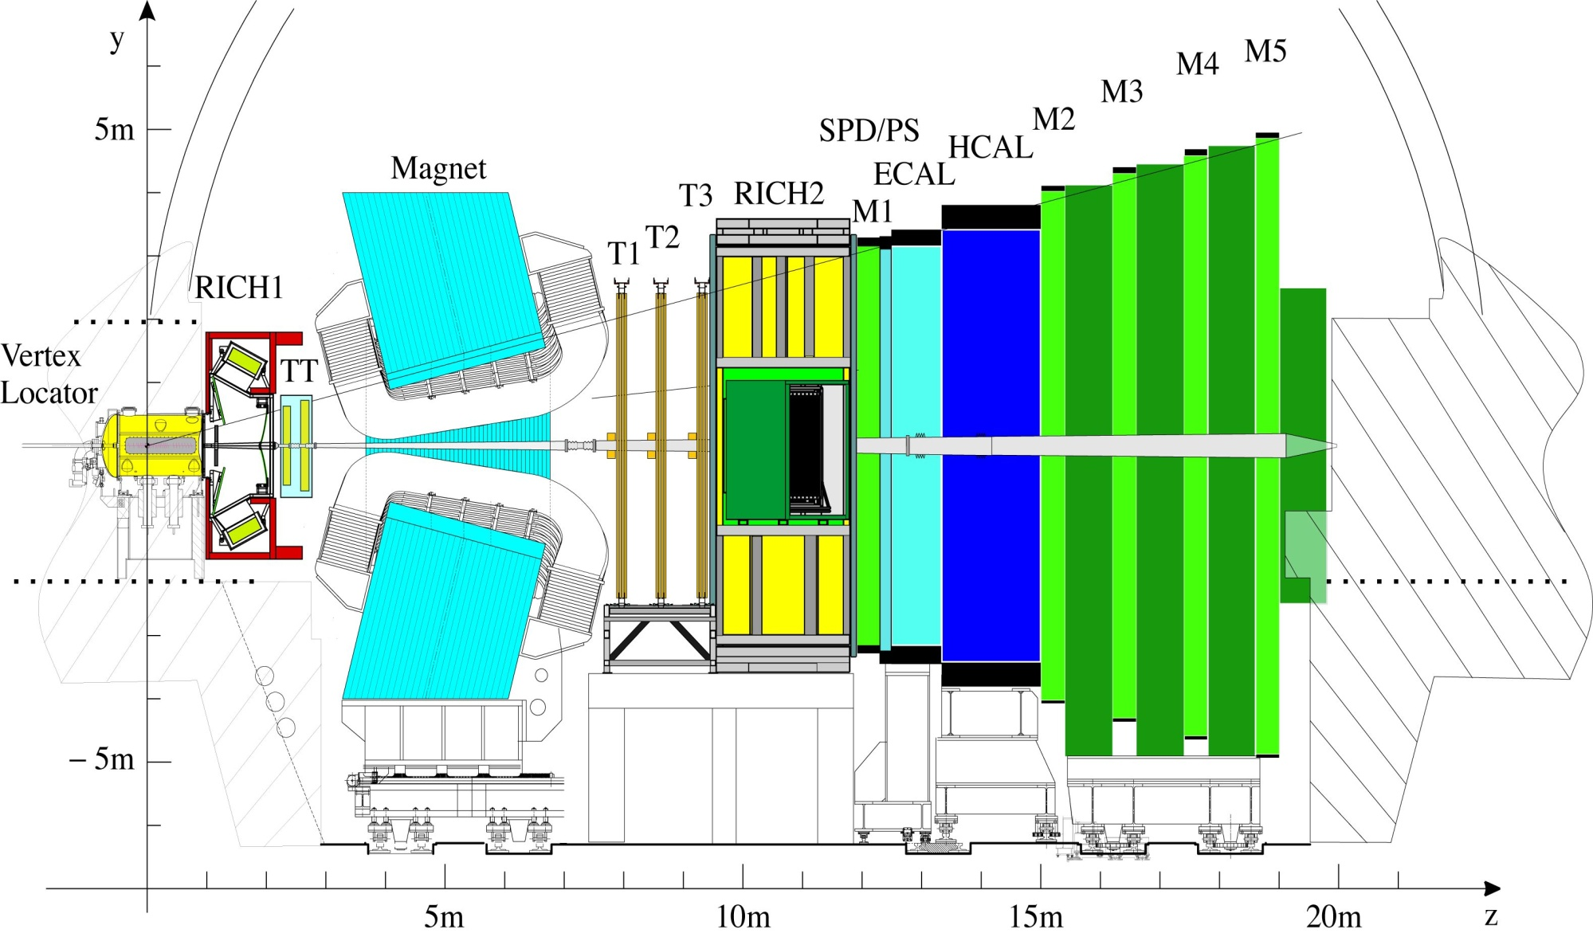
The LHCb Detector
Ecal, Hcal
Shaslik & Tilecal
with MaPMT readout
RICH
HPD + Si-pixel
Muon
MWPC
VELO
Si strips
Trackers TT,T1,T2,T3
Outer region: straw tubes
Inner region: Si strips
Academia Meets Industry - LHCb
26th March 2012 – Paula Collins
Notes:
VELO = Vertex LOcator

Slide 3
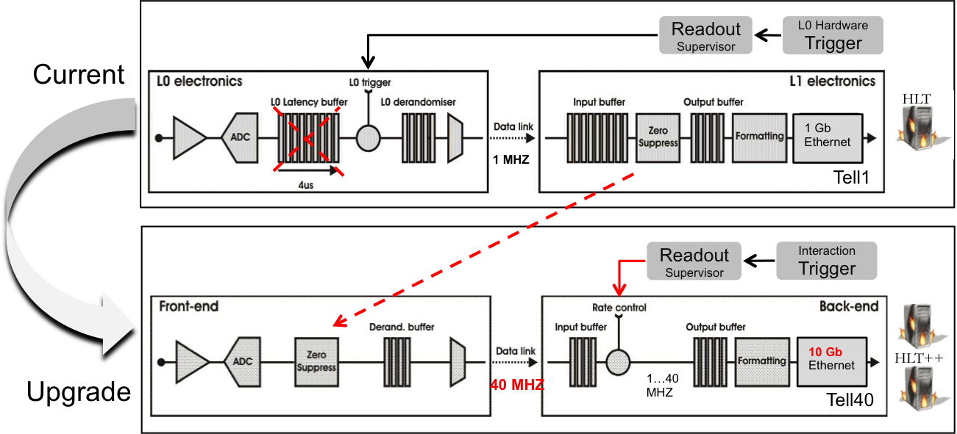
LHCb upgrade
In 2018 LHCb will upgrade the entire detector to a full 40 MHz readout
  Complete replacement of all silicon modules with new electronics and sensor designs
  Complete replacement of all photon detectors with possible new photon detector functionality
  A new DAQ system capable of transferring all zero suppressed front-end data straight into a large computer farm through a huge optical network and router
Academia Meets Industry - LHCb
26th March 2012 – Paula Collins

Slide 4
Talk outline
Environmental conditions of the current VELO detector
Modifications and additions needed for upgrade
  Sensor design; slim edges, HV tolerances, pixel and strip design, narrow pitches, pixel bump bonding
  Cooling structure: Microchannel cooling option
Other LHCb tracking detectors;
  Wide pitch bonding for lightweight silicon structures
  Custom patterning and cutting
Photon detectors for LHCb upgrade
Academia Meets Industry - LHCb
26th March 2012 – Paula Collins

Slide 5
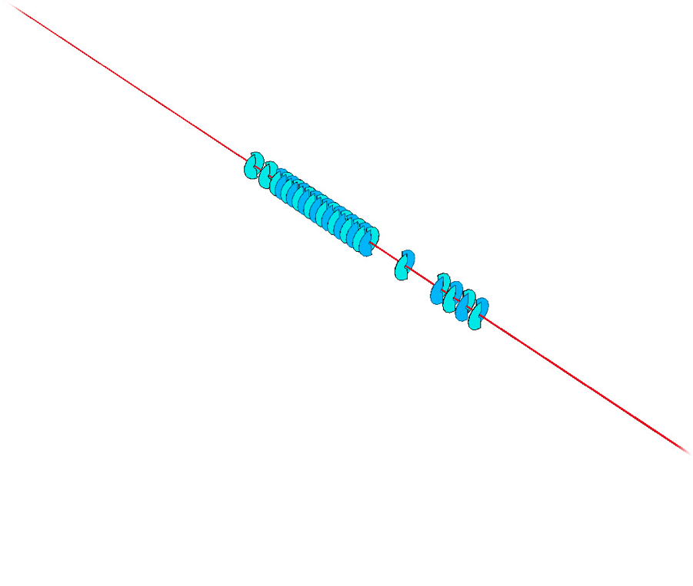
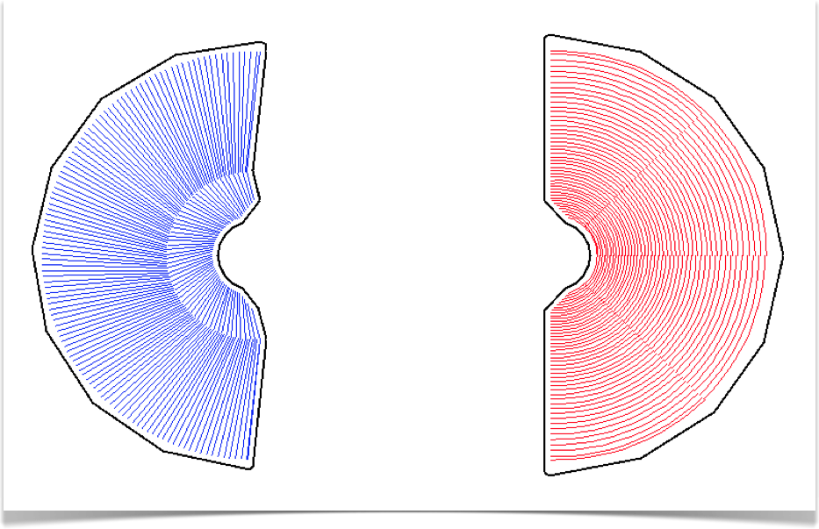


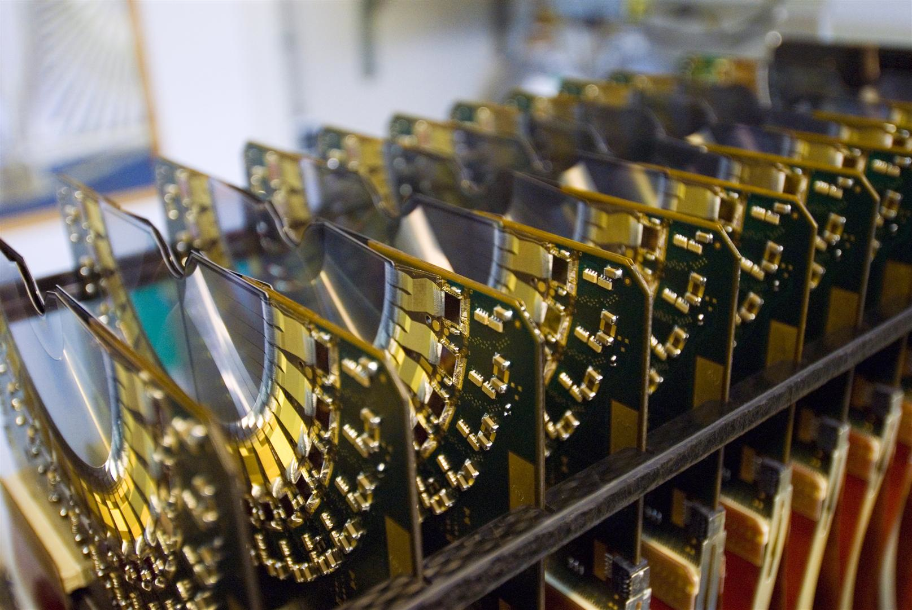
VELO: Semi-circular silicon detectors
R-φ design
300 μm, n⁺n Si
2048 strips
ractive = 8.2mm
pitchmin = 40 μm
21 R-φ planes.
p
1 m
p
4

Slide 6
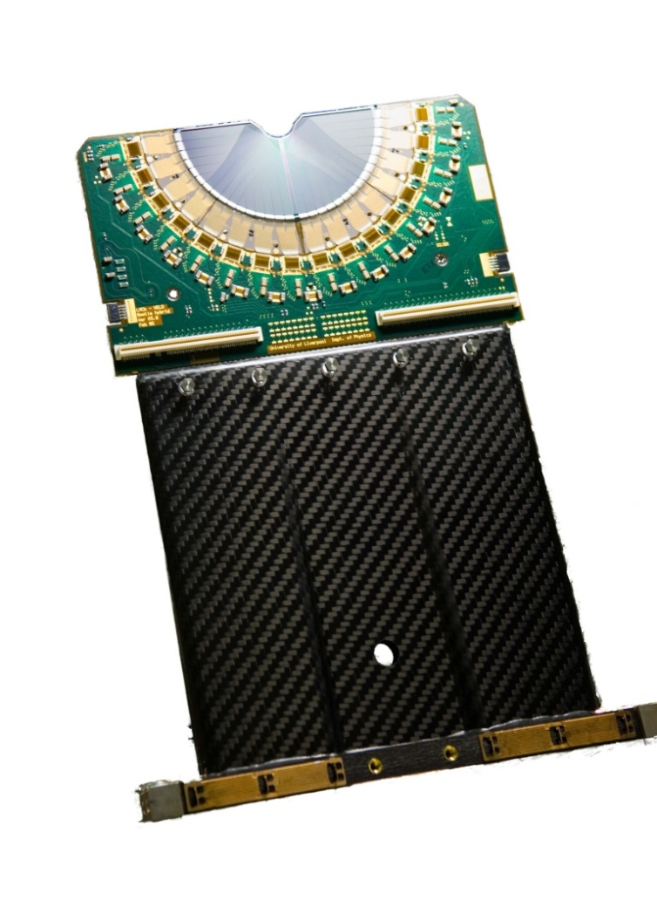
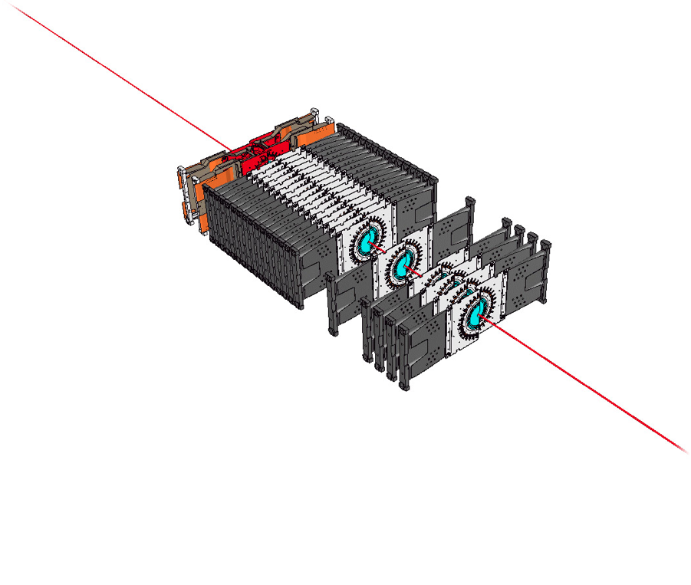
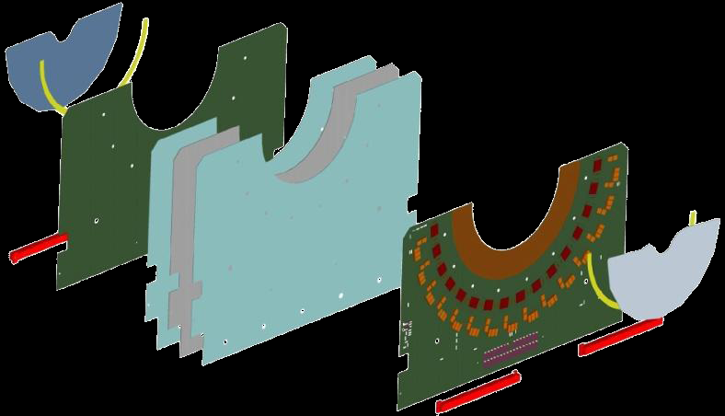
Hybrid circuit and rigid carbon paddle
16 beetle
readout asics
Rigid carbon
fiber paddle
Tpg cooling spine
Carbon fiber reinforcement
Sensor
Kapton multilayer circuit
7

Slide 7


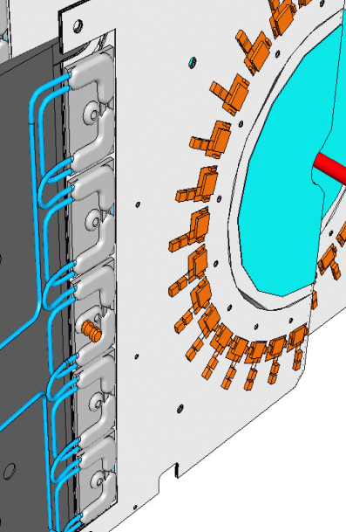
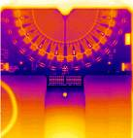
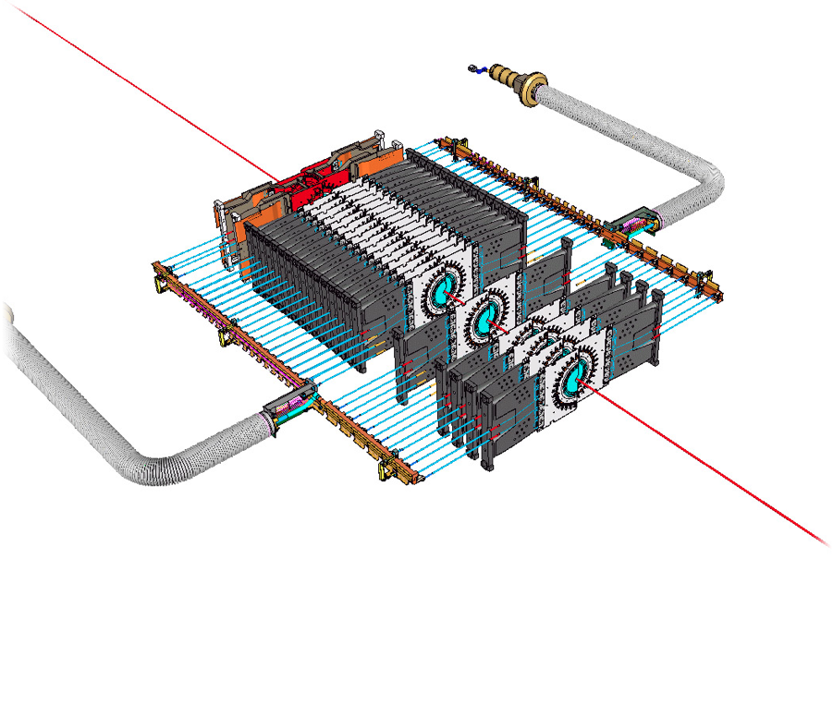
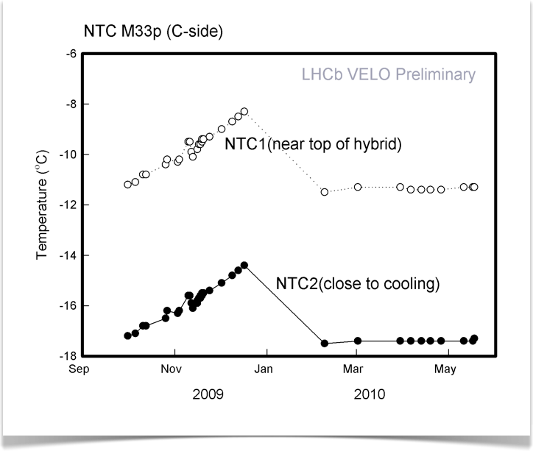
Cooling system : evaporative CO₂
-18◦C
-12◦C
18 Watt power
dissipation
Academia Meets Industry - LHCb
26th March 2012 – Paula Collins

Slide 8
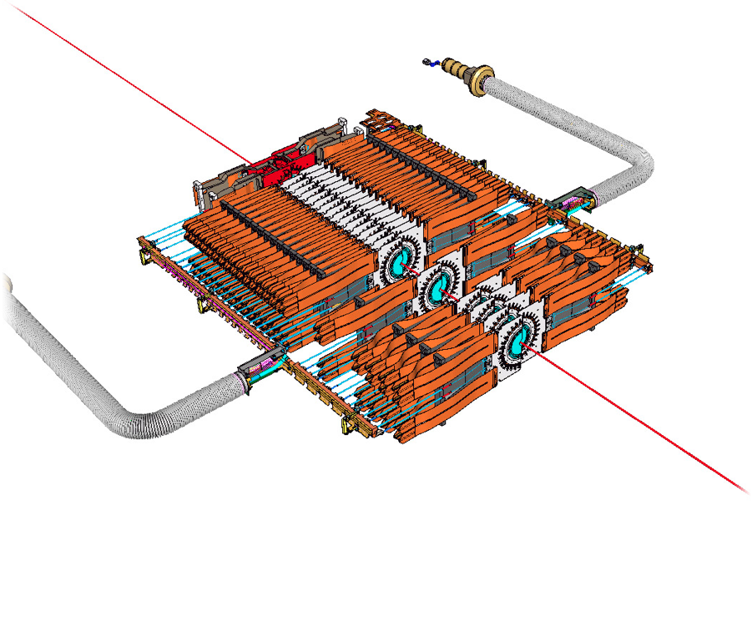
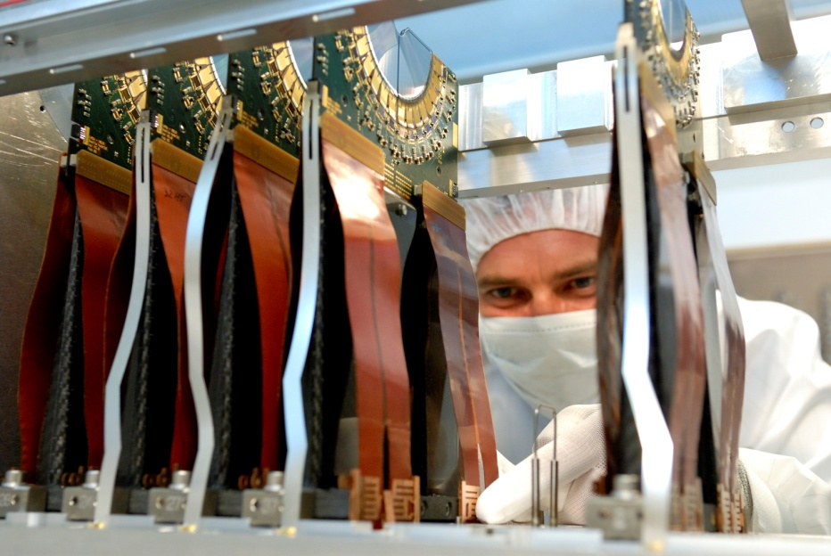
Short kapton cable: signal & power
Academia Meets Industry - LHCb
26th March 2012 – Paula Collins

Slide 9
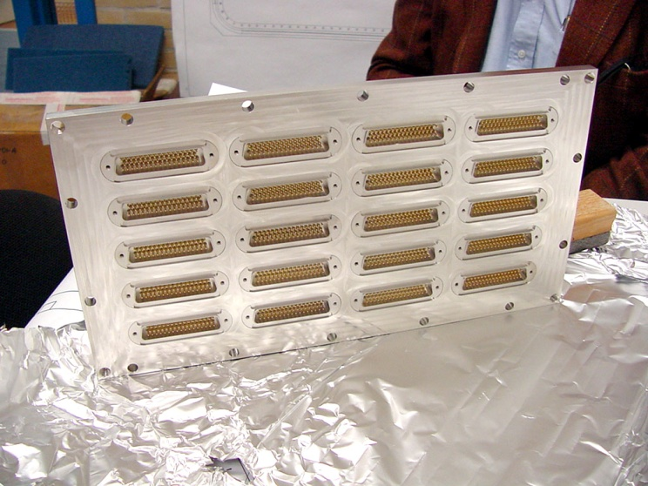
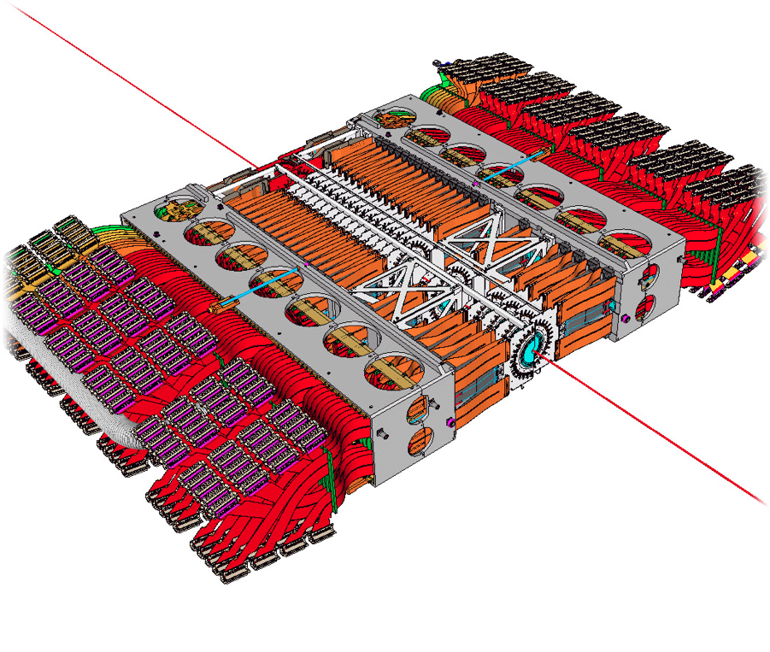
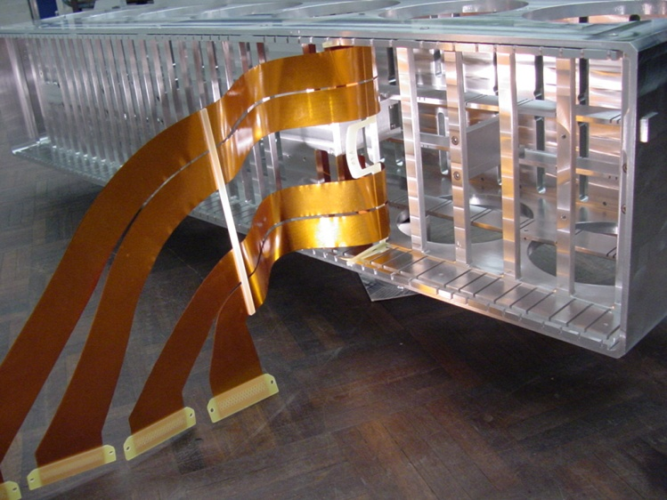
Module support and cabling to vacuum wall
24000 vacuum
Feed-through pins

Slide 10
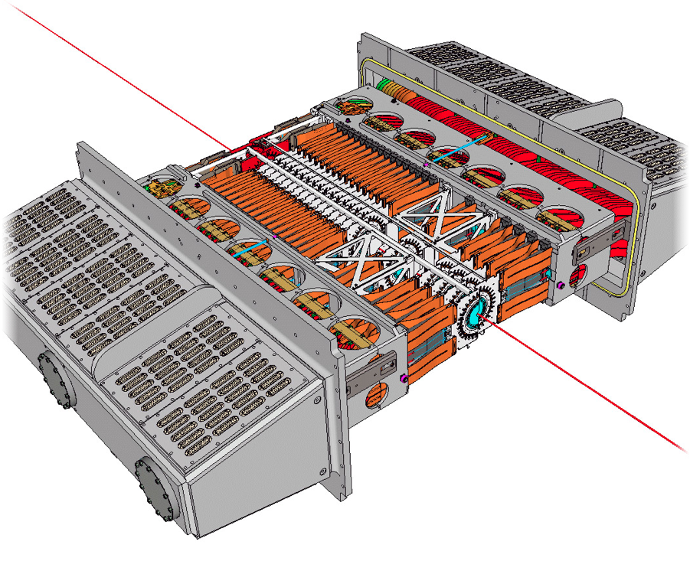
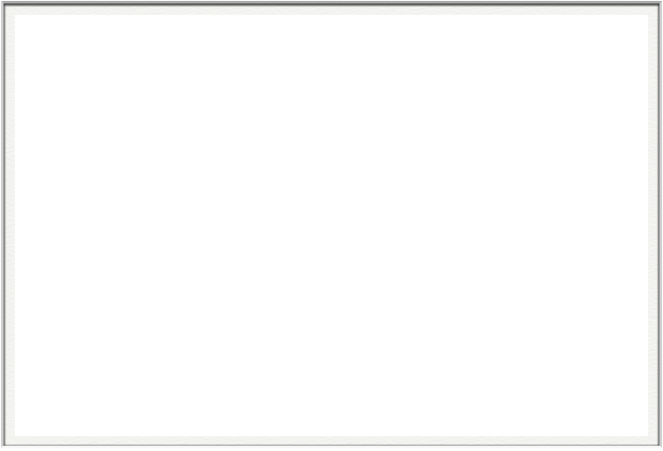
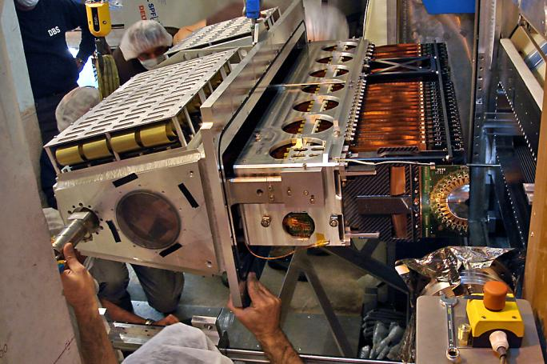
Vacuum-tight enclosure.

Slide 11
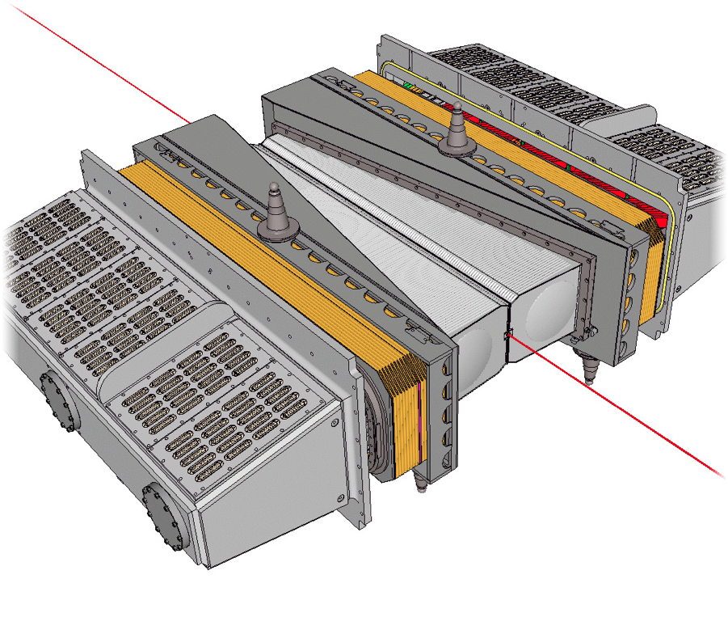
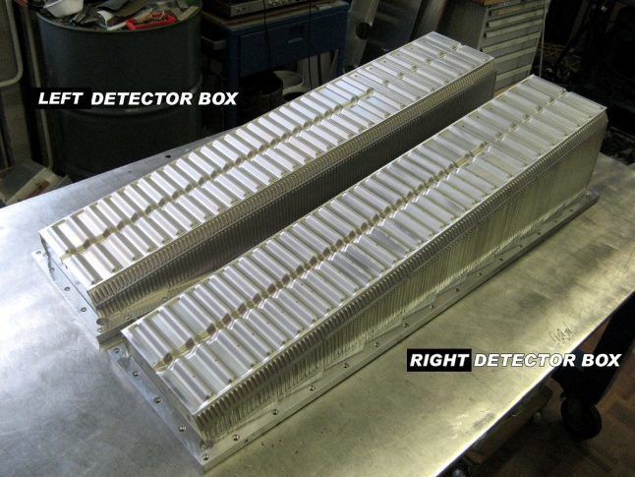

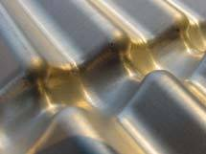
Detector box & RF foil
Detectors are entirely contained within a secondary vacuum (~10⁻⁷ mbar) seperated from the primary beam vacuum (<10⁻⁹ mbar)
RF pick-up from the passing beam is guarded against with a ~300μm-thick aluminium foil.

Slide 12
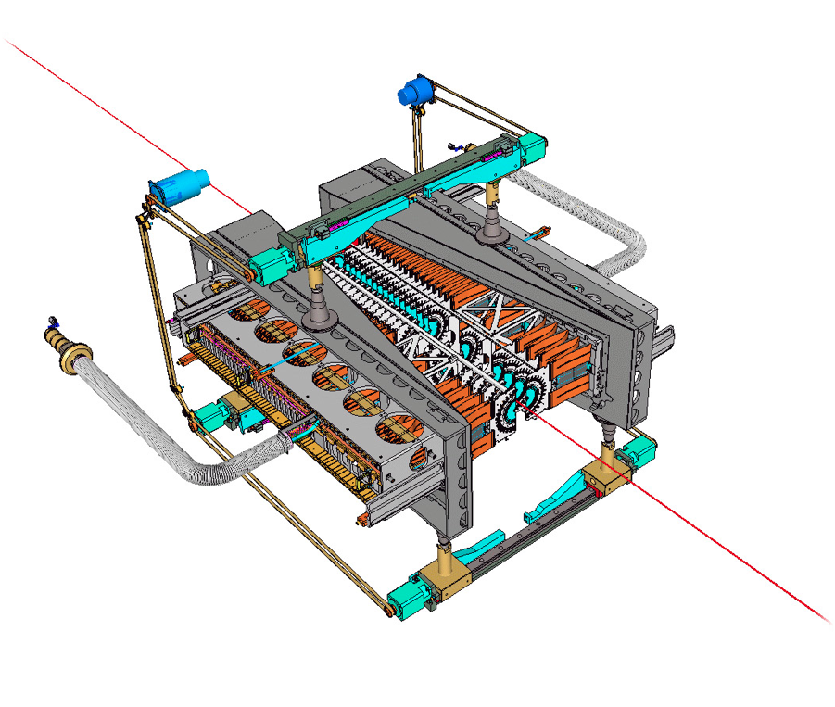
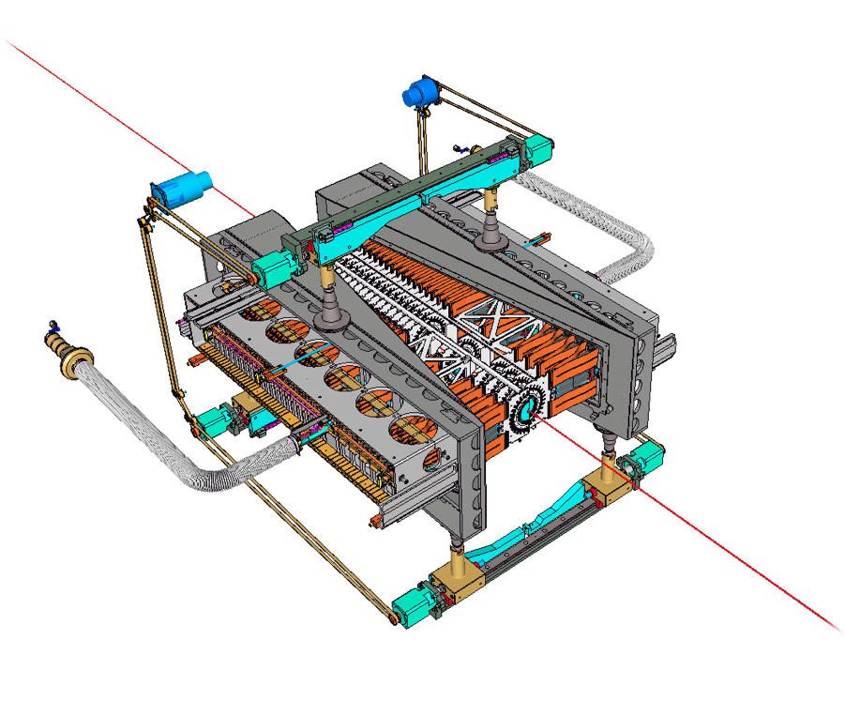

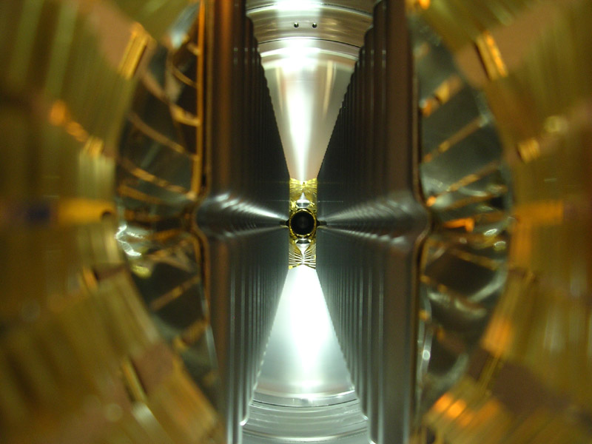
And the VELO moves …
At all times other than “STABLE BEAMS”, the VELO sits back ~3 cm from beam-line.
Beam’s eye view of the open VELO
Academia Meets Industry - LHCb
26th March 2012 – Paula Collins

Slide 13
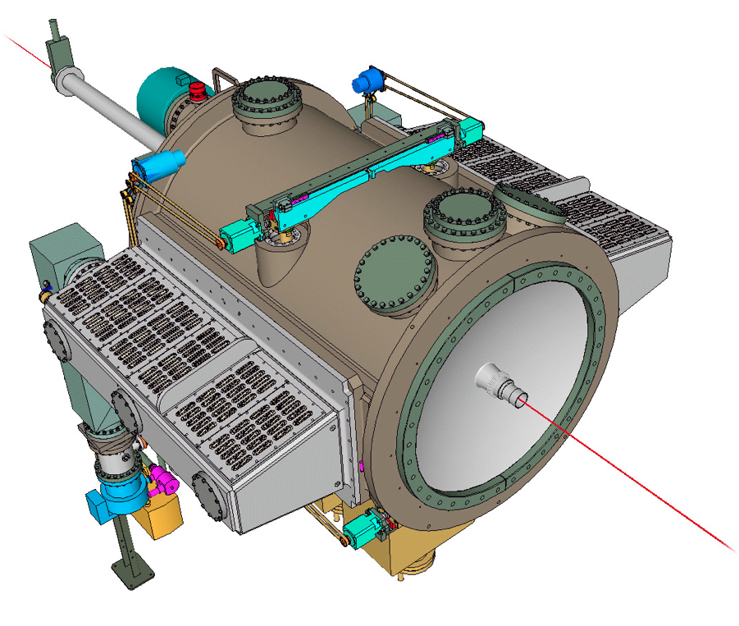
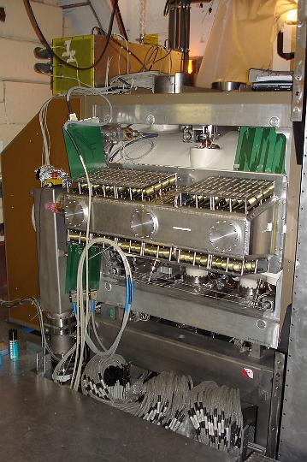
The VELO is part of the LHC ring.
Academia Meets Industry - LHCb
26th March 2012 – Paula Collins

Slide 14
VELO requirements
Future
  Maintain lightweight structure with increased power consumption and complexity
  Evaporative CO2 cooling
  Factor 10 improvement in Radiation hardness
  Vacuum compatibility
Past
  Lightweight structure
  Evaporative CO2 cooling
  Radiation hardness
  Vacuum compatibility

Slide 15
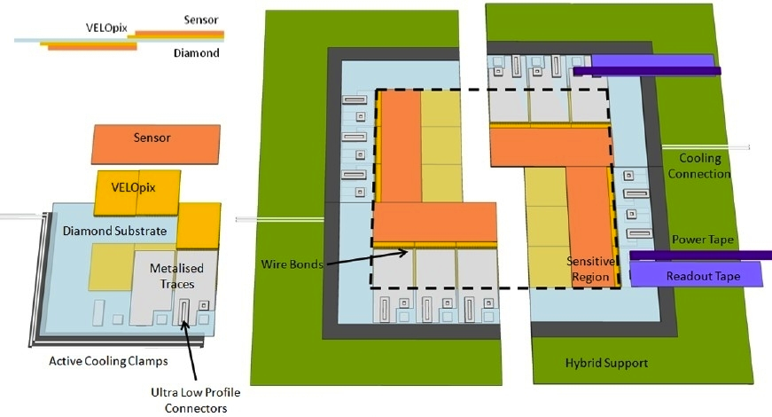
Pixel module upgrade concept

Slide 16

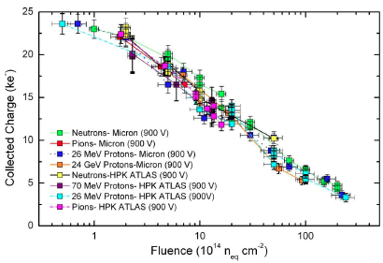
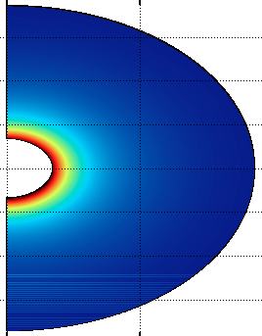
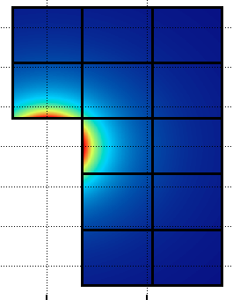
Radiation Environment
At 7 mm from beam we accumulate ~ 370 MRad or 8 x 10¹⁵ n_{eq}/cm² for 100 fb⁻¹
RD50 studies have shown that silicon irradiated at these levels still delivers a signal of ~ 8ke⁻ / MIP
Limit of strip sensor operation
Thermal runaway a potential issue
R&D has to go hand in hand between academia and industry – hard to guarantee performances
Dose is highly non-uniform – could pose a challenge, particularly for large sensors
factor 1/7
factor 1/20
factor 1/30
factor 1/20
Notes:
Design must guarantee protection against thermal runaway

Slide 17
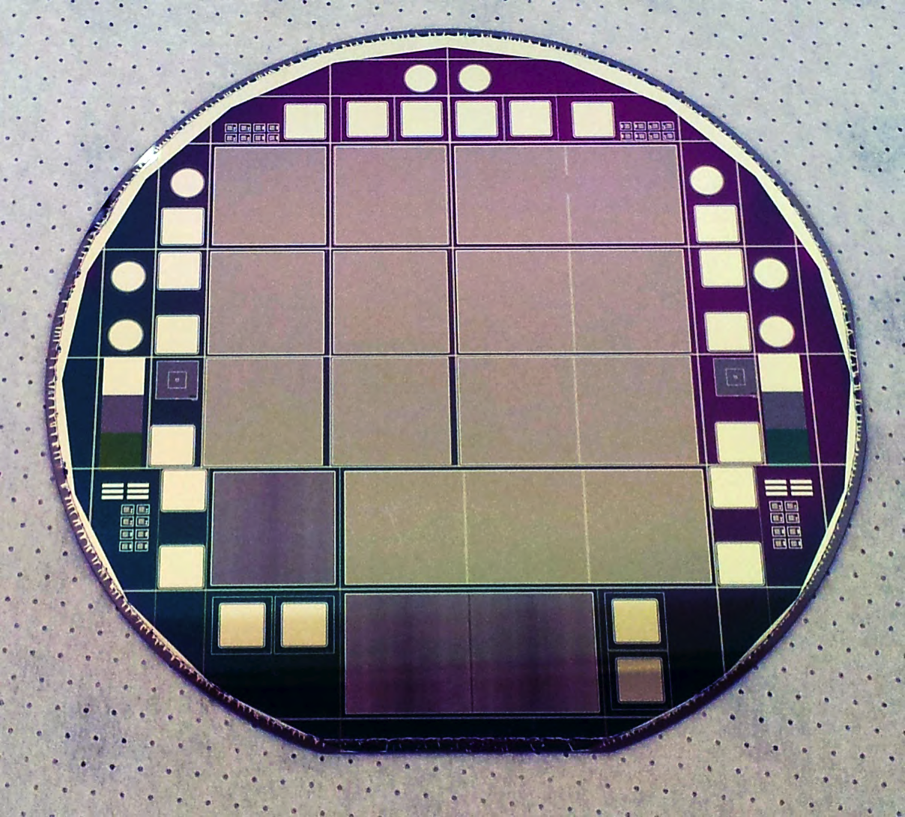
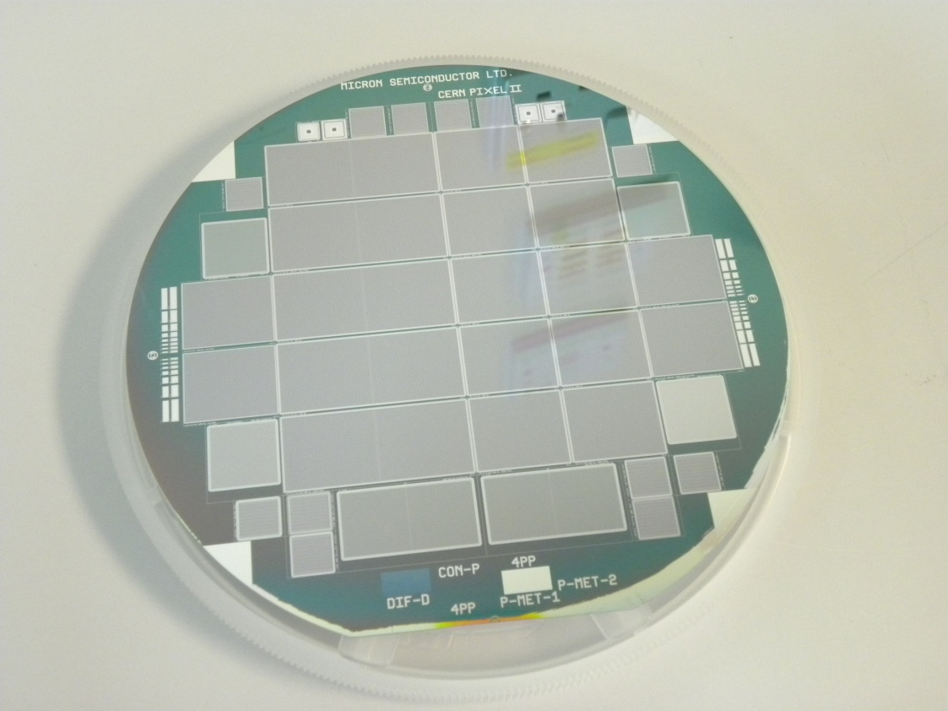
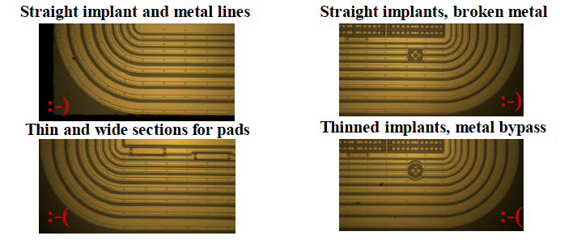
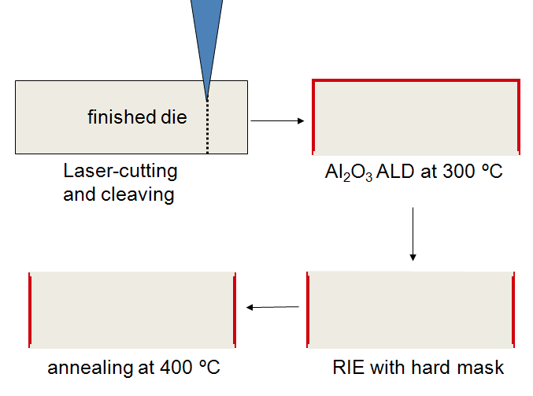
Sensor designs - radiation hardness
CNM
Micron
Benefit from GR design considerations
  Probe pad structures
  Alignment marks
  Scribing distances
  Sensor thickness dependence etc
.Edge passivation also an option
  Laser scribe and cleave sensors
  Deposit passivation layer on sidewall with Atomic Layer Deposition ALD
  Choice of AlO₃ for p bulk, SiO₂ for n type bulk
Academia Meets Industry - LHCb
26th March 2012 – Paula Collins

Slide 18
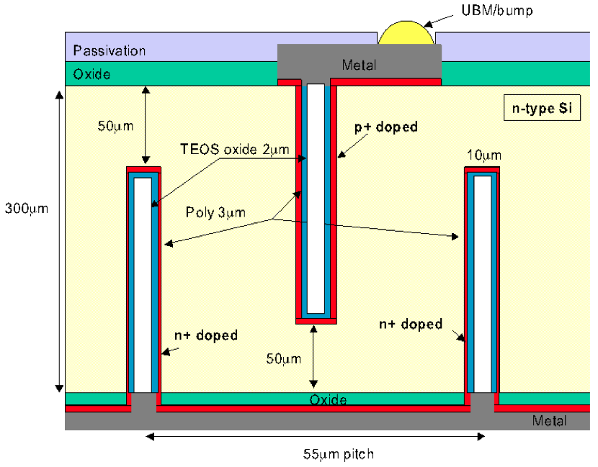
Pixel sensor designs - 3d sensor substrate
Array of electrode columns passing through substrate
Electrode spacing << wafer thickness (e.g. 30μm:300μm)
  V_{depletion} (Electrode spacing)²
  Collection time Electrode spacing
  Reduced charge sharing
More complicated fabrication - micromachining
Simplified 3D structures tested for LHCb
N- and p-type columns etched from opposite sides of substrate
  Columns do not pass through full substrate thickness
  e.g 250μm deep in 300μm substrate
Greatly improved yield, multiple successful runs
Geometry matches LHCb requirements
Academia Meets Industry - LHCb
26th March 2012 – Paula Collins
Notes:
New kinds of detectors from high radiation silicon
Micromachined silicon detectors enable a step forward in performance combining traditional vlsi processing with mems techniques
Deep reactive ion etching (electrodes definition) Bosch process
SiF4 (gas) +C4F8 (teflon)
Low pressure chemical vapr deposition (filling electrodes with doped polysilicon)
Active edge
Decouples detector thickness and charge collection
Fast charge collection and low bias voltages
Holes can be fabricated with 20:1 aspect ratio

Slide 19
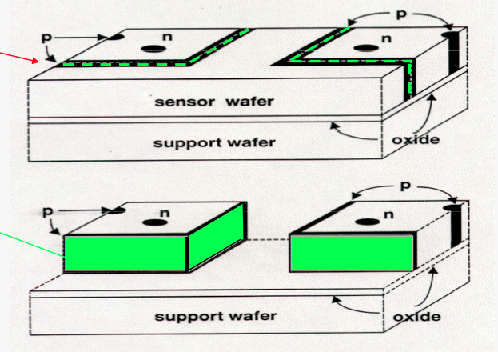
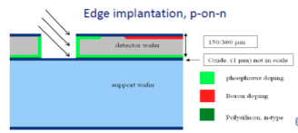
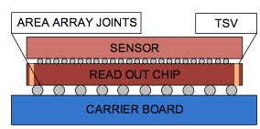
Sensor Designs - Efficiency & Material
Slim edge processes
  Natural overlap with 3d sensor designs
  Edgeless fabrication process
Sensor thinning
  Successfully employed by ALICE: 200/150 μm for sensors and ROCs
  Less is acheivable: Temporary bonding tapes, electrostatic support wafers etc.
  Handling/bondingMechanical stresses, bowing etc.
Interconnection techniques
  Close packing greatly simplifies module design
  Steps along the road to true 3d integration
VTT
Academia Meets Industry - LHCb
26th March 2012 – Paula Collins
Notes:
3d – a trench is etched and doped to terminate the field lines
After the full process is completed the material surrounding the sensor is etched away and the support wafer removed – no sawing avoid chips and cracks
VTT edgeless fabrication process

Slide 20
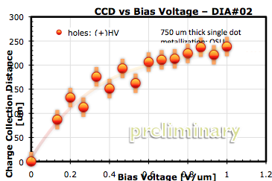
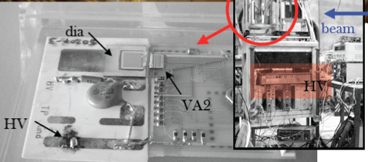
Pixel sensor designs - diamond sensor substrate
Diamond is a very promising material for the most irradiated sections of the LHCb VELO sensor upgrade
  Low leakage current
  Very radiation hard (can overcome initial small signal)
  Excellent mechanical characteristics
Sensor development:
  even for relatively large scale production the cost needs to go down & capabilities to handle large orders need to be validated.
  Desirable to produce single crystal quality diamonds in larger size (e.g. http://www.sciencedirect.com/science/article/pii/S0925963511000045)
  Thinning and polishing sometimes alters properties of the crystal (leakage current, lower maximum operating voltage)
Hybridization:
  Need to develop standard hybridization process, issues different than Si (some steps may graphitize the surface⇒short between pixel element).
  Industrialization of the process (more companies need to develop standard procedure).
Academia Meets Industry - LHCb
26th March 2012 – Paula Collins
Notes:
Challenges: industiralisation of the process, surface treatment, understand pumping
Quality of single crystal diamond can be good, but surface currents can develop as a result of processing/polishing etc.

Slide 21
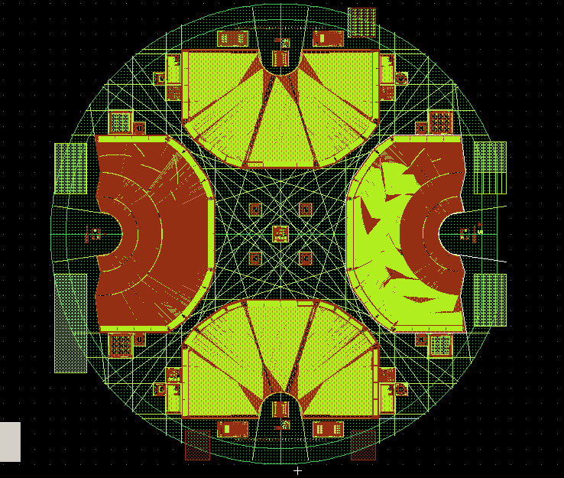
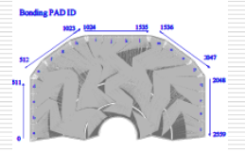
Strip sensor designs
Strips offer a lightweight design with sensitive area tailored for close approach to beams
Driving factor in design – occupancy
  Maintain current occupancy at 1%, even at 10 times higher luminosity
  Achieved by decreasing minimum strip pitch and increasing number of channels
  Complexity linked to strip chip design: FE chip must perform common mode correction and zero suppression
  Complex double metal layer to match chip design (radiation hardness issues)
  Challenges for manufacturing
    Thin, relatively large sensor
    Very close via placements
    Narrow pitches (25 μm would be idea)
    Guard ring designs to accommodate non uniform irradiation
Academia Meets Industry - LHCb
26th March 2012 – Paula Collins

Slide 22
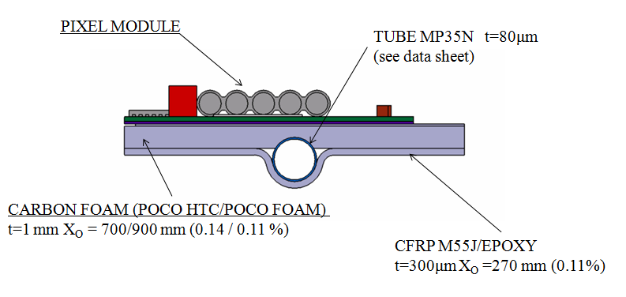
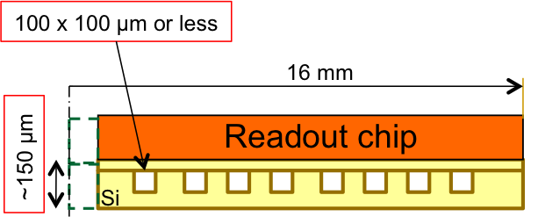
Module cooling
Cooling one of the major challenges
Choice of substrate, cooling block, and cooling attachment, all to accommodate evaporative CO2 cooling
Local thermal management of detector electronics through ultra-thin micro-structured silicon cooling plates is an extremely promising technique fo HEP with wide potential application in oteher fields.
It combines a very high thermal efficiency with a very low addition of mass and space, and suppresses all problems of CTE mismatch between heat source and heat sink.
Notes:
m-channel cooling naturally addresses this issue through the use of Si cooling plates with no CTE mismatch in extremely reduced thickness, and through the suppression of mechanical components required for thermal bridges
µ-channel cooling: very high heat transfer coefficients (very small D_{h} possible) and very high heat flux (large S available)
With an integrated m-channel cooling approach, the large surface available for the heat exchange (cold plate vs. cold pipe) and the natural minimization of the thermal resistance between the source and the sink effectively address the issue of the ΔT between the fluid and the element to be cooled

Slide 23
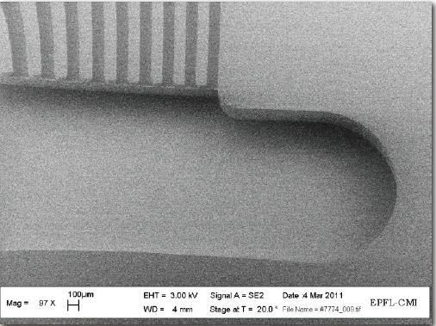
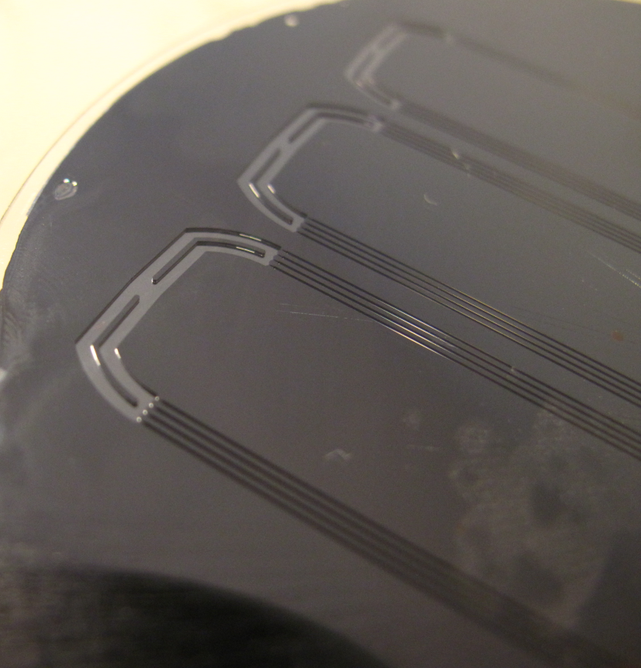
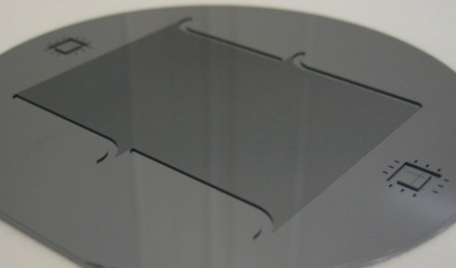
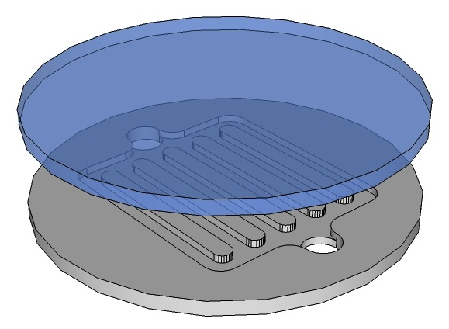

Microchannel cooling
Typical micro-fabrication techniques are involved in the process:
  Photolithography
  Etching
  Wafer bonding
  Thinning
Dedicated connectivity being developed for LHCb
Channels closed by bonding another wafer on top
Numerical simulations are not enough to complete the design and validation phase
Prototyping and direct testing is mandatory in order to optimize the performance and validate the reliability.
In particular, due to the fluid pressure involved in operation (up to 60 bar in some specific applications) the quality of the wafer bonding is a critical parameter.
This level of quality is extremely difficult to obtain in R&D/Academy clean rooms, in particular when the prior wafer process flow is complex: a flexible cooperation with an industrial partner, able to keep affordable prototyping costs and time would be fundamental to develop this innovative technique and to exploit its enormous potential.
Notes:
Channels closed by bonding another wafer on top
Anodic bonding
Pyrex-Si
Voltage + pressure @ intermediate temp.
Silicon Fusion Bonding
Si-Si or Si-SiO2
Pressure @ room temp. + annealing (high temp.)
Intermediate layer
Glass
Au eutectic
Polymer
sol-gel
…
.

Slide 24





Tracker upgrade – downstream stations
Factor 4 silicon area coverage incease
Priority is to reduce material
  Tab/bump bonding techniques
  Sensor-sensor
  Sensor-cable
  Sensor planarity
  Isolation techniques
Academia Meets Industry - LHCb
26th March 2012 – Paula Collins

Slide 25



Tracker upgrade – middle stations
New 3m² tracking stations before magnet
Challenges:
Integrated cooling
Thinning of electronics and low mass kapton cables
Custom designed patterns and cuts

Slide 26

Photon detection in LHCb
Particle identification is a vital component of LHCb and the upgrade
Two RICH detectors distinguish pions, kaons and protons from ~ 2 – 100 GeV/c
The current custom-built photon detectors integrate electronics which is incompatible with 40 MHz readout -> replace with MaPMTs and external 40 MHz readout electronics
Area to be covered 3.3 m² with 2.5x2.5 mm² granularity at the photocathode surface
R7600 vs R11265 (baseline)
8x8 pixels, 2.0x2.0 mm², 2.3 mm pitch (2.9 mm)
18.1x18.1 mm2 active area (23.5x23.5 mm2)
CE (simulation) : 80% (90%)
Fractional coverage: 50% (80%)
Also under consideration: HPDs with external readout electronics, hybrid MCP with Medipix/Timepix readout chip
Notes:
Difference between these two options
MCP: Burle/Photonis ion feedback, lifetime, magnetic field = ok
Magnetic field tolerance ~ 200 gauss w/o shielding -> 50 gauss + mu metal shield

Slide 27


Low momentum particle ID
Quartz Plane + Focusing block at edge to convert photon angle into position on detector
Focusing element currently designed around commercial micro-channel plate (MCP) device: the Planacon [Burle/Photonis]
available in 1024-channel (32×32) version
Pixellization would need to be adapted to meet our requirements:
~ 100 pixels in the transverse dimension
Academia Meets Industry - LHCb
26th March 2012 – Paula Collins
Notes:
Digital sipm – need 25 ns + 40 MHz readout
Pixel size small in one dimension, chip connectivity
Charge cloud, occupancies etc.

Slide 28
Conclusions
The LHCb upgrade demands position sensitive detectors with cutting edge technological performance
  Fast and lightweight silicon position sensitive detectors for vertex detection and tracking
  Photon detectors for particle identification and time of flight
  Possible use of novel micromachining techniques for microchannel cooling, TSV production etc.
2012 will see exciting collaboration with our industrial partners before the technology choices start to be finalised
Synergy with AIDA project has boosted our R&D

Slide 29
40 MHz read-out for LHCb
LHCb is expected to have an event-size (the data produced by one bunch-crossing) of about 100 kilobytes
This will be read-out 40 Million times per second → total data size is 4 Terabyte (4000 Gigabyte) / every second
This requires a network of at least 32 Terabit / s to transport the data from the front-end cards (interfaces to the detector) to a server-farm
The server farm is estimated to be between 3000 and 5000 servers all connected with a high-speed link of at least 10 Gigabit/s
  A server here is typically a dual-CPU mainboard with (currently) 32 cores total
  The use of co-processor cards (GPUs) is actively being studied to do CPU intensive number-crunching and reduce the number of conventioanl servers
The network technologies under consideration are 10/100 Gigabit Etherent and InfiniBand (FDR)
The farm will be a very dense installation of about 1.8 MW (container solution with free air-cooling is envisaged which is very power-efficient)

Slide 30



Foil - Critical component of VELO Upgrade
Two major options have seen considerable R&D
  CF composites
    Good X/X0
    CRFP layups can adopt “any shape”
    Benefit from CMA expertise in space based mirror manufacture (challenge of adhesion in vacuum)
    Suitable materials and clamping technique identified
    Additional investment needed for next step
    Milling out of one box
    Mill flange with holes.
Mill the inside.
Cover inside with hard wax.
Fill with Sikadur epoxy mixed with glass spheres.
Mill the outside.
Check the thickness (next slide).
Drain the wax at 75 degrees.
Remove the filler, clean the box

Slide 31


