Slide 1
WP8 - CMS WS24 - Logistics, RP and Safety related to TAS removal
O. Boettcher for WP8
18 September 2025 – CERN (530/R-030)
https://indico.cern.ch/event/1584567/

Slide 2
Introduction
The goal of the meeting is to discuss on:
TAS removal from UXC55 to SX5 (where is intended to be put in a container)
Related logistics on CMS surface and SX5 (evtl. storage space and time)
Evacuation from CMS site.

Slide 3
References
The following presentations and reports related to the topic exists:
Indico 1411975 : 139th HL-LHC WP8 Meeting [TAS to waste] (19 June 2024)
EDMS 3223760 : LS3 De-installation for HL-LHC - RP & Logistics – Summary Report (WP15 – Darshana Ramrekha, Maria Perez-Ornedo – 21-02-2025)
34th HL-LHC Coordination Group Meeting – Indico 1550370 - “CMS – experiment schedule interfacing with machine LS3 planning” (T. Loiseau, F. Sanchez-Galan)

Slide 4
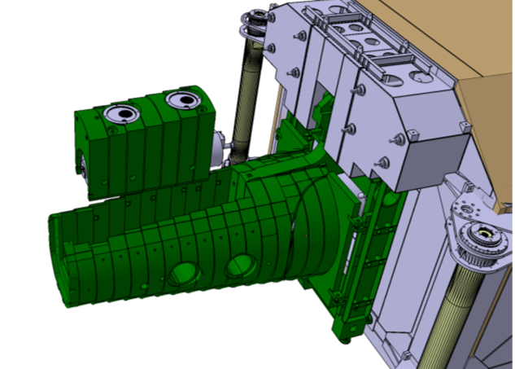
Preparation of TAS transport and waste storage
CMS TAS + cradle …
… will be removed from its installed position together with its cradle (S235 steel) chamber (SS), the vertical support jacking devices and still attached to the vertical support rods (assembly weight ~ 9.5t).
The CMS TAS cradle does not protect all around. TAS is free at the bottom and on tunnel side TAS reaches 235mm out of cradle.
Conclusions:
  CMS TAS require a shielded containment to meet requirements for surface transport (<2mSv/h contact, < 0.2mSv/h at trailer edges)
Notes:
Check if Z-Stop is latest design!

Slide 5
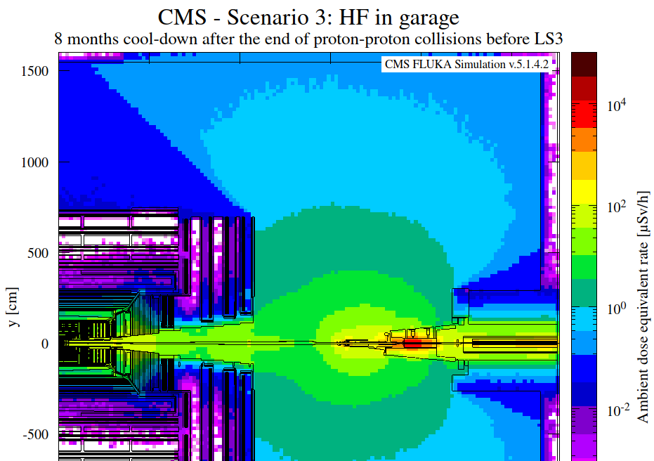
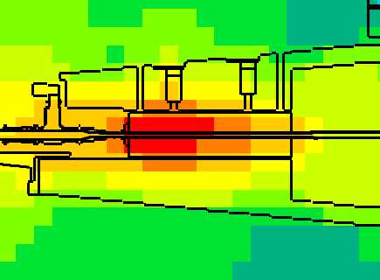
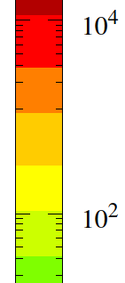

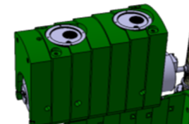
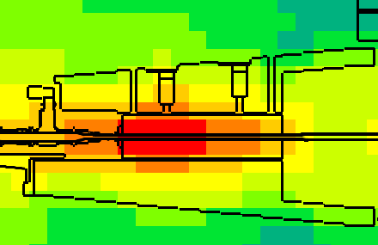
RP considerations for TAS and cradle removal
Assumption done here based RP assessment for CMS during LS3 (EDMS 2748870 )
CMS scenario 3) is applicable (Rotating Shielding opened /HF in garage position) and 9 - 10 months cool down time (3 months pb-run 2025 + 06-07/2026)
following corresponding chart TAS ambient dose is: 10mSv/h on IP side / 1-3mSv/h on tunnel side
simulations show further that at 20cm of steel shielding, ambient doses are < 3mSv/h.
Conclusions:
  Transport requirements are: <2mSv/h contact and < 0.2mSv/h at trailer edges.
  For surface transport TAS need additional shielding or a shielding containment!
10 months cool-down
8 months cool-down
CMS TAS + cradle
Notes:
Check if Z-Stop is latest design!

Slide 6
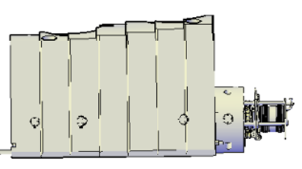
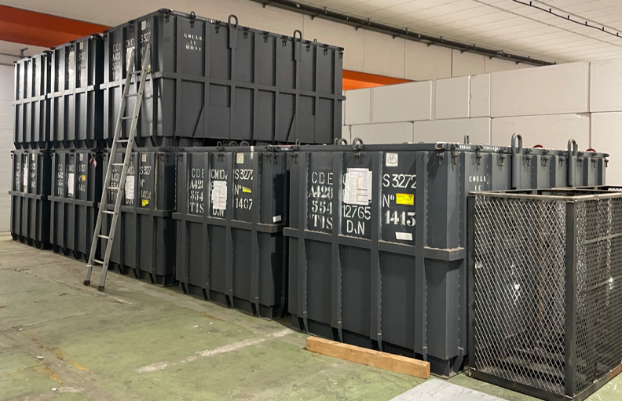
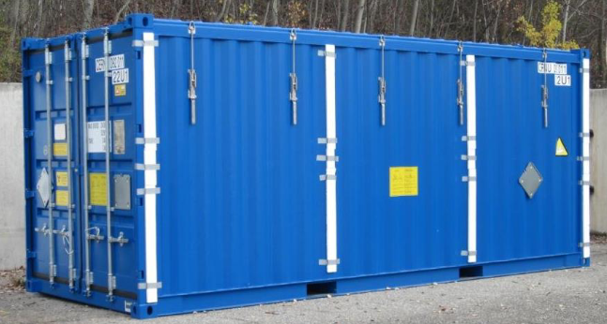
TAS transport and waste storage containers
Evacuation of CMS TAS + cradle from cavern and in containment from pt5 to RWTC …
RWTC proposal is to use ANDRA shielded containers for the storage in RWTC.
Proposal is on 54 side to place the container in the cavern to insert TAS + cradle and to bring all together to surface.
On 56 side, proposal is to place the container in SX5 and insert TAS + cradle on the surface.
The transport service will use a 20-foot container to bring all to RWTC.
Conclusions:
  Using ANDRA shielded containers would be required for surface transport.
  Again, special look need to be given to load capacities
  (max. 21t: 10.6t container, 2.5t cover, 9.5t ATLAS TAS assembly)
CMS TAS + cradle
… inside ANDRA container …
… inside 20 foot Transport container on truck
Notes:
Check if Z-Stop is latest design!

Slide 7
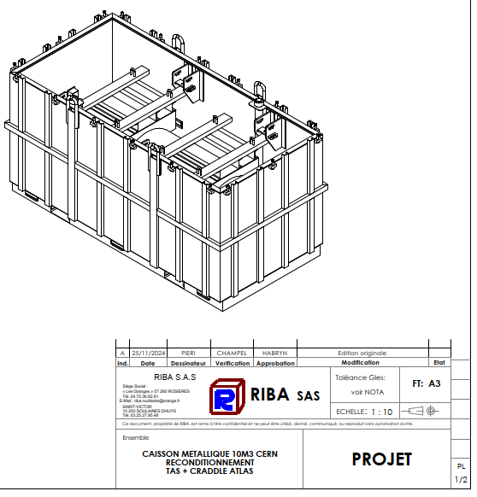
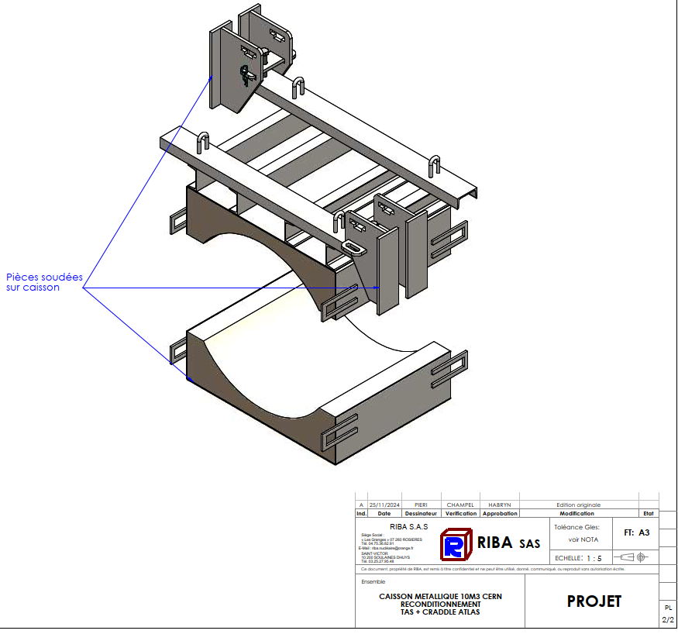
TAS transport with ANDRA shielded containers
  Remind, special look need to be given still to load capacities
  (max. 21t: 10.6t container, 2.5t cover, 9.5t CMS TAS assembly)
CMS TAS + cradle
… inside ANDRA container …
… inside 20 foot Transport container on truck
Notes:
Check if Z-Stop is latest design!

Slide 8
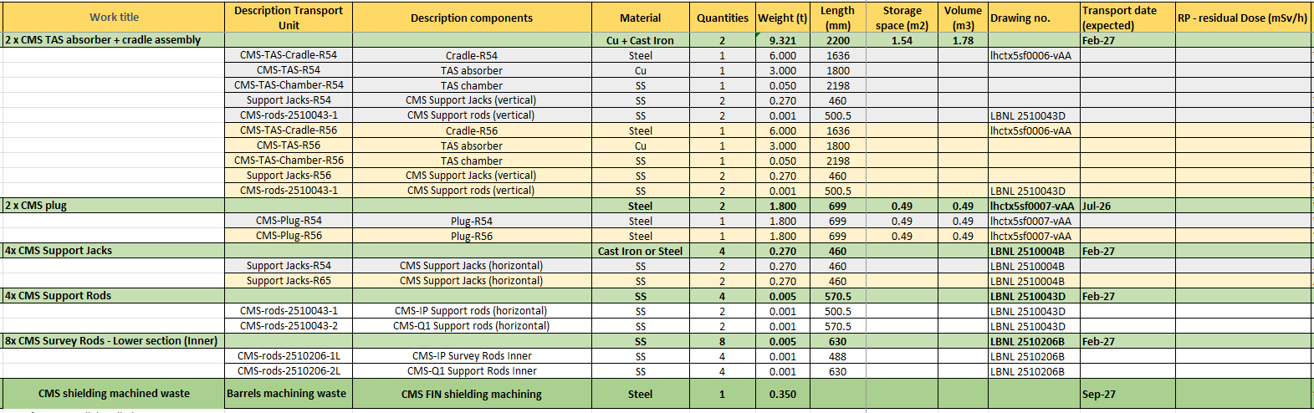
WP8 – Radioactive Waste inventory
Definition of residual dose for components that go to waste pending.
How detailed, where to get information from?

Slide 9
WP15 - Logistic and Buffer zone request
WP/Group | Equipment | Location | Exit Point | Buffer area (m2) | Start Date in Planning | End Date in Planning | Special container required? | Reuse/ Waste? | Requested on BDC SP for RP Buffer space | Destination after RP check (Storage ID)
WP8/ BE-EA | TAN 1R – U-Shielding | P1R | P1 - PM15 | 5.5 | 28/07/2026 | 30/07/2026 | Y | REUSE | ID242 | UX65
 | TAN 1R – Absorber boxes + chambers |  |  |  |  |  |  | WASTE |  | UX65 Bunker
 | TAN 1R – Marble + top shielding |  |  |  |  |  |  | WASTE |  | RWTCS
WP8/ BE-EA | TAN 1L – U-Shielding | P1L | P1 - PM15 | 5.5 | 03/08/2026 | 05/08/2026 | Y | REUSE | ID242 | UX65
 | TAN 1L – Absorber boxes + chambers |  |  |  |  |  |  | WASTE |  | UX65 Bunker
 | TAN 1L – Marble + top shielding |  |  |  |  |  |  | WASTE |  | RWTCS
WP8/ BE-EA | TAN 5R – U-Shielding | P5R | Through tunnel to UX65 | 5.5 | 26/08/2026 | 02/09/2026 | N | REUSE | Not required | UX65
 | TAN 5R – Absorber boxes + chambers |  |  |  |  |  |  | WASTE |  | UX65 Bunker
 | TAN 5R – Marble + top shielding |  |  |  |  |  |  | WASTE |  | RWTCS
WP8/ BE-EA | TAN 5L – U-Shielding | P5L | Through tunnel to UX65 | 5.5 | 26/08/2026 | 02/09/2026 | N | REUSE | Not required | UX65
 | TAN 5L – Absorber boxes + chambers |  |  |  |  |  |  | WASTE |  | UX65 Bunker
 | TAN 5L – Marble + top shielding |  |  |  |  |  |  | WASTE |  | RWTCS
WP8/ BE-EA | TAS 1R (absorber + cradle assembly, plugs, supports) | P1R | P1 (exp) - PX14/PX16 | 2.2 | 04/01/2027 | 08/01/2027 | Y | WASTE | ID283 | RWTCS
WP8/ BE-EA | TAS 1L (absorber + cradle assembly, plugs, supports) | P1L | P1 (exp) - PX14/PX16 | 2.2 | 04/01/2027 | 08/01/2027 | Y | WASTE | ID283 | RWTCS
WP8/ BE-EA | TAS 5R (absorber + cradle assembly, plugs, supports) | P5R | P5 (exp) - PX56 or PM54 | 1.5 | 16/02/2027 | 08/03/2027 | Y | WASTE | ID284 | RWTCS
WP8/ BE-EA | TAS 5L (absorber + cradle assembly, plugs, supports) | P5L | P5 (exp) - PX56 or PM54 | 1.5 | 16/02/2027 | 08/03/2027 | Y | WASTE | ID284 | RWTCS
WP8/FPhyEx | PPS (Joachim Baechler, Mario Deile from EP-CMT) Oliver Boettcher and Marija Majstorovic | P5 | P5 - PM54 | 8 | n/a | n/a | Undefined | REUSE | n/a | SX5 then B188

Slide 10
Next steps until LS3 readiness review
Are all stakeholders and service experts committing to the proposals? What are suggestions that would further optimize the proposals or make life easier?
What RP assessments / studies would be needed to validate the proposals?
What is required to organize road transport?
What is required to organize ANDRA containers?
What else?

Slide 11
Thanks to all contributing services and experts
Credits to: EN-HE, HSE-RP, RWTC and all other colleagues that worked on the studies

Slide 12
Backup slides

Slide 13
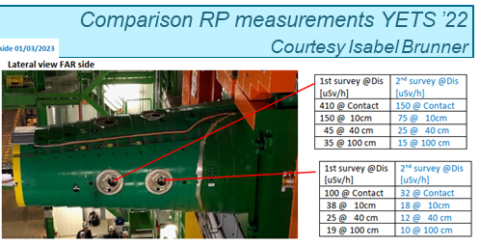

Slide 14


Slide 15
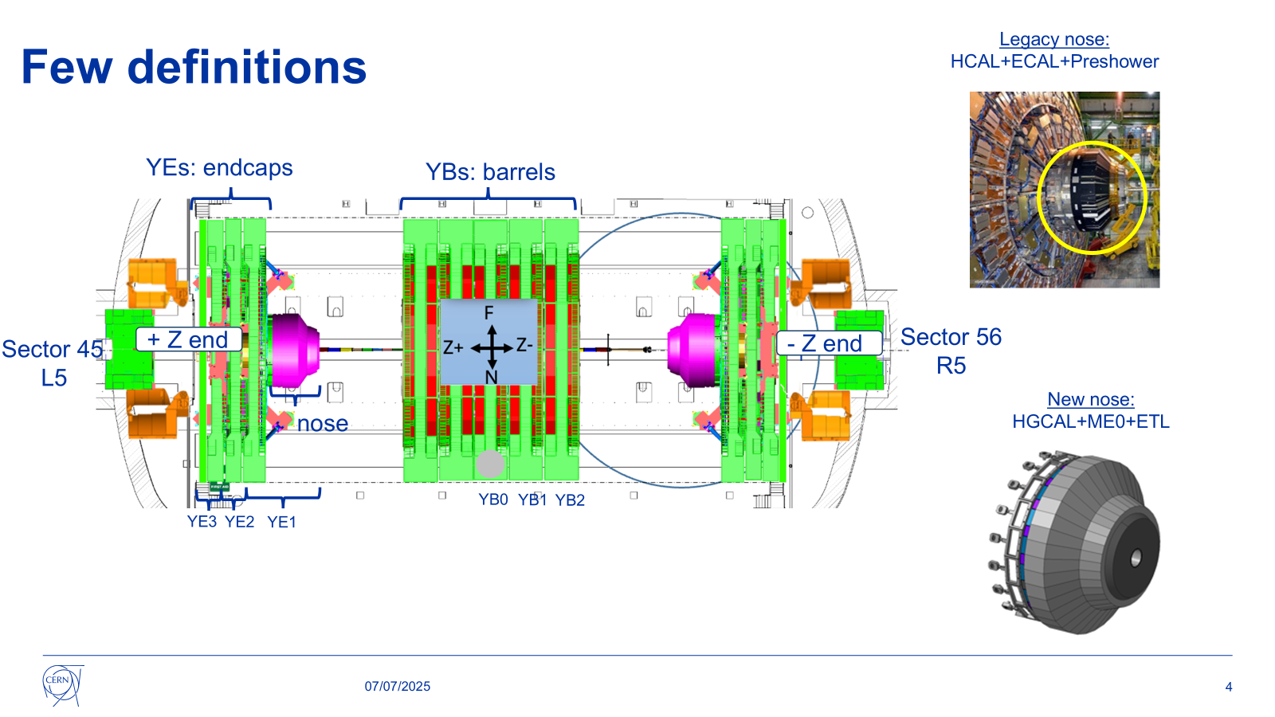

Slide 16
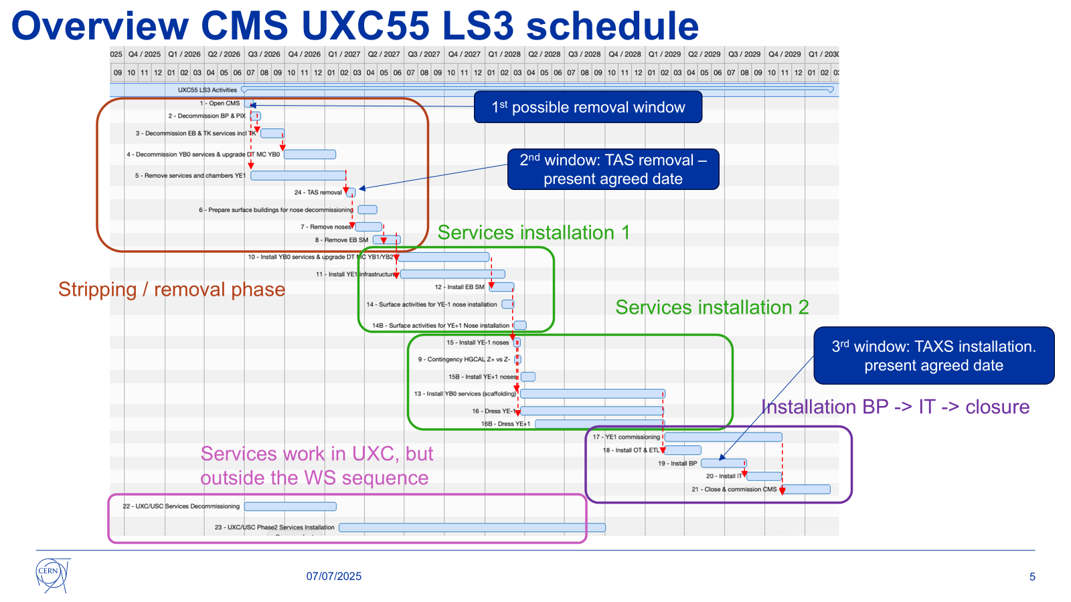

Slide 17
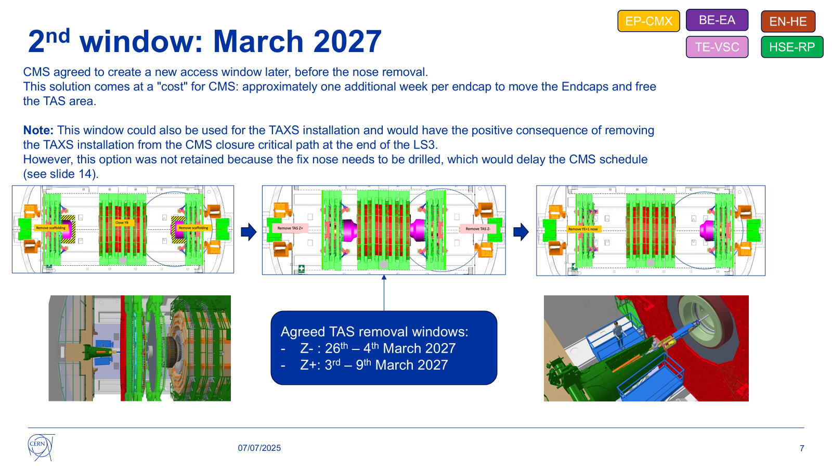

Slide 18
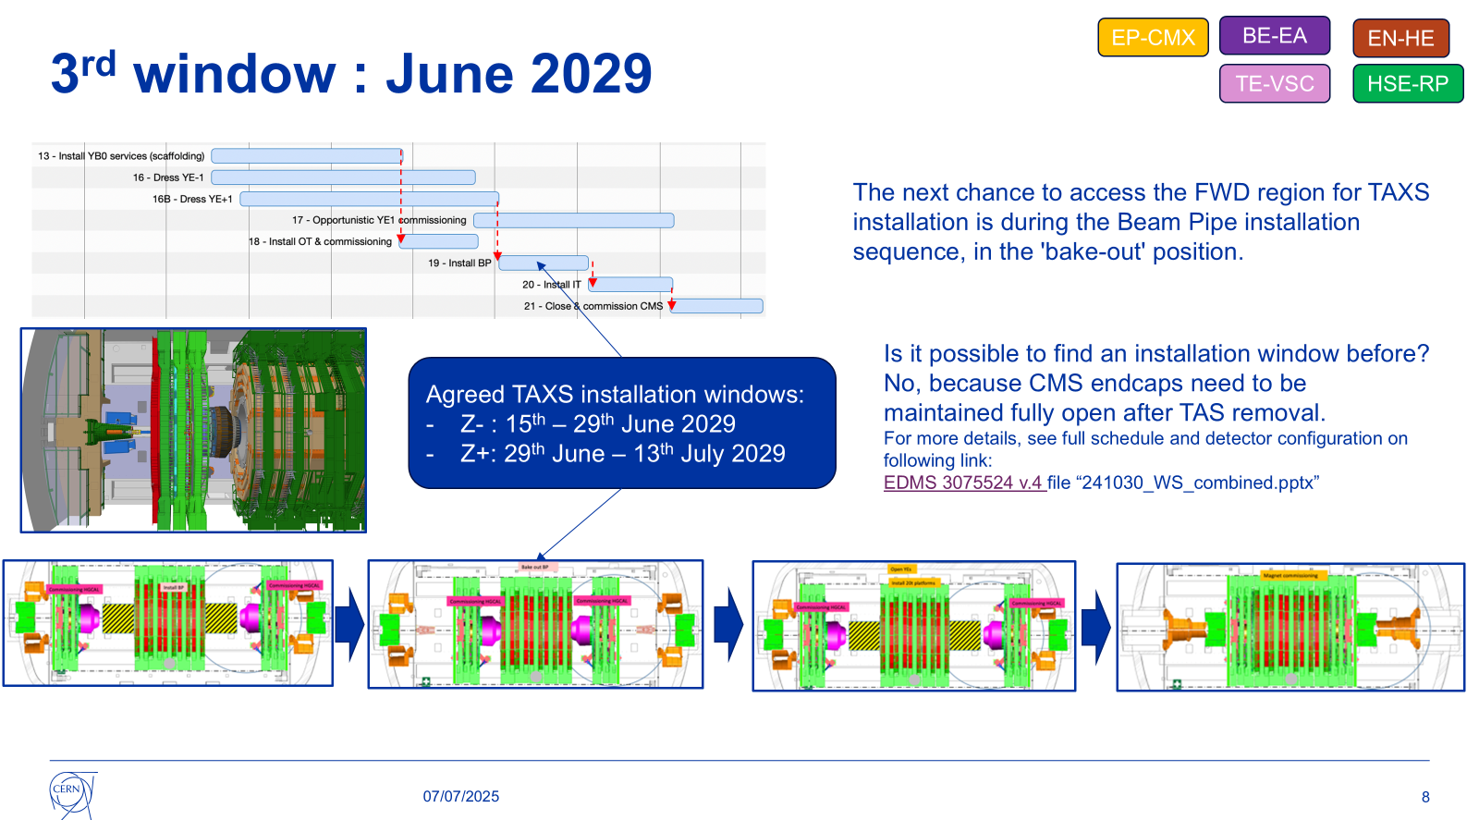

Slide 19
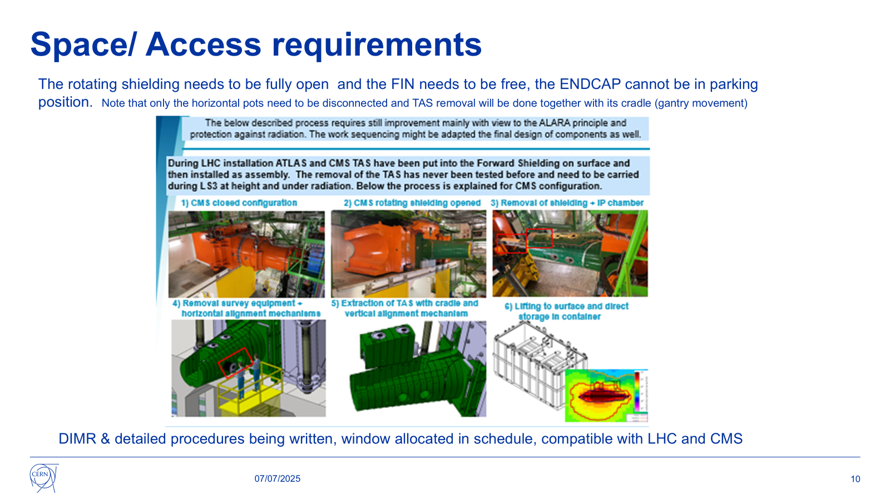

Slide 20
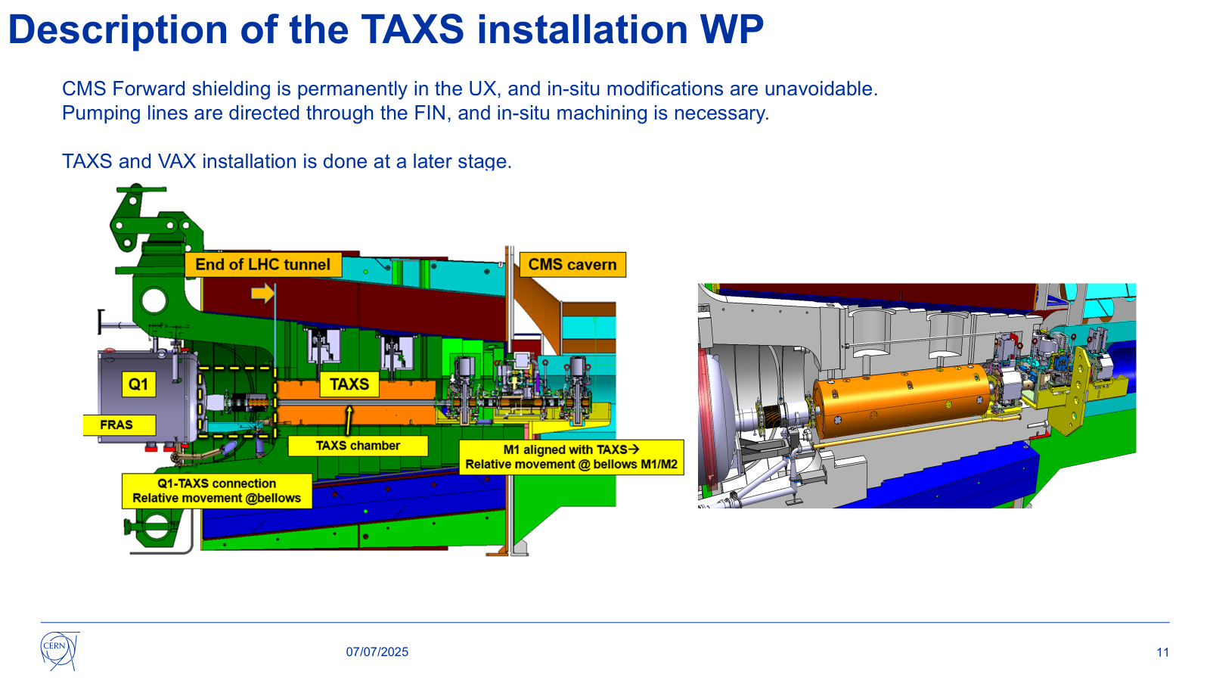

Slide 21
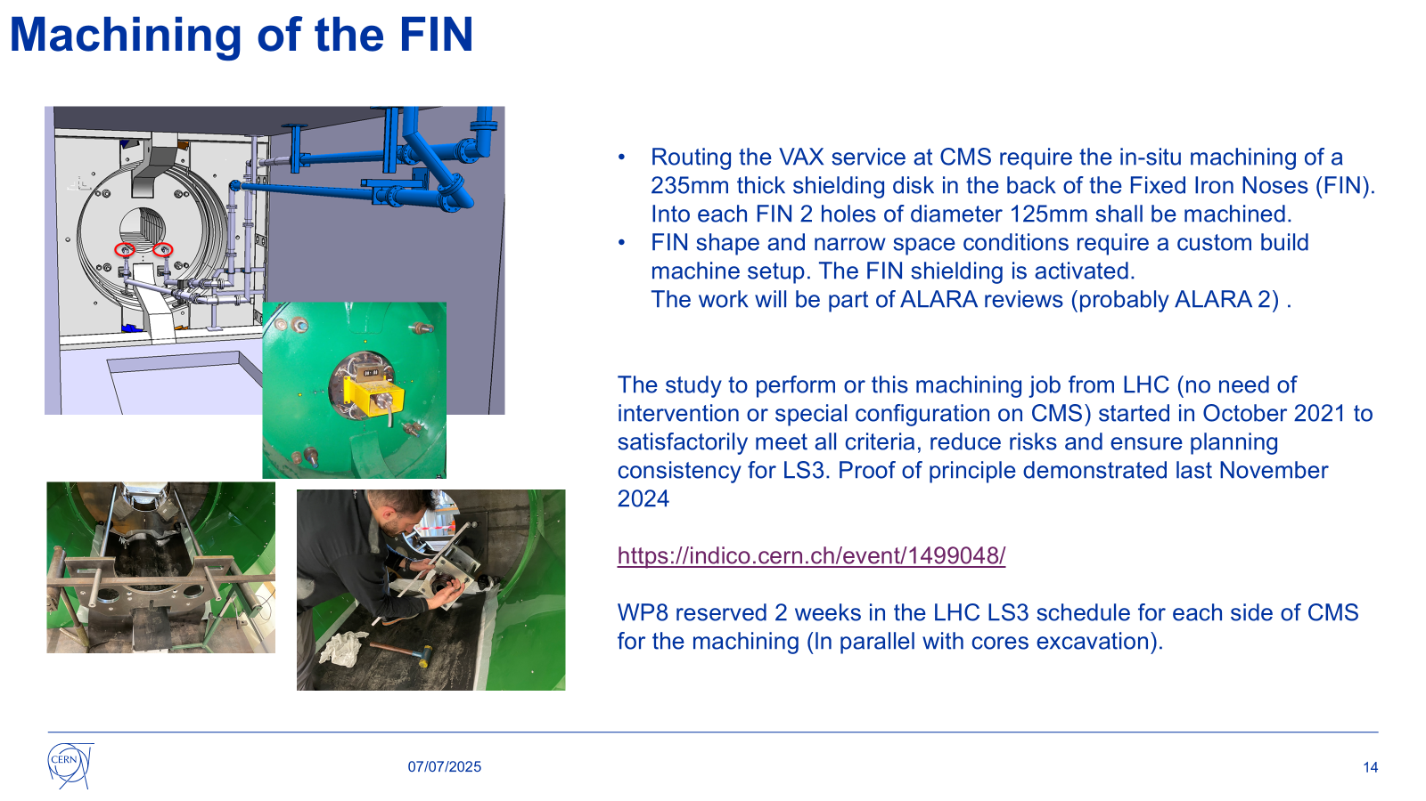

Slide 22
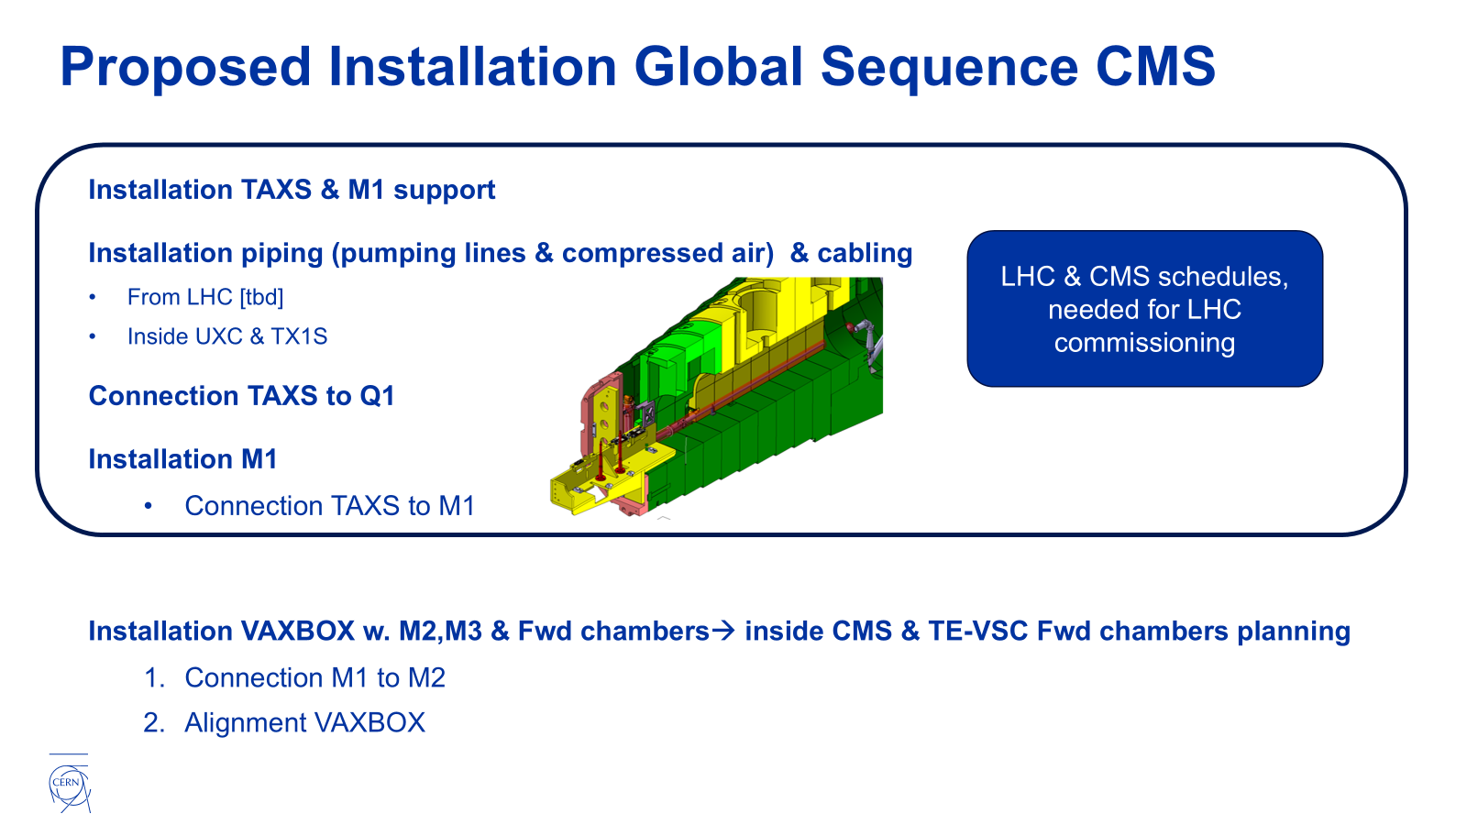

Slide 23
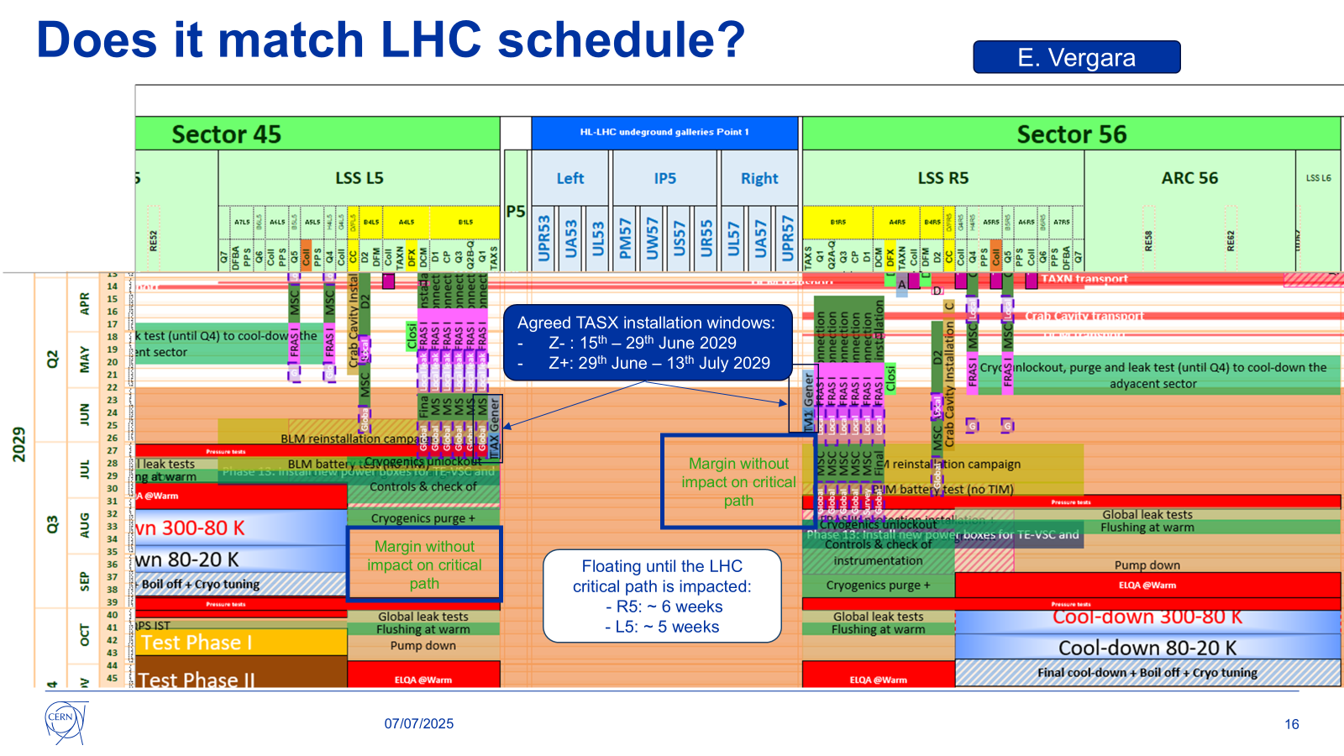

Slide 24
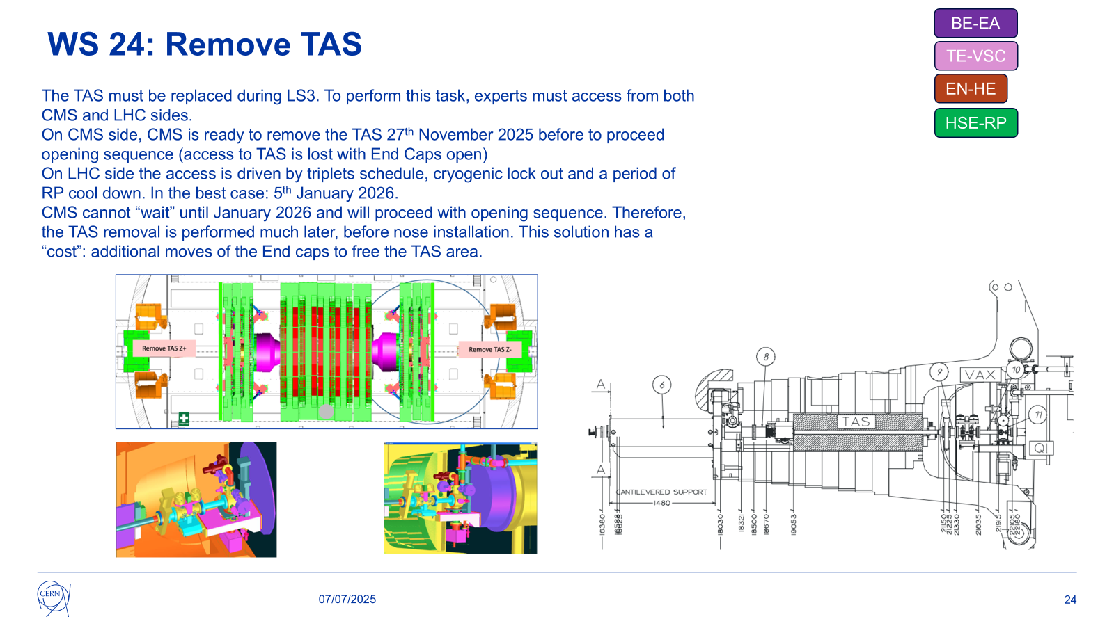

Slide 25
