Slide 1
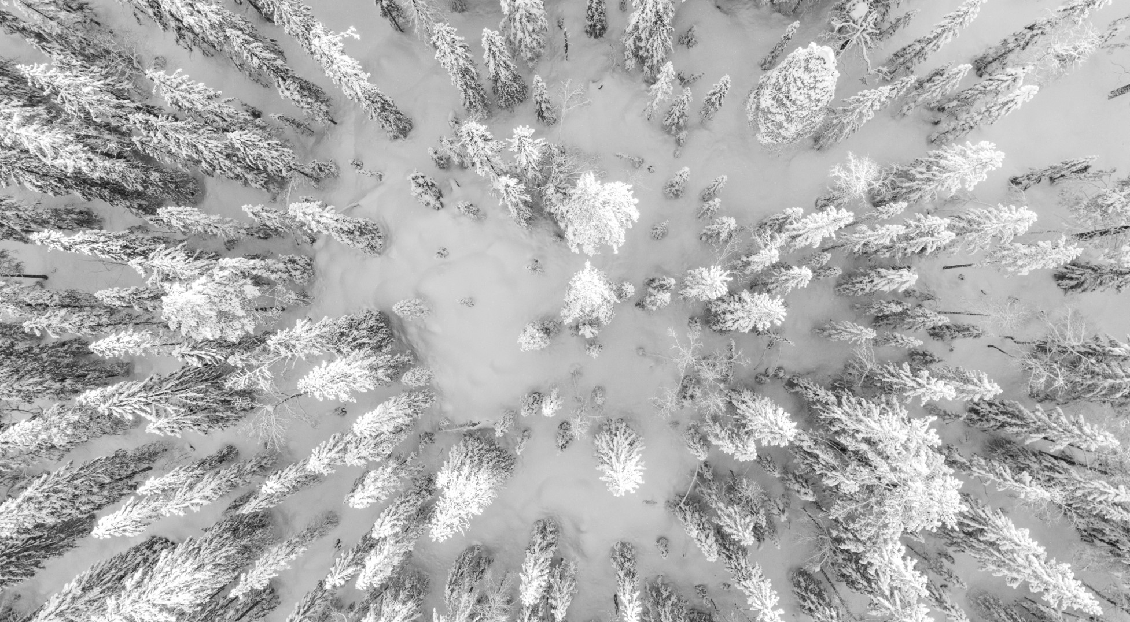

Ski Fitness 2024/25
Gabi Thiede

Slide 2
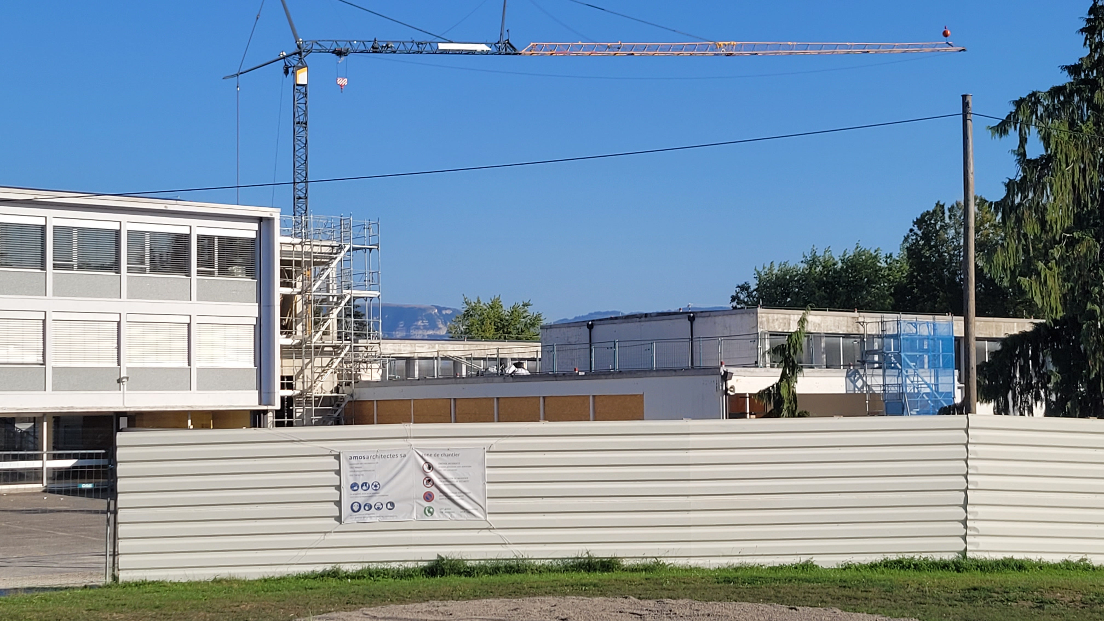
July 2024 – February 2025:
No gym hall! – No instructor!
Suspension of ski fitness

Slide 3

Fitness in spring?
18x Yes!
Survey #2
Other gym hall?
56% No!
Survey #1

Slide 4
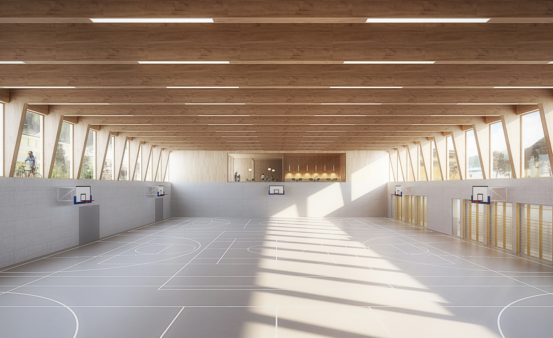
Support from Margherita
Organisation
Sebastian takes over from Laetitia
Instructor

Slide 5
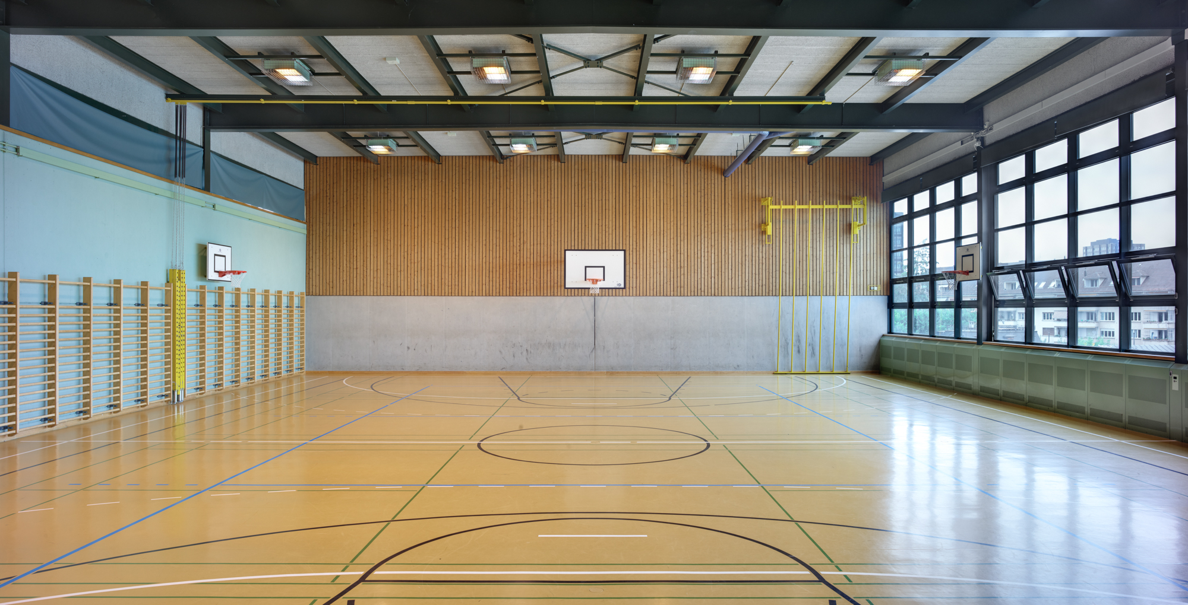
General Gym
04.03. – 27.05.25
On Tuesdays from 18:30 to 19:30 h
General Gym
Fees 50 Euro
Our Programme
Our Prices

Slide 6
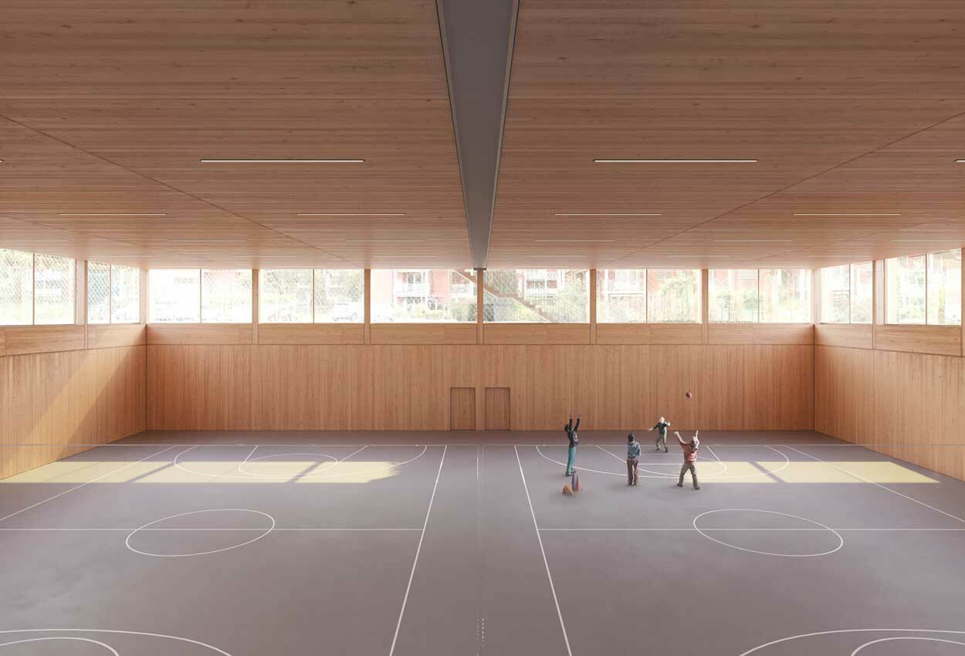
27 Participants

Slide 7
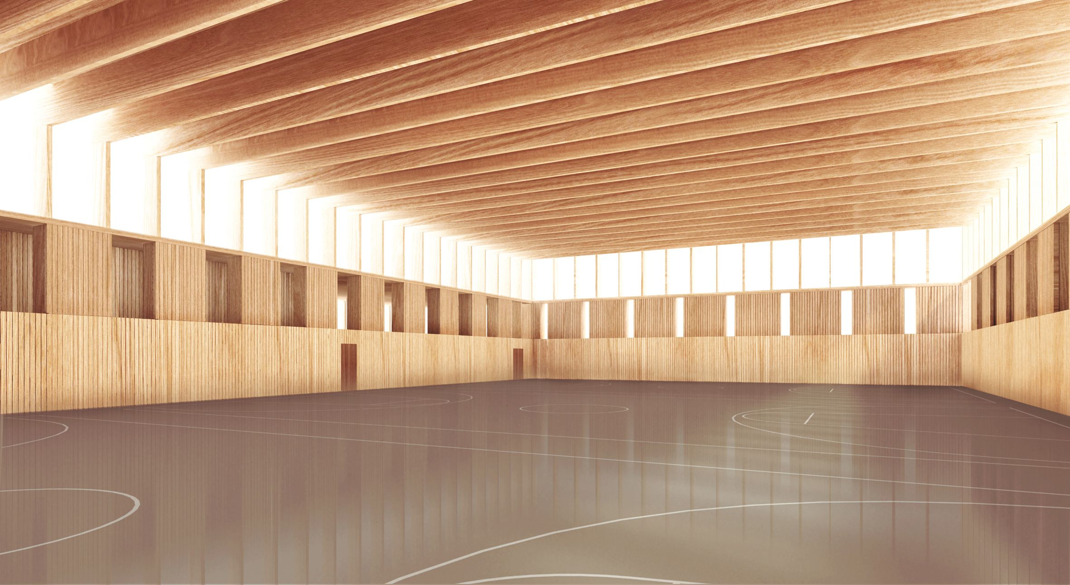
- Season start on 26.09.
- Spots still open
Gym hall avaible
Instructor stays
Good News
Ski Fitness 2025/26

Slide 8

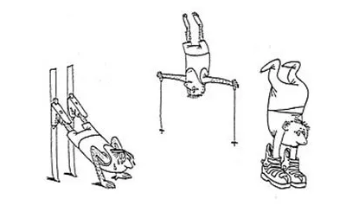
Thank You

