Slide 1
LHC Beam Synchrotron Radiation Telescope for Imaging Status, Performance, and HL-LHC Outlook
F.Roncarolo , D.Butti, S.Burger, J.Pucek
C.Pasquino, W.Andreazza
T.Lefevre , R.Veness
HL-LHC Beam Profile Review – 23-Sep-2025

Slide 2
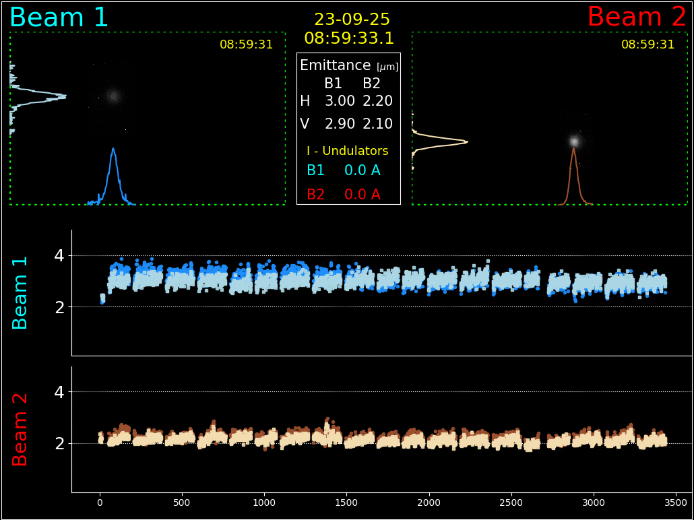
LHC Beam Synchrotron Radiation Monitor (this morning)

Slide 3
Contents
Instrument principles, design, current and expected performance
Towards Run4 Exploitation: Issues, mitigations, risks et al.
Template questions to easy compare to other monitors
Summary
N.B.: todays review (beam profile monitoring) and this presentation focus on operational synchrotron radiation monitor --managed with SY-BI exploitation budget, no HL-LHC costs

Slide 4
Glossary
BSR — Beam Synchrotron Radiation
BSRTM — BSR mirror-based extraction (legacy/operational line in IR4) In-vacuum mirror system that extracts visible/UV SR from: undulators at 450 GeV and D3 dipoles above ~2 TeV. Light is routed to the optical benches under the beam pipe in RA43/47. Serves BSRT (transverse profile), BSRA, and BSRL. No HL-LHC deliverables
BSRTMB — BSR mirror-based extraction, new “B” line (HL-LHC deliverable) Upgraded extraction from D4 dipoles with light transported to the UA43/47 caverns. Prototype in LS2, full implementation in LS3. Designed to serve BSRH (halo). Potential for transverse and longitudinal profiles redundancy at flat top energy
BSRT — Beam Synchrotron Radiation Telescope Transverse beam size/profile monitor imaging SR onto a gated, intensified CMOS/CCD chain. Provides bunch-resolved emittance/size, optics studies, and routine beam quality monitoring.
BSRH — Beam Synchrotron Radiation Halo Monitor High-dynamic-range SR instrument to measure beam halo and core-to-halo contrast at flat-top, leveraging the BSRTMB extraction and dedicated optics/apertures.
BSRA — Beam Synchrotron Radiation Abort-Gap Monitor Gated SR diagnostic measuring residual charge in the abort gap (and near-by empty buckets). Used to protect the dump system and assess cleaning efficiency.
BSRL — Beam Synchrotron Radiation Longitudinal Monitor SR-based longitudinal diagnostic for ghosts and satellite bunches and overall bunch-length/structure characterization (complements BWS/BPM-based info).
BSR Extraction Systems/Tanks
BSR Monitors

Slide 5
LHC Synchrotron Radiation (SR) monitors
Non-invasive diagnostics for transverse, longitudinal and intensity beam parameters
 | SR extraction Stations
 | BSRTM (Operational) | BSRTMB - HL-LHC (for ref., not for today’s review)
Location | Left and Right of IR4, for beams existing RF zone | Left and Right of IR4, for beams entering RF zone
SR sources | 450 GeV: Undulators (visible SR) >2 TeV: D3 dipoles (visible/UV SR) | >2 TeV: D4 dipoles (visible/UV SR)
Light transport | RA43/47 tunnel: To optical setup & detectors under beam pipe | UA43/47 service caverns: to new optical hutch, easier access, low-rad environment
Operational status | Operational since start of LHC. Will stay in Run4 | Prototype (tank+mirror only) installed LS2, tested Run3, final implementation LS3 (HL-LHC deliverable)
Main diagnostics served | BSRT: transverse beam profile BSRA: abort gap population BSRL: ghosts & satellites | BSRH: beam halo monitor (Transverse beam profile, Abort gap, Longitudinal profiles possible as redundant to BSRTM + R&D, not baseline)

Slide 6
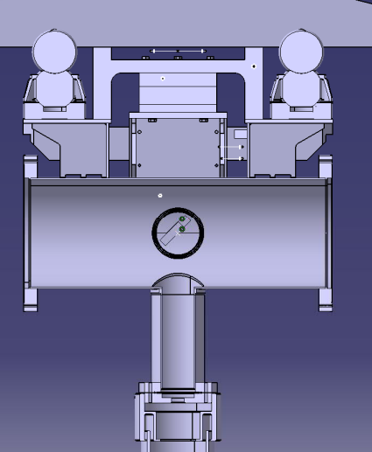
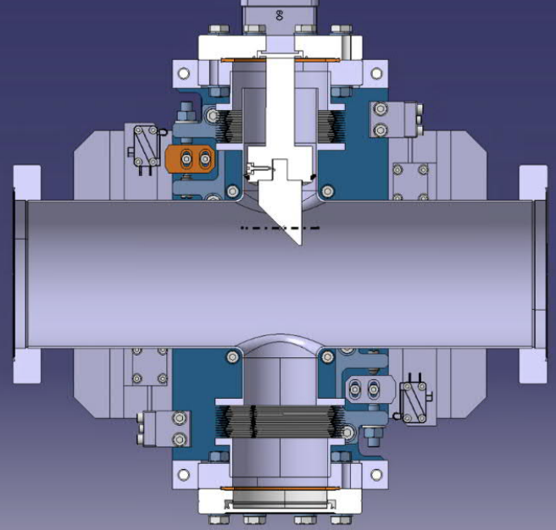
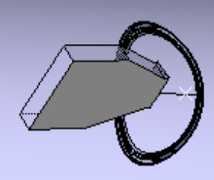
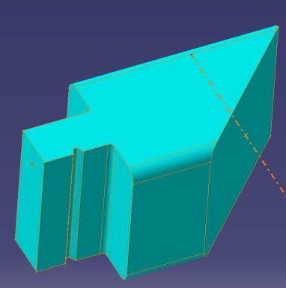
BSR extraction systems
For transverse and longitudinal beam profile (BSRTM)
For transverse beam halo (BSRTMB)
FIXED MIRROR
MOVABLE MIRROR
SR
SR
SR
Top View
SR
BEAM
Side View
X
Y
To detectors below beam pipe
To detectors in service gallery
S
S
Operational since LHC start (BSRT, BSRA, BSRL)
HL-LHC for beam halo Run4
(BSRH)

Slide 7
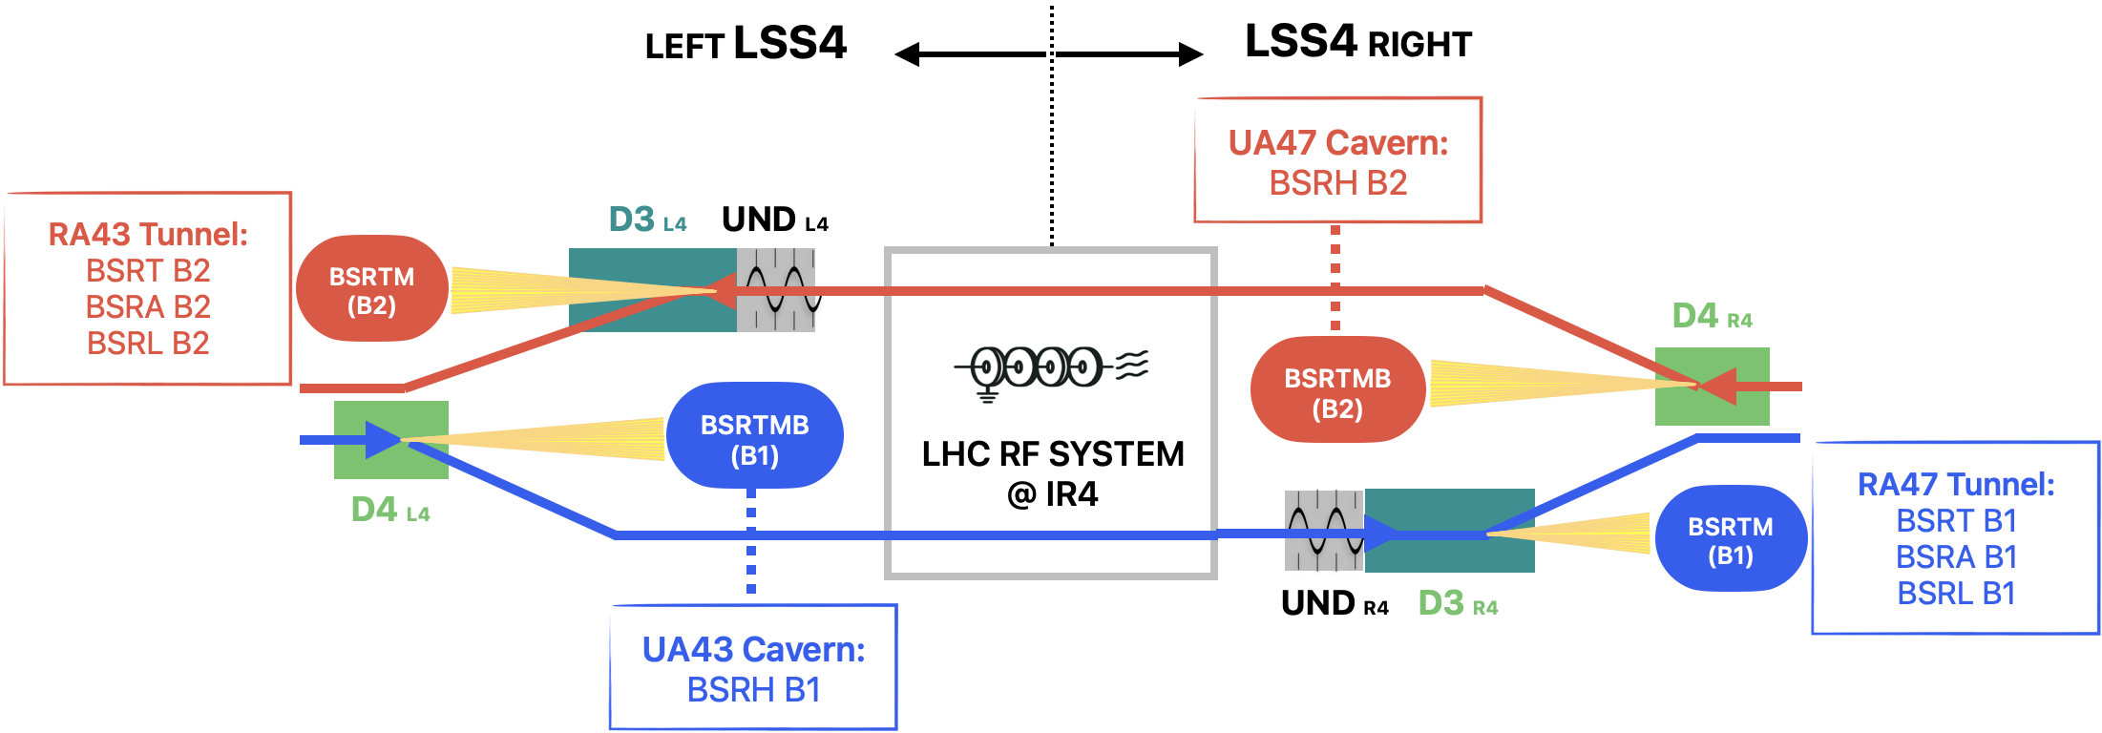
BSR Systems Layout/Synoptics

Slide 8
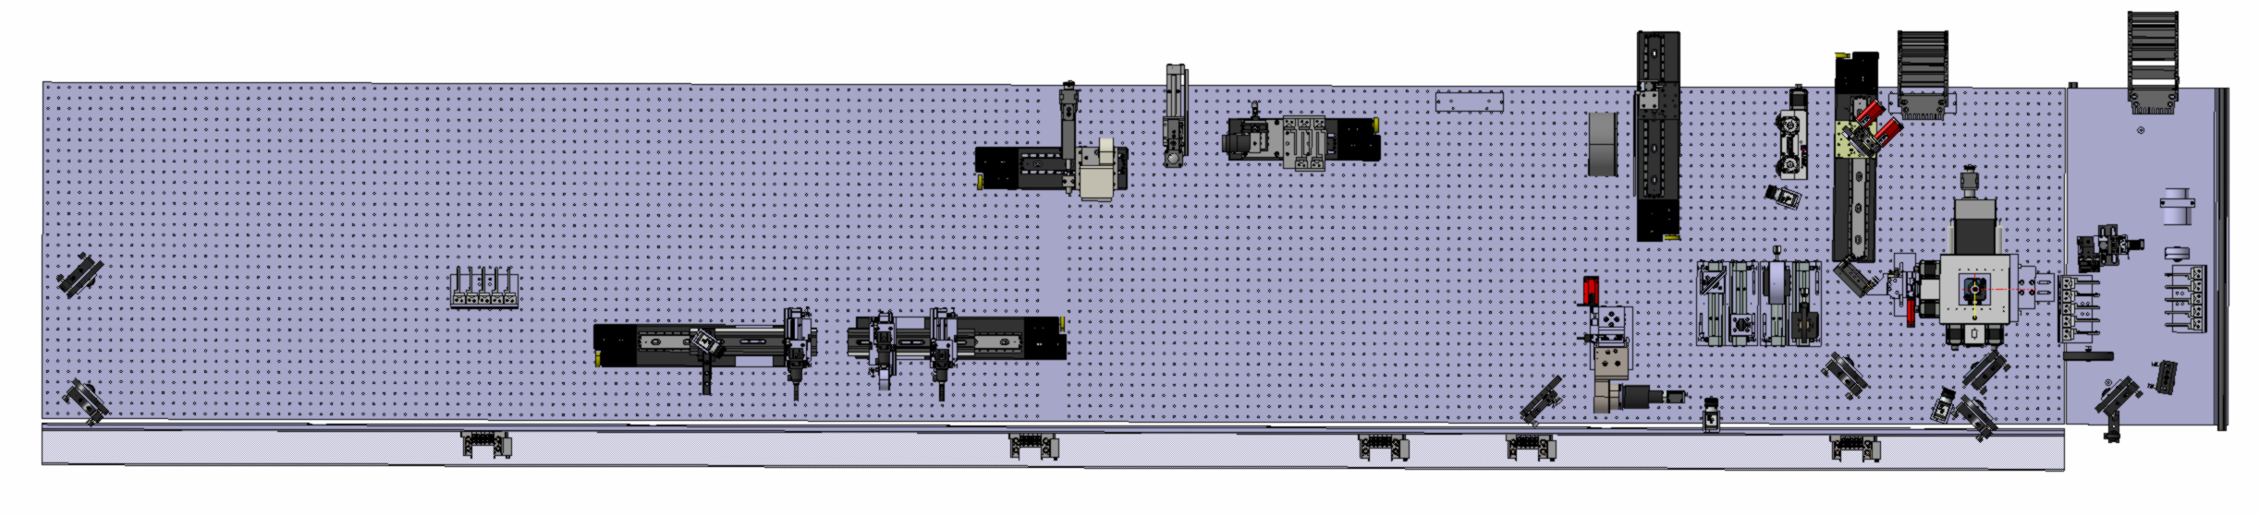
BSR Monitors optical table below beam pipe
Transverse beam profile line
Abort Gap and Long Profiles

Slide 9
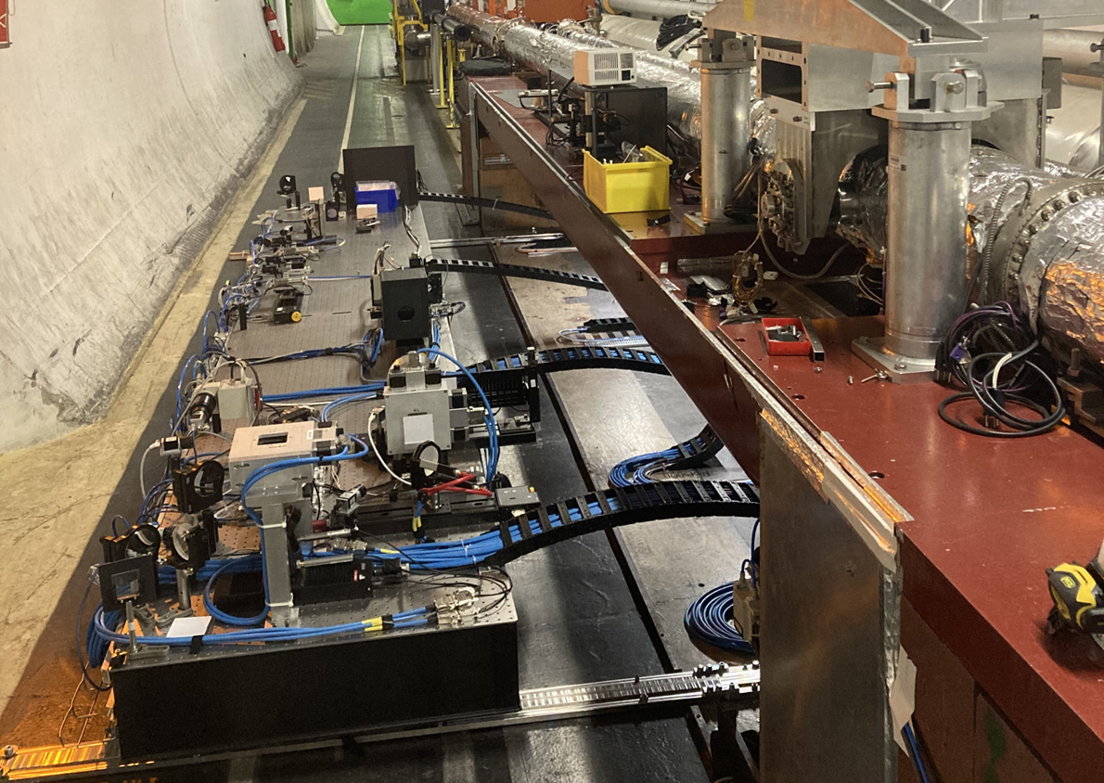
BSR monitors optical table

Slide 10
BSR profile monitor - Current Performance
Absolute calibration vs Wire Scanners (~10% accuracy)
Robust bunch-by-bunch, machine operation & MDs
Downtime rare
< few events per year resulting in missing monitoring for large part or entire LHC fill(s)
Radiation induced SEU in digital electronics and cameras
Automatic watchdog and reset make these have a minor impact on overall system availability
Occurrence rate increased beginning of Run3 --partially mitigated, see later slide -- more radiation expected with HL-LHC beams
Since Run3: Used for tails characterization (q-Gaussian fits)
Sofia Kostoglou’s talk, also for more numbers on performance

Slide 11
BSR profile monitor - Limitations
BSRT operates at different wavelengths at injection and flat top energies
Visible range @ injection: Offers robustness and long-term stability but at the cost of reduced spatial resolution (not a problem for mm-like beams at injection
UV range @flat top. Offers higher resolution but: special –often custom made- optics, more expensive than for the visible, more sensitive sensitivity to ageing
Calibration drifts at flat-top (optical ageing)
Even with reduced diffraction effects, resolution ~=200um, similar to beam size (1sigma).
Energy ramp: unreliable
Ions: no signal at injection (450 ZGeV)

Slide 12
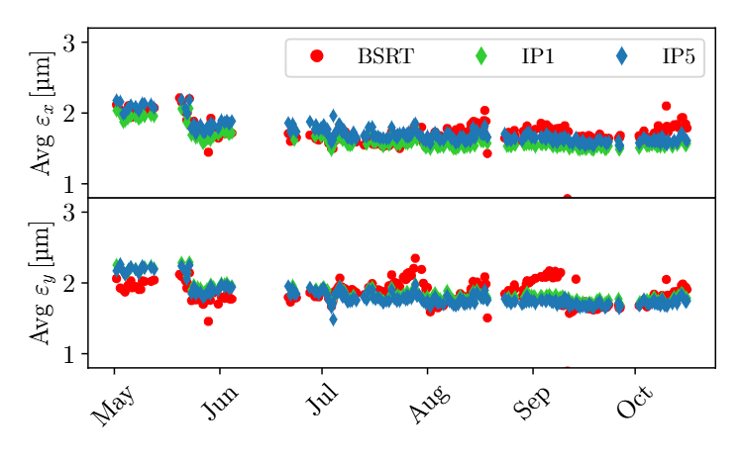
BSR profile monitor - calibration drift example
BSR imaging vs LHC emittance scans (from LHC experiments , convoluting B1 and B2)

Slide 13
Issues – General Summary
Component | Ageing Signature & Observations | Mitigation (in use)
Image Intensifier Photocathode | Local QE loss / non‑uniform response at SR spot; progressive sensitivity drop | “Spot painting” (translate camera on motorized X–Y stage to spread dose); keep MCP gain and gate width as low as practical. Image intensifier is a ‘consumable’ to be regularly replaced.
Image Intensifier MCP gain chain | Reduced gain over time; slower gain dynamics if routinely driven at high voltage | Operate at the lowest gain compatible with SNR; reserve high‑gain modes for special studies
Vacuum viewport / windows | Surface etching / haze → increased scatter, throughput loss | Cleanliness control; scheduled inspections and replacements
Optical filters | Coating burn marks and transmission drop when SR is focused on the filter | Place filters at a less‑focused plane (larger spot, lower W/mm²); share attenuation with upstream ND filters; monitor and replace as needed
In-Vacuum extraction mirror | Heating due to beam-coupling impedance. Major failure before LS2 | From metallic to dielectrics coating, LS2 BSRTM re-design, new BSRTMB concept
Radiation effects on electronics | Digital Cameras and other electronics SEU | New relay boxes with radiation tolerant components. Watchdog / Reset of cameras

Slide 14
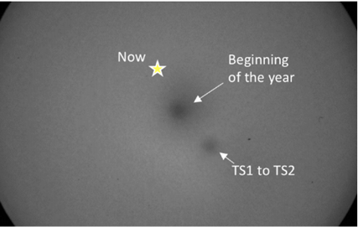
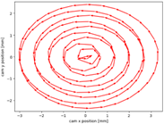
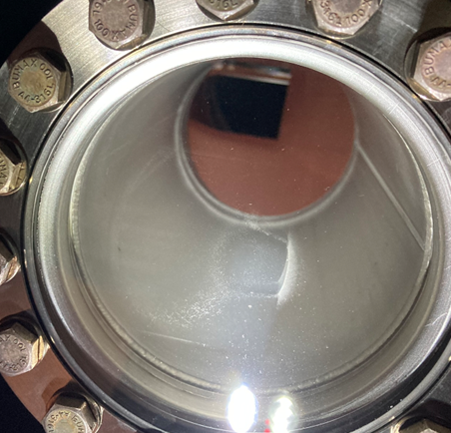
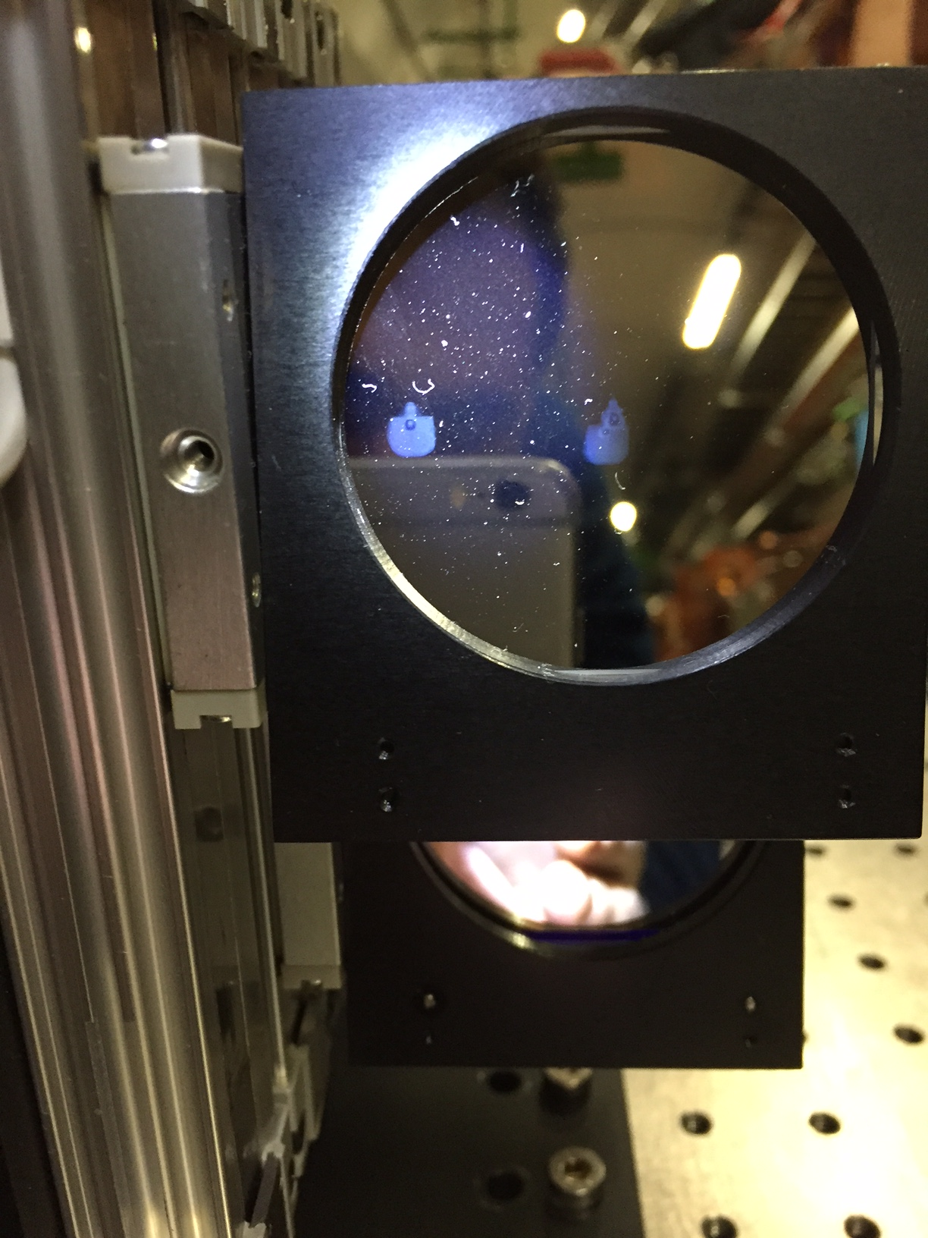
Issues – Specific Examples (I)
 | Issue / Observation | Cause / Mechanism & Mitigation
 | Image‑intensifier non‑uniform response | High SR photon dose concentrated on a fixed region of the photocathode; secondary MCP gain drift over time → Spot painting → MD: freeze pos. to ensure no response drifts
 | Viewport surface etching / haze (increased scatter, throughput loss) | Prolonged UV/SR exposure and thermal load on the vacuum viewport; surface chemical activation/contamination on the air side → Scheduled maintenance
 | 250 nm band‑pass filter damage | Focused SR spot concentrating power on the filter, local coating damage and spectral shift → Relocate filter to defocused spot , optimize ND filter use
G.Trad et al., 2019
From YETS to TS1
Painting map
From TS1 to TS2
SR footprint

Slide 15
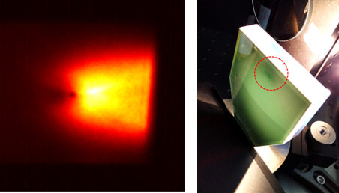
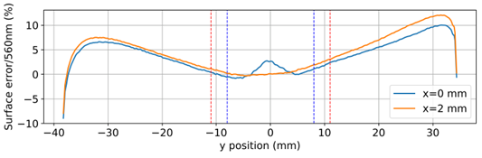
Issues – Specific Examples (II)
 | Issue / Observation | Cause / Mechanism & Mitigation
 | Extraction mirror coating detachment at specific location | X-Ray energy deposition from undulator emission at LHC top energy → Undulators (only used for imaging at injection) switched off during beam energy ramp
SR on mirror
Coating damage
Flatness profile measurement of damaged extraction

Slide 16
Expected Performance at HL-LHC
No major LS3 upgrades for operational BSR profile monitor
LS2 re-design and dielectric mirrors solved impedance/heating
On the paper compatible with HL-LHC beam spectra and power (see Carlo Zanini’s talk)
See also next slides on temperature measurements
BSRTMB extraction system for halo coverage, offers possibility of redundancy at flat top

Slide 17
Risks – Heating due to beam coupling impedance
General (recap from earlier table): present systems design based on beam coupling impedance simulations and RF lab measurements → Optimized geometry, dielectric coating. Re-iteration on HL-LHC beam parameters effects on-going (see C.Zanini’s talk)
Temperature measurements
Instrumentation: In-vacuum thermocouples mounted on the mirror support and near the mirror base.
Acquisition & Alarms: Continuous online logging since 2023, supervised by an automatic watchdog (thresholds & alerts).
Representativeness: Sensor readings track actual mirror temperature (validated during bake-out).
Operational Result: During physics operation, temperatures remain essentially unchanged—no measurable beam-induced heating with the current low-impedance design
See next slide

Slide 18
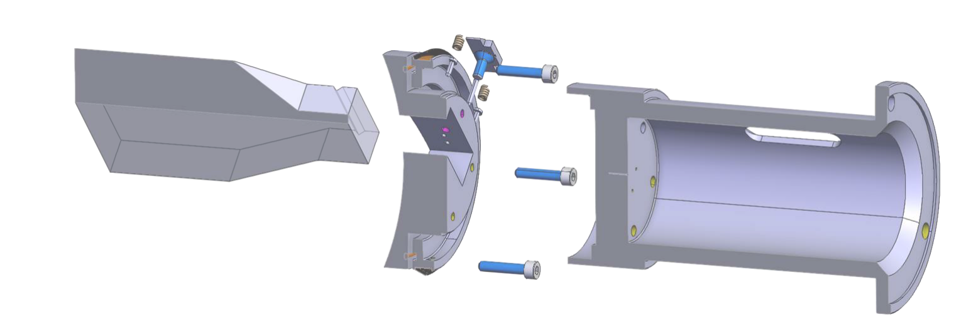
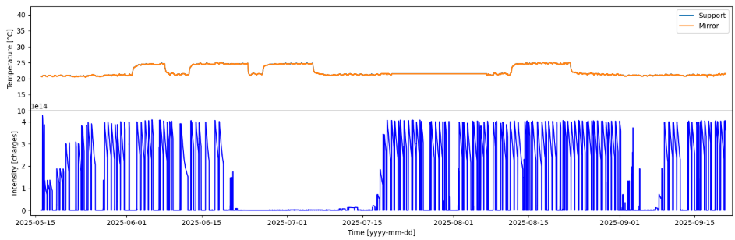
Temperature Measurements
2 probes , in contact with mirror and mirror support
T is correlated to tunnel heating/cooling not to beam power
2025

Slide 19
‘Template’ Questions (I)
Accuracy:
10% accuracy on emittance, after calibration to BWS
Can your technique provide:
1D beam profiles? ✅yes
2D beam images? ✅yes
Fastest acquisition rate:
Bunch per Bunch selection: ✅ yes (via the intensifier gate, typically 20–25 ns, synced to the RF).
Single-turn exposure: technically possible (open the gate once during a camera frame which lasts ~260turns), but not how we usually run because of photon statistics/SNR. In practice we integrate multiple identical gates over successive turns for the same bunch and build one image per frame → more infos in next slide

Slide 20
📑 BSRT Acquisition Parameters
LHC revolution period | 89 µs (≈11.2 kHz)
Component / Item | Parameter | Value | Notes
Image Intensifier (Hamamatsu C14245) | Minimum gate ON | 5 ns | Typical operation 20–25 ns (bunch selection)
 | Maximum repetition rate | 30 kHz (≈33 µs period) | Max gating pulses/s
Camera (Basler acA1920-40gm) | Minimum exposure time | 34 µs (≈29 kHz equiv.) | Shortest possible integration window
 | Maximum frame rate | 42 fps (≈24 ms period) | Full frame (1920×1200); scales with ROI
BSRT acquisition (Run 3) | Injection | ~2 × 8 Hz = 16 Hz (≈62 ms period) | Two frames per bunch, 8 and 16 Hz to have margin on S/N (see also photo budget below) Processing bottleneck (FESA/publishing), not photon statistics
 | Flat-top | ~2 × 13 Hz = 26 Hz (≈38 ms period) → 80sec to meas 2000 bunches
Photon budget (flat-top, UV) | Neutral density filters | ND1/ND2 | Removing filter increases light → higher acquisition rate possible
 | Boost mode (concept) | Higher rate possible | At expense of photocathode lifetime

Slide 21
‘Template' Questions (II)
What is the minimum number of particles needed per bunch?
Works down to pilot intensity (~5×10^9 p/b). Lower also possible at cot of exposure/integration time
Can it measure both protons and ions?
Protons: ✅ (all along cycle)
Ions: ✅ at top energy, ❌ at injection
Does your technique require calibration?
Yes: vs BWS, at least ~2×year. Recent drifts of beam1: more often, as agreed/requested by OP and experiments
Calibration meant to determine both optical magnification and point-spread-function, requires multi points == special fills with different emittances
If beam size at detector increased, would it gain/lose performance?
Larger beams → improved calibration stability and resolution margin

Slide 22
Q&A Summary Table
Template Question | Answer | Comments / Limitations
1D beam profiles? | ✅ Yes | Projection of SR image, calibrated vs BWS
2D beam images? | ✅ Yes | Full SR images, resolution-limited at flat-top
Fastest acquisition rate? | Single-turn, 20 ns gated camera | ~10% accuracy after calibration
Bunch-by-bunch measurements? | ✅ Yes | Integrating multi turns
Turns needed? | 260 | Margin for going faster exists
Minimum particles/bunch? | ~5×10⁹ protons | Below pilot intensity SNR deteriorates
Protons and ions? | Protons ✅ (all cycle), Ions ✅ (top energy), ❌ at injection | No visible SR from ions at injection
All along LHC cycle? | Protons: OK except ramp; Ions: not at injection | Ramp: strong SR source variation
Calibration required? | ✅ Yes, vs BWS (~2×/year) | Drift at flat-top due to optical ageing
Effect of larger beam size? | ✅ Gain | Improved calibration stability and resolution margin

Slide 23
Summary & Outlook (I)
Operational Experience (also profiting of Sofia’s talk)
BSR has proven essential for routine beam profile/emittance and beam quality monitoring since Run 1
High availability and reliability, with only rare interruptions per year.
Successfully used for tail characterization and advanced beam studies (q-Gaussian fits)
Performance
Absolute calibration to BWS within ~10% accuracy
Robust bunch-by-bunch profiles at injection and flat-top
Optical resolution limited at flat-top (~200 µm), but adequate for HL-LHC beams
Ion operation: no signal at injection

Slide 24
Summary & Outlook (II)
Issues & Risks
Optical ageing and calibration drifts at flat-top → mitigated by regular BWS reference scans
If drifts confirmed to be dominated by UV optical components:
Is re-designing flat top BSR optics for visible an option ?
Radiation effects (SEUs, optics damage) → watchdogs, rad-tolerant boxes, and spares strategy
Heating risk from beam coupling impedance → ruled out with redesigned dielectric mirrors and continuous temperature monitoring – re-checks ongoing
HL-LHC Outlook
Present BSRTM line remains operational and compatible with HL-LHC beams
BSRTMB line (HL-LHC deliverable) enables beam halo diagnostics and potential for redundancy at flat-top
Regular BWS calibration campaigns will remain crucial for accuracy
Long-term consumables (intensifiers, cameras, optics) require continued replacement strategy (exploitation budget)
System remains a key non-invasive diagnostic for HL-LHC, with expanded role in halo monitoring and advanced profile characterization

Slide 25
SPARE

Slide 26
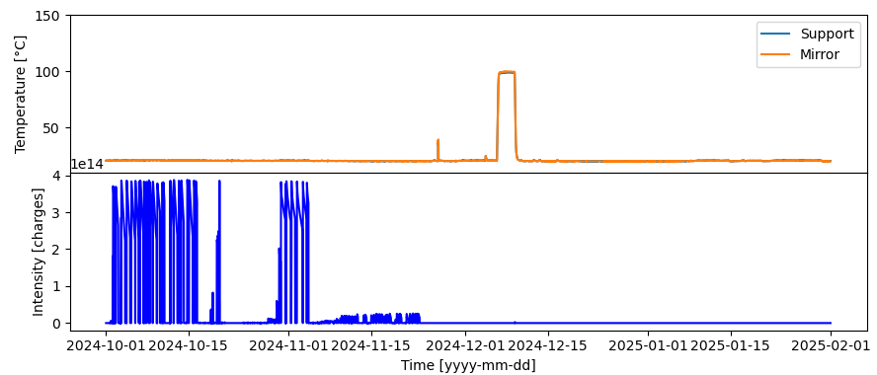

Slide 27
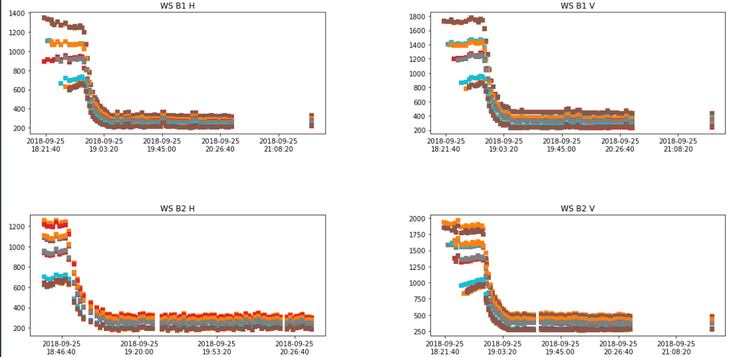

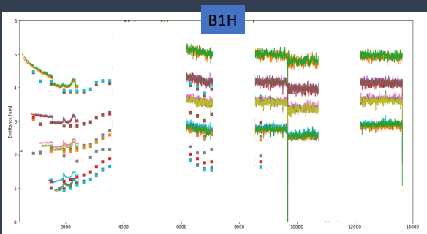
BSRT Calibration

Slide 28
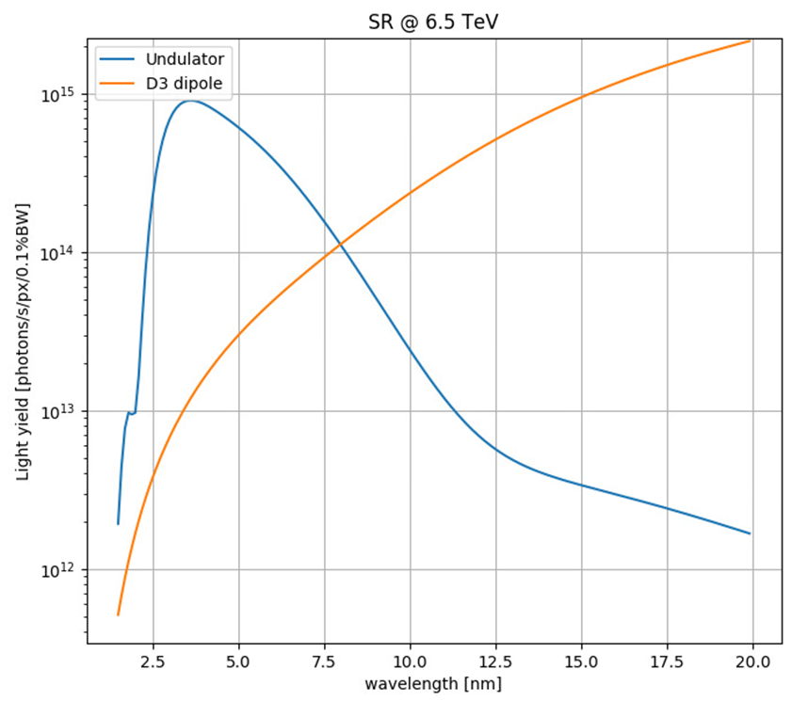
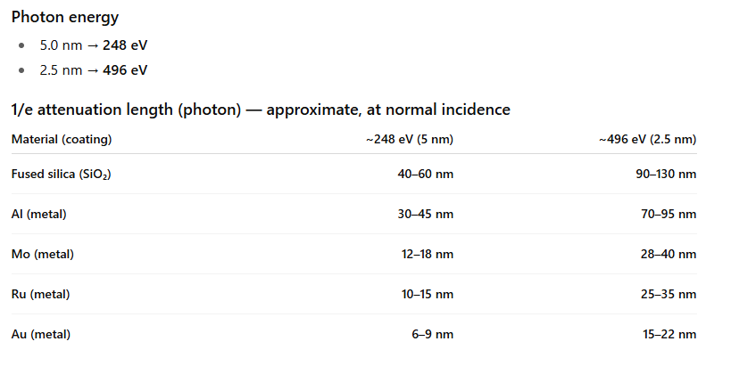
SR spectra and x-ray absorption length

Slide 29
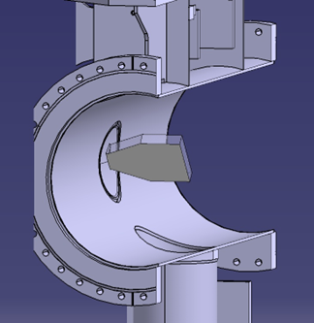
BSRTM

