Slide 1
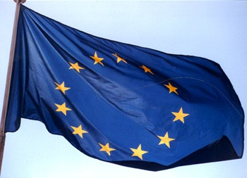
Accelerator R&D
ESPG
R. Aleksan
November 28th, 2011
Introduction
Accelerator Science and Technology
Conclusion

Slide 2
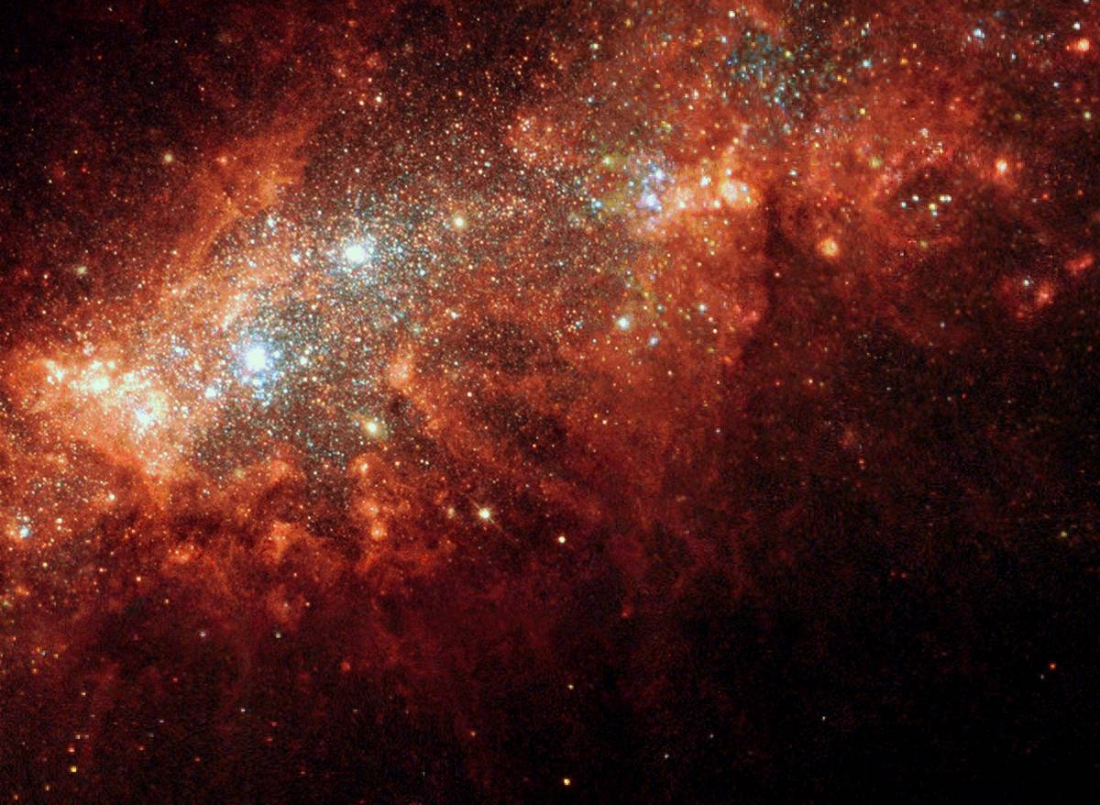
Unraveling the fundamental mysteries of the universe requires
State of the art accelerators
These accelerators have to address different challenges
“Energy Frontier” i.e. reaching ever higher energy
“Intensity/Power Frontier” i.e. delivering ever higher luminosity
“Probes Diversity” i.e. accelerating many different probes
State of the art accelerator technology, instrumentation
and test facilities are needed
Note: These infrastructures and technology can be useful (vital)
to many research fields, as well as for industrial developments

Slide 3
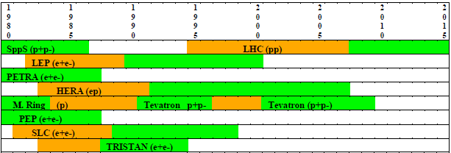
Energy Frontier Accelerators

Slide 4
To be able to build future accelerators, a strong
sustainable R&D program is indispensible
Exploratory R&D
Assessment of new ideas
Demonstration of conceptual feasibility of new and innovative principles
Targeted R&D
Demonstration of the Technical feasibility of all critical components
Demonstration of the feasibility of fully engineered system
Industrialization R&D
Transfer of technology
Large scale production and cost optimization
Diversification of Applications
It includes 3 levels of R&D
No planned facility exist
e.g. Plasma
acceleration
e.g. CTF3,
20T magnet
e.g. High Yield
production of
SC 35 MV/m
cavities

Slide 5
Accelerator Science and Technology
Topic to be discussed in Accelerator Science and Technology section :
Accelerator R&D and infrastructures needed
  for allowing one to realize the new (or upgrade of) accelerator facilities
  with their respective parameters required by Physics
  for developing new concepts/technologies
Each of these specific facilities should be identified in the corresponding
Physics section, including their main characteristics
In AS&T section:
For each discussed facilities and new concept/technology
Identification of the Key Accelerator Research Area (KARA)
Identification of related needed major « sub-infrastructures », if relevant
Assessment of State of Development (possibly with a schedule)
Assessment of Remaining Major Issue
Each of the specific facilities have to identify a contact person for
“ accelerator science and technology”, in charge of corresponding subsection

Slide 6
Accelerator Science and Technology
Proposed subsections
Energy Frontier Challenges
Intensity Frontier Challenges
Organization of Accelerator R&D for HEP in Europe
  Accelerator R&D coordination and collaborative programmes
  Education and Training
  Relation with industry
  Synergies with other fields of science
  Applications to societal Challenges
Example for Energy Frontier Challenges
Introduction
High Energy Hadron Colliders (incl. ions)
  LHC (14 TeV)
  HL-LHC
  HE-LHC (or VLHC?)
High Energy Lepton Colliders
  ILC
  CLIC
  Muon Collider
  Plasma accelerators
High Energy Hadron(ion)-Lepton Collider
  eRHIC?
  LHeC
Example for Intensity Frontier Challenges
Introduction
High Intensity ν facilities
  Super-beams
  β-Beams
  ν-Factories
High luminosity Flavor factories
  φ-Factories
  τ/c-factories
  B-Factories
High intensity single beams
  e, μ, K, p(pbar),n -beams

Slide 7
Accelerator Science and Technology
Other source of inputs (whenever not available from (or complementary to)
organized facility projects)
ESGARD committee (i.e. EU Accelerator R&D projects…)
TIARA :
  general KARA document already exists
  Several surveys to come
    Education&Training in accelerator science and technology
    Accelerator R&D infrastructures
Interview of selected key people (could be done jointly with other sections)
  From US (DoE(HEPAP)? and/or FNAL?)
  From Asia (ACFA? and/or KEK?)
Written contributions from the community
Essential that
I am the NOT the only responsible person in the PG for AS&T section!
We can form a committee with the contact people for editing the
Briefing Book section on AS&T

Slide 8

ESGARD developed and implemented a strategy to promote Accelerator R&D
with the incentive of the EC Framework Programme within ERA
 | 2003 |  | 2004 | 2005 | 2006 | 2007 | 2008 |  | 2009 |  | 2010 | 2011 |  | 2012 |  | 2013 | 2014 | 2105
Accelerator R&D
CARE |  | 3 Networks (e, ν, p) |  |  |  |  |  |  | EuCARD
CARE |  | SRF |  |  |  |  |  |  | EuCARD (SRF)
CARE |  | PHIN |  |  |  |  |  |  | EuCARD (SRF, ANAC)
CARE |  |  |  | HIPPI |  |  |  |  | EuCARD (SRF, ColMat)
CARE |  |  |  | NED |  |  |  |  | EuCARD (HFM)
HL-LHC |  |  |  |  |  |  | SLHC-PP |  |  |  |  |  | HiLumi
EUROTEV |  |  |  | DS: ILC+CLIC |  |  | ILC-HiGrade (PP)
EURISOL |  |  |  | DS: Neutrino β-beam
DS νFact |  |  |  | Scoping study |  |  |  | DS-EuroNu
EUROLEAP |  |  |  |  | e in plasma
SuperB
TIARA |  |  |  |  |  |  |  |  |  |  |  | R&D-RI & program
FP6
FP7
EuCARD (ANAC)
EuCARD (ANAC)
Altogether EC has partially financed projects in FP6 and FP7
with a total budget of ~197 M€ (60 M€ from EC)

Slide 9
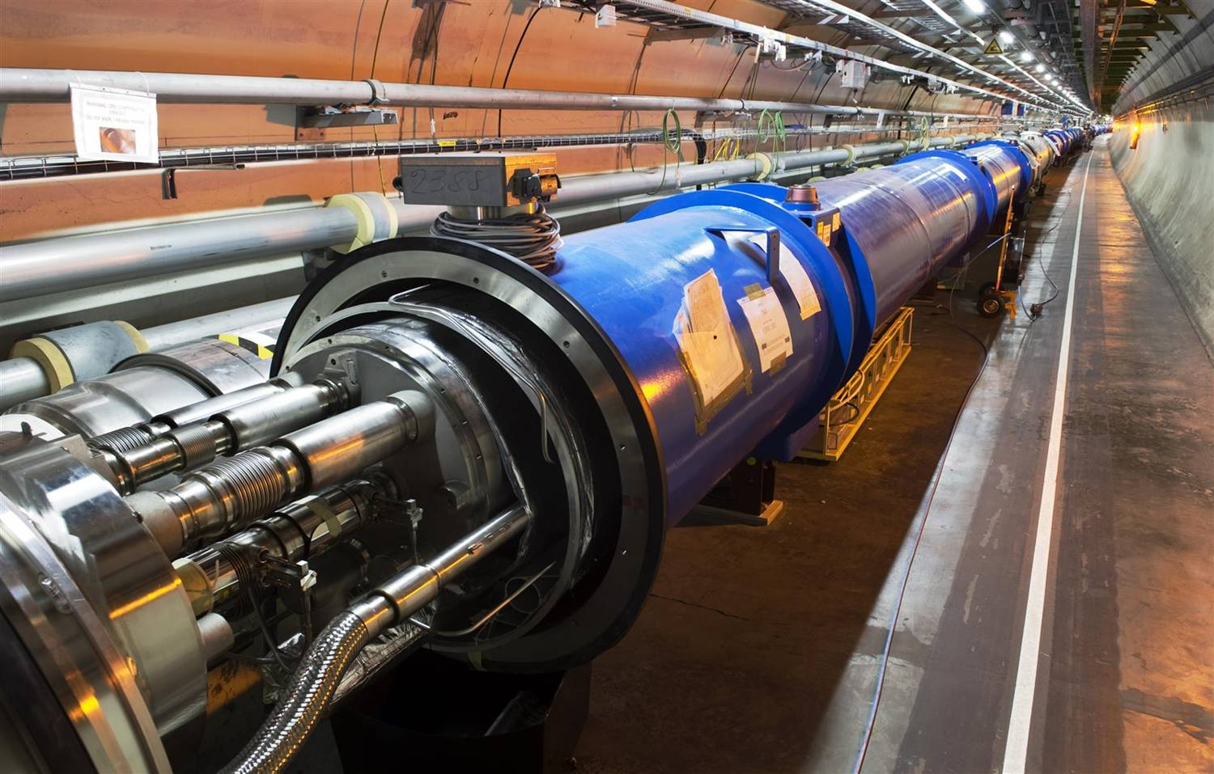
The use of Accelerators: much beyond HEP
The development of state of the art accelerators is essential for many many fields of science (fundamental, applied or industrial)
Research accelerators
Particle Physics, Nuclear Physics, Research fields using light source, Research fields using spallation neutron sources, Study of material for fusion, Study of transmutation…
In past 50 years, about 1/3 of Physics Nobel Prizes are rewarding work based on or carried out with accelerators
This « market » represents ~15 000 M€ for the next 15 years, i.e. ~1 000M€/year
Clinical accelerators
radiotherapy, electron therapy,
hadron (proton/ion)therapy…
Industrial accelerators
ion implanters, electron beam and X-ray irradiators, radioisotope production…
This market represents ~3 000M€/year and is increasing at a rate of ~10% /year

Slide 10
The use of Accelerators
Examples
projects | Science field | Beam type | Estimated cost
LHC | Particle Physics | proton | 3700M€
FAIR | Nuclear Physics | Proton /ion | 1200M€
XFEL | multi fields | electron aphoton | 1100M€
ESS | multi fields | Proton aneutron | 1450M$
IFMIF | Fusion | Deuton aneutron | 1000M€
MYRRHA | Transmutation | Proton aneutron | 700M€
In past 50 years, about 1/3 of Physics Nobel Prizes are rewarding
work based on or carried out with accelerators
This « market » represents ~15 000 M€ for the next 15 years, i.e.
~1 000M€/year

Slide 11
Clinical accelerators
Industrial accelerators
radiotherapy
electron therapy
hadron (proton/ion)therapy
ion implanters
electron cutting&welding
electron beam and X-ray irradiators
radioisotope production
…
Application | Total systems (2007) approx. | System sold/yr | Sales/yr ($M) | System price ($M)
Cancer Therapy | 9100 | 500 | 1800 | 2.0 - 5.0
Ion Implantation | 9500 | 500 | 1400 | 1.5 - 2.5
Electron cutting and welding | 4500 | 100 | 150 | 0.5 - 2.5
Electron beam and X-ray irradiators | 2000 | 75 | 130 | 0.2 - 8.0
Radioisotope production (incl. PET) | 550 | 50 | 70 | 1.0 - 30
Non-destructive testing (incl. security) | 650 | 100 | 70 | 0.3 - 2.0
Ion beam analysis (incl. AMS) | 200 | 25 | 30 | 0.4 - 1.5
Neutron generators (incl. sealed tubes) | 1000 | 50 | 30 | 0.1 - 3.0
Total | 27500 | 1400 | 3680
Courtesy: R. Hamm
Total accelerators sales increasing more than 10% per year

