Slide 1
MQXFB11 Coils:
Coil fabrication, manufacturing data and NC
N. Lusa, S. Izquierdo Bermudez, L. Baudin, A. Vieitez Suarez, J. M. Haack, L. Grand-Clement, R. Berthet
On behalf of MQXFB Coil Fabrication and QA team
https://indico.cern.ch/event/1585462/
17/09/2025

Slide 2
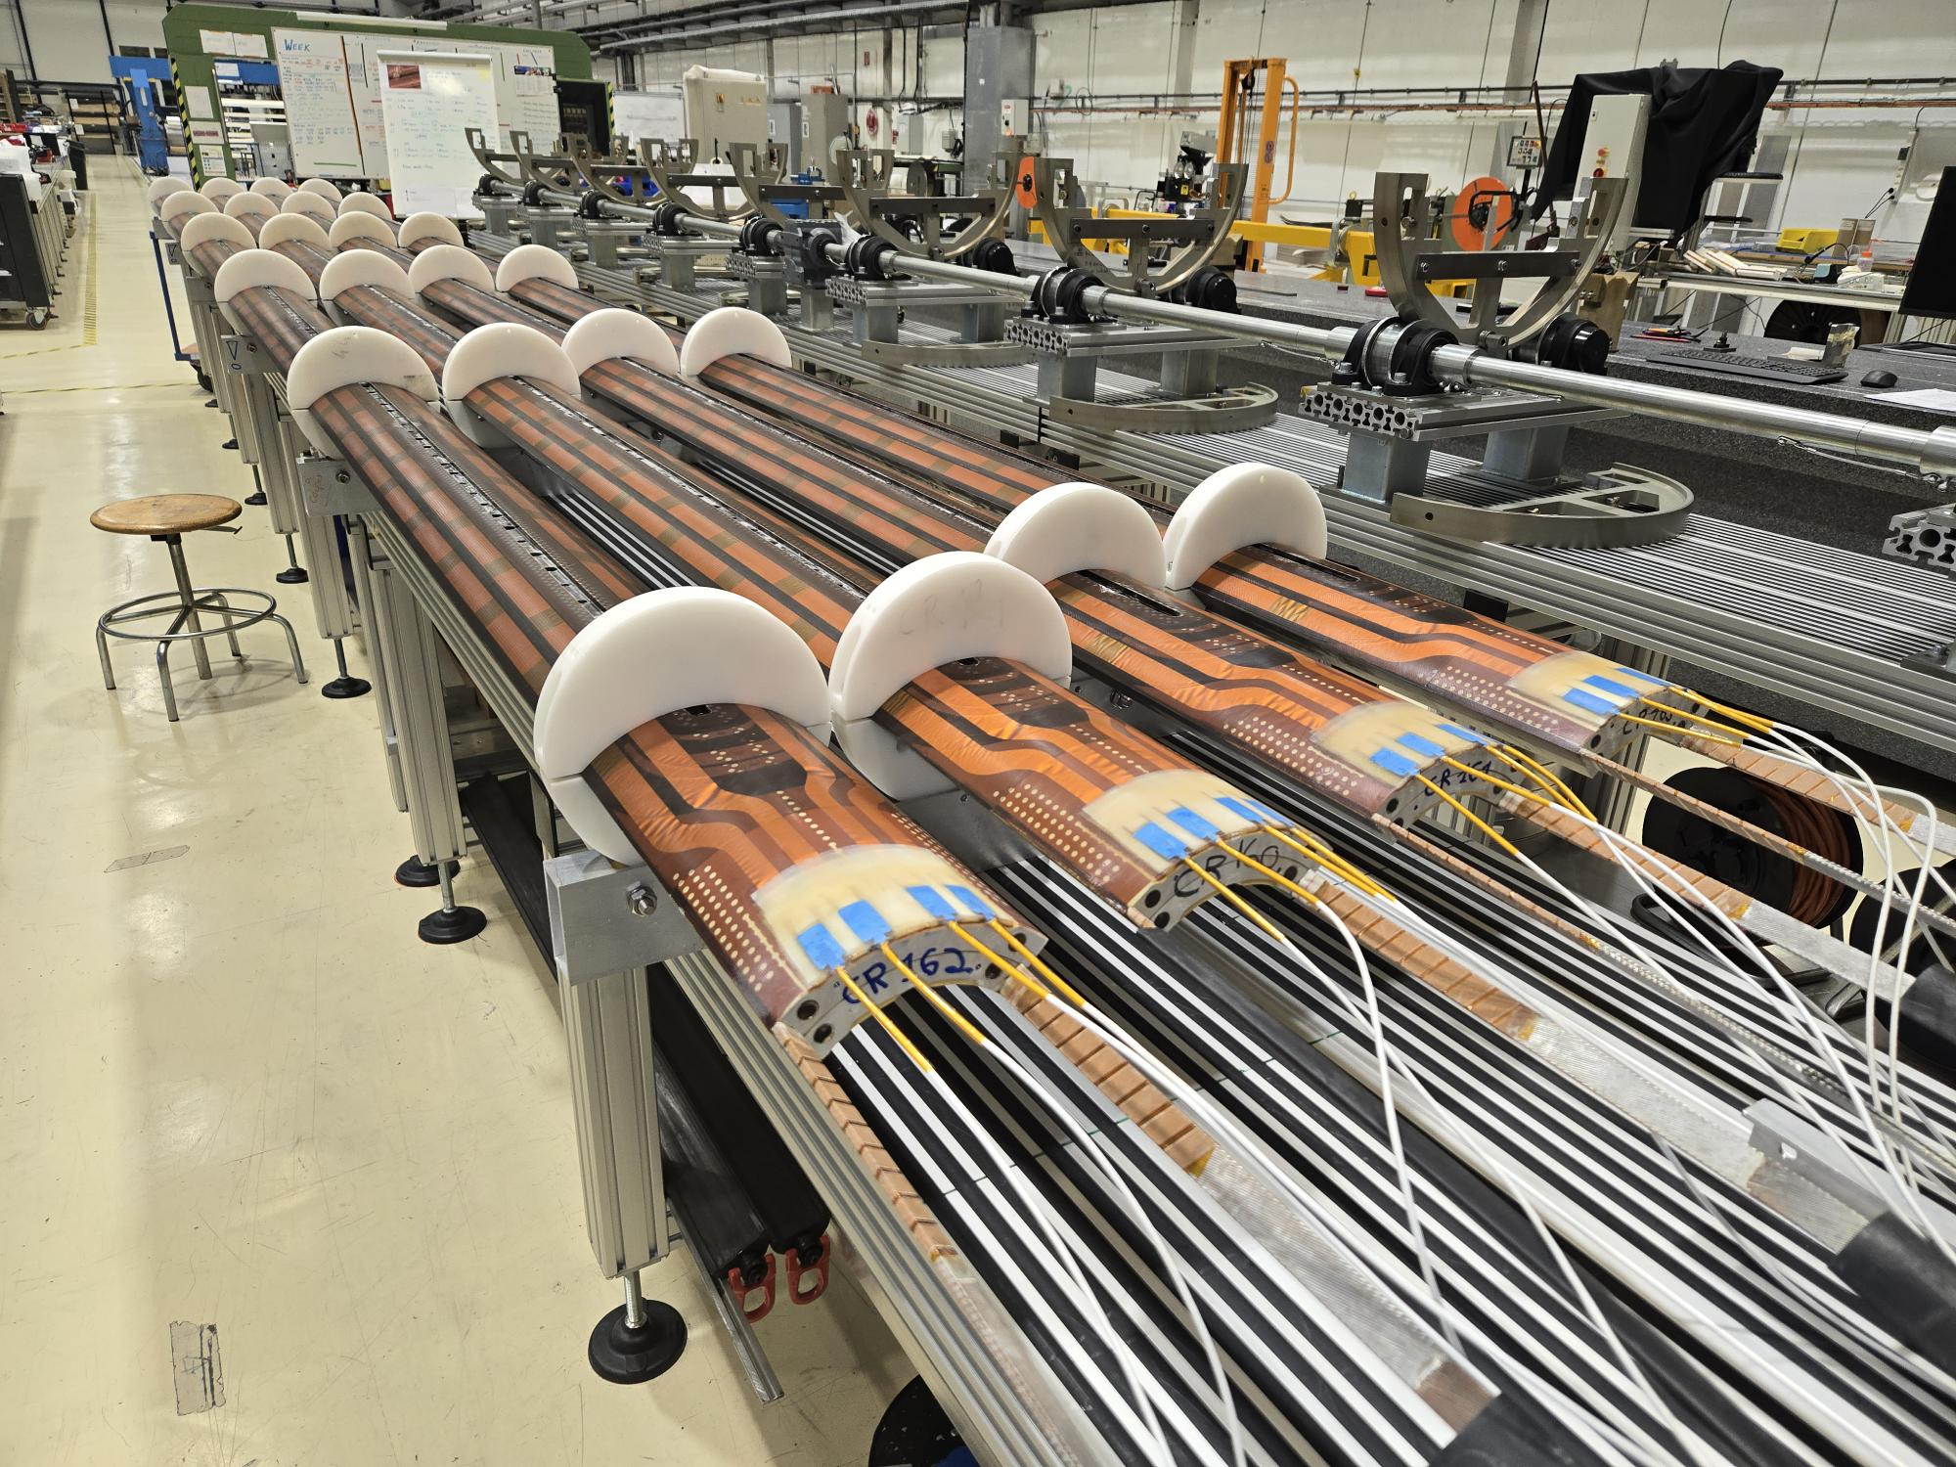
Coils for MQXFB10
Virgin coils available at the time of assembling MQXFB11
  Coil 109: Spare coil of MQXFBP1 (no b₆ correction)
  Coil 114: Quarantined, due to the electrical insulation issue QH to coil
  Coil 116: Quarantined, due to conductor damage during handling
  Coil 122: Conform previous generation coil
  Coils 160-161-162-163: proposal for MQXFB11

Slide 3
Outline
Manufacturing data
Non-conformities
Conclusion/Proposal

Slide 4
Outline
Manufacturing data
  Analysis of MQXFBP2 coils and comparison improvements with respect to MQXFBP1 available here
  Analysis of MQXFBP3 coils and comparison improvements with respect to MQXFBP2 available here
  Analysis of MQXFB02 coils and comparison improvements with respect to MQXFBP3 available here
  Analysis of MQXFB03 coils and comparison improvements with respect to MQXFB02 available here
  Coil fabrication data and non-conformities of MQXFB04 coils available here
  Coil fabrication data and non-conformities of MQXFB05 coils available here
  Coil fabrication data and non-conformities of MQXFB06 coils available here
  Coil fabrication data and non-conformities of MQXFB07 coils available here
  Coil fabrication data and non-conformities of MQXFB08 coils available here
  Coil fabrication data and non-conformities of MQXFB09 coils available here
  Coil fabrication data and non-conformities of MQXFB10 coils available here
Non-conformities
Conclusion/Proposal

Slide 5
Cable insulation thickness
Target insulation thickness is 145 (+0 µm/-10 µm)
Fine tuning insulation thickness

Slide 6
Coil elongation during reaction fixture opening
Coil elongation during reaction fixture opening
Magnet | Coil # | CS [mm] | NCS [mm] | Total [mm] | Total/L_{m} | Fab. Line
B03 | CR128, 129, 130, 131 | 2.6 - 4.2 | 3.1 - 4.8 | 5.7 - 8.7 | 0.8 - 1.2 ‰ | CERN
B04 | CR132, 133, 134, 135 | 2.1 - 4.3 | 2.9 - 3.8 | 5.1 - 8.0 | 0.7 - 1.1 ‰
B05 | CR136, 137, 139, 140 | 2.0 - 3.4 | 2.1 - 3.6 | 4.1 - 7.0 | 0.6 - 1.0 ‰
B06 | CR141, 142, 143, 144 | 2.9 - 3.4 | 2.8 - 3.7 | 5.8 - 6.6 | 0.8 - 0.9 ‰
B07 | CR138, 145, 146, 147 | 2.0 - 3.4 | 2.6 - 3.5 | 4.6 - 6.9 | 0.6 - 1.0 ‰
B08 | CR148, 149, 150, 151 | 1.6 - 2.8 | 2.0 - 2.9 | 3.6 - 5.6 | 0.5 - 0.8 ‰
B09 | CR152, 153, 154, 155 | 2.3 - 2.9 | 2.3 - 3.3 | 4.6 - 6.2 | 0.6 - 0.9 ‰
B10 | CR156, 157, 158, 159 | 2.0 - 2.7 | 2.2 - 3.5 | 4.5 - 6.2 | 0.6 - 0.9 ‰
B11 (proposal) | CR160 | 2.6 | 2.7 | 5.3 | 0.7 ‰
 | CR161 | 1.6 | 2.0 | 3.6 | 0.5 ‰
 | CR162 | 2.5 | 3.1 | 5.6 | 0.8 ‰
 | CR163 | 2.3 | 2.4 | 4.7 | 0.6 ‰
 | AUP 146 -147 | 2.9 - 3.6 | 0.6 - 0.4 | 3.6 - 4 | 0.8 ‰ - 0.9 ‰ | FNAL
 | AUP 237 -238 | 1.6 - 2.1 | 1.6 - 2.1 | 3.1 - 4.1 | 0.7 ‰ - 1 ‰ | BNL

Slide 7
Pole gaps
RE
LE
In new generation MQXFB coils pole gaps in the middle of the coil are not closed after reaction, as it is the case for AUP coils
Pole gap
1.5 mm
Pole gap
1.1 mm
Pole gap
1.2 mm

Slide 8
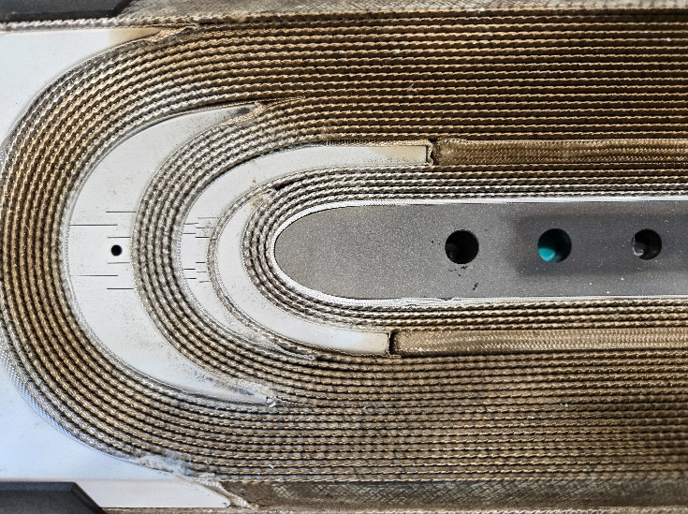
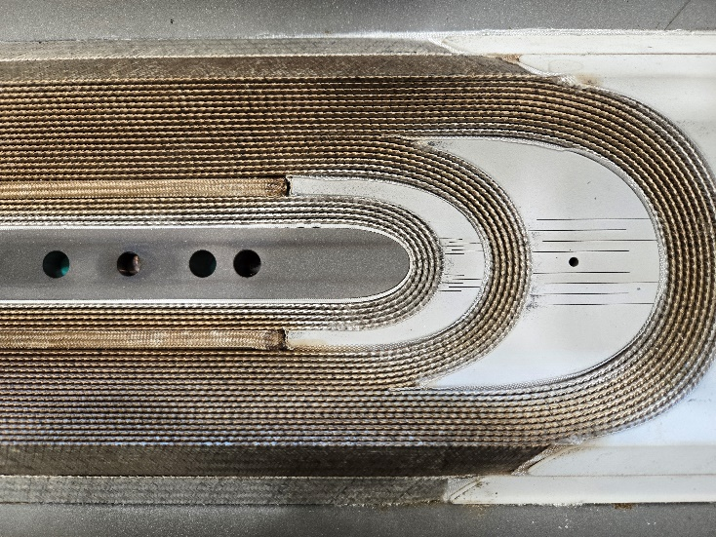
End spacers-copper wedges gaps
Starting from coil CR152, a new measurement is performed prior to prepare the IL of the reacted coil for impregnation: the gap between the copper wedges and the end spacers
The measurement is performed using a digital caliper and the result is the average of 3 measurements
LE OLJ
RE OLJ
LE LJ
RE LJ

Slide 9
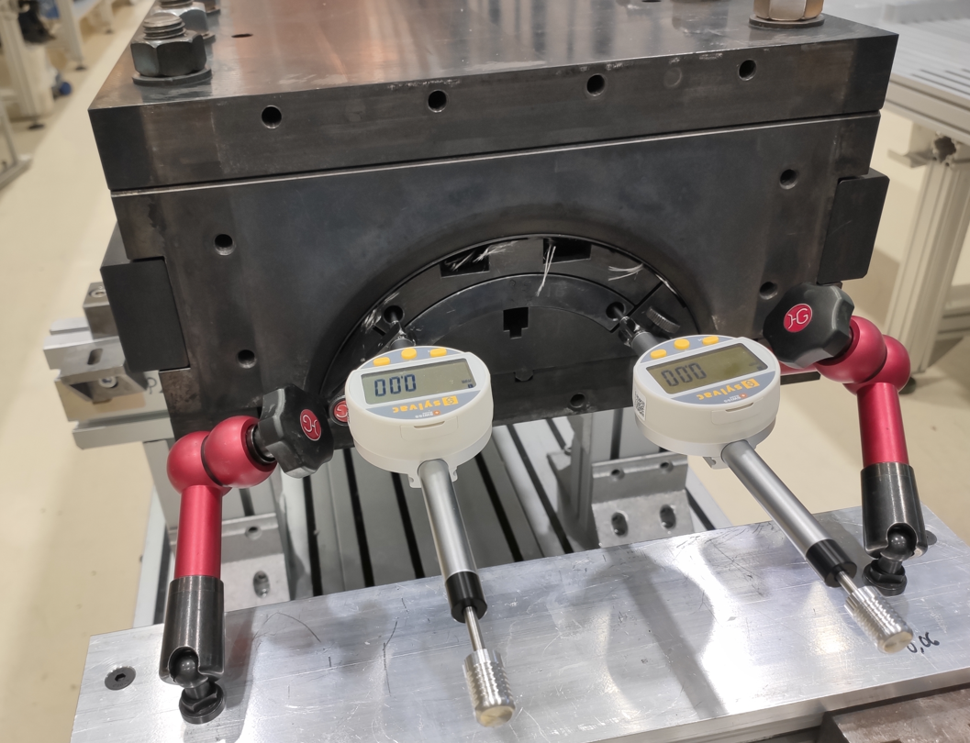
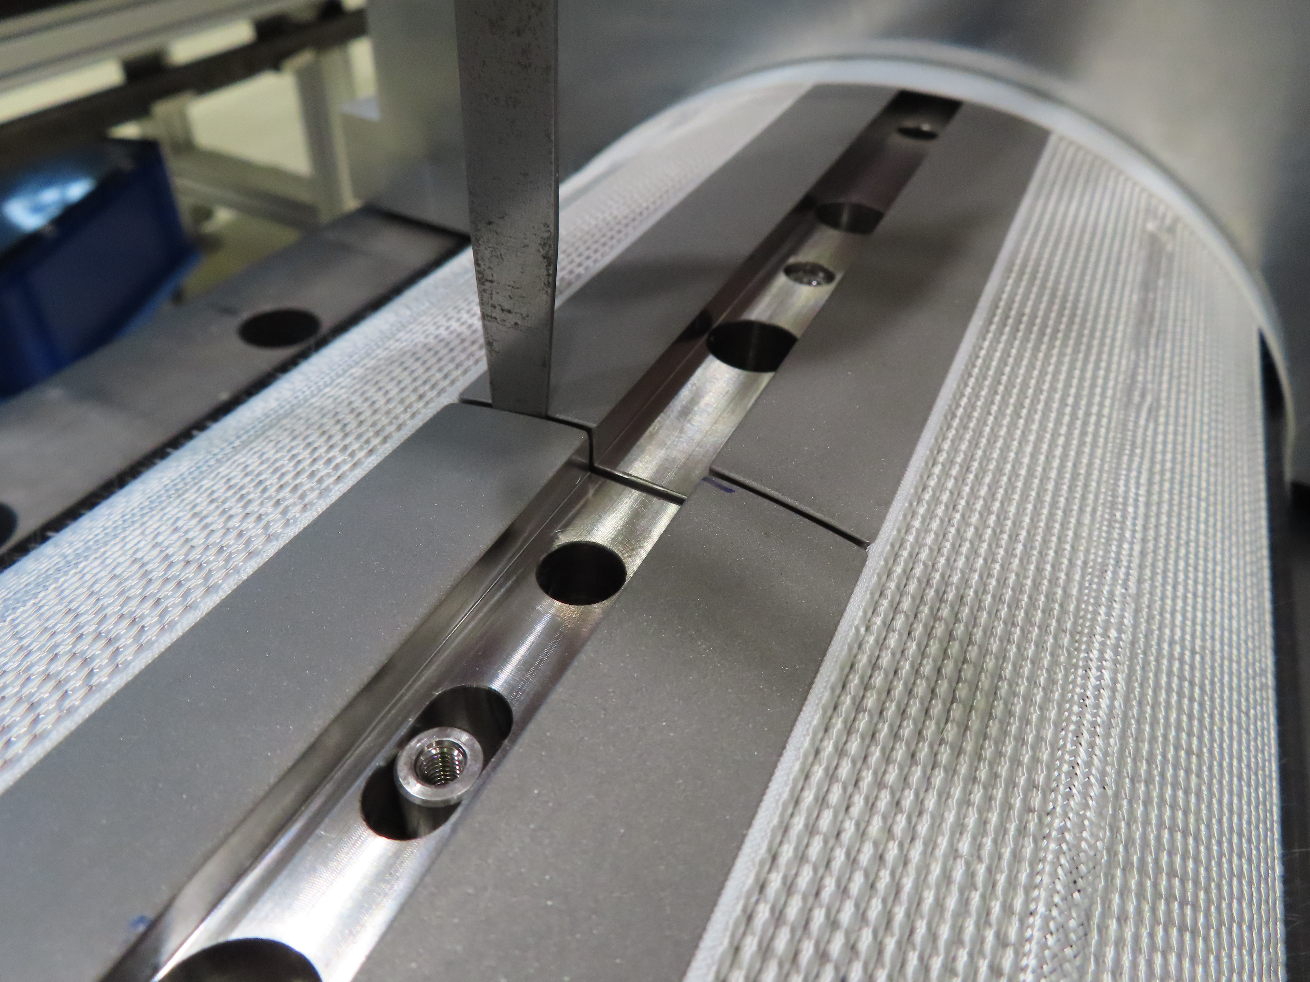
Pole gaps vs Coil elongation
The reacted coil gradually elongates on both ends during the mold opening and pole gap increases (indico 1220226)
From coil CR150 pole increased: 2.46 mm/m → 2.69 mm/m
Coil # | Total /L_{m} [‰] | Manufacturing line
CR127 | 1.50 | CERN w/ binder
CR128 – CR163 | 0.79 | CERN new gen. coils
AUP 146 – 147 | 0.89 | FNAL
AUP 237 – 238 | 0.88 | BNL

Slide 10
Coil hump after reaction

Slide 11
Impregnated coil geometry (Faro arm) - L+R

Slide 12
Impregnated coil geometry (Faro arm) - L+R
The coils do not have ‘belly’

Slide 13
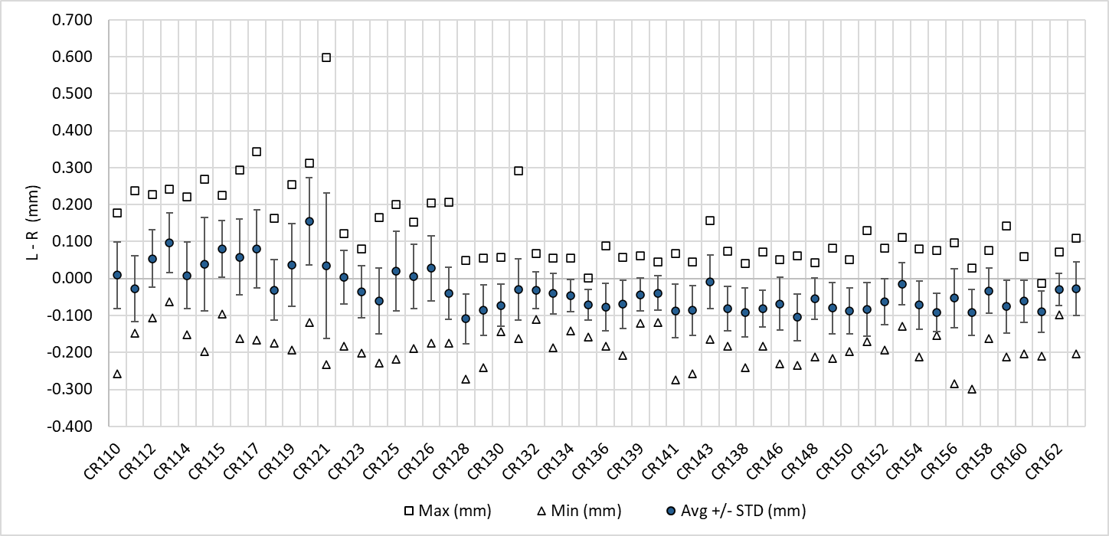
Impregnated coil geometry (Faro arm) – L-R
In terms of asymmetry, within specification (<0.3 mm) → no need of pole key machining

Slide 14
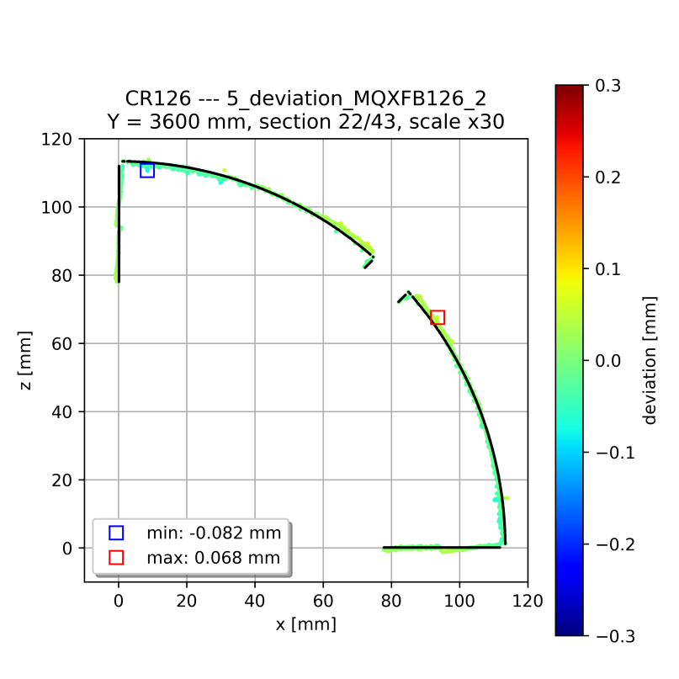
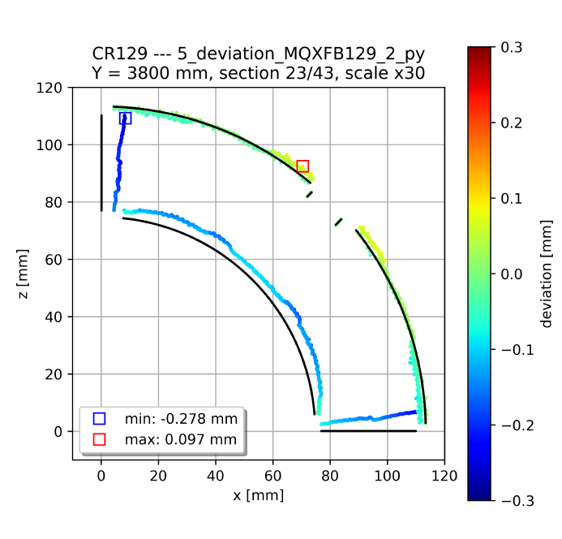
Impregnated coil geometry (Faro arm)
Systematic behavior in terms of coil shape to previous coils without binder: mid-plane has a little ‘wedge’ (the coil covers 89.6 degrees instead of 90 degrees)
Based on FEM we expect ≈ 15 MPa increase in the mid-plane stress (inner edge) under conservative assumptions, confirmed with a mock-up test, see https://indico.cern.ch/event/1260584/
Typical cross-section standard coil
Typical cross-section coil without binder in the OL

Slide 15
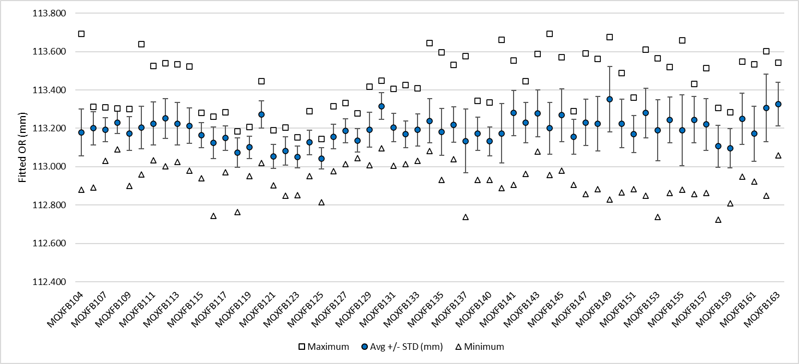
Impregnated coil geometry (Faro arm) - OR

Slide 16
Final coil length
B03
Pole gap change: 1.5 mm → 1.1 mm
Pole gap change:
1.1 mm → 1.2 mm
B04
B09
B05
B07
B08
B06
B10
B11 proposal

Slide 17
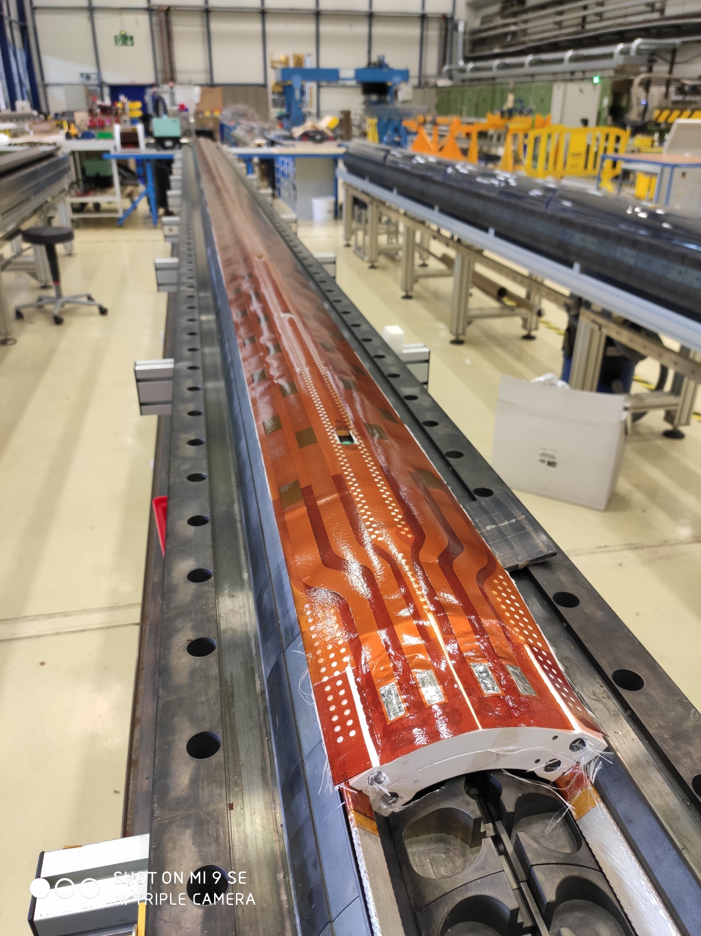
Dielectric strength
Coil to pole
Since coil 114, coil to pole insulation always above the minimum desired thanks to the reduction of ceramic binder and the use of heat cleaned fiber glass around the pole
QH to coil
From coil 126, ‘mini-swap’ quench heaters with improved fabrication process and higher qualification test voltages (see EDMS 2646046)
  From production performance monitoring plots EDMS 2374351

Slide 18
Dielectric strength

Slide 19
Outline
Manufacturing data
Non-conformities
Conclusion/Proposal

Slide 20
Analysis of non-conformities
CR160 | 3287144 | IR1 Spacer coating damaged | 1
 | 2884016 | Dwell3 homogeneity out of range | 1
 | 3303248 | Pairing issue between shims and mould during the preparation for impregnation | 1
 | 3309424 | Impregnation defect repair | 1
CR161 | 2884016 | Dwell3 homogeneity out of range | 1
 | 3316609 | Impregnation defect repair | 1
CR162 | 3307049 | Issue with the deformation slits of OR3 spacer after curing | 1
 | 3315433 | Unforeseen position of a pole key groove during reaction | 1
CR163 | 3316613 | Inner layer coil lead damaged | 3
 | 2884016 | Dwell3 homogeneity out of range | 1
 | 3342393 | Impregnation defect repair | 1
Very minor, not described in further detail in the slides
Described in detail in the next slides
Series of minor nonconformities in heat treatment, see next slides

Slide 21
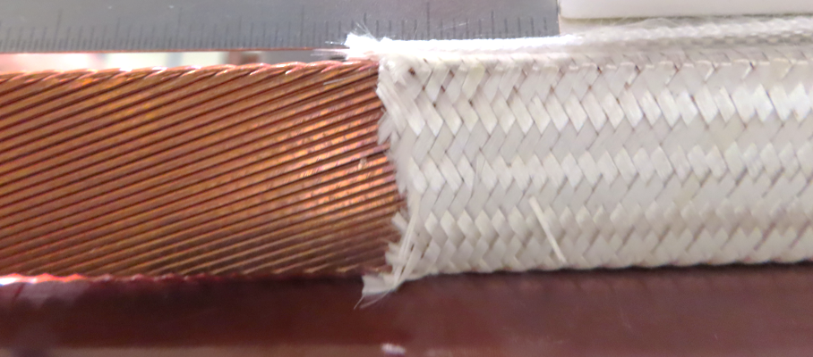
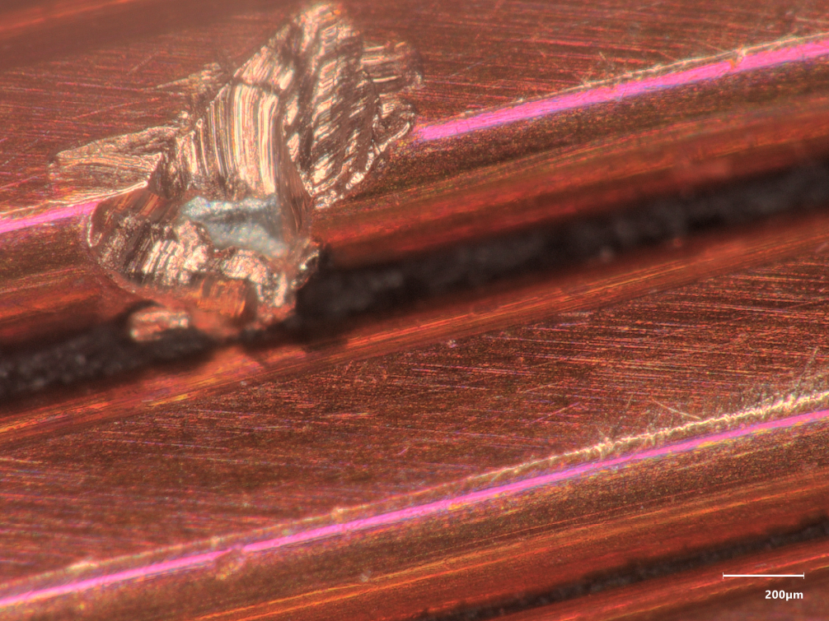
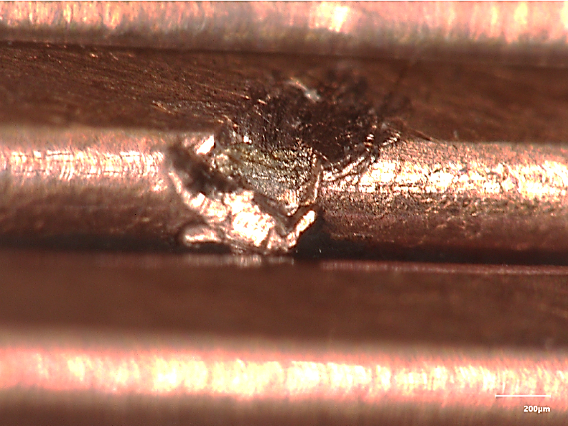
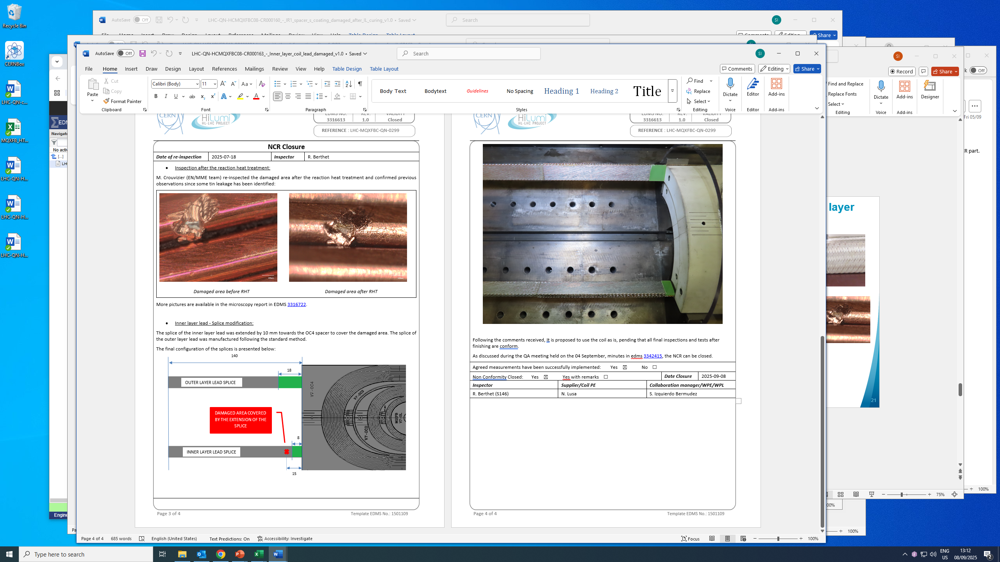
CR163: Conductor damage in the inner layer lead (NCR 3316613)
During the removal of the stainless-steel core, one superconducting strand was locally damaged
Even if the local damages was not severe, the splice Nb₃Sn-NbTi was moved towards the end spacer to cover the defect (from 18mm to roughly 10 to 12 mm)
Before RHT
After RHT

Slide 22
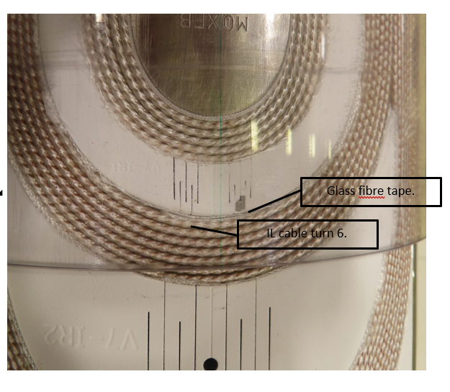
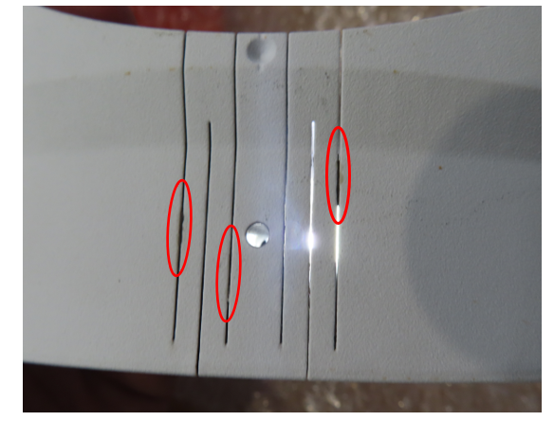
Coating of end spacers
CR160 – IR1 spacer's coating damaged after IL curing (3287144)
Use as is (insulation coil to spacer is not compromised)
CR162 – Dirt on slits detected after curing (3307049)
End part replaced after curing

Slide 23
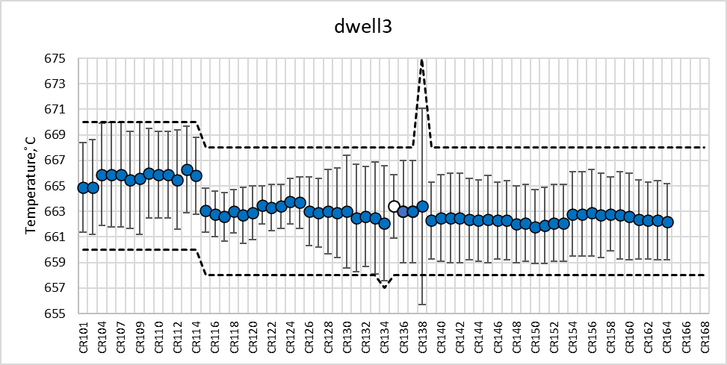
RHT NCR – dwell3
Homogeneity in dwell3 slightly above the +- 3°C stablished limit
Coil ID | ∆t [h] | Target [◦C] | Allowed Band [◦C] |  | max T [◦C] prec | mean | T [◦C] | mean H/2 [◦C] | mean Hasm/2 [◦C]
CR160 | 50.85 | 663 | 658 | 668 | n.a. | 662.6 | 3.4 | 3.2
CR161 | 51.07 | 663 | 658 | 668 | n.a. | 662.4 | 3.1 | 2.9
CR162 | 50.83 | 663 | 658 | 668 | n.a. | 662.3 | 3 | 2.8
CR163 | 50.93 | 663 | 658 | 668 | n.a. | 662.3 | 3.1 | 2.9

Slide 24
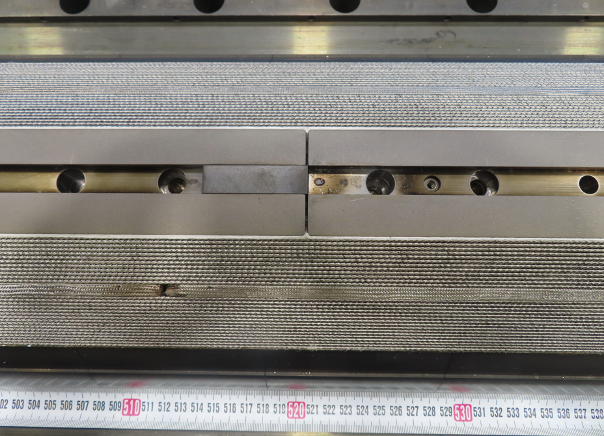
CR162 – unforeseen position of a pole key groove during reaction NCR 3315433)
The pole key groove, located at 520cm from LE side(between pole part n°12 and pole part n°13), was found completely displaced on the part n°12 instead of being positioned at the junction between pole part n°12 and pole part n°13
The mis-alignment was introduced during the preparation for reaction, no indication of any anomaly during reaction or risk of conductor damage.

Slide 25
CR160: Pairing issue between shims and mould during the preparation for impregnation (NCR 3303248)
Impregnation mould was closed at the first tightening pass at 60 Nm
  Typically, the mould closes at the 2nd tightening pass at 80 Nm
After checking the PFA coated metallic shims in contact with the midplane, it was noticed that there was a mismatch between the shim’s identifier (id: 16XXXX) and the rest of the impregnation mould (id: 15XXXX).
The mould was open and the shim was replaced by the correct one (15XXXX).

Slide 26
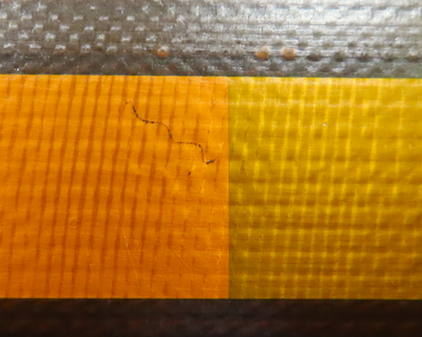
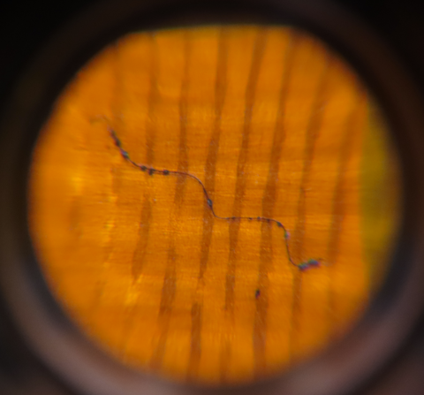
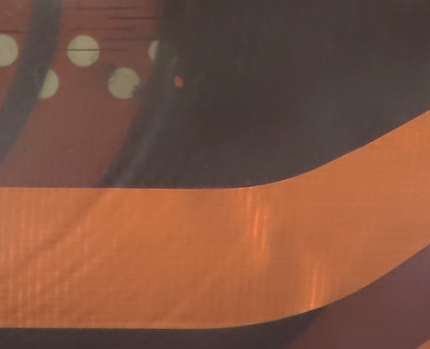
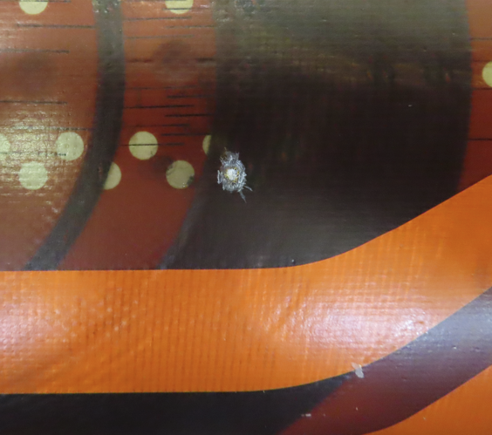
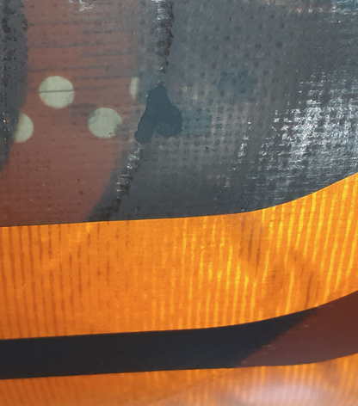
Impregnation defects repair
CR160: 3309424
Defect after impregnation (non metallic trapped particle)
Very superficial, slight scratch of the surface was enough to remove it
CR161: 3316609
Defect after impregnation (not clear if trapped particle).
After scraping the surface, it was concluded it was dry spot
Repaired with Stycast 2850 FT + 23LV

Slide 27
Outline
Manufacturing data
Non-conformities
Conclusion/Proposal

Slide 28
Conclusion/Proposal
Use CR160 - CR161 - CR162 - CR163 for MQXFB11 assembly
The coil instrumentation has begun this week, and the magnet loading is planned for the second half of October

Slide 29
Thank you!

