Slide 1

Coil Order Optimization for MQXFB11 regarding Voltage-to-Ground & Hotspot Temperature (CR160 – CR163)
E. Ravaioli & D. Pracht (CERN)
Thanks to:
S. Hopkins, S. Izquierdo Bermudez, A. Verweij
17th of September 2025

Slide 2
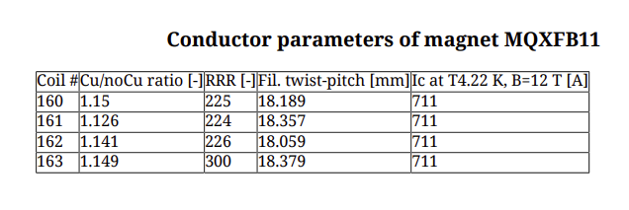
Introduction & Conductor Parameters
4 candidate coils: #160–#163 with
Coil #163 stands out: RRR = 300 vs. ~225 for others.
Simulated with nominal current of I_nom = 16230 A
Different coil order combinations simulated with and w/o different failure scenarios
Conductor Parameters kindly provided by Simon Hopkins

Slide 3
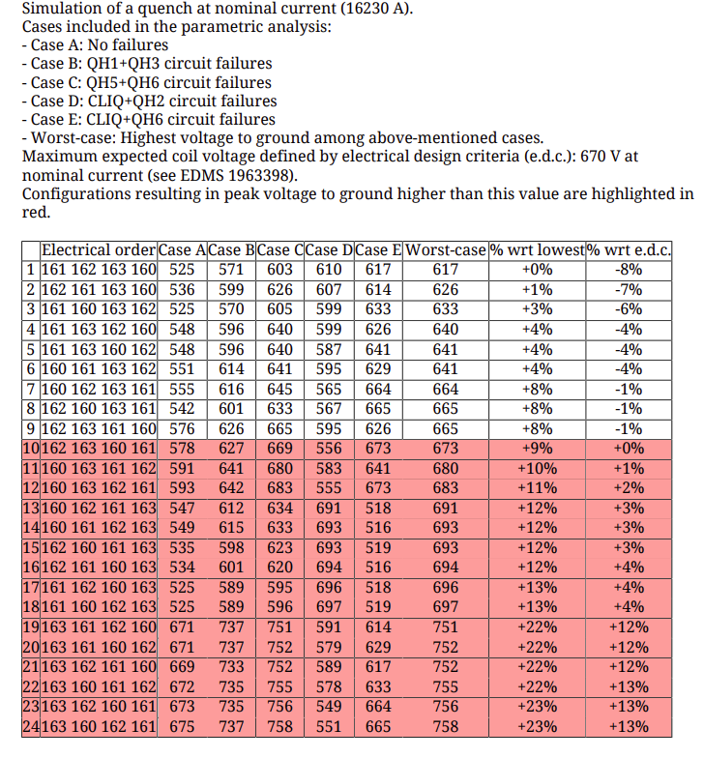
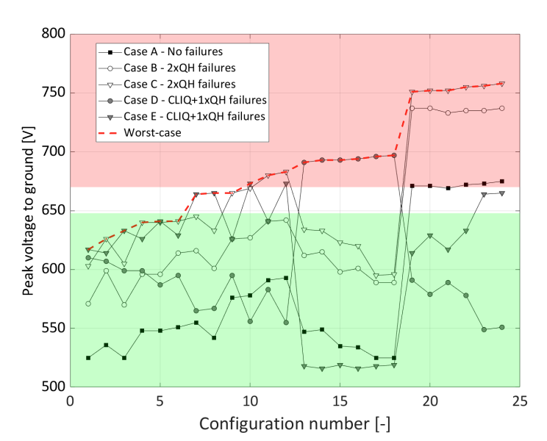
Simulated Peak Voltage to Ground
Design criterion: 670 V max, considering cases A-E:
Orders 1–3: best case ~617–633 V, safe margin.
Orders 7–9: close to E.D.C. (≈665 V).
Orders 19–24: worst case ~752–758 V, (+12–13%, related to E.D.C.).
Avoid putting coil #163 in first or last position.
coil #163 at 2nd/3rd position
coil #163 at first/last position

Slide 4
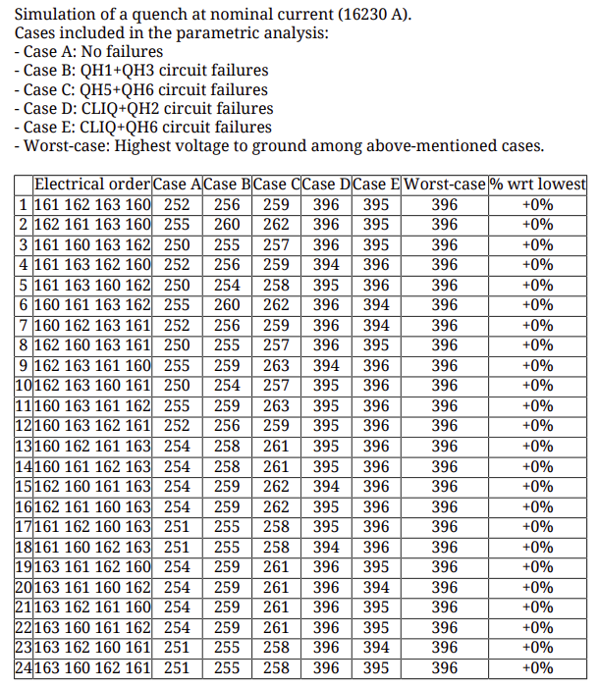
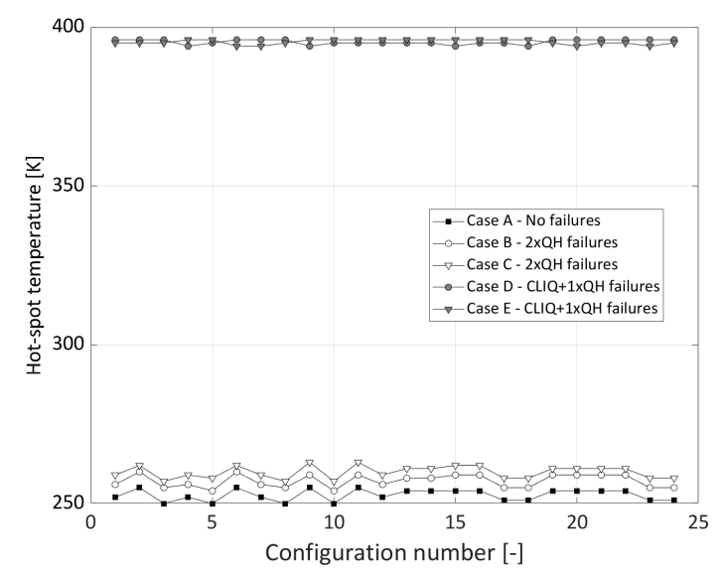
Simulated Hot-Spot Temperature
All orders show worst-case ~396 K hotspot during quench.
Minor spread in pre-protection temps (252–263 K).
Case D & E (CLIQ and QH failure) increase the Hotspot Temperature from ~250 K tup to ~ 400 K
Hotspot Temperatures results are effectively order-independent, but failure case dependent

Slide 5
Conclusions
Voltage-to-ground is the main design driver, since it varies strongly with coil order for the marked worst cases (617–758 V).
Hot-spot temperature shows order-independence, but increases with protection failures:
Case A (no failures) → ~250–260 K
Case D/E (CLIQ + QH failures) → ~396 K worst case.
Failure cases have a strong influence on peak voltage-to-ground
For coil order [161 162 163 160]: increase from ~525 V (Case A) to ~617 V (Case D/E) + strong variation with respect to QH circuit failure location
For coil order combinations no.19–24, voltage raises to ~752–758 V (> E.D.C.)
Recommendation: Using coil orders (1–3) to
keep voltages ≤633 V → sufficient margin to 670 V and ~396 K across different QH+CLIQ failure condition combinations

