Slide 1

MQXFB11: Coil ordering
Julia Haack, Susana Izquierdo Bermudez
17/09/2025

Slide 2
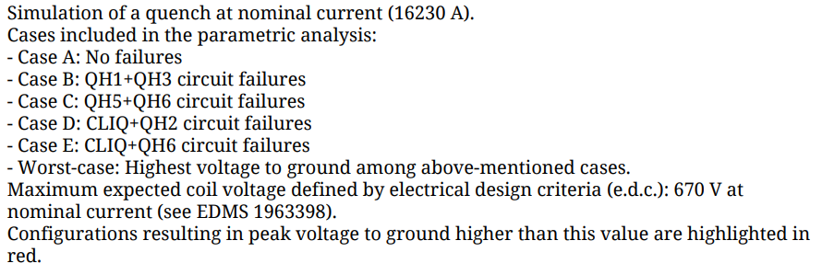
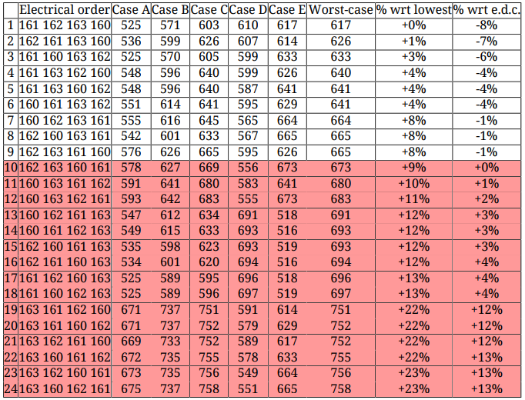
Coil sorting according to coil material properties
(RRR and Cu/Sc ratio)
Generated by D. Pracht and E. Ravaioli, TE-MPE-PE

Slide 3
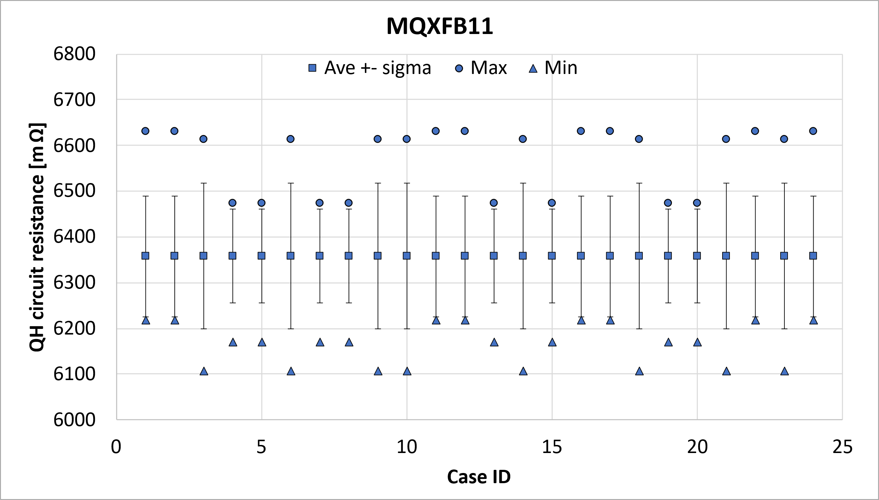
Coil sorting according to QH resistance

Slide 4
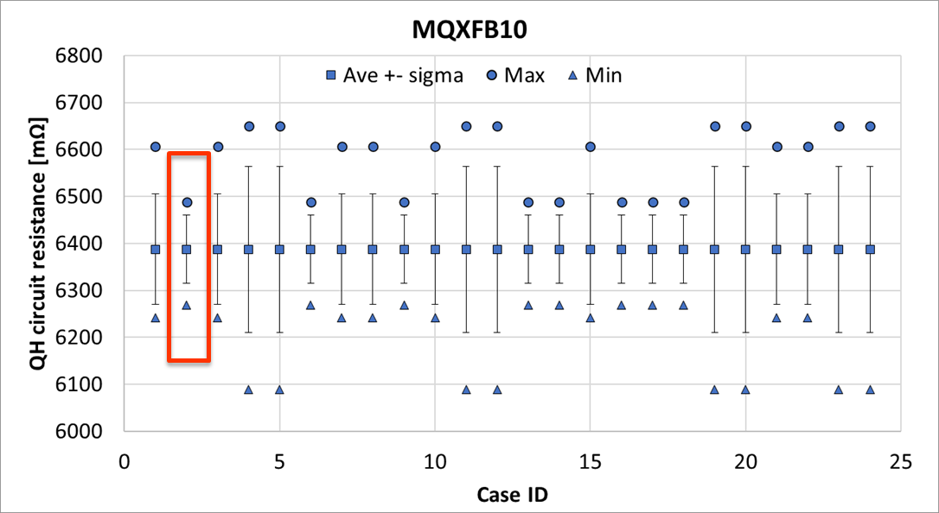
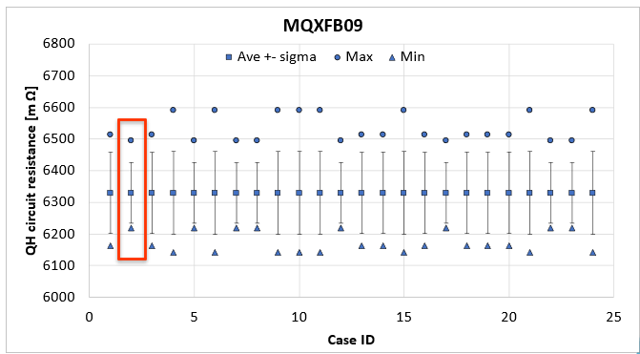
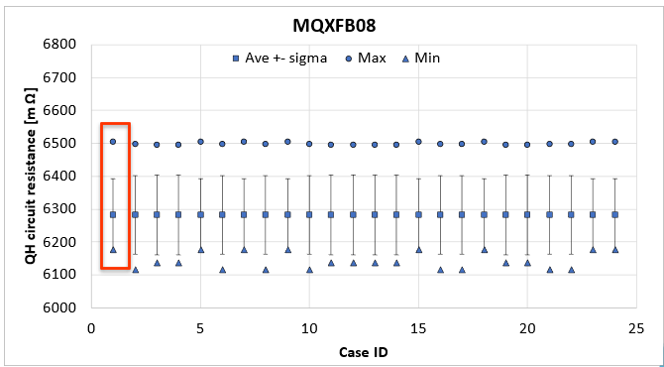
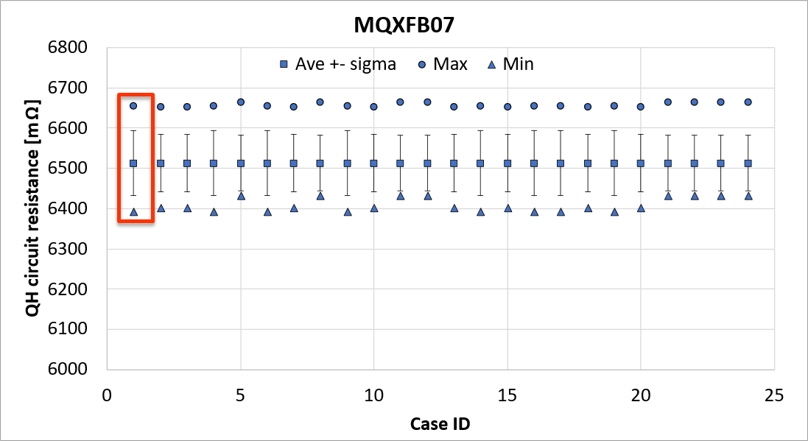
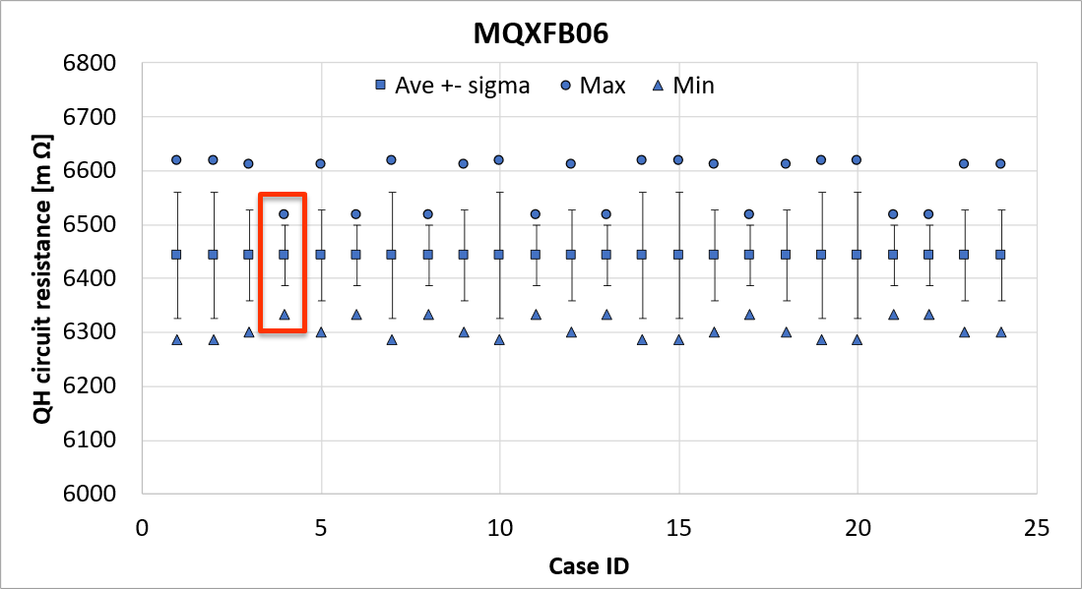
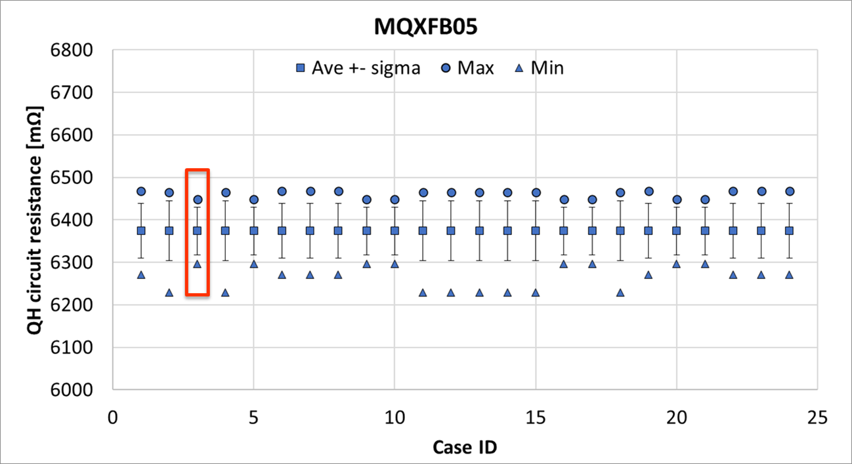
Coil ordering history: B04-B10

Slide 5
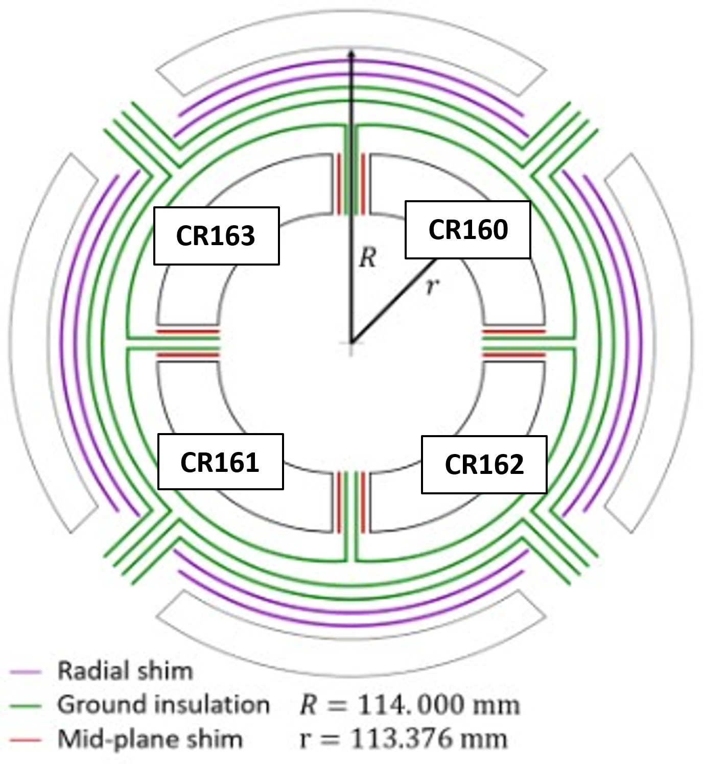
Conclusion
The chosen electrical order results in coils in these positions:

Slide 6
References
Quench heater parameters MQXF (22/01/2022) https://indico.cern.ch/event/1119409/
NCR MQXFBP3 QH resistance EDMS 2782298
Quench heater parameters MQXF (09/07/2021) https://indico.cern.ch/event/950696/
NCR MQXFBP2 QH resistance EDMS 2643444
HL-MCF Meeting #121 Update on the MQXFB QH Resistances https://indico.cern.ch/event/1305402/

Slide 7
Thank you

Slide 8
Background
With the introduction of the mini-swap in MQXFB magnets, there is a bit less margin in the protection at low field to tolerate the spread on QH parameters (circuit resistance, capacitance/voltage of the HFU…).
The established requirements for the quench heater resistance are:
  Quench heater resistance at 293 K between 5.6 and 7.3 Ω
  Quench heater resistance at nominal operation conditions between 3.2 and 4.2 Ω
  At least 6 quench heater circuits with at least 3.4 Ω resistance at nominal operation conditions
To ensure fulfillment of the requirements with margin, in addition to the usual criteria to select coil ordering (RRR and Cu/Sc ratio), a check on the spread of the QH circuit resistance is performed systematically before the assembly of every magnets, starting from MQXFB04.

