Slide 1

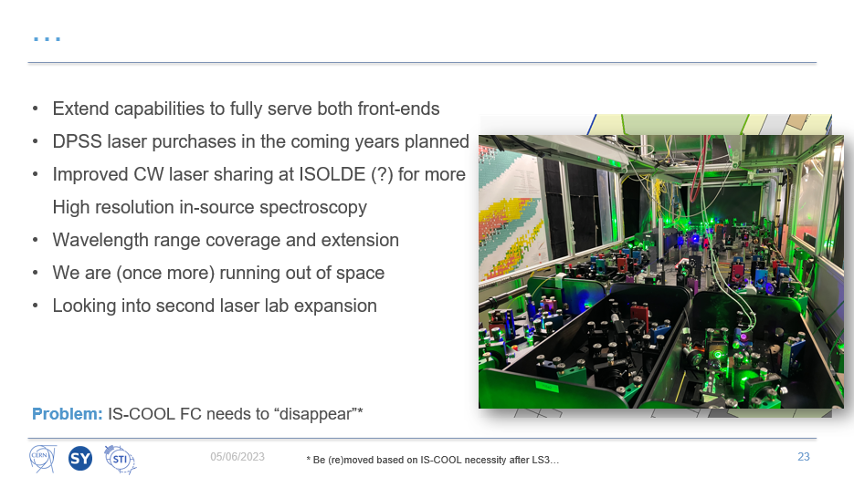

Slide 2
WP3: ISCOOL Cage Relocation
Lukas Nies (SY-STI-LP)
26 / 09 / 2025

Slide 3
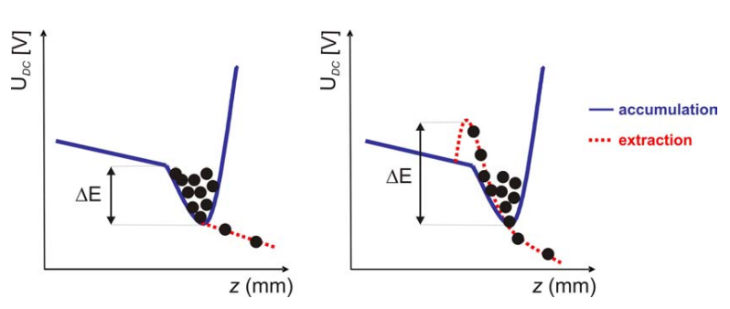
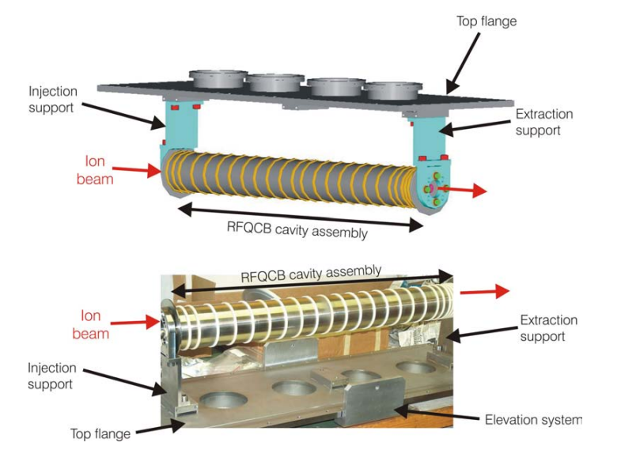
ISCOOL: The ISOLDE Ion Beam Cooler-Buncher primary hardware: remains unchanged
Receives ion beams from HRS frontend
Accumulation, cooling and bunching through He buffer-gas collisions
Either DC or bunched beam mode
Ivan Padora – Thesis (2007) – EDMS 1072182

Slide 4
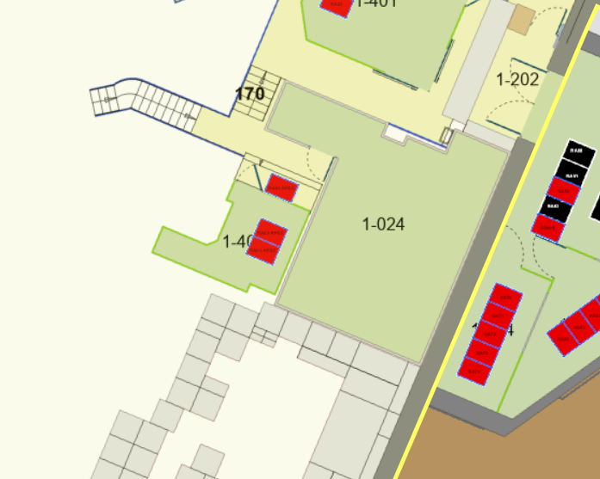
ISCOOL: The ISOLDE Ion Beam Cooler-Buncher secondary hardware: to be relocated
Green HT cage including the two racks + access rack
Decabling of all machine side cables (between HT cage and primary hardware)
Recabling/Extension of cables from EN/EL and EPC
ACC-CONS request for consolidation of some of the PLCs and RF drivers (more later)

Slide 5
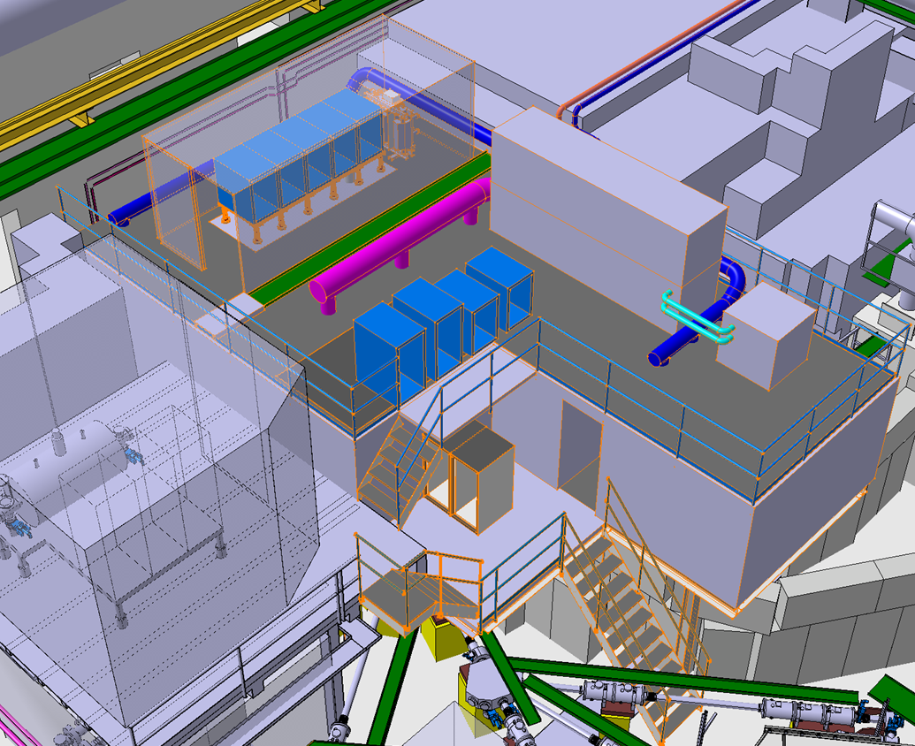
Secondary hardware relocation
HV Cage
HV Rack will move on top of RILIS cabin
EPC and EP racks (HT power supply, interlock and access, etc.) will remain in original position -> to be discussed
EPC and EP racks

Slide 6
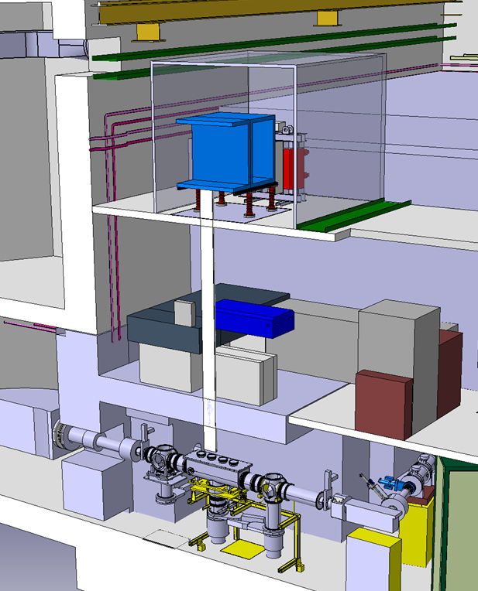
Secondary hardware relocation
HV Cage
HV Rack will move on top of RILIS cabin
EPC and EP racks (HT power supply, interlock and access, etc.) will remain in original position -> to be discussed
Extra distance to be compensated by new “HT tube” design
HT tube through RILIS cabin
Primary hardware

Slide 7
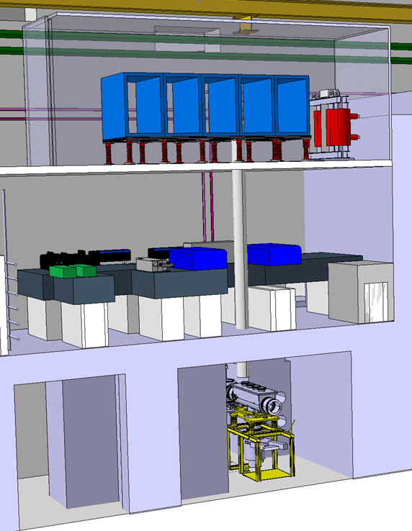
Secondary hardware relocation
HV Cage
HV Rack will move on top of RILIS cabin
EPC and EP racks (HT power supply, interlock and access, etc.) will remain in original position -> to be discussed
Extra distance to be compensated by new “HT tube” design
HT tube through RILIS cabin
Primary hardware

Slide 8
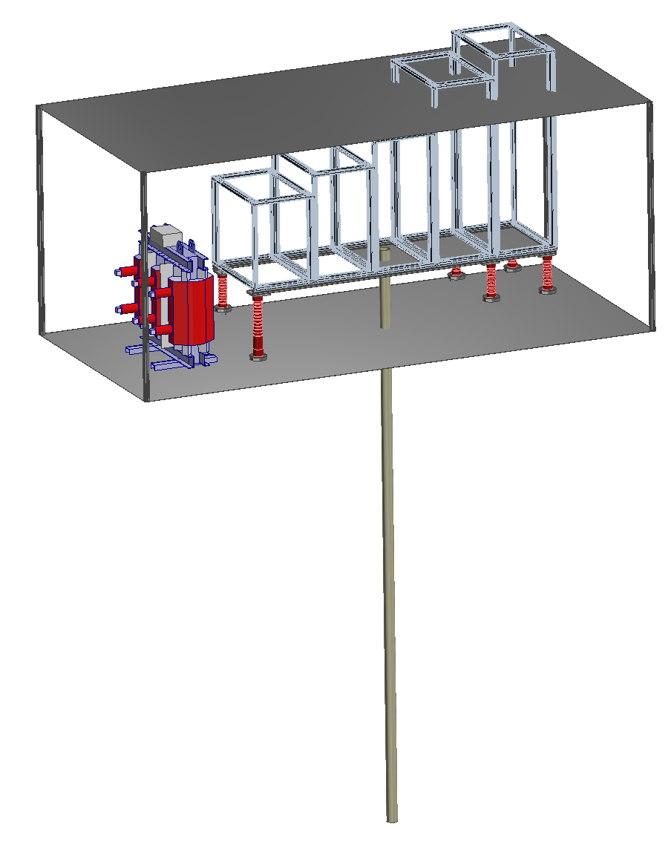
High-voltage cage and tube design
Maximize racks space
Maximize cage volume and rack space with the given roof constraints
Use lightweight extruded aluminium profiles, reuse PUMA-RC6 design
Simple di-electric tube in metal sleeve (no “Boris tube” needed)
-> Specs (dimensions) still to be defined
Transformer
Insulators
HT tube through RILIS cabin

Slide 9
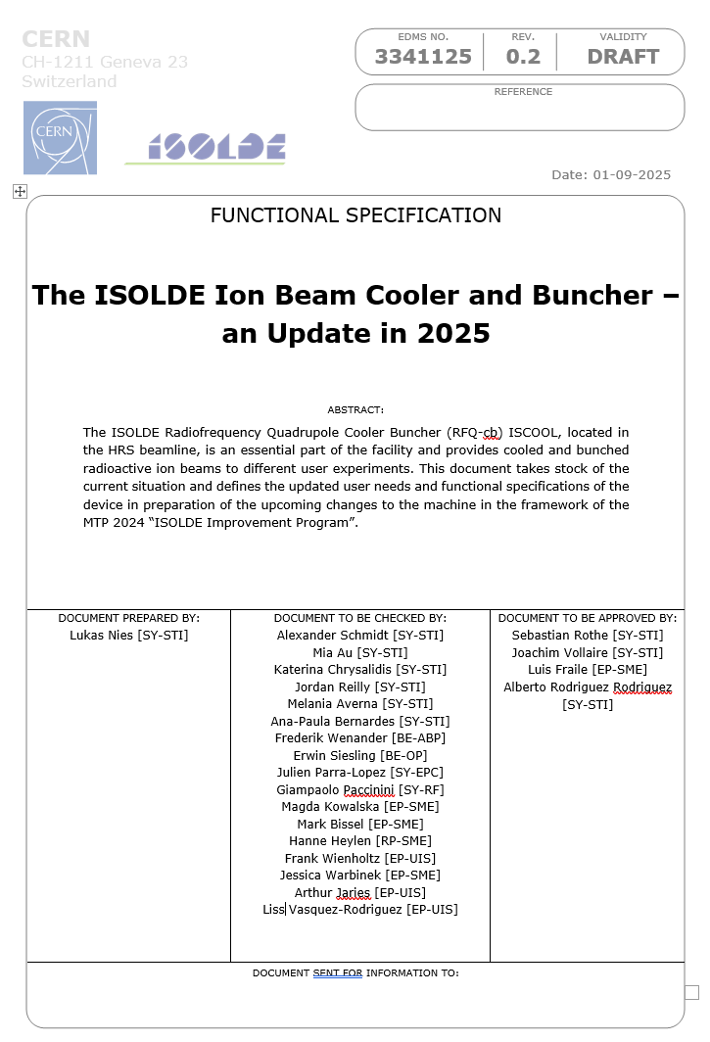
Updated Functional Specifications and CONS
User requirements and new insights into device operation after 15 years motivate update
New functional specs. document to be circulated for engineering check next week
Information from equipment owners required: estimation of rack space and power consumption on-platform
Basis for ACC-CONS request submitted this round

Slide 10
Updated Functional Specifications and CONS
 | Model (Suggestion) // Comments | Quantity | Estimated Price (kCHF) |  | 2025 |  |  |  | 2026 |  |  |  | 2027 |  |  |  | 2028
 |  |  |  |  | Q1 | Q2 | Q3 | Q4 | Q1 | Q2 | Q3 | Q4 | Q1 | Q2 | Q3 | Q4 | Q1 | Q2 | Q3 | Q4
HV CAGE RELOCATION AND PRIMARY INFRASTRUCTURE
Cabling work off-platform | EN-EL | 1 | 10 |  |  |  |  |  |  |  |  | 9 | 3
Cabling work on-platform | EN-EL, SY-STI | 1 | 5 |  |  |  |  |  |  |  |  |  | 1 | 1 | 1
HV Cage | SY-STI | 1 | 10 |  |  |  |  |  |  |  | 4 | 4 | 1
Racks and insulators | SY-STI | 1 | 5 |  |  |  |  |  |  |  |  | 3 | 2 | 1
Misc |  | 1 | 5 |  |  |  |  |  |  |  |  |  | 1 | 1 | 1 |  | 2
Total |  |  | 35
Total per year |  |  |  |  |  |  |  |  | 20 |  |  |  | 13 |  |  |  | 2
RF DRIVER SYSYEM
400W RF Amplifiers | online + offline (spares), commercial | 6 | 110 |  |  |  |  |  |  |  |  |  | 50 | 60
Transducer box | online + offline (spares), in-house (SY-RF) | 6 | 15 |  |  |  |  |  |  |  | 5 | 5 | 5
RF generators and digital scop | offline (spare) | 1 | 5 |  |  |  |  |  |  |  |  | 2 | 2 | 2
Misc |  | 1 | 5 |  |  |  |  |  |  |  |  |  | 1 | 1 |  |  | 2
Total |  |  | 135
Total per year |  |  |  |  |  |  |  |  | 12 |  |  |  | 121 |  |  |  | 2
POWERLINE CONVERTERS AND FAST SWITCHES
Transformer and interfaces | online + offline (spare) | 2 | 35 |  |  |  |  |  |  |  | 2.5 | 5 | 12 | 12 | 3.5
Switches | online + offline (spare) | 6 | 4 |  |  |  |  |  |  |  |  |  | 2 | 2
ISEG -20kV module | ISEG EHS-42-200n | 1 | 6 |  |  |  |  |  |  |  |  |  | 3 | 3
Fast voltage amplifiers | EDA-01892, online + offline (spare) | 6 | 6 |  |  |  |  |  |  |  |  |  |  |  |  |  | 3 | 3
Fast voltage amplifiers, crate | online + offline (spare) | 2 | 3 |  |  |  |  |  |  |  |  |  |  |  |  |  | 3
DSS Ressources, 4 weeks |  |  | 10 |  |  |  |  |  |  |  |  | 2.5 | 7.5
Misc |  |  | 3 |  |  |  |  |  |  |  |  |  | 1 | 1 |  |  | 1
Total |  |  | 67
Total per year |  |  |  |  |  |  |  |  | 10 |  |  |  | 47 |  |  |  | 10
Total per Q
Total per year |  |  |  |  |  |  |  |  | 42 |  |  |  | 181 |  |  |  | 14
FULL TOTAL |  |  | 237 kCHF
35 kCHF
If funded would relief some stress on the RILIS budget

Slide 11
Tentative work schedule WP3
 |  |  |  |  | 2026 |  |  |  |  |  |  |  |  |  |  |  | 2027 |  |  |  |  |  |  |  |  |  |  |  | 2028
 |  |  |  |  | Jan | Feb | Mar | Apr | May | Jun | Jul | Aug | Sep | Oct | Nov | Dec | Jan | Feb | Mar | Apr | May | Jun | Jul | Aug | Sep | Oct | Nov | Dec | Jan | Feb | Mar | Apr
Tasks |  |  |  | Teams
Lockout of mains power, lockout of HT PLC |  |  |  | EN-EL, EPC
Removal of secondary equipment on HT platform |  |  |  | EPC, RF, STI, EP
Removal of off-platform seconday equipment and racks |  |  |  | EPC, STI, EP, EN/HE
Removal of racks and any remaining secondary hardware |  |  |  | STI, EN/HE
Decabling HT platform <-> ISCOOL |  |  |  | STI
Removal HT cage
Design freeze HT cage |  |  |  | STI
HT cage procurement |  |  |  | STI
Construction of new platform and lab
Recabling secondary eqipment |  |  |  | EPC, EN-EL, STI
Installation off-platform equipment |  |  |  | EPC, STI, EP
Cage assembly |  |  |  | STI
Installation and cabling of transformer, HT platform, HT tube |  |  |  | STI, EPC
HV conditioning 1 |  |  |  | STI
Installation of on-platform equipment |  |  |  | EPC, RF, STI, EP
Recabling secondary eqipment |  |  |  | STI
Powerwing seconday equipment |  |  |  | EPC, RF, STI, EP
HV conditioning 2 |  |  |  | STI
Commissioning with stable beam |  |  |  | STI

