Slide 1
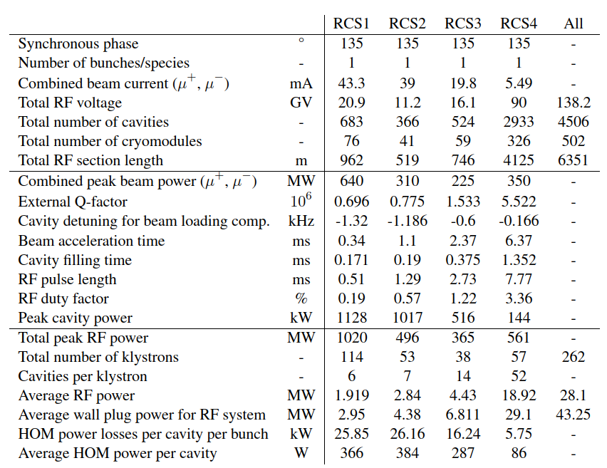
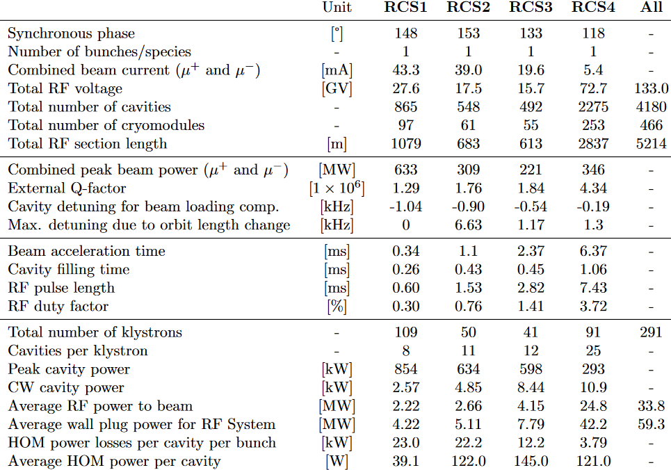
RF parameters for 2025 greenfield
Notes:
Average HOM power → corrected (most likely wrong time reference)
Inst HOM power → calculated with extraction, was higher last time in RCS1 → difference
Average wall plug calculation was wrong → higher now
Also: average rf power was including transfer losses

Slide 2
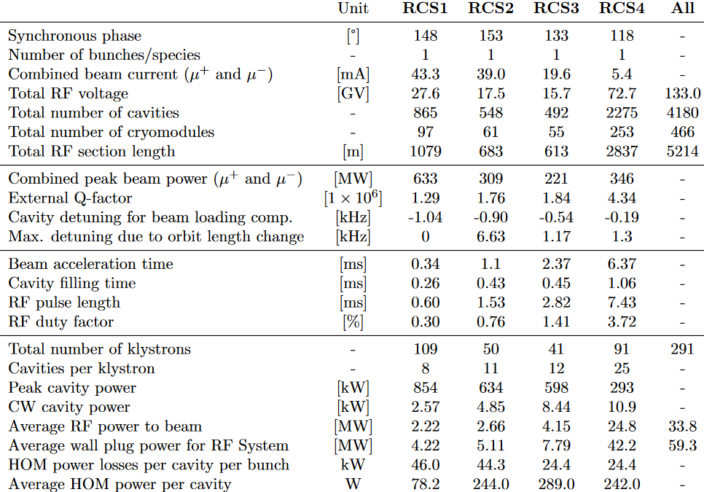
RF parameters for 2025 greenfield

Slide 3
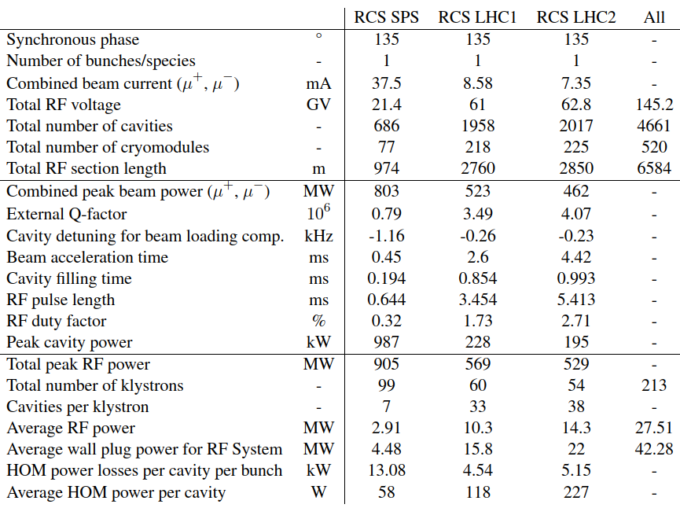
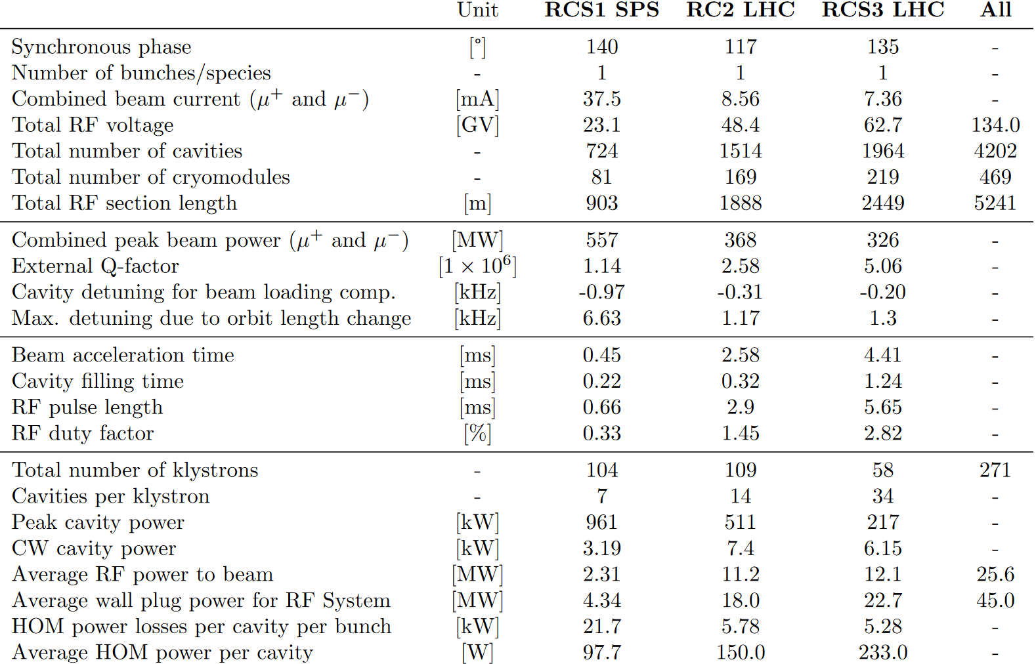
RF parameters 2025
CERN-siting
Bunch length was only available for injection last year → this year, extraction → worst case
Peak beam power was missing $sin⁡(φ_{s})$→ which definition do we use? Currently: $I_{beam}∗V_{total}∗sin⁡(φ_{s})$

Slide 4
RF parameters 2025
CERN-siting

