Slide 1
EN-HE Updates
HI-ECN3 WP4 - Coordination meeting #16 – C. Duran Gutierrez, R. Rinaldesi – EN-HE
08/10/2025

Slide 2
Content
New TCC8 crane (PR623)
ECR – ECN3 transfer trolleys
TCC8 mezzanine transport volume
Ongoing and future assessments

Slide 3
New TCC8 crane (PR623)
Auxiliary hoist towards TCC8
ST1A83373_01
The contractor shared a preliminary 3D model
Some modifications to be addressed:
  Auxiliary hoist towards TCC8
  Relocate the access to the maintenance walkway
  Add main hook and optimize lateral approach and height
    Crane coverage will be modified accordingly
  Some adjustments to the trolley
Next visit – 15/10/2025. Access to TCC8 (upstream) and define control panel location and cable routing (TA851)
Contractual schedule for onsite intervention: 31/08/26 – 27/11/26
Waiting for a definitive schedule from the dismantling and installation coordination team
2100

Slide 4
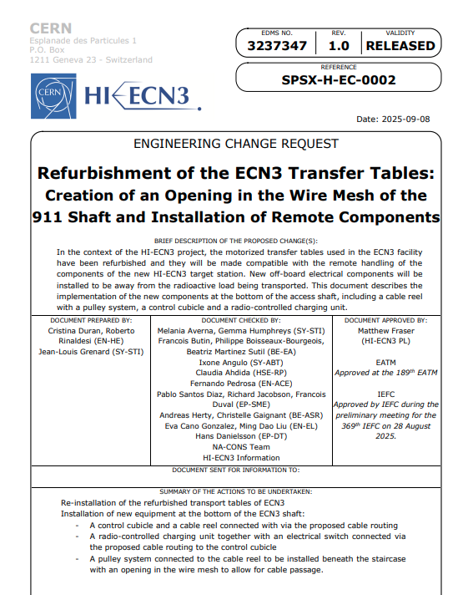
ECR – ECN3 transfer trolleys
ECR approved and released on 08/09/2025
Refurbished trolleys currently stored in building 947
Works planned for YETS 2025/2026
Exact execution date to be defined
  First proposal → 02/02/2026 – 06/02/2026 (5 days)
Thank you very much for your feedback and comments!

Slide 5
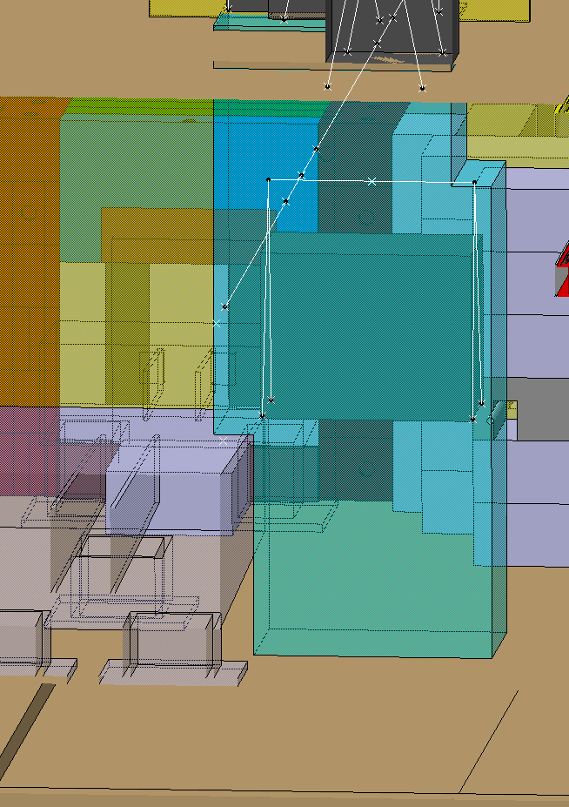
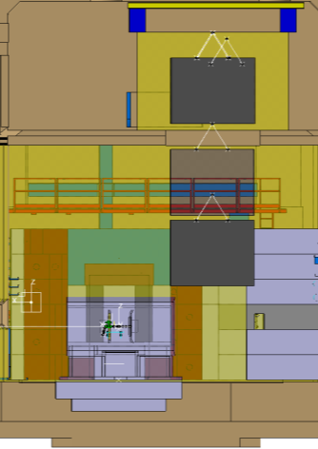
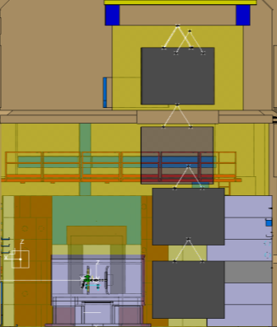
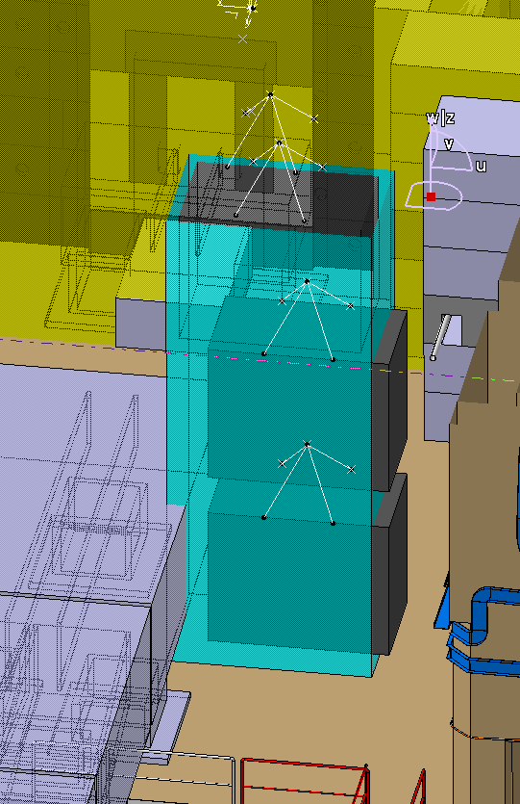
TCC8 mezzanine transport volume
The reserved transport volume has been updated based on a transport study evaluating the potential dismantling of the largest section of the ECN3 AHU unit located on the mezzanine.
Procedure
Lowering through the opening
Stop before reaching the muon shield (leaving a safety clearance. 280mm considered for this study)
Translate along the monorail towards the Jura side
Continue lowering until reaching the floor
Modified transport volume
1 - 2
3 – 4
First transport volume

Slide 6
Ongoing and future assessments
ECN3
Visit to ECN3 to check lifting equipment and dismantling activities – 15/10/2025
TCC8
TCC8 Dismantling – Ongoing
  Needed containers
  Special tooling identification
Visit on-site with the new crane contractor (15/10/2025)
BDF target and shielding cask handling requirements

