Slide 1
Joint Discussion on positron production and DR acceptance

Slide 2
Positron production @FS

Slide 3

FCC-ee positron source: current requirements
The complete filling for Z running => Requirement ∼ 3 ⨯ 10¹⁰ e⁺/bunch (4.8 nC) at the linac end
or 5 nC accepted in the DR
Beam energy | 2.86 GeV
Bunch charge | ∼5 nC (max)
Bunch length | 1 mm
Bunch transverse size | ≳ 0.5 mm
Nb of bunches per pulse | 4
Bunch separation | 25 ns
Repetition rate | 100 Hz
Beam power | ∼5.7 kW (max)
e⁻ drive beam
N_{e-}/bunch ⨯ η^{e+}_{Accepted} ≥ 5 nC/bunch ⨯ 2.6
~ 13 nC
*A safety margin of 2.6 is currently applied for the whole studies (~50% losses for injection in the DR + ~20 % losses from target up to the end of the e+ linac )
with N_{e-}~5 nC ➔ η^{e+}_{Accepted} ≳ 2.6
Accepted e⁺ yield is a function of primary beam characteristics + target + capture system + DR acceptance
DR acceptance window: (Energy : 2.86 GeV ± 2% ; Time : 20 mm/c)

Slide 4
Positron production: FS baseline
E = 2.86 GeV
Q = 13 nC (considering 60% losses for transport, collimation and injection into DR)
2.86 GeV electron beam
from e- linac
Capture linac 2 GHz, 13.3 MV/m
100 Hz, 6 RF structures
Positron linac 2 GHz, 13.3 (12.8) MV/m
100 Hz, 20+52 RF structures
Positron/Electron
Separation at 170 MeV
Target & cryostat
DC solenoid
Injection section
E = 2.86 GeV
Q = ~3.8 nC
Damping Ring
E = 2.86 GeV
Q_{b} = 5 nC
DC solenoid
Electron/Photon dumps
Energy collimator
and compressor
Capture system (~ 20 meters)
Positron production : conventional scheme (e- beam size on target = 1 mm rms ). Target exit located at 40 mm w.r.t. HTS solenoid peak field.
Matching device is based on the SC solenoid (5 HTS coils, 72 mm bore, ∅ 60 mm including shielding)
Capture linac is based on the 6 L-band TW RF structures ( 2 GHz, ∅ 60 mm, 3-m long)
NC solenoid B = 0.5 T (realistic conventional design based on the short coils B = 0.31 T) + short “tuning” solenoid B = 0.25 T before the 1st RF structure
Positron linac (~ 280 meters)
Separator chicane : Rectangular beampipe and hor./vert. collimators, Dipole peak field: ~0.2 T
Section 1 : up to ~ 930 MeV. Same RF structure as that of the Capture Linac (CL). 20 structures. G = 13.3 MV/m
Matching section : 5 quadrupoles (0.4 m long)
Section 2 : up to 2.86 GeV. Same RF structure as that of the CL. 52 structures. Quadrupole (0.4 m long), 2 structures per FODO cell. G = 12.8 MV/m

Slide 5
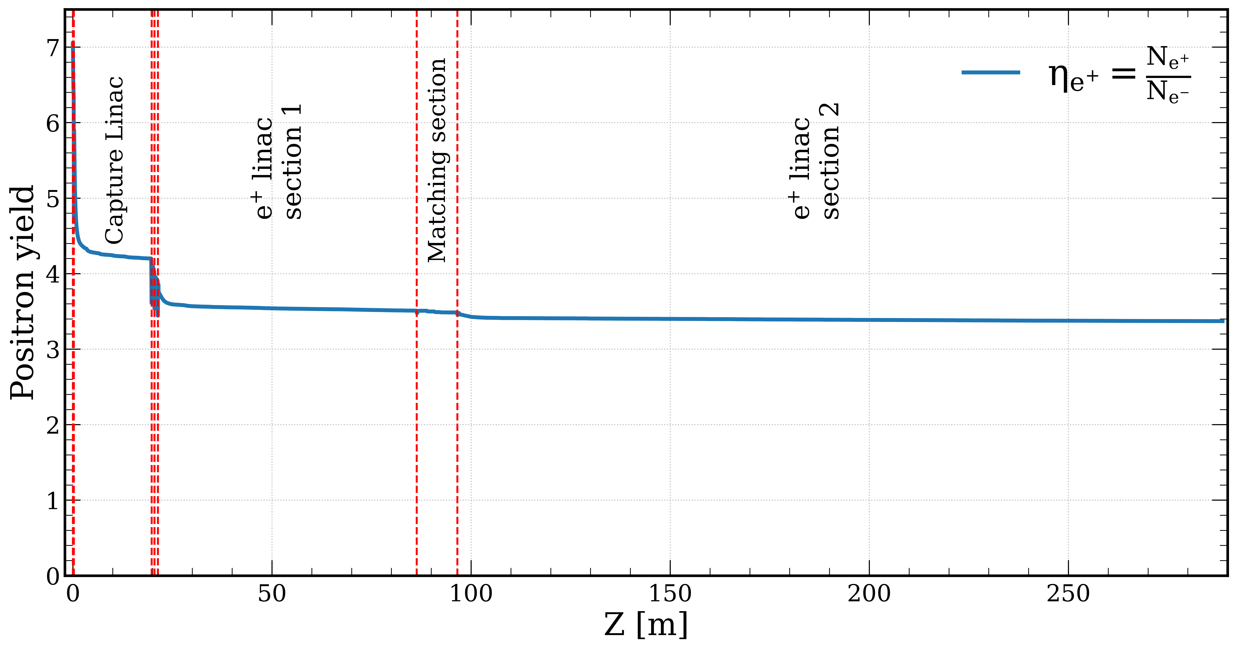
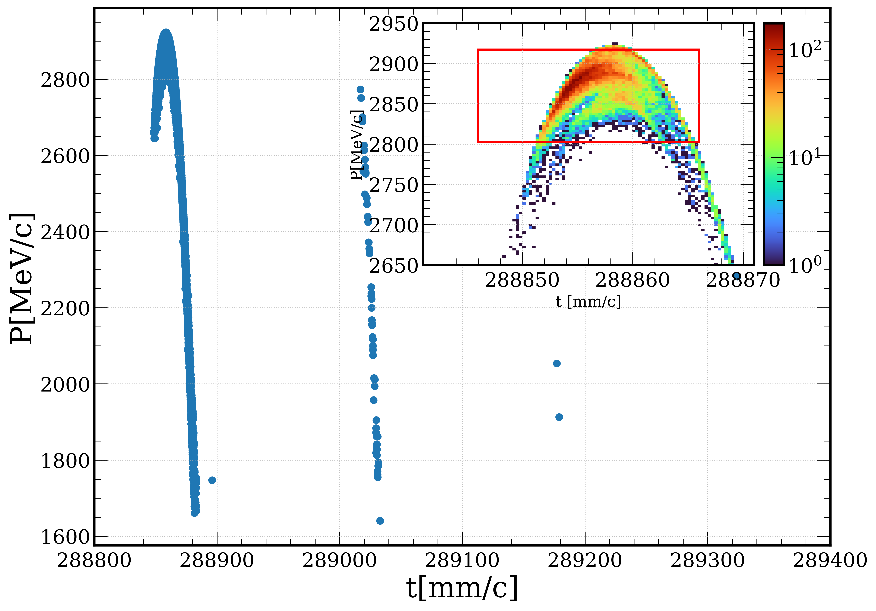
Positron capture and linac overall efficiency (FS baseline)
to DR
2.86 GeV
CL
PL1
MS
PL2
e⁺ yield ~ 3.4
Accepted yield @ DR ~ 3.0
(ΔE: ±2%, Δt: 20 mm/c)
*Simulations include collective effects
(space charge and short-range wakefield)
Start-to-end simulation (from target to the DR)
FS design ensures reliable e⁺ production and meets the requirements set by FCC-ee (Z-pole) with the safety margins

Slide 6
Summary of the simulation results (FS baseline)
e⁻ Drive beam
Target-converter
Beam energy [GeV] | 2.86
Repetition rate [Hz] | 100
Number of bunches | 4
Bunch charge [nC] | 3.8
Bunch length [mm] | 1
Beam size @Target [mm] | 1
Beam power [kW] | 4.3
Thickness [mm] | 15
Production rate [N_{e+}/N_{e-}] | 7.07
Deposited power [kW] | 1
PEDD [J/g] | 5.8
e⁺ Linac
Average energy [GeV] | 2.87
Positron yield [N_{e+}/N_{e-}] | 3.4
Accepted positron yield @DR [N_{e+}/N_{e-}] | 3
Bunch length [mm] | 2.8
Energy spread | 0.9
Spots size [mm] | 5.3/2.8
Normalized emittance [mm∙rad] | ~13
e⁺ Capture system
AMD peak field [T] | 15 (12)
Solenoid strength [T] | 0.5
AMD/CS aperture [mm] | 60
Average energy [MeV] | 173
Positron yield [N_{e+}/N_{e-}] | 4.2

Slide 7
Positron production @FS with 6D Damping Ring acceptance
Transfer Line simulation via 6D matrix element in RF-Track
ECS via analytical transformation

Slide 8
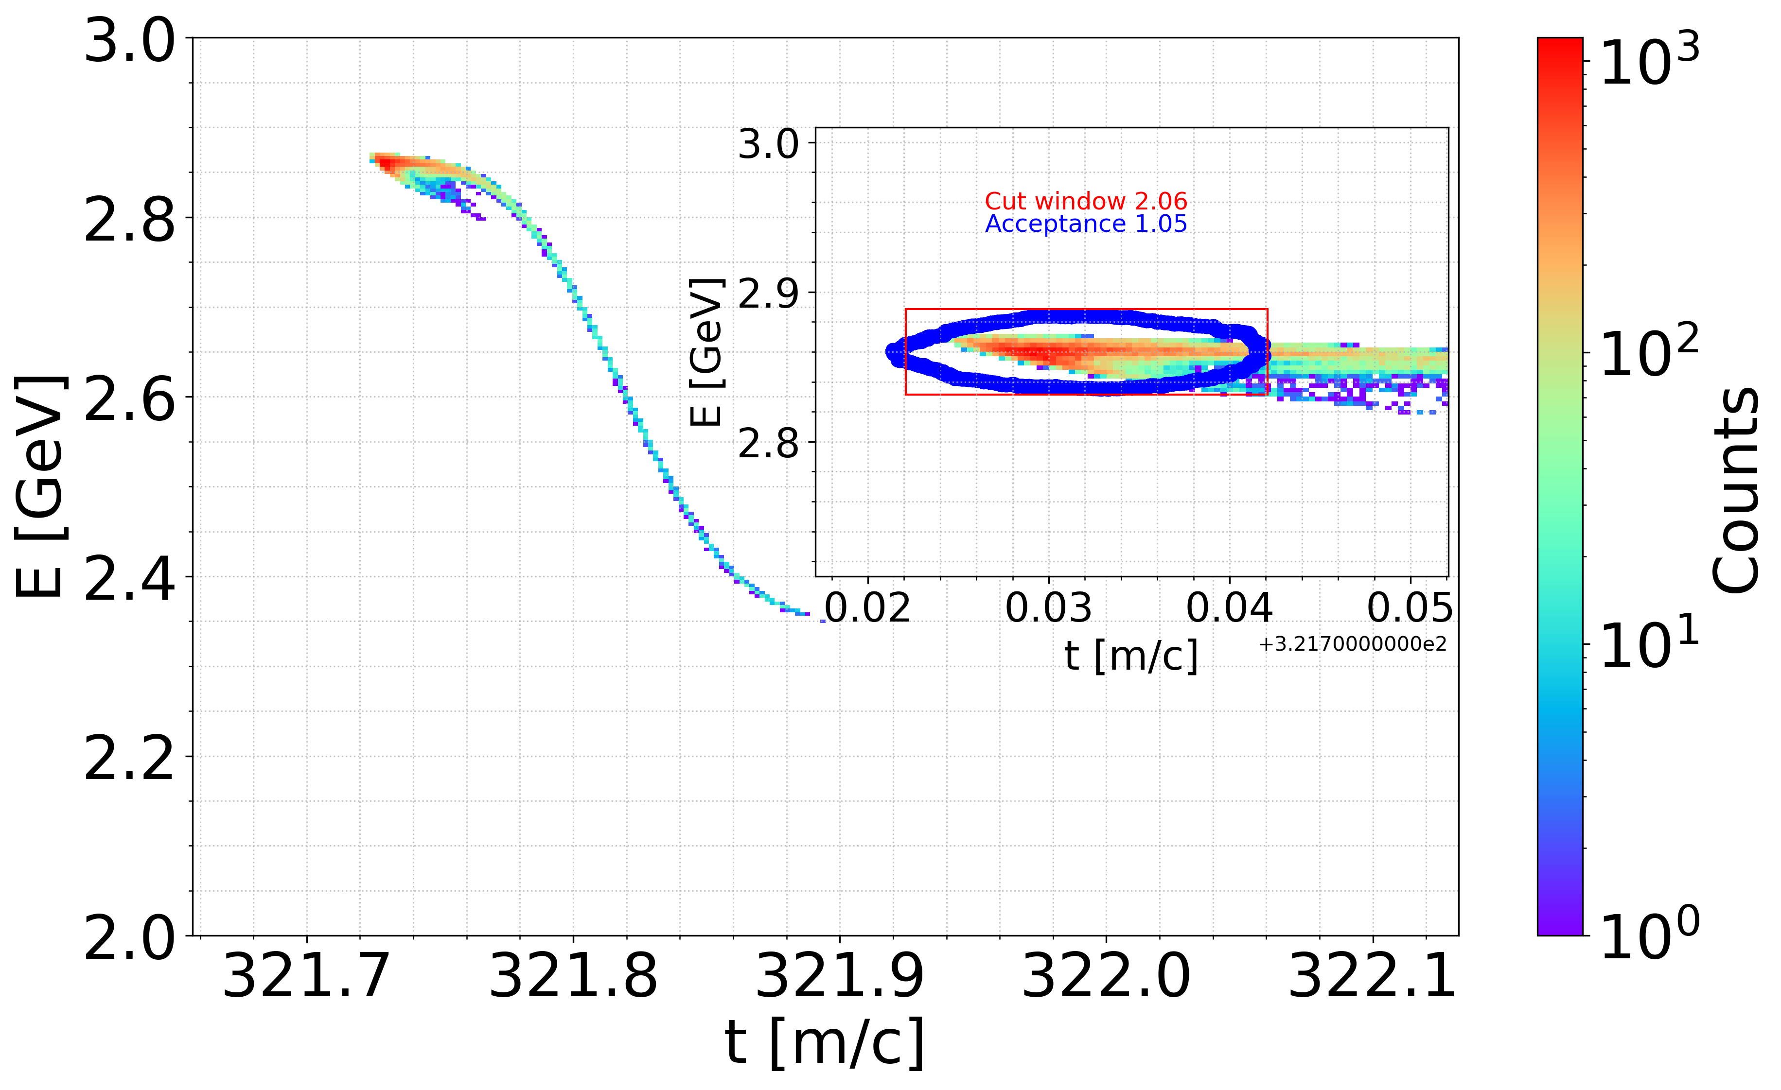
Results for the FS design
Y. Wang
Start-to-end simulation including the DR (using the FS layout + TL + ECS).
The DR acceptance is based on the linear tracking without errors. The realistic acceptance will probably be even smaller.
 | Main Bucket (95 %)
e⁺ yield @ Linac end [N_{e+}/N_{e-}] | 3.3 (3.4 FULL)
e⁺ yield @DR [N_{e+}/N_{e-}] 6D acceptance | 1.05/ (≲ 2.6*)
Norm. emittance @ECS [mm*rad] Within 6D acceptance | 14.1/13.2 5.0/6.1
Geom. emittance @ECS [mm*mrad] Within 6D acceptance | 2.54/2.40 0.89/1.09
Energy spread @ECS (RMS) [%] Within 6D acceptance | 2.5 % 0.18 %
Bunch length @ECS (RMS) [mm] Within 6D acceptance | 24.2 mm 3.3 mm
Beam size @ECS Within 6D acceptance | 2.6/2.2 1.6/1.2
Work in progress to quantify the losses in transverse and longitudinal planes
*Minimum required e⁺ yield for an e⁻ bunch charge of 5 nC

Slide 9
Discussion
Accepted e⁺ yield: ~1 N_{e+}/N_{e-} when taking into account the 6D DR acceptance.
With safety margins, an e⁻ drive beam charge of 6.7 nC is required to meet FCC-ee specifications (exceeding the current e- source limit 5 nC). Thermionic e- gun ? Modulation of the bunch intensity for top-up ? Studies and cross-checks are still ongoing.
e+ production chain (FS layout): already defined and optimized => can be tested against different DR versions. Next step: quantify room for improvement in DR acceptance and evaluate the impact on the accepted e+ yield for current baseline.
Once the DR design (and its acceptance is “fixed” as a intermediate milestone), we could re-optimize the current baseline (only parameter space) for e+ production, if needed.
To be done: confirm the accepted e+ yield with 1.54 GeV DR (previous design). We need the DR lattice. The e+ beam in this case will be taken at 1.54 GeV.
How now to proceed with the ”Towards TDR” studies ?

Slide 10
Realistic acceptance of the DR (to be fixed, at least for the first phase)
RF frequency: 3.006 GHz or 1.504 GHz ?
Impact on the layout/performance. Design studies.
Start-to-end simulations and optimizations. Misalignment/error studies (jitters).
Hardware specs and tolerances (e.g. for e- beam on the target)
Diagnostics
…
Towards TDR

Slide 11
Discussion
Start-to-end simulation (from target to the DR)
TL + ECS to DR
2.86 GeV
DR
T
MD
CL
CH
PL1
MS
PL2
Choice of RF frequency 3.006 GHz (e+ linac) and 2GHz and 1.504 GHz (capture linac) => we should know the starting parameters: exact frequency, mode, aperture, gradient. Fieldmap to start?
Start with the capture section + chicane. Alternative layouts :
MD + capture linac + NC vs. SC solenoidal focusing?
MD + capture linac + downstream quadrupole focusing (becomes more like SuperKEKB)
MD + subharmonic RF frequency Buncher + capture linac +….. ????
Positron linac
Reoptimization for a new RF frequency
Solenoid till ~900 MeV ?
Quadrupole focusing starting from chicane ? One single section (PL)
TL+ ECS + DR
Start from the matrix/analytical treatment
Realistic design of the TL and ECS
for all studies we need “fixed/reliable” DR acceptance

Slide 12
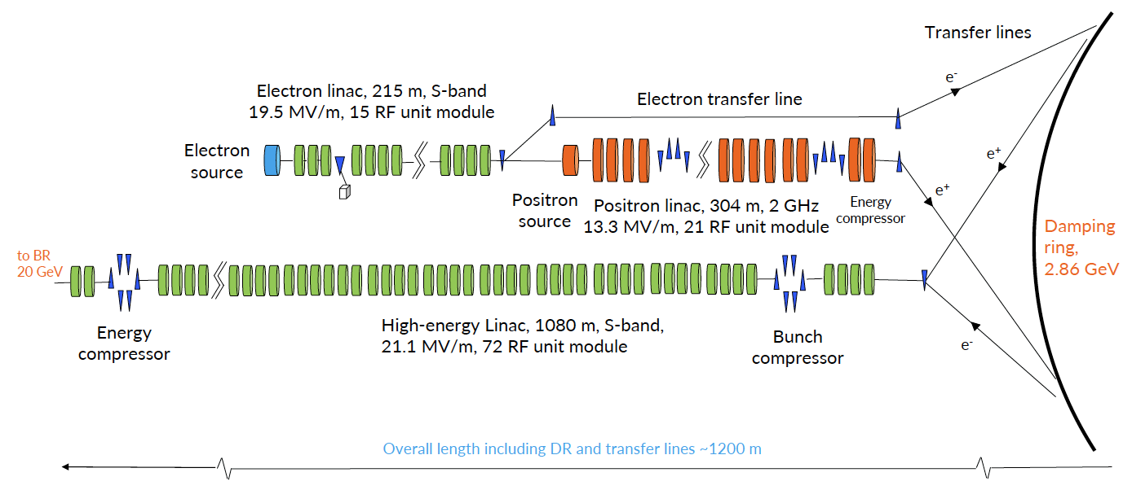
Energy of the e- drive beam
How can we increase the accepted e+ yield to relax constraints on the e- drive beam ?
Improving DR acceptance => high priority !
In addition to above item, increase the energy of the e- drive beam ? Add RF sections upstream the target or TL from HEL ?

Slide 13
Fundamental constrain. How to trick the Liouville theorem?
Needed phase space before HEL
Phase space after a e+ target
To make system unconservative:
Accelerate before DR: 1/γ
Lose particles
Increase DR acceptance & Damping rate/time
Brute force: increase phase space density by putting more e+ in the same phase space <= Increase e- drive beam energy

Slide 14
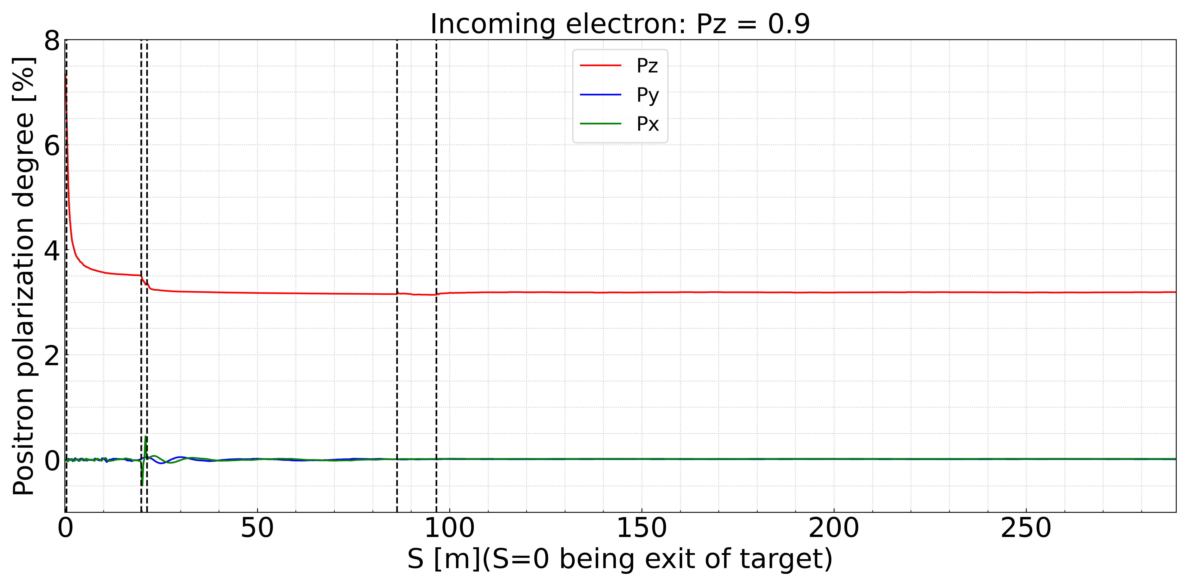
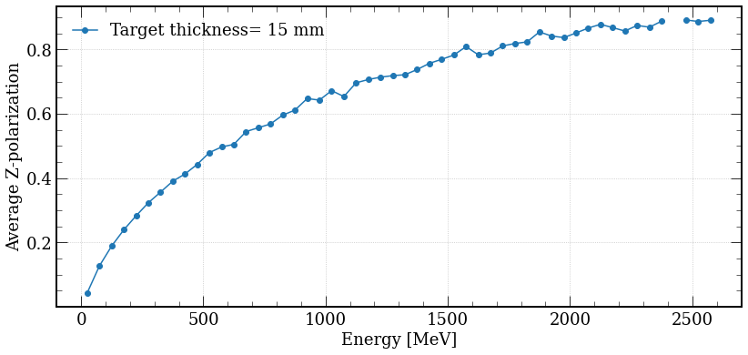
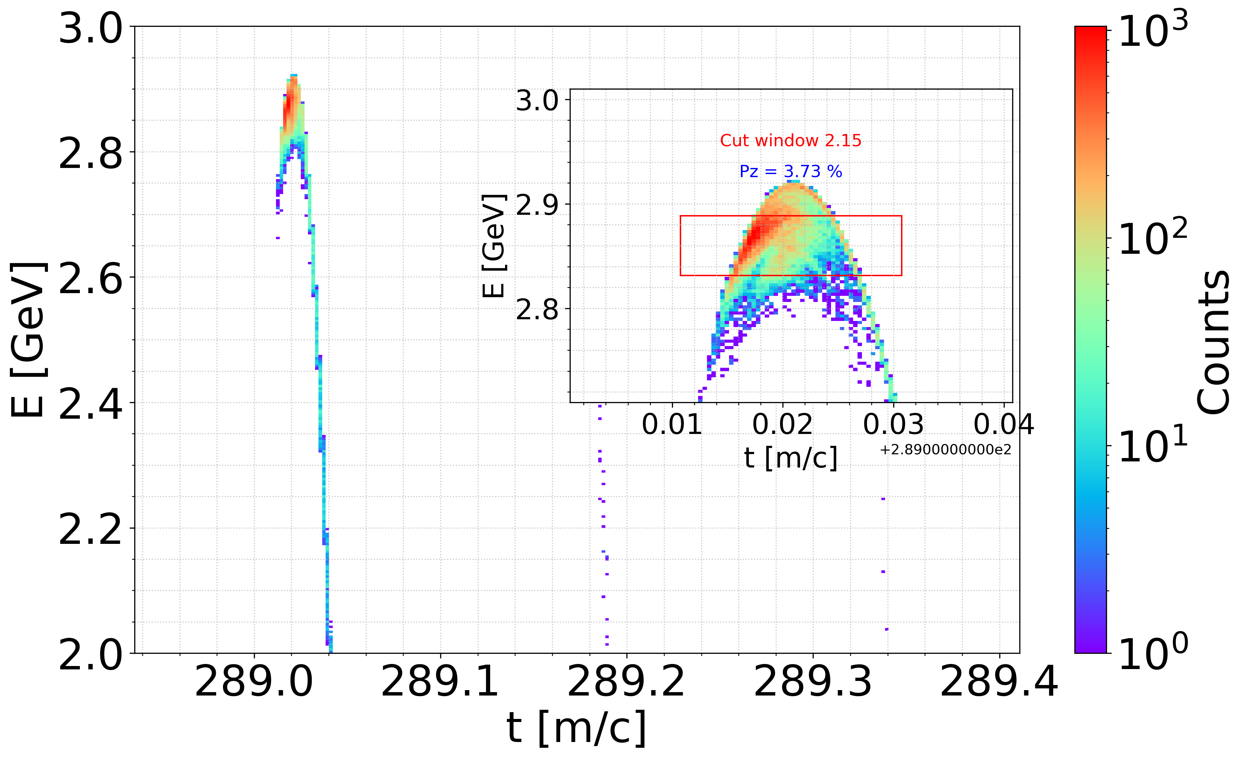
Polarization (FS report)
RF-Track
with polarization tracking
 | Yield [Ne+/Ne-] | Pz [%]
Cut window t = 20 mm/c, δE/E = ±1% | 2.15 | 3.73
Cut window t = 20 mm/c, δE/E = ±2% | 3.01 | 3.43
GEANT 4
Px, Py, Pz (incoming electron) | 0, 0, 0.9
Target thickness [mm] | 15
Target material | W
Beam energy [GeV] | 2.86
Beam spot x/y [mm] | 1
Geant4 output files were used as input for RF-Track
t = 20 mm/c, δE/E = ±1%
F. Alharthi, Y. Wang
Next step: results with 6D DR acceptance

