Slide 1
NF C15-100:2024
Review
M. Dolanbay, E. Freddi, M. Papamichali, J. Vieco, M. Wolf, K. Zielinski
2025-10-06, 2025-10-08
EDMS: 3343136
Indico: 1586687 & 1586741

Slide 2





Introduction
NF C 15-100 Change review – Collaborative effort
The review consisted of a strong collaboration between EN-EL-DDO and HSE-OHS
(6 staff members)
650+ hours dedicated to the review, ≈ 800 pages compared
Objectives:
  Inform the general community
  Identify potential differences from EL or CERN usual practices*
  Highlight new impacts
  Flag points requiring action or reflection
*From the authors perspective – respective experts/sections to reverify this with the standard

Slide 3
Guiding Principles of the Workshop
We need to cover more than 120 topics during the workshop,
the aim is to inform, not to debate or discuss impacts in this session
Our preference is to keep today’s flow focused and concise so we can cover the full range
of topics
Please take note of the key points and refer to the respective services/experts for deeper engagement offline and after the workshop

Slide 4
Purpose & Limitations
How to use this review
While every effort was made to be thorough, some points may have been missed — always verify directly with the standard
This review does not replace the obligation to read the full NF C 15-100 standard
Technical experts and equipment managers must still read the specific sections related to their equipment/field of expertise (especially before ordering equipment).
In the next few slides, we will explain the importance hereof

Slide 5
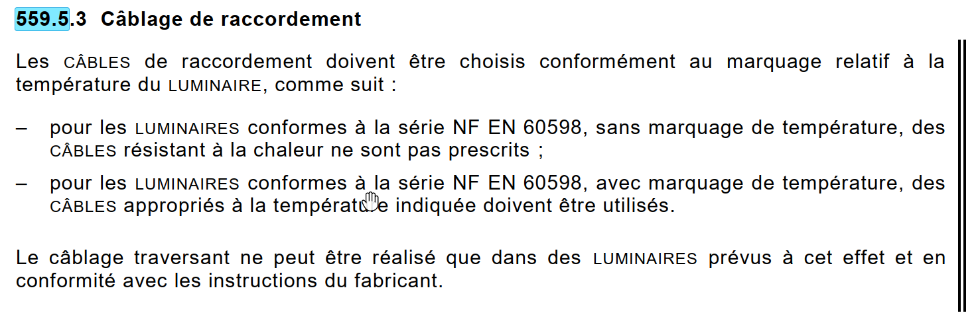
Detailed Compliance – Example 1
Importance of reading the standard
Example: If luminaires comply with NF EN 60598 and carry a temperature marking, the associated cables must meet the corresponding temperature class,
have these been checked in the past?
In this review, we do not assess such detailed compliance for specific equipment or installations. It remains the responsibility of each equipment owner to be aware of, and ensure adherence to, these requirements

Slide 6
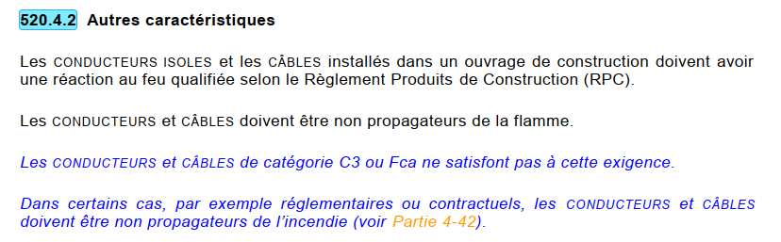
Detailed Compliance – Example 2
Importance of reading the standard
Example: Are the cables we install RPC Compliant?
In this specific case it is advised that people ordering cables at CERN read this entire chapter.
In this review, we do not assess such detailed compliance for specific equipment or installations. It remains the responsibility of each equipment owner to be aware of, and ensure adherence to, these requirements

Slide 7
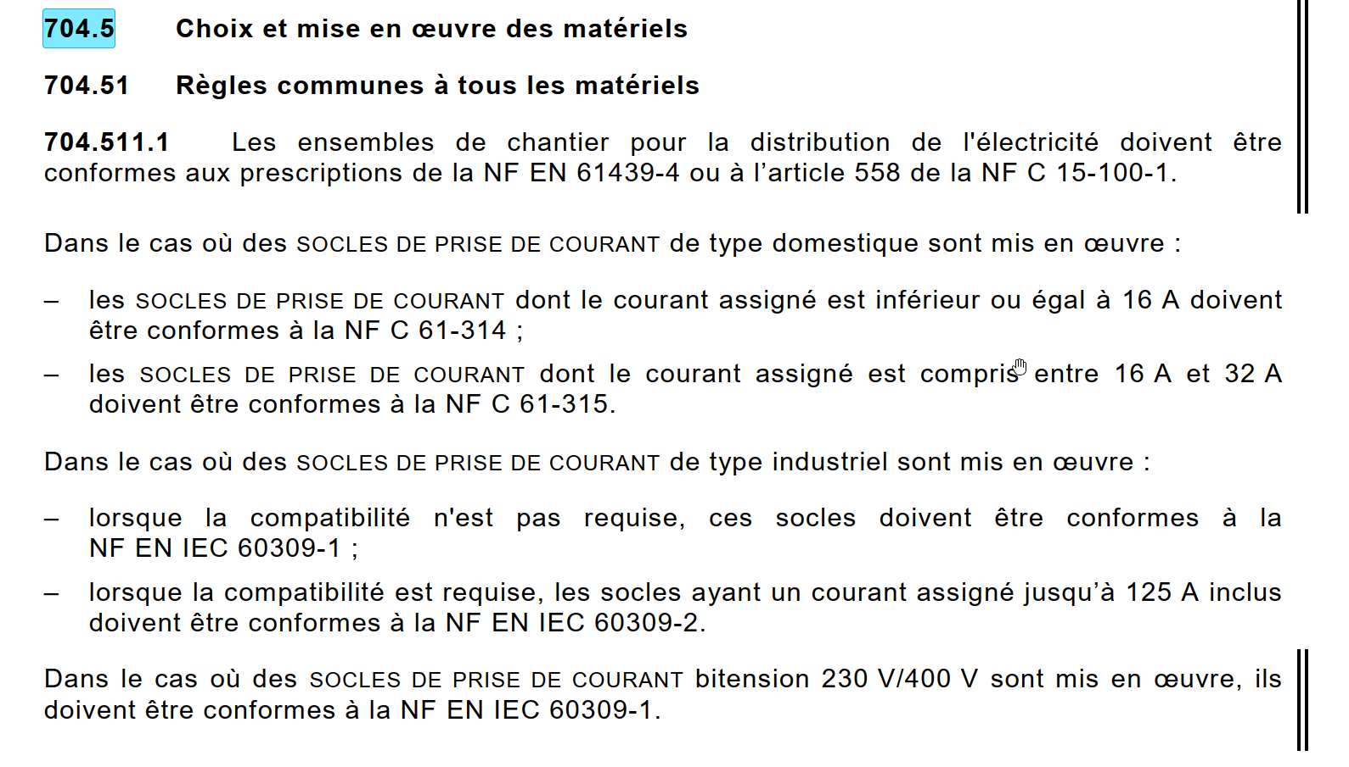
Detailed Compliance – Example 3
Importance of reading the standard
Example: Are the sockets we install compliant with these regulations?
In this review, we do not assess such detailed compliance for specific equipment or installations. It remains the responsibility of each equipment owner to be aware of, and ensure adherence to, these requirements

Slide 8
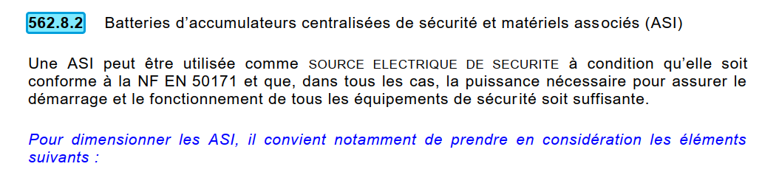
Detailed Compliance – Example 4
Importance of reading the standard
Example: Are our UPS units used in this configuration and if so, are they conform to the NF EN 50171?
In this review, we do not assess such detailed compliance for specific equipment or installations. It remains the responsibility of each equipment owner to be aware of, and ensure adherence to, these requirements

Slide 9
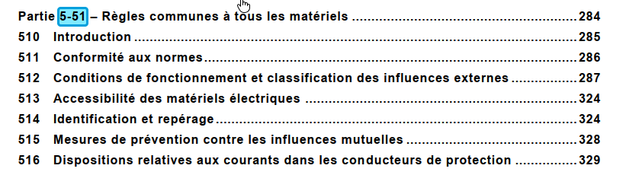
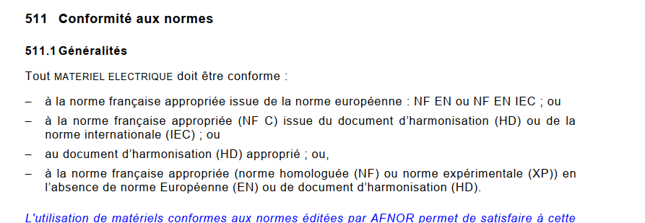
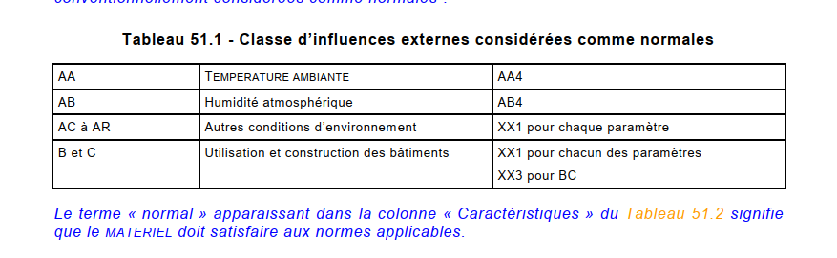
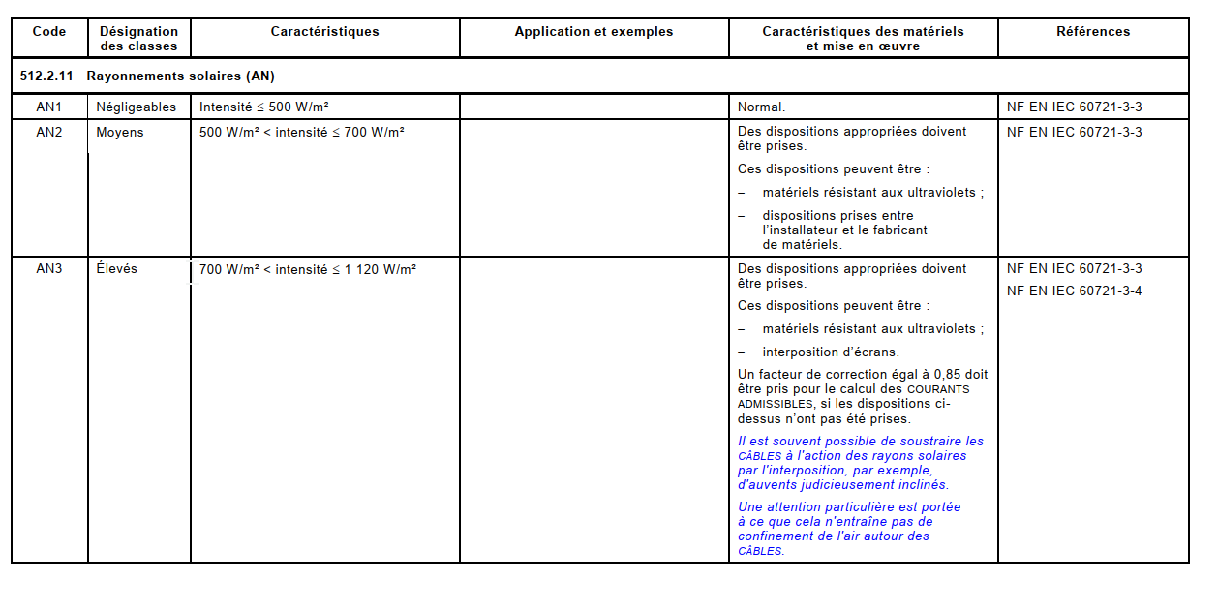
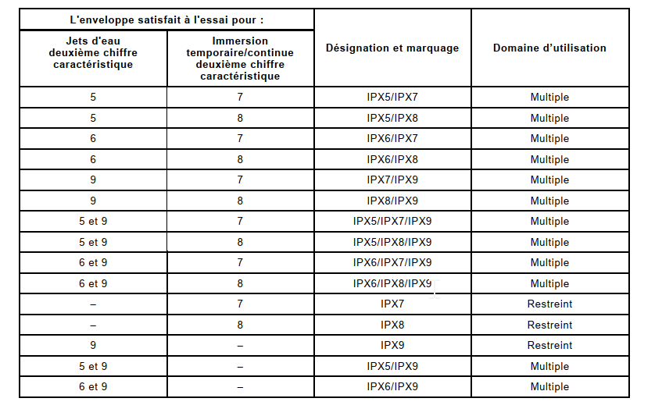
Detailed Compliance – Example 5
Importance of reading the standard
Example: common requirements for all equipment - ≈45 pages to be studied by the equipment managers.
In this review, we do not assess such detailed compliance for specific equipment or installations. It remains the responsibility of each equipment owner to be aware of, and ensure adherence to, these requirements
Compliance
IP ratings
Solar radiation
External
factors

Slide 10
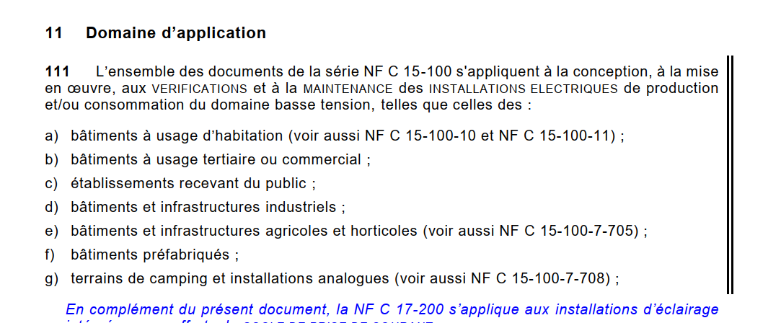
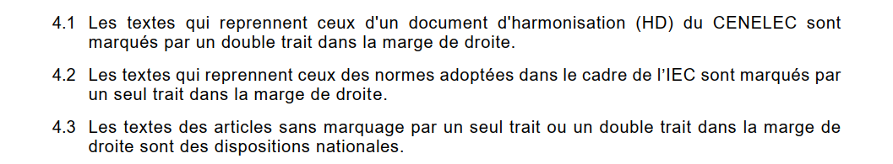
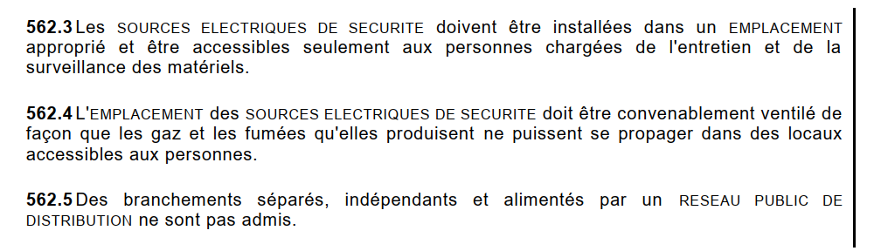
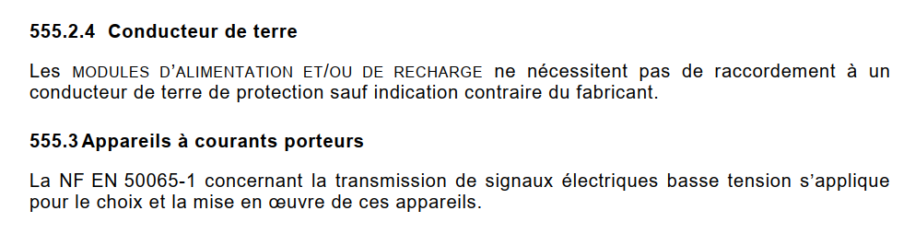
Preface
Revision bars
CENELEC Harmonisation
IEC Harmonisation
National requirement

Slide 11
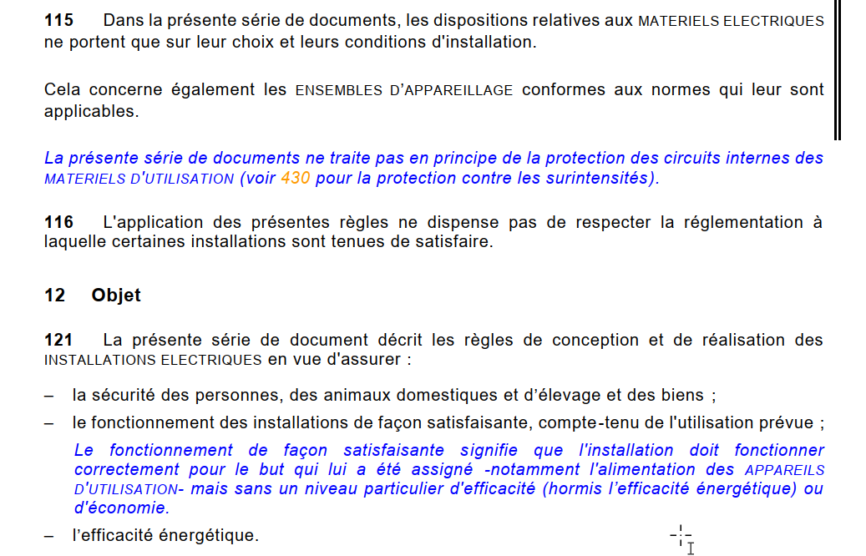
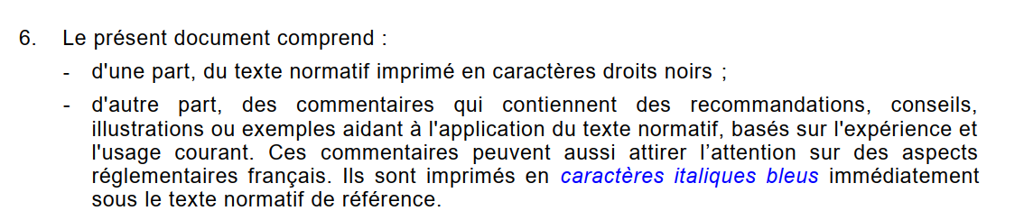
Preface
Text colour
Regulation in force
Recommendation based on current practices. We have observed that many of the blue paragraphs of old standard are now black

Slide 12
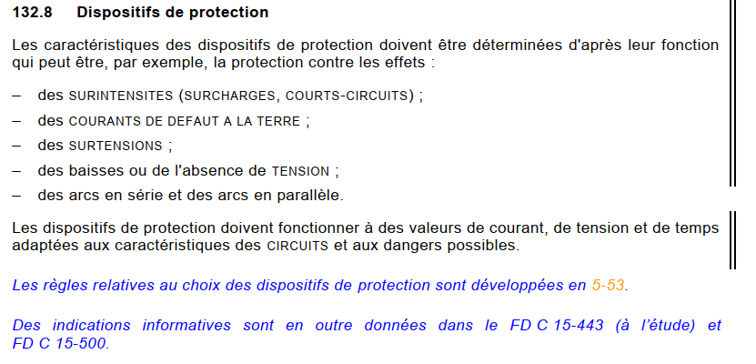

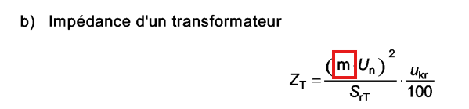
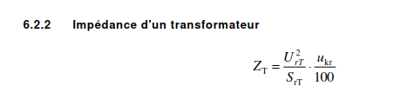

132.8 Dispositifs de protection
Modification of transformer impedance calculation formula
Change in the reference document regarding the calculation formulas.
UTE C 15-105 → FD C 15-500
There was an error in the formula for calculating the transformer impedance.
ElecCalc used this incorrect formula between 2012 and 2015 → non-conform switchboards.

Slide 13
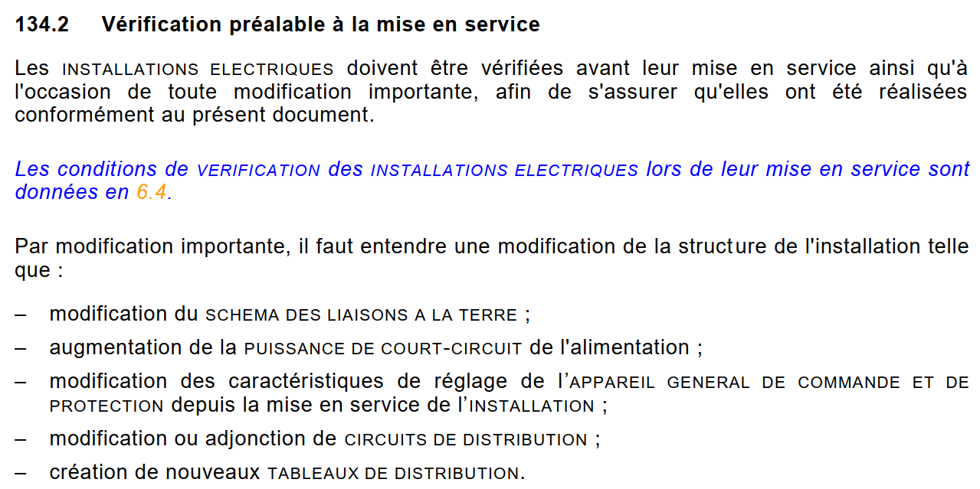

134.2 - Vérification préalable à la mise en service
Conformity with new standard and definition of “major modification”
Conformity to the new standard shall be checked before energization and upon any major modification, including, in particular:
Modification of the short circuit current or modification of the settings of the main incomer of the TGBT (= replacement of a transformer with different size)
Creation or modification of distribution circuits (= extension of circuits, increase of loads, …)
Notes:
The conformity checked - if done, are done after the energization

Slide 14
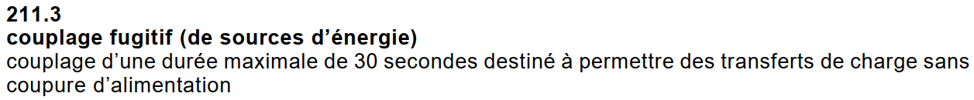
211.3 – Couplage fugitif
Maximum coupling time
The standard now indicates 30 seconds as maximum time two sources can be coupled during a transfer.

Slide 15
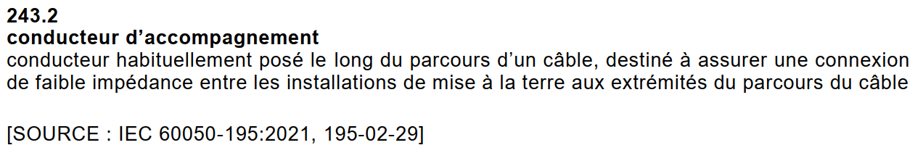
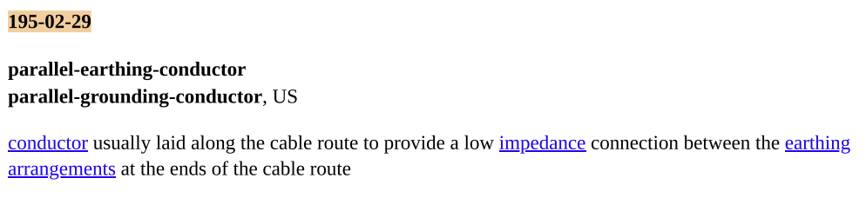

243.2 – Conducteur d’accompagnement
New definition of what we are already doing
The standard now includes provisions and a formal definition of the 120 mm² copper cable we normally route with our cableways runs.
It calls it “parallel earthing conductor” (English text from IEC standard).
(nota: the same was defined in other NF standards, not in the NF C 15-100)

Slide 16
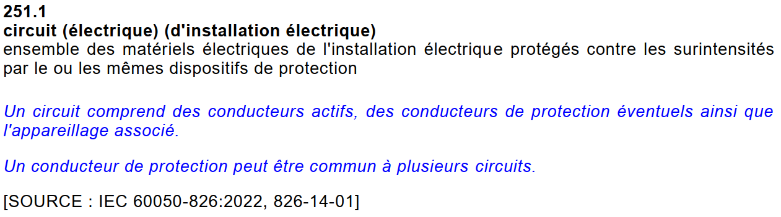
251.1 – Circuit (électrique) (d'installation électrique)
Small but important modification and precisions on common PE wires
The old text said:
Ensemble des matériels électriques de l'installation électrique alimentés à partir de la même origine et protégés contre les surintensités par le ou les mêmes dispositifs de protection.
The new standard removes the bold part: a circuit can have multiple origins.
Moreover, a PE can be common between more circuits, which validates our approach of using existing PE between buildings for different circuits issued from the same switchboard.

Slide 17
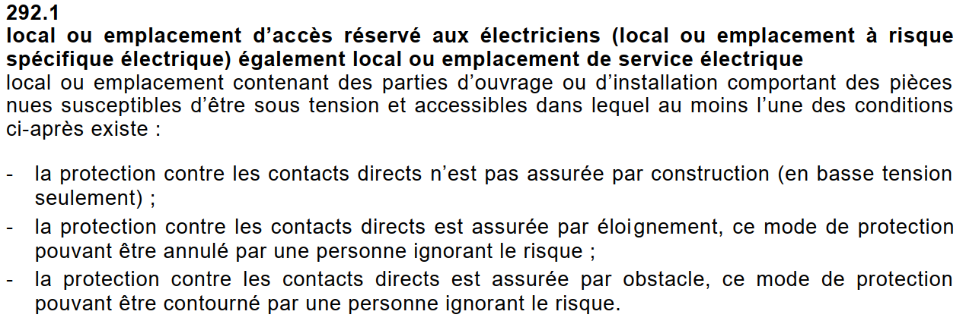
292.1 – Local ou emplacement d’accès réservé aux électriciens
Substations without live parts exposed are not reserved for electricians
Our typical substations do not fall into the definition of “location reserved for electricians”, (except the old ME10), because in normal conditions we never have live exposed parts.

Slide 18
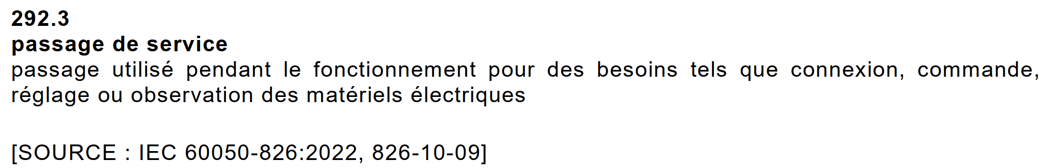
292.3 – Passage de service
Useful definition for non-MO EL member when defining roles for habilitation
New definition of “service access”.

Slide 19
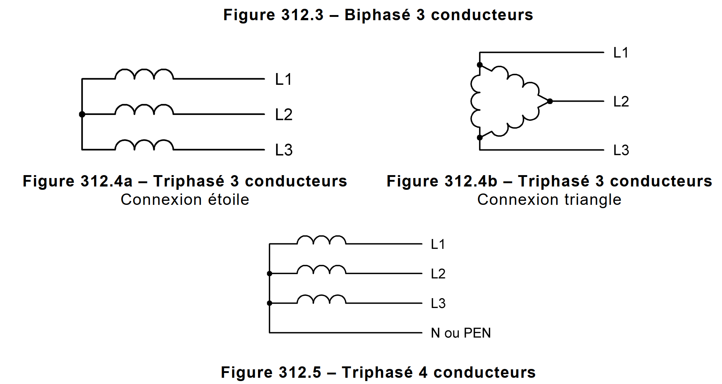
312.1.1 – Conducteurs actifs dans des circuits à courant alternatif
Standardise phase naming and align with IEC naming
Not directly related with the new standard, but in EL we should adopt the IEC nomenclature with reference to the naming of the phases, specifically L1, L2, L3 and N for conductors.
This means dropping the common “R, S, T, N” naming.

Slide 20
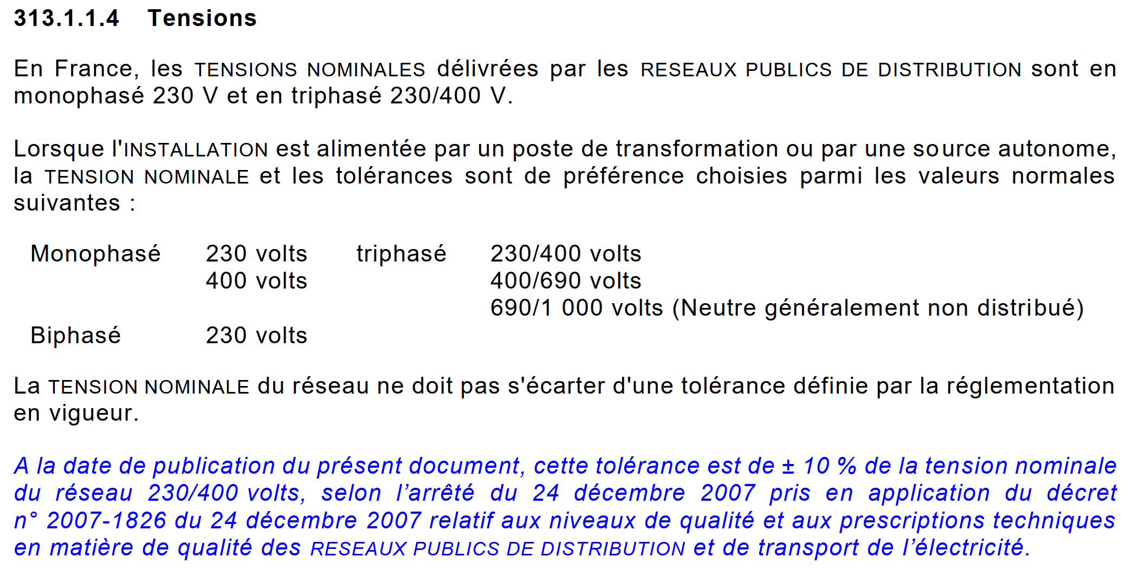
313.1.1.4 – Tensions
NF aligns with IEC on voltage tolerance
The NF now aligns with the IEC tolerance of
+/- 10 % of V_{n} (previously it was +6/-10 %)

Slide 21
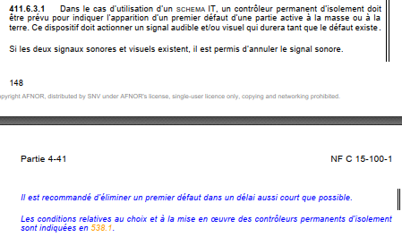
411.6.3.1 – Premier défaut schéma IT
Clearing the first electrical fault
In the previous version, there was less emphasis on this because continuity of supply was valued more highly.
In the 2025 version, for safety reasons, it is recommended to clear the fault as quickly as possible.

Slide 22
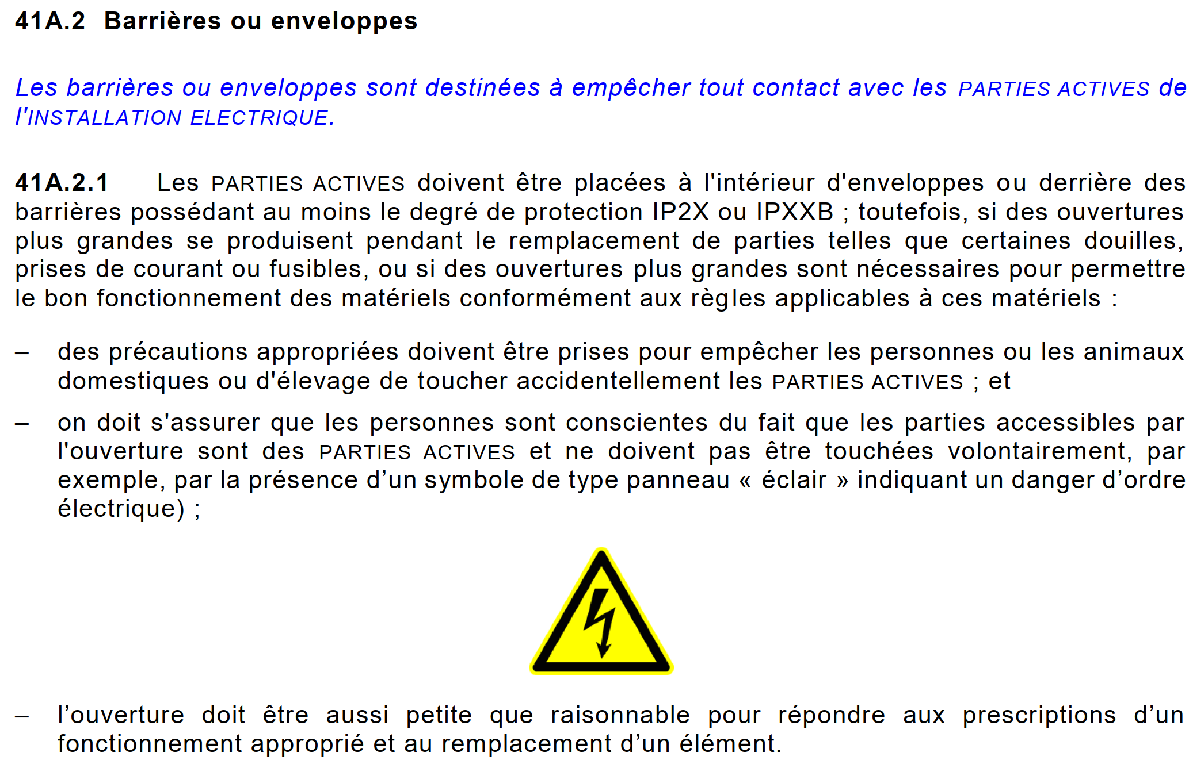
41A.2.1 – Barrières ou enveloppes
Symbol on last barrier before active parts
It is suggested to apply the “lightning” symbol on the last barrier before active parts.
E.g. cover of LV cables compartments?

Slide 23
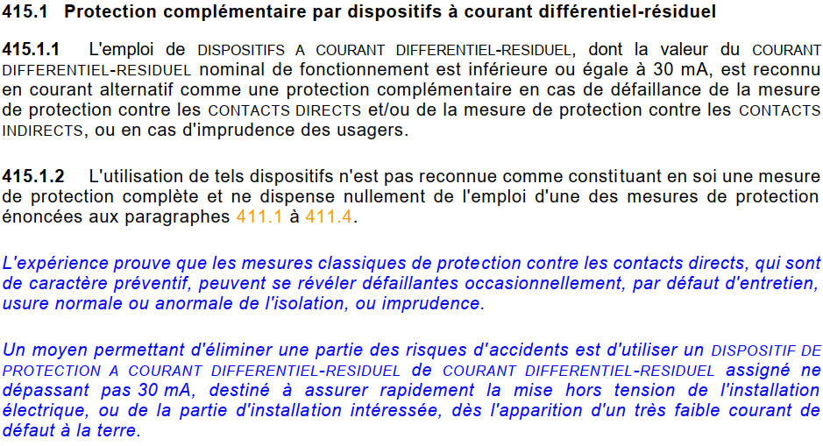
415.1 – Protection complémentaire par dispositifs à courant différentiel-résiduel
As a complementary protection, the RCD 30 mA can be used
The differential 30 mA protection can be used as a complementary protection in case of circuit breaker trip failure.
As an example, unknown distribution of lighting circuit can be complementary protected by RCD to guarantee the protection again direct or indirect contact.
Lack of calculation note implies the use of 30 mA RCD protection.
Notes:
Today we use 300 mA for lighting circuits

Slide 24
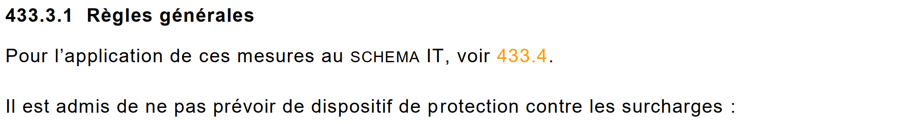
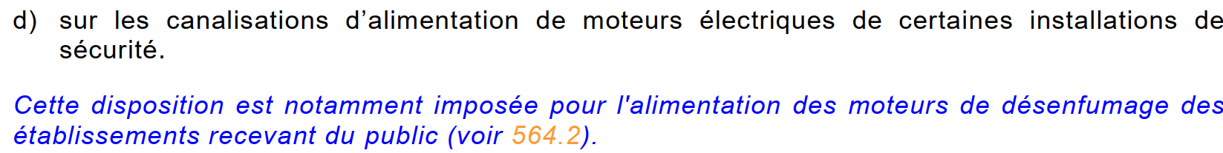
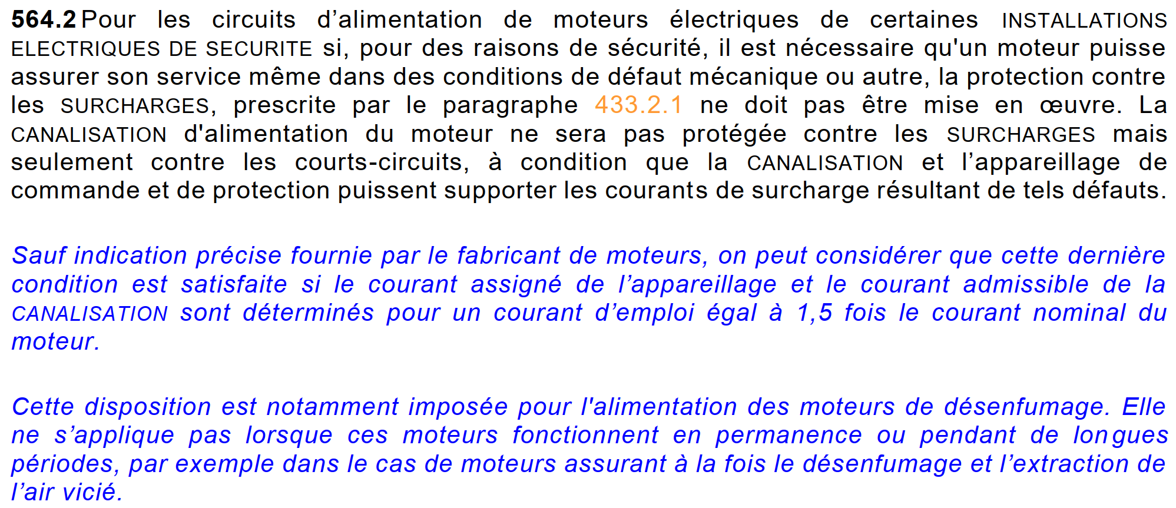

433.3.1– Dispense de protection contre les surcharges
No overload protection on safety motors
Smoke extraction motors, or any other motors that ensure people safety should not be protected against overload, being the people safety a priority over the equipment aging or thermal damages.
For public buildings this is mandatory.
Moreover, the circuit of these installations, shall be sized at 150% the rated current.
[…]

Slide 25
Multiple – Earthing resistance measurement
Lack of a solid procedure and data
We do not systematically do earthing resistance on NEW installations (nor older ones?), we lack a database or at least a dedicated place where to store this information.
Our current installation practices can be improved to allow an easier connection of measurements instrument (e.g. fond de fouille on a separate barrette).
As an example during the working group, we could not find the earthing resistance for the Science Gateway, and the one we found for PCC was done incorrectly.

Slide 26

4.42 – Classification of buildings environmental conditions
We have none
We do not have a reliable way to assess the environmental conditions of an installation,
BE2, BE3 conditions, etc.
We also lack a database to store these information (e.g. GIS portal).

Slide 27
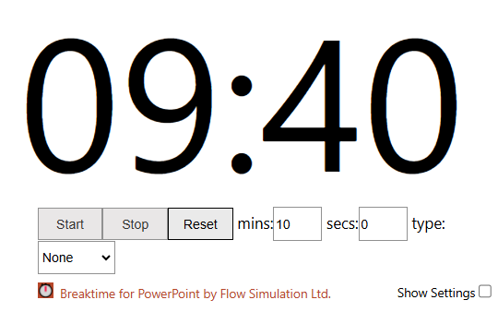
Discussion Break

Slide 28
4-42 – Protection contre l’incendie, les brûlures et l’explosion
Revisions in the NF C15-100-1 (2024) Update
Material Classification: Uses Euroclass system (A to F) for flammability (previously M0 to M4).
Euroclass Cable Ratings: Applies Euroclass types like Cca-s1,d2,a1 (replaces older system).
Dust Accumulation and Protection: Extra precautions required in dusty locations (AE4) to avoid heat buildup (new). Enclosures must be IP5X in dust and IP6X in conductive dust/gaseous environments (stricter).
Non-Propagation of Flame: Cables not embedded in non-combustible material must be flame-retardant per relevant EN standards (new requirement).
BE2 Locations Luminaires (Lighting Fixtures): Minimum distances from flammable materials: 0.5 m (<100 W), 0.8 m (100–300 W), 1.0 m (300–500 W).
BE2 Locations Heating & Ventilation Systems: Enhanced fire-prevention rules for the installation of heating equipment (more detailed than before).
BE2 Locations (Fire-Risk Areas): Control/protection devices installed outside BE2 zones (new)
BE2 Locations TBTS/TBTP circuits require IP2X/IPXXB enclosures and insulation withstands 500 V DC for 1 min.
BE3 Locations (Explosion-Risk Areas): Current Reduction Table 42.3 with specific coefficients (0% or 15%) based on auto-ignition temperatures.
Building hazard zones
must be classified

Slide 29
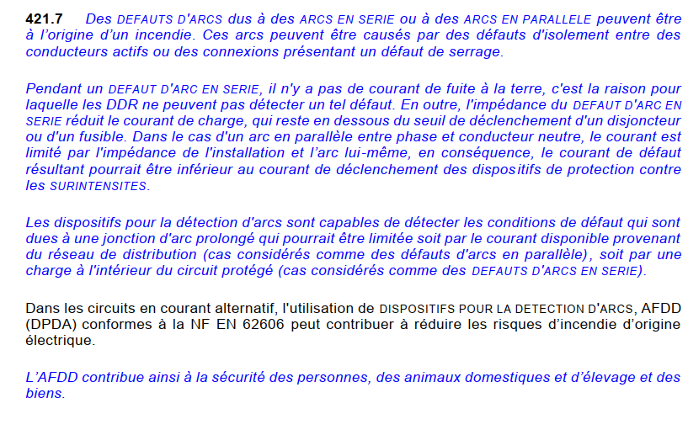
4-42 – Protection contre l’incendie, les brûlures et l’explosion
Arc Fault Detection Device (AFDD)
Arc faults can cause fires from insulation damage or loose connections which aren’t detected by RCDs, fuses or breakers
AFDDs (per NF EN 62606) detect dangerous arcs early to help prevent fires.
Boosts fire safety in both new and existing installations; complements but doesn’t replace other protections.

Slide 30
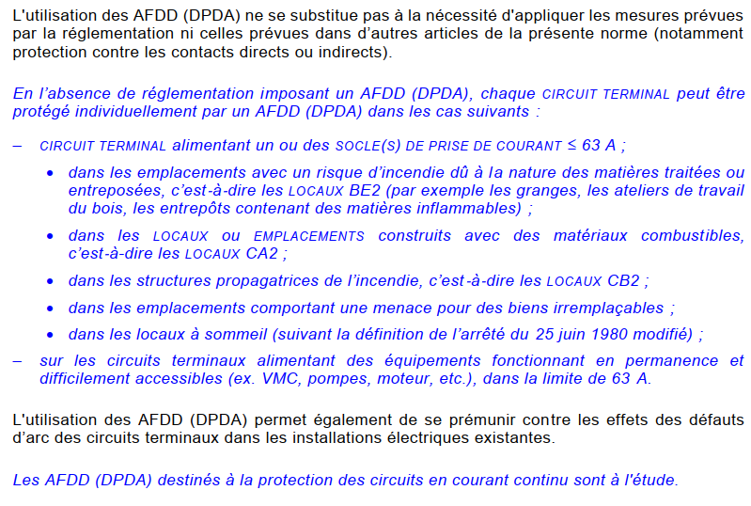
4-42 – Protection contre l’incendie, les brûlures et l’explosion
Arc Fault Detection Device (AFDD)
Recommended in:
▪️ Fire-risk areas (barns, woodshops, flammable storage – BE2)
▪️ Combustible buildings (CA2) and fire-propagating structures (CB2)
▪️ Places with irreplaceable items (e.g., museums, archives)
▪️ Sleeping areas (hotels, dorms, hospitals)
▪️ Circuits with critical/hard-to-access devices (e.g., VMC, pumps ≤ 63 A)

Slide 31
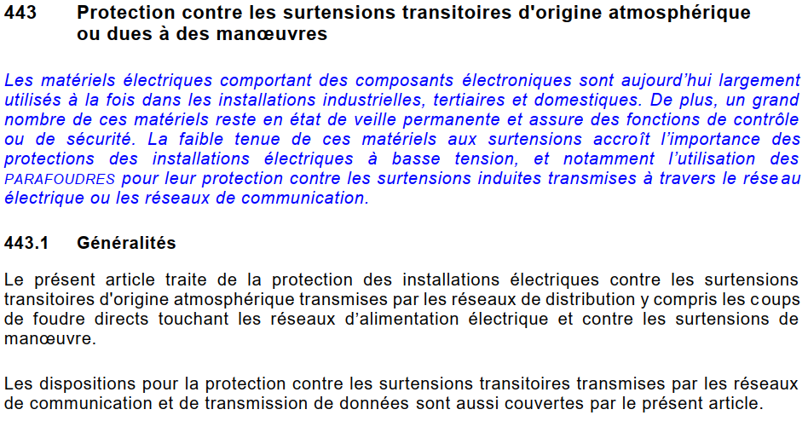
443 – Protection contre les surtensions transitoires d'origine atmosphérique ou dues à des manœuvres
Surge arresters are recommended not only for electrical network
The communication networks should be protected against overvoltage originating from lightning strikes or maneuvers.
More in next slides …
Notes:
What is blue now in x years can be black…

Slide 32
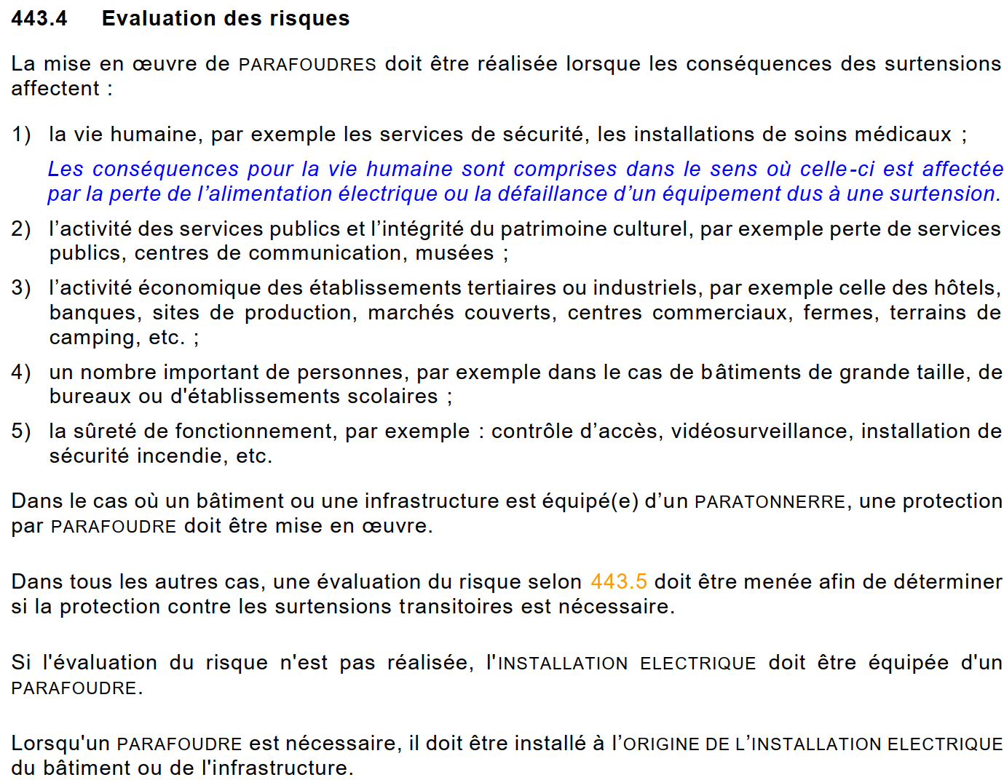
443.3 – Evaluation des risques (foudre)
Surge arresters are now de-facto mandatory at CERN
If the buildings has lightning rods we need surge arresters.
If not, we need a risk analysis.
If we do the simplified risk analysis according to the NF C 15-100, the result will very likely indicate that we need lightning rods.
Alternatively, a more detailed study could be done according to the EN 62305-2 e.g. (e.g. EDMS 1729268).
HSE to direct which standard to use.
If we don’t have a risk analysis, we shall install a surge arrester.
[…]

Slide 33
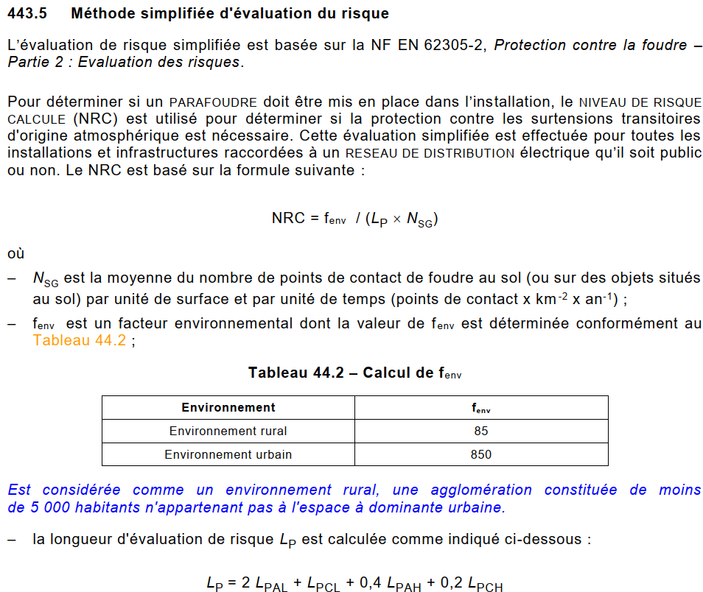
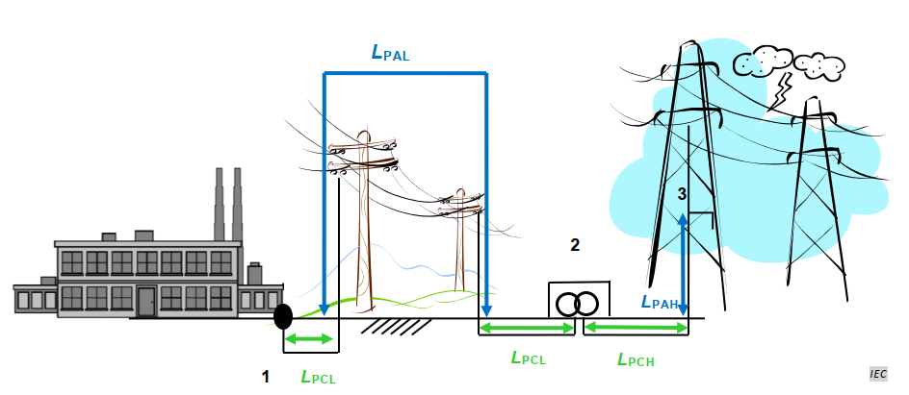
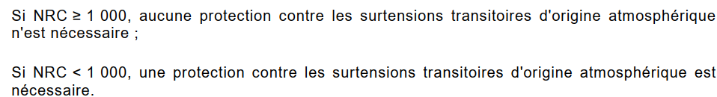
443.5 – Méthode simplifiée d'évaluation du risque
Simplified method yields always bad results for CERN
… when doing the calculations with typical CERN conditions, the result is always the same: we need to install surge arresters (NRC << 1000).

Slide 34
534.1.4 – Choix et mise en œuvre des parafoudres
We need CERN-wide guidelines on this
As the surge arresters are becoming de-facto mandatory, HSE is asked to establish clear guidelines on how to implement them at CERN.
There are multiple points in the new standard to be addressed, including the requirements on secondary SPD (do we need them, or one SPD on the TGBT is enough? If yes, then what about coordination?), installation (do we need an SPD for each incoming line, does the rule apply for adjacent buildings, …), SPD types, etc.
The SRF is already sent.
The SA18 building already requires installation of coordinated SPD – urgent topic.

Slide 35
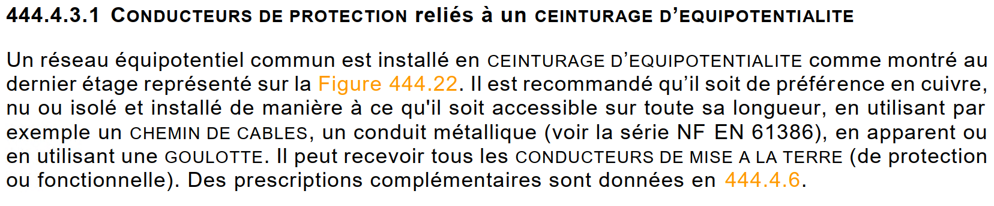
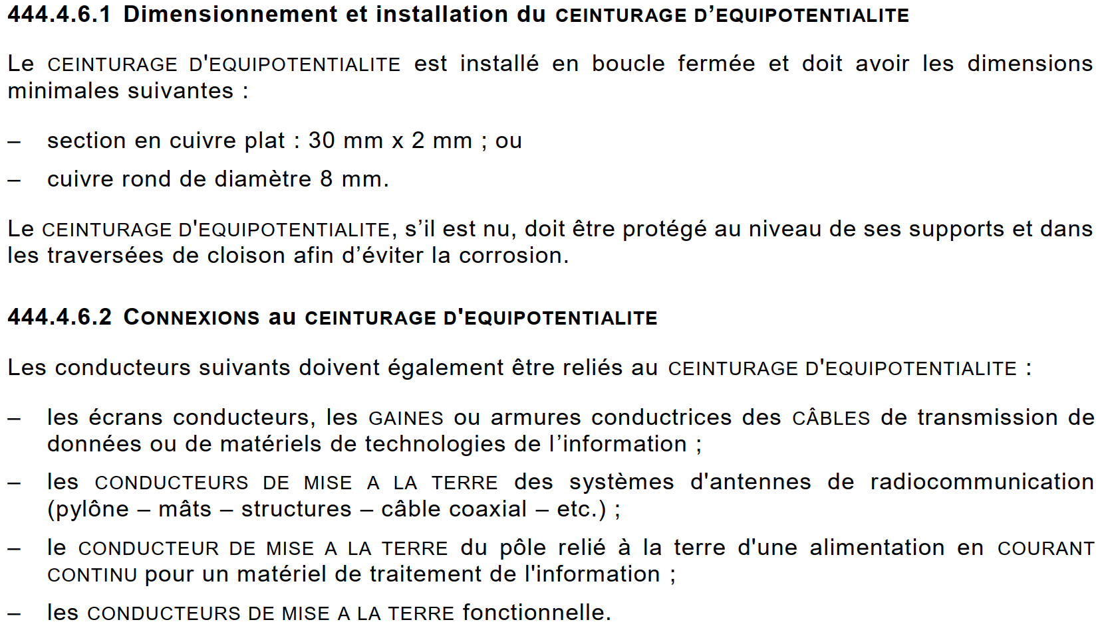
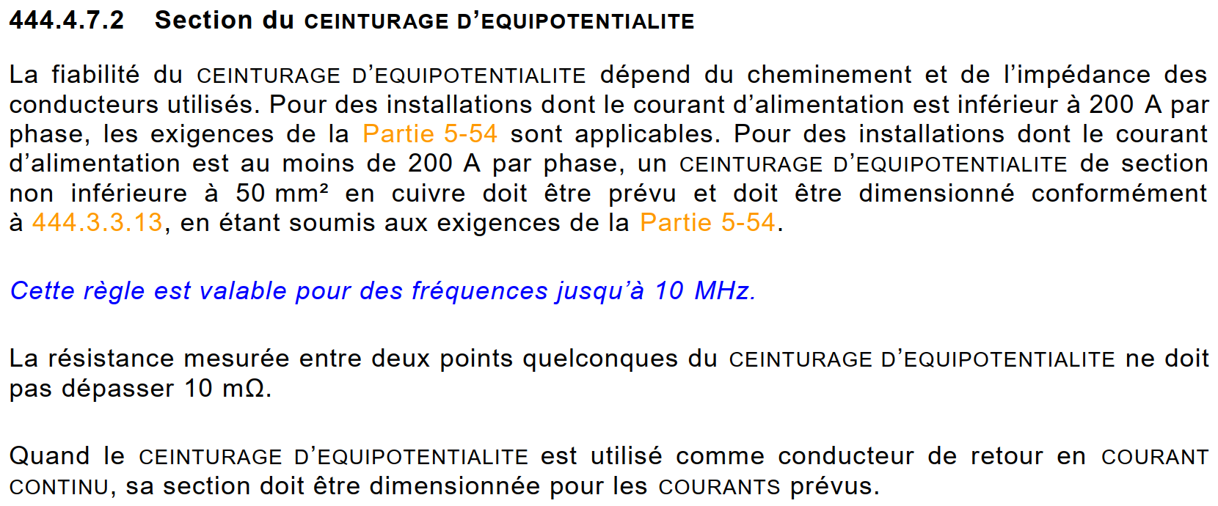
444.4.3.1 – Conducteurs de protection reliés à un ceinturage d’équipotentialité
New specifications about the equipotential bonding ring
Many new recommendations on how and when to install the equipotential bonding ring.
To be discussed for the PGI, prescriptions are to use 200 A as nominal current of a building to define if a ring is needed, maximum resistance of the ring to 10 mOhm (~120 m circumference with 120 mm², above we need multiple inner rings in the same building), protection when passing through walls, supported (not laying on ground), etc.

Slide 36
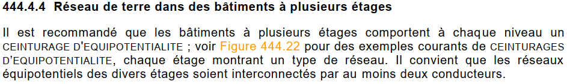
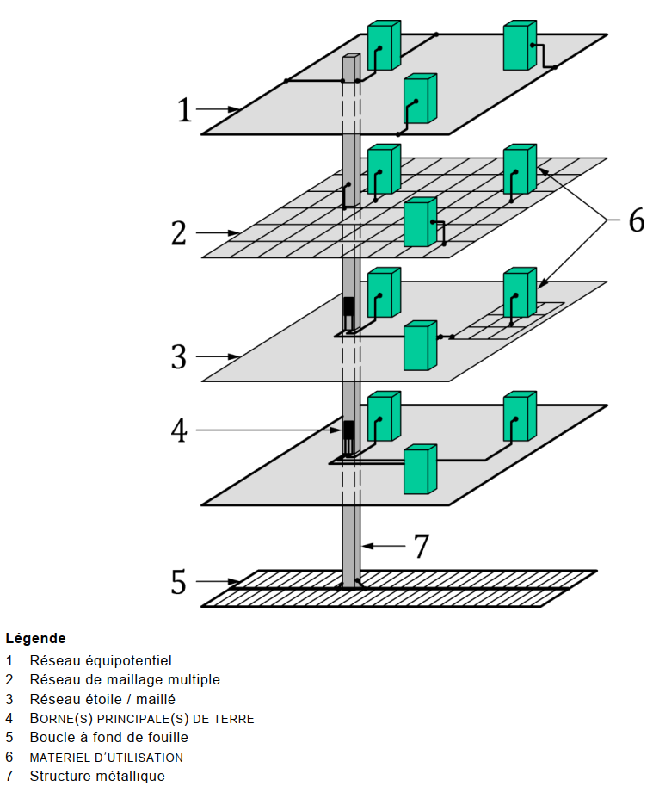
444.4.4 – Réseau de terre dans des bâtiments à plusieurs étages Equipotential loop on all levels
The equipotential loop should be present on each level of the building.
The interconnection of the loops should be done by using two conductors as a minimum.

Slide 37
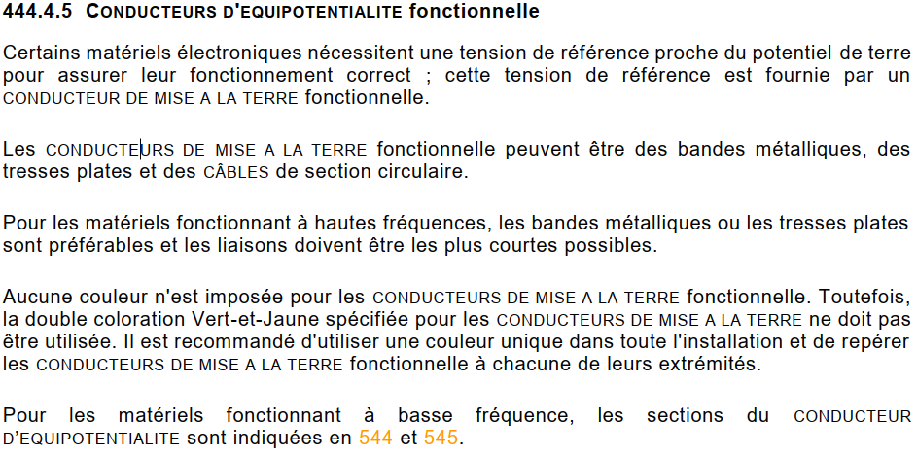
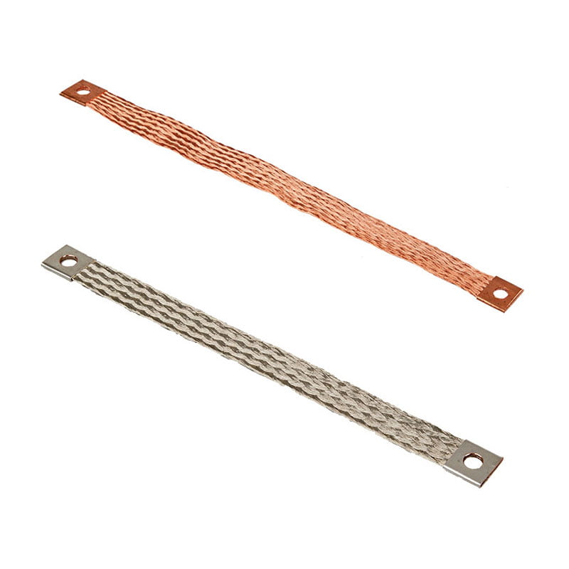
444.4.5 – Conducteurs d’équipotentialité fonctionnelle
Round cable is not the best solution for power converter earthing
High frequency can lead to skin effect on the round earthing cable.
It is recommended to use metal strips or flat braids.

Slide 38
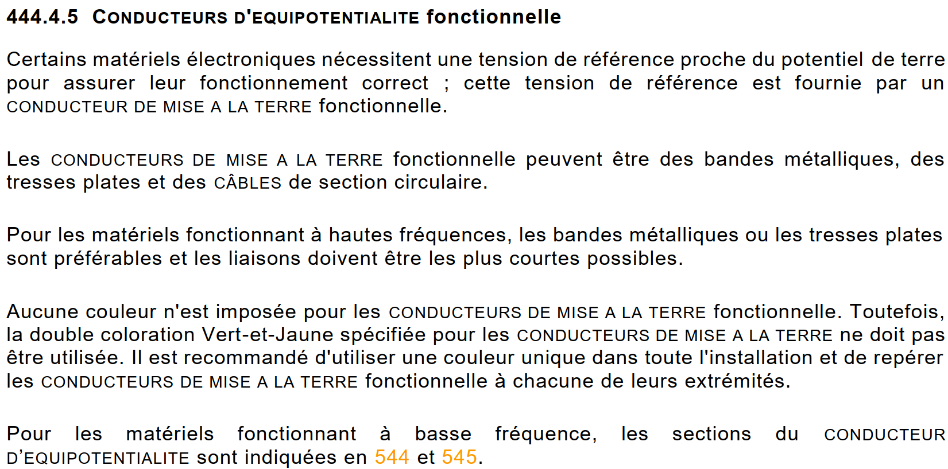
444.4.5 – Conducteurs d’équipotentialité fonctionnelle
New accent on the separation between PE and functional earthing
Information to be acknowledged by groups operating power converters or other equipment who may have a dedicated functional earthing not simultaneously serving as PE, in which case this earthing shall not be colored yellow/green (but pink, according to IEC 60445:2021).

Slide 39
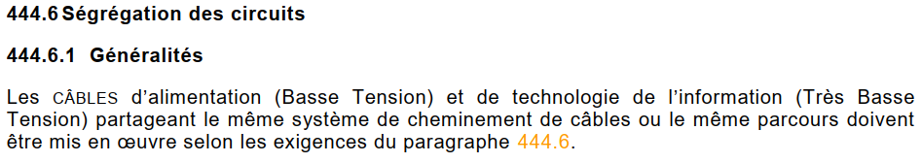

444.6 – Ségrégation des circuits
If a cable ladder EB+EC is used, then a proper separator is needed
Mixing power and communication circuits on the same cable ladder requires 1,5 mm thick solid metal separator.
Other type of separator implicates circuits spacing.

Slide 40

463.1.2 – Commande fonctionnelle
Single pole switching shall be on L, not on N
The standard allows the single-pole functional switching on neutral for lighting circuits, but it doesn’t allow it in any other case.
For sake of simplicity, we shall make sure that we never switch the neutral as a general rule.

Slide 41

464.1 – Coupure pour entretien mécanique
The “Inter BACO” now has an official name
The always-called “Inter BACO” now got a standard name “proximity lockout switch”.
We’ll probably keep calling it “Inter BACO”.

Slide 42



Multiple – Emergency cutoff vs AUG
AUG is to stop a process, emergency cutoff to remove an electric danger
The AUG is meant to stop a process (e.g. the beam) and an emergency power cut is to remove an electric danger.
Importantly, the emergency power cut explicitly does not require undervoltage coils.
The IS5 should be realigned with the standard (UV coil requirement and naming).

Slide 43



512.1.2 – Courant
New formula for the simultaneity factor of power sockets
The impact of the new recommendation is shown below:

Slide 44


512.2 – Influences externes
External factor(s) must be communicated by the client or project
This text is new:
The combined effect of multiple EXTERNAL INFLUENCES must be communicated in advance by the client or project owner in order to determine the corresponding equipment characteristics – this must be provided to those responsible for selecting, installing, and ensuring the correct functioning of the electrical equipment.
e.g. a Class II device must also be IPx4 rated if used outside, else the indirect protection could be nullified.

Slide 45



514.5.1 – Schémas et documentation
Electrical documentation for buildings containing workers
A new text has been added in the recommendation from the French law:
Essentially for buildings receiving workers (i.e. CERNs case), a list of documents are required, similar to our safety file. It does not explicitly state that it must be on site, but it must be available.

Slide 46



522.11 – Rayonnements solaires (AN) et ultraviolets
Cables in direct sunlight need screens or material resistant to UV
Cables exposed to direct sunlight must reply to the AN2 or AN3 external influence conditions:
Material resistant to UV (e.g. UV stabilisers)
Shielded appropriately
For AN3 a derating factor of 0.85 is also required.

Slide 47


523.1 – Généralités
Visual improvement in laying configurations
A considerable improvement is seen on the table layout, as the ampacity and configuration images are on the same page.

Slide 48


523.1 – Généralités
Cable ampacities have reduced slightly, and the 5% tolerance is not always allowed
Comparison of I_{Z} on a 400 mm² cable on a cable ladder 825 A → 823 A
The 5% tolerance is not always allowed (e.g. exclusion on Nappe and buried cables configurations)

Slide 49

523.1 – Généralités
Vertical spacing of cable galleries/construction spaces
A distance V is introduced giving the minimum height of a caniveau or construction space
De is the external diameter of a cable,
2.2 for trèfle and 3 for nappe configurations

Slide 50





523.5.1 – Groupement de circuits dans l'air
The chapter has changed and is missing some info from the previous version.
Essentially the chapter has been rewritten (less clear and omits important parts of the old standard).
Single-core cable groups are limited to 3, major impact for our LV transformer links (4 x 400 mm² in parallel) - Even though a maximum of 4 circuits are allowed in the standard
These are the only configurations provided for Trèfle configured cables on cable ladders. Does not match our configuration of 4 x 400 mm² touching

Slide 51



523.5.1 – Groupement de circuits dans l'air
Temporary resolution #1
CERN contacted AFNOR:
They confirmed that the grouping factors of the multiconductor in Table 52.13 can be used and that it will be updated in the UTE C 15-105. The value of 0.8 corresponds to the old standard in table 52N
Temporary workaround in ElecCalc:
1. Select single-core to assure the I_{Z} value is
correct
2. Use a CCF from table 52.13 of 0.8

Slide 52

523.5.1 – Groupement de circuits dans l'air
Temporary resolution #2
CERN also requested that AFNOR include the following cases in the standard, particularly regarding the effect of adding spacing between groups (reply pending)

Slide 53

Discussion Break

Slide 54


514.2 – Identification et repérage des canalisations
Cables should be identified at regular distances
Not normative but suggested to identify the cables every X meters to facilitate their tracking.

Slide 55


52.17 – Buried cables derating factor
Never install two layers of ducts underground
With the new derating factors, having two rows of underground ducts (unless they are VERY spaced), can easily and quickly derate all the cables inside to 0.4-0.5.
$$$ tradeoff to be remember when deciding between trench width or cables sections.
[…]

Slide 56

524.2.4 – Harmonic content of loads and derating
THDi measurement or information from datasheet gets more critical
To comply with the standard, we need THDi measurements or datasheets of loads.
Without this information, a derating factor shall be included.
Today we consider THDi = 16 % if no information, footnote (1), but most of our loads now actually falls into footnote (2), i.e. THDi > 33 % (without specifications or datasheets).
Note: The TH3 value is now in the formula and the derating has changed from 0.84 to 0.86

Slide 57



52.8F – Facteurs de correction de groupement
New clearances for cableways
Derating factors are now given for installation method considering cable ladders spaced by
30 cm (not 25 cm), 2 cm from walls and 22.5 cm when mounted one next to the other. Different configurations shall be derated.
Possibly a linear derating ( 300 mm = 1 , 0 mm is equivalent to 2 layers of cables in the same ladder = 0.8 ?)
Question asked to AFNOR, reply pending.

Slide 58

521.10.2 – Mise en œuvre des canalisations
Stick with 30% max occupancy ratio in ducts
The standard impose 33% occupancy ratio in conduits. The NF C 13-200 impose 40% for multicore cables and 30% for single core cables.
Proposal is to update the PGI and stick to
30 % ± 10 % maximum occupancy ratio for our installations, no matter the voltage level.

Slide 59

521.2 – Choix des canalisations
Same circuit = same cable ladder
A new note now indicates that ALL the conductors belonging to a given circuit shall be installed on the same cable ladder.
If we have 8 cables per phase (e.g., twisted cables), they shall lay on the same ladder!

Slide 60

521.4.2 – Coupleurs d’installation
Read “connectors without need of RCDs”
The standard keep RCDs mandatory on power sockets, however it doesn’t explicitly mention it for “installation couplers”. These are connectors meant to be disconnected off load.
The “installation couplers” shall be installed in an inaccessible way, in e.g., under the false floor.
This somehow integrates in the standard the approach already adopted for the PDU and detailed in the HSE memo for the specific application.

Slide 61

522.8.3.2 – Minimum bending radius for ducts
New reference table to use in case no information available
A new table provides minimum bending radius for ducts, where no indications from the manufacturer exist.

Slide 62

522.8.8 – Parcours des canalisations
Don’t go Escher when tracing cableways
Cable ladders shall be vertical, horizontal or parallel to the corners of the walls.

Slide 63

523.4.3 – Résistivité thermique du sol
The correction factor reference value changed
The correction factor equal to 1.0 starts from resistivity of the soil equal to 2.5 K.m/W.
In the old standard correction factor 1.0 was referring to 1.0 K.m/W.
As written in table 52.8H, in France most common thermal resistivity is 1.0 K.m/W.
This value of thermal resistivity has been proven by doing measurements in 2024 for MP7 ampacity study.

Slide 64

523.7.2 – Câbles monoconducteurs en parallèle
Not more than 4 cables per phase in // if single core cables are used
The wording of the new standard clearly doesn’t allow more than 4 parallel conductors, in which case BTS shall be used instead.
For twisted cables: the standard is slightly ambiguous regarding whether the number of conductors in parallel is limited to four or not. Technically it should not be limited to four. A clarification request has been sent to AFNOR (pending feedback).
[…]

Slide 65

523.8 – Variations des conditions d'installation sur un parcours
Maximum wall thickness to be neglected in thermal calculation reduced to 1/3
In the previous standard, a cable passing through a wall (or other variation in installation method) up to 1 m could be neglected.
Now this limit is ~1/3, equal to 35 cm.
This can impact especially installations with large walls (radiation shields), but also many other cases previously ignored.

Slide 66

526.2.1 – Caractéristiques des dispositifs de connexions
New chapter on rules for terminal connections
Terminals (BORNES) must respect their assigned capacity — no conductors larger or smaller than declared limits.
Rules for connecting multiple conductors to one terminal:
Same material
Similar cross-sections (max 1 size difference ≤ 4 mm²)
Connection must prevent accidental removal
Tightening force must not damage terminal or conductor
Clearer rules for screwless/automatic terminals
Repiquage (tapping conductors) detailed more precisely, with explicit conditions (same nature/section, terminals designed for it
…
Proposal is to update the PGI (where necessary)

Slide 67

526.8 – Connexion de conducteurs multibrin
New chapter on rules for terminal connections of stranded cables
Use appropriate connectors or treat conductor ends properly
Tin soldering of stranded ends allowed only with appropriate connectors
Tin soldering not allowed where subject to movement or vibration
…
Proposal is to update the PGI (where necessary)

Slide 68

529.7 – Chemins de câbles et échelles à câbles
We need MORE zip ties…
New requirement of minimum spacing for cableways installed perpendicularly to the walls.
For PGI update.

Slide 69



531.3.5.2 – Schéma TN
Local earthing resistance measurement & pulling of PEs
If certain masses are not electrically connected to the masse of the TN system or have their local earthing system, they shall be considered as a TT system, requiring:
An RCD
Local earthing measurement
Alternative is to connect these masses to the main TN system earth by pulling a PE or by pulling a grouped PE conductor (see section 251.1)

Slide 70

533.1.3 – Exigences générales relatives aux disjoncteurs
CB settings shall be visible
Today our Type 1 switchboards do not have visible settings for circuit breakers (unless the drawer is extracted).
Future tenders shall impose this requirement (e.g. little window to allow inspection when the CB is in service).

Slide 71

533.3.1.2 – Schéma TN (pouvoir de coupure sous un pole)
The single pole breaking capacity issue is still unsolved
The long-standing issue of lack of information about the single pole breaking capacity for ABB breakers (and some for SE) is still unsolved.
The standard is now much clearer and gives solutions for domestic CB, but for industrial CB it bounces back the responsibility to the manufacturers.
To be remembered in future tenders, we need to know these values to comply with the standard.
Equipment responsible to please get this value from the manufacturer and to add the requirement to have this data for the future tender

Slide 72

537.1.2 – Dispositifs pour sectionnement et coupure
Indicate all incoming supply of the equipment
Equipment shall have an indication mentioning all the supply origins.
Not new and already present in the older standard, just a reminder to make sure we do this consistently on all equipment.

Slide 73

538.1.3 – Réglage des contrôleurs permanents d'isolement
Suggested CPI settings
The standard now suggests alarm settings for CPIs, to be checked what are our standard settings and reflect whether or not adopt the suggested ones / make sure they are consistent across the network as well.

Slide 74

538.3 – Contrôleurs permanents d’isolement pour la surveillance des matériels hors tension
Safety equipment deenergized by default require CPIs
All safety related equipment which are OFF by default and only turn ON during an emergency must have CPIs installed.
Major cost and implementation impact expected!
Example: If the supplying contactor of a smoke extraction system is normally open, a CPI shall be installed downstream.

Slide 75

551.4.3.3.1 – Exigences supplémentaires pour les installations comprenant des convertisseurs statiques
A solution to the small earth fault downstream of UPS
The standard finally recognize the UPS current limitation function as a safety measure enough to provide a formula to size the supplementary equipotential bonding to be used when earth fault downstream of UPS and limited by the electronic cannot be cleared by the CB and an RCD cannot be installed.
The formula uses the limitation current of the UPS and allows us to justify the absence of instantaneous trip for earth faults downstream of UPS.
Earthing installation shall follow accordingly.

Slide 76

551.7.1 – Générateur en parallèle avec d’autres sources
Protection against thermal effects and overcurrent
The previous version was limited to describe the synchronisation between different sources and the coupling protections.
New important consideration that may give rise to non-conformities.
With parallel sources, protections must have sufficient breaking capacity to protect downstream equipment and conductors.
Since our diesels can be paralleled on load while testing, the switchboards shall be sized accordingly (the Icc may be greater than
70 kA).

Slide 77

553.3.4.1 – Emplacement des ASI
New requirements for the positioning of UPS units
New requirements for the positioning of UPS units

Slide 78

553.3.2.2 – Application de la mesure de protection par coupure automatique de l'alimentation
Suggestions for next tender
Suggestion to integrate in the next UPS tender an “inverse” requirement for manufacturers: we specify the maximum breaker (e.g., C10) that we want to install downstream the breaker, and the UPS shall comply with this requirement.

Slide 79
Discussion Break

Slide 80

555.1.4 – Socles de prise de courant
Automatic trip in case of disconnection of plugs > 32 A
Only sockets equipped with mechanical or electrical interlocks preventing the disconnection onload can be installed.
Excerpt from GENEB___0027

Slide 81




555.1.4 – Socles de prise de courant
Need shutters on T13 sockets
The nonindustrial sockets (e.g. T13) shall now have shutters to prevent accidental ingress.
This impact all CERN sockets.
NOT OK
OK
(not impacted)

Slide 82

559.4.1 – Luminaires et installations d'éclairage - Généralités
New symbols for lighting installation
LIGHTINGS must be installed in line with the indications provided by the symbols in accordance with the NF EN 60598 series.

Slide 83

561.1 – Installations de sécurité
Diesels should start after AT
In CERN terms the “replacement source” is the auto transfer and the “safety source” are the diesels.
Since the safety source shall act in case of failure of the normal or replacement source, this suggests that the AT should act faster than the diesels.
For discussion in roadmap WG.

Slide 84

561.3 – Choix et mise en œuvre des matériels électriques – Installations de sécurité
CPIs need a signal and audible alarm
We have PSEN, nevertheless added for clarity if other users are not aware.

Slide 85

562.3 – Alimentation électrique des installations de sécurité
Access should be more restrained for safety sources
Safety power sources must be located in a suitable place accessible only to authorized maintenance and monitoring personnel.
Zone managers to verify this point (e.g. do cleaning staff have access to our diesel generators and AES?)

Slide 86

562.6 – Alimentation électrique des installations de sécurité
Safety network shall be sized with simultaneity factor = 1
The power of safety installations shall be such to allow ALL safety installation to run in the most unfavorable conditions.
I.e., simultaneity factor = 1.
Today we do not do that, and we apply a simultaneity factor in ESD networks.
Accurate and realistic load lists are extremely important not to oversize safety networks.

Slide 87

563 – Canalisations des installations de sécurité
New cabling classification
New cabling classification in accordance with the new European classification system Euroclass.
In 2015, use category C2 cables. With the new version, cables must meet the requirements for fire resistance and smoke emission, according to Euroclasses (B2ca, Cca, etc.).

Slide 88
563 – Canalisations des installations de sécurité
Safety cables through walls shall pass in ducts
When a safety cable passes through a wall an additional mechanical protection (duct) shall be added.
For PGI.
[…]

Slide 89
563 – Canalisations des installations de sécurité
No plastic zip-ties for fire rated cables
Fire rated cables and cable paths must remain securely in place during a fire.
For PGI.
[…]

Slide 90

564.1 – Tableaux de distribution de sécurité
TGS and TGBT can be in the same room
TGS and TGBT shall be two separate switchboards. However, they can be installed in the same room, the standard does not require separation of the TGS as we typically try to do.

Slide 91



570.2.2 – Batteries fixes
Non-slip service floor required around batteries > 120 VDC
For batteries above 120 V, a 1 m wide non-slip, insulated floor must be installed around them to prevent simultaneous contact with the ground and a battery element.
Note: Concrete is not considered as insulating.

Slide 92

570.2.3 – Batteries fixes
Do not disable the flow switch!
In case of insufficient air flow, the boost charge shall be blocked.
We already provide for this mechanism in our installations.
Bottom line: don’t disable the flow switch, it is mandatory to have it in working conditions.

Slide 93
Multiple – Building evacuation plan / escape paths
Lack of a solid and timely procedure
Today we do not get evacuation paths for new buildings or existing ones in time for our safety lighting studies, so we put the lighting by our best guess.

Slide 94



6.4.1 – Vérifications et mise en service
Installation verifications before handing over to the client
All installations must be inspected during implementation or once it is completed, and before being made available to the user. Temporary installations included.
When extending, adding to, or modifying existing installations, it must be verified that the extensions or modifications comply with the requirements of this standard and do not compromise the safety of the existing installation
Inspections must be carried out by a qualified person, competent in the field of inspections, with thorough knowledge of the provisions of this standard and of the applicable national regulations.
Hence, an inspector from Dekra/Bureau Veritas must verify every installation at the right time.
Even for modifications.

Slide 95

6.4.2 – Examen sur site
Site inspector roles to be clarified
“Examen sur site” is required before tests (“essais”) and measurements (“mesurages”) and energisation.
The “examen sur site” is intended to verify whether the permanently connected electrical equipment:
  Complies with the safety requirements of applicable equipment standards;
  Is correctly selected and installed in accordance with this standard and the manufacturer’s instructions;
  Shows no visible damage that could affect safety.
Today we have >120 non-conform underrated T3 SB installed at CERN which went undetected for decades.

Slide 96



6.4.2 – Examen sur site
Elements inspected
Different elements checked during the visual inspection in an Initial Inspection – for Project Leaders guideline. Examples:
Measures to avoid electrical shock
Presence of electrical schematics
Identification of circuits, circuit-breakers, terminal blocks
Accessibility and identification of emergency switch-off equipment

Slide 97


6.4.3 – Essais ou mesurages
Elements inspected
Different elements submitted to testing and measurement during the Initial Inspection – for Project Leaders guideline. Examples:
Continuity of PE conductors and equipotential bonding
Differential protection
Safety lights

Slide 98

6.4.3.7.1 – Vérification des conditions de protection par coupure automatique
Fault loop measurements #1
Essentially, the standard requires tripping devices to trip instantaneously in the event of a fault to protect against indirect contact. Therefore, the fault current must fall within the magnetic tripping range of the breaker (the basis of the TN-S system). This, in turn, requires accurate knowledge of the fault loop, including the protective earth (PE) conductors.
If this is not known, a fault loop measurement is required.

Slide 99



6.4.3.7.1 – Vérification des conditions de protection par coupure automatique
Fault loop measurements #2
411.4.4 – Fault current sufficient/not
It is essential to have PEs pulled for all installations that the data can be used in the calculation notes.
No calculation note = mandatory fault loop measurement (HSE to inform other services at CERN about this)
The installed cable lengths must also be controlled
415.2 you still need to trip regardless of SB
411.3.2.5
If the trip is not guaranteed, pull supplementary bonding (SB)

Slide 100


On Vérification Initiale et mise en service
Roles and responsibilities
Recommendation
All electrical services at CERN to re-read this chapter and compare it to current working practices to ensure we meet the requirements of the standard.
Roles, responsibilities and process to be clarified between each electrical service, HSE and the controlling bodies such as DEKRA/Bureau Veritas.
To request an Initial Inspection, please send the EDMS 1212097 to electrical-verifications.service@cern.ch.

Slide 101

6.5 – Vérification périodique
Spécificités
For information: since 2025, a non-conformity is noted by DEKRA/Bureau Veritas if the removal of the “plastrons” is not allowed by the equipment owner (obligation in France).
The settings of the protection devices need to be visible, to compare them w.r.t the Initial Inspection.

Slide 102

6.6.1 – Maintenance
Objective
Version 2002: only one phrase as obligation “les installations doivent être maintenues constamment en bon état”.
Version 2024: enriched content.
The “chef d’établissement” shall prepare procedures on maintenance, if none exist from the turnkey project contractors or the manufacturer.
Objective: ensure and maintain the safety of property, persons and their safe evacuation.

Slide 103

6.6.2 – Documents pour la maintenance
Preliminary documentation to gather onsite before executing maintenance
Before executing maintenance, multiple documents are to be collected by the responsible for the maintenance, such as plans, calculation notes, single line diagrams, layouts, cable lists, inspection reports, conformity declarations, …

Slide 104

6.6.3 – Les constituants objets de la maintenance
Examples of equipment where maintenance is expected to be performed
Examples of installations and equipment that shall be subjected to maintenance:
safety installations
switchboards
lights
EV charging stations

Slide 105
Discussion Break

Slide 106


6.6.4.6 – Prises de terre
Earth resistance values shall be controlled periodically
During maintenance, the earth resistance values shall be measured and controlled.

Slide 107


Tableau 61.3 – Maintenance tableaux électriques
Example on maintenance matrix on switchboards
Valuable example of maintenance matrix on switchboards.
Methods: Visual inspection, measurement, functional tests
Type of maintenance: During intervention, preventive, corrective
Actions: Repair, replace, clean

Slide 108

704.3 – Détermination des caractéristiques générales des installations (sur chantier)
Works where overhead lines exist
When a construction site is near overhead power lines, special precautions must be agreed upon with the line owner, taking into account the size of the machinery being used, such as cranes or scaffolding

Slide 109

704.4 – Protection contre les chocs électriques (sur chantier)
Barriers or obstacles not allowed on worksites
Protection against direct contact (e.g. accessible live parts) shall not be ensured by obstacle or distance on a worksite.
This means that no live parts shall be left uncovered on a worksite.
A “bache de protection” is not considered a protection on a worksite.

Slide 110

704.410.3.101 – Protection contre les chocs électriques (sur chantier)
All sockets shall be protected by 30 mA RCD, but …
… for sockets rated more than 32A the RCD is not mandatory for fixed loads which are supplied directly.
In this case, the circuit must be clearly marked "Non protected by 30 mA RCD".

Slide 111


704.5 Choix et mise en œuvre des matériels
Standards for the sockets
Standards for the sockets are updated.
Two new requirements added for the material selections:
AF: présence de substance corrosive ou polluante.
AF2 is corrosives or polluted areas.
CB: structures des bâtiments,
CB4 is flexible or instable installation like tents, inflatable structures etc.

Slide 112

704.542.2 – Prise de terre (sur chantier)
Temporary earthing needed before the fond de fouille is ready.
The boucle de fond de fouille is mandatory for all work-related buildings.
Before the fond de fouille is made, a temporary earthing shall be used!
On a new building we should install at least a temporary earthing rod.

Slide 113

704.56 – Installations de sécurité
Very generic condition
Who is responsible for deciding whether safety lighting needs to be installed on a construction site?

Slide 114

729.351 – Éclairage de sécurité (dans les soustations)
BAPI is back
Safety lighting is mandatory in the substations, and substations shall also be equipped with a portable intervention light, on batteries (BAPI).
The BAPI shall have its own dedicated power socket.

Slide 115

729.103 – Socles de prise de courant (dans les sous-stations)
At least one socket per room
In addition to the socket reserved for the BAPI, at least one 16 A 2P socket shall be present in each room.

Slide 116


729.30 – Détermination des caractéristiques générales des installations (dans les sous-stations)
Emergency exit doors are mandatory
Emergency exit doors (“anti-panic”), are mandatory and as such their renovation shall be included in every consolidation plan to comply with the new standard.
If the substation doesn't have them already, we shall install new ones.
Emergency exit door shall be at least 700 mm width and 2000 mm tall.
[…]

Slide 117

729.513 and others – Accessibilité
New minimum clearances in substations 1/2
New minimum clearance of 90 cm in front of the switchgear with the CB in extracted position.
This practically will result in 100 cm for front-to-front switchboards.
70 cm on the back part.

Slide 118


729.513 and others – Accessibilité
New minimum clearances in substations 2/2
50 cm from the drawer fully extracted or a door fully opened to a wall.
Applicable to racks? If so a 60 cm wide rack now needs a clearance of 110 cm from the wall.

Slide 119

729.513.3.3 – Accès des passages
Space for passage, and limits of dead ends
Maximum row length is 10 m, after which a 700 mm passage shall be provided. We normally use 800 mm so we are better than the standard.
Zones longer than 20 meters shall have at least 2 doors at the two extremities.

Slide 120

(8-1).10.2.2.2 – Transformateurs et bobines d'inductance
+2.5% tap is good!
For energy efficiency, a voltage equal to the nominal or slightly higher is preferred.
For roadmap and discussion on NLTC setpoint at + 2.5 %

Slide 121


8-1 : Efficacité énergétique
Preface on which recommendations to implement
The chapter provides several recommendations to follow; to our understanding, none are mandatory.
Rather than allowing each electrical service to decide independently what to implement, it would be preferable to establish a global strategy. Electrical Services, HSE, and CERN’s Energy Coordinator could meet to define clear directives.

Slide 122

(8-1).6.3 – Détermination de l'emplacement du transformateur et du TGBT par la méthode du barycentre
A.k.a. sci-fi power system design at CERN
Transformer and TGBT should be placed in a way to minimise losses (cables lengths), by using the barycentric method.
We should do that for new installations, but we already struggle to get normal load lists from users, imagine energy consumption forecasts.
To use this method, the estimated annual load consumption and operating mode of each load must be provided (in kWh)….
This is much more information than what is provided currently

Slide 123

(8-1).6.4.3 – Point de fonctionnement du transformateur
And we are even lower than that!
For energy efficiency the optimal loading of a power transformer is around 50 %.
We still are far lower than that, too.

Slide 124

(8-1).6.4.3 – Efficacité du transformateur
Are we good on that?
Are our 18 kV transformer specified with energy efficiency criteria?
If not already, keep in mind for next tender.

