Slide 1
CERN/EFP technical handshaking meeting

Slide 2


CERN/WLCG and EFP
We already had a presentation from EuroHPC Federation Platform (EFP) at the HEP/HPC Strategy Meeting last January
Today: going to more technical details!
Aims of the meeting:
  Understand better each other needs/capabilities
  Handshake on communication / work paths
  Discuss!

Slide 3
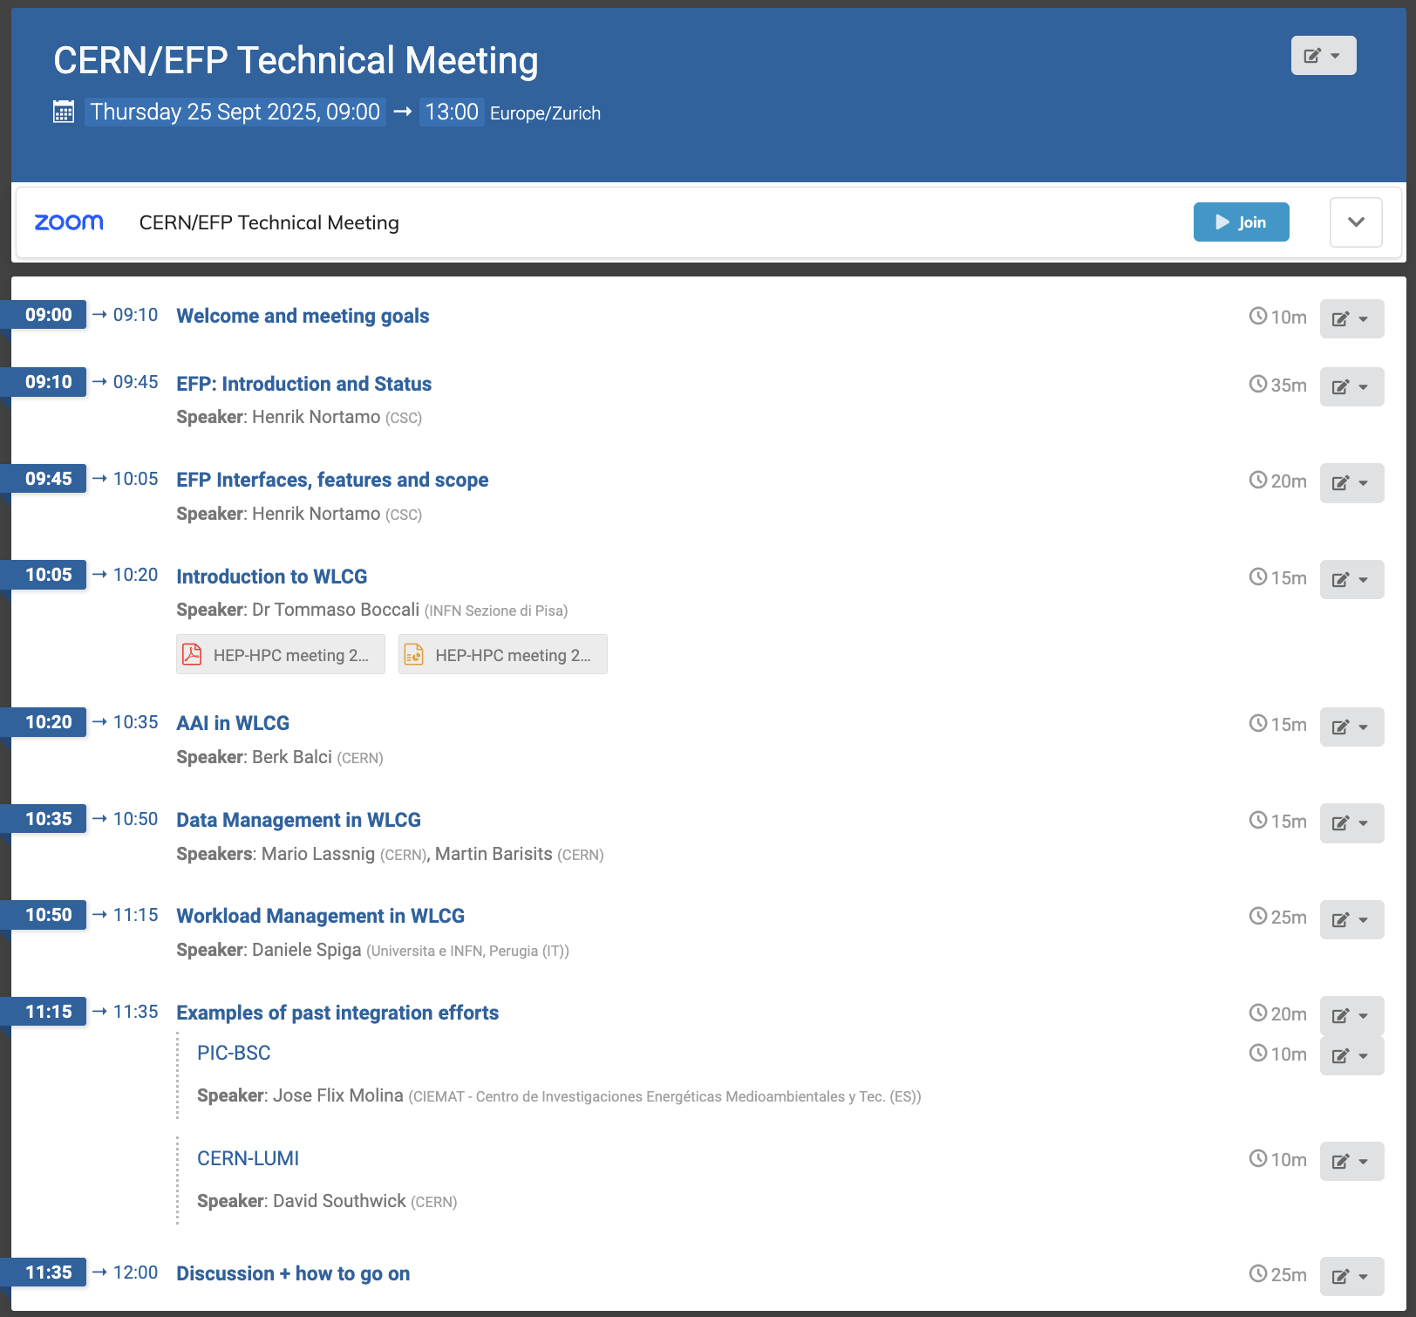
Today’s agenda
In January, on HEP side we had experiment-specific talks
Today, we are moving to technical aspects
  AAI, Data Management, Workload Management
+ a couple of short talks on previous integration experience (not meant to be comprehensive, there are obviously many more)

Slide 4
Some notes
(if no one objects) we will record the meeting
We have live notes here
We can have questions at the end of the talks BUT we also have a discussion slot at the end. Not a formal workshop, let’s do what is best for a productive meeting

Slide 5
Some possible discussion points
Which is the best way in which we can interact?
How can we open (more or less formal) channels of technical communication?
  On data management?
  On workload management?
  On AAI?
  Or are already tables opened with other user communities in which we can participate?
Is there a way to beta-test EFP from HEP side?
  E.g, is there a beta testing forum / list?
Would EFP need access to specific documentation / information to evaluate the needs of high energy physics?

