Slide 1
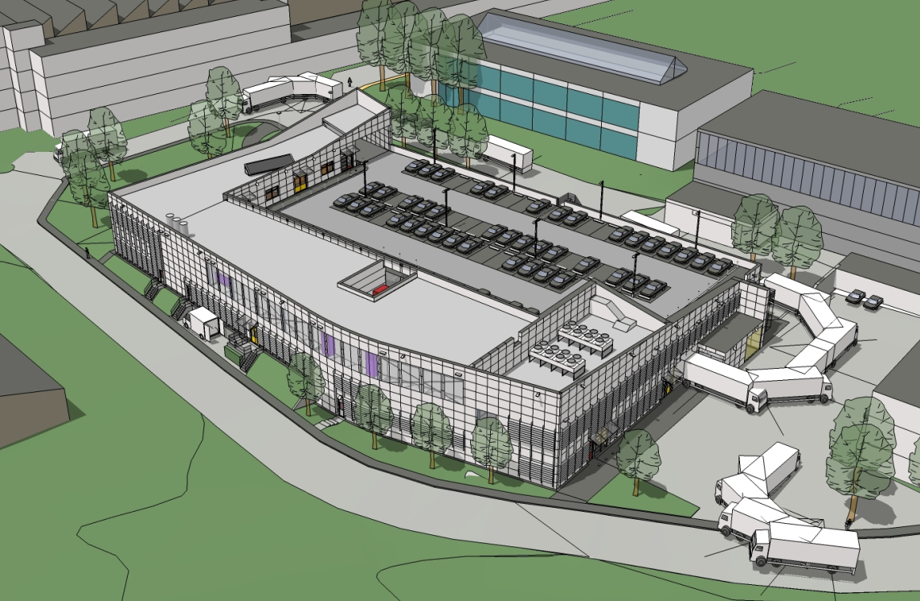
Building107 Update
New surface finishing workshop

Slide 2
Building107 Update
Goals to be achieved
General overview (of the building)
Into the details

Slide 3
Building107 Update
Goals to be achieved
Safety:
  Space for maintenance;
  Avoid workshop air contamination (extraction);
  Containment of chemicals.
Environmental:
  Avoid water and soil pollution;
  Avoid outside air pollution;
  Reduce water consumption.
Centralisation of activities:
  Move B867 cleaning workshop & electrochemical laboratory into the new facility.

Slide 4
Building107 Update
General Overview

Slide 5
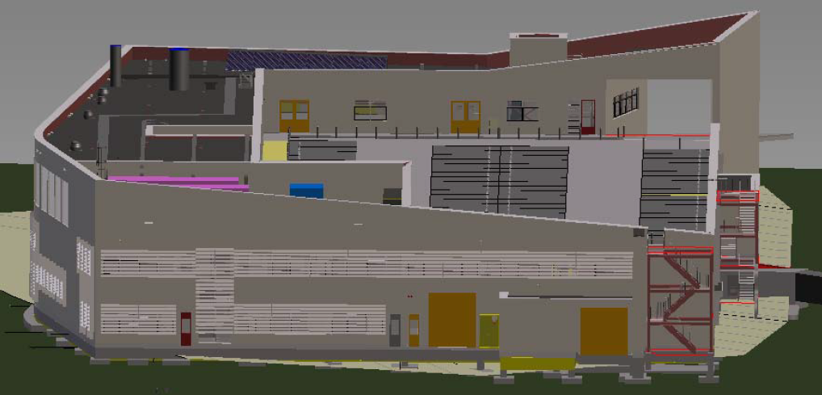
Building107 Update
General Overview
Salève side

Slide 6
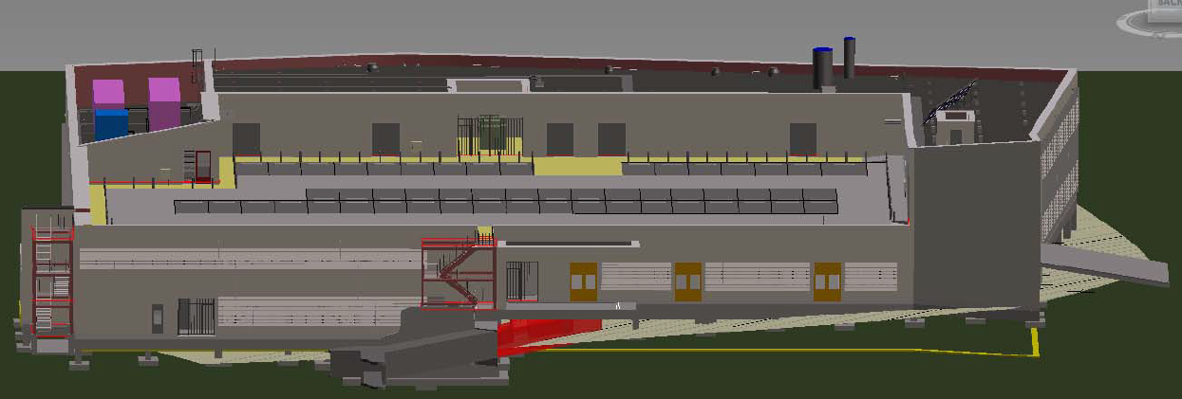
Building107 Update
General Overview
B. 29 side

Slide 7
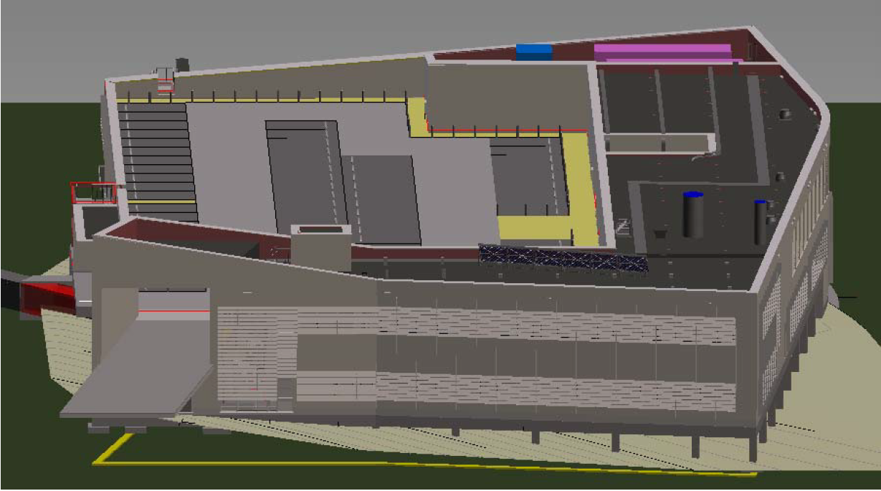
Building107 Update
General Overview
Jura side

Slide 8
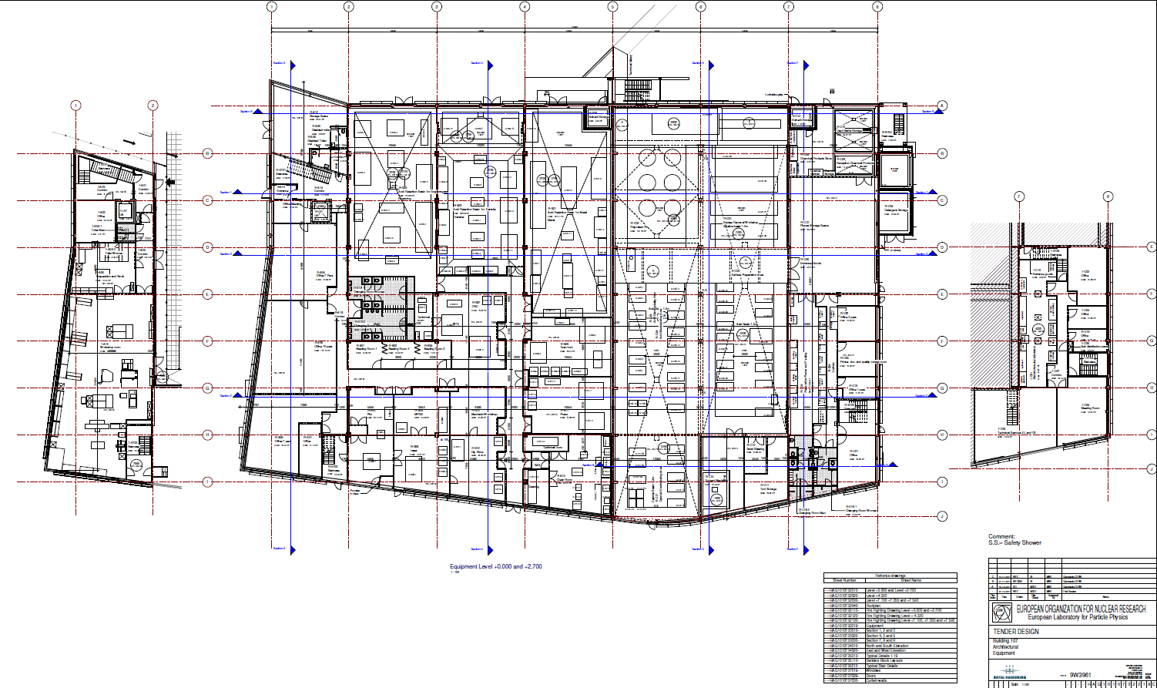
Building107 Update
General Overview
Layout

Slide 9
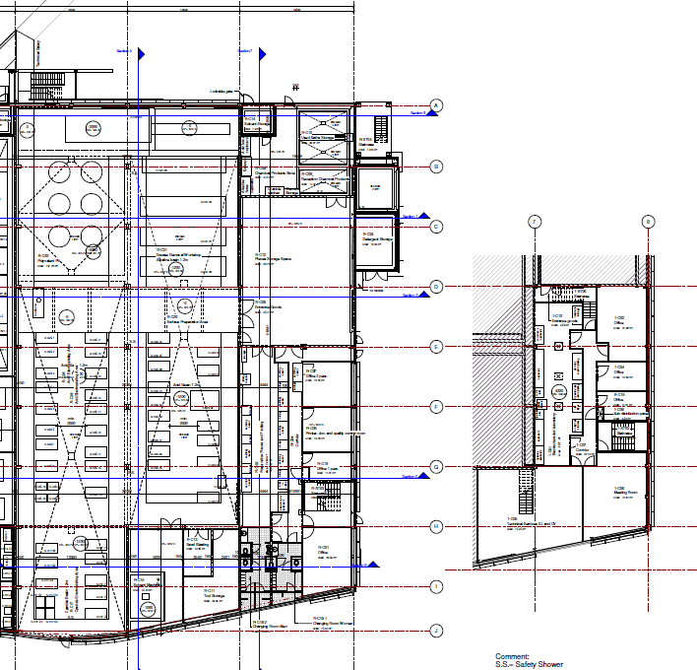
Building107 Update
Into the details
867
Functional Areas
Poly
Chemicals Storage
Parts Storage
Preparation
Acid
Prep.
Workshop
Electrochemical lab
Offices/CR/Meeting room
Cyanide
Sol/Blast

Slide 10
Building107 Update
Into the details
Access
Parts
Emergency exits
Persons

Slide 11
Building107 Update
Into the details
Access
Chemicals path

Slide 12
Building107 Update
Into the details
-0.2 m
Floor levels + Basins/Retentions
- 4 m
-1.2 m
Coated
concrete
0.0 m
Grated floor
-1.2 m
-1.2 m
-1.2 m

Slide 13
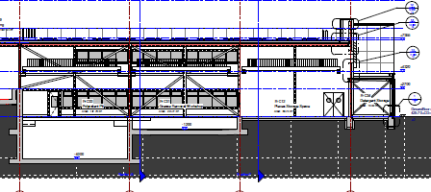
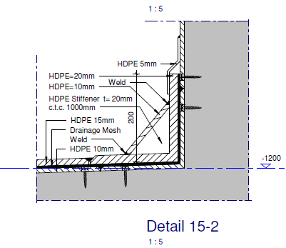
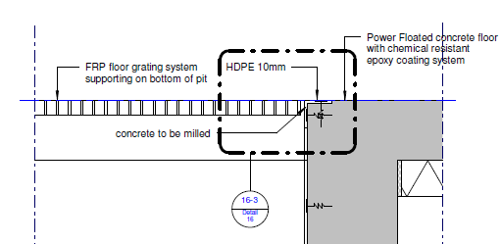
Building107 Update
Into details
Floor levels + Basins/Retentions

Slide 14
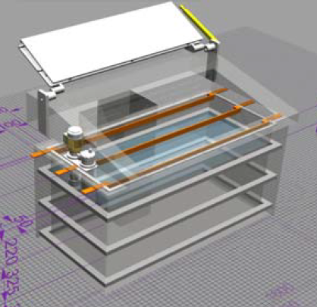
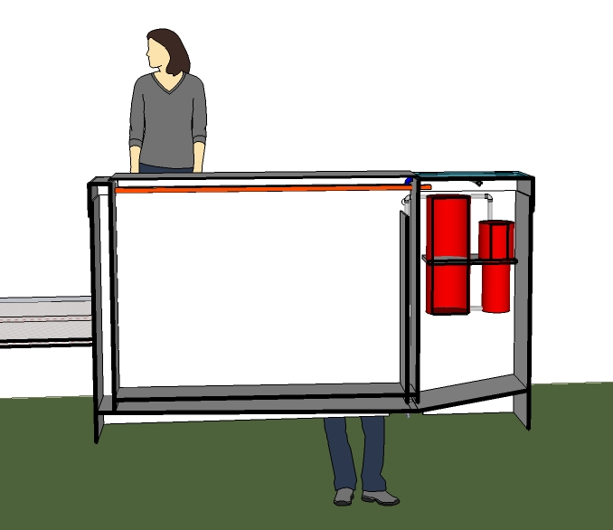
Building107 Update
Into details
Floor levels + Basins/Retentions
Tanks concept

Slide 15
Building107 Update
Into details
Extraction networks
Acid/Cr/Alkaline
Cyanide
Solvent

Slide 16
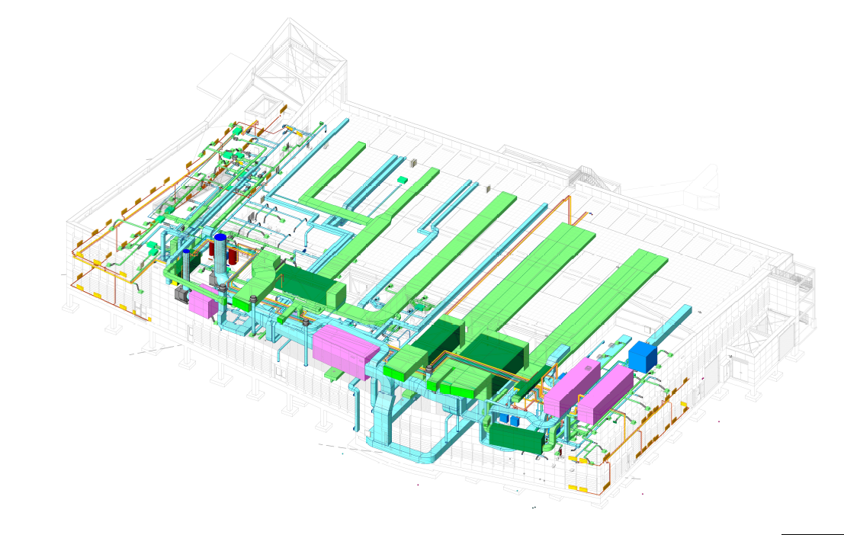
Building107 Update
Into details
Extraction networks

Slide 17
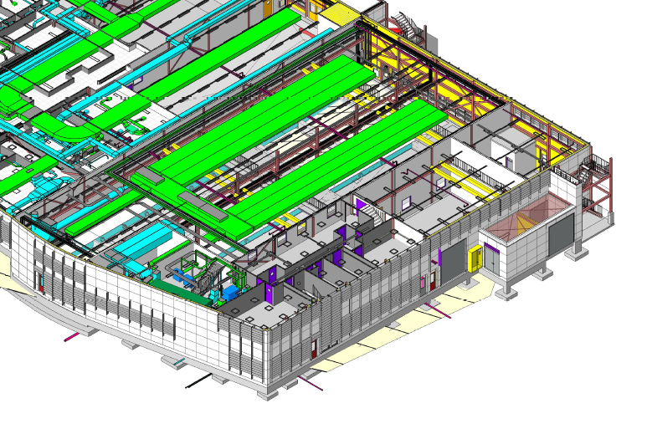
Building107 Update
Into details
Extraction networks

Slide 18
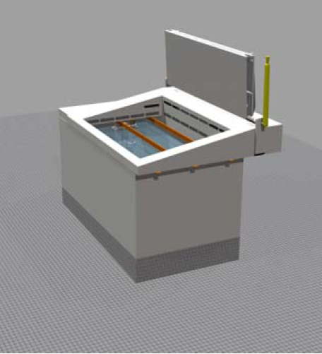
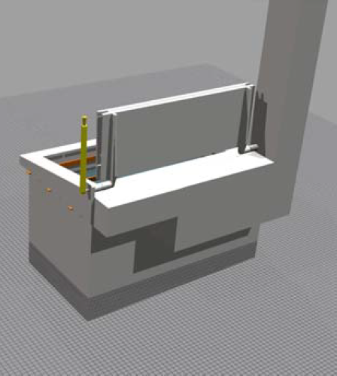
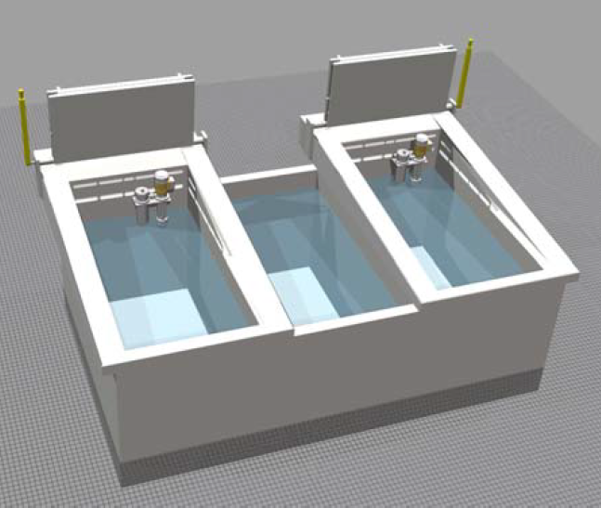
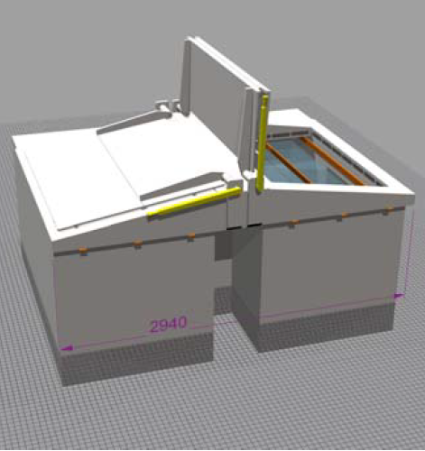
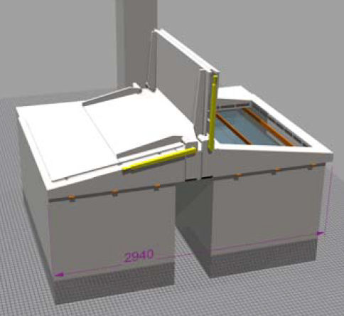
Building107 Update
Into details
Extraction networks
Tanks concept

Slide 19
Building107 Update
Into details
Space for maintenance

Slide 20
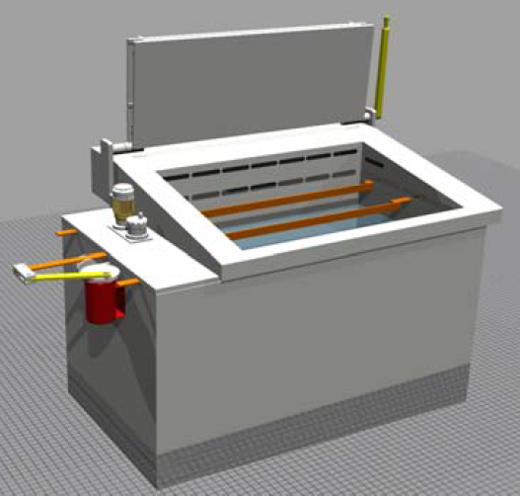
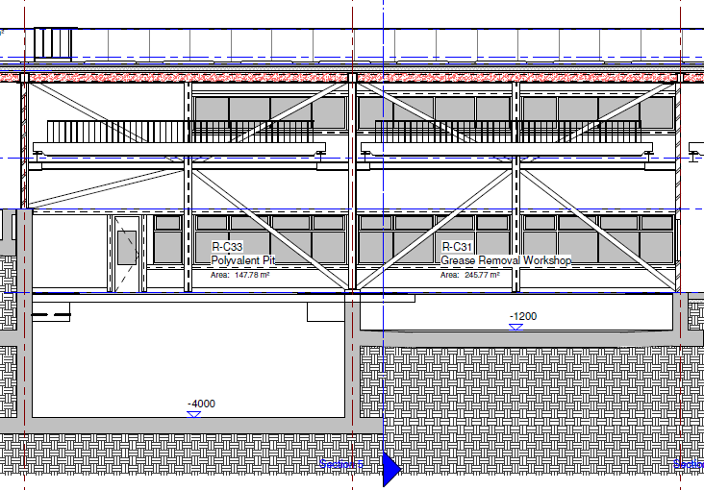
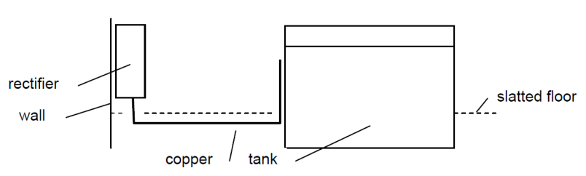
Building107 Update
Into details
Space for maintenance

Slide 21
Building107 Update
Questions

