Slide 1

WP4.2
I.Laktineh

Slide 2
WP4.2
Vacuum Photo-Detector
4.2.1: VPD: New material, new coatings, longevity and rate capability study
  D4.2.1: Production and characterisation of a new generation of MCP-PMT using innovative techniques. We will develop new MCP either with low resistivity lead glass or other materials (alumina, silicon, etc) with smaller pitch to reach better spatial and time resolution. ALD techniques will be tested to prolong the lifetime of the new MCP
4.2.2: VPD-PMT: New photocathode materials, structure and high quantum efficiency VPD
  D4.2.2:Production and characterisation of photocathodes either transmissive or reflective made of different materials using different structures and in particular a granular one to improve on the spatial resolution
4.2.3: VPD time and spatial resolution performance
  D4.2.3: Production and test of read-out system demonstrators able to fully exploit simultaneously timing and spatial resolution of the MCPs (tens of microns and tens of ps). The development will use the PICMIC and Timepix concepts as baseline to advance the state of the art.

Slide 3
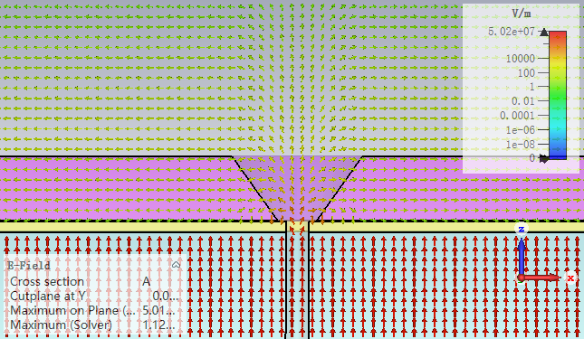
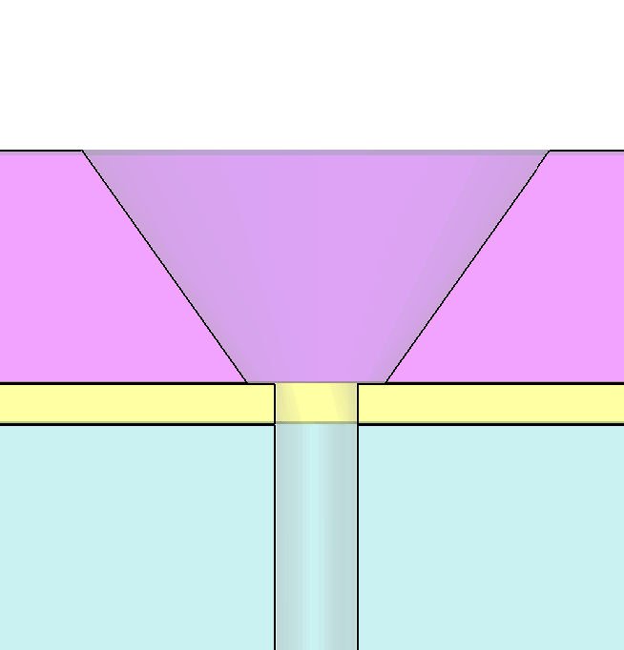
Simulation team:
IP2I: H. Abreu, G. Garillot and Th. Dimov
XiOPM: X. Zhang
IHEP: L. Chen, X. Li and x. Wang.
Objective: Develop the needed tools to simulate the response of new MCPs and the different kinds of photocathode
If you are interested to join you are welcome.
Simulation based on CST by X. Zhang
0eV

Slide 4

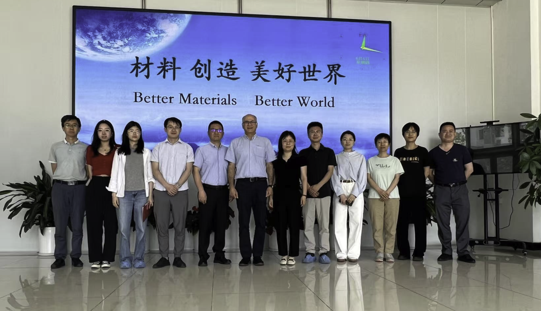
New industrial partner : CBMA@Beijing

Slide 5
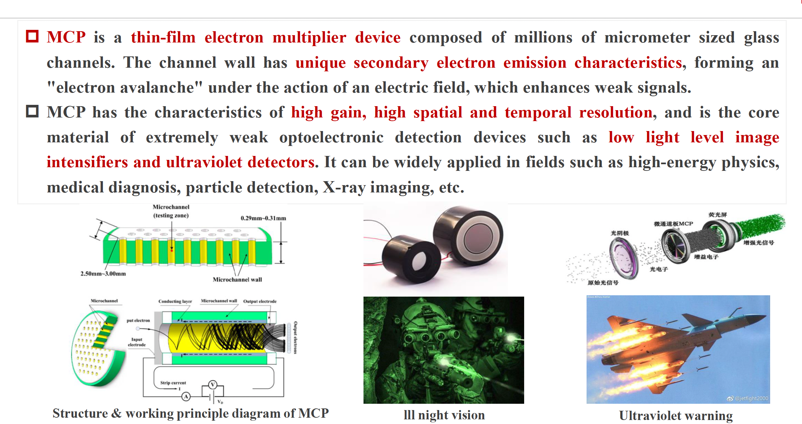
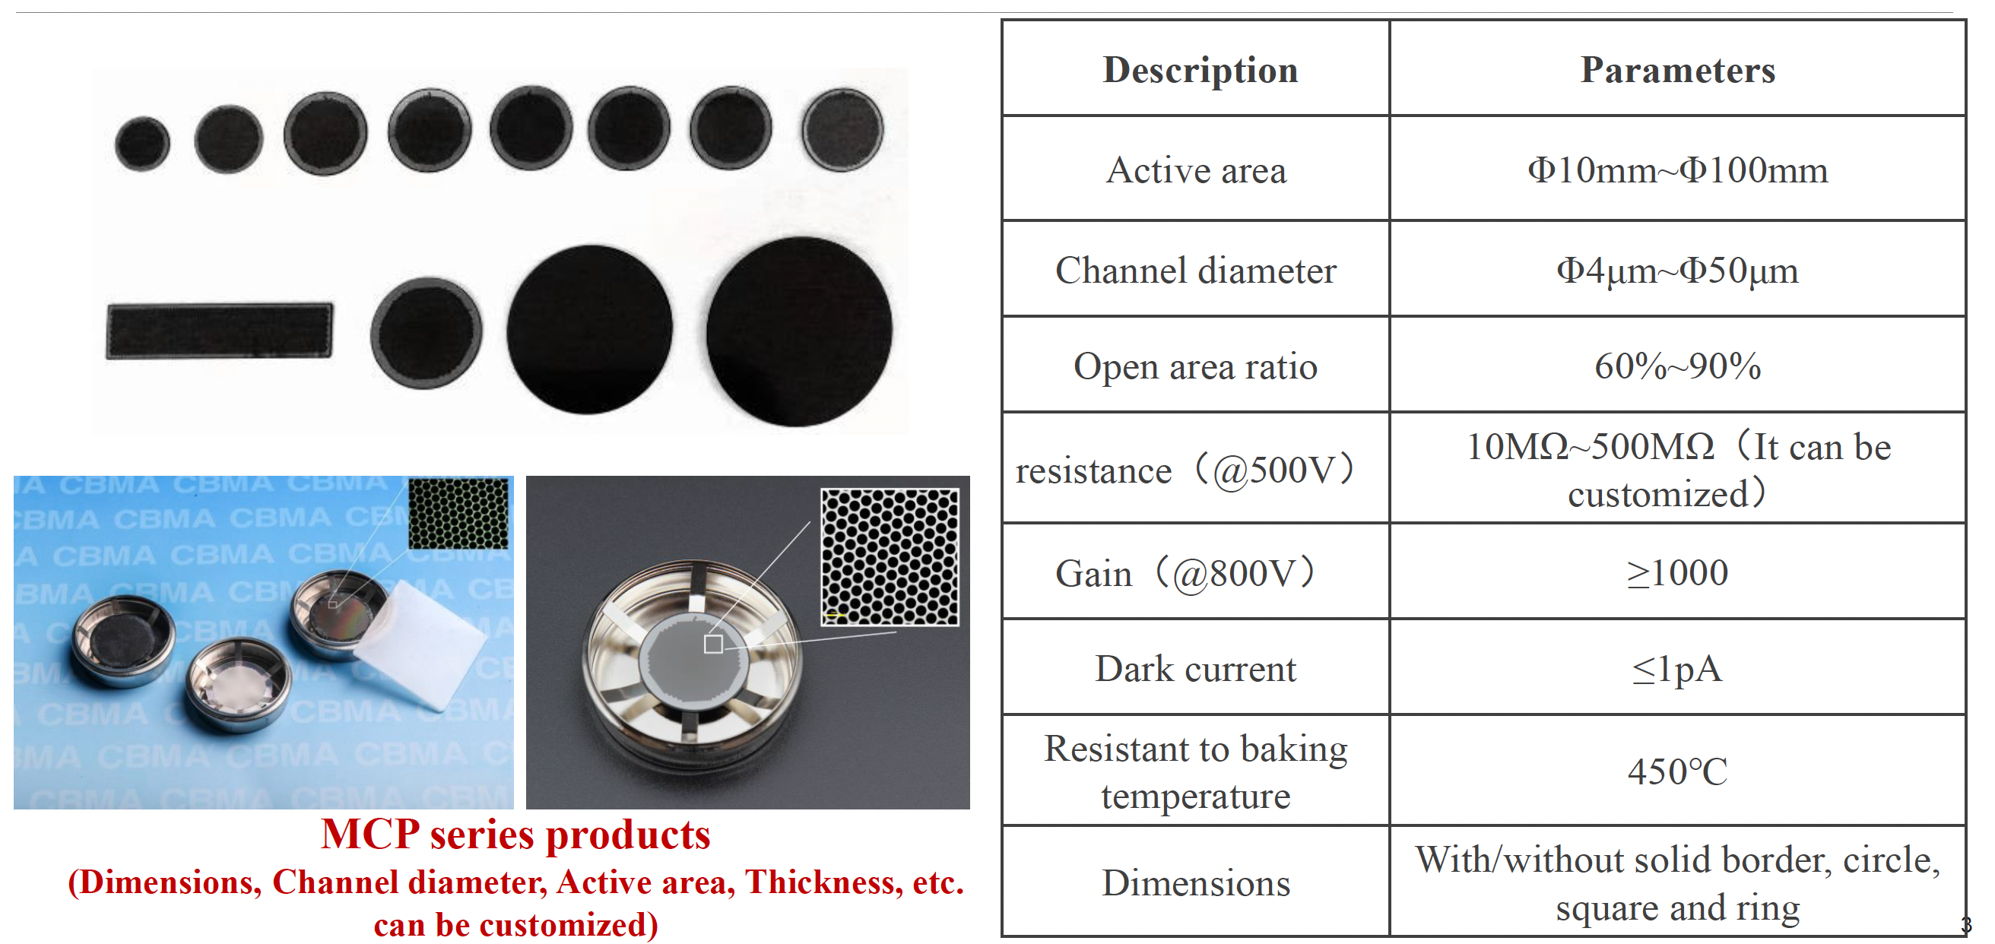
Industrial partners : CBMA@Beijing

Slide 6
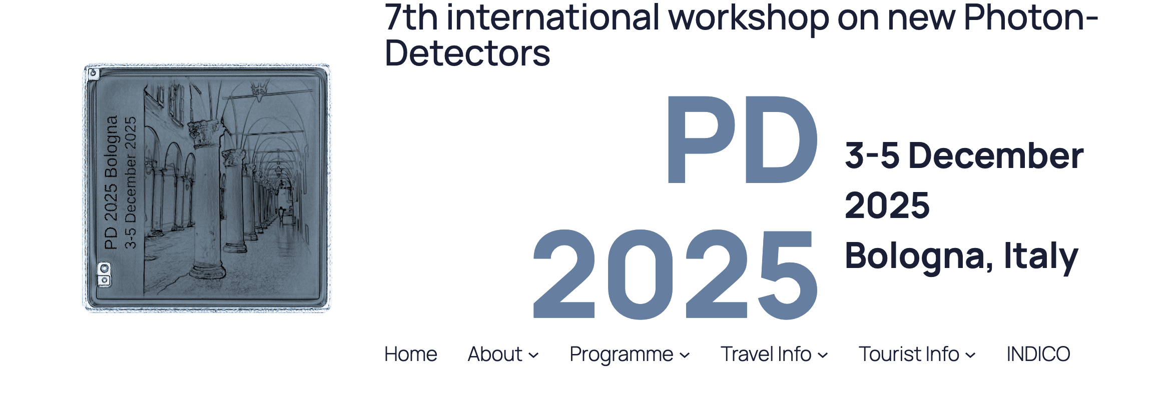
There will be a dedicated session for vacuum photodetectors
Please submit your work as as possible
https://web.infn.it/photondetectors2025/
Deadline for abstract submission: TODAY (10/09/2025)

Slide 7
4.2.1: VPD: New material, new coatings, longevity and rate capability study
Some progress on NCP based on AAO and Silicon: to be presented in October
VPD-PMT: New photocathode materials, structure and high quantum efficiency VPD
Some progress on nanostructure production but coating with photocathodic material and transport are issues to fix: t be discussed in October
4.2.3: VPD time and spatial resolution performance
Very good progress both in using Timepix4 and PICMIC. We need to extend the use of these electronics readout systems and adapt them to several applications

