Slide 1
MPO 20111006
Part 2
M.Jonker

Slide 2
CLIC next phases
European Strategy
for Particle Physics
@ CERN Council
Final CLIC CDR and
feasibility established
After 2016 – Project Implementation phase:
Including an initial project to lay the grounds for full construction (CLIC 0 – a significant part of the drive beam facility: prototypes of hardware components at real frequency, final validation of drive beam quality/main beam emittance preservation, facility for reception tests – and part of the final project)
Finalization of the CLIC technical design, taking into accoun the results of technical studies done in the previous phase, and final energy staging scenario based on the LHC Physics results, which should be fully available by the time
Further industrialization and pre-series production of large series components with validation facilities
2011-2016 – Goal: Develop a project implementation plan for a Linear Collider :
Addressing the key physics goals as emerging from the LHC data
With a well-defined scope (i.e. technical implementation and operation model,
energy and luminosity), cost and schedule
With a solid technical basis for the key elements of the machine and detector
Including the necessary preparation for siting the machine at CERN
Within a project governance structure as defined with international partners
Notes:
Need to define fly ins

Slide 3
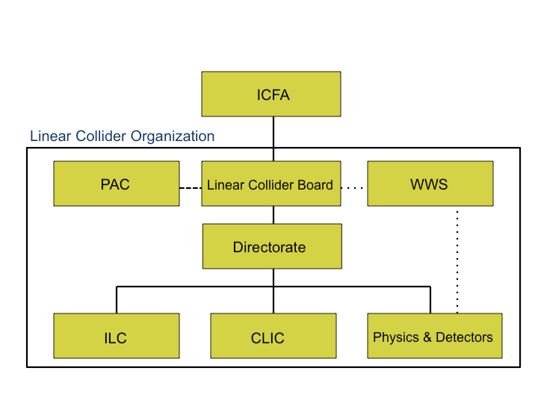
Linear Collider Organization post 2012
Mumbai meeting a good step forward
Challenges now in implementation of the parts/boxes, and developing further the connections between them
Several adaptions needed for CLIC – to be discussed in CB 4.11:
  It is compatible with CLIC CB model
  Representation in Directorate
  Further development of combined activities
  Detector/Physics organisation
“Global accelerator projects and their Governance”
Council Working Group on the Scientific and Geographical Enlargement of CERN:
A discussion of CERN’s potential role and willingness to engage in a future Global Project, and possible Governance Models:
In many implementation models a Project Governing Board could be created and mandated to monitor the project
As for the actual management of the project, the most suitable model would seem to be that of the Scientific Collaboration.

Slide 4
Project structure
CASC (weekly – 1 hour)
Focus on links to WPs and the activity managers for these work-packages
2-3 more with major work-package responsibilities (Doebert, Riddone)
2 representatives from line management (group level) – from July if possible (Erk Jensen and Olivier Bruning)
Tech. Secretary for Proj. meetings when needed (Tecker)
Augier as secretary for CASC
LC implementation issues (Lebrun) – e.g. cost, schedule, power, interface to site and civil engineering (incl. conv. facilities?) WPs in GS, ILC-CLIC common issues and industrial studies
Beam physics and machine parameters (Schulte) – work-packages formulated, specific studies urgent, as a staged approach for volume 3
Systemtests (e.g. CFT3+) including preparation of CLIC 0 (Corsini) – work-packages formulated
RF structure development (Wuensch) – work-packages formulated
Technical developments and integration (Schmickler) – work-packages formulated
CLIC/CTF3 Collab. Board
CLIC Steering Committee
Repr. from accelerator and detector/physics management structures
CLIC accelerator activities and management
Detector/Physics activities and management

Slide 5
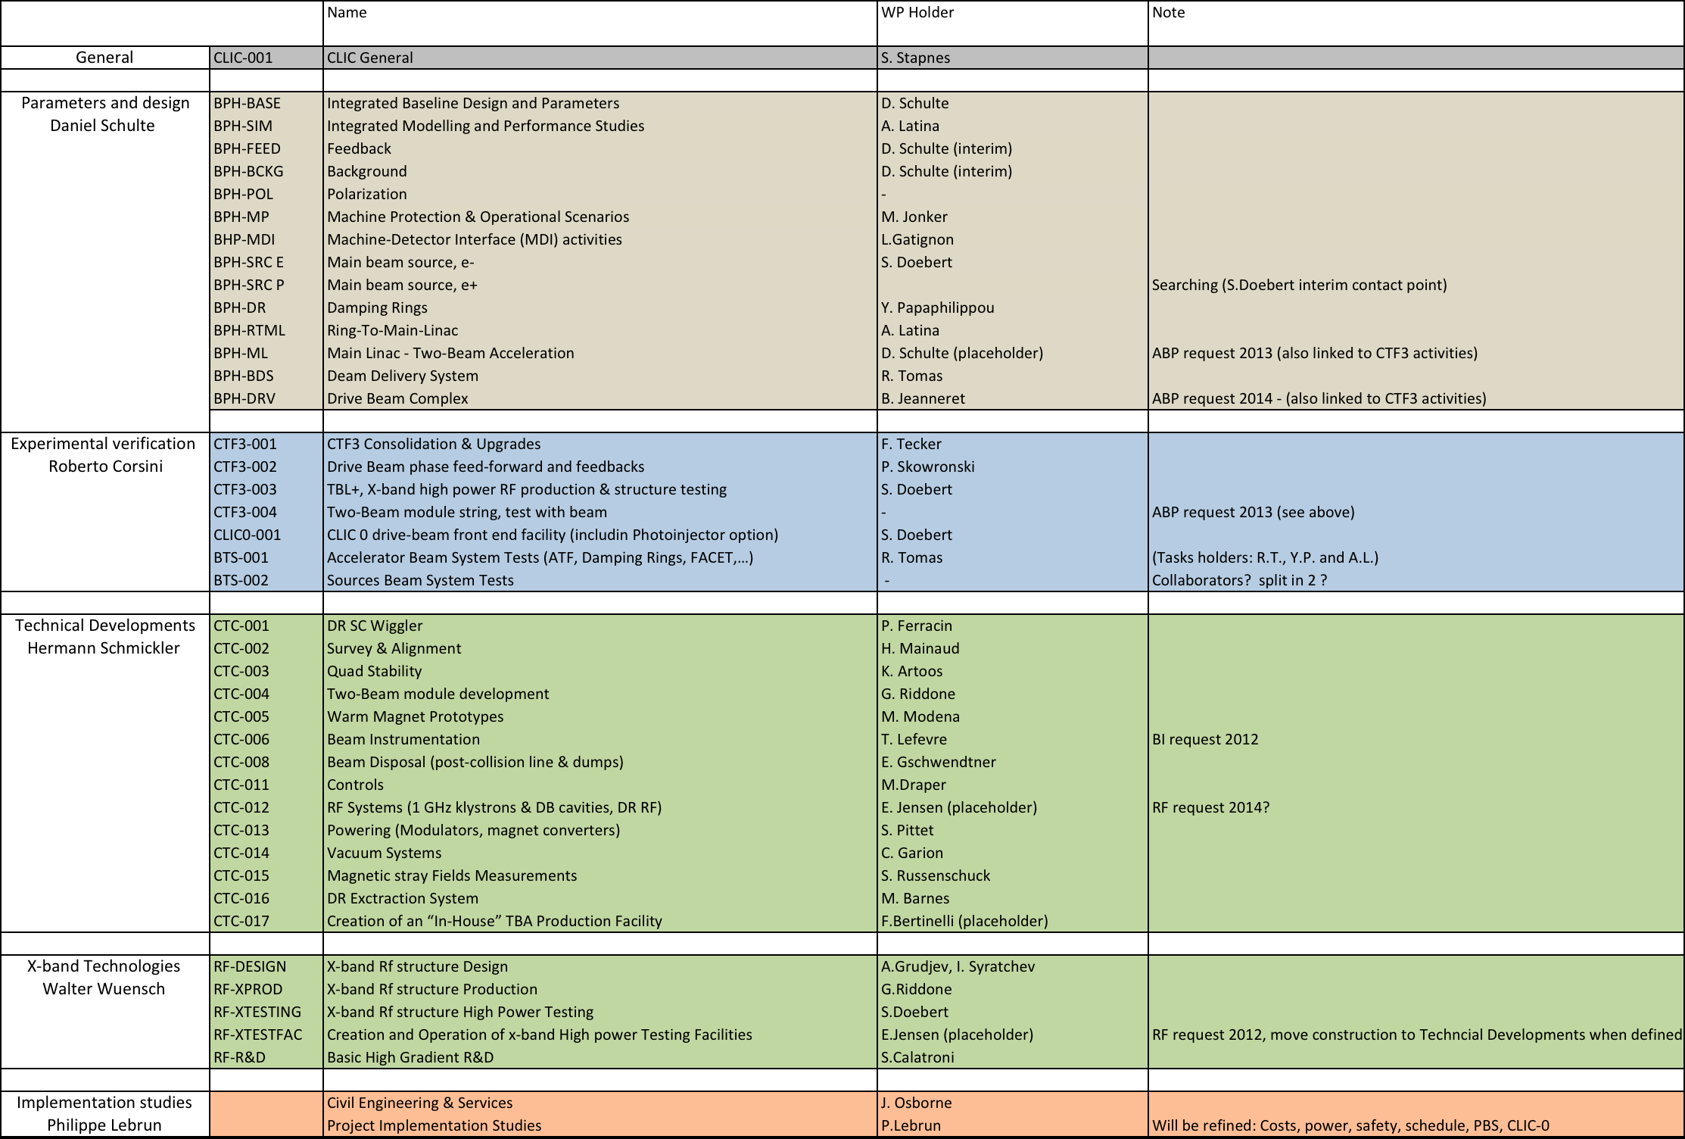
Work-package responsibilities

Slide 6
What next ?
Warnings:
  The work-package resources needed are still significantly above our forecasted resources, so the WPs might change scope and even be suppressed in a final analysis
  Some tuning of the work-package leadership and activity areas still probably needed
  In particular we need to be sensitive to collaborators that would like to phase in new people (not necessarily as WP leaders but deputies or task responsible), and it is possible that large collaborative contributions to specific work-packages should be combined with (co-)leadership of some of the WPs
We do expect the work-package leaders to feel responsible and “take ownership” of the work-packages
Some key issues to address:
  Understand/review the WPs content/tasks and resources with activity leaders (if not already done), (help to) improve documentation of tasks and resources
  Use the Granada Workshop (LCWS11) to review critical items and issues – feed back into WP planning and tuning (see guidance from Daniel and co)
  Define/discuss with activity leader if a deputy or other substructure are needed fort the work-package
  Work with activity leaders to understand, plan and increase the collaborations participation and help to put people in recognized responsibilities (task responsible, deputies, etc)
  Review with activity leader organisation of the work, meeting structures etc ..
  Participate/support activity leaders in preparation of the November workpackage planning meeting 3-4.11
Notes:
ACE ?

Slide 7
Machine Protection and Operation
BPH - OP | Purpose/Objectives/Goals | Deliverables | Schedule
Machine protection system design | Define the machine protection concept and the required hardware implications Implementation of MP consequences for equipment (2ms fail-proof) and personal safety. | Reports Safety Procedures and agreements
Extraction channel (damping rings, combiner rings, turn around) | Extraction channel design and mask specifications | Designs | 2011 – 2016
Material studies and mask and collimator design | Detailed designs of subcomponents (masks and collimators).
Loss generation | Estimate halo generation in main linacs and other machine areas Contribute to integrated collimation systems | Code, report, database | 2011 – 2016
Radiation issues | Simulation of radiation levels Personnel safety Component damage
Critical failures | Critical failure modes |  | 2011 – 2014
Reliability | Key reliability issues Reliability model of the machine Fault catalog (area leaders to contribute to the failure catalogue) Definition of SIL levels for components. | SIL level specifications Provide models for integrated studies

Slide 8
Machine Protection and Operation
BPH - OP | Purpose/Objectives/Goals | Deliverables | Schedule
Experimental verification | Implementation of a model MP system in CTF3 for validation of the “Next Pulse Permit” concept. | Working prototype of MP system integrated into the control system. | 2014 – 2016
Operational scenario | Objective: Definition of operational scenario Activity: Definition of scenario Verification in CTF3 | Coordinated discussions between RF experts, Beam dynamics experts and equipment experts in order to define a commissioning and operations scenario: write‐up of Results | 2012 – 2013
Luminosity evolution | Objective: Estimate luminosity evolution during the first years of operation | Reports on the commissioning | 2011 – 2016

Slide 9
Generic Tasks for each Area
BPH-generic | Purpose/Objectives/Goals | Deliverables | Schedule
Beam line design | Objectives: Provide optimised beam line design of the area | Lattice deck Supporting documents | 2011 – 2016
Correction techniques | Objectives: Provide the description of correction techniques and feedback layout | Documents | 2011 – 2016
Hardware performance | Objectives: Provide hardware performance specifications Contribute to the development of performance models of key hardware in collaboration with hardware experts Follow hardware progress and integrate feedback from hardware | Documents Reports documenting the models Design changes | 2011 – 2016 2011 – 2016 2011 – 2016
Cost and power | Objectives: Provide input for the cost estimate Contribute to a cost model to optimise the machine in collaboration with the cost effort and other working groups Identify cost saving options and follow costing progress and integrate feedback | Documents on number of components and layouts Cost model Improved baseline designs | 2011 – 2016 2011 – 2016 2011 – 2016

Slide 10
Generic Tasks for each Area
BPH-generic | Purpose/Objectives/Goals | Deliverables | Schedule
Performance studies | Objectives: Provide the evidence that the area can reach the performance target by supporting studies | Reports | 2011 – 2016
Experimental programme | Objectives: Define the experiments required to support the claimed performance Analyse the experimental results and their impact on the design validation | Experiment proposals Reports on experimental results | 2011 – 2016
Integrated studies | Objectives: Contribute to integrated studies, in particular for the overall parameter and design optimisation, the machine protection and operation, feedback studies | Reports and models | 2011 – 2016

Slide 11
MP packages
Simulation
Carlos (failure effects)
tbd (halo & tail generation)
Radiation, effects and protection
Sophie, Joachim, Marcus
Extraction protection, mask design, materials
Jan, tbd
Fault catalogue, failure modes
tbd
Specification, Prototyping
Patrice, ...
Operational aspects
Ramp procedures, tbd
Luminosity prediction, tbd
Availability, tbd

Slide 12
