Slide 1
MPO 20111006
Part 1
M.Jonker

Slide 2
The CDR
CDRs:
Vol 1: The CLIC accelerator and site facilities (H.Schmickler)
  CLIC concept with exploration over multi-TeV energy range up to 3 TeV
  Feasibility study of CLIC parameters optimized at 3 TeV (most demanding)
  Consider also 500 GeV, and intermediate energy ranges
Vol 2: The CLIC physics and detectors (L.Linssen)
Vol 3: CLIC study summary (S.Stapnes)
  Summary and available for the European Strategy process, including possible implementation stages for a CLIC machine as well as costing and cost-drives
  Proposing objectives and work plan of post CDR phase (2012-16)
Timescales:
  By end 2011: aim to have Vol 1 and 2 completed
  Spring/mid 2012: Vol 3 ready for the European Strategy Open Meeting
Main information page:
http://clic-study.org/accelerator/CLIC-ConceptDesignRep.php
Accelerator http://project-clic-cdr.web.cern.ch/project-CLIC-CDR/
About 90% of the contributions received
About 60% of the contributions received as final, for the Editorial Board to address
Physics and Detectors http://lcd.web.cern.ch/LCD/CDR/CDR.html#Overview
A link to subscribe as a signatory for the CLIC CDR can be found on the main information page

Slide 3
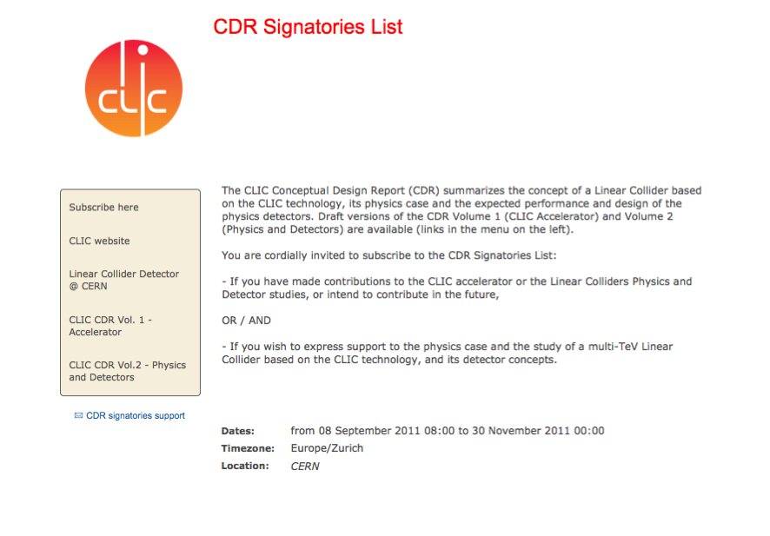
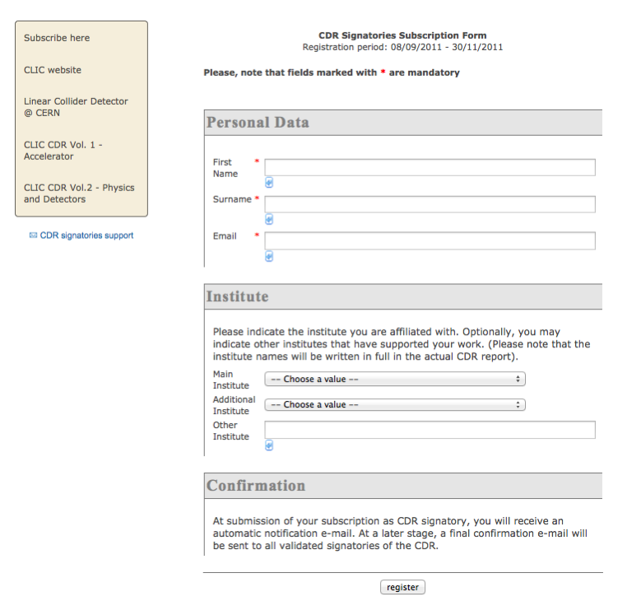

Slide 4
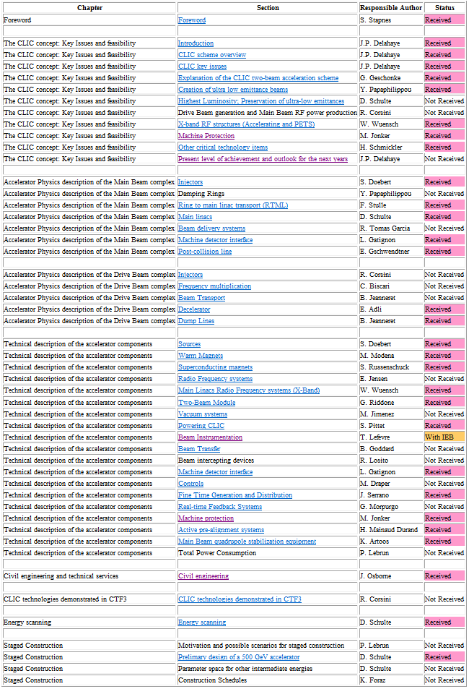
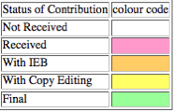
CDR Vol1
Status – snapshot
The linked documents (in blue) are all the available drafts.
Updated on 2011.09.01 17:00, Mick Drapper

Slide 5
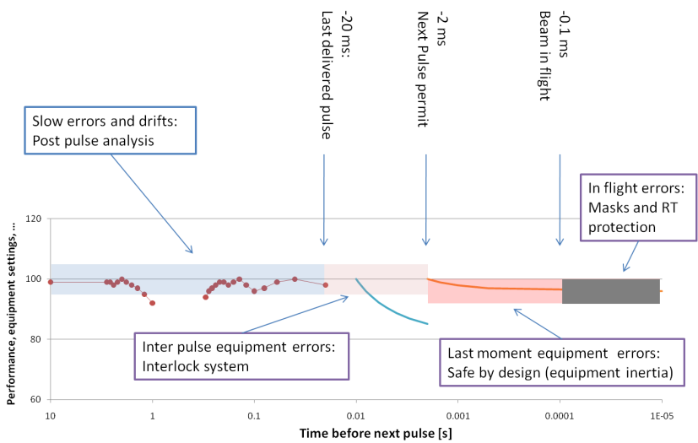
CDR CLIC Machine Protection
Inspired on IPAG2010 paper
2 The CLIC concept: Key issues and feasibility
2.9 Machine Protection
2.9.1 Overview,
2.9.2 Strategy
2.9.3 Intensity ramps
2.11 Present level of achievement and outlook for the next years

Slide 6
CDR CLIC Machine Protection
5 Technical description of the accelerator
5.7 The CLIC machine protection
5.7.1 Overview & 5.7.2 Specific dangers of CLIC beams (Beam Power and destructive capacity)
5.7.3 Failure types (Fast Failures, Inter-Cycle Failures, Slow Failures)
5.7.4 Protection Strategies (Passive Protection, Real-Time Protection, Beam Interlock System, Safe by Design, Post Cycle Analysis and Next Cycle Permit)
5.7.5 Beam Interlock System Layout
5.7.6 FAULT Analysis (Critical Case Studies)
5.7.7 Operational Scenario (Drive Beam, Main Beam, Beam Positions Measurements (BPM) requirements)
5.7.8 Technical issues
  Protective masks
  Drive beam linac real time protection
  Emittance control of the damping rings
  Fault catalogue and fault simulation
  Intensity ramp
5.7.9 Component inventory, Cost considerations
5.7.10 Outlook for Technical Design Report phase
CTF3 tests foreseen:
Development and test of a prototype beam interlock system.
Test of the next cycle permit concept.
Test of drive beam intensity ramps, optionally including the parallel generation of multiple trains (i.e. non continuous filling of the drive beam linac).
...
...
...
...
Header followed by two sub pulses (121 bunches each)
2 sub pulses per train
121 x 2
18 sub pulses per train
121 x 18
24 sub pulses per train
121 x 24

Slide 7
CDR mp related
5.9.2.5 Beam Loss Monitors
6 Civil engineering and technical services
6.5 Safety systems
6.5.1 Access control and personnel safety system
6.5.2 Beam zone
6.5.3 Access to beam zones
6.5.4 Patrol sectors
6.5.5 Personnel safety systems
6.5.6 Cost considerations
6.5.7 Radiation safety and Radiation Protection
6.5.7.1 Beam loss
6.5.7.2 Model of the Accelerator
6.5.7.3 Radiation Damage
6.5.7.4 Radiation protection

Slide 8
Agenda
Status of the CDR
MP related Work packages
Status of fault simulation and analysis (Carlos)
Tour de table
Planning of coming meetings
Next meeting

