Slide 1
Lecture 24
The Muon Collider
Rapid Cycling Synchrotron (RCS)
JAI Student Design Project 2025-2026
Professor Emmanuel Tsesmelis
Principal Physicist, CERN
Department of Physics, University of Oxford
Accelerator Physics Graduate Course
John Adams Institute for Accelerator Science
4 December 2025

Slide 2
JAI Training

Slide 3
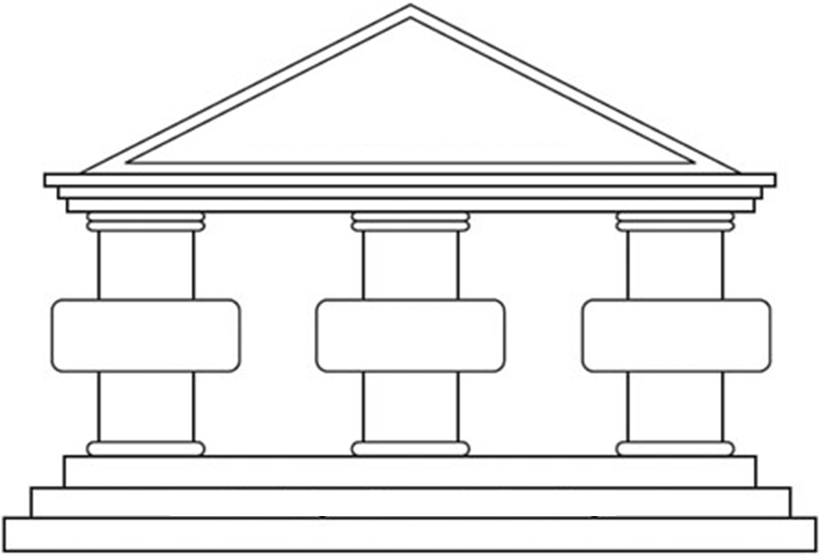
Foundation of the JAI Programme
One of three pillars of JAI
Students’ design project is very important part of that
JAI
programme
Training next generation of scientists
Research at the forefront of accelerator science
Connections with industry and outreach programme

Slide 4
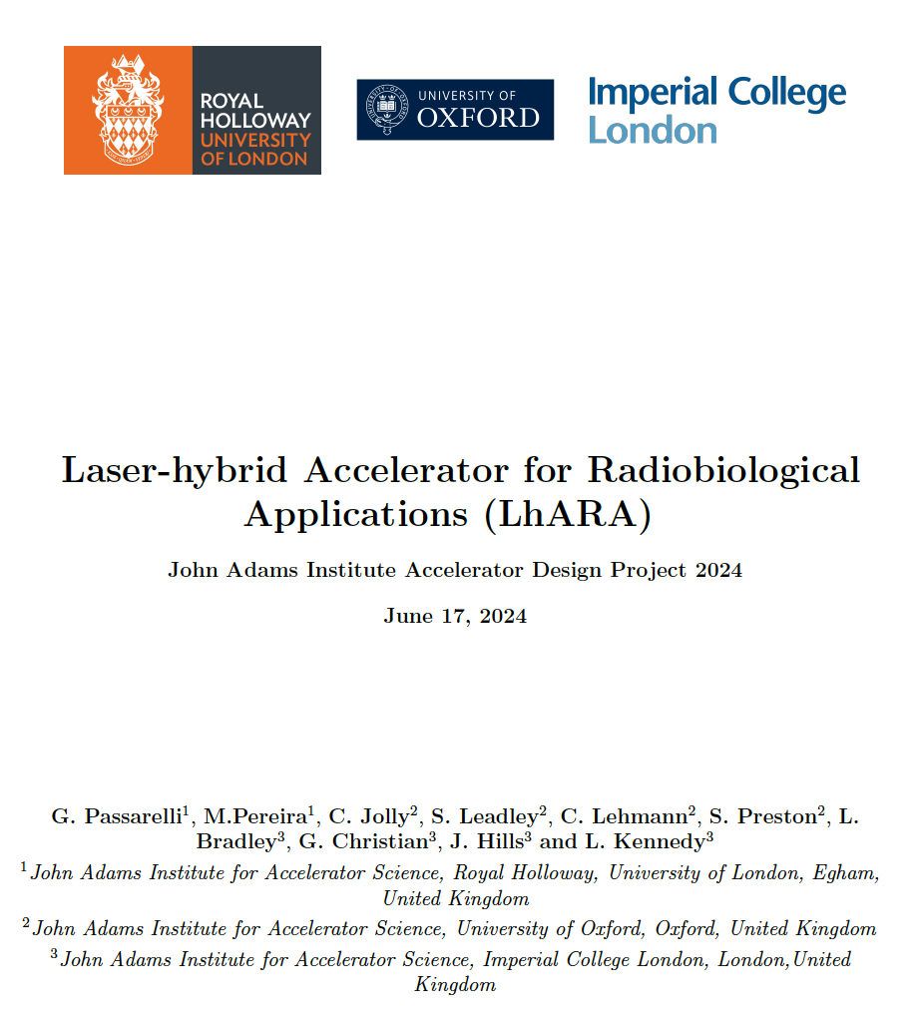
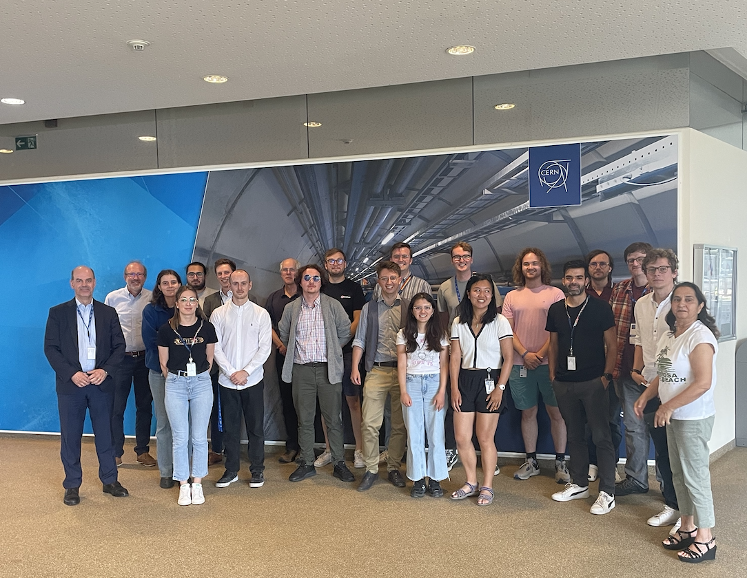
Accelerator Design Project
Accelerator Design Study for
  Electron SPS: 2020-2021
  FCC-ee Booster Ring: 2021-2022
  FCC-ee Positron Damping Ring: 2022-2023
  LhARA: 2023-2024
  HALHF: 2024-2025
  Design work consisted of study of the lattice, magnet systems and RF cavities.
“The design project significantly contributes to the value of a PhD at the JAI and is a very effective learning tool ... it played an essential role in helping me to find a postdoc.”
“To me, the design project was by far the best part of the course. It puts the material taught into context and bridges the gap between lectures ... and a DPhil project ... .”
For 2023-2024:
LhARA Report published on CDS (10.17181/CERN.9K4Y.MM92)
Students delivered JAI Seminar on
15 March 2024.
Student Seminar @ CERN, 12 July 2024

Slide 5
Muon Collider RCS Student Design Project Plan
Study Areas for Muon Collider RCS (January-March 2026)
Lattice for RCS
  Optics studies, optimization of lattice using Xsuite software.
Magnet Design
  Prepare list of design parameters for RCS dipole & quadrupole magnets.
  Design RCS dipole and quadrupole magnets using FEMM software.
RF Cavity Design
  Prepare list of design parameters for RCS RF cavity.
  Design RCS RF cavities using Superfish and CST software.

