Slide 1



Lecture 1 Introduction to Particle Accelerators
Professor Emmanuel Tsesmelis
Principal Physicist, CERN
Visiting Professor, University of Oxford
Graduate Accelerator Physics Course
John Adams Institute for Accelerator Science
16 October 2025

Slide 2
JAI Graduate Accelerator Physics Course
Delivered over two Academic Terms
Term I (Michaelmas Term 2025)
24 lectures and 6 tutorials
First three lectures and first tutorial includes Oxford PP students.
Term II (Hilary Term 2026)
Lectures, tutorials and design project
Course site is https://indico.cern.ch/category/5869/
Includes all lecture / tutorial material, videoconference connection, student handbook etc.
Videoconference facility for remote connection
Contact e-mail: Emmanuel.Tsesmelis@cern.ch

Slide 3
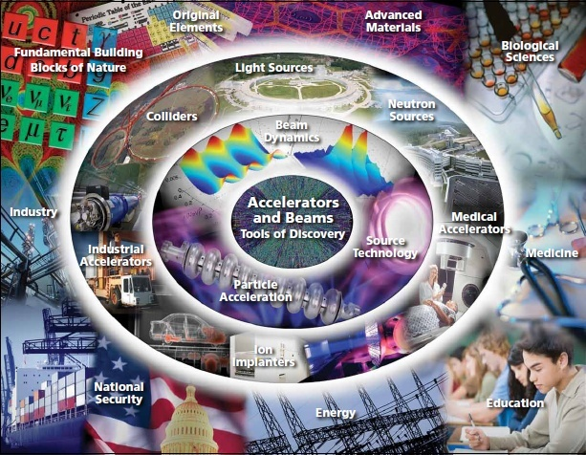
Introduction

Slide 4
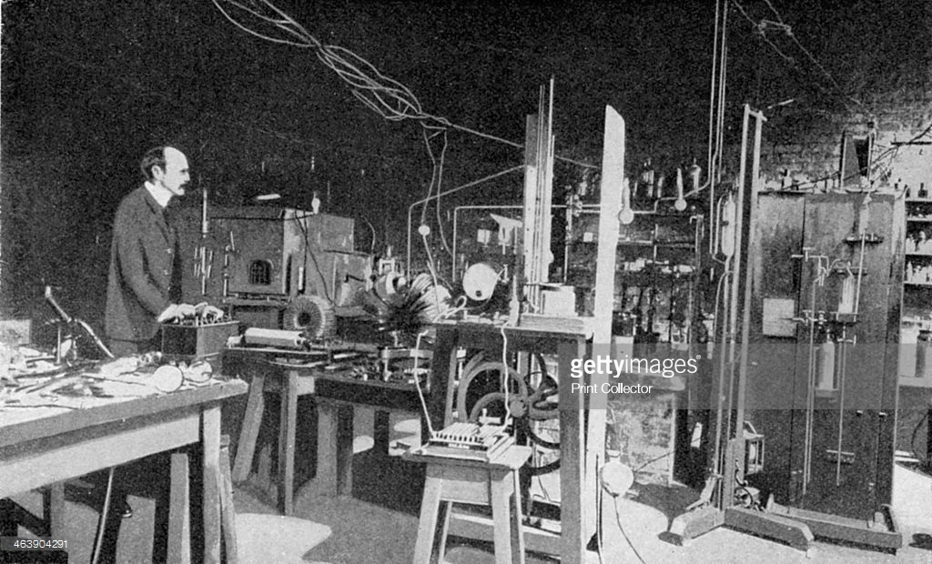
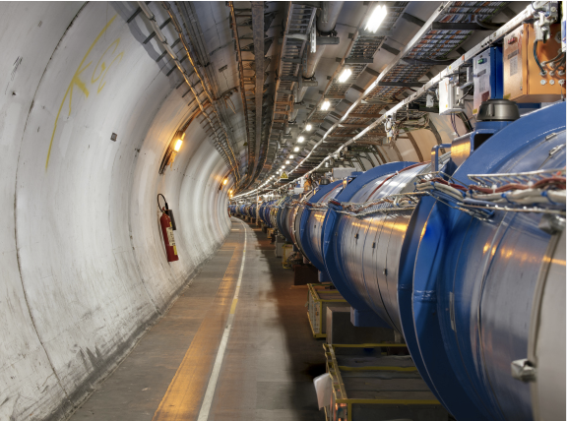
Accelerator Development
Characterised by rapid progress for over a century.
From cathode-ray tubes to the LHC.
From the discovery of the electron to the discovery of the Higgs boson.
Advances in accelerators require corresponding advances in accelerator technologies
Magnets, vacuum systems, RF systems, diagnostics,...
But timelines becoming long, requiring:
Long-term planning.
Long-term resources.
Global collaboration.

Slide 5
24 (+1) Nobel Prizes in Physics that had direct contribution from accelerators
A.Chao and E. Haussecker "Impact of Accelerator Science on Physics Research", published in ICFA Newsletter, Dec 2010; & submitted to the Physics in Perspective Journal, Dec 2010.

Slide 6

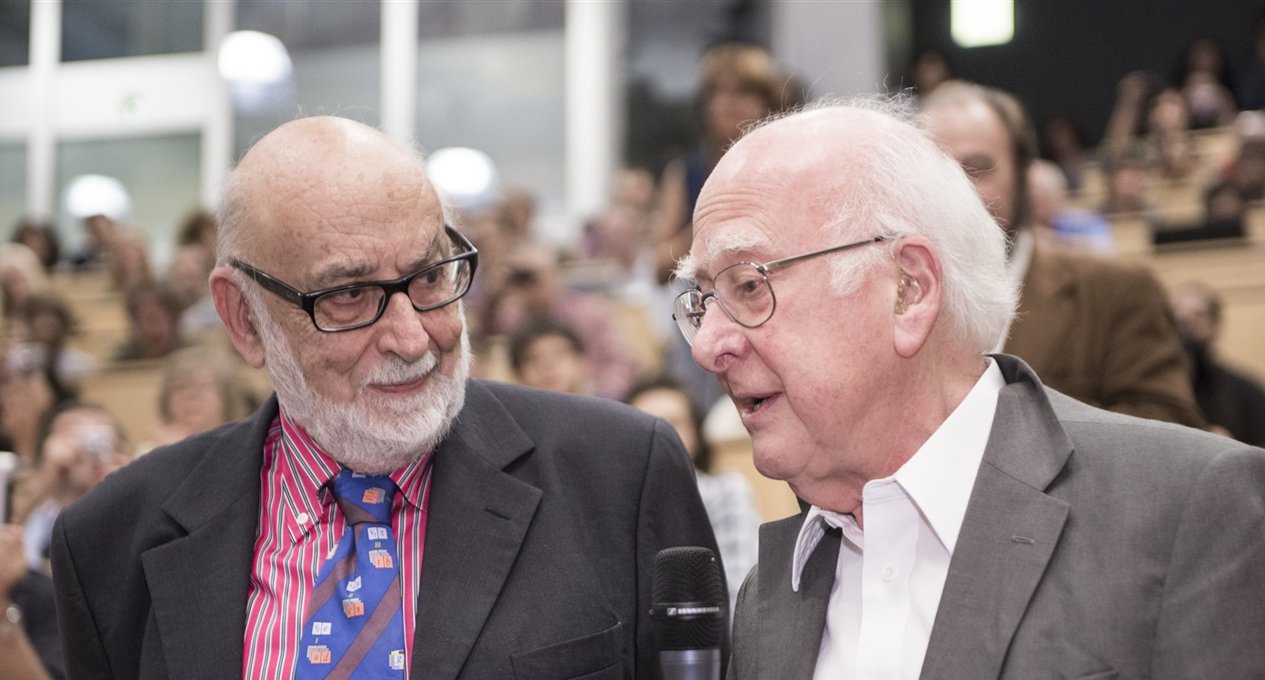
Nobel Prize in Physics 2013
The Nobel Prize in Physics 2013 was awarded jointly to François Englert and Peter W. Higgs "for the theoretical discovery of a mechanism that contributes to our understanding of the origin of mass of subatomic particles, and which recently was confirmed through the discovery of the predicted fundamental particle, by the ATLAS and CMS experiments at CERN's Large Hadron Collider”.

Slide 7
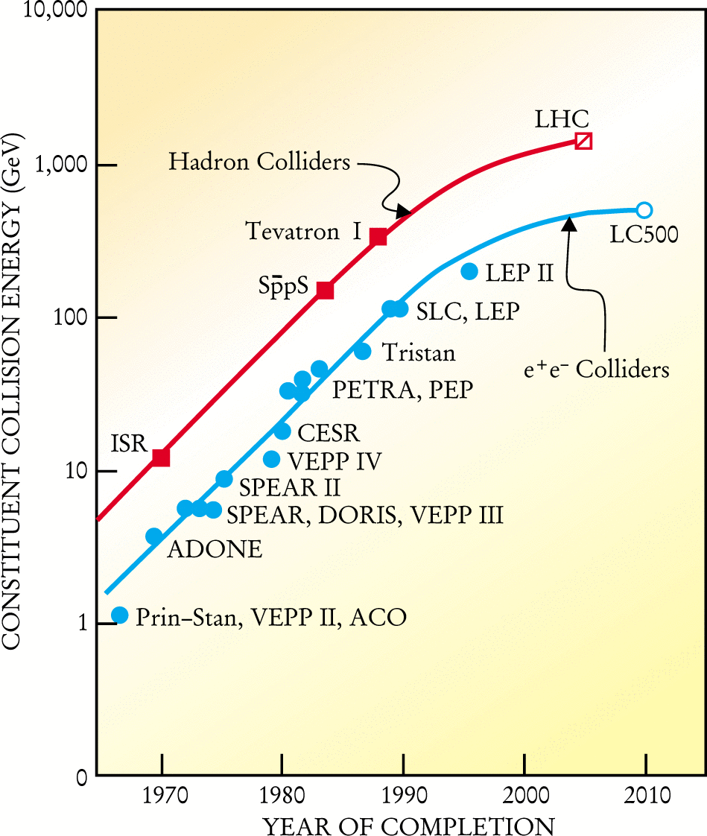
Livingston Plot
Around 1950, Livingston made following observation:
Plotting energy of accelerator as a function of year of commissioning, on semi-log scale, the energy gain had linear dependence.
Observations today:
Exhibition of saturation effect:
New technologies needed.
Overall project cost increased
Project cost increased by factor of 200 over last 40 years.
Cost per proton-proton E_{CM} energy decreased by factor of 10 over last 40 years.

Slide 8
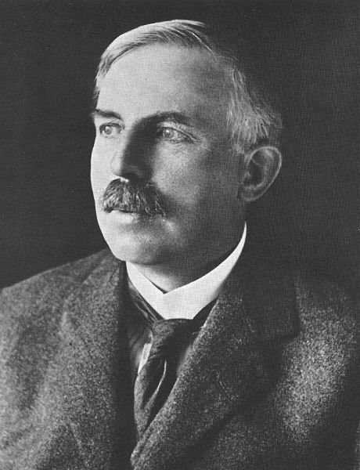
Rutherford fired the starting pistol
At the Royal Society in 1928 he said:
“I have long hoped for a source of positive particles more energetic than those emitted from natural radioactive substances”.

Slide 9
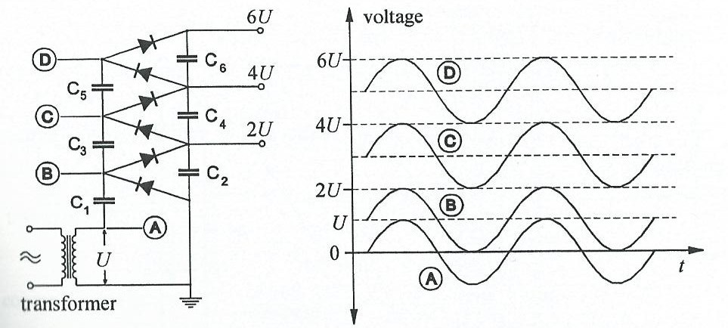

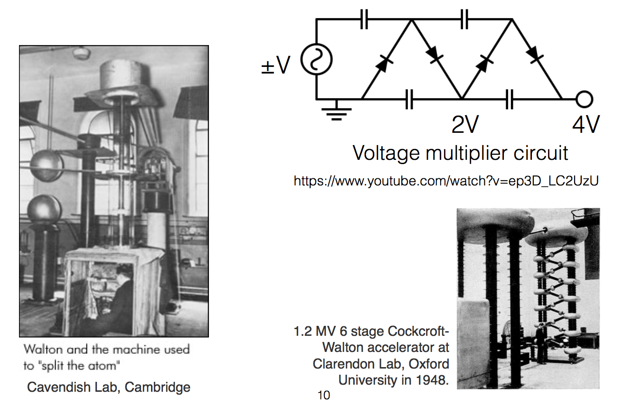
Electrostatic Accelerators The Cockcroft-Walton
Based on system of multiple rectifiers.
Voltage generated by cascade circuit
Modern CWs
Voltages up to ~4 MV.
Beam currents of several hundred mA with pulsed particle beams of few μs pulse length.

Slide 10
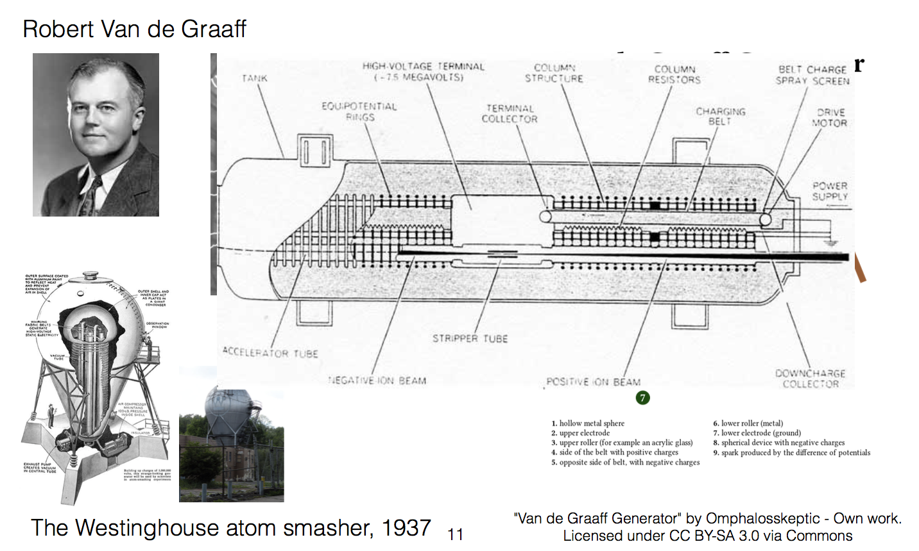
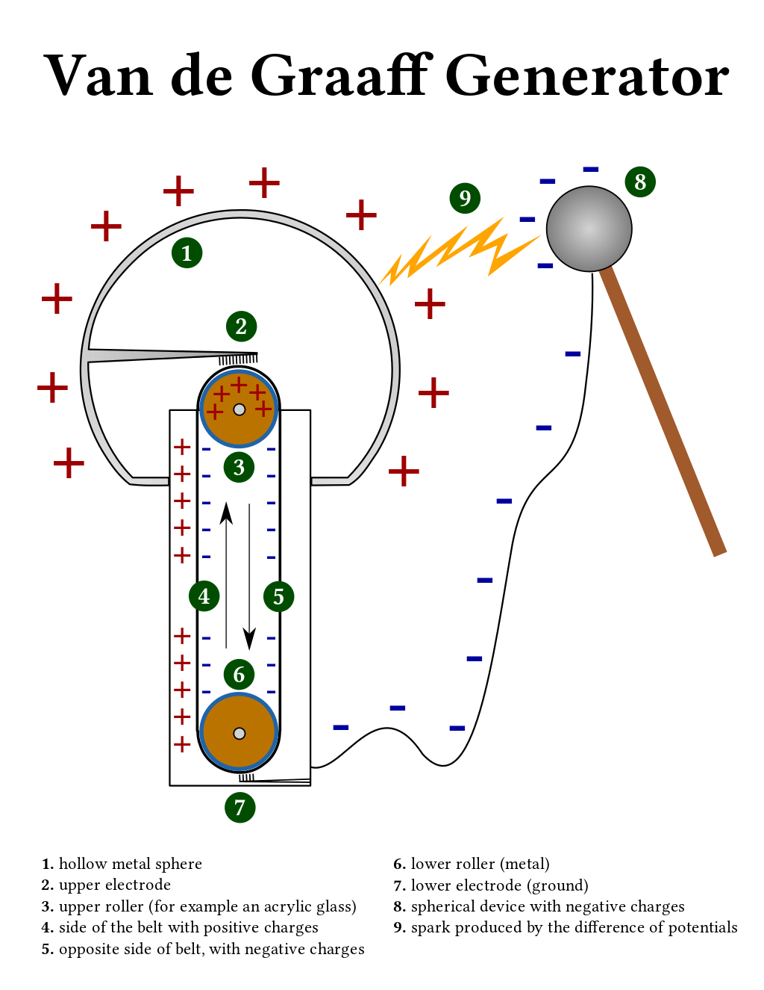
Electrostatic Accelerators – The Van de Graaff
With any electrostatic accelerator, it is difficult to achieve energy higher than ~20 MeV (e.g. due to practical limitations of the size of the vessels).
1929

Slide 11
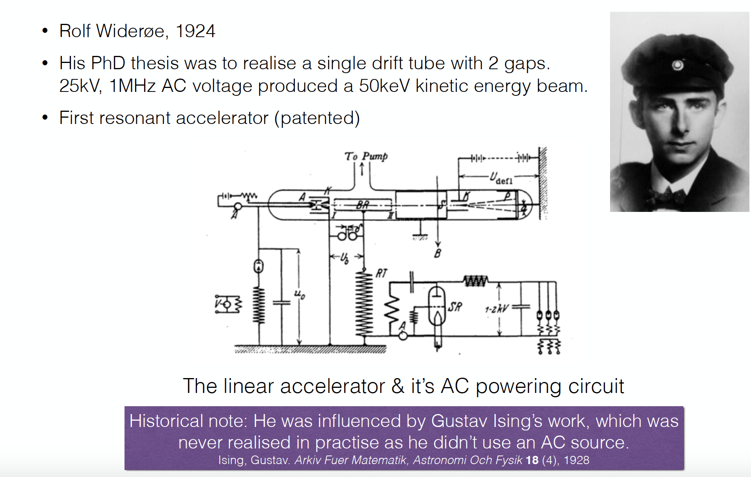
Linear Accelerators

Slide 12
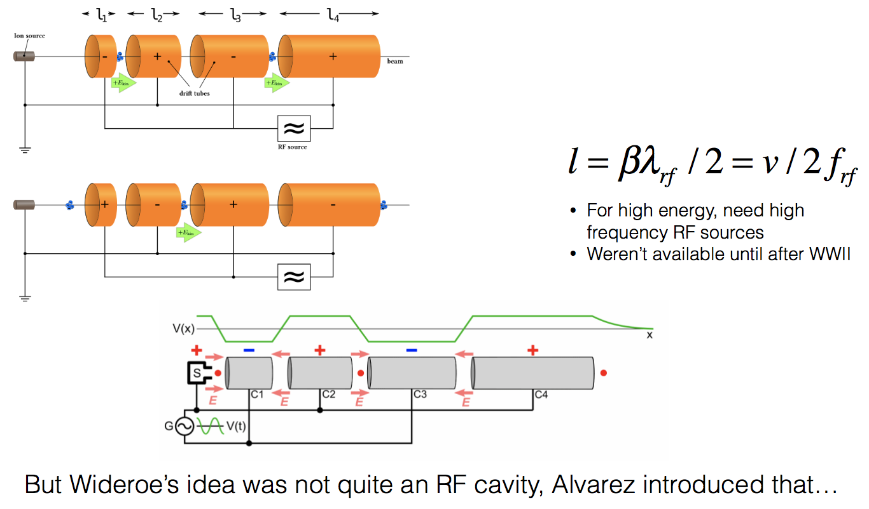
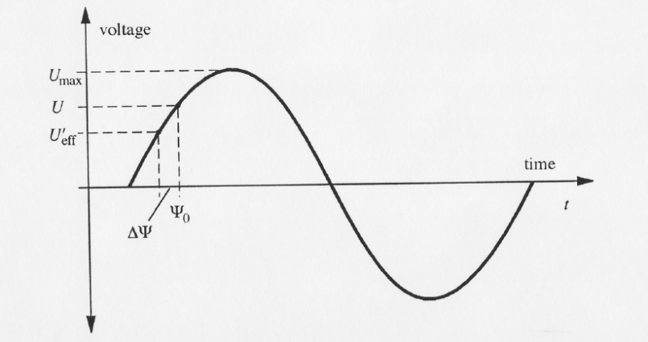
Linear Accelerators
Principle
Use rapidly-changing high frequency voltages instead of direct voltages (Ising)
Energy is proportional to number of stages i traversed by particle.
The largest voltage in entire system is never greater than V_{max}
Arbitrary high energies without voltage discharge.
Phase focusing in linacs

Slide 13
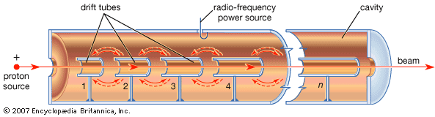
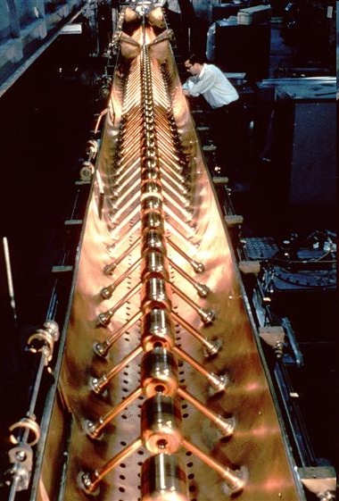
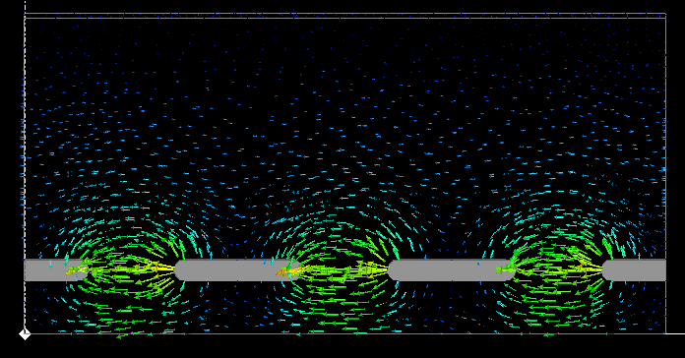
Drift Tube Linac: Higher Integrated Field
CERN LINAC1
© CERN CDS 6808042
Notes:
13
13

Slide 14
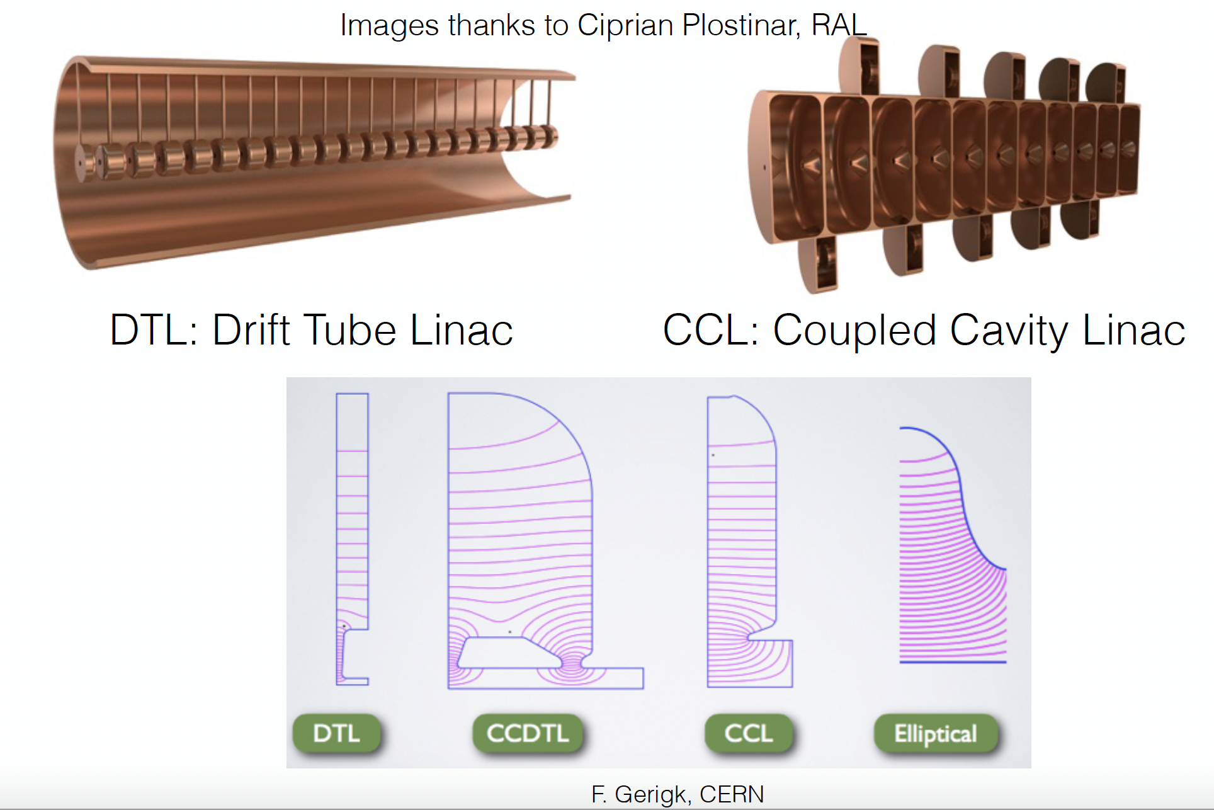
Linac Structures

Slide 15
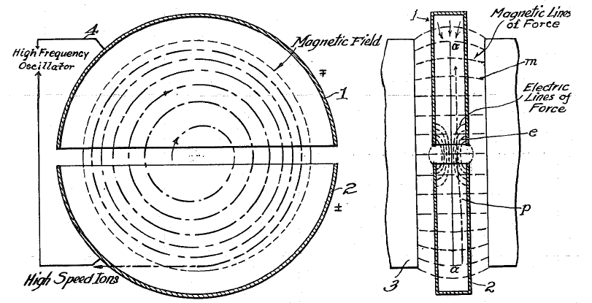
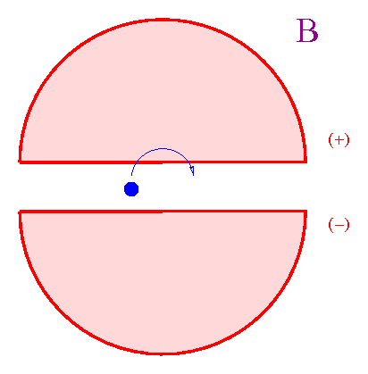
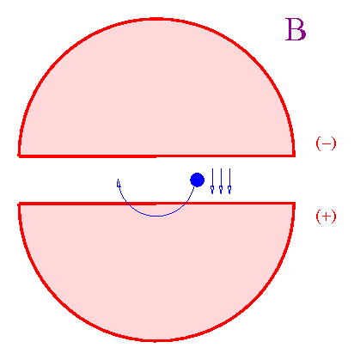
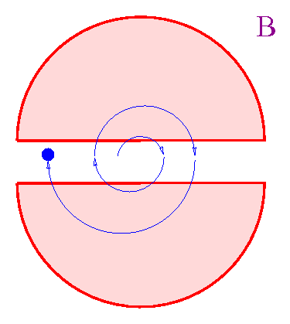
The Cyclotron (1/3)
In 1929-1930 Lawrence designed a “cyclotron”, a circular device made of two electrodes placed in a magnetic field.
Cyclotrons can accelerate (e.g.) protons up to hundreds of MeV.
Cyclotrons cannot accelerate to higher energies due to relativistic effects

Slide 16
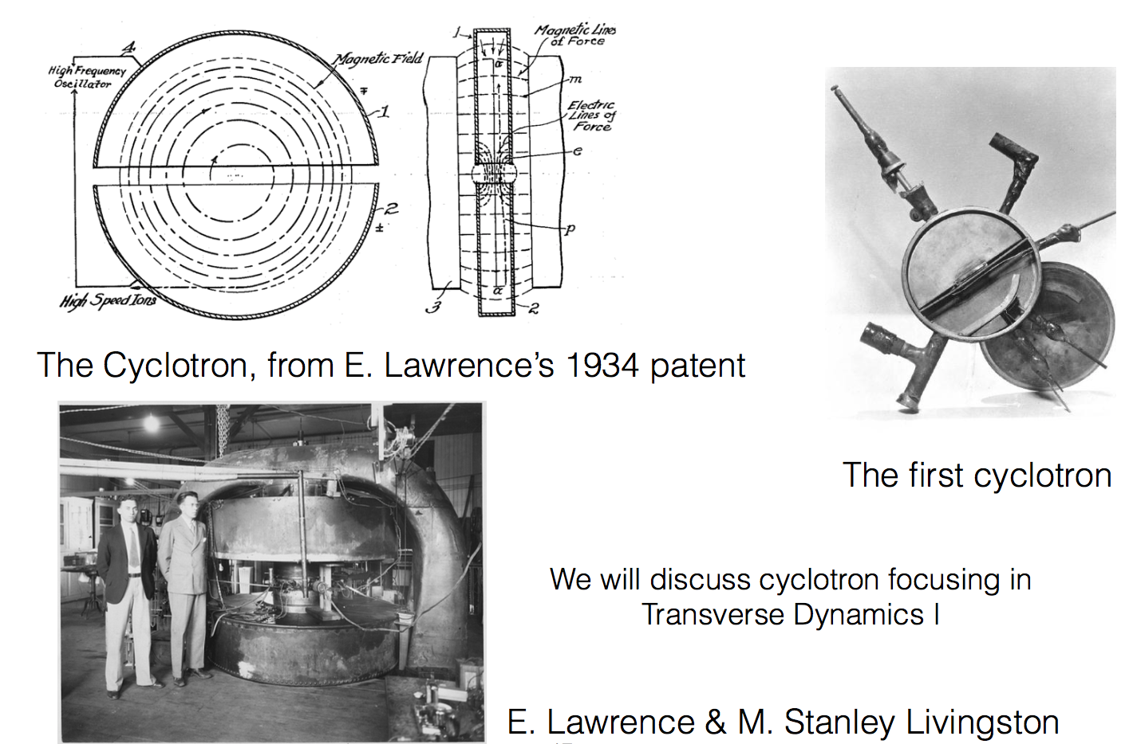
The Cyclotron (2/3)

Slide 17
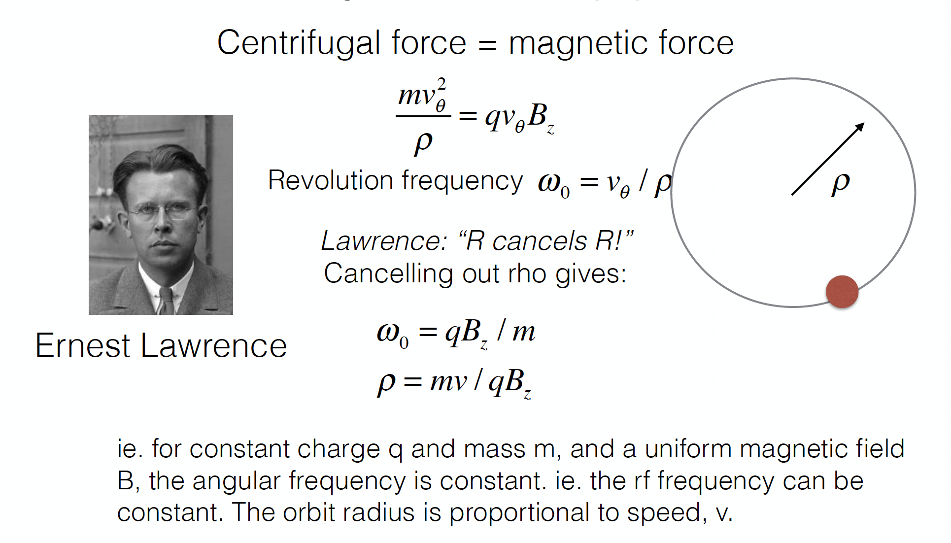
Cyclotron (3/3)

Slide 18
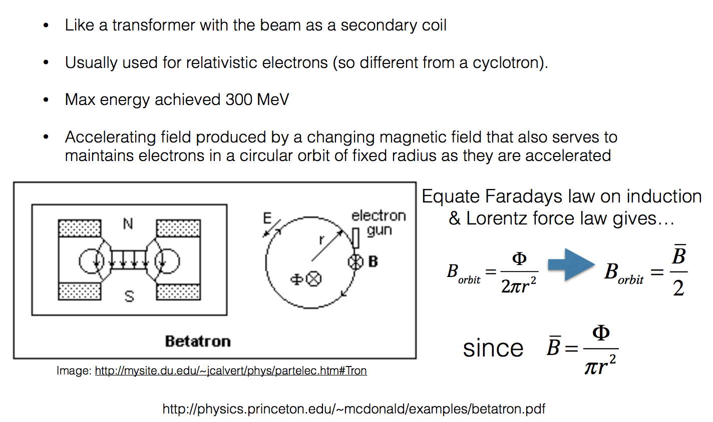
The Betatron
Wideroe Condition
Centripetal force provided by Lorentz force

Slide 19
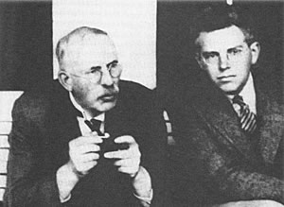
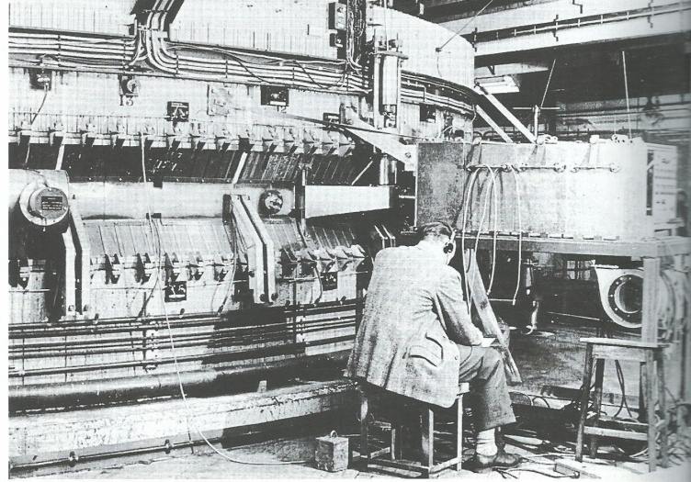
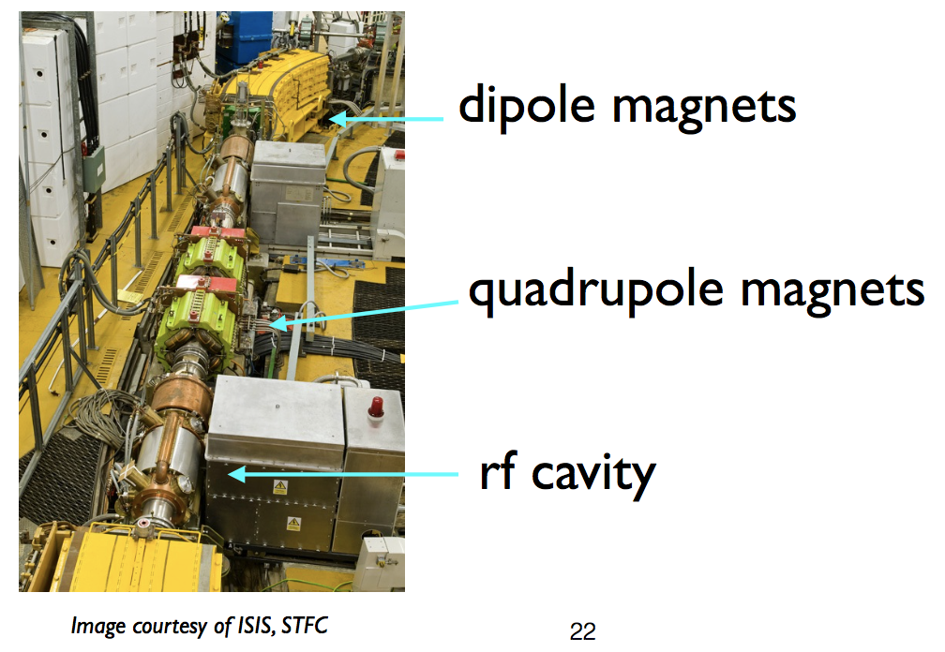
The Synchrotron - Origins
“Particles should be constrained to move in a circle of constant radius thus enabling the use of an annular ring of magnetic field...which would be varied in such a way that the radius of curvature remains constant as the particle gains energy through successive accelerations by an alternating electric field applied between coaxial hollow electrodes.”
Mark Oliphant, Oak Ridge, 1943
With Ernest Rutherford in 1932
1 GeV machine at Birmingham University

Slide 20
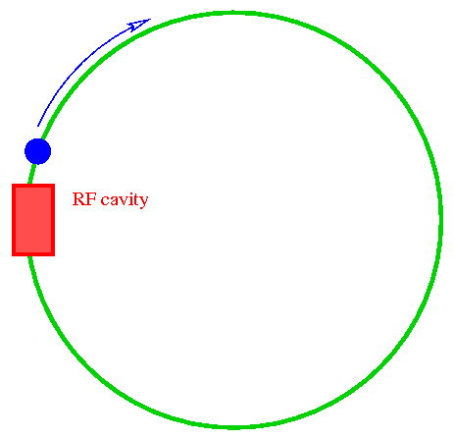
Synchrotrons - Principles
From
R = E / (ecB)
E/B kept constant since R is fixed.
B increases synchronously with rising E
Synchrotrons, such as LHC, can accelerate to much higher energies.
Limitation of synchrotrons (especially for electrons) is due to “synchrotron radiation”.
R = radius of curvature
E = particle energy
B = magnetic field

Slide 21




Beam Optics
Physical fundamentals for beam steering & focusing.
Fix particle trajectory and then repeatedly steer diverging particles back onto ideal trajectory.
Performed by EM fields (E and B) satisfying Lorentz Force
Lorentz force = centrifugal force

Slide 22
Magnetic Rigidity
The force evB on a charged particle moving with velocity v in a dipole field of strength B is equal to its mass multiplied by its acceleration towards the centre of its circular path.
This is:
=
=
mv
2
Radius of curvature
F
evB
ρ
Like for a stone attached to a rotating rope
ρ
=
mv
=
p
Which can be written as:
B
Momentum
P=mv
e
e
Bρ is called the magnetic rigidity, and in the correct units obtain:
Bρ = 33.356·p [KG·m] = 3.3356·p [T·m] (if p is in [GeV/c])

Slide 23
Energy & Momentum
Total energy:
kinetic + rest mass
Einstein’s relativity formula:
Rest mass
For a mass at rest this will be:
Rest energy
as being the ratio between the total energy and the rest energy.
Define:
Then the mass of a moving particle is:
Define:
, then can write:
, which is always true and gives:

Slide 24
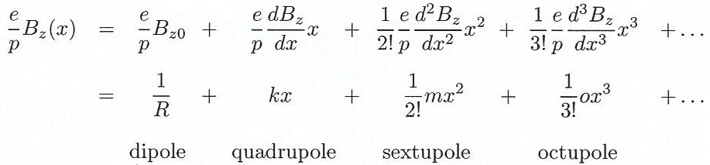
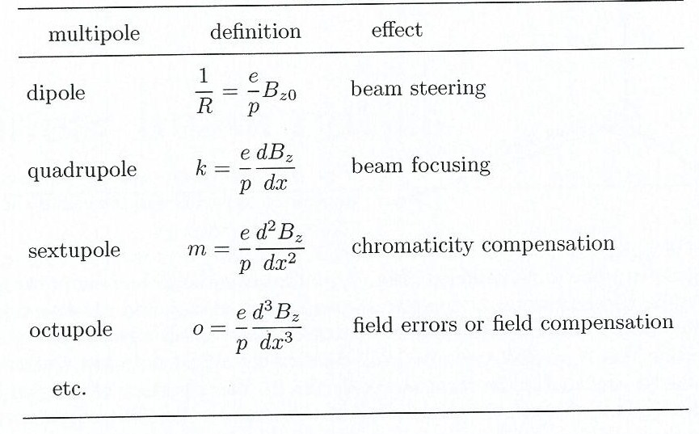
Multipoles in Beam Steering
Magnetic field around beam is sum of multipoles.
Each has different effect on particle path.
Linear beam optics refers to use of only dipoles and quadrupoles for beam steering.

Slide 25
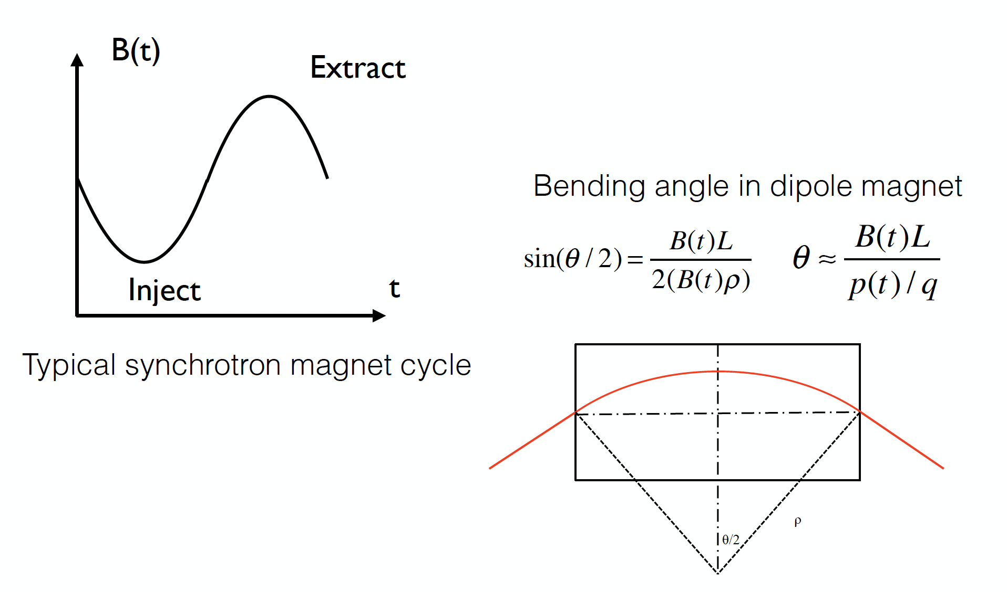
Synchrotrons- Bending Magnets

Slide 26
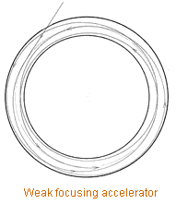
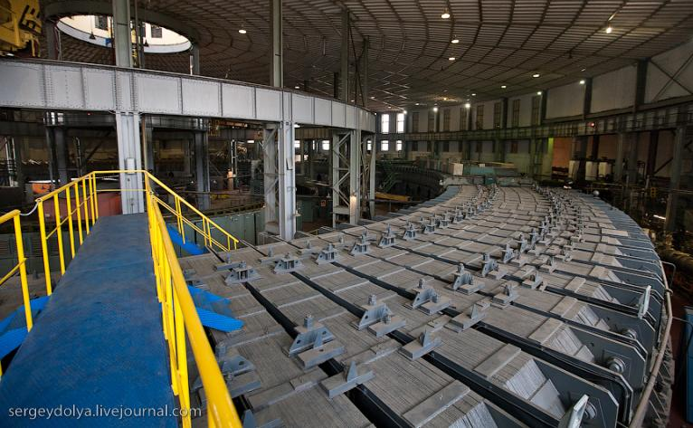
Synchrotrons - Focusing
Focusing is needed to confine the orbits.
First accelerators had “weak focusing” – focusing period is larger than the perimeter.
Vertical focusing comes from the curvature of the field lines when the field falls off with radius.
Horizontal focusing from the curvature of the path.
Negative field gradient defocuses horizontally & must not be so strong as to cancel path curvature effect
10 GeV weak-focusing Synchrophasotron built in Dubna in 1957, the biggest and the most powerful of its time. Its magnets weigh 36,000 tons and it was registered in the Guinness Book of Records as the heaviest in the world.

Slide 27
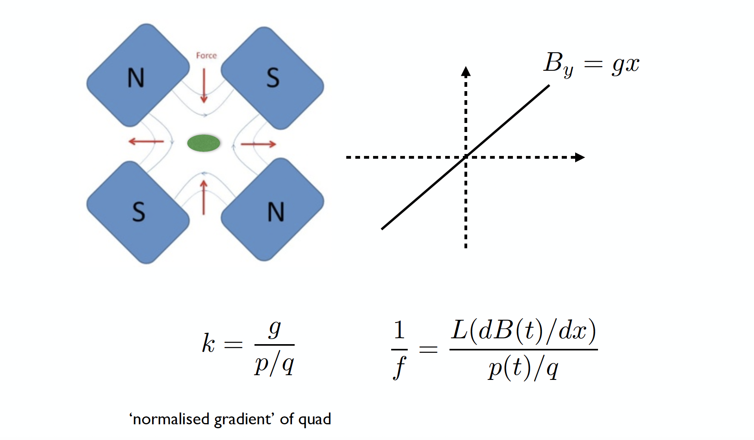
Synchrotron – Focusing Magnets

Slide 28
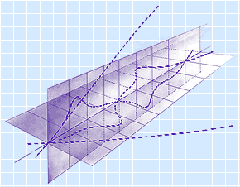
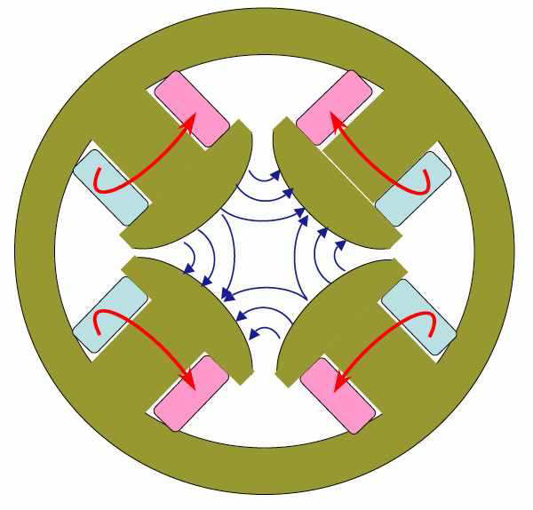
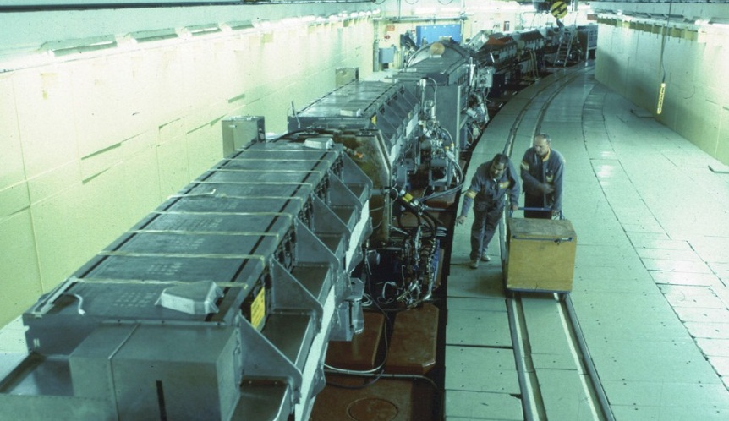
“Strong focusing” alternates focusing-defocusing forces (provided by quadrupoles) to give overall focusing in both X & Y planes.
Transverse trajectories
Strong focusing
Weak focusing
Strong focusing allows use of more compact magnets, thus achieving many times larger energy with the same cost.
CERN's Proton Synchrotron, was the first operating strong-focusing accelerator.
200-m diameter ring, weight of magnets 3,800 tons

Slide 29
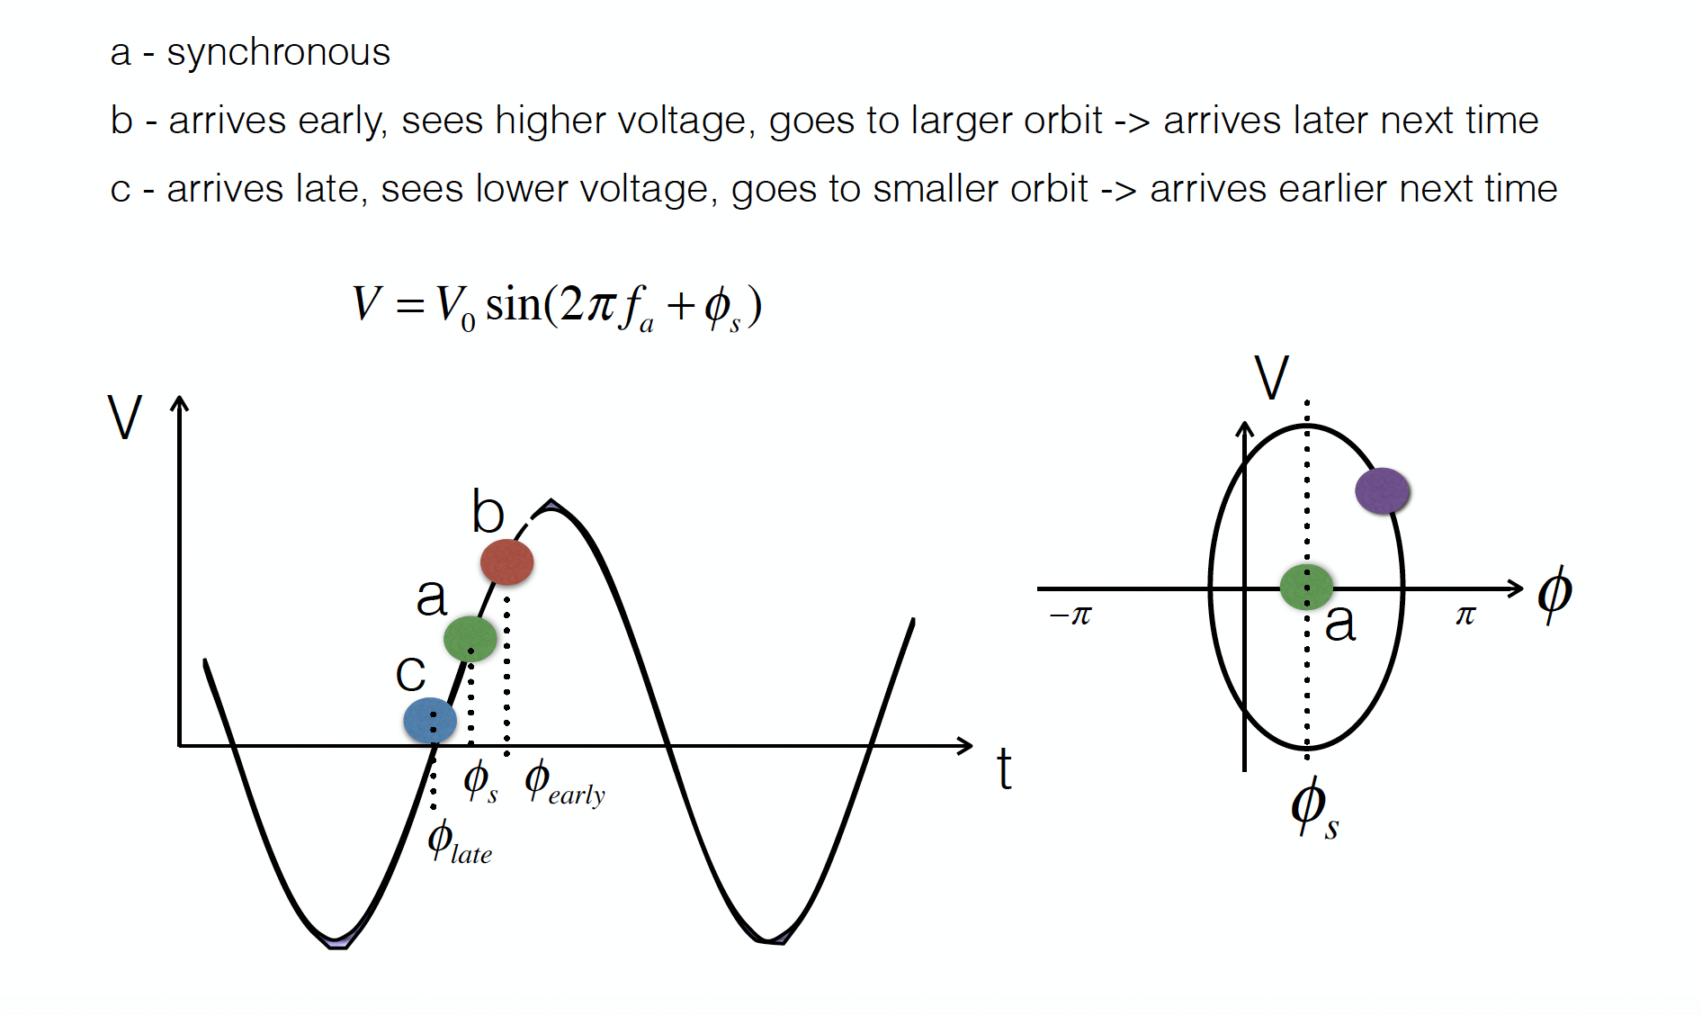
Synchtroton – Phase Stability

Slide 30


Why Colliders?
v~c
v=0
=>
E_{B} = γ m₀ c²
P_{B} = γ m₀ v
Only a tiny fraction of energy converted into mass of new particles
(due to energy and momentum conservation)
v~c
v~c
E_{B} = γ m₀ c²
E_{B} = γ m₀ c²
Entire energy converted into the mass of new particles

Slide 31
De Broglie Wavelength
Momentum
Planck Constant
De Broglie Wavelength
De Broglie Wavelength
Wave-particle duality;
For higher E, probe shorter distances inside matter

Slide 32
Luminosity
Particle colliders designed to deliver two basic parameters to HEP user.
Measure of collision rate per unit area.
Event rate for given event probability (“cross-section”):
For a Collider, instantaneous luminosity L is given by
→ Require intense beams, high bunch frequency and small beam sizes at IP.

Slide 33
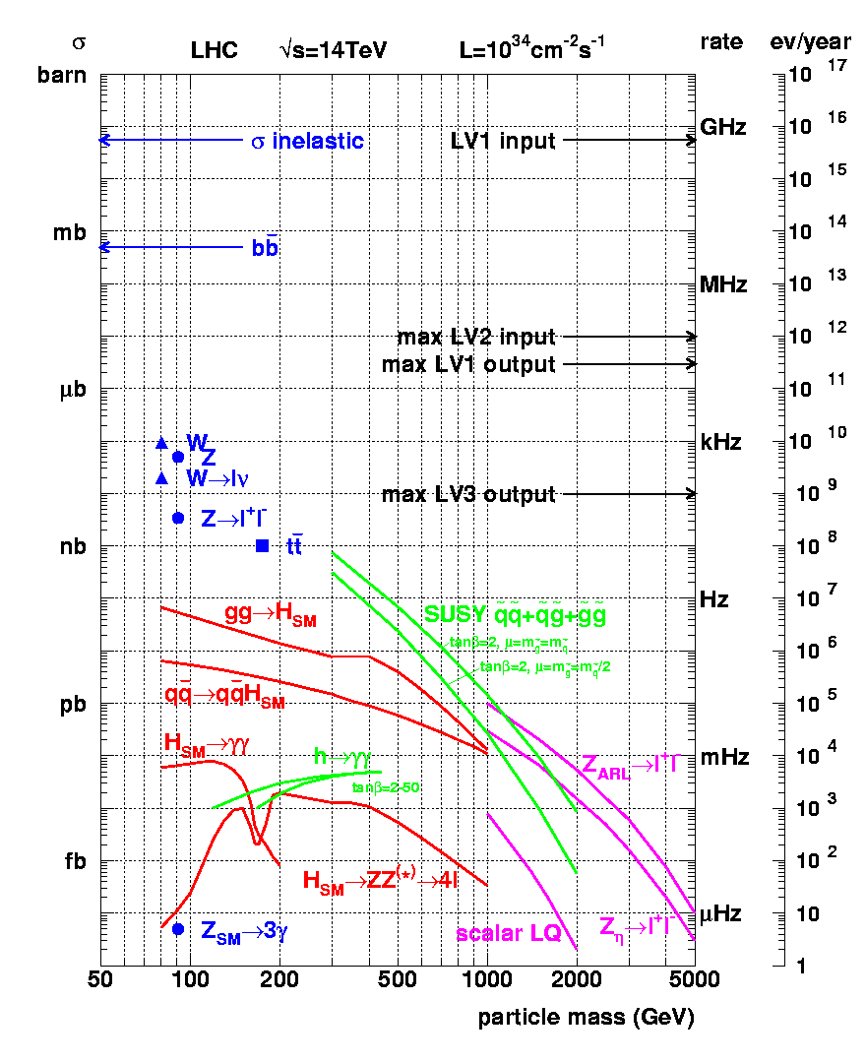
Cross-sections at the LHC
“Well known” processes. Don’t need to keep all of them …
New Physics!!
We want to keep!!

Slide 34
Collider Types
Hadron Colliders
Desire high energy
Only ~10% of beam energy available for hard collisions producing new particles
Need O(10 TeV) Collider to probe 1 TeV mass scale.
High-energy beam requires strong magnets to store and focus beam in reasonable-sized ring.
Desire high luminosity
Use proton-proton collisions.
High bunch population and high bunch frequency.
Anti-protons difficult to produce if beam is lost
c.f. SPS Collider and Tevatron

Slide 35

Collider Types
Lepton Colliders (e+e-)
Synchrotron radiation is the most serious challenge
Energy loss of a particle per turn
Emitted power in circular machine is
For collider with E_{CM} = 1 TeV in the LHC tunnel with a 1 mA beam, radiated power would be 2 GW
Would need to replenish radiated power with RF
Remove it from vacuum chamber
Approach for high energies is Linear Collider.

Slide 36
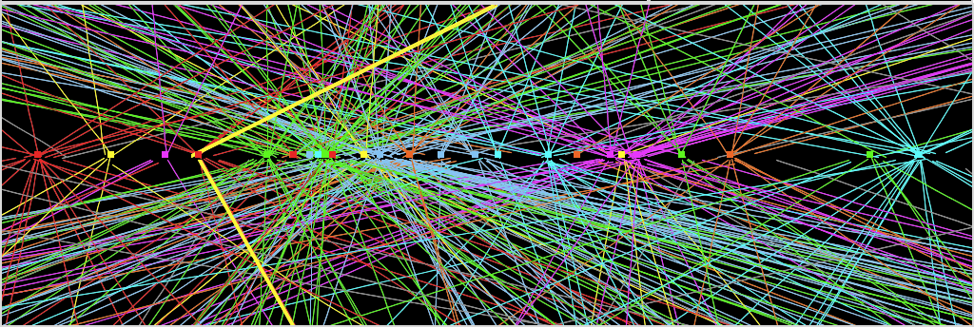
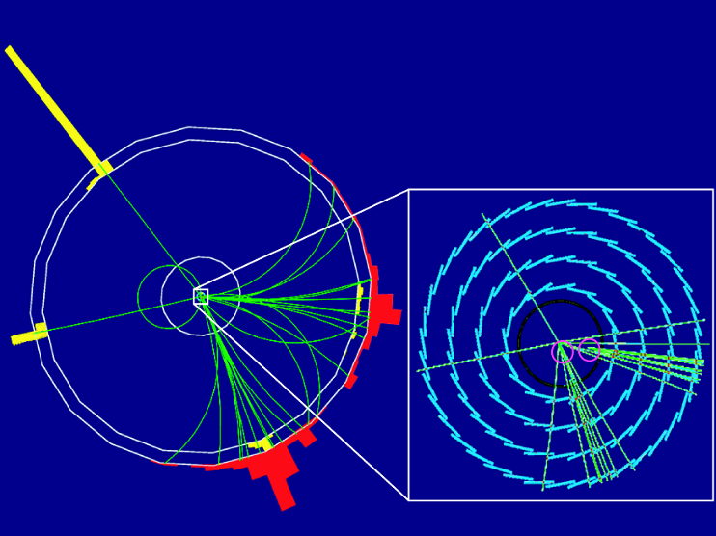
Collider Characteristics
Hadron collider at the frontier of physics
Huge QCD background
Not all nucleon energy available in collision
Lepton collider for precision physics
Well defined initial energy for reaction
Colliding point like particles
ATLAS Z → μμ event from 2012 data
with 25 reconstructed vertices
p
p
Simulation of HIGGS production e⁺e– → Z H Z → e⁺e–, H → bb
e+
e-

Slide 37
The Higgs is hiding in thousands
of trillions interactions…
Z→ μμ event from 2012 data with 25 reconstructed vertices
Z→ μμ

Slide 38
Circular versus Linear Collider
accelerating cavities
N
N
S
S
Circular Collider many magnets, few cavities, stored beam
higher energy → stronger magnetic field
→ higher synchrotron radiation losses (E⁴/m⁴R)
source
main linac
Linear Collider few magnets, many cavities, single pass beam
higher energy → higher accelerating gradient
higher luminosity → higher beam power (high bunch repetition)

Slide 39
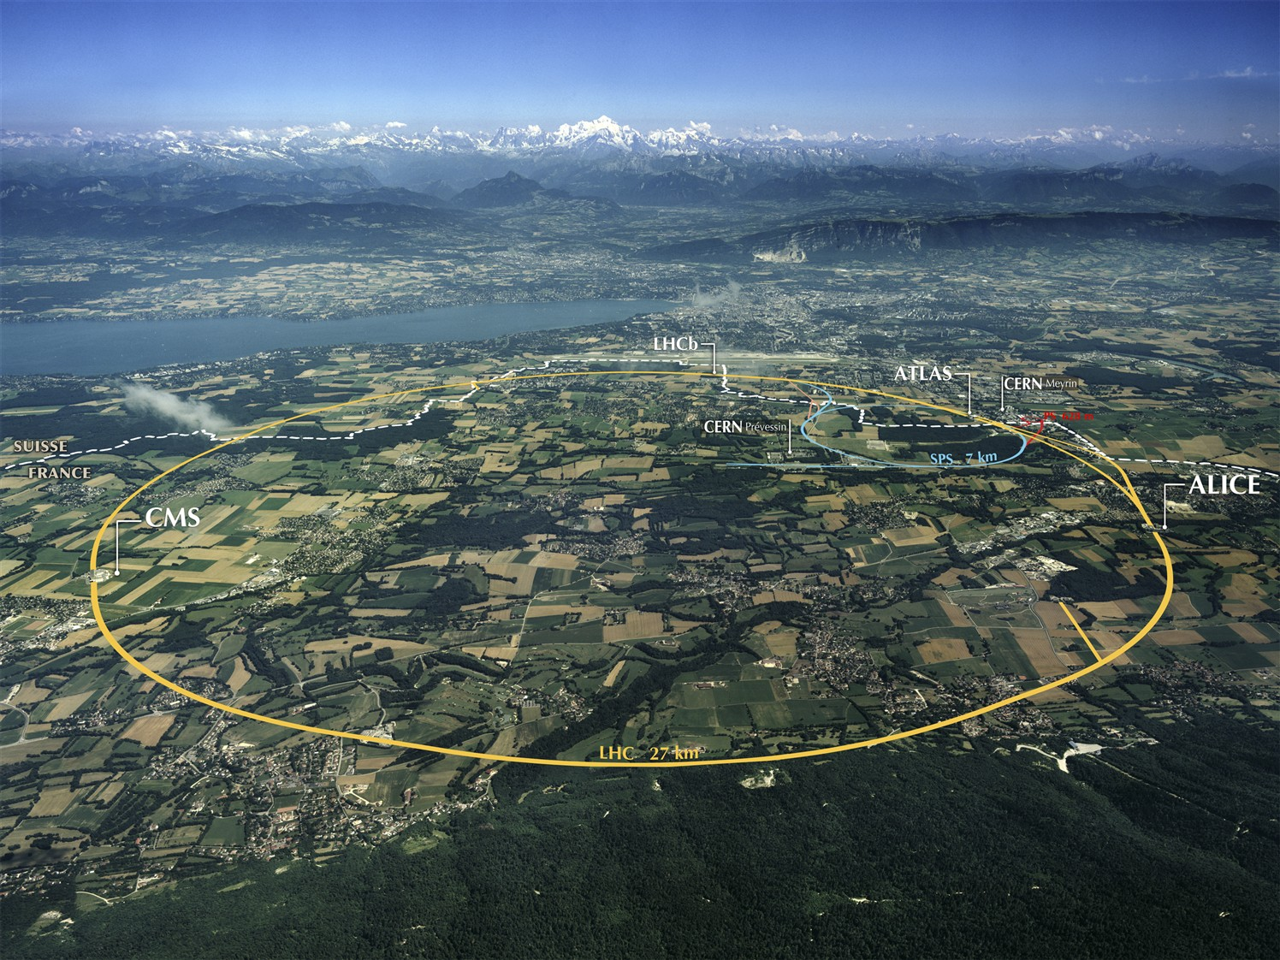
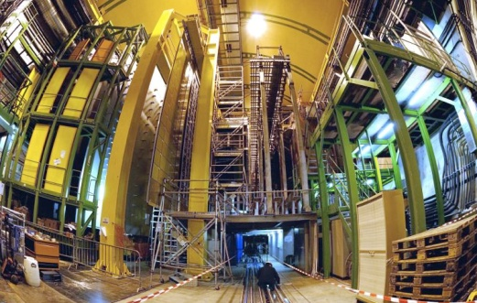
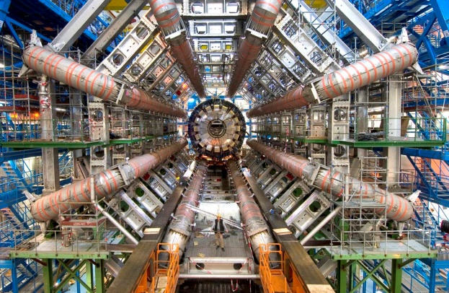
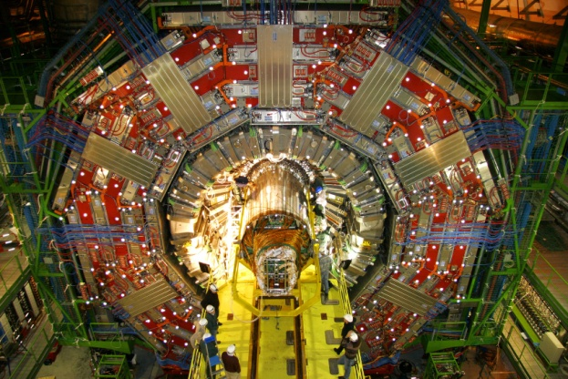
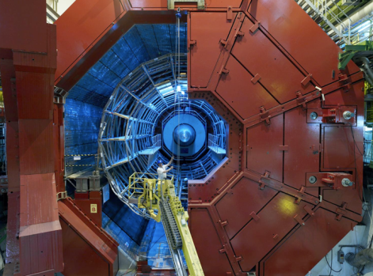
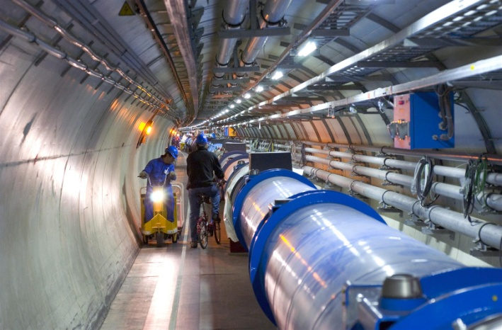
A New Era in Fundamental Science
LHCb
CMS
ATLAS
Exploration of a new energy frontier
in p-p and Pb-Pb collisions
ALICE
LHC ring:
27 km circumference
Notes:
39

Slide 40
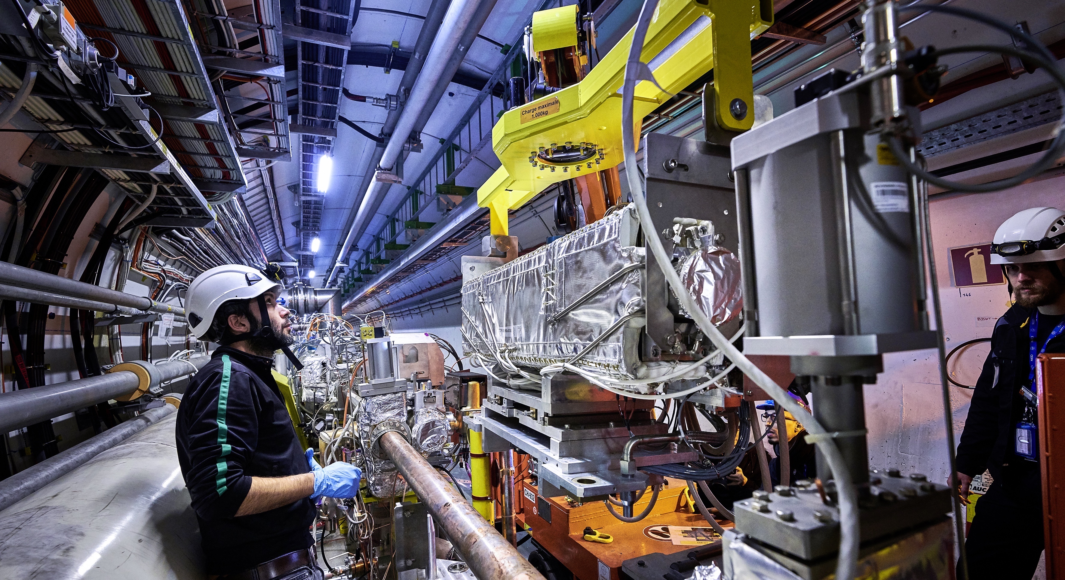
Upgrade to the High-Luminosity LHC is under way
The HL-LHC will use new technologies to provide 10 times more collisions than the LHC.
It will give access to rare phenomena, greater precision and discovery potential.
It will start operating in 2030, and run until approx. 2041.

Slide 41

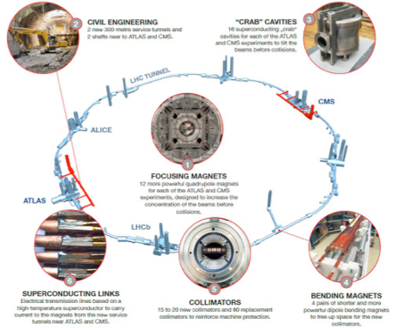
High-Luminosity LHC (HL-LHC)
New quadrupole magnets near the interaction points
New 11 Tesla short dipole magnets
Collimation upgrade
Crab Cavities
Accelerator safety upgrade
Major interventions on 1.2 km of the LHC
New quadrupole magnets near the interaction points
New 11 Tesla short dipole magnets
Collimation upgrade
Crab Cavities
Accelerator safety upgrade
Major interventions on 1.2 km of the LHC
New quadrupole magnets near the interaction points
New 11 Tesla short dipole magnets
Collimation upgrade
Crab Cavities
Accelerator safety upgrade
Major interventions on 1.2 km of the LHC

Slide 42
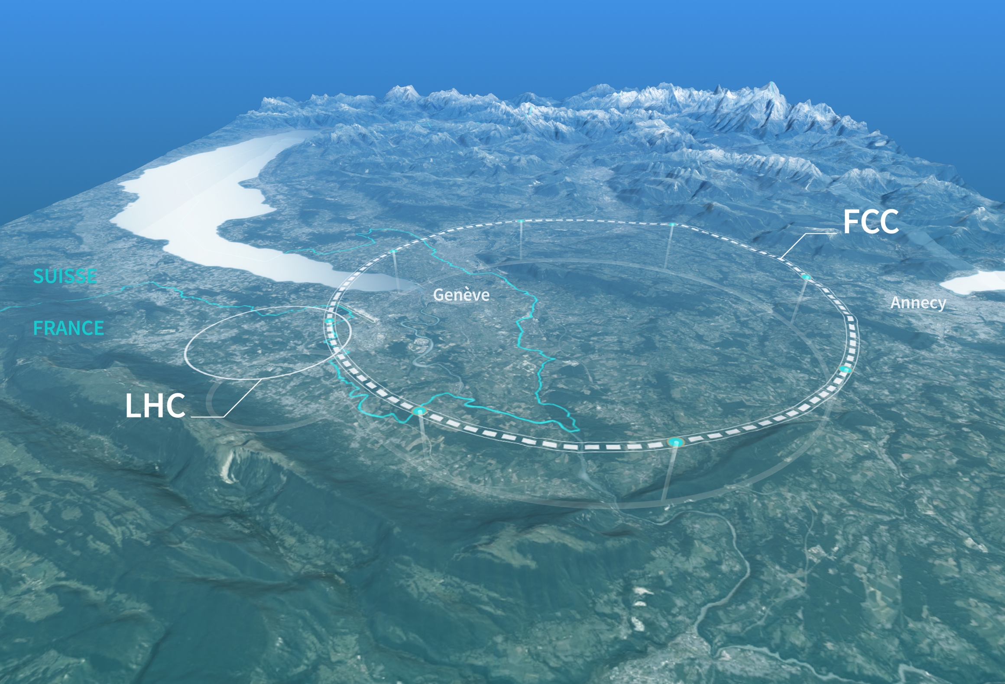
Preparing CERN’s Future
Driven by the 2020 Update of the European Strategy for Particle Physics
Technical and financial feasibility study of a Future Circular Collider (report in 2025)
Accelerator R&D to develop technologies for FCC and for alternative options
Detector and computing R&D
Maintain and expand a compelling scientific diversity programme
Continue to support other projects around the world

Slide 43





FCC Integrated Programme
Comprehensive long-term programme maximising physics opportunities
Stage 1: FCC-ee (Z, W, H, $\text{t}\overline{\text{t}}$) as Higgs factory, electroweak & top factory at highest luminosities
Stage 2: FCC-hh (~100 TeV) as natural continuation at energy frontier, pp & AA collisions; e-h option
Highly synergetic and complementary programme boosting the physics reach of both colliders
Common civil engineering and technical infrastructures, building on and reusing CERN’s existing infrastructure
FCC integrated project allows the start of a new, major facility at CERN within a few years of the end of HL-LHC
FCC-ee
FCC-hh

Slide 44
FCC-ee Main Machine Parameters
Parameter | Z | WW | H (ZH) | ttbar
beam energy [GeV] | 45.6 | 80 | 120 | 182.5
beam current [mA] | 1270 | 137 | 26.7 | 4.9
number bunches/beam | 11200 | 1780 | 440 | 60
bunch intensity [10¹¹] | 2.14 | 1.45 | 1.15 | 1.55
SR energy loss / turn [GeV] | 0.0394 | 0.374 | 1.89 | 10.4
total RF voltage 400/800 MHz [GV] | 0.120/0 | 1.0/0 | 2.1/0 | 2.1/9.4
long. damping time [turns] | 1158 | 215 | 64 | 18
horizontal beta* [m] | 0.11 | 0.2 | 0.24 | 1.0
vertical beta* [mm] | 0.7 | 1.0 | 1.0 | 1.6
horizontal geometric emittance [nm] | 0.71 | 2.17 | 0.71 | 1.59
vertical geom. emittance [pm] | 1.9 | 2.2 | 1.4 | 1.6
vertical rms IP spot size [nm] | 36 | 47 | 40 | 51
beam-beam parameter ξ_{x} / ξ_{y} | 0.002/0.0973 | 0.013/0.128 | 0.010/0.088 | 0.073/0.134
rms bunch length with SR / BS [mm] | 5.6 / 15.5 | 3.5 / 5.4 | 3.4 / 4.7 | 1.8 / 2.2
luminosity per IP [10³⁴ cm⁻²s⁻¹] | 140 | 20 | ≥5.0 | 1.25
total integrated luminosity / IP / year [ab⁻¹/yr] | 17 | 2.4 | 0.6 | 0.15
beam lifetime rad Bhabha + BS [min] | 15 | 12 | 12 | 11
Design and parameters to maximise luminosity at all working points:
Allow for 50 MW synchrotron radiation per beam.
Independent vacuum systems for electrons and positrons
Full energy booster ring with top-up injection, collider permanently in collision mode
4 years
5 x 10¹² Z
LEP x 10⁵
2 years
> 10⁸ WW
LEP x 10⁴
3 years
2 x 10⁶ H
5 years
2 x 10⁶ tt pairs
x 10-50 improvements on all EW observables
up to x 10 improvement on Higgs coupling (model-indep.) measurements over HL-LHC
x10 Belle II statistics for b, c, τ
indirect discovery potential up to ~ 70 TeV
direct discovery potential for feebly-interacting particles over 5-100 GeV mass range
Up to 4 interaction points → robustness,
statistics, possibility of specialised detectors
to maximise physics output
F. Gianotti

Slide 45
FCC-hh Main Machine Parameters
parameter | FCC-hh | HL-LHC | LHC
collision energy cms [TeV] | 81 - 115 | 14
dipole field [T] | 14 - 20 | 8.33
circumference [km] | 90.7 | 26.7
arc length [km] | 76.9 | 22.5
beam current [A] | 0.5 | 1.1 | 0.58
bunch intensity [10¹¹] | 1 | 2.2 | 1.15
bunch spacing [ns] | 25 | 25
synchr. rad. power / ring [kW] | 1020 - 4250 | 7.3 | 3.6
SR power / length [W/m/ap.] | 13 - 54 | 0.33 | 0.17
long. emit. damping time [h] | 0.77 – 0.26 | 12.9
peak luminosity [10³⁴ cm⁻²s⁻¹] | ~30 | 5 (lev.) | 1
events/bunch crossing | ~1000 | 132 | 27
stored energy/beam [GJ] | 6.1 - 8.9 | 0.7 | 0.36
Integrated luminosity/main IP [fb⁻¹] | 20000 | 3000 | 300
With FCC-hh after FCC-ee: significant amount of time for high-field magnet R&D,
aiming at highest possible collision energies
Target field range for cryo-magnet R&D
Formidable challenges:
high-field superconducting magnets: 14 - 20 T
power load in arcs from synchrotron radiation: 4 MW → cryogenics, vacuum
stored beam energy: ~ 9 GJ → machine protection
pile-up in the detectors: ~1000 events/xing
optimization of energy consumption: → R&D on cryo, HTS, beam current, …
Formidable physics reach, including:
Direct discovery potential up to ~ 40 TeV
Measurement of Higgs self to ~ 5% and ttH to ~ 1%
High-precision and model-indep (with FCC-ee input) measurements of rare Higgs decays (𝛄𝛄, Z𝛄, µµ)
Final word about WIMP dark matter
F. Gianotti

Slide 46




Projected Timeline to Start of Construction
2024 |  |  |  | 2025 |  |  |  | 2026 |  |  |  | 2027 |  |  |  | 2028 |  |  |  | 2029 |  |  |  | 2030 |  |  |  | 2031 |  |  |  | 2032 |  |  |  | 2033
Q1 | Q2 | Q3 | Q4 | Q1 | Q2 | Q3 | Q4 | Q1 | Q2 | Q3 | Q4 | Q1 | Q2 | Q3 | Q4 | Q1 | Q2 | Q3 | Q4
Feasibility Study
Pre-TDR Phase
TDR Phase
Construction →→→
FS Report
cost update
ESPPU
2025/26
pre TDR
cost update
TDR
cost update
Project Decision
accelerator design, technical infrastructure design, R&D, towards TDR
engineering design →
Environmental Impact study & Authorization Process
Phase 1 Site Investigations
Phase 2 Site Investigations
CE Concept Design update
CE Tender Design
Construction Design
Start construction
Detector EOI submissions
FC³ formation, call for CDRs
Detector CDRs submitted to FC³

Slide 47


FCC Integrated Programme - Timeline
Note: FCC Conceptual Design Study
started in 2014 leading to CDR
in 2018
FCC construction can proceed in parallel with HL-LHC operation.
“Realistic” schedule taking into account:
past experience in building colliders at CERN
approval timeline: ESPP, Council decision
that HL-LHC will run until 2041
Can be accelerated if more resources available
2033
2048
2074

Slide 48


Linear Colliders
CLIC
Linear e⁺e⁻ colliders
Luminosities: few 10³⁴ cm⁻²s⁻¹
ILC
2-beam acceleration scheme at room temperature
Gradient 100 MV/m
√s up to 3 TeV
Physics + Detector studies for 350 GeV - 3 TeV
Superconducting RF cavities (like XFEL)
Gradient 32 MV/m
√s ≤ 500 GeV (1 TeV upgrade option)
Focus on ≤ 500 GeV, physics studies also for 1 TeV

Slide 49

The International Linear Collider (ILC)

Slide 50


CLIC Implementation
⬅ Possible lay-out near CERN
⬇ CLIC parameters
Note: the design is currently being re-optmised, e.g. to include 350 GeV as the first stage

Slide 51

Physics with Muon Beams
Muon Beams and the Neutrino Sector
Decay kinematics well known
ν_{e} → ν_{µ} oscillations give easily detectable wrong-sign µ
Muon Beams and the Energy Frontier
Point particle makes full beam energy available for particle production.
Couples strongly to Higgs sector
Muon Collider has almost no synchrotron radiation
Narrow energy spread
Fits on existing laboratory sites

Slide 52
Muon Beam Challenges
Muons created as tertiary beam (p → π → µ)
Low production rate
Need target that can tolerate multi-MW beam
Large energy spread and transverse phase space
Need solenoidal focusing for the low-energy portions of the facility
Solenoids focus in both planes simultaneously,
Need ionisation cooling, high-acceptance acceleration system & decay ring.
Muons have short lifetime (2.2 µs at rest)
Mean distance travelled in the lab frame from production to decay
L = (p/mc) c tau with momentum p, mass m, lifetime at rest tau
Puts premium on rapid beam manipulations
High-gradient RF cavities (in magnetic field)
Decay electrons give backgrounds in Collider detectors and instrumentation & heat load to magnets

Slide 53

Muon Accelerator Synergies

Slide 54

Plasma Accelerators
e.g. AWAKE at CERN
Demonstration experiment to verify novel
technique of p-driven plasma
wakefield acceleration
Plasma
accelerators:
Transform transverse fields into longitudinal fields.
Significantly higher accelereating gradients than conventional RF.
Laser driven
e- driven
p driven
Dielectric wakefields

Slide 55
Bibliography
Unifying Physics of Accelerators, Lasers and Plasma, Andrei Seryi, CRC Press, 2015
The Physics of Particle Accelerators – An Introduction, Klaus Wille, OUP, 2000
An Introduction to Particle Accelerators, Edmund Wilson, OUP, 2001
Engines of Discovery, Andrew Sessler & Edmund Wilson, World Scientific, 2006
Engines of Discovery Revised & Expanded Edition, Andrew Sessler & Edmund Wilson, World Scientific, 2014

