Slide 1
WP3: Vacuum
Jose A. Ferreira Somoza and Alice Michet (TE-VSC)
10th October 2025

Slide 2
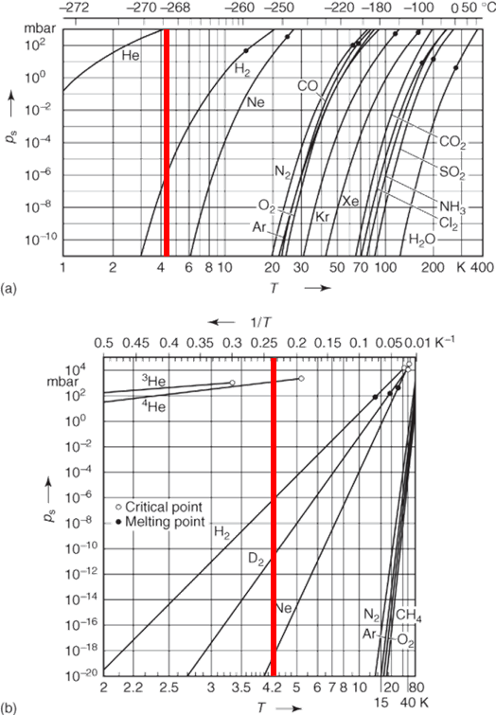
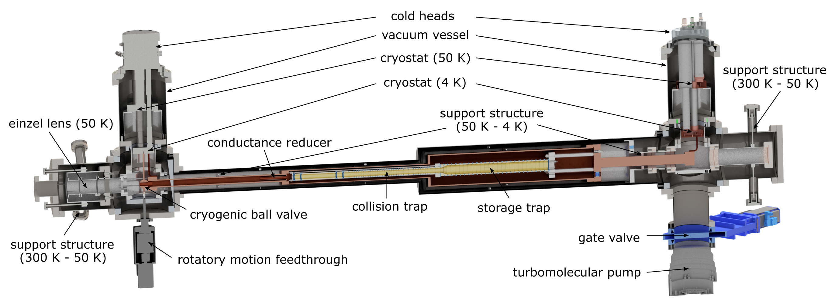
PUMA requirements: Trap requirements
Pumping on cold surfaces (4.2K) of gases entering the trap
Maximum allowed pressure at the entrance of the trap ⇒ Defined by expansion of gas
Only H₂ and He pressure will evolve with time ⇒ Sub ML coverage
Small conductance between the entrance and collision and storage trap.

Slide 3
PUMA layout

Slide 4
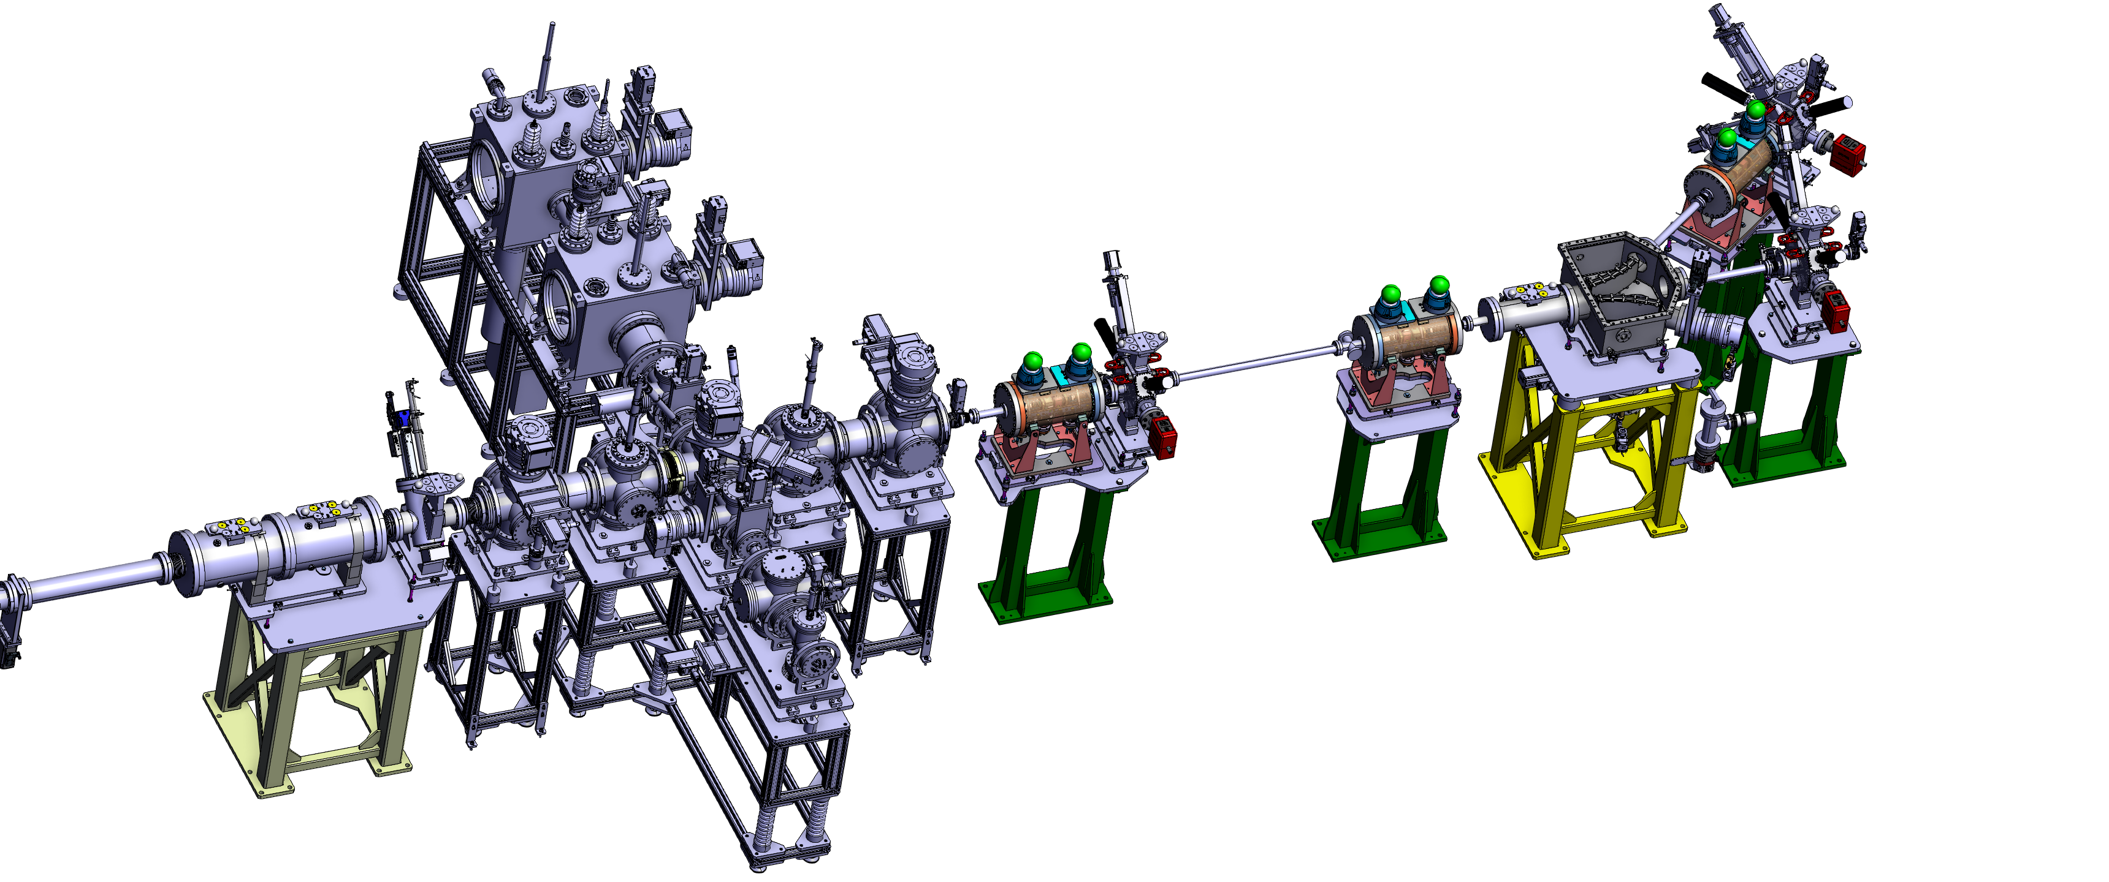
PUMA layout: Sectorization
Sector valve
Sector valve
Sector valve
Sector valve
Sector valve
Sector valve

Slide 5
PUMA layout: RC610

Slide 6
PUMA layout: RC610

Slide 7
PUMA layout: MRTOF

Slide 8
PUMA layout: PT

Slide 9
PUMA layout: RC620
Add H₂ pumping speed (NEG)

Slide 10
PUMA layout: RC620

Slide 11
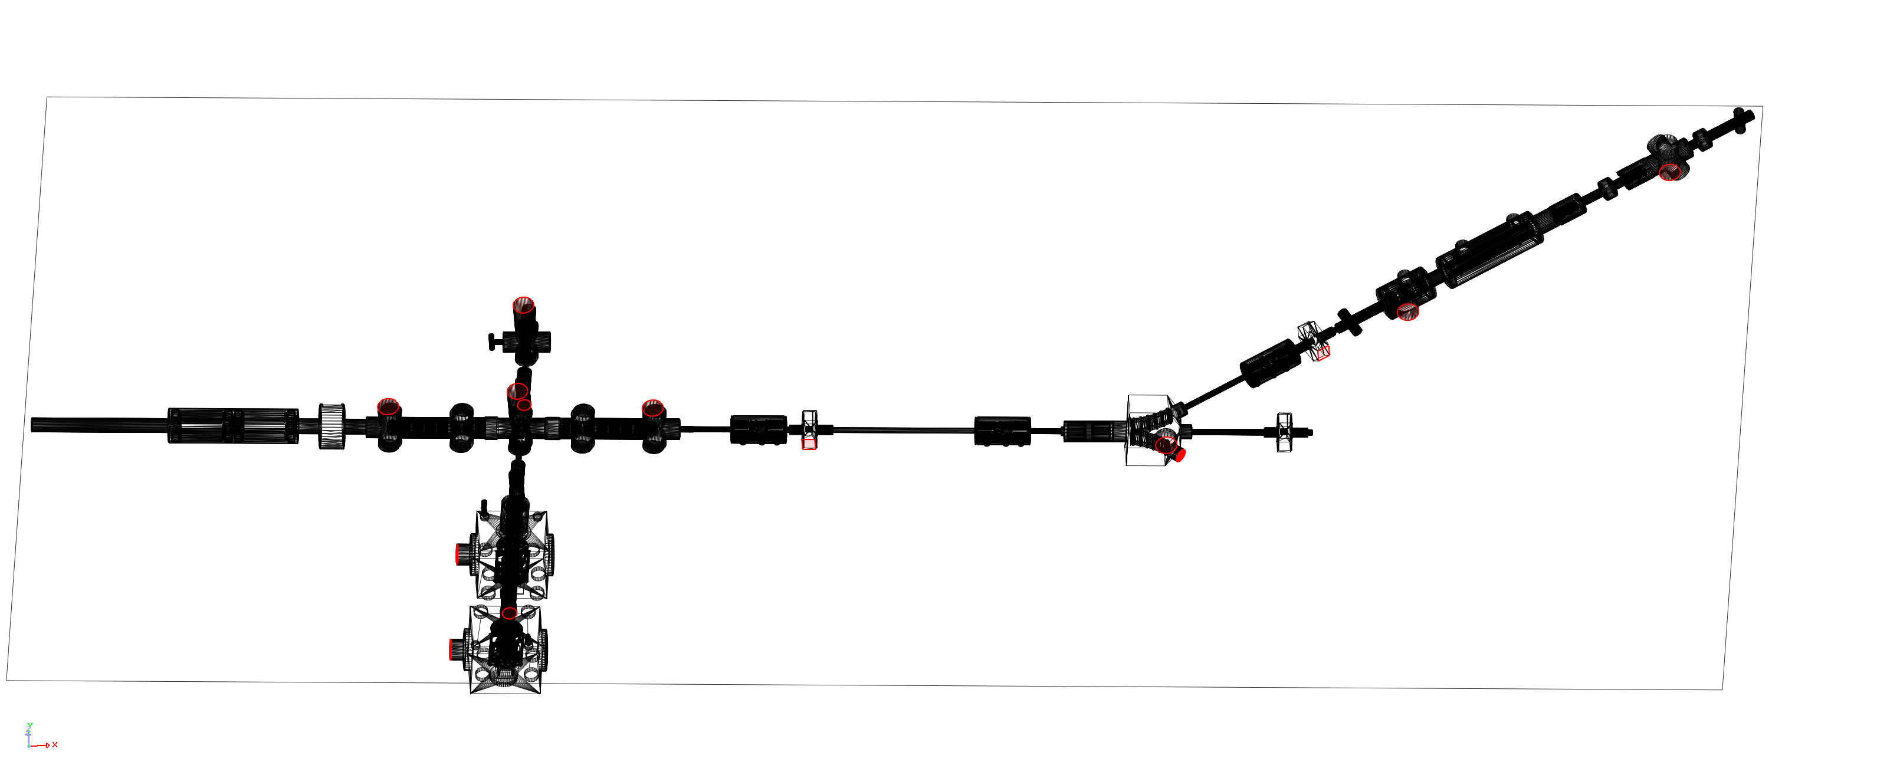
PUMA simulations

Slide 12
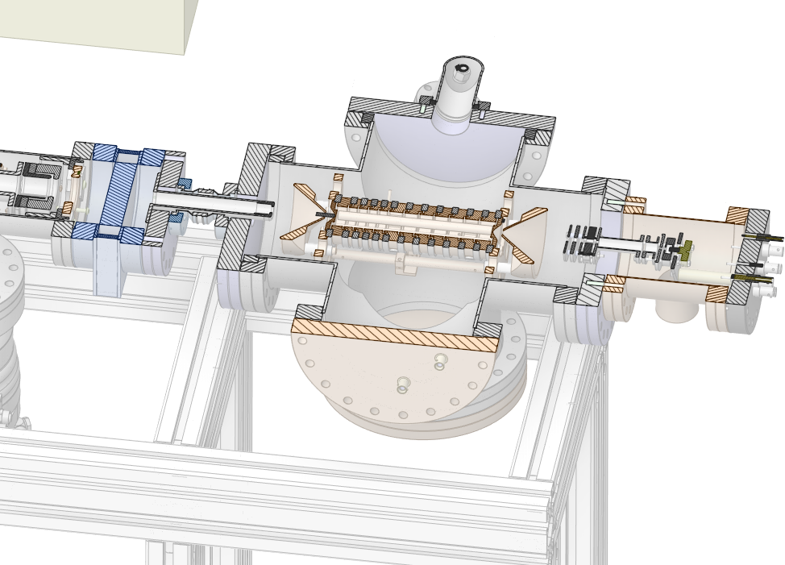
PUMA beam line requirements
Input: Paul trap with He injection at 10⁻⁴ mbar (absolute)=> Inside the trap pressure is >10⁻² mbar!
Main concern is the He propagation.
He pumping strategy:
(many) turbopumps along the beam line
ion pumps next to the trap at very low pressure.
H₂ easier to treat. Its pumping speed can be progressively increased to cope with the outgassing gas loads in the vicinity of the trap. Starting with turbopumps and ending with ion pumps and NEG cartridges and coatings

Slide 13
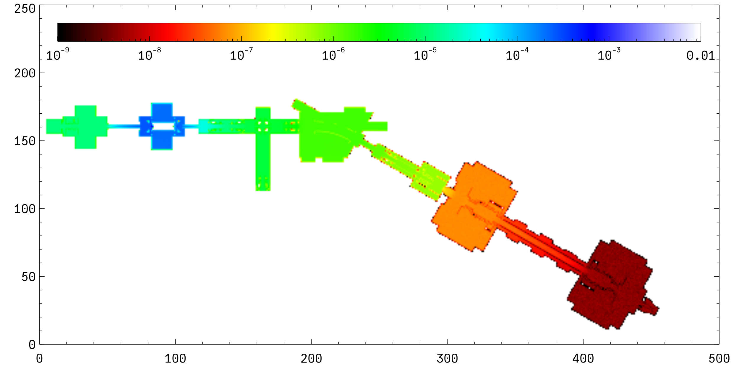
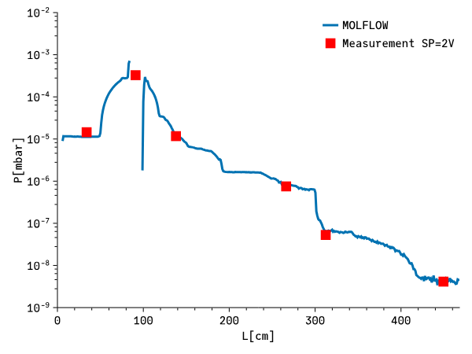
Test at MIRACLS
SP[V] | Q [mbar×l/s]
0.1 | 2.74E-03
0.2 | 7.68E-03
0.3 | 1.24E-02
0.5 | 2.30E-02
1.0 | 4.84E-02
1.5 | 7.41E-02
2.0 | 1.03E-01
2.5 | 1.31E-01
3.0 | 1.58E-01
3.5 | 1.85E-01
4.0 | 2.12E-01
4.5 | 2.38E-01
5.0 | 2.67E-01
With calibrated leak discrepancy of approx. 5% between simulation and real value => Compression ratio has to be considered => Exhaust

Slide 14
Iris
Iris

Slide 15
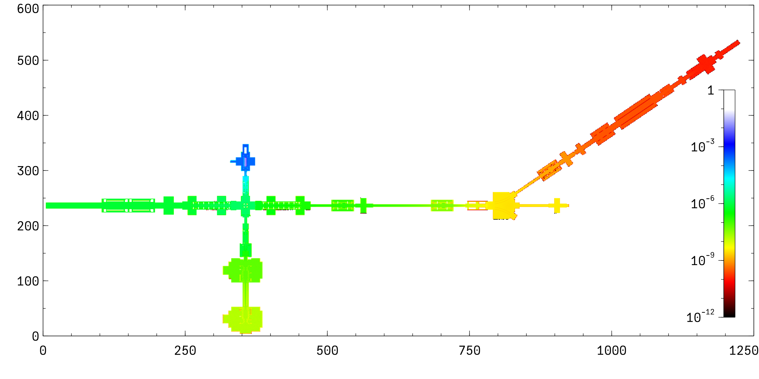
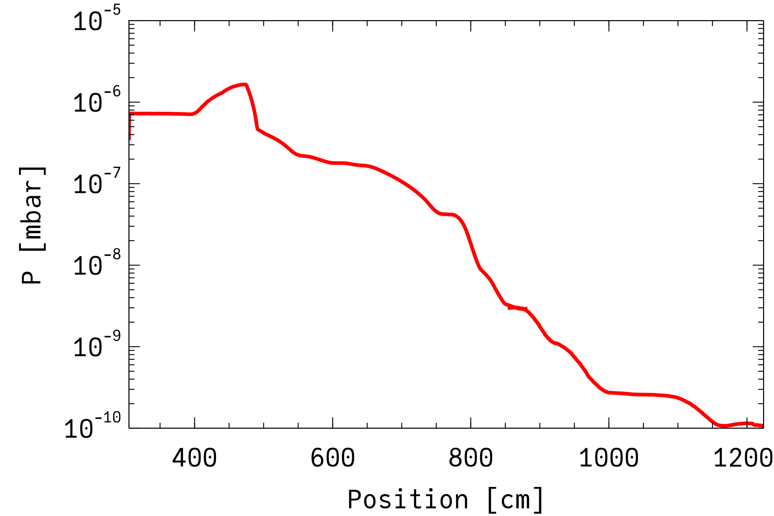
He propagation 20 mm orifice
SP 2V => Injection ≈0.1 mbar×l/s
Simulation in two steps to overcome the lack of statistics (MC simulation)
2×StarCell 300 as in PUMA at ELENA
No pumping from the trap
P ≈ 10⁻¹⁰ mbar next to the trap

Slide 16
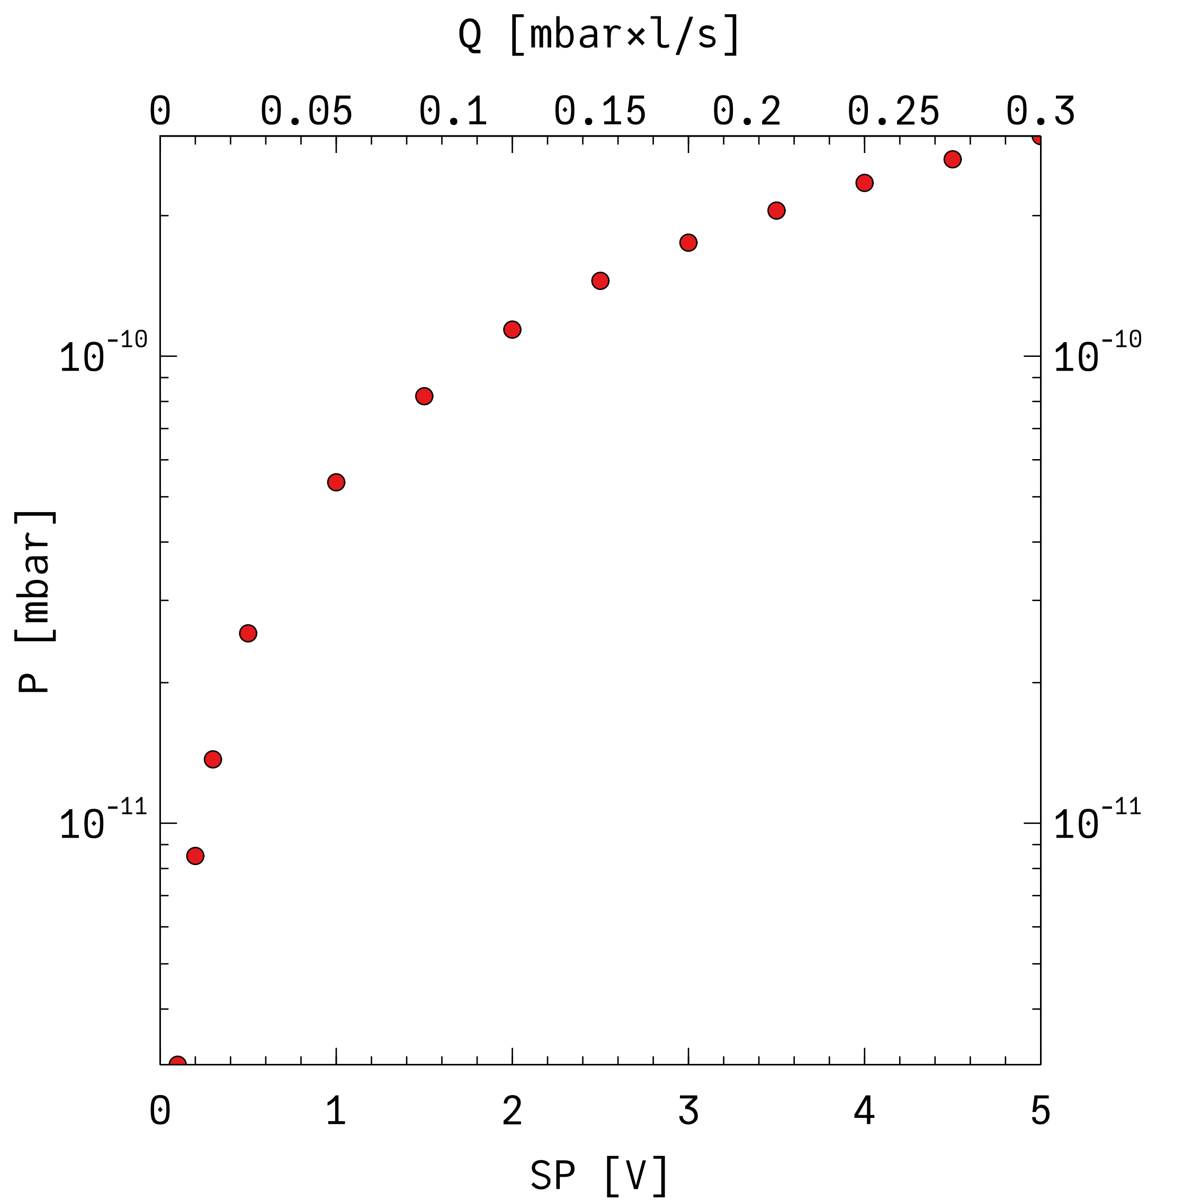
He propagation 20 mm orifice
SP 2V => Injection ≈ 0.1 mbar×l/s
Simulation in two steps to overcome the lack of statistics (MC simulation)
2×StarCell 300 as in PUMA at ELENA
No pumping from the trap
P ≈ 10⁻¹⁰ mbar next to the trap

Slide 17
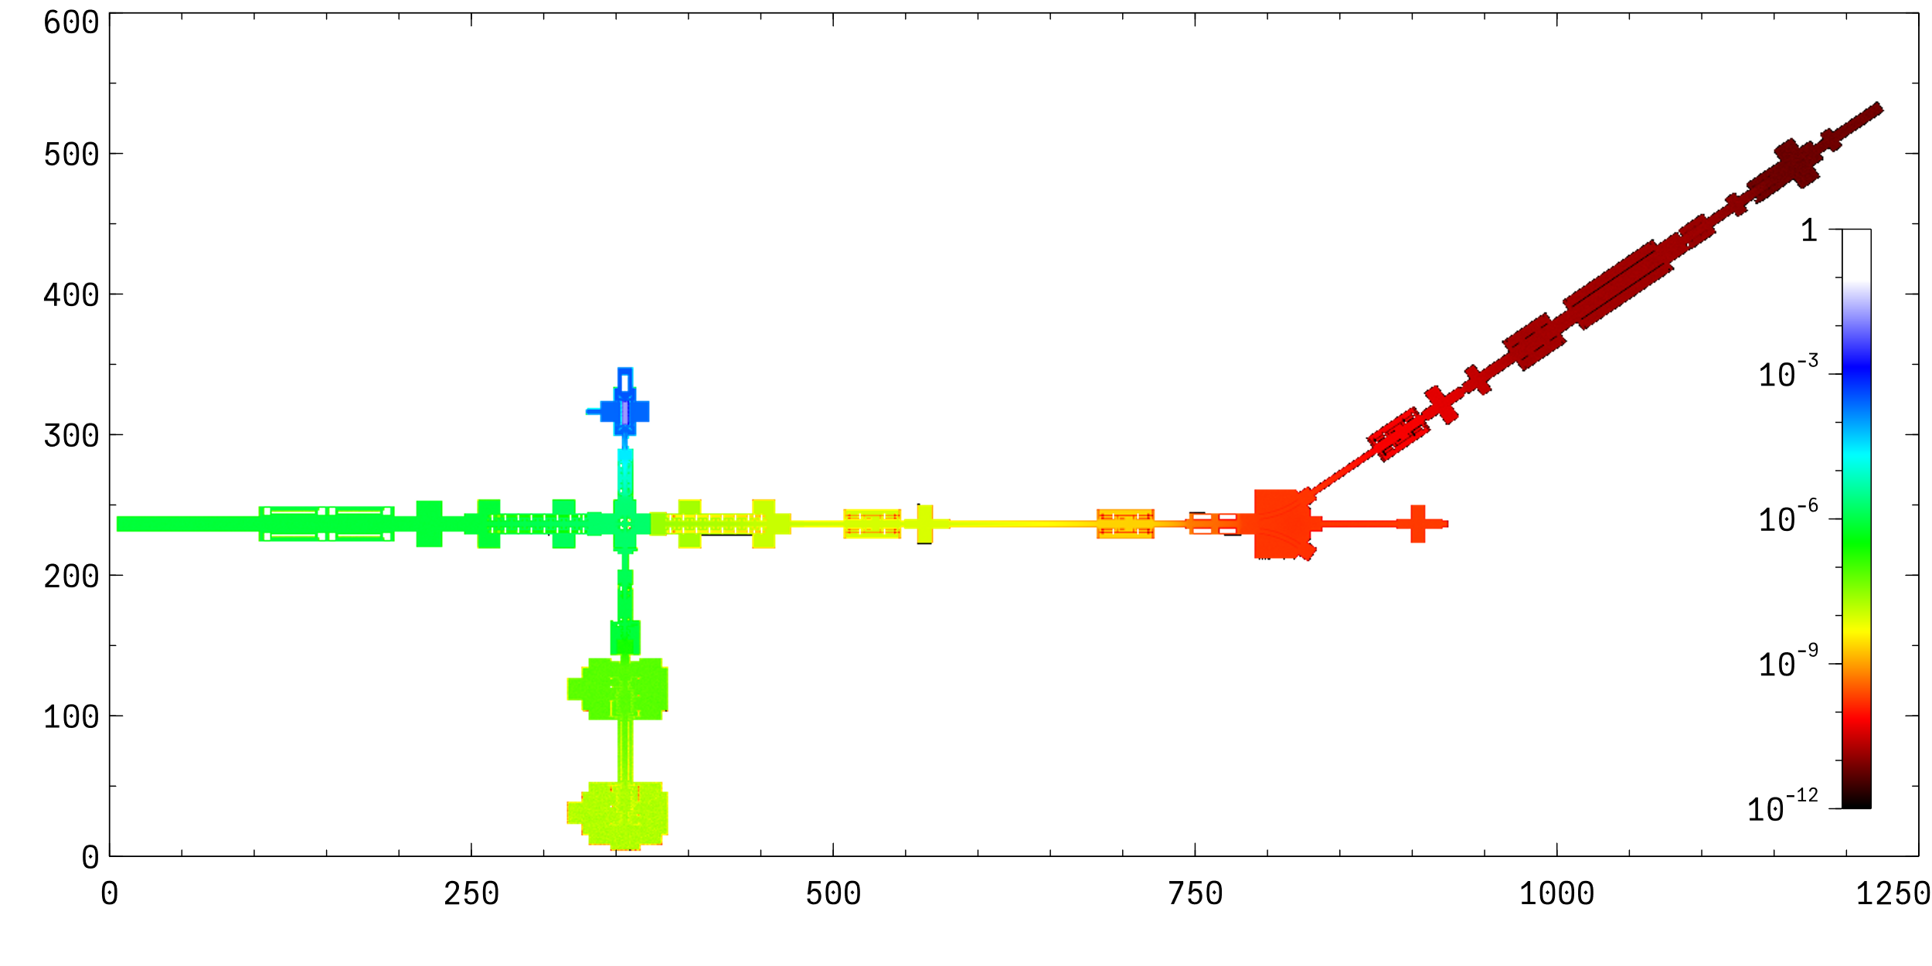
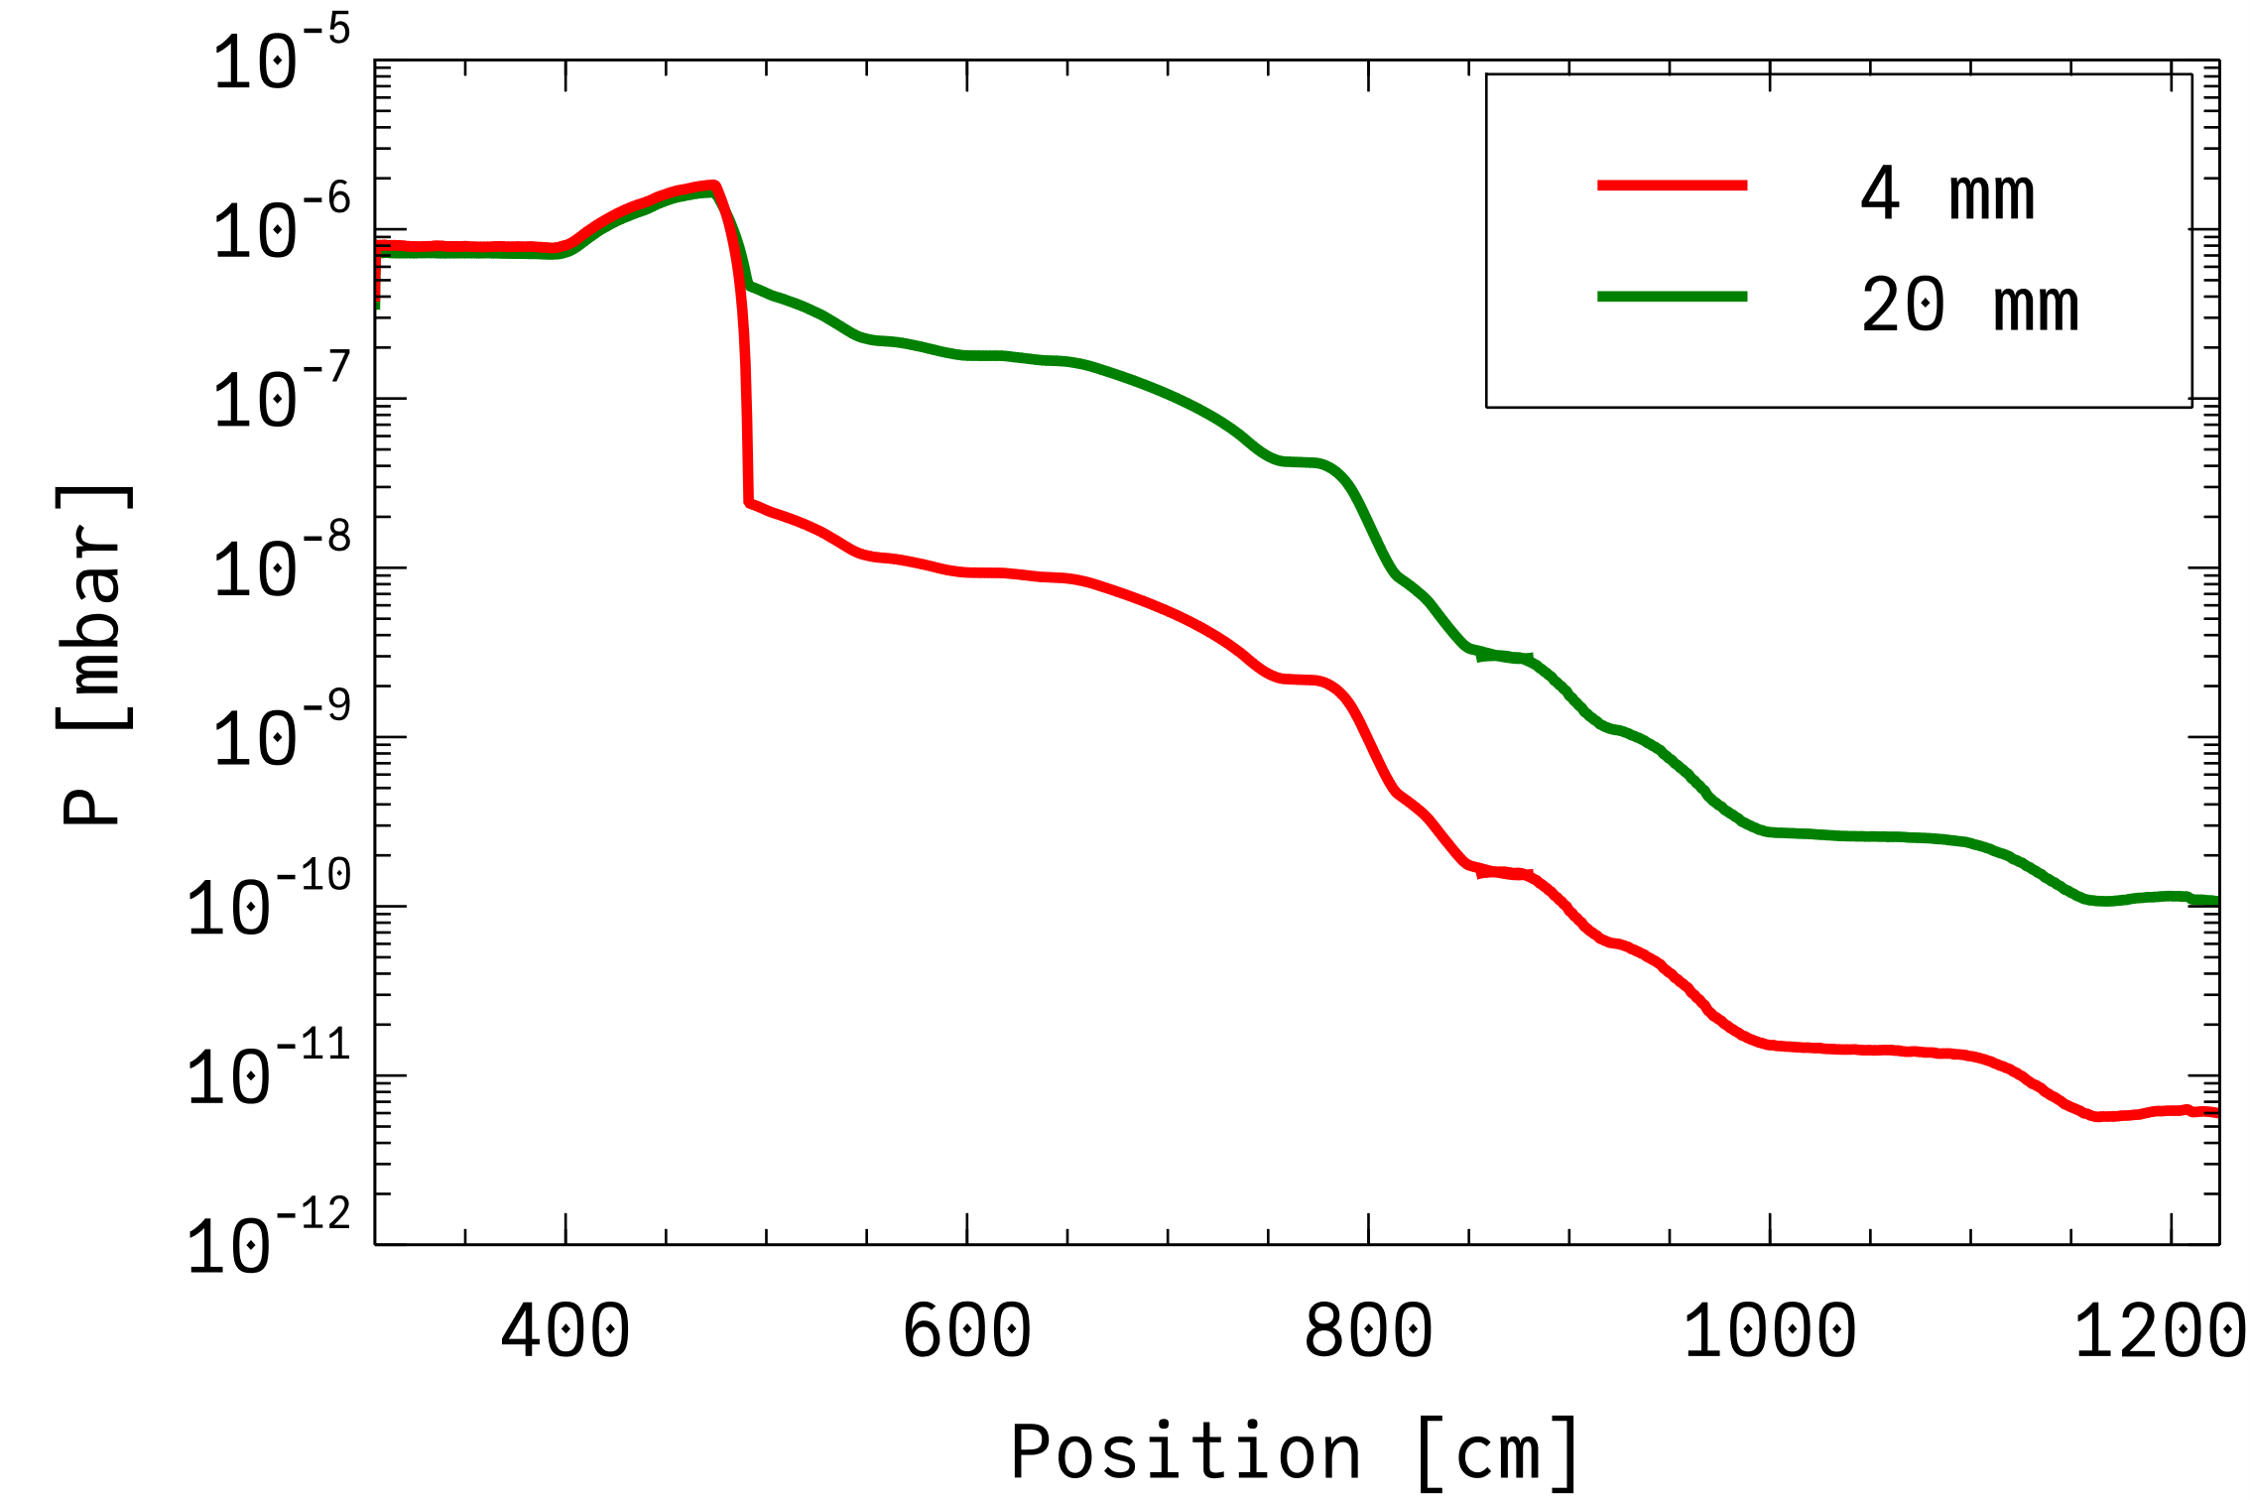
He propagation 4 mm orifice
SP 2V => Injection ≈0.1 mbar×l/s
Simulation in two steps to overcome the lack of statistics (MC simulation)
2×StarCell 300 as in PUMA at ELENA
No pumping from the trap
P <10⁻¹¹ mbar next to the trap

Slide 18
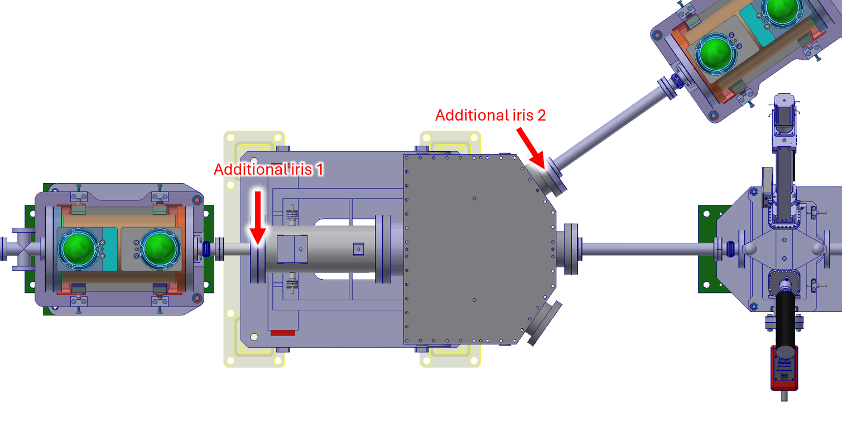
More iris

Slide 19
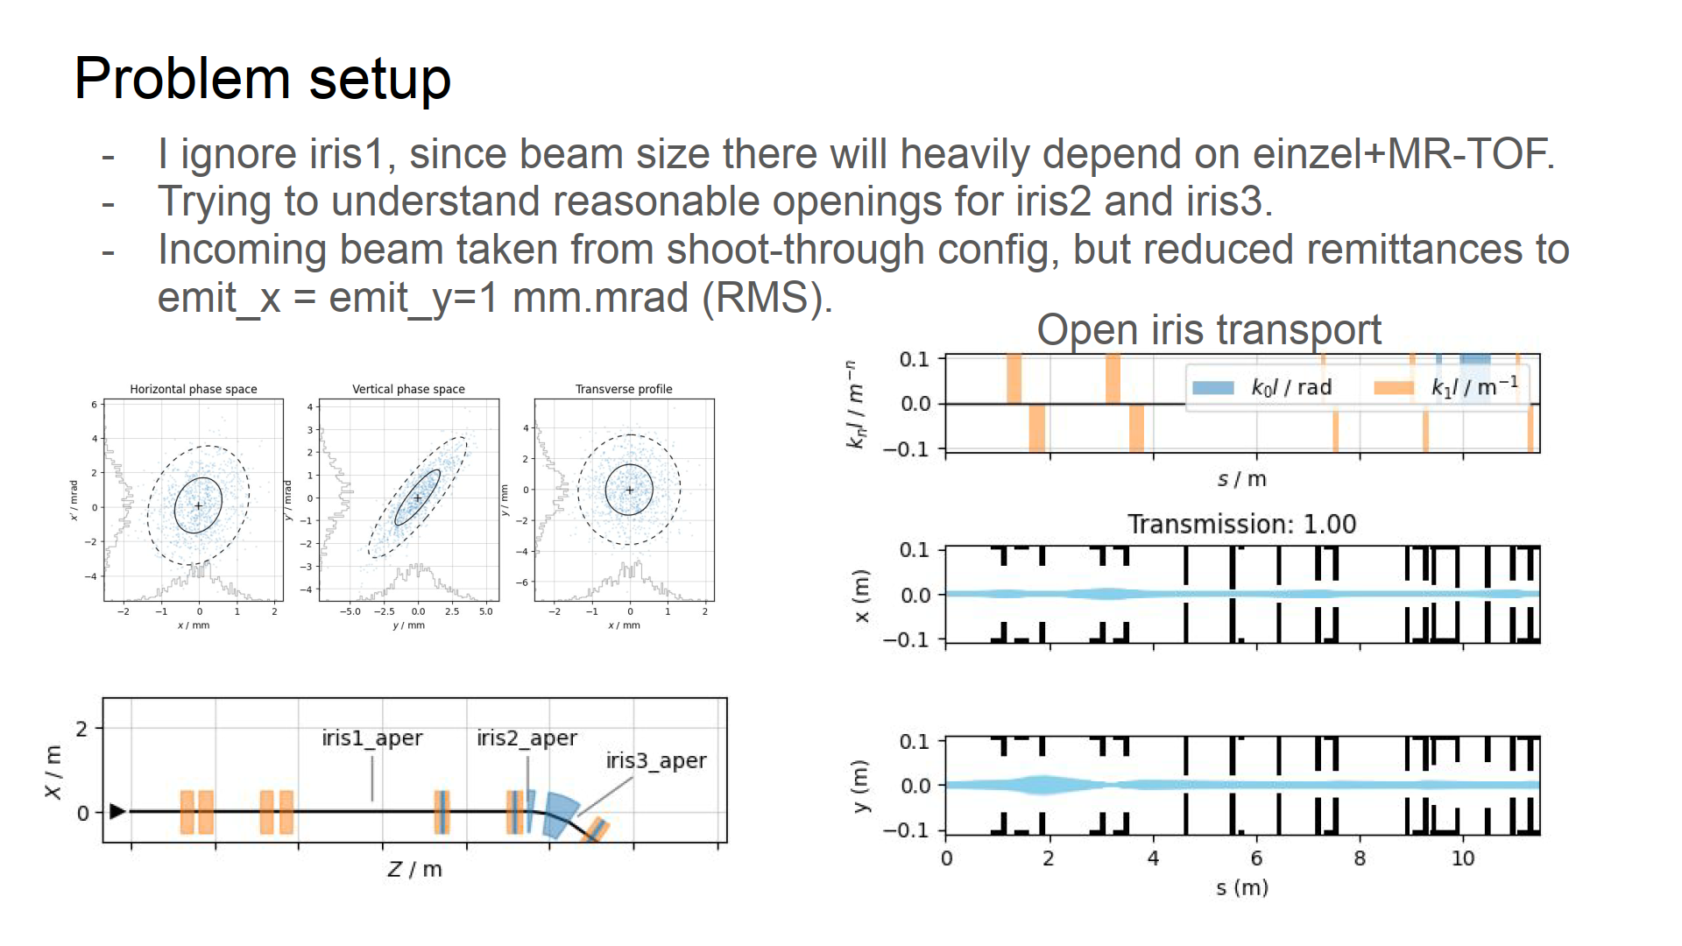
Courtesy P. Arrutia

Slide 20
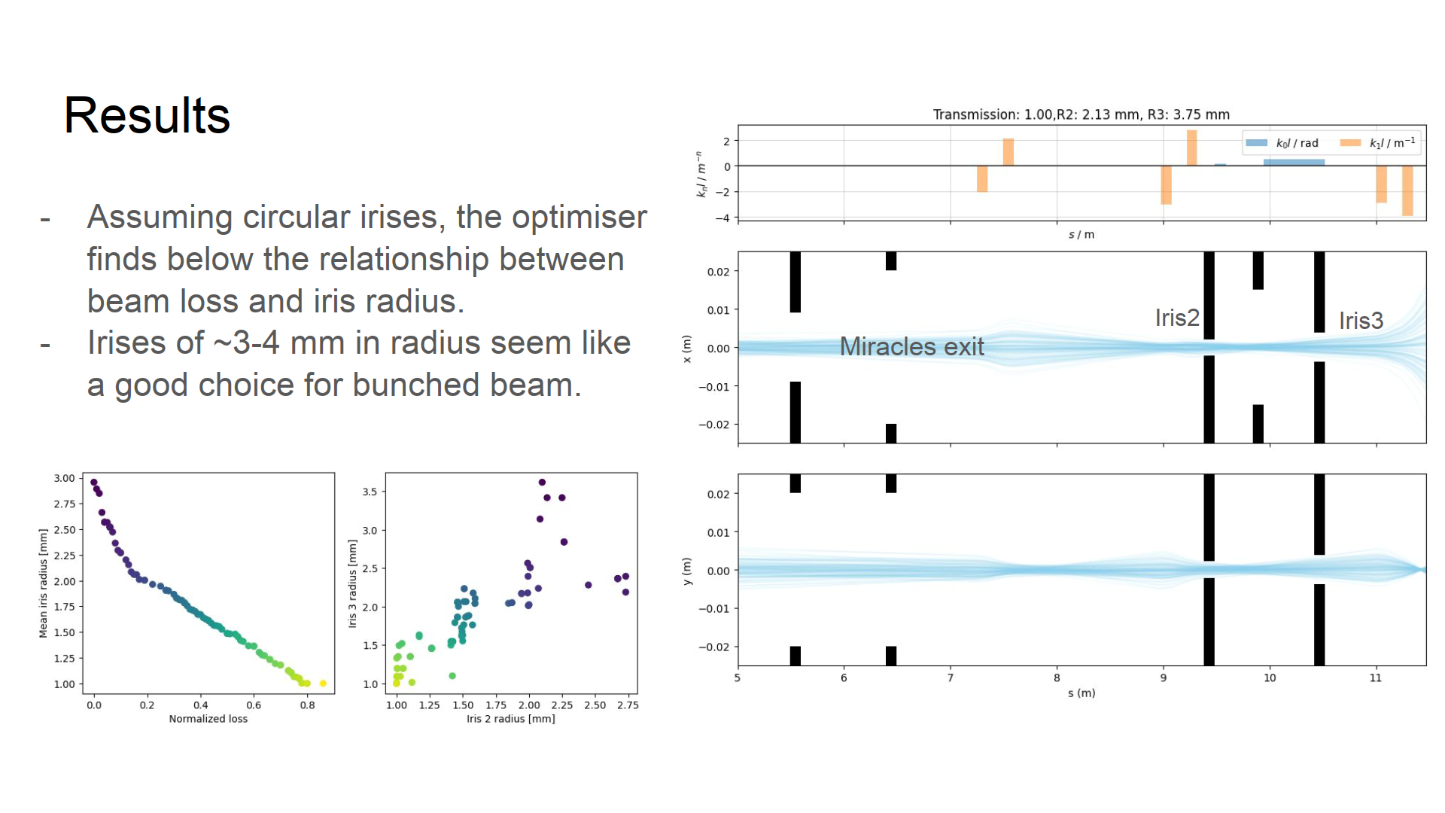
Courtesy P. Arrutia

Slide 21
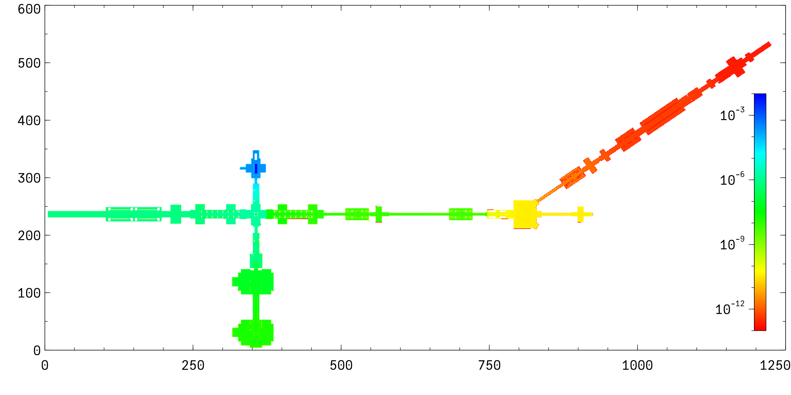
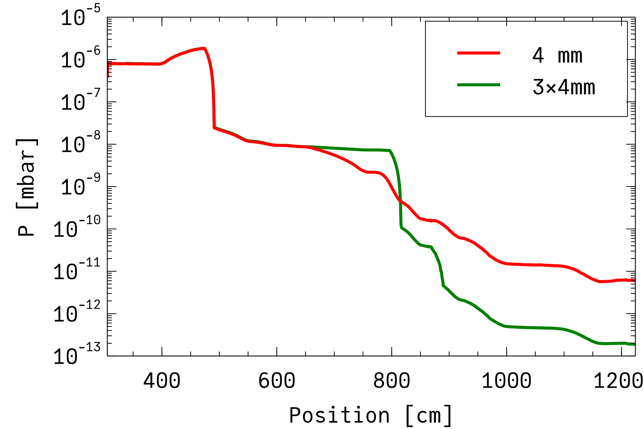
He propagation 3×4 mm orifices
SP 2V => Injection ≈0.1 mbar×l/s
Simulation in 4 steps to overcome the lack of statistics (MC simulation)
2×StarCell 300 as in PUMA at ELENA
No pumping from the trap
P <10⁻¹² mbar next to the trap!

Slide 22
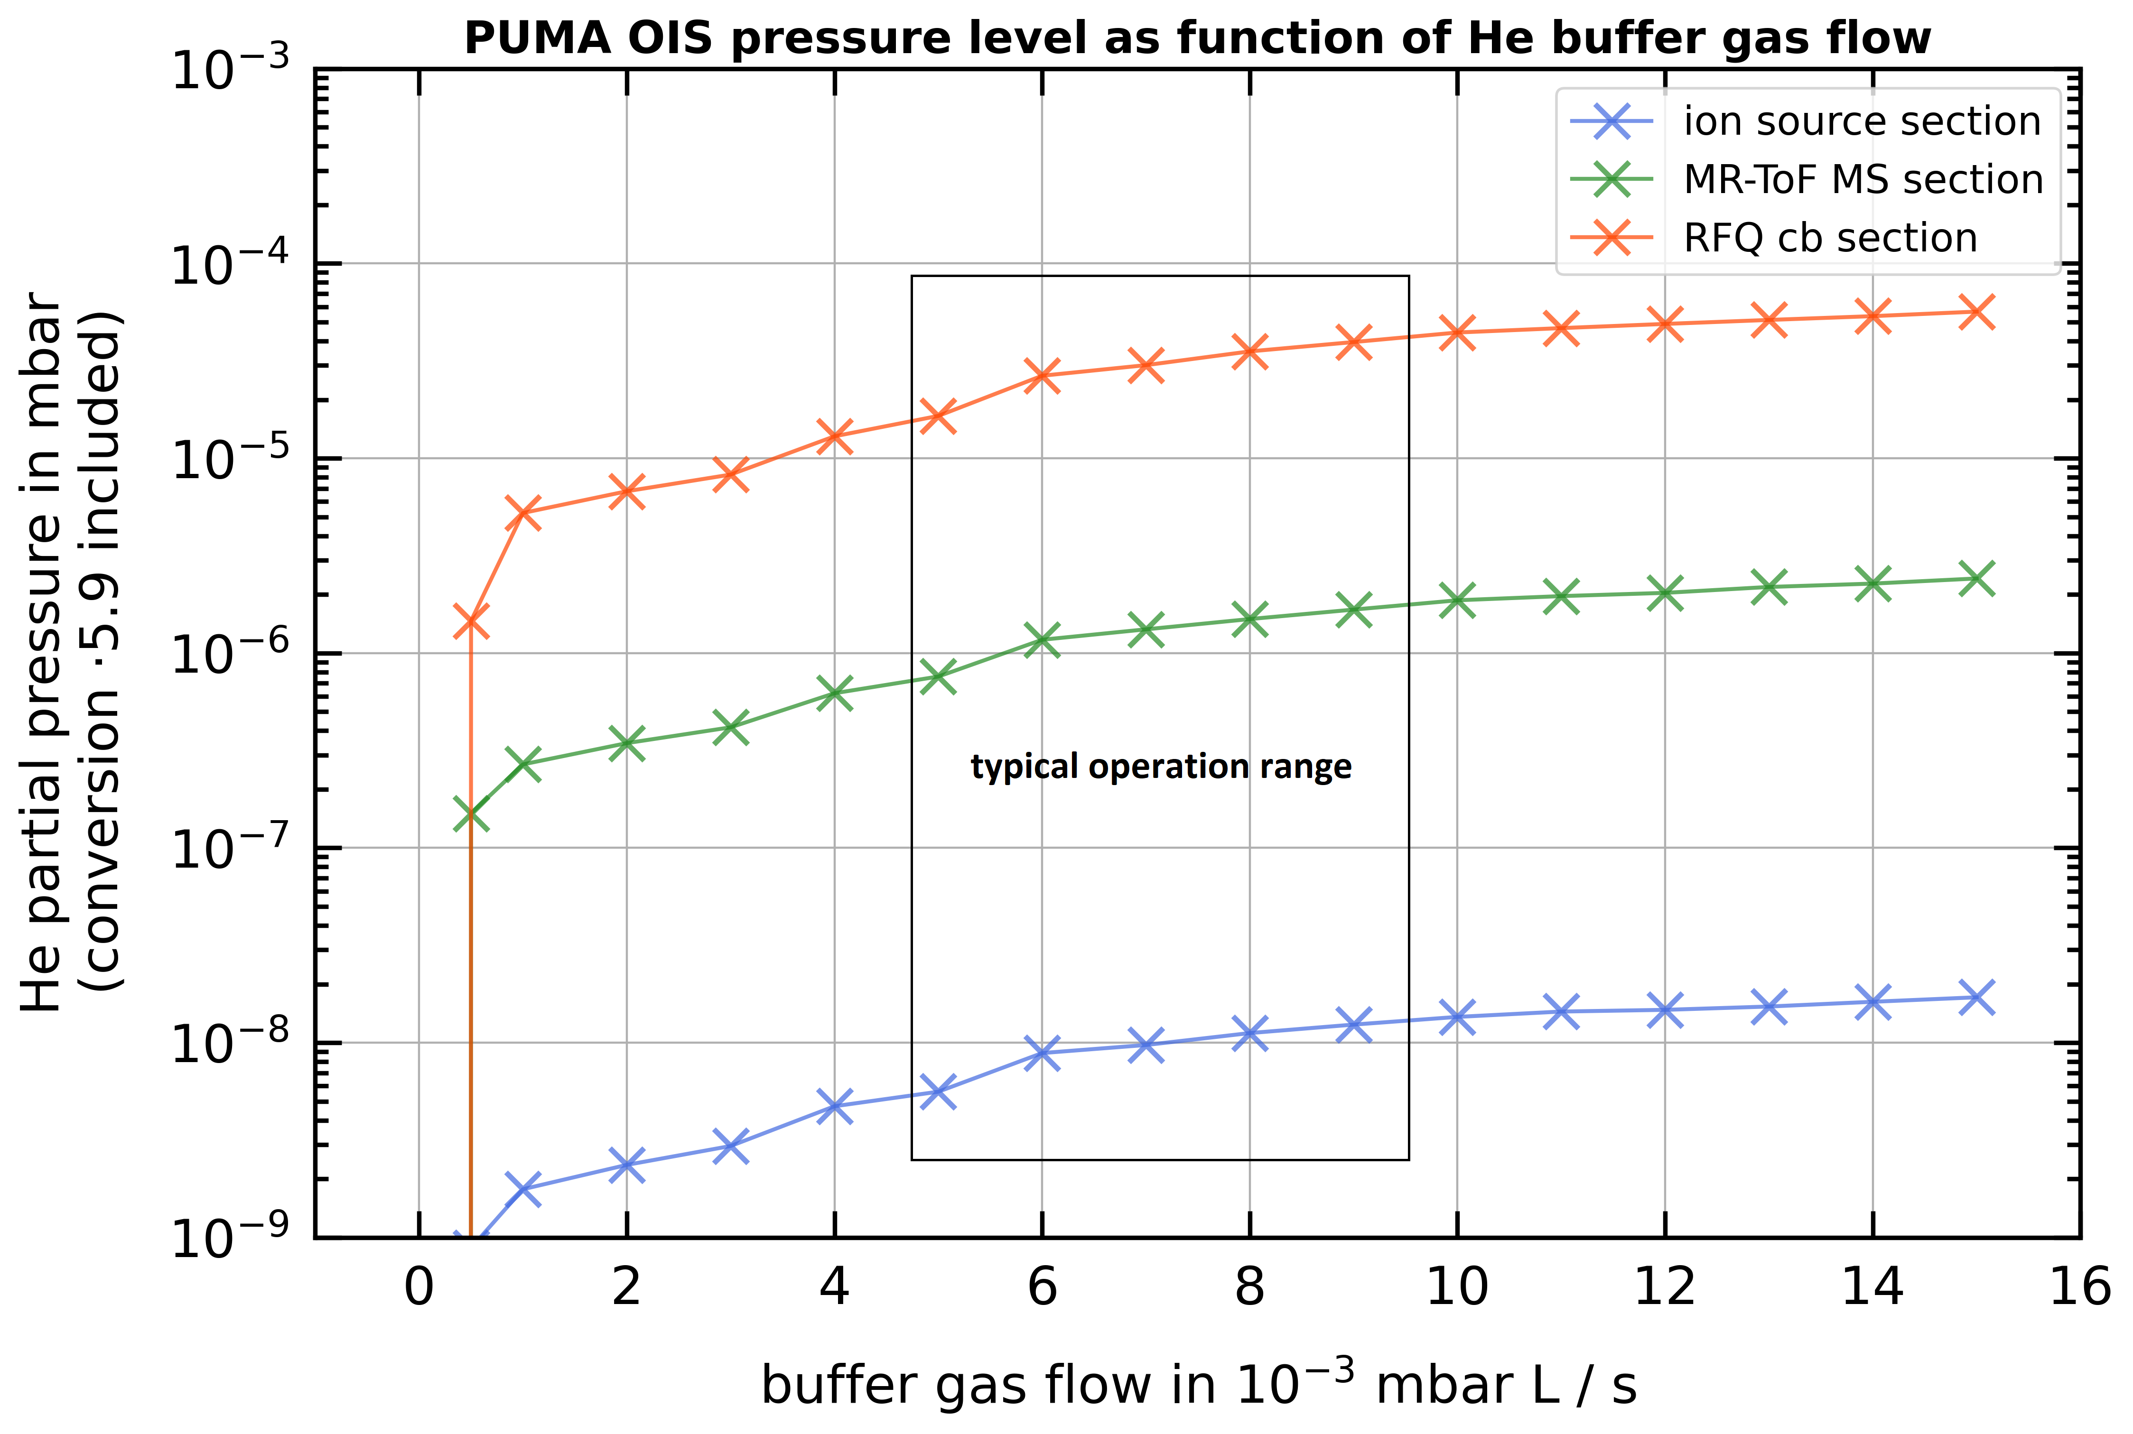
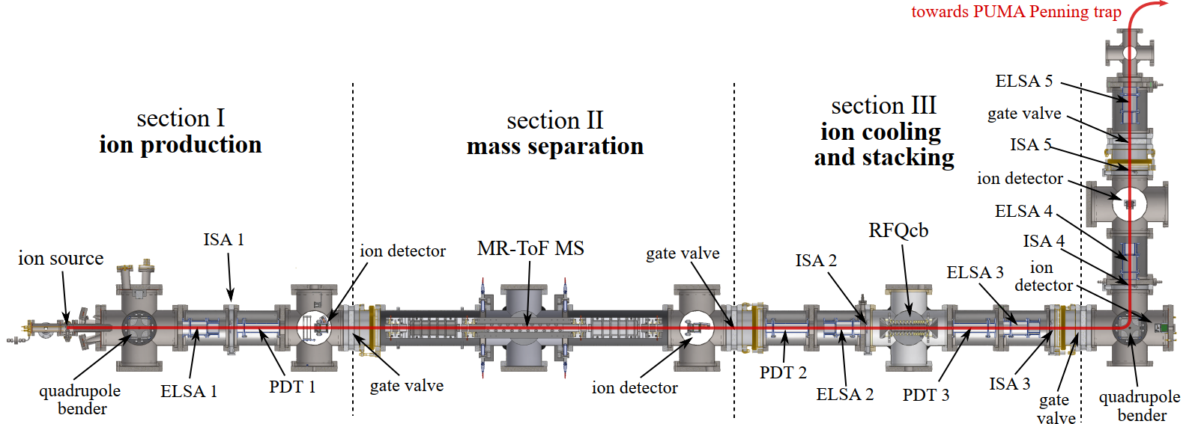
PUMA offline ion source (Moritz Schlaich)
As a reminder, we do have one iris shutter in between each section and during the measurements I had them at a diameter(ISA 1) = 4.5 mm and a diameter(ISA 2) = 7.5 mm. Compare the figure of our ion source setup for the locations of both irises.
1000 times higher than requirement

Slide 23
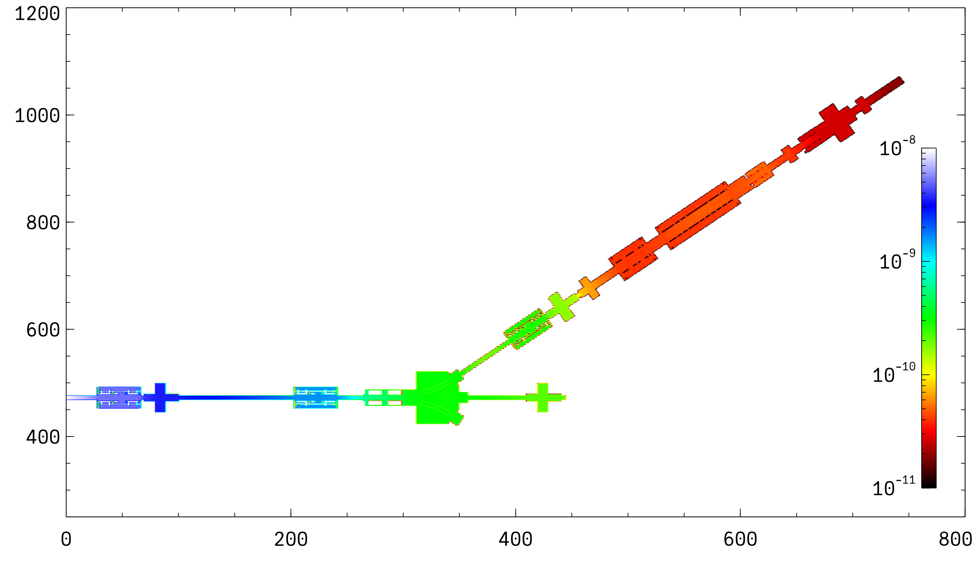
H₂ propagation
10⁻⁸ mbar at entrance of the previous sector
Assuming NEG coating in the first drift towards PUMA and in most of PUMA elements (0.005 sticking factor)
2×StarCell 300 as in PUMA at ELENA
Outgassing pessimistic assumption 5×10⁻¹² mbar×l/s/cm²
Effect of irises conductance restriction not considered
Not considered pumping from the trap, neither NEG cartridges.
P~10⁻¹¹ mbar next to the trap

Slide 24
Equipment and budget
Item | Q | CHF/piece | Total
Series 10 DN100CF | 7 | 4 | 28
Series 10 DN40CF | 1 | 4 | 4
HiPace 700 | 7 | 7 | 49
Series 10 DN150CF | 7 | 5 | 35
Angle valve DN25KF | 18 | 0.5 | 9
Hipace 300 | 3 | 6 | 18
Angle valve DN16KF | 6 | 0.5 | 3
Venting valve TMP | 10 | 1 | 10
VGR | 21 | 1.5 | 31.5
Primary pumps | 5 | 4 | 20
VGP | 7 | 1 | 7
VVV | 4 | 2 | 8
Series 48 DN40CF | 2 | 15 | 30
NexTorr 500 -StarCell | 3 | 9 | 27
 |  | TOTAL | 279.5
Order TMPs, primary pumps and instrumentation?
Sector valves to order as soon as layout is frozen
All metal or series 10 Viton sealed valve at the interface with the experimental line?
Hardware estimation 30 kCHF higher than in previous estimation
Old slide
First evaluation sent 2023

Slide 25
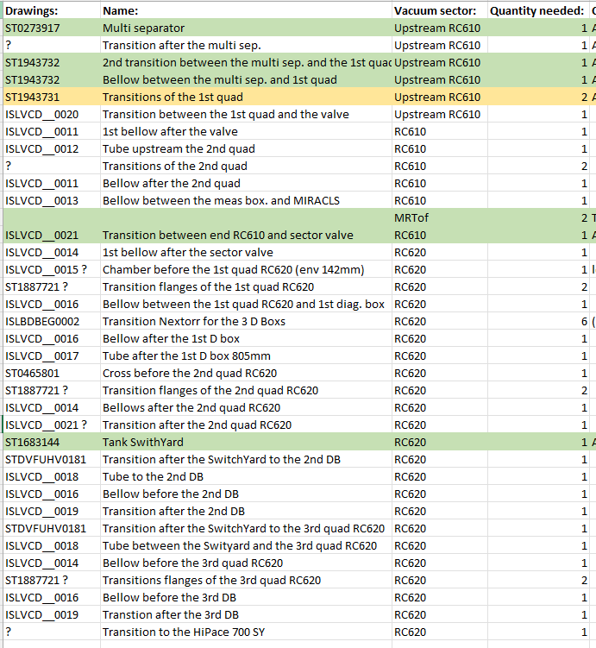
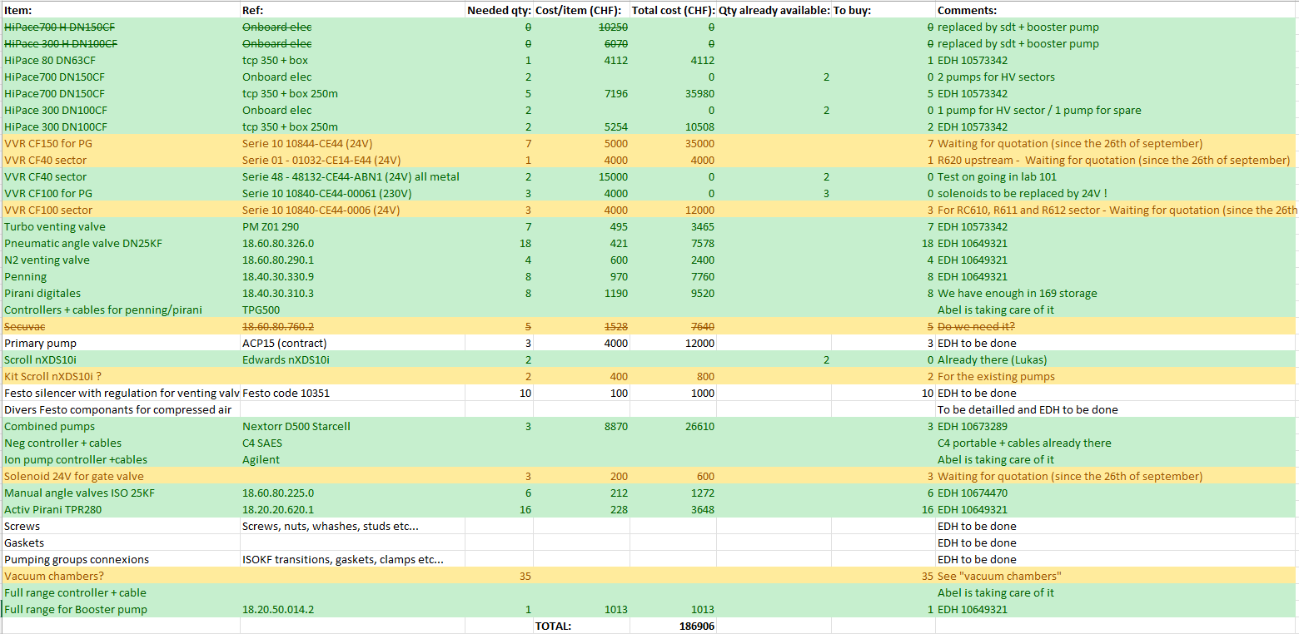
Equipment and budget
TMPs, NexTorr, angles valves and instrumentation ordered.
Waiting for quotation for the gate valves (problem with the manufacturer). But we have enough in the storage if needed.
Tests of the all-metal gate valves DN40CF on going (results on next week).
Primary pumps and small std components (gaskets, screws, compressed air connexions, ISOKF transition…) are going to be ordered.
Vacuum chambers (x35) to be ordered as soon as the drawings are validated
Old slide
Total = 187kCHF + ~ 93kCHF (chambers) + ~ 15kCHF (std components) + ~83kCHF (control – cables installation and rack services not included) = ~378kCHF

Slide 26
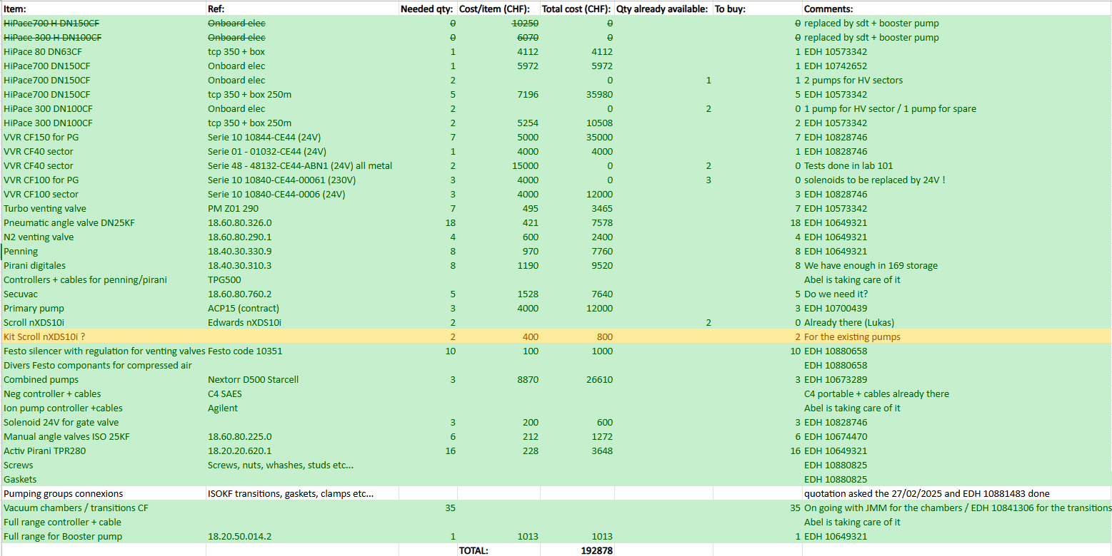
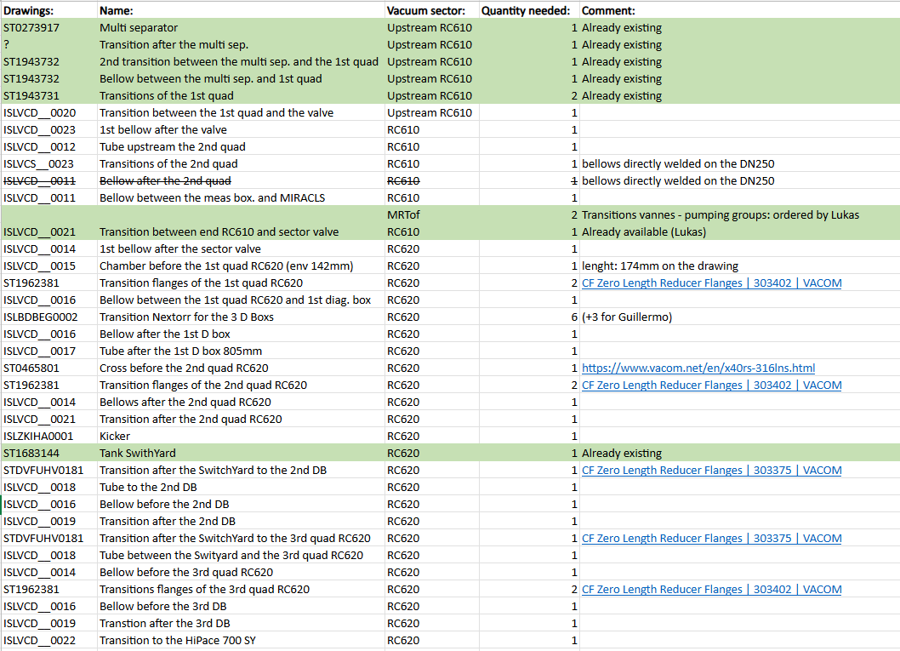
Equipment and budget
Pompes (turbos, primaries, NexTorr) + valves + instrumentation) : EDHs done -> 168kCHF
Small Std components (vacuum connexions, compressed air…) : EDHs done -> 16kCHF
The chambers are in production (~ 40kCHF (it’s less than expected)) -> ready by end of June.
+ ~83kCHF (control – cables installation and rack services not included)
Total = ~310kCHF
Old slide

Slide 27
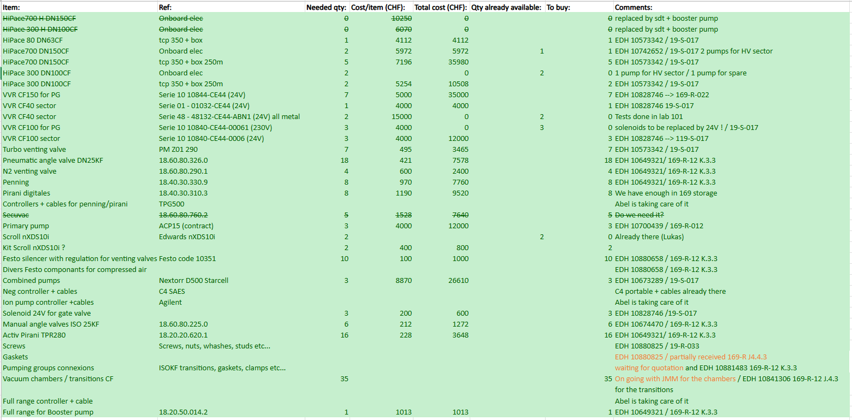
Equipment and budget
Pumps (turbos, primaries, NexTorr) + valves + instrumentation) – 168kCHF: received
Small Std components (vacuum connections, compressed air…) – 16kCHF: received, CF gaskets are late
The chambers are in production (~ 40kCHF (less than expected)): should arrive middle of October!
+ ~83kCHF (control – cables installation and rack services not included)
Total = ~310kCHF

Slide 28
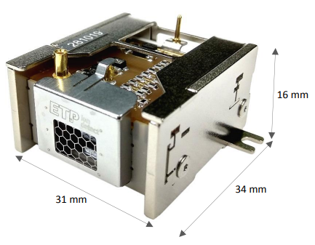
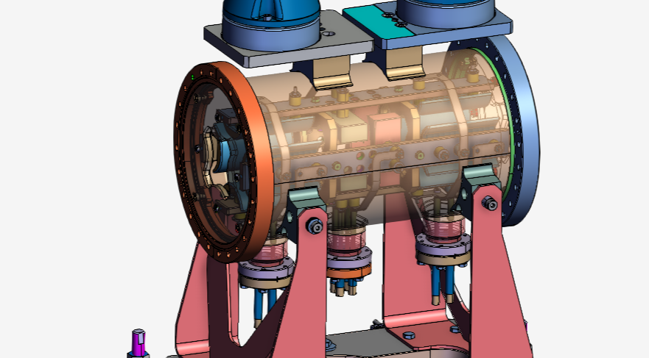
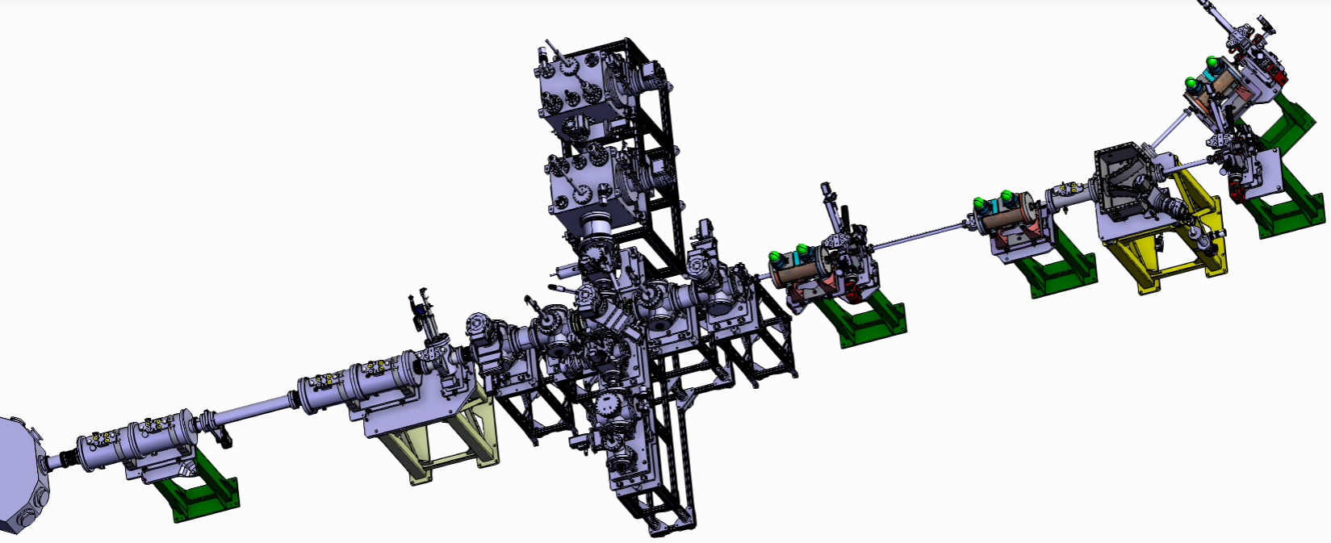
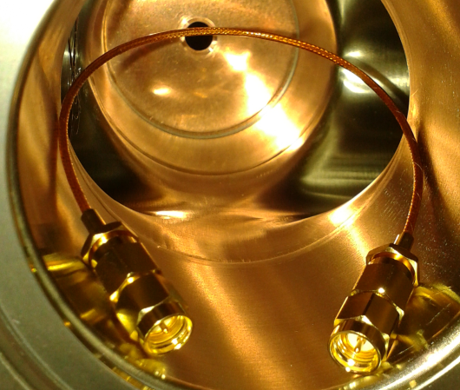

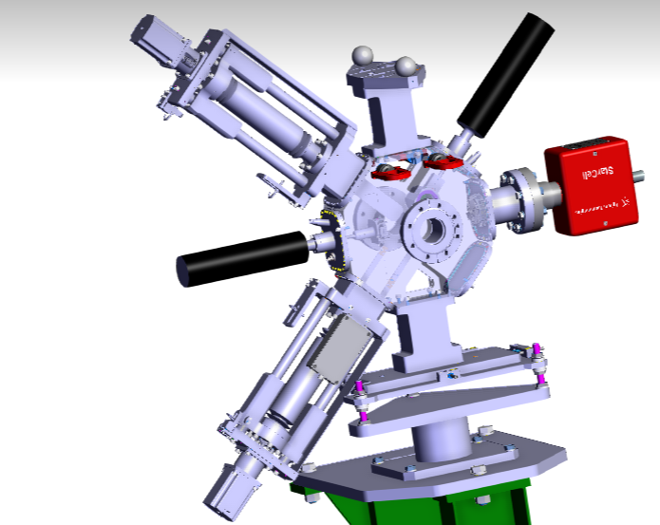
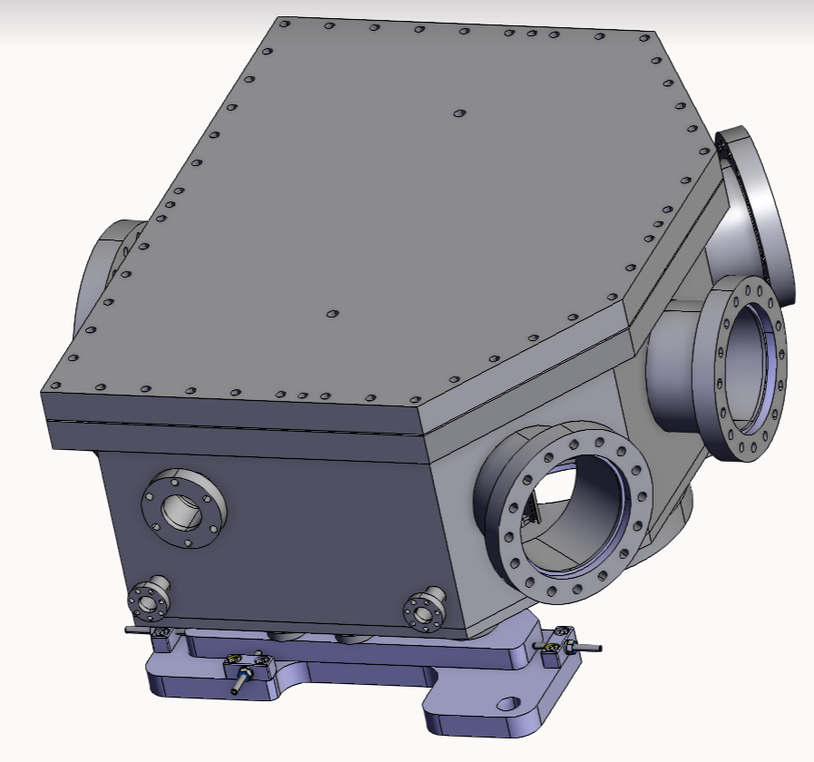
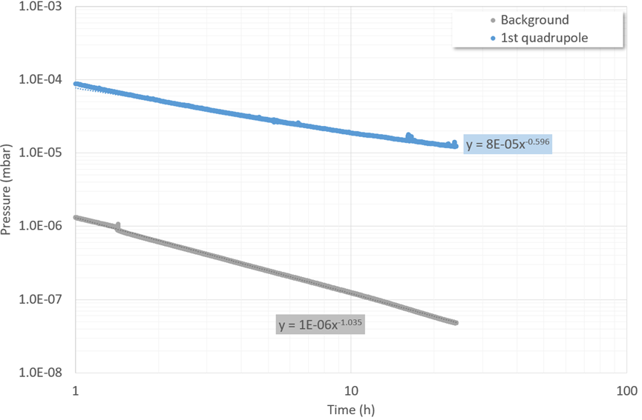
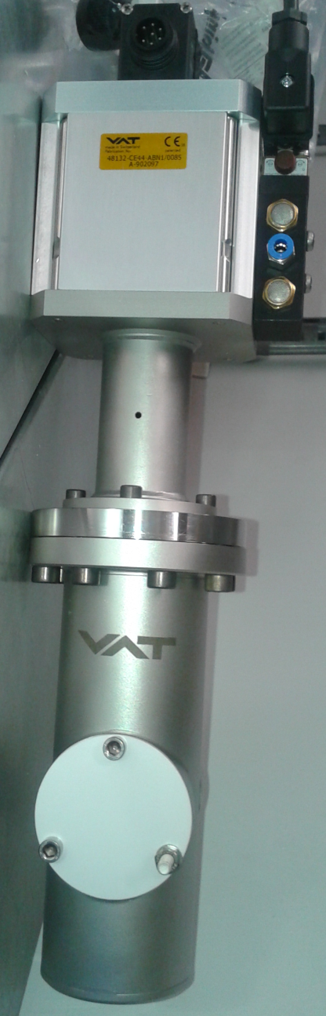
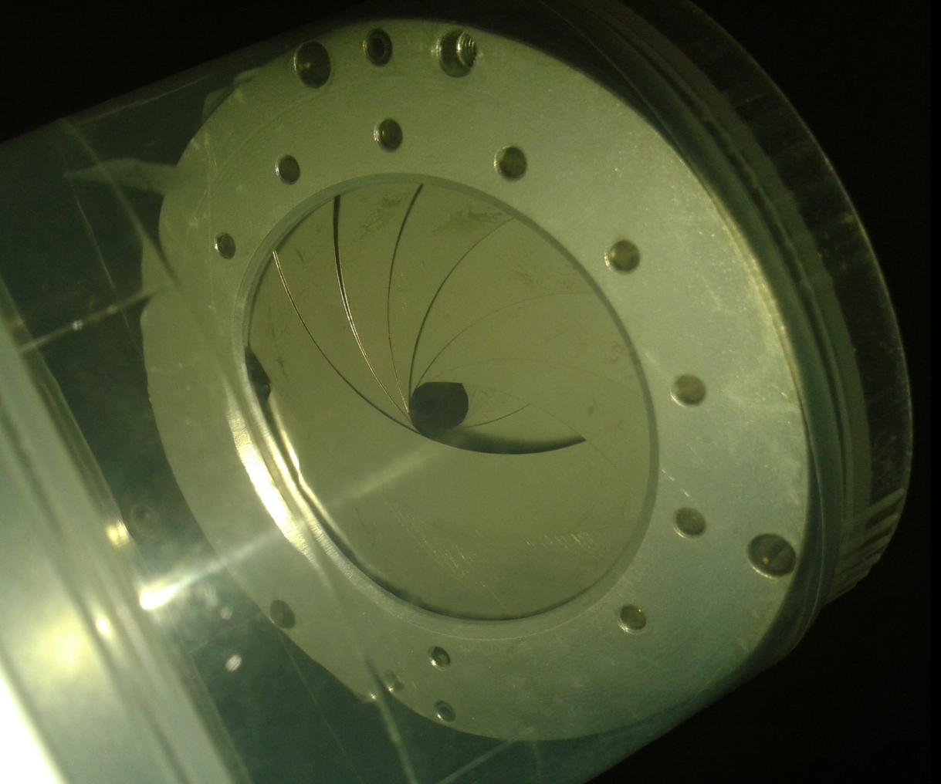
Vacuum acceptance tests
Acceptance test done
Acceptance test to be done
Acceptance test on going
Magnetof
ZQNA Quadrupoles
Kicker
New cable for magnetof
Diagnostic
2nd Quadrupole
1st Quadrupole
D boxes
Old all metal gate valves
Bender
Iris
Q_{24h}=1.4 10⁻⁴ mbar.l/s !
MRTof, PaulTrap line
Notes:
To obtain a good pressure, all the devices installed on the line have to be tested in our laboratory to check that their outgassing rates are compatible with the required pressure level.

Slide 29
What do we have and what do we need?
What we have:
Vacuum layout is 100% defined
Main risk => He propagation. With estimated flow there is no margin. One irises achieves a 17 times reduction => Second iris? => 2 extra solve the issue, but not integrated at this stage!
Reasonable H₂ pumping speed => H₂ pressure in front of the trap will be determined by the outgassing sources and pumping speed in its vicinity.
TMPs H version for maximum compression ratio (50 times higher for H₂ and 30 for He) => Too expensive => Booster TMP for last 2 turbos
PUMA offline ion source => He propagation may be an issue => Deserves a detailed study => Rough estimate 10⁻¹⁰ mbar range.
The two primary pumps for the high voltage parts will work at high voltage.
What we need:
Installation planning => End of 2025?
TE/VSC/ICM can not do more at this stage. They need to know what are the vacuum signals required by “users”?

Slide 30
Thank you

