Slide 1
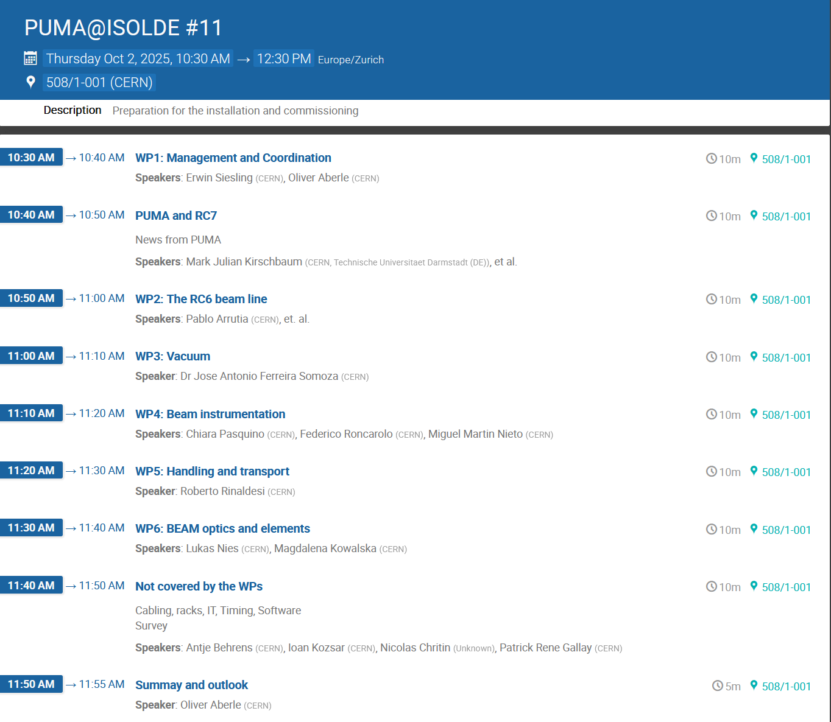
Today's agenda
Updating from last meeting in July
Update everyone on the progress
Installation progress
Project timeline and budget
Goal:
Hand over and close of project Q2 2026

Slide 2
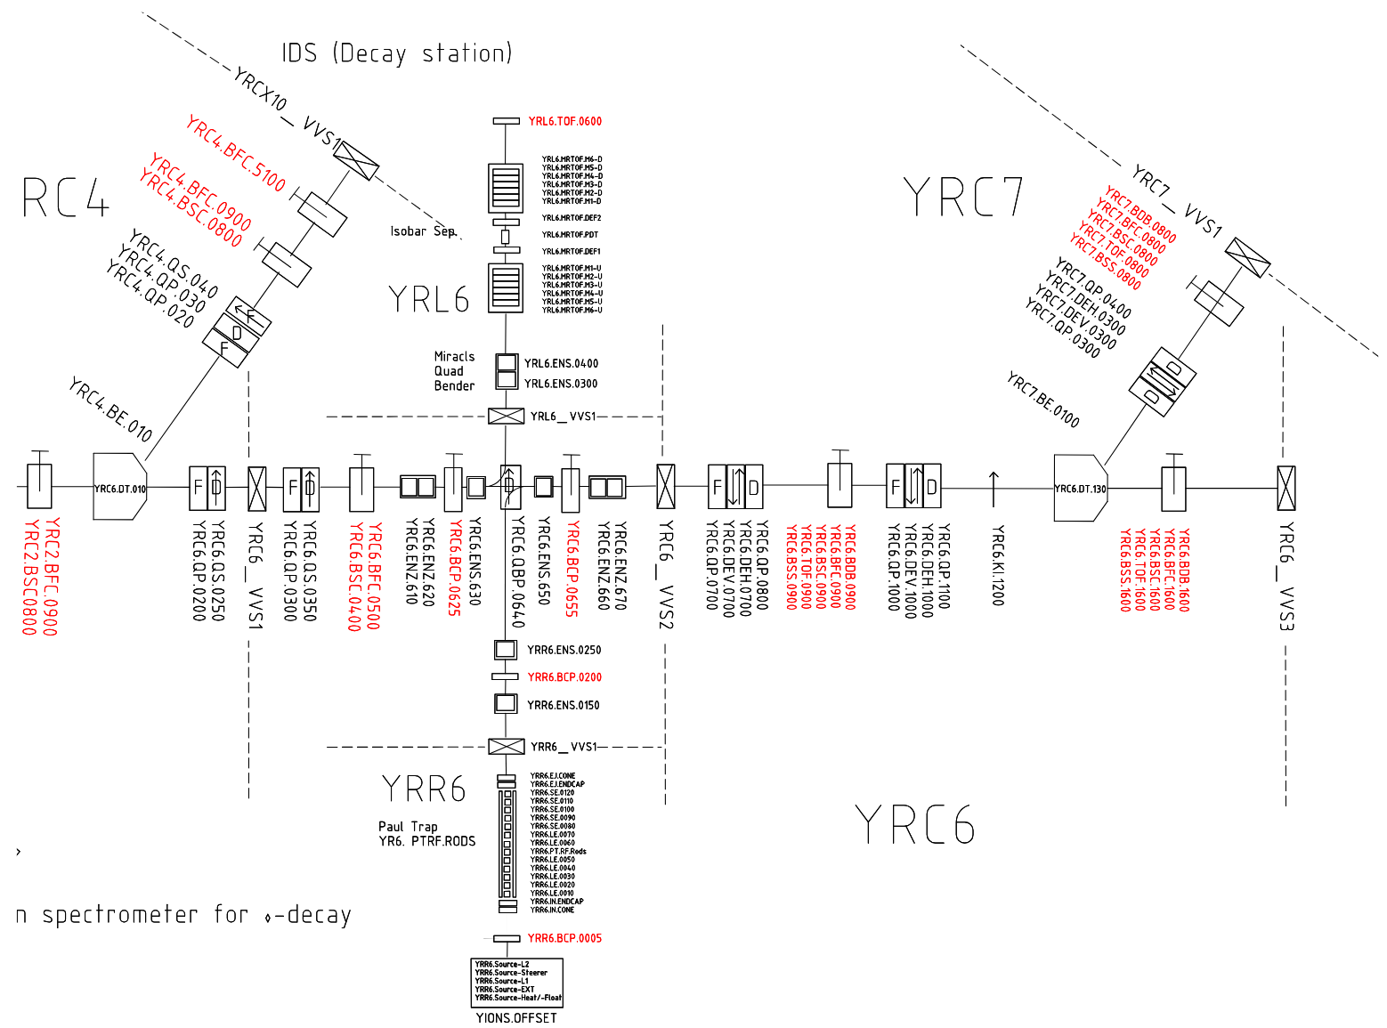
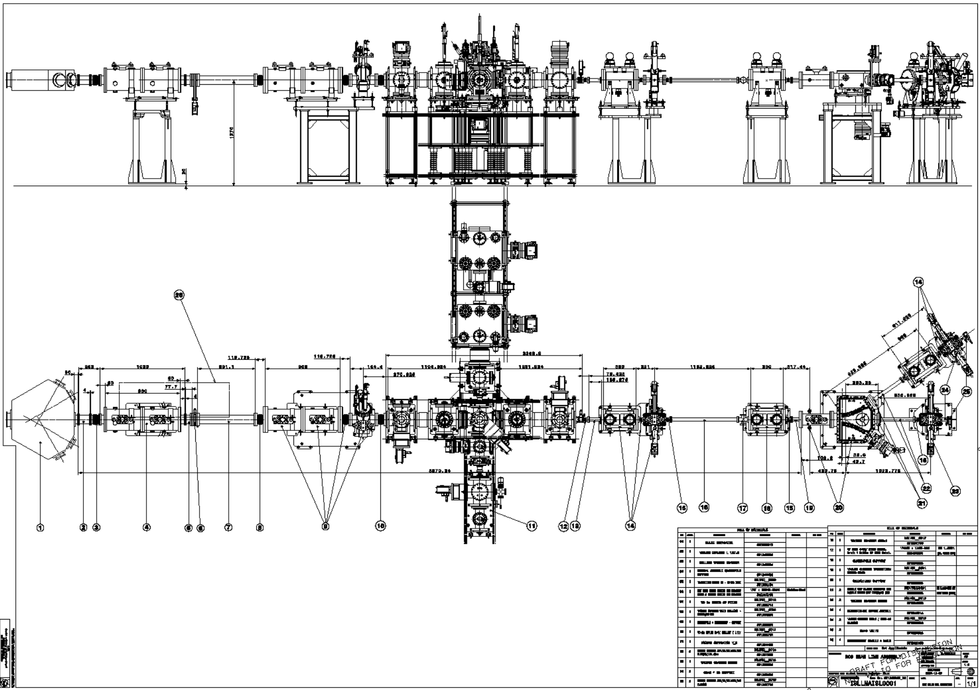
Layout
ISLLMAISL0001 – ST1828365
https://edms.cern.ch/document/2404472/0.3 Simon Mataguez

Slide 3
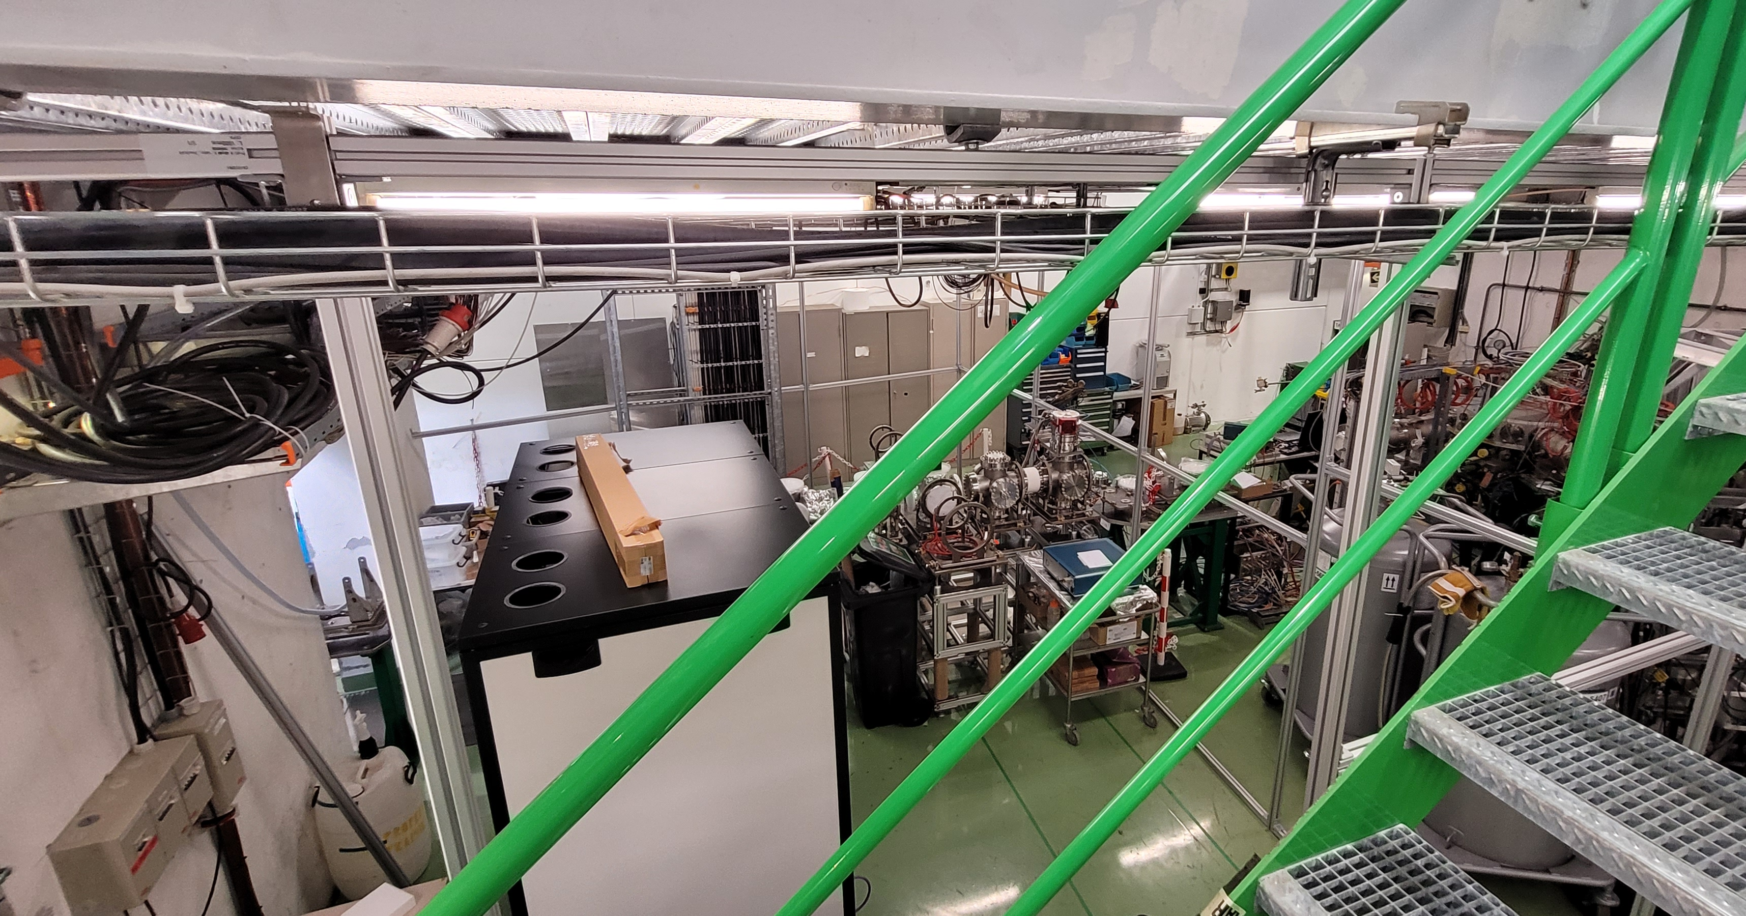
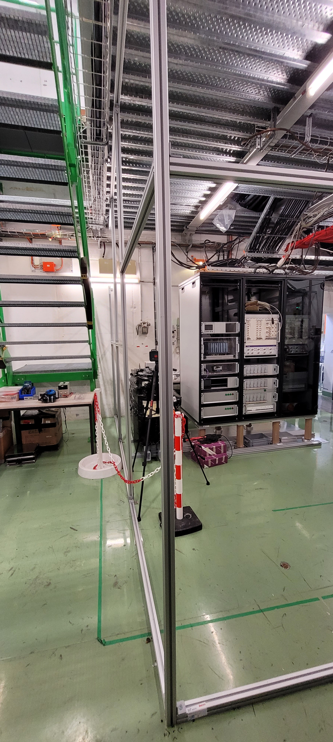
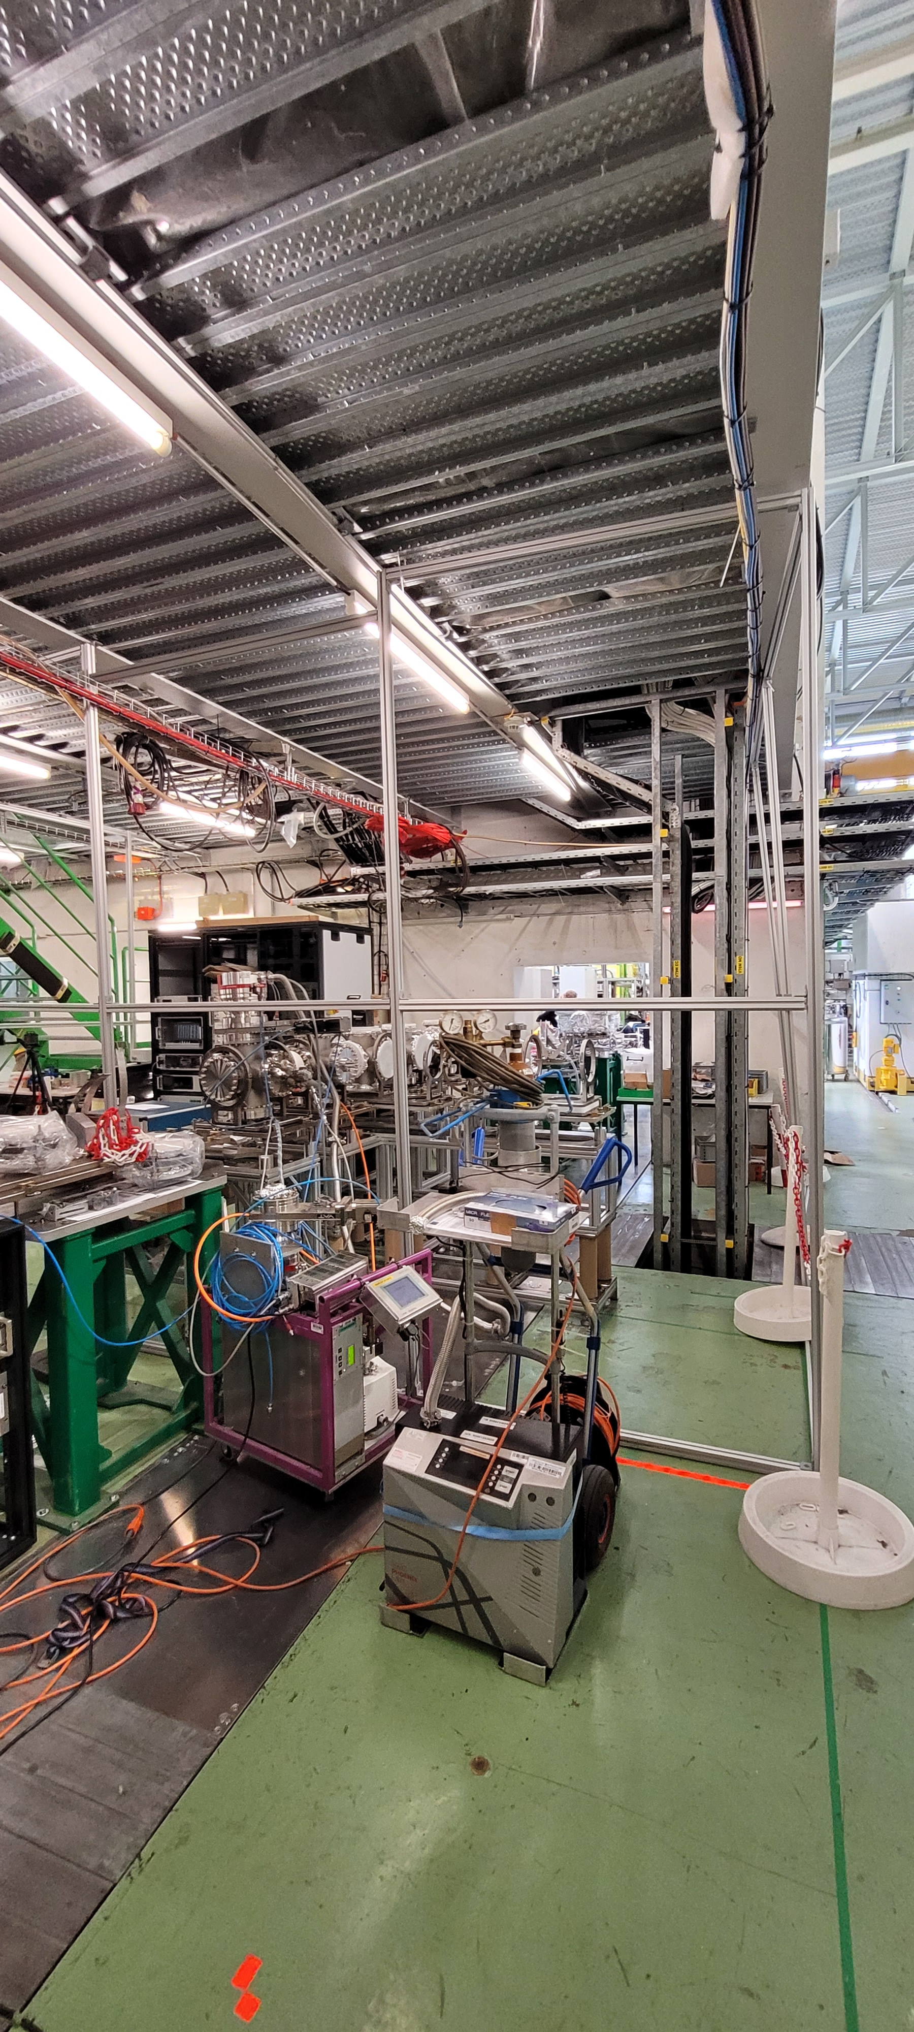
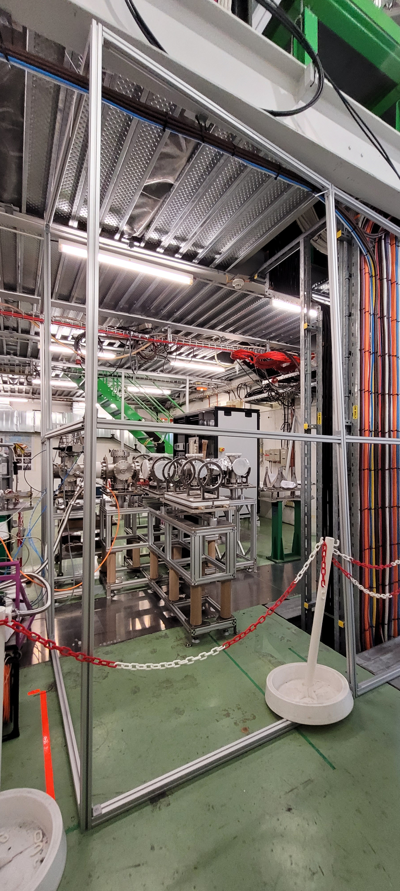
Installation, some pictures

Slide 4
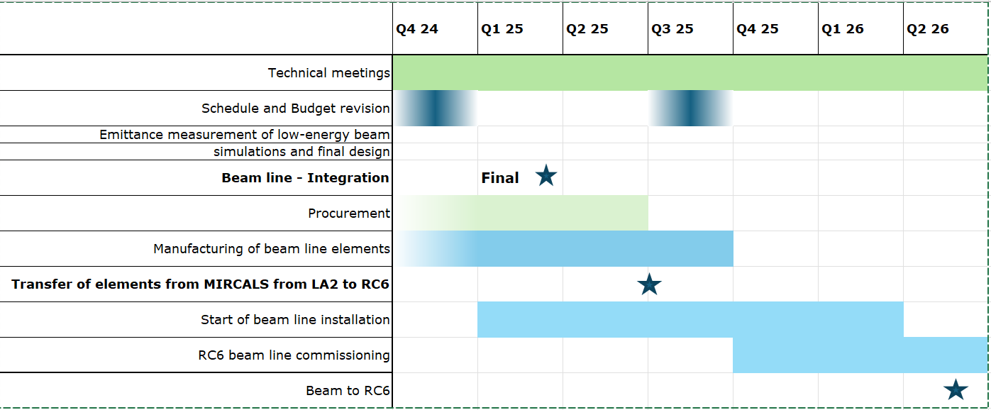
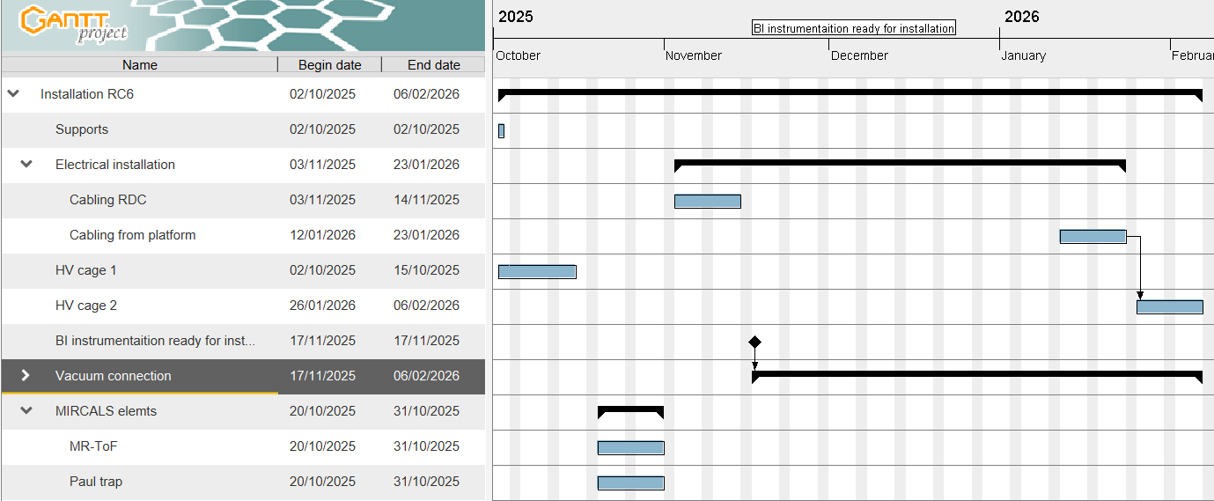
Schedule
Draft

