Slide 1
REDWOOD – Track 2 NRT Workflows Status Update
October 1, 2025
S. Klasky, F. Suter, A. Gainaru, N. Podhorszki
L. Wan, S. Ranka (GSU, UFL)
ORNL, GSU, UFL

Slide 2
Organizational updates
Summer intern developing a simulation—analysis—visualization workflow
Student V. Esaulov (3rd year PhD Student), hired through Georgia State University, L. Wan
Topic: JANUS + Simulation of resilient NRT workflow executions
Informal collaboration with University of Hawai`i, H. Casanova
Topic: Theoretical study of resilient NRT workflow scheduling
Student being hired through University of Florida L, S. Ranka
Topic: Data Refactoring using a foundation model

Slide 3
Publication and software updates
NRDPISI-2, Singapore, March 10
HPC Campaign Management: Remote Data Access with User-Defined Error Bound Using ADIOS and ZFP
Cluster’25, Edinburgh, September 2-5
A Versatile Simulated Data Transport Layer for In Situ Workflows Performance Evaluation
Applied Science (Journal)
CAESAR: A Unified Framework for Foundation and Generative Models for Efficient Compression of Scientific Data
DTLMod v0.1, July 4
SimGrid Data transport layer module
v0.2 scheduled within two weeks: integration of python bindings

Slide 4
Track 2: NRT workflows Y2/Y3 milestones
Milestone | YR | Milestone
2.1 | 2 | Develop monitoring and control knobs for NRT workflows
2.4 | 2 | Develop data refactoring with streaming
3.1 | 3 | Integrate monitoring and scheduling to optimally replicate NRT workflows with varying accuracy levels

Slide 5
Modeling and Simulation of NRT workflows with SimGrid

Slide 6
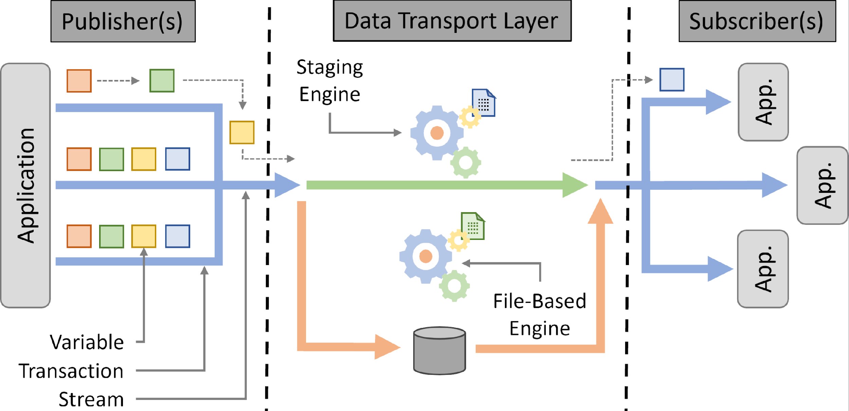
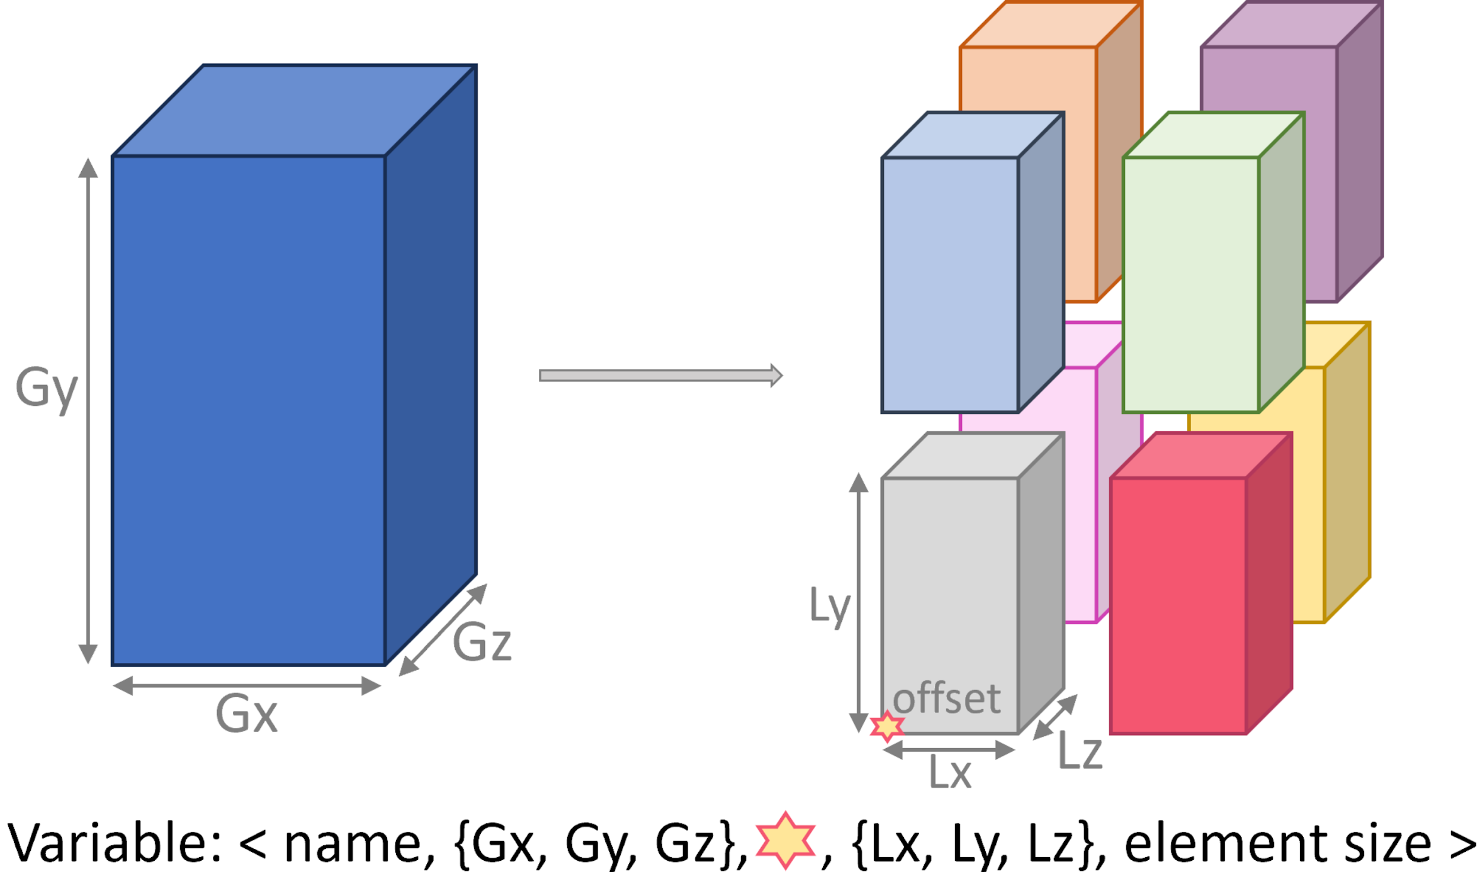

Simulation of NRT workflow executions
Simulated Data Transport Layer
https://github.com/simgrid/DTLMod
Experimental artifact: 10.6084/m9.figshare.28872509
New Python bindings (WIP)
Suter, F., A Versatile Simulated Data Transport Layer for In Situ Workflows Performance Evaluation, Cluster’25

Slide 7
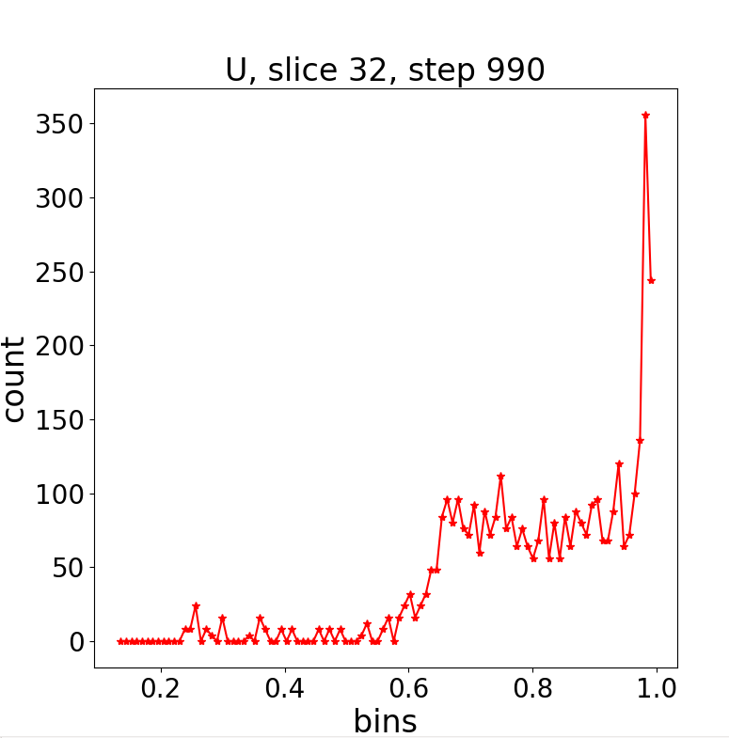

In Situ Simulation/Analysis/Visualization Workflow
3D domain decomposition MPI code
MPI Analysis code
Numerical
Simulation
Visualization
From 3D-variables
to 2D slices

Slide 8
Next Paper: Resilience to Variability and Delays
Pub Cluster
256 96-core nodes
11 Gflops/s
Sub Cluster
128 48-core nodes
6 Gflops/s
Extend the computing infrastructure
Additional Sub clusters to perform replicas of analyses and visualizations
Different capacities and connections
Inject variability and failures
On computing and network resources
Explore and evaluate
The capacity to respect time constraints
Target: IPDPS’26 workshop (ESSA, HCW, PDSEC)
1Gb/s
10Gb/s
crossbars
…
…
20 Gb/s
1Gb/s
Node-local 1TB SSDs
Shared PFS
100 TB

Slide 9
Develop data refactoring with streaming

Slide 10
Resilience for NRT workflows
Goal is to meet near-real-time guarantees for application
Constraints in time and accuracy
We will work with Markus Diefenthaler for EPIC near-real-time workflows for EIC
Last meeting at SciDAC PI meeting, where we agreed to get the workflow and data to try out our research techniques

Slide 11
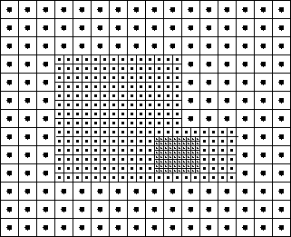
Data Refactoring to Improve Resilience and Resource Requirements
User Data Exploration controlled Decompression for Variable Resolutions
Smaller Data size for Faster Streaming
Refactored data
Reduced Time for NRT workflows
Reduced
Representation
with variable levels of accuracy on different regions
Faster Execution Time with guarantees on Error Bounds
Numerical
Simulation
Computing on Reduced Representations
Optimally replicate NRT workflows with varying accuracy levels

Slide 12
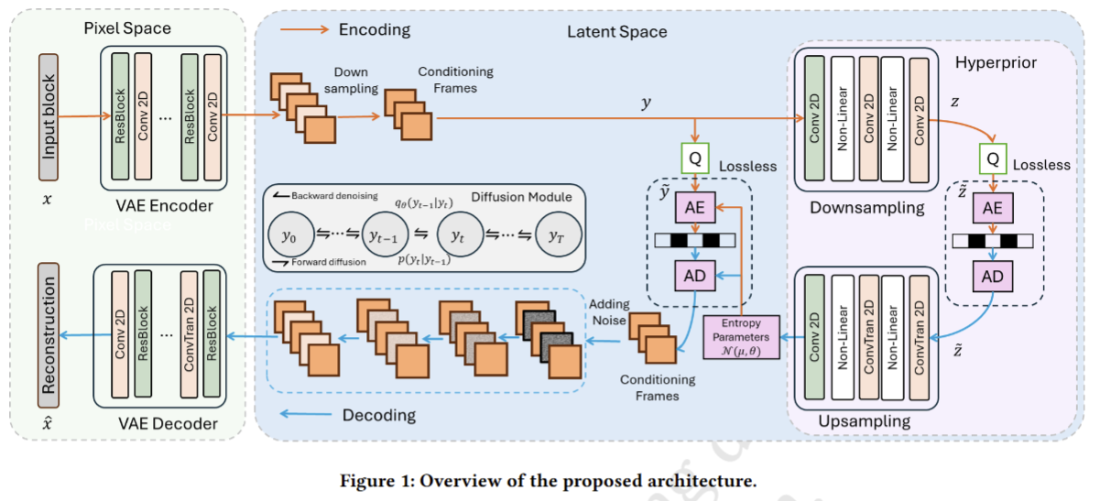
Latent Diffusion based Foundation Model (CAESAR) https://github.com/Shaw-git/CAESAR

Slide 13
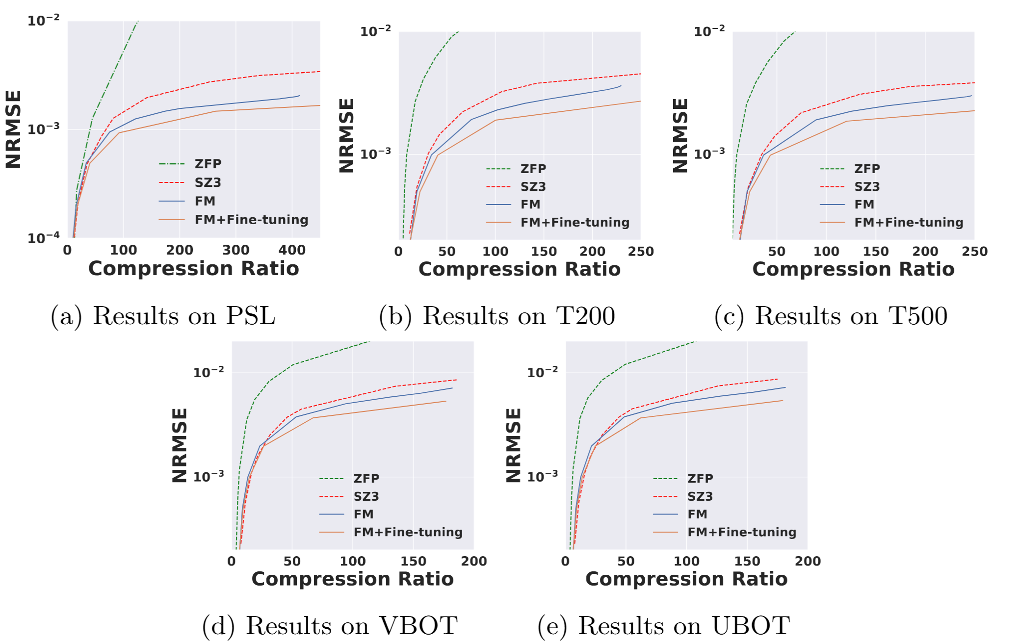
Experimental Results
We have evaluated CAESAR with many datasets and see a typical compression ratio of 200X
Overwhelmingly our approach outperforms all other compressors with 10⁻² errors
New extensions for NRT workflows in REDWOOD include
Refactoring by creating a hierarchical series of nested grid (AMR-like)
Integration with ADIOS for progressive data movement

Slide 14
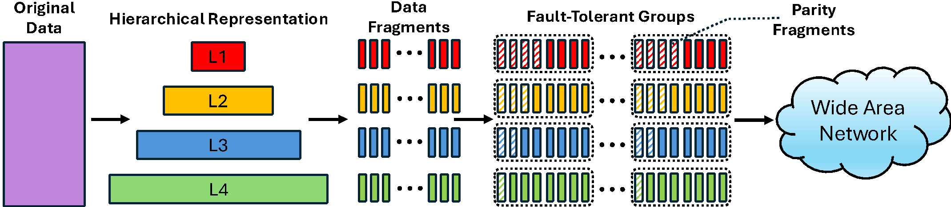
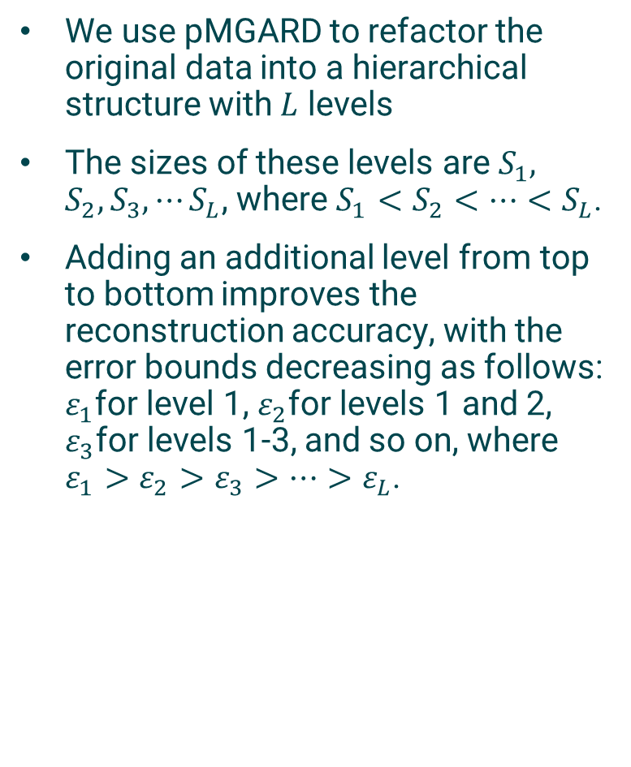
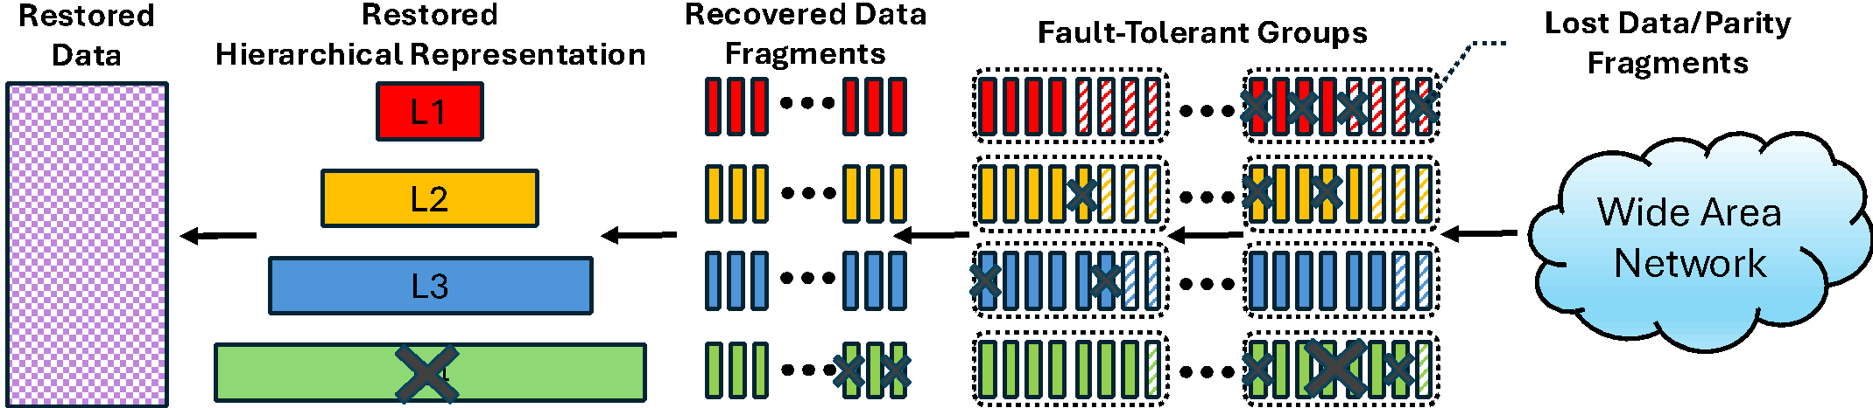
Paper submitted to IPDPS-26
FTG – Fault-Tolerance Groups
Sender: The data is refactored into a hierarchical representation. Each level further divided into fixed-size data fragments. Erasure coding is applied to every k data fragments to generate m parity fragments, forming fault-tolerant groups of k+m fragments.
Receiver: UDP packets may be lost during transmission. In each fault-tolerant group, as long as no more than m fragments are lost, the missing data fragments can still be recovered. If more than m fragments are lost, at least one data fragment becomes unrecoverable, leading to corruption of the entire level. In such cases, an approximation of the original data is reconstructed using the remaining hierarchical structure.
Notes:
The size of each data fragment is the size of each UDP packet size, which is 4KB in our experiment. This is tunable parameter in our approach.
K+M=32. This is the maximum fragments that the external EC library we use can support for each encoding process.
In this example, for the first level, as long as no more than 4 fragments are lost within each FTG, the data can be fully recovered. Similarly, lost fragments at levels 2 and 3 can be recovered using parity fragments. However, at level 4, if 2 fragments are lost from an FTG, recovery is not possible due to the single parity fragment. If retransmission is not enabled, only the top three levels can be used for reconstruction within error bound 𝜀_3. The number of parity fragments at each level can be adjusted based on user requirements.

Slide 15
These research components are being integrated into ADIOS campaign management
adios2::Variable<double> varGlobal2D = io.InquireVariable<double>("global2d");
std::vector<double> global2D; // e.g. 100x100 2D array
adios2::Accuracy requestedAccuracy = {0.1, adios2::Linf_norm, false};
varGlobal2D.SetAccuracy(requestedAccuracy);
reader.Get(varGlobal2D, global2D);
adios2::Accuracy actualAccuracy = varGlobal2D.GetAccuracy();
# Python
accuracy = adios2.Accuracy(0.1, 0.0, False);
var.SetAccuracy(accuracy)
data = reader.read(var)

Slide 16
Integrate monitoring and scheduling to optimally replicate NRT workflows with varying accuracy levels

Slide 17
Integrating the infrastructure
Our workflow components are currently being tested with data from a CFD simulation, XCOMPAT3D, to ensure that we have a controlled environment
Every output physics-step is approximately 100 wallclock seconds
The workflow consists of multiple analysis and visualization steps
We will consider an execution infrastructure composed of multiple machines
Frontier, Andes (analysis and visualization cluster @ ORNL), desktop computer, and remote machines
We will develop a generic simulator of execution scenarios
Use it as a basis for the evaluation of allocation and scheduling strategies
Relying on DTLMod/SimGrid for data transport
Multiple producers and multiple consumers
Sequential or parallel, abstract or MPI codes
Different data reduction strategies and mutiple reduced data streams
Execution scenarios described in a JSON file
We will design algorithms that generate such execution scenarios and evaluate their respective performance

