Slide 1
Optimizing the Distributed Computing System via Curriculum Reinforcement Learning
Redwood Project October General Meeting
Shengyu Feng (CMU), Yiming Yang (CMU)

Slide 2
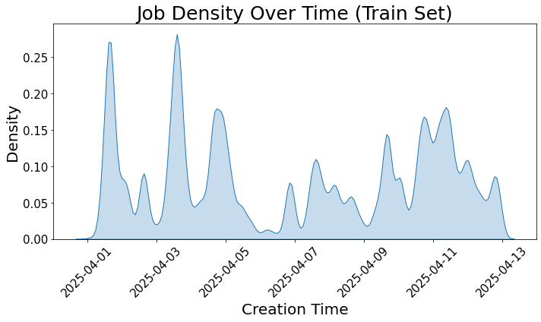
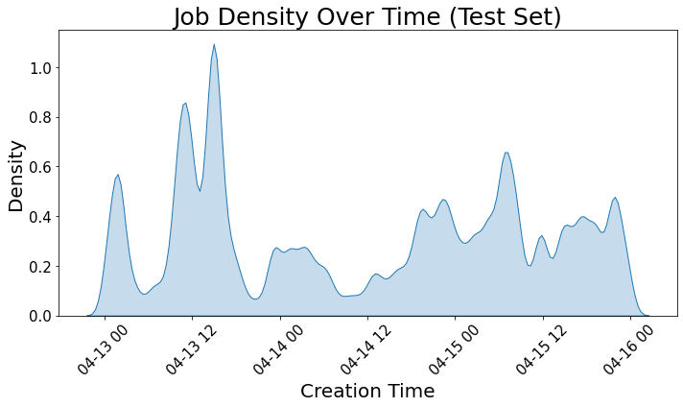
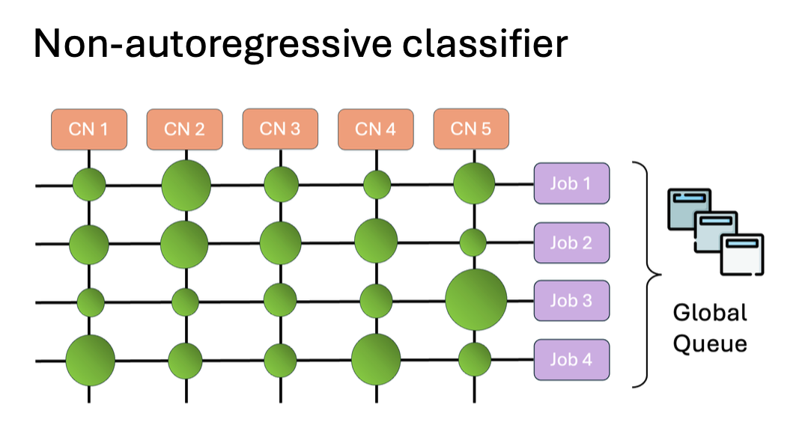
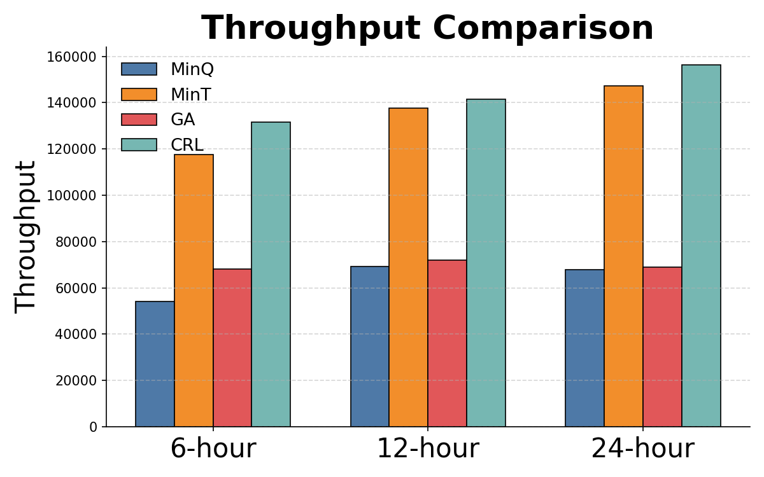
Optimizing the Distributed Computing System via Curriculum Reinforcement Learning (CMU Team)
Summary of progress
2025/08, AlterMILP (non-learning) accepted by FGCS
2025/05-09, learning approach on data management system data
Simulated data
Data (ATLAS, PanDA, Rucio, 2025/04/01-15) provided by Kuan-Chieh
Processing method from David’s AI Surrogate Model paper
Develop our version of simulated environment for model training ✅
Disable the data cloning and cache due to missing data ⬜
Formulation and challenges
Formulation: Partially observable Markov decision problem
Objective: optimize the throughput of the system
Challenge 1: Partial observable (needs prediction)
Challenge 2: Sparse rewards (long horizon & delayed rewards)
Technical Approach: Curriculum Reinforcement Learning (CRL)
First train the model to predict the job workload ✅
Then optimize the one-step makespan as a surrogate objective ✅
Finally train the model to maximize the long-term throughput ⬜
Current results: slightly outperforming the baselines on the above data
Fig1. Stats of the simulated environment
Fig2. Overview of the neural classifier used in CRL
Fig3. Comparison between (current) CRL and baselines

Slide 3
Future Steps (Next 6 months)
Target venue (one of the following)
ICLR AI4S workshop (early 2026, TBD)
ICML main track (Jan., 2026)
Action items
⬜ Finish the long-time horizon training of CRL on the current data/simulator
⬜ Integrate the CGSim environment (from Sairam) for testing
⬜ Add the data cloning and cache if new data is provided

